Slide 1
Conflict of Interest
No conflict to disclose.
Notes:
SLOW DOWN, take breaks between sections.

Slide 2

Fast & accurate pedigree-based imputation from sequenced data in a founder population
O. Livne¹, L. Han¹, G. Alkorta-Aranburu¹, W. Wentworth-Sheilds¹, L. Pesce^{2,3}, C. Ober¹, M. Abney¹, D. Nicolae^{1,4,5}
¹DepT. of Human Genetics, UNIVERSITY OF CHICAGO. ²DEPT. of pediatrics, UNIVERSITY OF CHICAGO. ³computation institute, university of chicago & argonne national laboratories. ⁴DEPT. of medicine, UNIVERSITY OF CHICAGO. ⁵DEPT. of statistics, UNIVERSITY OF CHICAGO
Notes:
I would like to thank the organizers and the session chair for this opportunity.
I will present a pedigree-based imputation algorithm for reconstructing whole genomes from a small number of sequenced individuals in a large pedigree, beyond the capability of LD-based imputation.

Slide 3
Outline
Pedigree-based Imputation
Algorithm
Results

Slide 4
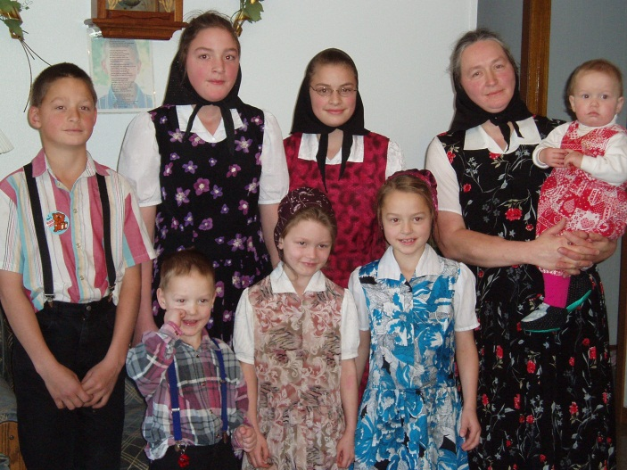
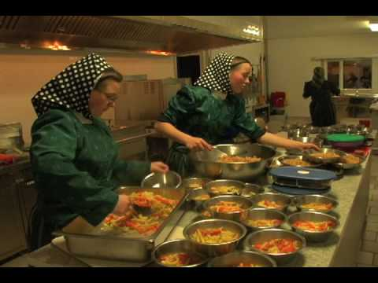
The Hutterites
Live in large communal farms in South Dakota
14,000 descendants of 64 founders of European ancestry
Average kinship coefficient ≈ 3.4%¹
¹Ober, C., Abney, M. and McPeek, M.S. “The Genetic Dissection of Complex Traits in a Founder Population. “ Am J Hum Genet. 69, no. 5 (2001) : 1068–1079.
Notes:
First, I’ll describe the framework of our algorithm. We study the Hutterites, a founder population who lives in large commual farms …

Slide 5
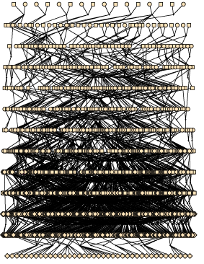

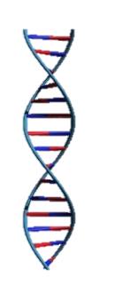
Pedigree-Based Imputation
Physical Location [bp]
0
0
?
1
2
?
1
1
?
?
1
Affymetrix Genotypes
N=1,415
271,486 SNPs after QC
2
?
0
?
1
2
2
?
0
1
?
?
0
?
2
2
?
0
1
?
?
?
2
0
?
N=1,317=1,415 - 98
1
1
0
?
2
2
?
?
?
1
?
2
2
?
1
1
?
1
0
?
?
2
0
?
1
1
1
?
2
1
?
1
0
?
?
?
Pedigree
N=3,671
13 generations
Whole-Genome Sequences (WGS)
N=98
12.3M variants after QC
2
1
0
0
1
2
2
2
2
2
1
?
2
2
2
2
2
0
2
1
2
1
0
0
0
0
2
1
2
0
0
1
Notes:
Each row represents a sample.
Each column represents a bi-allelic variant.
Genotypes are encoded as 0, 1 and 2. Question marks represent missing data.
Sequenced data has been stringently-QCed.
The 98 were chosen to be mostly related to the 1317.

Slide 6

Pedigree-Based Imputation: Why do it?
Larger sample
Haplotype IBD dictionary
Reduce genotyping costs
Increase statistical power
Call rare alleles with high accuracy
Parental origin
Untyped ancestor imputation
Theoretical Performance:
Accuracy = 100% Mendelian rules
Call rate ≈ 85 ± 9% Relatedness of 98 to 1,317
Notes:
Increase statistical power of downstream analyses.
The optimal call rate in the Hutterites is derived from the percentage of IBD sharing between the 1317 and 98 [SNP call rate varies along the chromosome]. The 98 were chosen to maximize this percentage.
This is the opposite scenario of LD-based imputation, which has a perfect call rate but lower accuracy

Slide 7
Algorithm Workflow
Phase¹
Find IBD Segments
Index IBD Segments
Assign PO
Index IBD Segments
Assign PO
Impute
A T
A T
A
T
A
A T
T
A
A
A
A
A A
A
A
A
T
T
1,415×2 haplotypes
IBD segments in 1,415×1,415×4 haplotype pairs
IBD cliques @ each SNP
Parental Origin (PO) assignment
Imputed genotypes
Runtime [CPU Hours]
1,400
48,000
24,000
1,400
140
¹Kong, A. et al. “Detection of sharing by descent, long-range phasing and haplotype imputation." Nature Genetics 40 (2008): 1068-1075.
Notes:
Phasing – surrogate parent, similar to the Decode project phasing
IBD – using HMM between all haplotype pairs
Impute – in the last step, we use the data structure we’ve built for fast imputation
We will highlight a couple of novel steps of this work: IBD segment indexing and parental origin tagging.
[The complexity of pre-processing is O(s n^2) where s=#affy variants, n = #samples. There’s also a term that depends on the average population kinship (mean clique size^2). We have ideas for speeding this algorithm up.]

Slide 8

IBD Segment Indexing
Cliques =
IBD-sharing graphs
Efficient data structure for IBD queries
Reduced storage
Fast lookup
Transitivity ?
SNP
…
A
G
…
B
rs42
…
…
H
C
D
E
Clique-partitioning algorithm
Calculate pairwise algebraic distances¹
Disconnect distant nodes; connect proximal nodes
Reduced imputation runtime from 24,000 to 140 CPU hours!
¹Ron, D., Safro, I. and Brandt, A. "Relaxation-Based Coarsening and Multiscale Graph Organization." Multiscale Modeling & Simulation 9 , no. 1 (2011): 407-423.
Notes:
IBD segments are indexed in a special data structure. For every SNP, we keep a list of cliques.
Nodes are haplotypes; haplotypes are connected if they are IBD at the SNP, forming an IBD clique. The cliques are complete graphs because of IBD transitivity.
Cliques are important because they you get more IBD information and faster than storing IBD segments.
Imputation becomes fast: if A belongs to a WGS sample, all other haplotypes in its clique are imputed with its allele value.
The algebraic distance cutoff was based on several representative SNPs from our particular data set and may need to be tuned in other populations.

Slide 9
Parental Origin (PO) Assignment
Quasi-founder = typed sample with untyped parents
Quasi-founder
A
B
A’s IBD clique
A
B
B’s IBD clique
Median Kinship
 | A Clique | B Clique
Father | 0.24 | 0.06
Mother | 0.07 | 0.21
 | A Clique | B Clique
Father | 0.06 | 0.24
Mother | 0.21 | 0.07
Assigned 300 / 450 quasi-founders with >99% confidence!
Notes:
First, define quasi founder.
Non-quasi-founders’ haplotypes are automatically labeled as paternal and maternal since we use Mendelian rules.
But for quasi-founders haplotype parental origin is unknown at first.
We are able to ASSIGN PO by finding which one of the two parental assignments (AB or BA) are more likely from the kinship table.
[We use pedigree-based kinships between each parent and each clique (genotypes not required – calculated from pedigree!)]
Our measure of flipping haplotype labels is probabilistic. Still, we could tag 2/3rds of all founders.

Slide 10
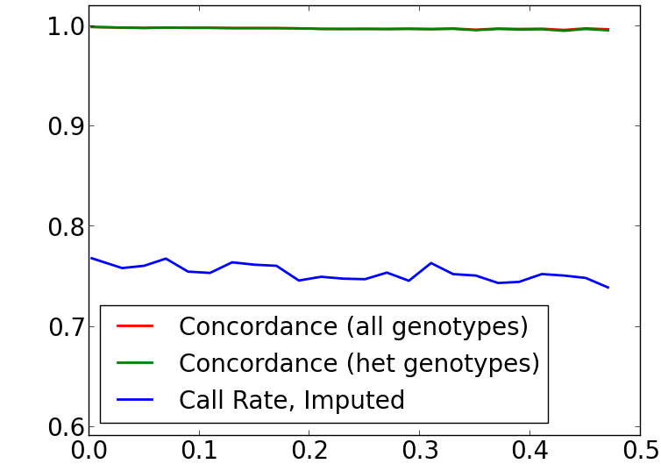
Imputation Cross-Validation
Phased Affymetrix data (N=1,415; 14,809 SNPs; MAF ≥ .0007)
Calculated IBD segments
Masked genotypes of N=1,317 non-WGS samples
Imputed N=1,317 samples
Calculated concordance between imputed & Affy genotypes
1.0
Concordance 99.7% ± .01%
Het concordance 99.7% ± .01%
Phasing rate 99.6% ± .01%
Allele call rate 91 ± 8%
Genotype call rate 77 ± 17%
PO assignment rate 73 ± 15%
0.9
Fraction
0.8
0.7
0.6
0.0
0.1
0.2
0.3
0.4
0.5
MAF
Notes:
All non-QCed Affy SNPs: 344,175; we took a sample representing all allele frequencies.
Minimum MAF among them = 0.0007 = 2/2830 (excluded singletons).

Slide 11
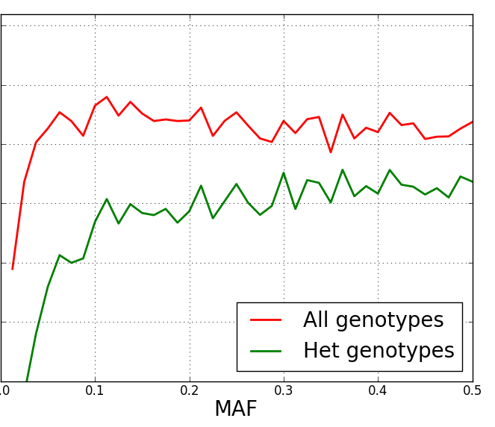

Super Imputation
What about remaining 23%?
LD-based imputation!
Want to keep accuracy > 99%
Het accuracy, in fact
Pedigree-based Imputation
Phased Haplotypes
IMPUTE2¹
Filter Variants
1.0
Imputed variants 7,328,284
Accuracy ≈ 99.3%
WGS phasing rate 99.4%
Allele call rate 97%
Genotype call rate 93.6%
PO assignment rate 73%
IMPUTE2-Pedigree Imputation Concordance
SUPER IMPUTATION
Accuracy > 99%
Call Rate = 93.6%
Genotypes
Pedigree-Based Imputation
Accuracy > 99%
Call Rate = 77%
LD-based Imputation
Accuracy > 99%
Call Rate = 70%
0.99
Fraction
0.98
0.97
0.0
0.1
0.2
0.3
0.4
0.5
MAF
¹Howie, B. N., Donnelly, P. and Marchini, J. “A flexible and accurate genotype imputation method for the next generation of genome-wide association studies “PLoS Genetics 5, no. 6 (2009) : e1000529.
Notes:
We use LD-based imputation. For instance, we chose IMPUTE2.
We use IMPUTE2 to fill in variants where the het concordance with the pedigree-based imputation was > 98%. We keep high-quality variants (high concordance with pedigree-based imputation, which roughly corresponds to common SNPs with MAF >= 5%).
Why use pedigree-based and not IMPUTE2 for imputation?
Using our phased haplotypes as input to IMPUTE2 significantly improved its performance, which speaks to the phasing quality.
Pedigree-based has a higher accuracy for rare alleles. This is reflected by the drop in het concordance.

Slide 12
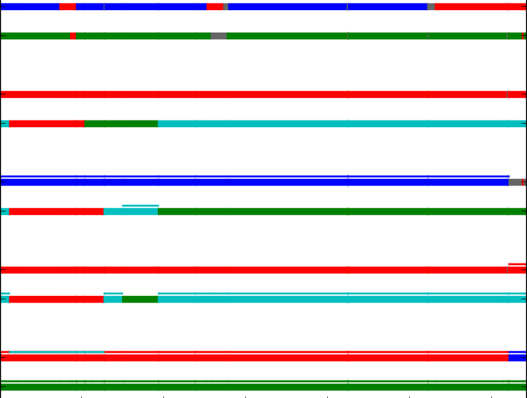
Untyped Ancestor Imputation
Apply recursively to
past generations
Parental haplotypes
reconstructed!
4
3
Assign colors to parents
Align PO phases
2
Color haplotypes
with ≤ 4 colors
1
Notes:
An application we’re excited about is the imputation of untyped individuals, for instance, the parents of 5 quasi-founder siblings.
Consider the 3 possible partitions of 4 parental haplotypes to 2 groups.
2. Max child IBD coverage for each child POO phase. Maximize min coverage after flipping phases to optimal.
Coloring non-unique, HBD colors interchangeable
NOTE (if people ask about it): this step is performed during phasing, because it allows correctly phasing unphased sib of these quasi founders. Otherwise, even if the unphased sib is IBD with a phased sib, we would not be able to tell which of his haplotype to assign using the IBD segment. With PO tagging, we can match paternal hap with paternal hap, and maternal with maternal.
Call this “light blue” if needed to refer to the color.

Slide 13
Summary
Pedigree-based imputation is accurate, especially for low-frequency variants
Call rate is increased by integrating LD-based imputation super-imputation
Haplotype IBD segments also useful for parental origin, untyped ancestor imputation

Slide 14
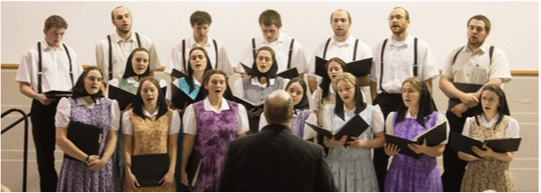
Acknowledgments
The Hutterites
The University of Chicago
Ober Lab
Nicolae Lab
Abney Lab
Open-source software forthcoming
Contact: Oren Livne livne@uchicago.edu

Slide 15

Backup slides

Slide 16

IBD Segments: Haplotype HMM
Haplotype U,1
A
T
T
T
A
T
T
T
A
A
T
A
T
T
T
T
T
T
T
T
T
T
T
T
T
T
T
T
T
Haplotype V,0
Observed: IBS ≥ 1
LD-pruned Frame
1
0
1
0
Emission(MAF, ε)
Hidden: IBD
1
1
1
0
Transition(f, λ)
Notes:
Adaptation of Abney, 2002 (HBD HMM)

Slide 17
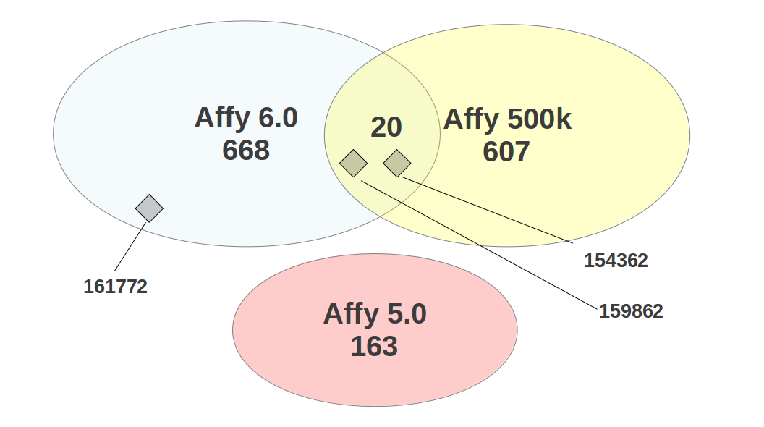
Affymetrix Chip Overlap Data
Total People = 1415 = 668 + 607 + 163 – 20 (common) – 3 (excluded)

Slide 18
Phasing Workflow
Solos
63%
1. Homozygous Genotypes
2. Mendelian Rules
3. IBD: Parent -> Child
4. IBD: Sibs Comparison
6. IBD: Surrogate Parents
5. IBD: Sibs Without Parents
A A
A
A
Duos
Trios
87%
Nuclear Families
93%
Pedigree
99.2% phased
Genohap-HMM

Slide 19
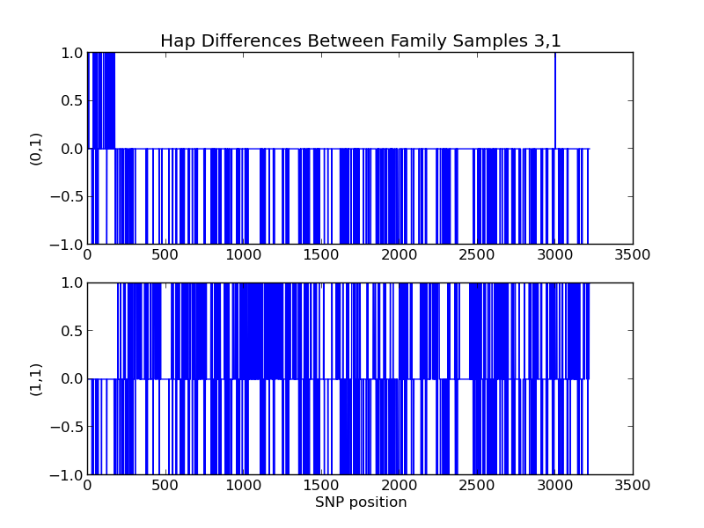
Stage 3: Parent-Child IBD
Child’s paternal haplotype is IBD with one of the father’ haplotype
No restriction on segment length
F
F,0 – C,0
0
1
C
F,1 – C,0
0
1
Het SNPs
Median Filter
Edge Detection
Phase in IBD Segments
Flag errors
Notes:
Because the child’s haplotype is colored in EITHER red or green, the difference must be either 0 in a segment or 1 in a segment. So a median filter is sound and helps clear errors.

Slide 20
Stage 3: Parent-Child IBD in Family
Find sets of haps sharing IBD segments phase each set
F,0
F,1
1,0
2,0
3,0
4,0
F,0
F,1
1,0 = F,0
2,0 = F,1
3,0 = F,0
4,0 = F,0
4,0
1,0
3,0
2,0
Notes:
Because the child’s haplotype is colored in EITHER red or green, the difference must be either 0 in a segment or 1 in a segment. So a median filter is sound and helps clear errors.

Slide 21
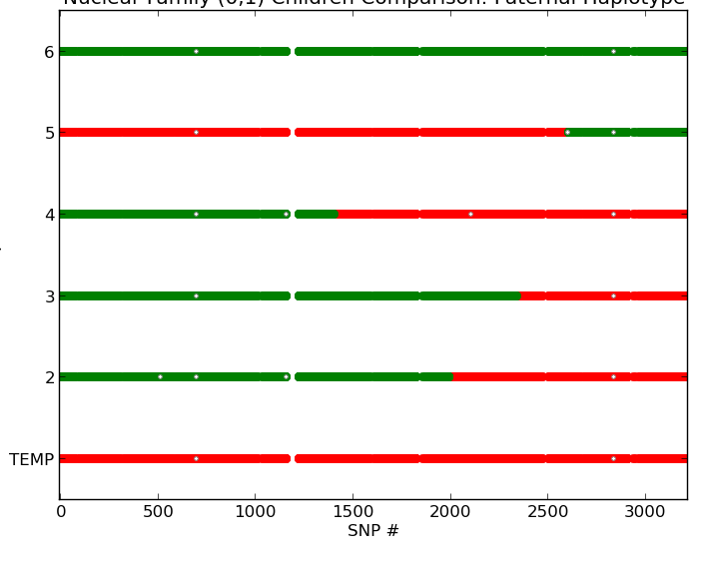
Stage 4: Sib Comaparison
Parent and N ≥ 3 sibs genotyped
# Diff | Conclusion
0 | No recombination
1 | Non-template recombination
N-1 | Template recombination
Else | ERROR
2
3
4
5
6
Template Child
Select SNPs
Recomb-inations
Phase
Concensus Hap

Slide 22
Stages 5,6: Phase by Surrogate Parents
Unphased sample: look for surrogate parents
Find IBD segments; remove short ones
Phase all haps that share a segment using each other
m=3
m=4
m=4

Slide 23
IBD Segments for Phasing: Genohap-HMM
Genotype of U
A
T
A
A
A
A
T
A
A
A
T
A
A
T
T
T
A
T
T
T
A
A
T
A
T
T
T
T
T
T
T
T
T
T
T
T
T
T
T
T
T
Haplotype V,0
Observed: IBS ≥ 1
LD-pruned Frame
1
0
1
0
Emission(MAF, ε)
Hidden: IBD
1
1
1
0
Transition(f, λ)
Notes:
As in Abney’s HBD 2002 (or IBDLD, degenerated to haplotypes), but replacing LD modeling with pruning as in Lawrence’s work.

Slide 24
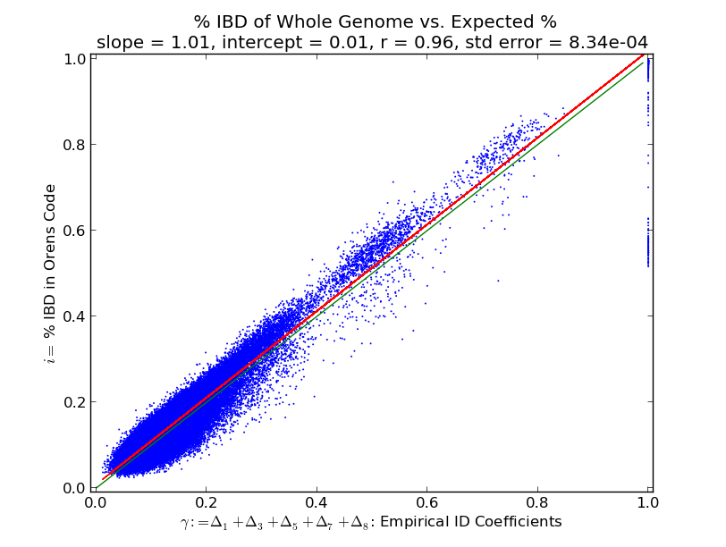
IBD Segment Coverage
Green: i=γ
Red: best fit
Slope=1.01, r=0.96

Slide 25
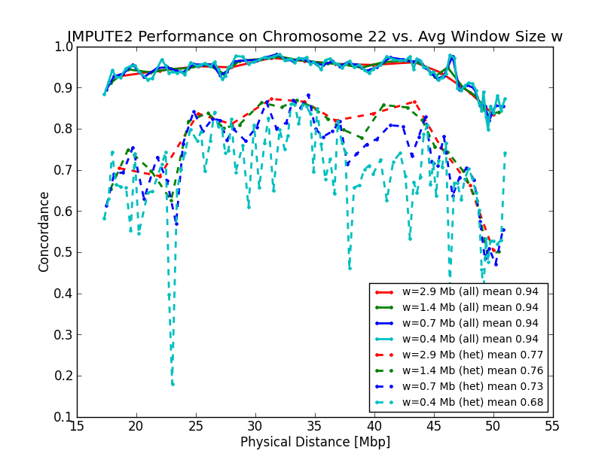
IMPUTE2 Window Size Optimization
Max concordance on hets ~ 75% for 1.5-3 Mbp
Most cost-effective: 1.5 Mbp

Slide 26
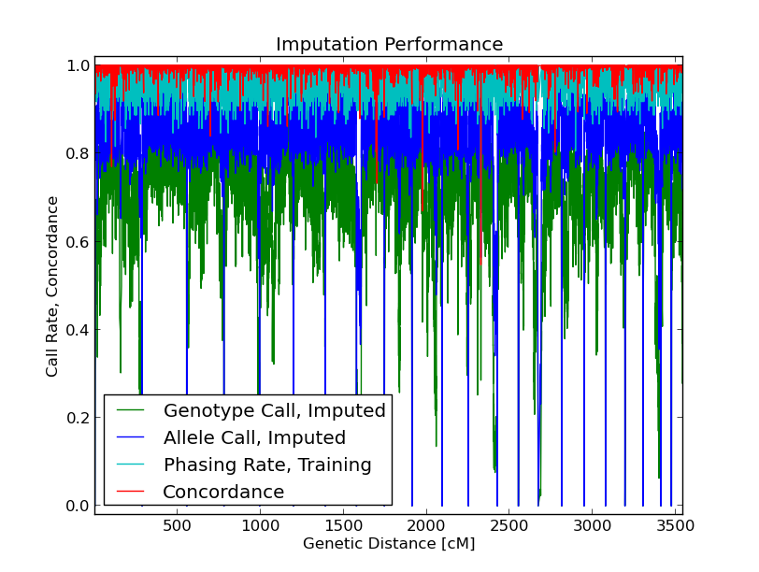
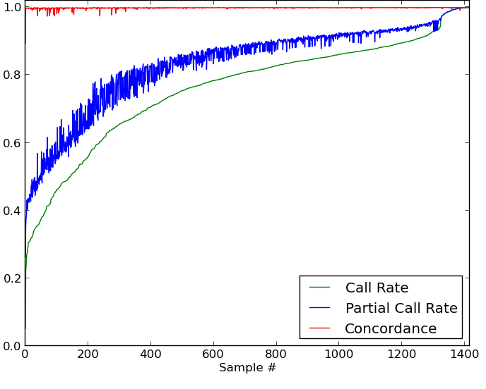
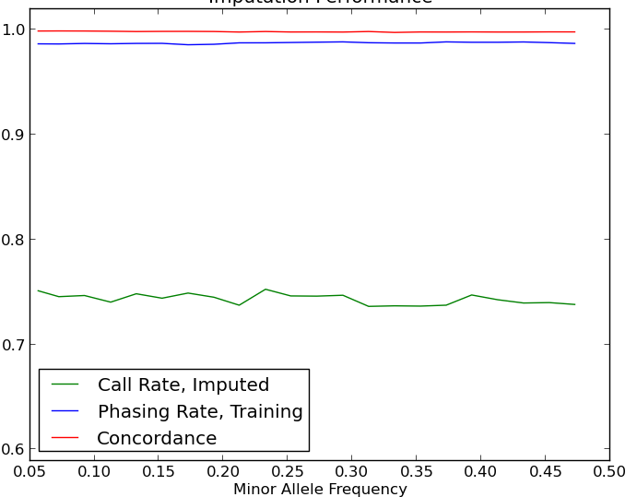
Imputation Validation: Affymetrix SNPs
N = 1,415
Mean Concordance 99.985%
Phasing rate 96 ± 5%
Allele call rate 94 ± 8%
Genotype call rate 77 ± 18%
% PO-aligned 73 ± 15%

Slide 27
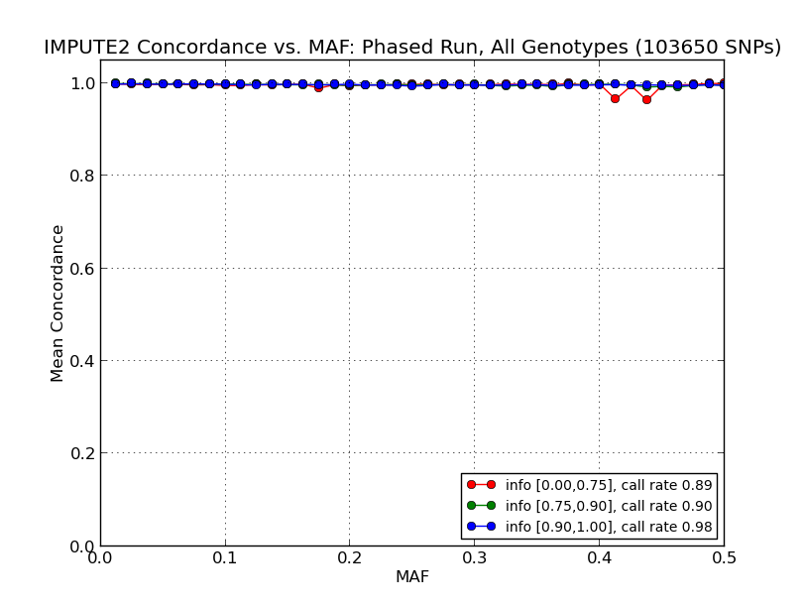
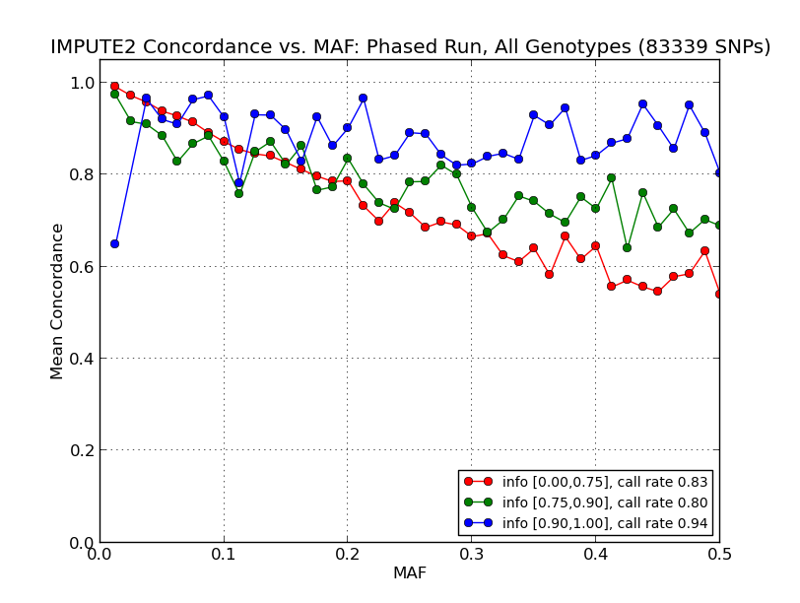
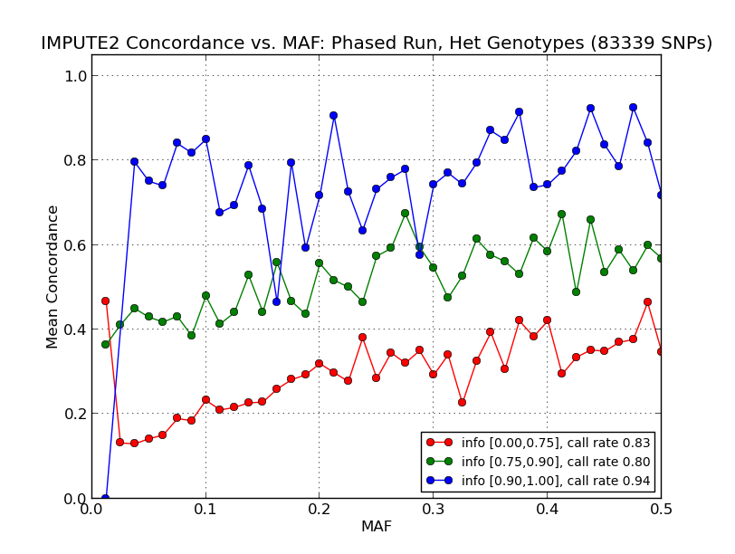
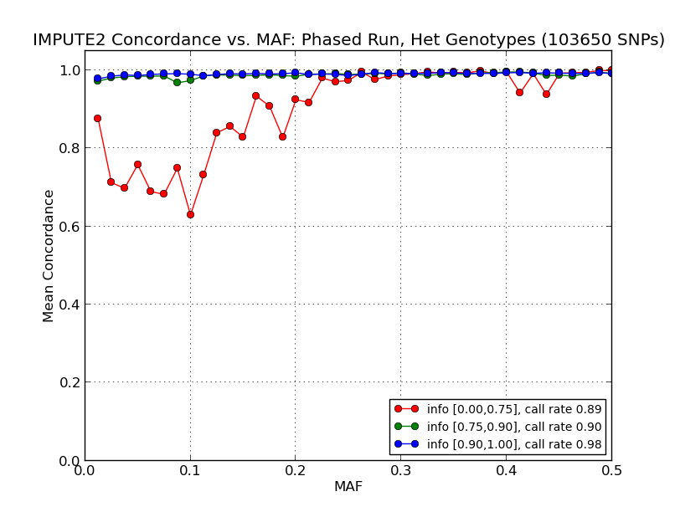
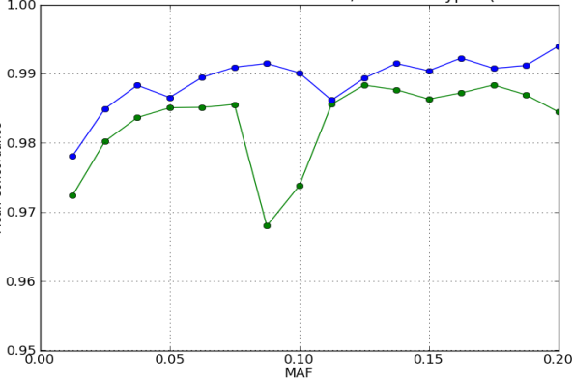
Integrating LD-based Imputation*
Unphased input
Pedigree-based phased haps
High quality
Medium
Low
* chr22 results
Notes:
These are chr22 results. Genome-wide results are similar; het concordance is about 98.5% instead of 99%.

Slide 28
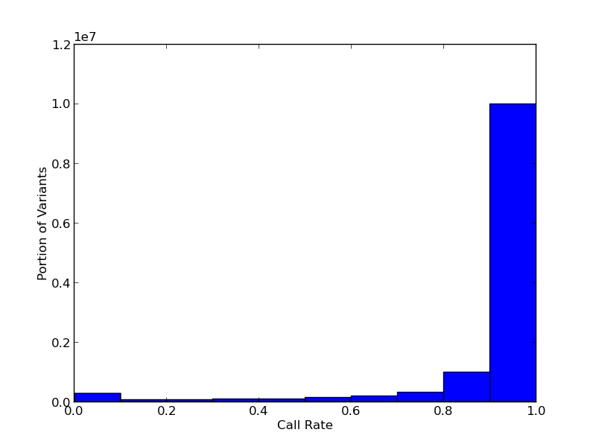
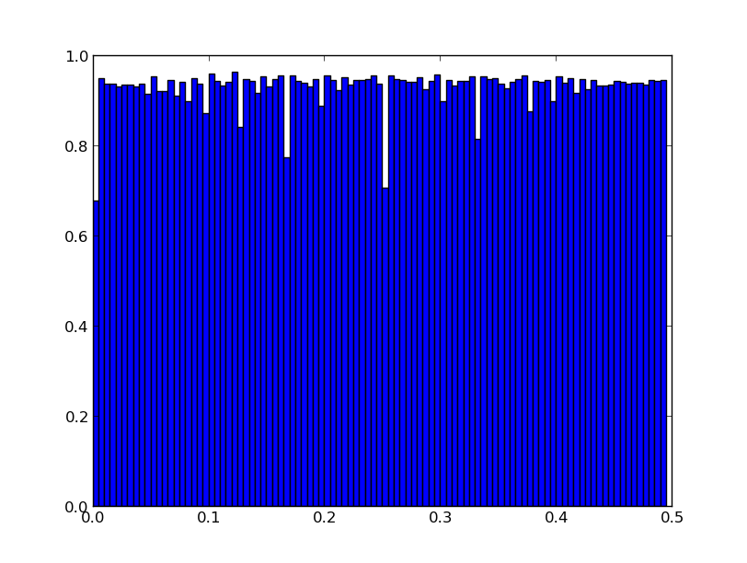
CGI Call Rate Breakdown
# Variants
Call Rate
Call Rate
MAF

