Slide 1
COMP 6600 Final Project: Time Delayed Neural Network for Improved Satellite Orbit Propagation
Oren Miller & Luke Zins

Slide 2
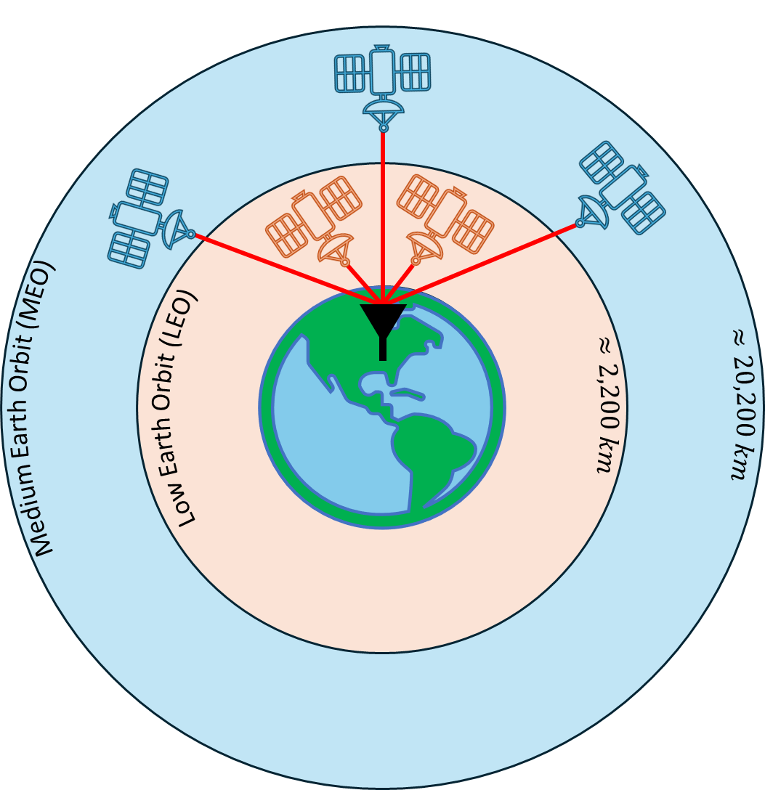
Background/Motivation
Satellite navigation systems, such as the Global Positioning System (GPS), have become and integral to modern day society
These systems provide the user precise Position, Navigation, and Timing (PNT)
While GPS is effective, it has a low received signal power due to its satellites being in Medium Earth Orbit
With this reliance on GPS, researchers have been investigating methods to leverage growing quantity of satellites within Low Earth Orbit

Slide 3
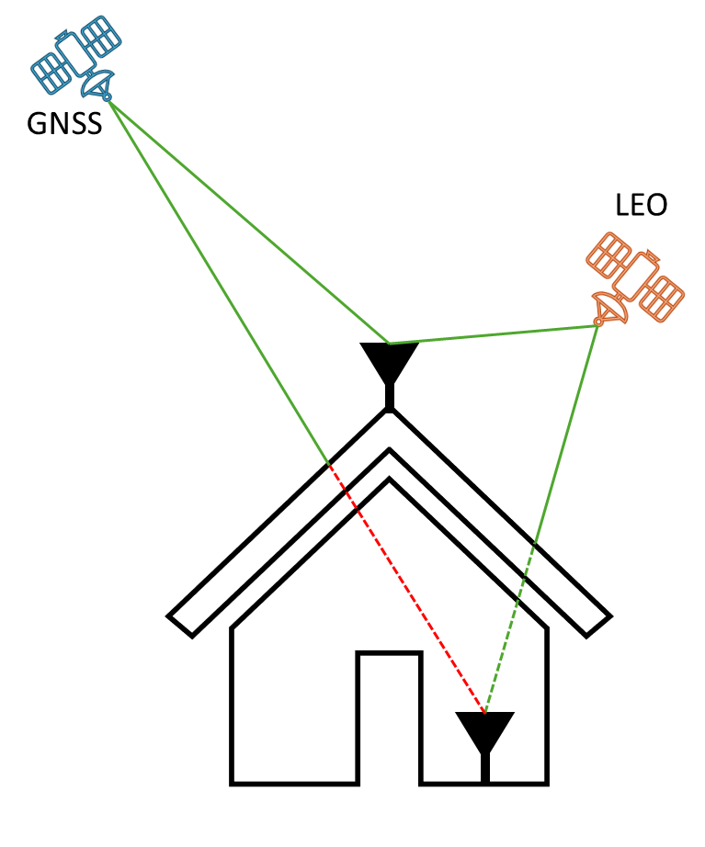
LEO Satellite Qualities
Typical Global Navigation Satellite Systems (GNSS) broadcast a signal with a modulated pseudorandom code that allows the user to “find” the signal below the noise floor
In contrast, many LEO satellites can be directly signal processed due to his high received signal power
This allows the signal to penetrate indoors and becomes easier for a receiver to maintain signal tracking
With the explosion of commercial satellite companies, there has become a diverse geometric diversity of LEO satellites

Slide 4
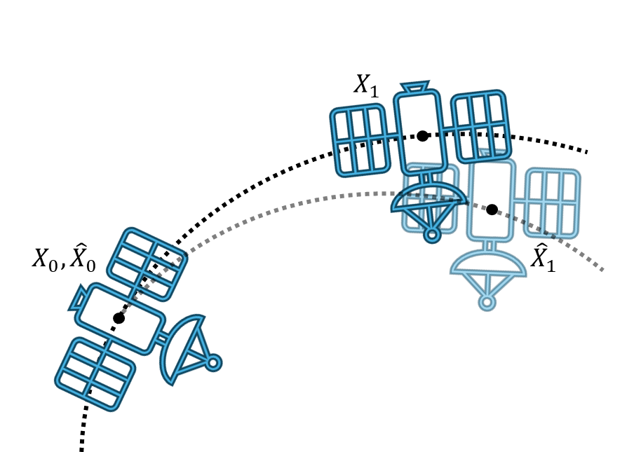
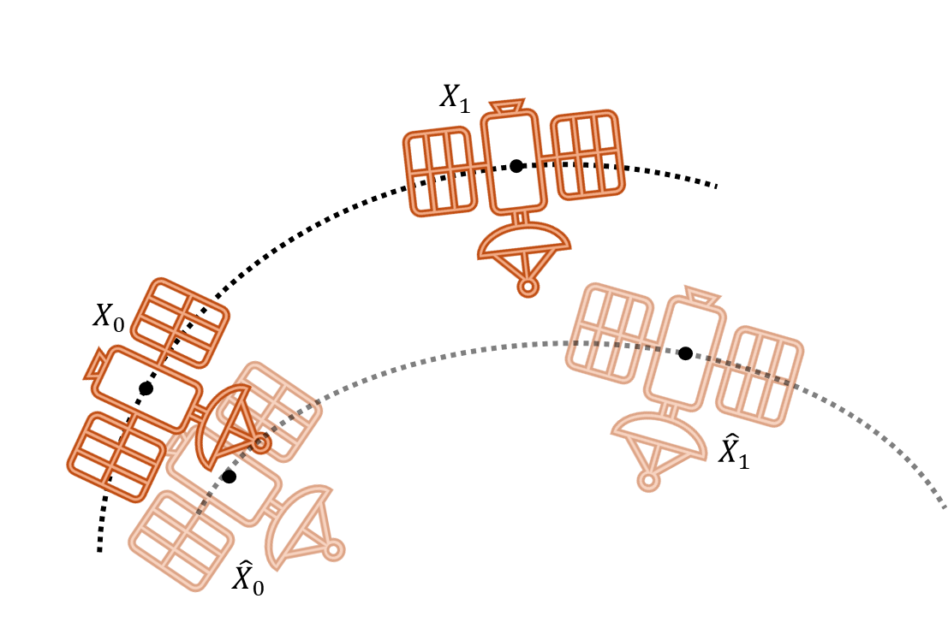
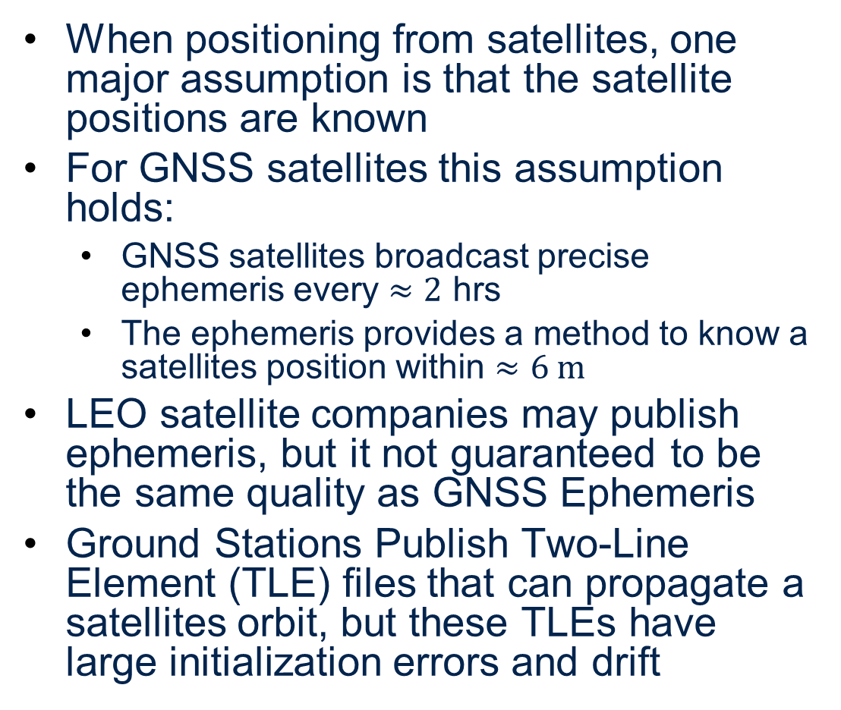
LEO Drawbacks
When positioning from satellites, one major assumption is that the satellite positions are known
For GNSS satellites this assumption holds:
GNSS satellites broadcast precise ephemeris every $≈2$ hrs
The ephemeris provides a method to know a satellites position within $≈6 m$
LEO satellite companies may publish ephemeris, but it not guaranteed to be the same quality as GNSS Ephemeris
Ground Stations Publish Two-Line Element (TLE) files that can propagate a satellites orbit, but these TLEs have large initialization errors and drift
GNSS Propagation
LEO TLE Propagation

Slide 5
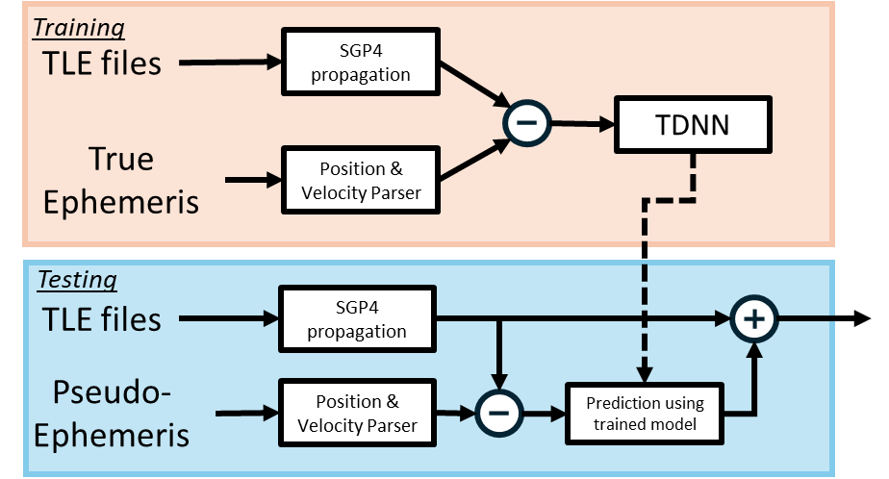
Methodology
This project attempts to create a Time Dependent Neural Network (TDNN) to estimate a satellites position using both pseudo-published ephemeris and published TLEs [1], [
A Time-Delay Neural Network is designed to learn patterns over time using past inputs as explicit delays
This structure is well-suited to modeling orbital dynamics and propagation errors, which depend on historical motion.

Slide 6
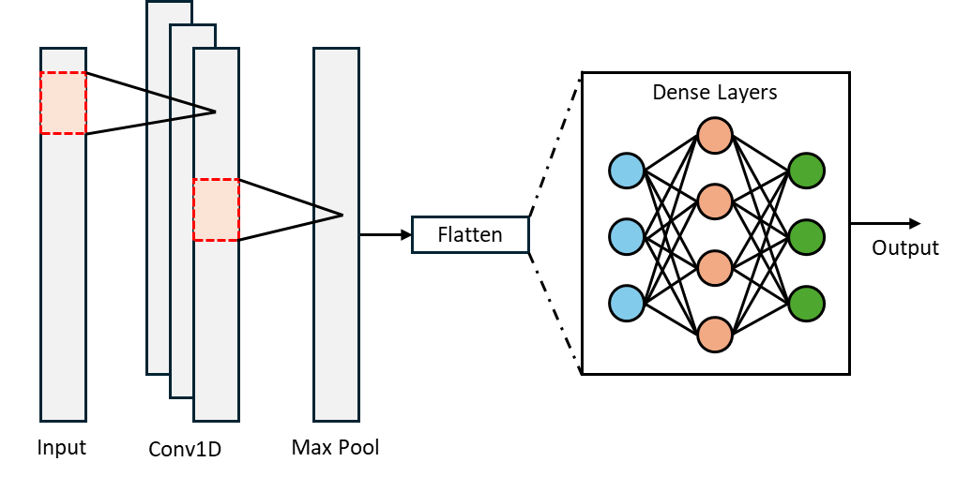
Methodology - TDNN
TDNN Components:
1D Convolution Layer * kernel only extends to previous timesteps *
Max Pooling Layer & Flattening Layer
Multi-Layer Perceptron (MLP)

Slide 7
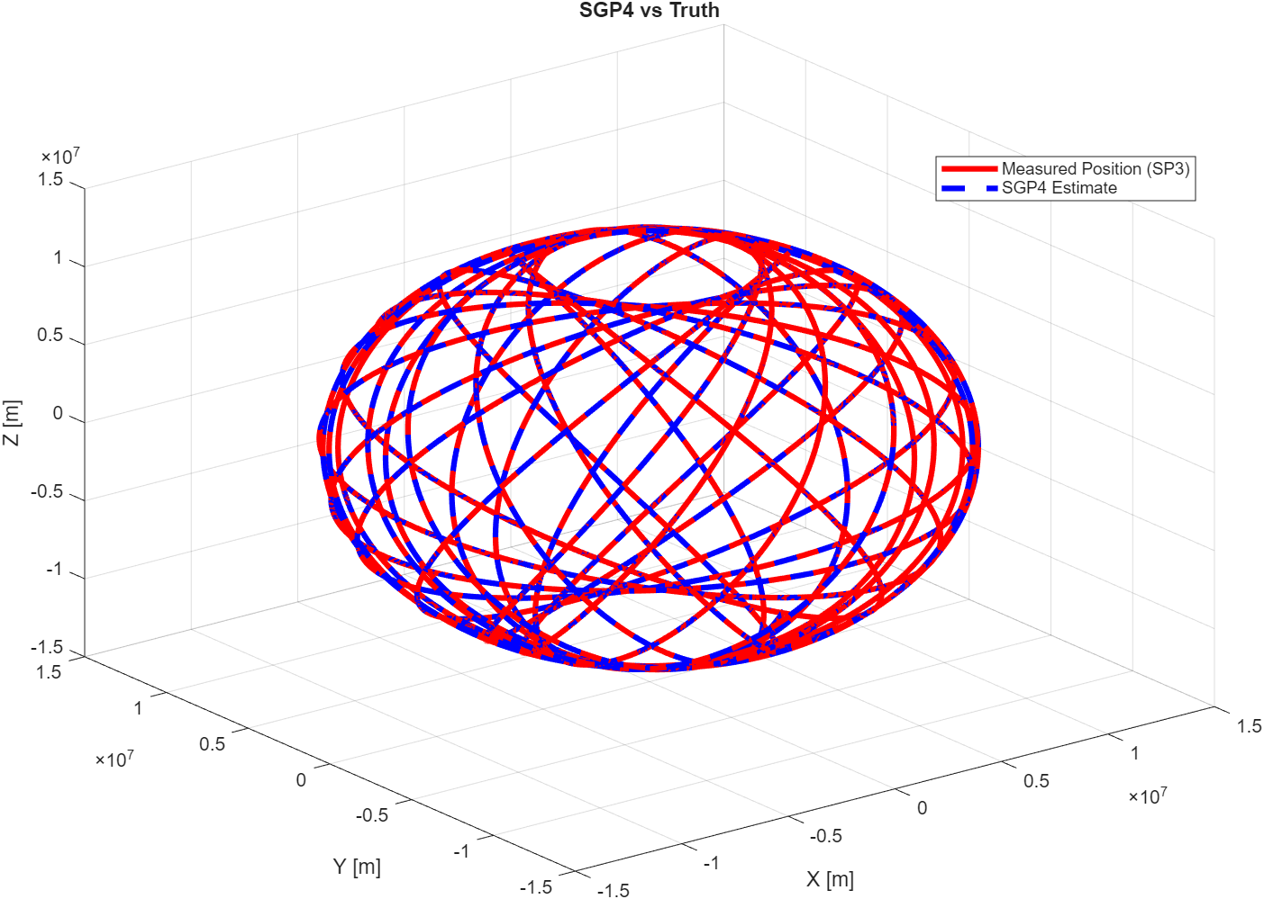
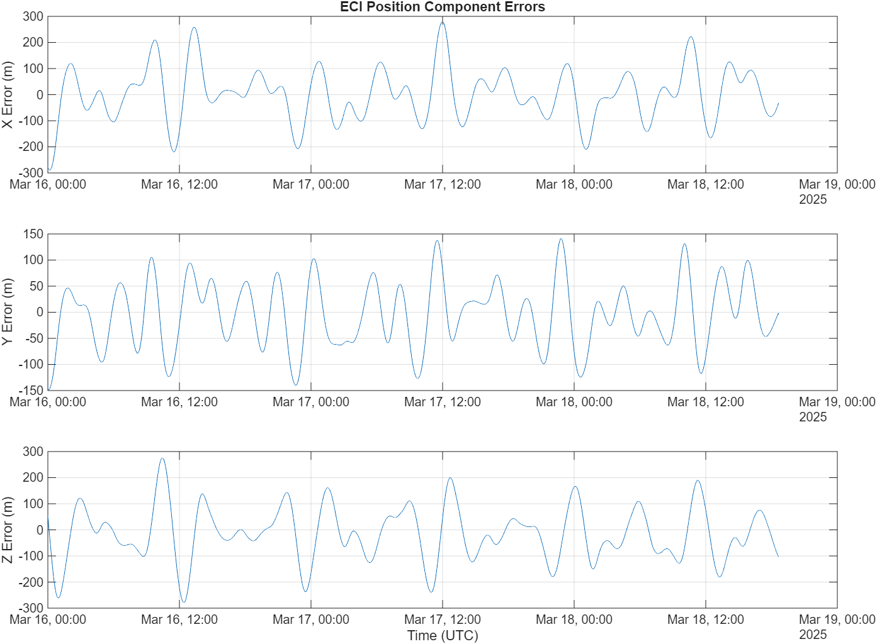
Training Data and TDNN Parameters
Example Testing Data taken from LAGEOS-1 scientific satellite
TDNN Parameters
Parameter | Value
Window Size | 180
Epochs | 100
Batch Size | 128
Learning Rate | 0.0001
Optimizer | ADAMS
Activation Function | ReLu

Slide 8
Training Data and TDNN Parameters
Example Testing Data taken from LAGEOS-1 scientific satellite
TDNN Parameters
Parameter | Value
Window Size | 180
Epochs | 100
Batch Size | 128
Learning Rate | 0.0001
Optimizer | ADAMS
Activation Function | ReLu

Slide 9
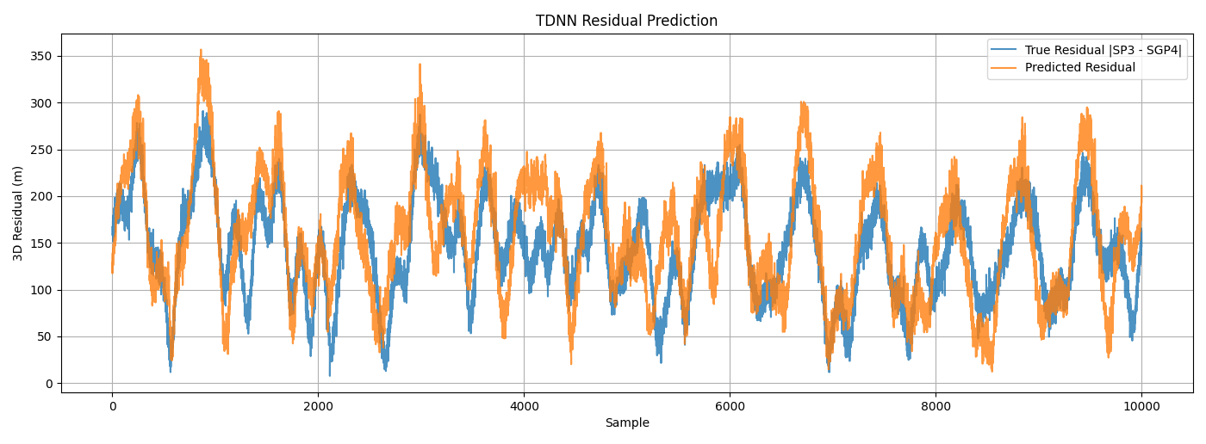
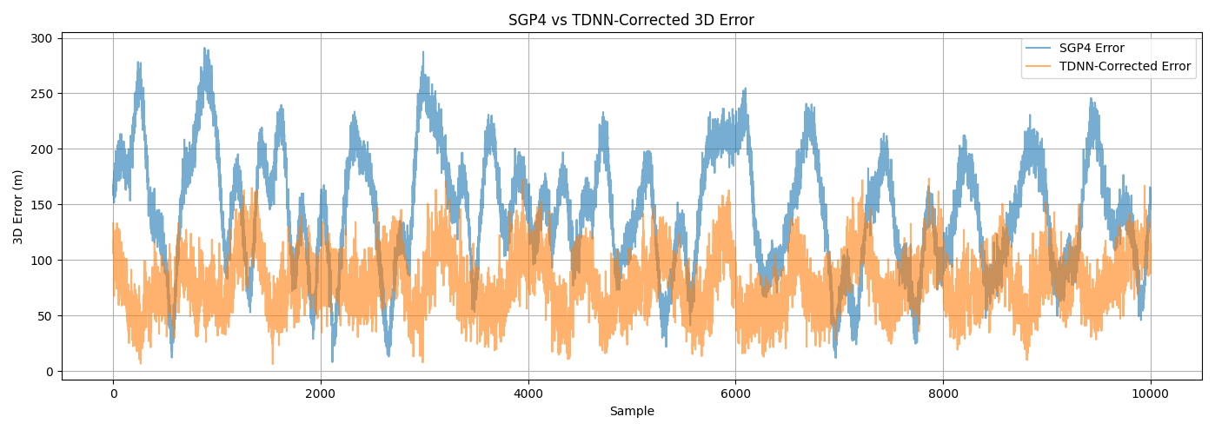
Results
The predicted residual can closely follow the true residual proving the model can predict the error of the orbit propagation.
The TDNN-corrected error is consistently lower, reducing the varience, improving the orbit estimation.

Slide 10
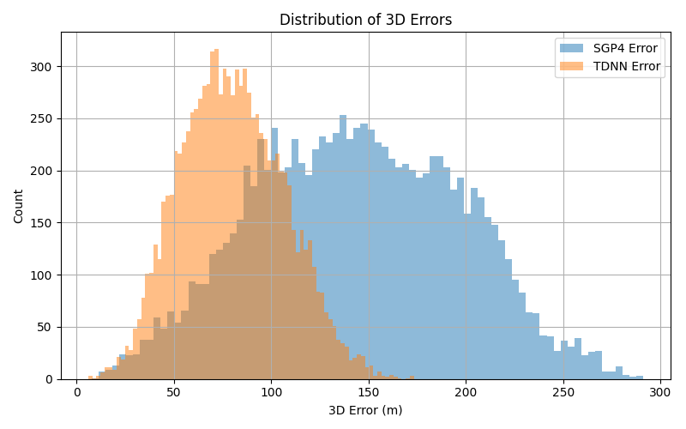
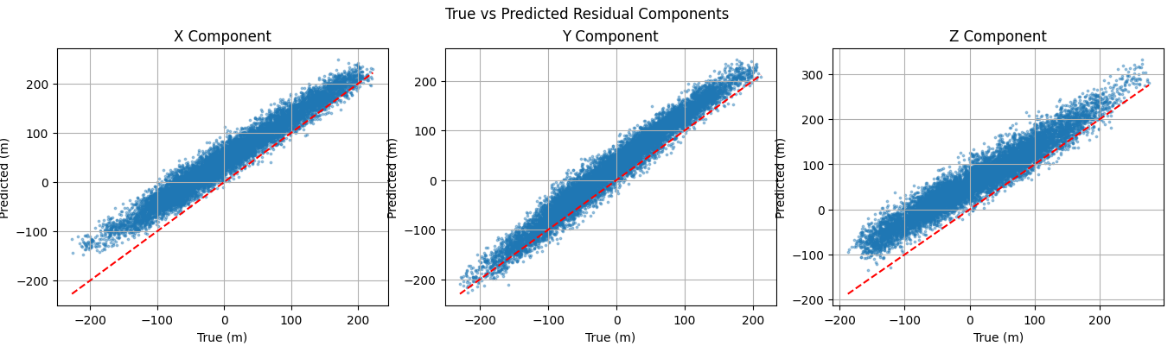
Conclusion
The designed TDNN was able to provide a %45.40 improvement over the traditional SGP4 orbit propagation
The distribution of the model errors appears to be gaussian, with the TDNN decreasing mean and variance when compared to SGP4
Model | RMSE (m)
SGP4 | 153.77
TDNN | 83.952
Improvement | %45.40
While the mean error is decreased, there appears to be a bias is the estimate.

Slide 11
Future Work
The TDNN showed viable performance to improve satellite propagation
Evaluating the TDNN within a positioning algorithm to fully quantify the improvements of the model
Expanding this model to estimate satellite positions for commercial satellites, rather than a scientific satellite.
An exploratory study on changing number and size of Conv1D and dense layers would prove benefit to evaluating the TDNN

Slide 12
References
[1] Sharbel Kozhaya, Jamil Haidar-Ahmad, Ali Abdallah, ZaherKassas, and Samer Saab. Comparison of neural network archi-tectures for simultaneous tracking and navigation with LEOsatellites. In Proceedings of the ION GNSS+ Conference,pages 1–10, St. Louis, MO, 2021
[2]

