Slide 1
Interacting Multiple Model (IMM) Algorithm for Mode Detection and Filter Fusion
Oren Miller & Alex Rist
04/09/2025

Slide 2
Agenda
Project Overview
Kalman Filter Review
Interacting Multiple Model (IMM) Overview
Model Definitions
Trajectory Generation
Results
Future Steps
Questions

Slide 3
Project Overview
Goal: To research and implement an Interacting Multiple Model (IMM) algorithm for mode detection and fusion Kalman Filter outputs

Slide 4
Kalman Filter Review

Slide 5
Interacting Multiple Model

Slide 6
Basics Of Interacting Multiple Model
Markov Chains
Probability of possible events
Ex)
0.95
Walk
0.025
0.03
Stop
0.04
0.025
Run
0.02
0.95
0.01
0.95

Slide 7
Basics Of Interacting Multiple Model
Markov Chains
Probability of possible events
Ex)
0.95
Walk
Markov Chain Matrix
0.025
0.03
0.95 | 0.04 | 0.01
0.025 | 0.95 | 0.025
0.01 | 0.03 | 0.95
Stop
0.04
0.025
Run
0.02
0.95
0.01
0.95

Slide 8
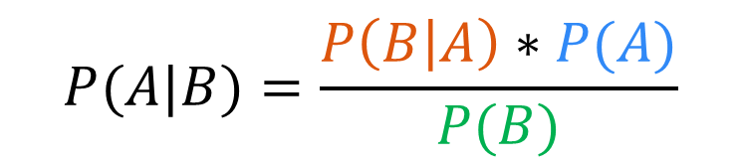
Basics Of Interacting Multiple Model
Markov Chains
Probability of possible events
Ex)
Bayes Rule
Probability of posterior given prior
0.95
Likelihood
Prior
Walk
$$P(A|B)=\frac{P\left(B | A\right)∗P(A)}{P(B)}$$
0.025
0.03
Marginalization
Stop
0.04
0.025
Run
0.02
0.95
0.01
0.95

Slide 9
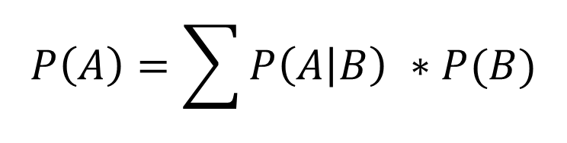
Basics Of Interacting Multiple Model
Markov Chains
Probability of possible events
Ex)
Bayes Rule
Probability of posterior given prior
0.95
Likelihood
Prior
Walk
$$P(A|B)=\frac{P\left(B | A\right)∗P(A)}{P(B)}$$
0.025
0.03
Marginalization
Stop
0.04
0.025
Run
Total Probability Theorem
0.02
$$P\left(A\right)=\sum{P\left(A | B\right) ∗P(B)}$$
0.95
0.01
0.95

Slide 10
Interacting Multiple Model Algorithim
Step Interaction
Kalman Filter State and Covariance Estimate Updated by a Conditional Model Probability
Goal is to mix Kalman Filter States such that the model possibilities doesn’t grow exponentially
Model Probability Update
Model Probability Updated using the likelihoods from the Kalman Filter Bank
Conditional Model Probability Created
State Estimate Combiner
Kalman Filter Bank Measurement Updates are Combined with New Model Probability
One State and Covariance Estimate
State Interaction
KF
Measurement
Model Probability Update
State Estimate Combiner

Slide 11









Interacting Multiple Model Example
State Interaction
$${\hat{X}}^{01},{\hat{P}}^{01}$$
$${\hat{X}}^{02},{\hat{P}}^{02}$$
Kalman Filter #1
Kalman Filter #2
Time Update
Time Update
Meas.
Measurement Update
Measurement Update
$${\hat{μ}}^{i|j}$$
$$Λ^{2}$$
Model Probability Update
$$Λ^{1}$$
$${\hat{μ}}^{j}$$
$${\hat{X}}^{2}$$
$${\hat{X}}^{1}$$
State Estimate Combiner
$${\hat{X}}^{IMM}$$

Slide 12



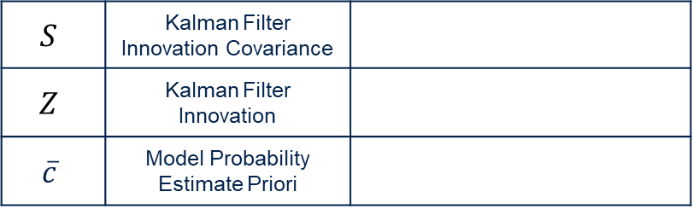


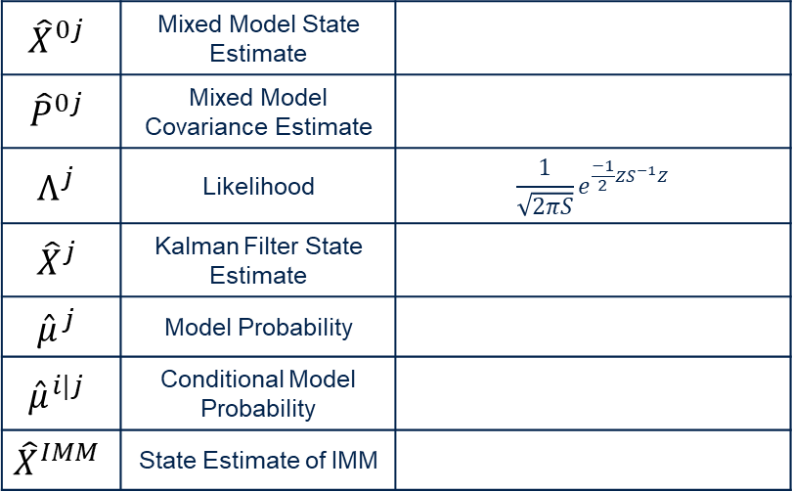




Interacting Multiple Model Example
$${\hat{X}}^{0j}$$ | Mixed Model State Estimate
$${\hat{P}}^{0j}$$ | Mixed Model Covariance Estimate
$$Λ^{j}$$ | Likelihood | $$\frac{1}{\sqrt{2πS}}e^{\frac{−1}{2}ZS^{−1}Z}$$
$${\hat{X}}^{j}$$ | Kalman Filter State Estimate
$${\hat{μ}}^{j}$$ | Model Probability
$${\hat{μ}}^{i|j}$$ | Conditional Model Probability
$${\hat{X}}^{IMM}$$ | State Estimate of IMM
State Interaction
$${\hat{X}}^{01},{\hat{P}}^{01}$$
$${\hat{X}}^{02},{\hat{P}}^{02}$$
Kalman Filter #1
Kalman Filter #2
Time Update
Time Update
Meas.
Measurement Update
Measurement Update
$${\hat{μ}}^{i|j}$$
$$Λ^{2}$$
Model Probability Update
$$S$$ | Kalman Filter Innovation Covariance
$$Z$$ | Kalman Filter Innovation
$$\overline{c}$$ | Model Probability Estimate Priori
$$Λ^{1}$$
$${\hat{μ}}^{j}$$
$${\hat{X}}^{2}$$
$${\hat{X}}^{1}$$
State Estimate Combiner
$${\hat{X}}^{IMM}$$

Slide 13
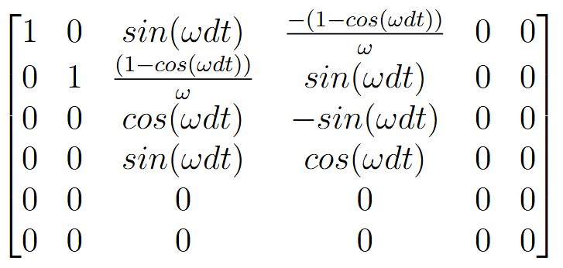
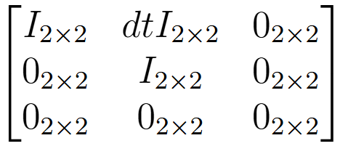
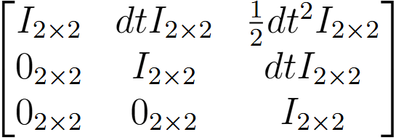
Model Modes
System States: $[P V A]$
Constant Velocity (CV)
Constant Turn Rate (CT)
Constant Acceleration (CA)

Slide 14
Trajectory Generation

Slide 15
Results

Slide 16
Future Steps

Slide 17
Questions?

Slide 18
References

Slide 20
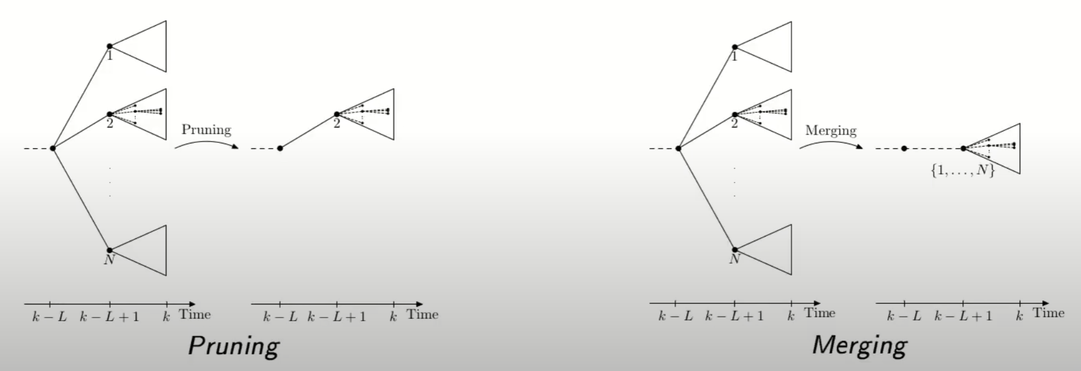
https://www.youtube.com/watch?v=pqxICLvcYlE

