Slide 1
Interacting Multiple Model (IMM) Algorithm for Mode Detection and Filter Fusion
Oren Miller & Alex Rist
04/09/2025

Slide 2
Agenda
Project Overview
Kalman Filter Review
Interacting Multiple Model (IMM) Overview
Model Definitions
Trajectory Generation
Results
Future Steps
Questions

Slide 3
Project Overview
Goal: To research and implement an Interacting Multiple Model (IMM) algorithm for mode detection and fusion Kalman Filter outputs

Slide 4
Kalman Filter Review

Slide 5
Interacting Multiple Model

Slide 6
Basics Of Interacting Multiple Model
Markov Chains
Probability of possible events
Ex)
0.95
Walk
0.025
0.03
Stop
0.04
0.025
Run
0.02
0.95
0.01
0.95

Slide 7
Basics Of Interacting Multiple Model
Markov Chains
Probability of possible events
Ex)
0.95
Walk
Markov Chain Matrix
0.025
0.03
0.95 | 0.04 | 0.01
0.025 | 0.95 | 0.025
0.01 | 0.03 | 0.95
Stop
0.04
0.025
Run
0.02
0.95
0.01
0.95

Slide 8
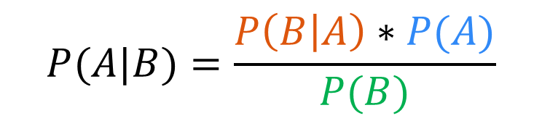
Basics Of Interacting Multiple Model
Markov Chains
Probability of possible events
Ex)
Bayes Rule
Probability of posterior given prior
0.95
Likelihood
Prior
Walk
$$P(A|B)=\frac{P\left(B | A\right)∗P(A)}{P(B)}$$
0.025
0.03
Marginalization
Stop
0.04
0.025
Run
0.02
0.95
0.01
0.95

Slide 9
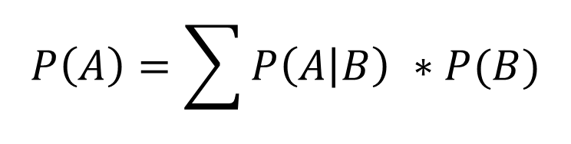
Basics Of Interacting Multiple Model
Markov Chains
Probability of possible events
Ex)
Bayes Rule
Probability of posterior given prior
0.95
Likelihood
Prior
Walk
$$P(A|B)=\frac{P\left(B | A\right)∗P(A)}{P(B)}$$
0.025
0.03
Marginalization
Stop
0.04
0.025
Run
Total Probability Theorem
0.02
$$P\left(A\right)=\sum{P\left(A | B\right) ∗P(B)}$$
0.95
0.01
0.95

Slide 10
Interacting Multiple Model Algorithim
Step Interaction
Kalman Filter State and Covariance Estimate Updated by a Conditional Model Probability
Goal is to mix Kalman Filter States such that the model possibilities doesn’t grow exponentially
Model Probability Update
Model Probability Updated using the likelihoods from the Kalman Filter Bank
Conditional Model Probability Created
State Estimate Combiner
Kalman Filter Bank Measurement Updates are Combined with New Model Probability
One State and Covariance Estimate
State Interaction
KF
Measurement
Model Probability Update
State Estimate Combiner

Slide 11









Interacting Multiple Model Example
State Interaction
$${\hat{X}}^{01},{\hat{P}}^{01}$$
$${\hat{X}}^{02},{\hat{P}}^{02}$$
Kalman Filter #1
Kalman Filter #2
Time Update
Time Update
Meas.
Measurement Update
Measurement Update
$${\hat{μ}}^{i|j}$$
$$Λ^{2}$$
Model Probability Update
$$Λ^{1}$$
$${\hat{μ}}^{j}$$
$${\hat{X}}^{2}$$
$${\hat{X}}^{1}$$
State Estimate Combiner
$${\hat{X}}^{IMM}$$

Slide 12

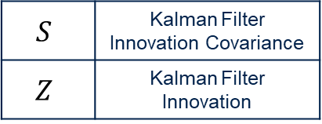


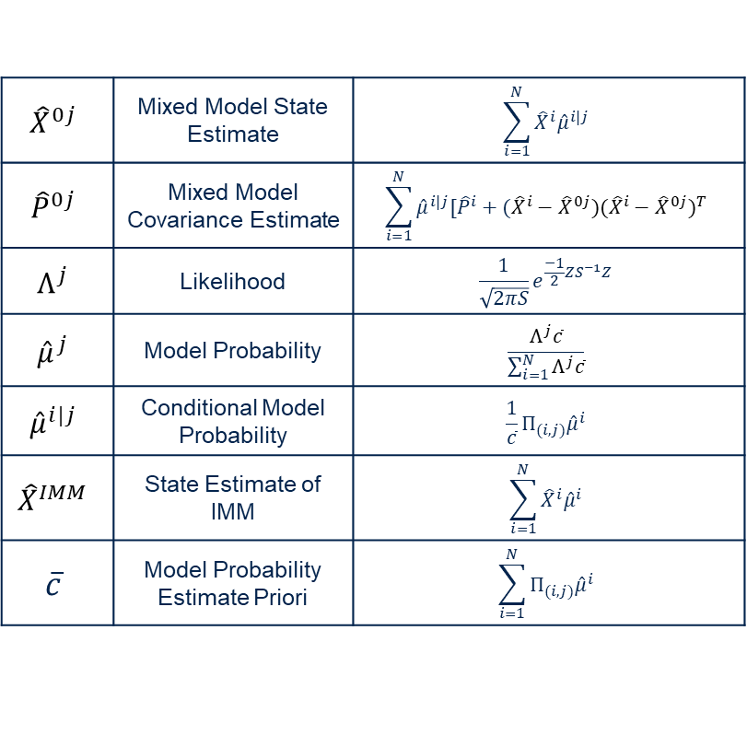






Interacting Multiple Model Example
State Interaction
$${\hat{X}}^{0j}$$ | Mixed Model State Estimate | $$\sum_{i=1}^{N}{{\hat{X}}^{i}{\hat{μ}}^{i|j}}$$
$${\hat{P}}^{0j}$$ | Mixed Model Covariance Estimate | $$\sum_{i=1}^{N}{{\hat{μ}}^{i|j}[{\hat{P}}^{i}+({{\hat{X}}^{i}−\hat{X}}^{0j})({{\hat{X}}^{i}−\hat{X}}^{0j})^{T}}$$
$$Λ^{j}$$ | Likelihood | $$\frac{1}{\sqrt{2πS}}e^{\frac{−1}{2}ZS^{−1}Z}$$
$${\hat{μ}}^{j}$$ | Model Probability | $$\frac{Λ^{j}\overline{c}}{\sum_{i=1}^{N}{Λ^{j}\overline{c}}}$$
$${\hat{μ}}^{i|j}$$ | Conditional Model Probability | $$\frac{1}{\overline{c}}{Π_{(i,j)}\hat{μ}}^{i}$$
$${\hat{X}}^{IMM}$$ | State Estimate of IMM | $$\sum_{i=1}^{N}{{\hat{X}}^{i}{\hat{μ}}^{i}}$$
$$\overline{c}$$ | Model Probability Estimate Priori | $$\sum_{i=1}^{N}{{Π_{(i,j)}\hat{μ}}^{i}}$$
$${\hat{X}}^{01},{\hat{P}}^{01}$$
$${\hat{X}}^{02},{\hat{P}}^{02}$$
Kalman Filter #1
Kalman Filter #2
Time Update
Time Update
Meas.
Measurement Update
Measurement Update
$${\hat{μ}}^{i|j}$$
$$Λ^{2}$$
Model Probability Update
$$Λ^{1}$$
$${\hat{μ}}^{j}$$
$$S$$ | Kalman Filter Innovation Covariance
$$Z$$ | Kalman Filter Innovation
$${\hat{X}}^{2}$$
$${\hat{X}}^{1}$$
State Estimate Combiner
$${\hat{X}}^{IMM}$$

Slide 13
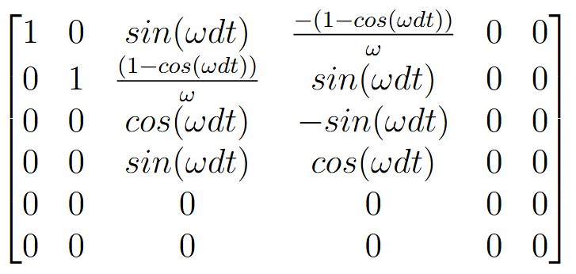
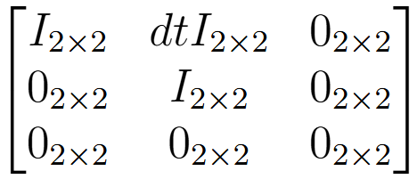
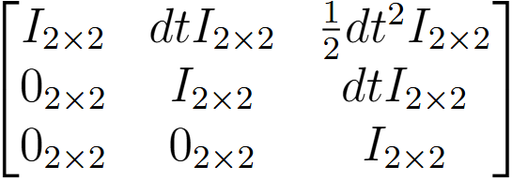
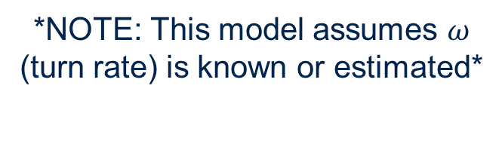
Model Modes
System States: $[P V A]$
Constant Velocity (CV)
Constant Turn Rate (CT)
Constant Acceleration (CA)
*NOTE: This model assumes $ω$ (turn rate) is known or estimated*

Slide 14
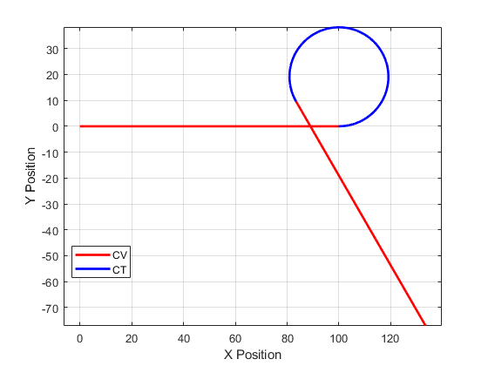
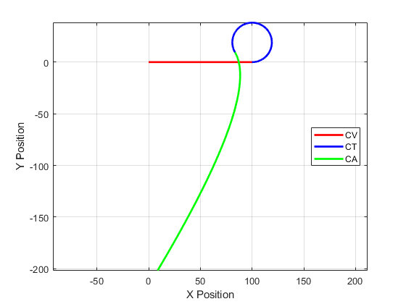
Trajectory Generation
CV-CT
10m/s East for 10sec
30°/s for 10sec
10m/s at resultant heading for 10sec
CV-CT-CA
10m/s East for 10sec
30°/s for 10sec
5m/s² in x and y directions for 10sec

Slide 15
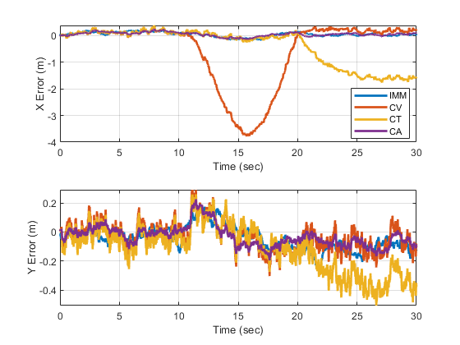
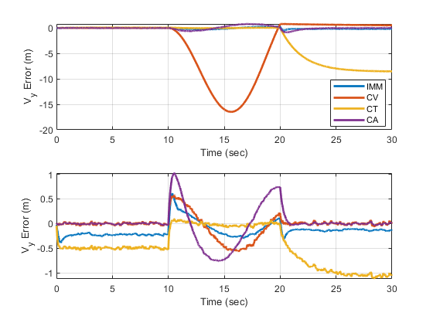
Results (CV-CT) - Errors
Error Plots of Filters Shown Below:

Slide 16
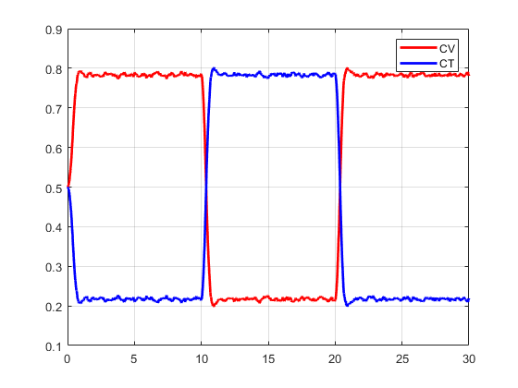
Results (CV-CT) – Mode Probability
The IMM model was able to accurately predict the changing modes
The CT model assumes that the turn rate is known

Slide 17
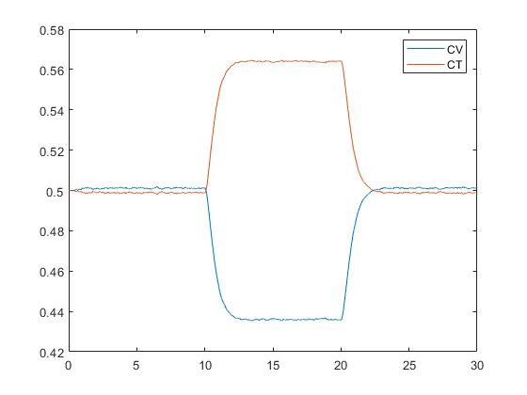
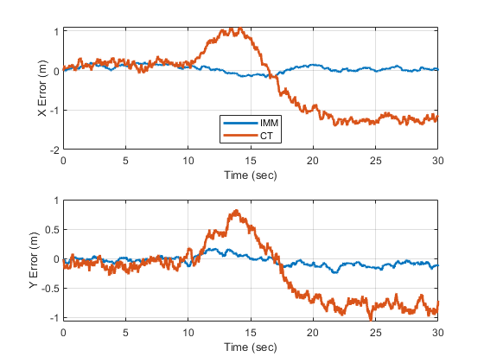
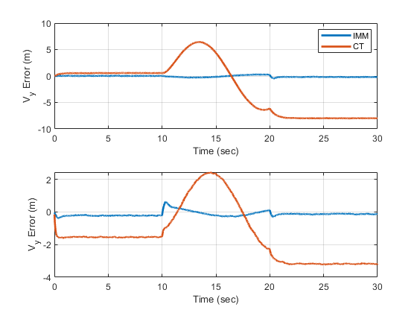
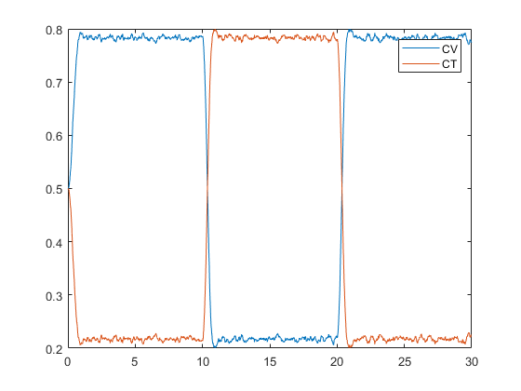
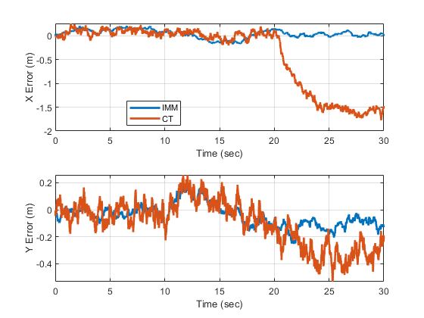
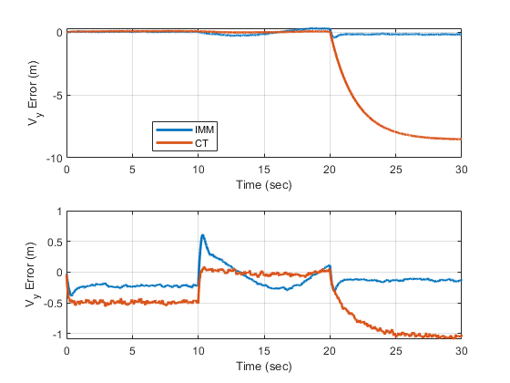
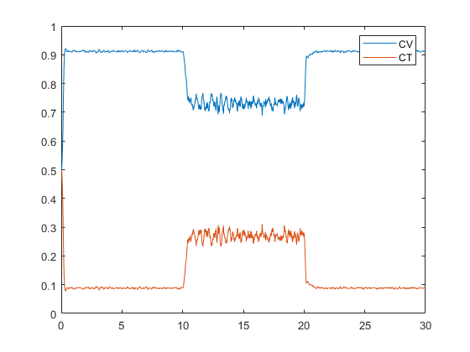
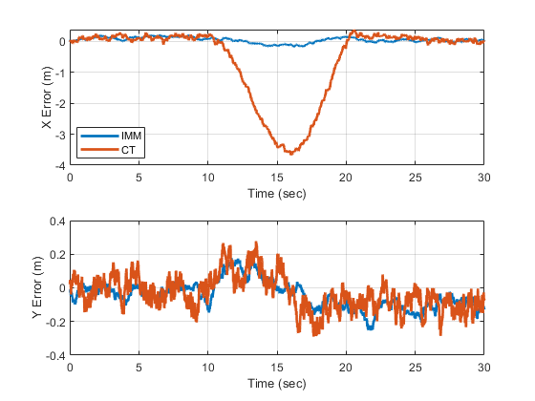
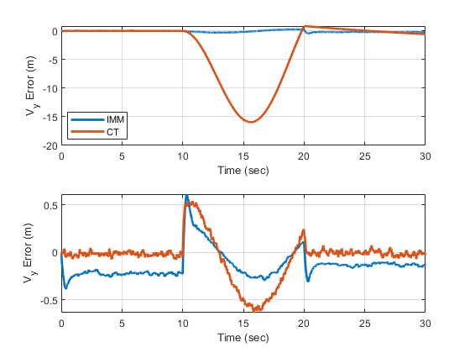


Results (CV-CT) – Effect of Incorrect Turn Rate
$$∞$$
0
Turn Rate Error
$$−∞$$

Slide 18
Future Steps

Slide 19
Questions?

Slide 20
References

Slide 22
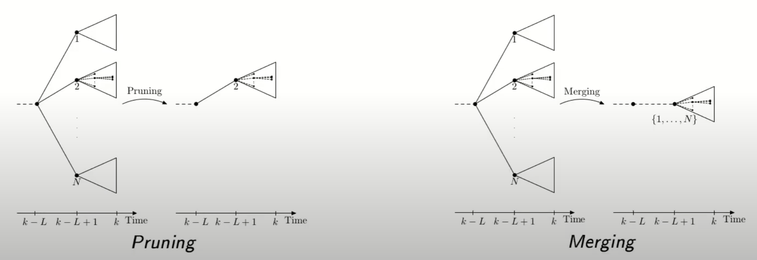
https://www.youtube.com/watch?v=pqxICLvcYlE

