Slide 1
Interacting Multiple Model (IMM): Algorithm for Mode Detection & Filter Fusion
Oren Miller & Alex Rist
04/09/2025

Slide 2
Agenda
Project Overview
Kalman Filter Review
Interacting Multiple Model (IMM)
Overview
Algorithm
Example
Model Definitions
Trajectory Generation
Results
Constant Velocity – Constant Turn Rate IMM
Constant Velocity – Constante Turn Rate – Constant Acceleration IMM
Future Steps
Questions

Slide 3
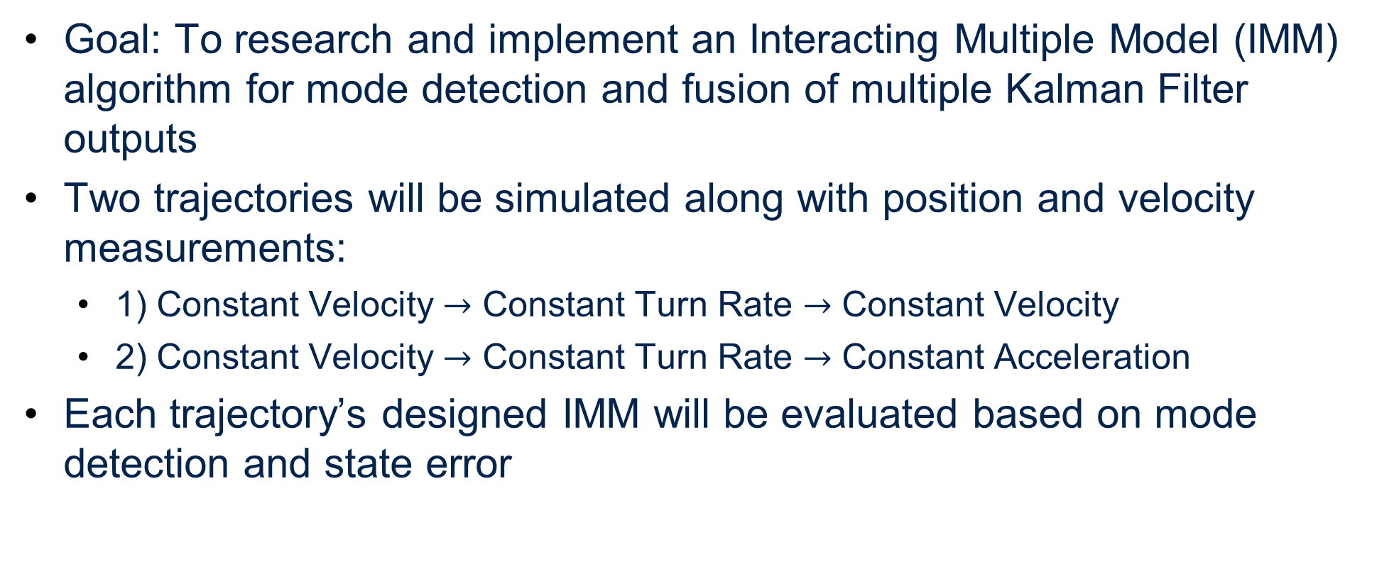
Project Overview
Goal: To research and implement an Interacting Multiple Model (IMM) algorithm for mode detection and fusion of multiple Kalman Filter outputs
Two trajectories will be simulated along with position and velocity measurements:
1) Constant Velocity $→$ Constant Turn Rate $→$ Constant Velocity
2) Constant Velocity $→$ Constant Turn Rate $→$ Constant Acceleration
Each trajectory’s designed IMM will be evaluated based on mode detection and state error

Slide 4
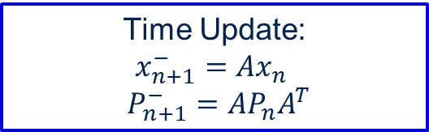
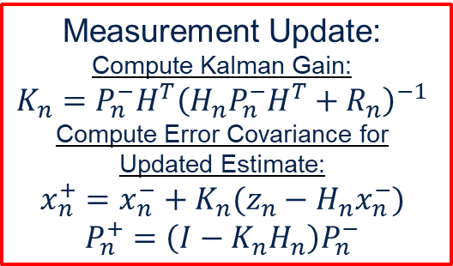
Kalman Filter Review
First developed in1958 by Rudolph Kálmán. [1]
The Kalman filter is an optimal filter for LTI systems that is applicable to many estimation and navigation practices.
Consists of two primary steps:
Time Update:
Model based propagation of all states, under known inputs.
Measurement Update:
Measurement Correction of the propagated model states.
Time Update:
$$x_{n+1}^{−}=Ax_{n}$$
$P_{n+1}^{−}=AP_{n}A^{T}$
Measurement Update:
Compute Kalman Gain:
$$K_{n}=P_{n}^{−}H^{T}{\left(H_{n}P_{n}^{−}H^{T}+R_{n}\right)}^{−1}$$
Compute Error Covariance for Updated Estimate:
$$x_{n}^{+}=x_{n}^{−}+K_{n}(z_{n}−H_{n}x_{n}^{−})$$
$P_{n}^{+}=\left(I−K_{n}H_{n}\right)P_{n}^{−}$

Slide 5
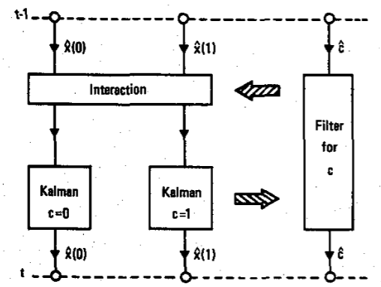
Interacting Multiple Model
First Proposed by H.A.P. Blom in 1984. [2]
Proposed as a high-efficiency solution to estimation of processes with Markovian coefficients.
Processes where the parameters evolve according to a Markov process.
Utilizes multiple models to propagate the system and based on the innovations of each model the best update is selected and mixed with the other outputs.
This allows for complex dynamics to be estimated with various simple kinematic models.
[2]

Slide 6
Basics Of Interacting Multiple Model
Markov Chain: Probability of the future state possibilities of a system based on current knowledge of the state
0.95
Walk
0.025
0.03
Stop
0.04
0.025
Run
0.02
0.95
0.01
0.95

Slide 7
Basics Of Interacting Multiple Model
Markov Chains:
0.95
Walk
Markov Chain Matrix
0.95 | 0.04 | 0.01
0.025 | 0.95 | 0.025
0.01 | 0.03 | 0.95
0.025
0.03
Stop
0.04
0.025
Run
0.02
0.95
0.01
0.95

Slide 8
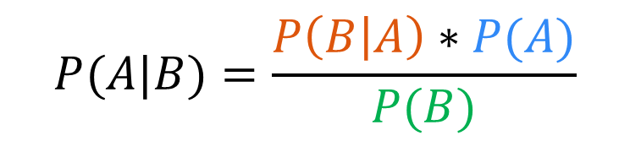
Basics Of Interacting Multiple Model
Markov Chains:
Bayes Rule
Probability of posterior given prior
0.95
Likelihood
Prior
Walk
$$P(A|B)=\frac{P\left(B | A\right)∗P(A)}{P(B)}$$
0.025
0.03
Marginalization
Stop
0.04
0.025
Run
0.02
0.95
0.01
0.95

Slide 9
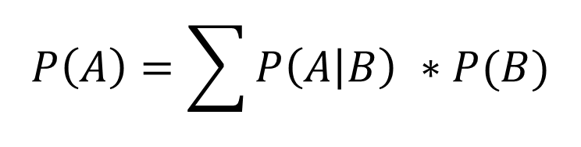
Basics Of Interacting Multiple Model
Markov Chains:
Bayes Rule
Probability of posterior given prior
0.95
Likelihood
Prior
Walk
$$P(A|B)=\frac{P\left(B | A\right)∗P(A)}{P(B)}$$
0.025
0.03
Marginalization
Stop
0.04
0.025
Run
0.02
Total Probability Theorem
$$P\left(A\right)=\sum{P\left(A | B\right) ∗P(B)}$$
0.95
0.01
0.95

Slide 10
Interacting Multiple Model Algorithim
Step Interaction
Kalman Filter State and Covariance Estimate Updated by a Conditional Model Probability
Goal is to mix Kalman Filter States such that the model possibilities doesn’t grow exponentially
Model Probability Update
Model Probability Updated using the likelihoods from the Kalman Filter Bank
Conditional Model Probability Created
State Estimate Combiner
Kalman Filter Bank Measurement Updates are Combined with New Model Probability
One State and Covariance Estimate
State Interaction
KF
Measurement
Model Probability Update
State Estimate Combiner

Slide 11









Interacting Multiple Model Example
State Interaction
$${\hat{X}}^{01},{\hat{P}}^{01}$$
$${\hat{X}}^{02},{\hat{P}}^{02}$$
Kalman Filter #1
Kalman Filter #2
Time Update
Time Update
Meas.
Measurement Update
Measurement Update
$${\hat{μ}}^{i|j}$$
$$Λ^{2}$$
Model Probability Update
$$Λ^{1}$$
$${\hat{μ}}^{j}$$
$${\hat{X}}^{2}$$
$${\hat{X}}^{1}$$
State Estimate Combiner
$${\hat{X}}^{IMM}$$

Slide 12

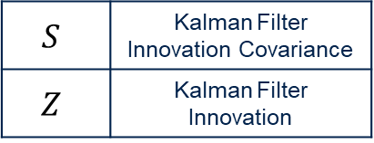


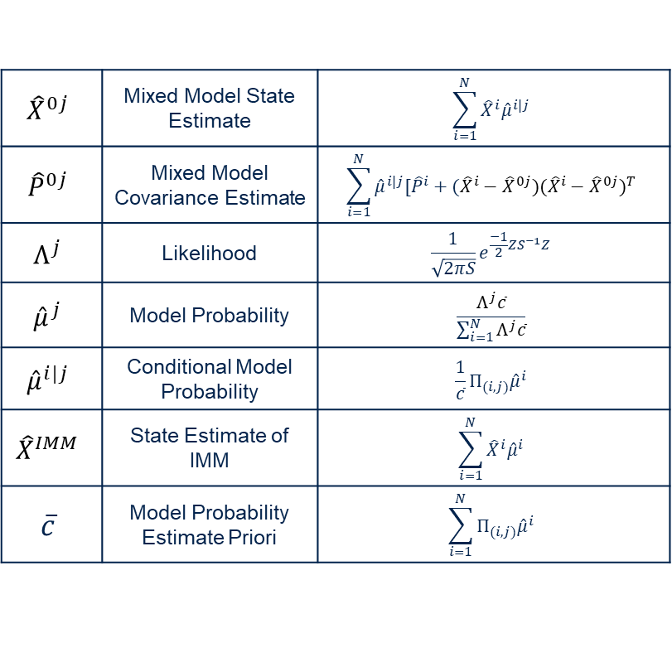






Interacting Multiple Model Example
State Interaction
$${\hat{X}}^{0j}$$ | Mixed Model State Estimate | $$\sum_{i=1}^{N}{{\hat{X}}^{i}{\hat{μ}}^{i|j}}$$
$${\hat{P}}^{0j}$$ | Mixed Model Covariance Estimate | $$\sum_{i=1}^{N}{{\hat{μ}}^{i|j}[{\hat{P}}^{i}+({{\hat{X}}^{i}−\hat{X}}^{0j})({{\hat{X}}^{i}−\hat{X}}^{0j})^{T}}$$
$$Λ^{j}$$ | Likelihood | $$\frac{1}{\sqrt{2πS}}e^{\frac{−1}{2}ZS^{−1}Z}$$
$${\hat{μ}}^{j}$$ | Model Probability | $$\frac{Λ^{j}\overline{c}}{\sum_{i=1}^{N}{Λ^{j}\overline{c}}}$$
$${\hat{μ}}^{i|j}$$ | Conditional Model Probability | $$\frac{1}{\overline{c}}{Π_{(i,j)}\hat{μ}}^{i}$$
$${\hat{X}}^{IMM}$$ | State Estimate of IMM | $$\sum_{i=1}^{N}{{\hat{X}}^{i}{\hat{μ}}^{i}}$$
$$\overline{c}$$ | Model Probability Estimate Priori | $$\sum_{i=1}^{N}{{Π_{(i,j)}\hat{μ}}^{i}}$$
$${\hat{X}}^{01},{\hat{P}}^{01}$$
$${\hat{X}}^{02},{\hat{P}}^{02}$$
Kalman Filter #1
Kalman Filter #2
Time Update
Time Update
Meas.
Measurement Update
Measurement Update
$${\hat{μ}}^{i|j}$$
$$Λ^{2}$$
Model Probability Update
$$Λ^{1}$$
$${\hat{μ}}^{j}$$
$$S$$ | Kalman Filter Innovation Covariance
$$Z$$ | Kalman Filter Innovation
$${\hat{X}}^{2}$$
$${\hat{X}}^{1}$$
State Estimate Combiner
$${\hat{X}}^{IMM}$$

Slide 13
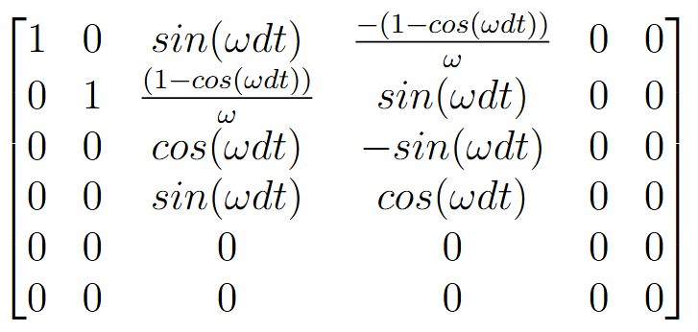
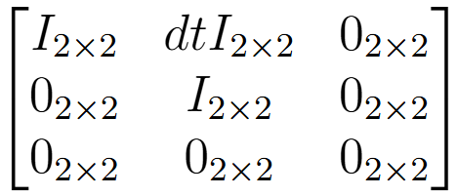
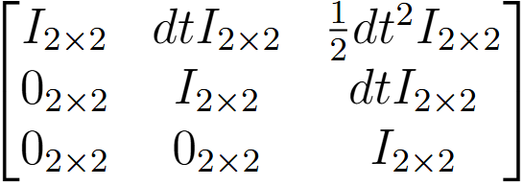
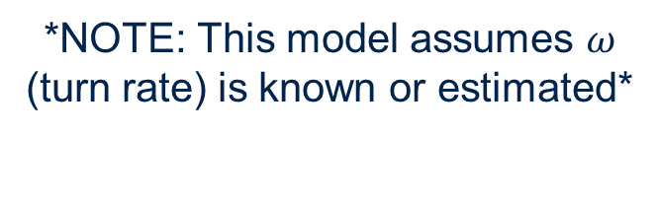
Model Modes
System States: $[P V A]$
Constant Velocity (CV)
Constant Turn Rate (CT)
Constant Acceleration (CA)
*NOTE: This model assumes $ω$ (turn rate) is known or estimated*

Slide 14
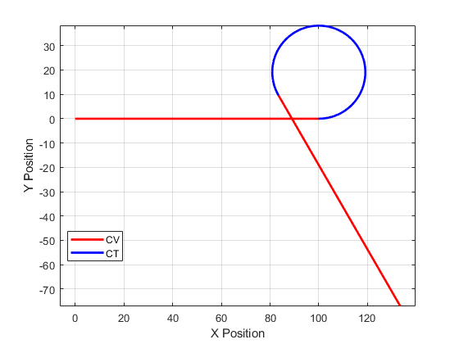
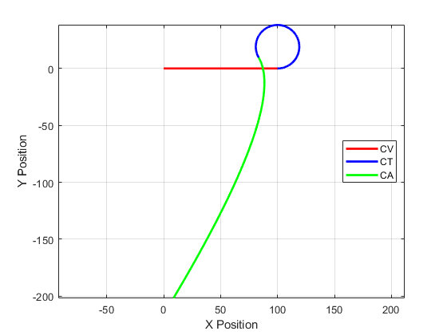
Trajectory Generation
CV-CT
CV-CT-CA

Slide 15
Constant Velocity – Constant Turn Rate IMM

Slide 16
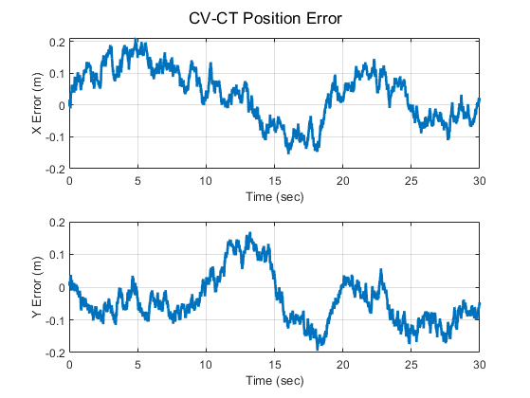
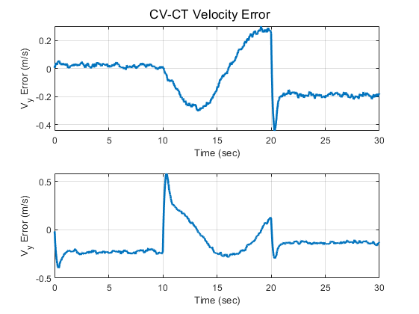
Results (CV-CT) - Errors
Performance of IMM CV-CT Filter:

Slide 17
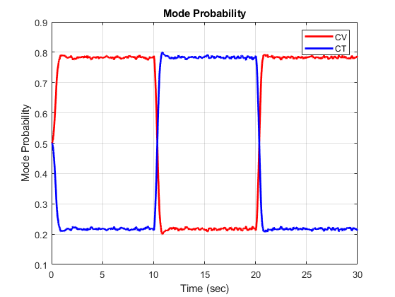
Results (CV-CT) – Mode Probability
IMM Model Mode Prediction:

Slide 18
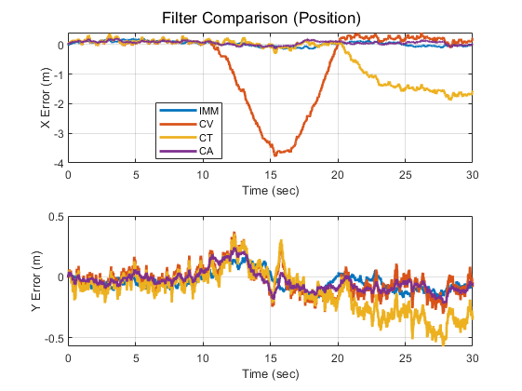
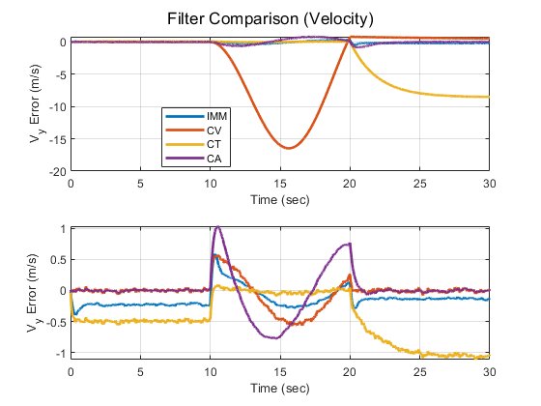
Results (CV-CT) - Errors
Comparison of IMM CV-CT Filter:

Slide 19
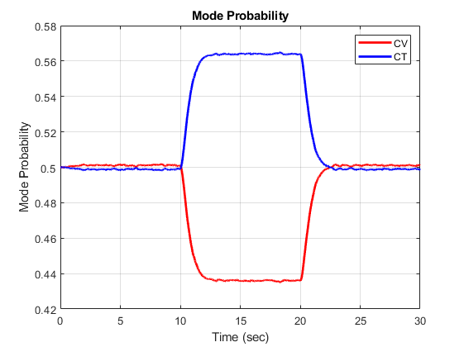
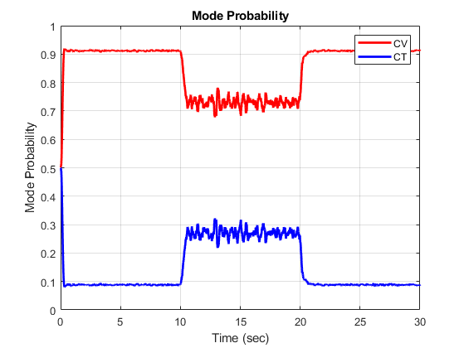

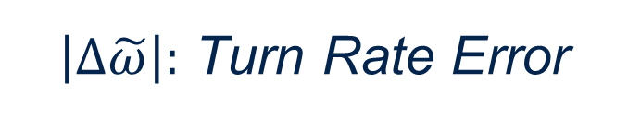
Results (CV-CT) – Effect of Incorrect Turn Rate
$\left|∆\tilde{ω}\right|:$ Turn Rate Error
0
$$∞$$

Slide 20
Constant Velocity – Constant Turn Rate – Constant Acceleration IMM

Slide 21
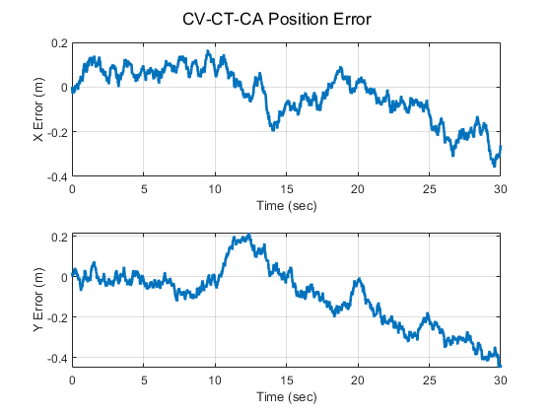
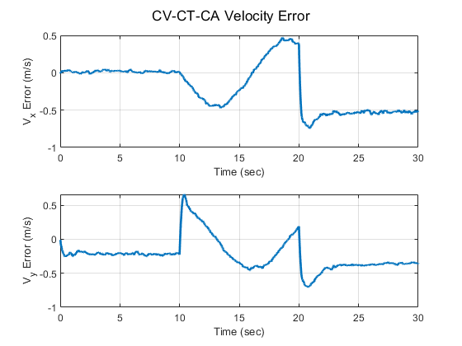
Results (CV-CT-CA) - Errors
Performance of IMM CV-CT-CA Filter:

Slide 22
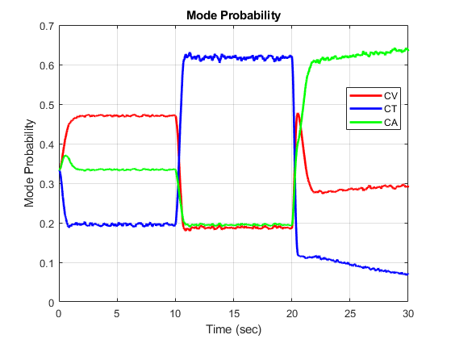
Results (CV-CT-CA) – Mode Probability
IMM Model Mode Prediction:

Slide 23
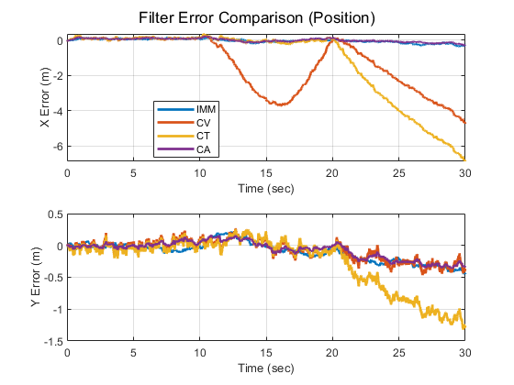
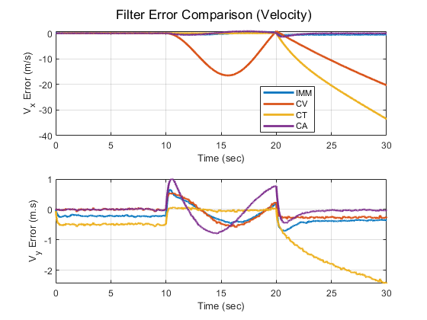
Results (CV-CT-CA) – Error Comparison
Comparison of IMM CV-CT-CA Filter:

Slide 24
Future Steps
Implement IMM with a non-linear measurement model (ranges & range rates)
GPS/INS implementation
Real vs. Simulated trajectories and measurements
Increased complexity in model selection (Adding Vehicle Dynamic Model)

Slide 25
Questions

Slide 26
References
[1] Kalman, R. E. (March 1, 1960). "A New Approach to Linear Filtering and Prediction Problems." ASME. J. Basic Eng. March 1960; 82(1): 35- 45. https://doi.org/10.1115/1.3662552
[2] Blom, Henk. (1984). An efficient filter for abruptly changing systems. Proceedings of the 23rd IEEE Conference on Decision and Control. 656 - 658. 10.1109/CDC.1984.272089.

Slide 27
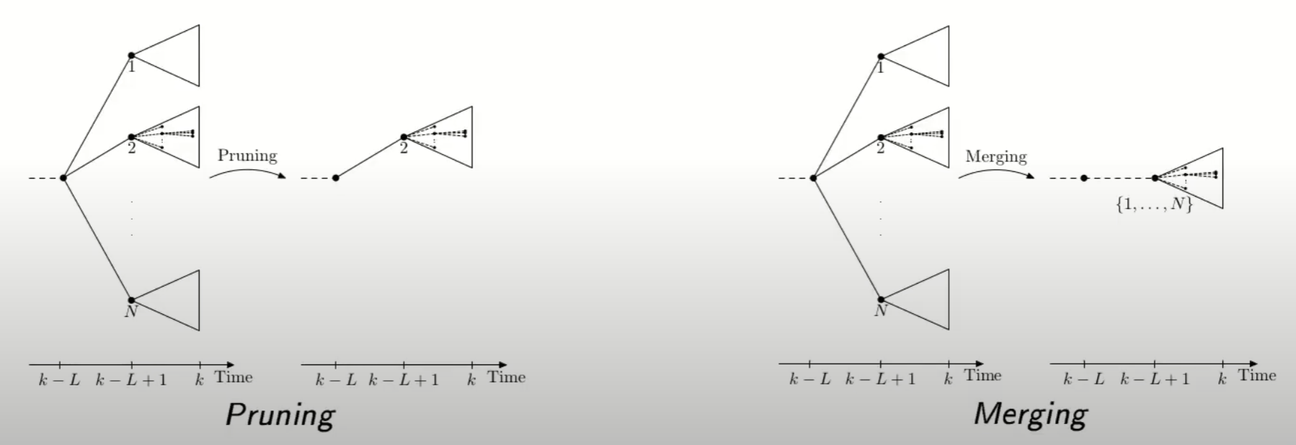
https://www.youtube.com/watch?v=pqxICLvcYlE

Slide 28
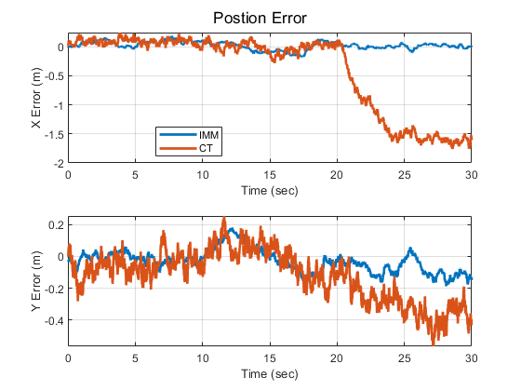
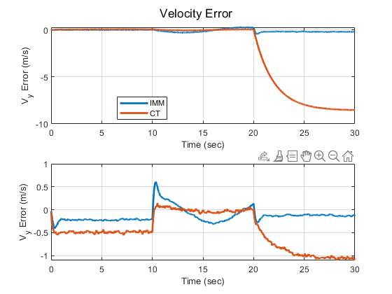
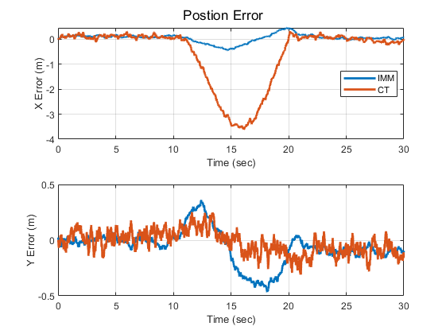
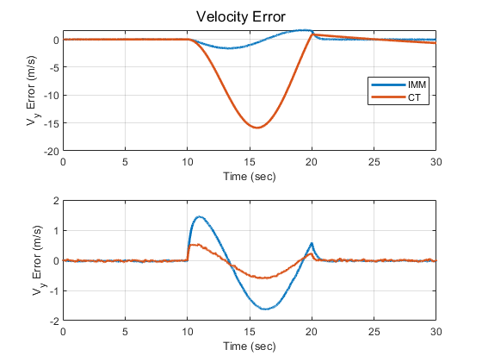
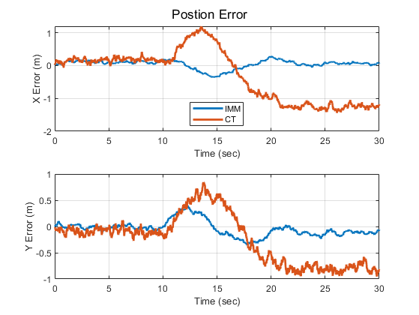
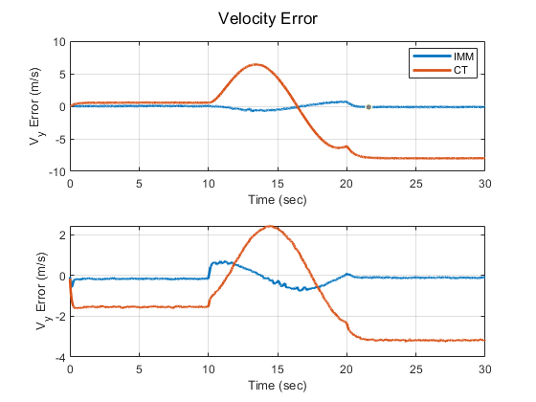

Results (CV-CT) – Effect of Incorrect Turn Rate
0
| Turn Rate Error |
$$∞$$

