Slide 1
PYTHON FOR ECONOMICS · SESSION 11
Session 11: Linear Regression with Python
Fit a line. Interpret its numbers. Predict carefully.
One explanatory variable, one outcome, one small illustrative dataset.
Notes:
0–2 minutes. Introduce the goal: turn a relationship into a numerical statement. All example numbers today are illustrative, not real economic statistics.

Slide 2
Where we are in the course
Describing relationships
Modelling relationships
Look at a table and notice whether two variables move together.
Fit a line that summarises how much the outcome changes.
From describing relationships to modelling them.
2
Notes:
2–4 minutes. Ask what a table can tell us, then what a fitted slope adds. Avoid assuming specific earlier software lessons.

Slide 3
Today's 90 minutes
Focus | Question
Idea of regression | What does a fitted line summarise?
Building a model | How do we fit it in Python?
Interpreting | What do the two numbers mean?
R squared | How much variation is explained?
Prediction | What outcome does the line predict?
Causality | What can we actually conclude?
3
Notes:
4–6 minutes. Schedule: foundations through minute 21; preparation and fitting through 32; interpretation and practice through 45; break 45–50; R squared through 61; prediction and residuals through 73; causality through 82; mistakes, recap and assignment through 90.

Slide 4


The question regression answers
How much does change when changes by one unit?
A simple linear regression summarises the average relationship with a straight line.
For example: how does consumption vary with income?
4
Notes:
6–9 minutes. Emphasise average relationship, not a guarantee for every household and not yet a causal claim.

Slide 5


Explanatory and dependent variables
helps explain or predict. is the outcome we model.
Economic question | Explanatory x | Dependent y
Household spending | Income | Consumption
Demand | Price | Quantity demanded
Choose the roles from the question. Swapping them changes the model.
5
Notes:
9–12 minutes. Ask students to identify x and y in each example. Calling a variable explanatory does not establish causation.

Slide 6
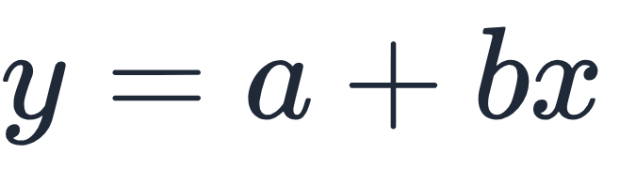
The line
The hat means “predicted value”.
Intercept a
Slope b
The predicted value of y when x is zero.
The change in predicted y for one extra unit of x.
6
Notes:
12–15 minutes. The outline's y = a + b x is the line equation; use a hat to distinguish predictions from observations.

Slide 7
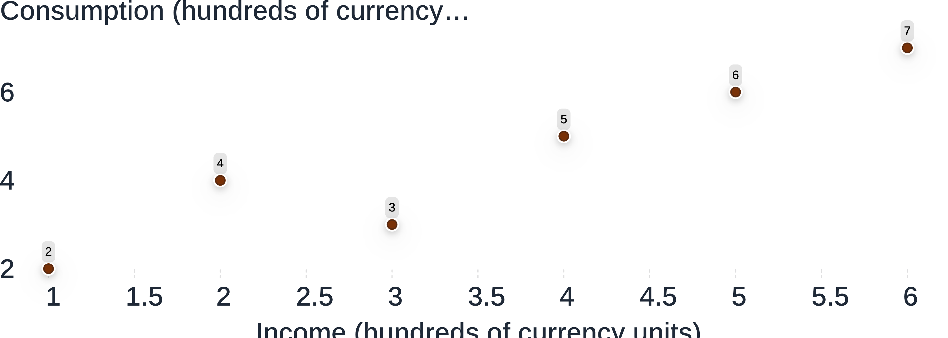
A scatter of data
Illustrative data only · Six observations · Income on the horizontal axis; consumption on the vertical axis.
7
Notes:
15–18 minutes. Each point is one observation. Notice the upward pattern and the fact that the points do not lie on one straight line.

Slide 8
What does best fit mean
Choose the line with the smallest total squared vertical distance from the observations.
01
02
03
Find each gap
Square it
Add the squares
Actual y minus the line's prediction.
Positive and negative gaps cannot cancel.
The fitted line makes this total smallest.
8
Notes:
18–21 minutes. Explain vertical rather than perpendicular distances. Larger errors receive more weight when squared. No optimisation mathematics is needed.

Slide 9
Preparing the data
Keep x and y as columns, with matching observations in each row.
import numpy as np
x = np.array([[1], [2], [3], [4], [5], [6]])
y = np.array([[2], [4], [3], [5], [6], [7]])
Each array has six rows and one column. The double brackets preserve the column shape.
Illustrative income and consumption, both measured in hundreds of currency units.
9
Notes:
21–25 minutes. Run in a prepared notebook where NumPy and scikit-learn are installed. Check that students pair the first x with the first y. Keep y two-dimensional throughout so later indexing stays consistent.

Slide 10
Importing scikit-learn
from sklearn.linear_model import LinearRegression
This imports the tool that fits a straight-line regression.
The package is called scikit-learn. In Python imports, its name is sklearn.
10
Notes:
25–28 minutes. Explain the import as bringing a tool into the notebook. This line does not fit a model or print a result.

Slide 11
Fitting the model
model = LinearRegression()
model.fit(x, y)
The first line creates a model.
The second learns the intercept and slope from our paired observations.
Run the data and import cells first.
11
Notes:
28–32 minutes. Run both lines. Notebook environments may display the fitted estimator automatically; that is not the coefficient output.

Slide 12
Reading the intercept
print(model.intercept_.round(3))
OUTPUT · ILLUSTRATIVE DATA
[1.2]
The line predicts consumption of 1.2 hundreds of currency units when income is zero.
Zero income is outside our observed range, so interpret this cautiously.
12
Notes:
32–35 minutes. Explain that the trailing underscore is part of the attribute name. The intercept positions the line; it need not describe a realistic zero-income household.

Slide 13
Reading the slope
print(model.coef_.round(3))
OUTPUT · ILLUSTRATIVE DATA
[[0.943]]
Each extra hundred of income goes with about 0.943 hundreds of predicted consumption.
A positive slope means the fitted line rises as x increases.
13
Notes:
35–38 minutes. The coefficient is about 94.3 currency units of consumption per additional 100 of income. Keep association language.

Slide 14
Example: income and consumption
model = LinearRegression()
model.fit(x, y)
print(round(model.intercept_[0], 3))
print(round(model.coef_[0, 0], 3))
Printed quantity | Output
Intercept | 1.2
Slope | 0.943
Illustrative data · x is income; y is consumption · Both use hundreds of currency units.
14
Notes:
38–41 minutes. Refit and print scalar values. The indexing selects the single intercept and single coefficient from the arrays.

Slide 15
Writing the result in words
SENTENCE TEMPLATE
Each extra unit of x goes with b units of y.
In our illustrative data, each extra hundred of income goes with about 0.943 hundreds of predicted consumption, on average.
Name both variables, both units and the direction of the relationship.
15
Notes:
41–43 minutes. Contrast “goes with” with “causes”. Ask students to say the sentence without using the words coefficient or regression.

Slide 16
Practice: interpret a coefficient
ILLUSTRATIVE OUTPUT · WORK IN PAIRS
x is price in currency units.
y is quantity demanded in units per week.
Write one sentence interpreting the slope.
Include the direction and units. Do not claim causation.
Notes:
43–45 minutes. Answer: each one-unit higher price goes with three fewer units of predicted weekly quantity demanded, on average. Then take a short break from minute 45 to 50 before slide 17.

Slide 17
R squared
The share of variation in y explained by the fitted model, relative to predicting the same mean for everyone.
0
1
No improvement over the mean.
Every observation lies on the fitted line.
For this fitted model on its training data, R squared lies between 0 and 1.
17
Notes:
50–54 minutes. Welcome students back. Qualify the range: ordinary least squares with an intercept on training data. Scores on new data can be negative; do not develop that topic today.

Slide 18
Computing R squared
r_squared = model.score(x, y)
print(round(r_squared, 3))
OUTPUT · ILLUSTRATIVE DATA
0.889
About 88.9% of the variation in consumption is explained by this fitted line in our illustrative sample.
This is not “88.9% of predictions are correct”.
18
Notes:
54–57 minutes. Explain that score returns R squared for LinearRegression. The rounded result follows from the six observations already used.

Slide 19
Reading R squared
Reading | What it suggests
Low | The line explains little of the variation.
Medium | Some variation is explained; much remains.
High | The line explains a large share of variation.
There are no universal cutoffs. A high value is not proof of a good model, accurate future predictions or causality.
19
Notes:
57–61 minutes. Keep these categories qualitative. What counts as useful depends on the economic question and data.

Slide 20
Prediction
Give the fitted model a new x value in the same column format.
prediction = model.predict([[4]])
print(prediction.round(3))
OUTPUT · ILLUSTRATIVE DATA
[[4.971]]
At income of 4 hundreds, predicted consumption is about 4.971 hundreds. It is a fitted value, not a promise.
20
Notes:
61–65 minutes. General pattern is model.predict([[value]]). The double brackets mean one observation with one explanatory variable.

Slide 21
Predicting inside the data range
Our illustrative income values run from 1 to 6 hundreds of currency units.
Inside the range
Beyond the range
The prediction stays within the observed income range.
The prediction extends the line beyond our evidence.
Be careful beyond the observed values. The relationship may change.
21
Notes:
65–68 minutes. Name interpolation and extrapolation verbally if helpful. Even an in-range prediction can be wrong; it simply avoids extending beyond observed x values.

Slide 22
Residuals in simple words
A residual is actual minus predicted.
residuals = y - model.predict(x)
Actual y | Predicted y | Residual
5 | 4.971 | +0.029
Positive means the observation is above the line. Negative means it is below.
Illustrative observation at x = 4 · Values rounded to three decimals.
22
Notes:
68–73 minutes. Both arrays have the same six-by-one shape. Use the residual sign to connect actual observations with fitted values. Zero means the prediction matches that observation.

Slide 23
Statistical relation versus causality
Association
Causality
Two variables move together in the data.
Changing one variable produces a change in another.
Regression describes this pattern.
A fitted line alone cannot establish this.
Association is not cause.
23
Notes:
73–77 minutes. Other factors, reverse direction and coincidence can generate association. A causal conclusion needs evidence beyond this regression.

Slide 24
Example of a spurious relation
Ice cream sales and swimming incidents may rise together in warm weather.
Warm weather → more ice cream sales
Warm weather → more swimming
More swimming can mean more opportunities for incidents.
The shared factor can create an association. It does not show that buying ice cream causes incidents.
Conceptual example, not an empirical estimate. Variables can also move together by coincidence.
24
Notes:
77–82 minutes. Ask students to identify the third factor before revealing it. No numbers or real statistical claim are being asserted.

Slide 25
Common mistakes
Mistake | Better habit
Wrong shapes | Keep x two-dimensional; match the rows.
Mixing up x and y | Name the explanatory variable and outcome first.
Extrapolating | Check the observed x range before predicting.
Ignoring causality | Say “goes with”, not “causes”.
25
Notes:
82–85 minutes. Ask each student to choose the mistake they are most likely to make. Reinforce that our lesson also keeps y as a column for consistent output shapes.

Slide 26
Recap
01
02
03
04
Fit
Interpret
Check
Predict carefully
Learn a line from paired x and y values.
Explain the intercept and slope in units.
Read R squared and residuals.
Check the range and avoid causal claims.
26
Notes:
85–88 minutes. Ask for one spoken sentence per stage. Revisit the difference between a predicted value and an actual observation.

Slide 27
Before next session
Fit a regression on a small table and write the interpretation.
Choose and name x and y, including their units.
Fit the line and report its intercept, slope and R squared.
Write the slope in words and make one in-range prediction.
Next: graphs. Bring your table and fitted results.
Notes:
88–90 minutes. Students may reuse the illustrative data or choose a small suitable table. Ask them to label invented practice data as illustrative and include one sentence explaining why the fitted relation is not proof of causality.

