Slide 1
Python for economics
Session 12
Fundamentals · 90 minutes
Session 12: Visualising Data: Fundamentals
Turn numbers into a clear economic story.
Line charts, bar charts and scatter plots with Matplotlib.
Notes:
0–2 minutes. Ask students where they have recently seen an economic chart. All numerical examples in this lecture are illustrative, not real statistics.

Slide 2
Where we are in the course
01
02
We analyse data
now we show it
Load a table, select useful columns and calculate summaries.
Choose a chart that makes a pattern easy to see.
Keep the question in view. A chart should help answer it.
2
Notes:
2–4 minutes. Connect plotting to the DataFrame work students already know.

Slide 3
Today's 90 minutes
Topic | What you will do
Matplotlib basics | Import and display a chart
Line charts | Show change over time
Bar charts | Compare groups
Scatter plots | Explore relationships
Titles, labels, legends | Make charts readable
Choosing a chart | Match the question
3
Notes:
4–6 minutes. Schedule: introduction 0–10; basics 10–20; lines 20–40; bars 40–50; break 50–55; scatter 55–65; DataFrames and presentation 65–79; selection and recap 79–88; homework 88–90.

Slide 4
Why charts matter
A clear chart communicates faster than a table.
A table helps us look up an exact value.
A chart helps us notice a trend, a difference or a relationship.
Start with a question: “How has the price changed?”
4
Notes:
6–10 minutes. Qualify the claim: a table remains useful when the reader needs exact values.

Slide 5
Importing Matplotlib
import matplotlib.pyplot as plt
Output
No chart yet. The plotting tools are ready.
plt is a short name for Matplotlib's plotting tools.
Run this import before the plotting examples.
5
Notes:
10–13 minutes. Explain import, the module name and the alias without introducing package internals.

Slide 6
Your first chart
plt.plot([10, 12, 11, 15])
plt.show()
Output
A line joins the four values.
Without x values, positions start at 0.
plot() draws. show() displays the figure.
Illustrative values. Import plt first.
6
Notes:
13–17 minutes. Run live. Ask students to change one value and predict what moves.

Slide 7
Anatomy of a chart
Part | Job
Title | Names what the chart shows
Axis labels | Name variables and units
Data | Appear as lines, bars or points
Legend | Identifies multiple series
Grid | Helps readers judge values
Use only the parts that help the reader.
7
Notes:
17–20 minutes. Point out these parts on the live chart. A single series often needs no legend.

Slide 8
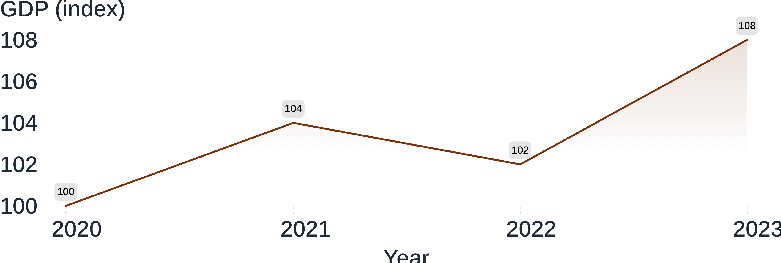
Line chart for trends
Use for change over time. Put time in order on the horizontal axis.
Illustrative GDP index, not actual economic data.
8
Notes:
20–23 minutes. Read the dip as well as the overall increase. A connecting line expresses ordered observations.

Slide 9
Line chart code
years = [2020, 2021, 2022, 2023]
gdp = [100, 104, 102, 108]
plt.plot(years, gdp)
plt.show()
Output
The GDP trend from the previous slide.
Each year pairs with one GDP value.
Illustrative GDP index. The two lists must have the same length.
9
Notes:
23–27 minutes. Read each list position as a pair. Demonstrate the error caused by unequal lengths verbally.

Slide 10
Adding a title and labels
plt.plot(years, gdp)
plt.title("Illustrative GDP trend")
plt.xlabel("Year")
plt.ylabel("GDP (index)")
plt.show()
Output
The same line, now with a title and named axes.
Add labels before show(). Include the unit, not only the variable name.
10
Notes:
27–30 minutes. Uses years and gdp from slide 9. Ask what “GDP” alone leaves unclear.

Slide 11
Practice: plot a trend
Try it · illustrative data
Year | 2020 | 2021 | 2022 | 2023
Inflation (%) | 2 | 4 | 6 | 3
Create lists for year and inflation.
Draw a line chart.
Add a title and both axis labels.
Check: does the line rise, then fall?
11
Notes:
30–36 minutes. Allow four minutes of independent work and two minutes to review. These values are invented for practice.

Slide 12
Several lines and a legend
cost = [80, 84, 83, 88]
plt.plot(years, gdp, label="GDP")
plt.plot(years, cost, label="Cost")
plt.title("Illustrative indices")
plt.xlabel("Year")
plt.ylabel("Index")
plt.legend()
plt.show()
Output
Two lines share the axes. The legend names each one.
Illustrative indices on the same scale; years and gdp from slide 9.
12
Notes:
36–40 minutes. Explain label and legend together. Avoid comparing variables with incompatible units on one axis.

Slide 13
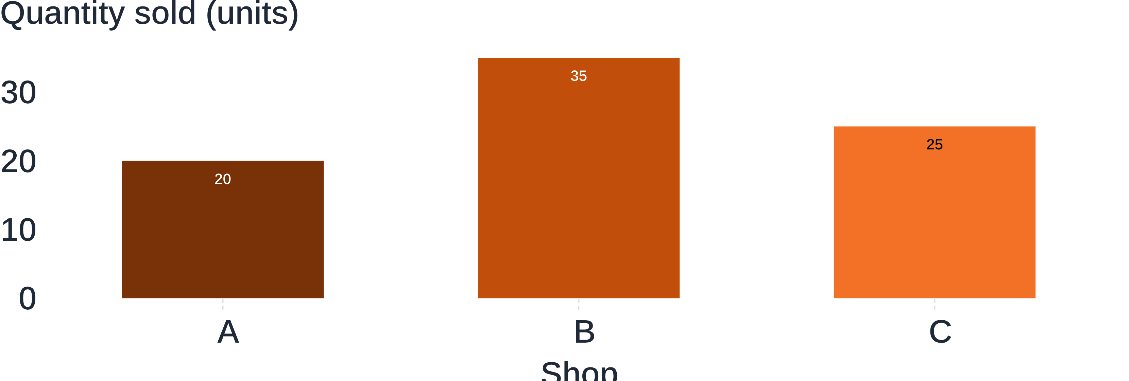
Bar chart for comparing groups
Use for categories. Bar height represents each group's value.
Illustrative quantity sold by shop. Bars start at zero.
13
Notes:
40–43 minutes. Categories do not imply continuous change. Ask which shop sold most.

Slide 14
Bar chart code
shops = ["A", "B", "C"]
quantity = [20, 35, 25]
plt.bar(shops, quantity)
plt.title("Illustrative sales")
plt.xlabel("Shop")
plt.ylabel("Quantity sold (units)")
plt.show()
Output
One bar per shop, matching the previous chart.
14
Notes:
43–45 minutes. Compare plt.bar with plt.plot: the data pairing stays the same.

Slide 15
Horizontal bars for long labels
sectors = [
"Food production",
"Transport services",
"Retail services"
]
cost = [30, 45, 25]
plt.barh(sectors, cost)
plt.xlabel("Cost (currency units)")
plt.show()
Output
Horizontal bars leave room for readable category names.
Illustrative costs. With barh, the numeric axis is horizontal.
15
Notes:
45–47 minutes. Read barh as horizontal bar.

Slide 16
Practice: compare groups
Make a bar chart of average income by region.
Region | North | South | West
Income | 30 | 24 | 27
Illustrative annual income, thousands of currency units.
Choose vertical or horizontal bars.
Name the regions and the income unit.
Check that the numeric axis starts at zero.
16
Notes:
47–50 minutes. Short paired exercise. Then take a five-minute break, 50–55 minutes. Resume with relationships rather than group comparisons.

Slide 17
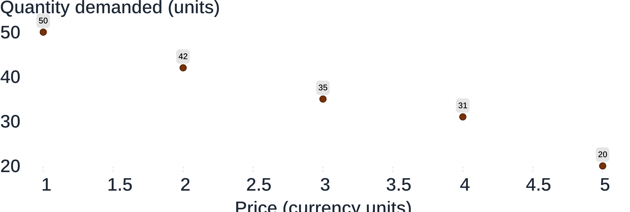
Scatter plot for relationships
Use for two numeric variables. Each point is one observation.
Illustrative price and quantity observations, not an estimated demand curve.
17
Notes:
55–58 minutes. No line connects the observations. Higher price is associated with lower quantity in this example.

Slide 18
Scatter plot code
price = [1, 2, 3, 4, 5]
quantity = [50, 42, 35, 31, 20]
plt.scatter(price, quantity)
plt.title("Illustrative observations")
plt.xlabel("Price (currency units)")
plt.ylabel("Quantity (units)")
plt.show()
Output
Five separate points show the price–quantity pairs.
18
Notes:
58–61 minutes. Pair the first x value with the first y value. The variables could also be named x and y.

Slide 19
Reading a scatter plot
Direction
Strength
Outliers
Do points tend upward, downward or neither?
Do points follow a clear pattern or spread widely?
Are any observations far from the rest?
A relationship in a chart does not establish cause and effect.
19
Notes:
61–65 minutes. Ask students to describe slide 17 using these three prompts. Outliers deserve checking, not automatic deletion.

Slide 20
Plotting from a DataFrame
Use existing columns instead of typing the lists again.
df.plot(x="year", y="gdp")
plt.show()
plt.plot(df["year"], df["gdp"])
plt.show()
Output
Two separate charts of the same columns.
Choose either approach. Sort the rows by year before drawing a time trend.
Assumes df contains year and gdp columns with illustrative data.
20
Notes:
65–69 minutes. These are alternatives, not two required steps. Use the familiar DataFrame from class.

Slide 21
Colors and markers in moderation
plt.plot(
years, gdp,
color="tab:orange",
marker="o"
)
plt.show()
Output
An orange line with a circle at each observation.
Use sparingly and consistently. Keep the same series style across charts.
Illustrative GDP values from slide 9.
21
Notes:
69–72 minutes. Color should carry meaning. Markers can help identify observations without relying on color alone.

Slide 22
Axis ranges and honest charts
Bar charts
Line charts
Start bars at zero. Their length communicates magnitude.
A narrower range can reveal small changes.
Truncated axes can exaggerate a difference.
Make the scale clear and keep comparisons consistent.
Read the axis before judging the size of a change.
22
Notes:
72–76 minutes. Explain why bars and lines differ. A nonzero line-chart baseline is not automatically dishonest, but the range must be clear.

Slide 23
Saving a figure
plt.plot(years, gdp)
plt.title("Illustrative GDP trend")
plt.xlabel("Year")
plt.ylabel("GDP (index)")
plt.tight_layout()
plt.savefig("chart.png")
plt.show()
Output
A chart on screen and a file named chart.png.
Save before show(). Check the working folder for the file.
23
Notes:
76–79 minutes. tight_layout helps labels fit. Uses the illustrative lists from slide 9.

Slide 24
Choosing the right chart
Question | Chart type | Example
How does it change over time? | Line | Price by year
How do groups compare? | Bar | Cost by sector
How do two numbers relate? | Scatter | Price and quantity
Choose the question first, then the chart.
24
Notes:
79–82 minutes. Give one new question and ask the room to choose a chart before naming any Python function.

Slide 25
Common mistakes
Mistake | Repair
Missing labels | Name variables and include units.
Too many lines | Show fewer series or use separate charts.
Wrong chart type | Return to the question you want to answer.
Before sharing, ask a classmate what the chart says.
25
Notes:
82–85 minutes. Have students inspect one chart from either practice task.

Slide 26
Recap
Line for time
Bar for groups
Scatter for relations
Show change across ordered observations.
Compare values across categories.
Explore two numeric variables.
plt.plot()
plt.bar()
plt.scatter()
Label the variables. State the units. Check the scale.
26
Notes:
85–88 minutes. Ask students to name each chart's purpose without reading the function names.

Slide 27
Before next session
Make three charts from one data set.
Choose a data set with time, groups and two numeric variables.
Create a line chart, a bar chart and a scatter plot.
Label and save each figure. Write one sentence about what it shows.
Next: histograms and final practice.
27
Notes:
88–90 minutes. Students may use illustrative data but must label it as such. Ask them to bring their code, saved figures and any questions to the next session.

