Slide 1
Global Video Game Sales Analysis
Oreoluwa Bonojo

Slide 2
Introduction
The Dataset of 16,599 video games sourced from vgchartz.com (Kaggle).is a global video games analysis sales which Includes platform, genre, pusblisher, games, year, and sales data.
Goal: Identify trends across genres, platforms, regions, and publishers.

Slide 3
Data Cleaning Summary
Removed 272 rows with missing Year (1.64%).
Converted sales columns to numeric format (millions).
Standardized publisher/platform text entries.

Slide 4
Global Sales Review
KPI Cards: Total Number of Games, Total Global Sales.
Bar Chart: Top 10 Games by Global Sales.
Pie Chart: Global Sales by Region (NA, EU, JP, Other).
Insight: North America leads global sales; Nintendo games top the chart.

Slide 5
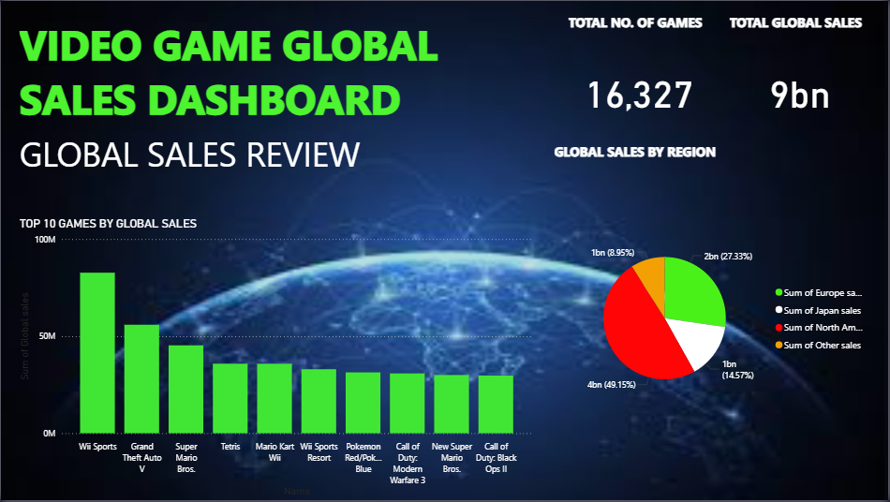

Slide 6
Genre Analysis
Year Slicer for dynamic analysis.
Four bar charts representing top 10 genres for each region
Genres include Action, Sports, Shooter, Role-Playing.
Insight: Action and Sports genres dominate consistently.

Slide 7
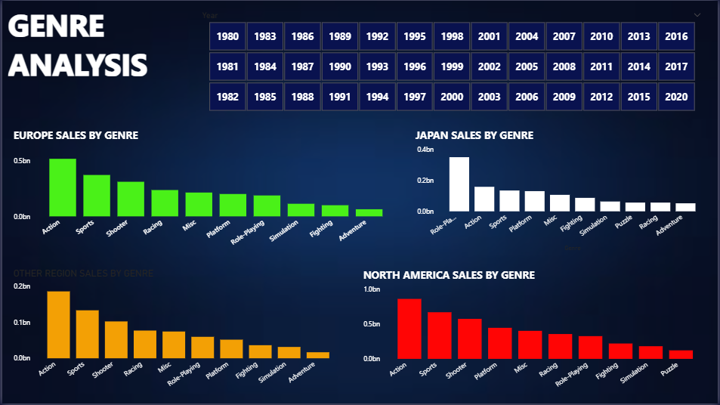

Slide 8
Platform Performance
Table: Platforms and corresponding global sales.
KPI Card: Total number of platforms.
Bar Chart: Top 5 Platforms by Global Sales.
Insight: Nintendo platforms (Wii, DS) dominate sales rankings.

Slide 9
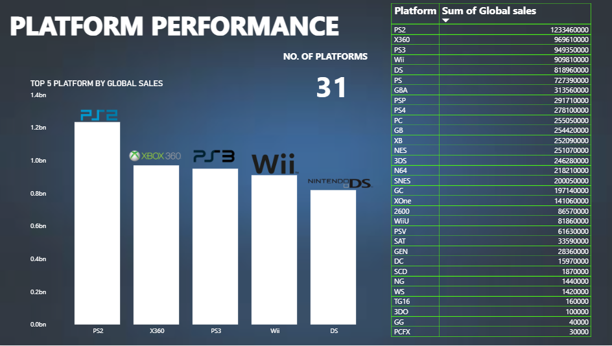

Slide 10
Publisher Impact
Year slicer for focused analysis.
KPI Card: Total number of publishers.
Bar Chart: Top 10 Publishers by Global Sales.
Count Chart: Number of games published by top publishers.
Insight: Nintendo leads in both sales volume and number of games.

Slide 11
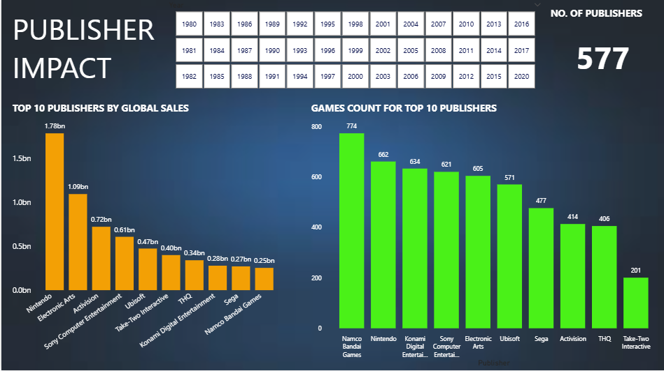

Slide 12
Conclusion
Nintendo dominates in games, platforms, and publishers.
North America is the largest market by global sales.
Action and Sports genres consistently top across decades.
Power BI enabled interactive and dynamic data exploration.

