Slide 1



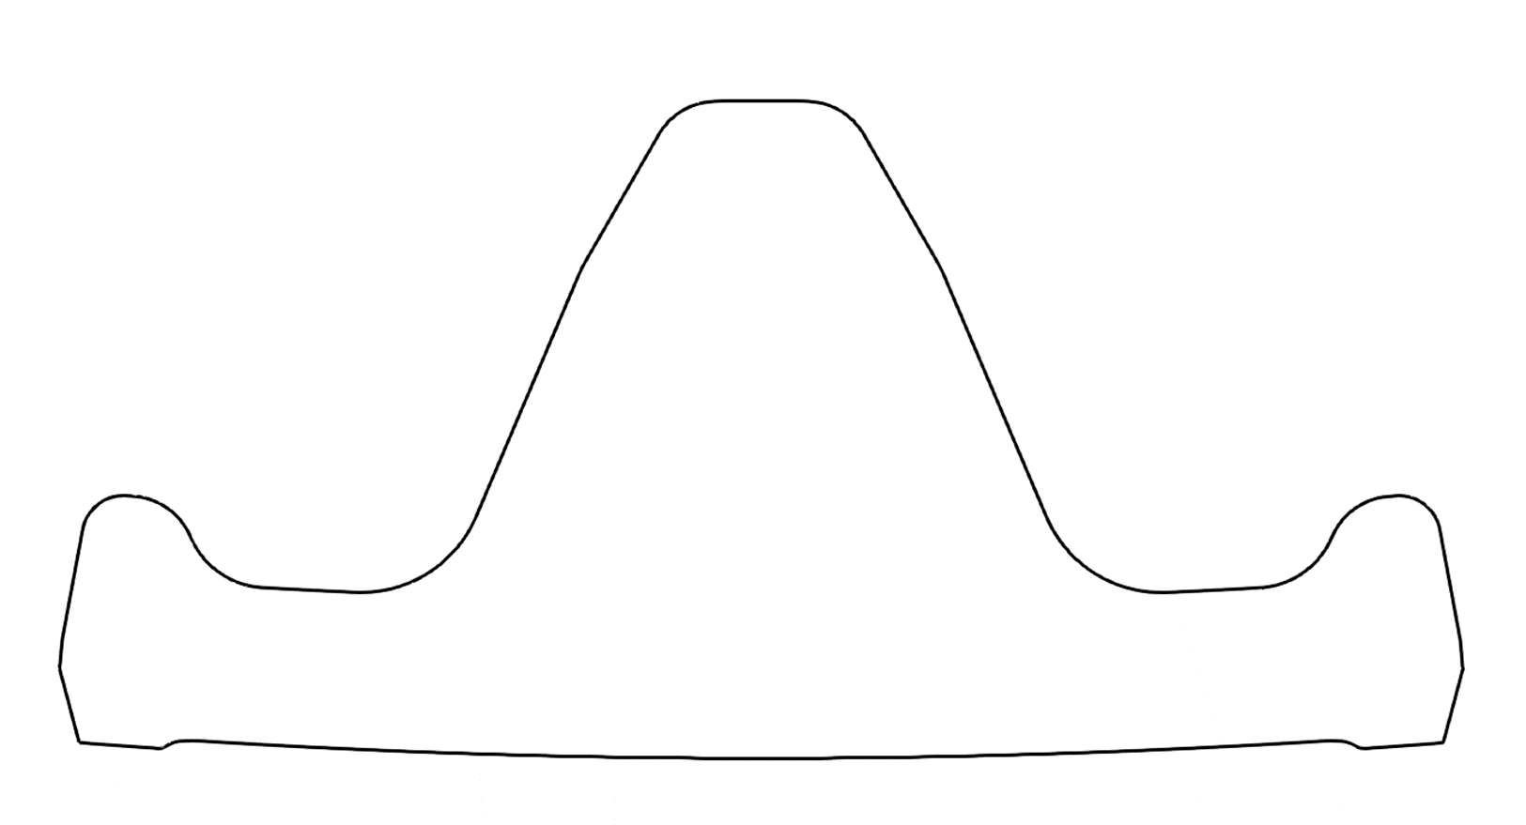
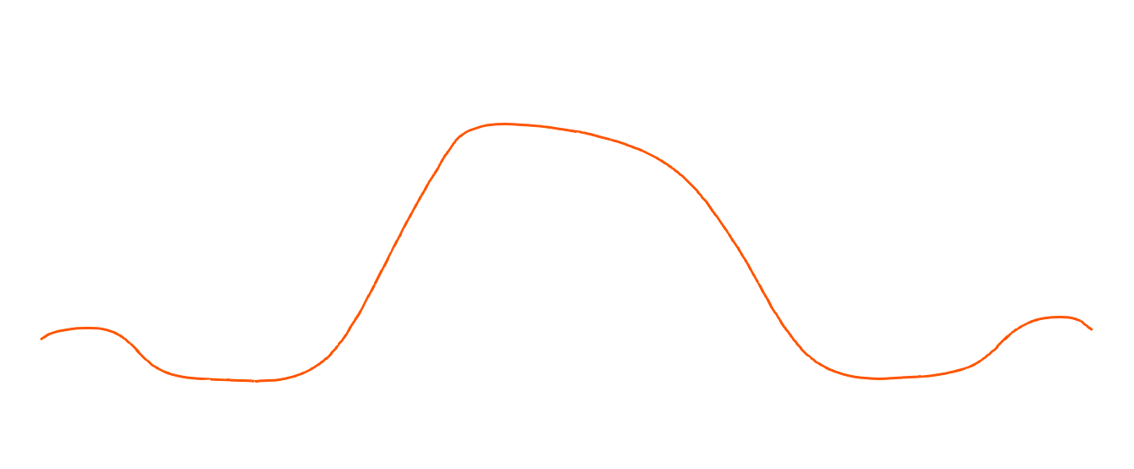
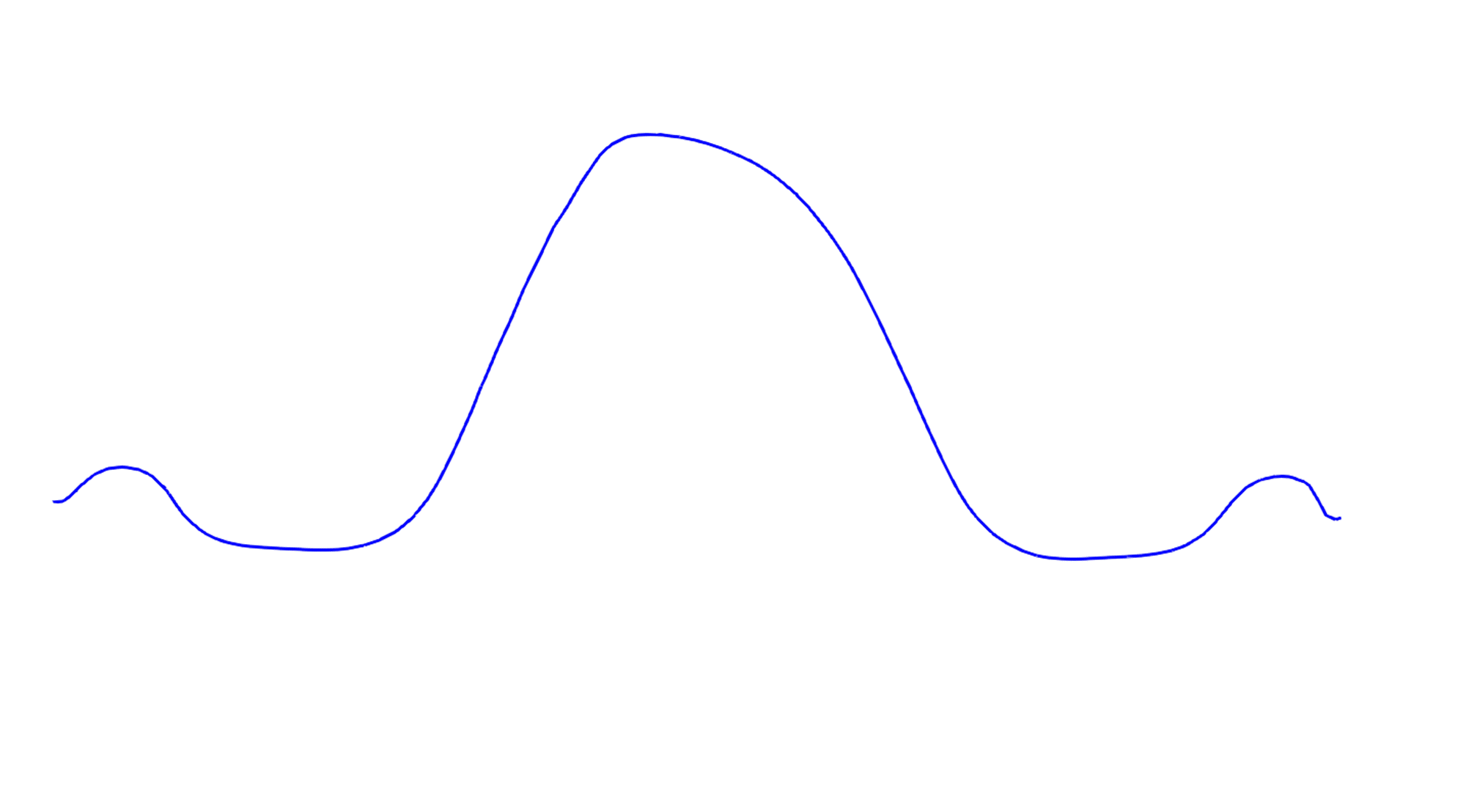
As-installed Profile
21-May-2022 Scan Profile
25-July-2022 Scan Profile
22-August-2022 Scan Profile
15-September-2022 Scan Profile
10-October-2022 Scan Profile

Slide 2
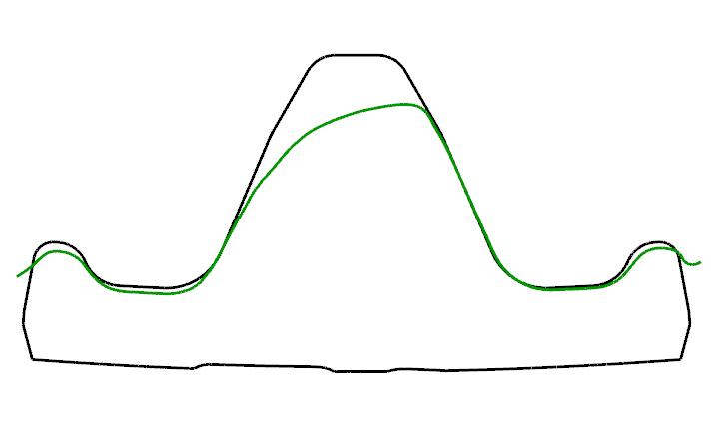

As-installed Profile
FE - DE
12-DEC-2022 Profile

