Slide 1
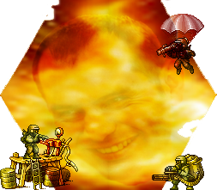
The Lanza Wars
Hanieh, Lokesh, Orestis, Stephan, Vitor

Slide 2
Game Introduction
Goal of the game
Currency
Combat mechanics
Strategic placements
RPG elements
Game types

Slide 3

Main goal of the Game
Destroy enemies’ main base (headquarters).
Winning battles increases your experience level and it enables you to produce more units etc…

Slide 4

Currency (Soldiers)
All players start with the same amount of soldiers.
To create units you need a certain amount of soldiers in order to purchase a unit.
After every turn each player receives the same amount of soldiers.
There are ways to obtain more soldiers.

Slide 5
Combat Mechanics
Difference between attack and defense.
Partially random damage during battles.
Restriction between different types of units.

Slide 6
Strategic Placements
Fog of war (restricted visibility) and each unit has a different range of visibility.
Neutral entities in the map which provide extra power if conquered. (extra soldiers per turn, extra bases, extra units, extra action points etc…)
Some units have some terrain-specific restrictions. (air, land, sea)

Slide 7

RPG elements
Inside and outside the game.
INSIDE
Units gain levels, which improve their abilities.(action points required for moving, attacking, etc…)
OUTSIDE
Player gains levels and chooses specific paths(Navy Admiral, Explosive Specialist, Air General etc…) and increase specific stats, which enables him to produce more units, different action points or currency per turn, etc…

Slide 8

Game Types
Players can choose from different modes:
Time lengths. (3min/turn – 24hrs/turn)
Map sizes. (30x30 – 3000x3000)
Goals. (standard, king of the hill etc…)
Number of players. (1vs1 – 4vs4).

Slide 9

Timeline
Map generation (1 week).
Units generation (1 week).
Rules/Mechanics of the game (2 week).
Server Side support (2 week).
User Interface (1 week).

