Slide 1
BiggMann++

Slide 2
BiggMann ++
C++ open source software for complete highly customizable physics simulations from mesh generation to post process.
Features :
Curvilinear Mesh Generation
Arbitrarily spaced Finite Difference Schemes (up to 6th order accuracy)
High Performance Computing (multi-thread / CUDA matrix / vector operations, sparse matrix operations (to be announced)
Linear Algebra tools (direct & iterative solvers, matrix eigendecomposition, statistical utility etc)

Slide 3
Motivation
Initially a personal drive to learn more about the art of Computational Mechanics from the cryptic mathematical notations to memory adress pointers.
Leisure time activity. I am 30 and I got bored of pc games.
Fulfillment of my intrinsic need to express, explore and create. It is an (almost) cost free physics sandbox. Computational mechanics are the poor man’s experiment.
Serotonin boost from:
Watching my GPU filled with numerical matrices
Watching the CPU being 100% occupied as i commanded
RAM overflow due to bad coding or huge matrices
Convergence to correct solution and other computational small thrills.
Serotonin Draaaaaaiiiiinage
SIGSEV
Deadlines

Slide 4
Software Design– Core Ideas
Complete avoidance of external libraries (only std)
Parametrize what is parametrizable with ease.
Conceive and programm valid mathematical abstractions behind the physics/engineering cases
Complete simulation solution the user from mesh generation to ParaView ready result data
Clear and descriptive naming
OOP principles to avoid code repetition and boost maintainability. Main target is to avoid ifs and extensive case consideration (FD schemes, matrix storage formats etc)
Cache friendly data storage for frequently accessed objects and numerical data structures

Slide 5
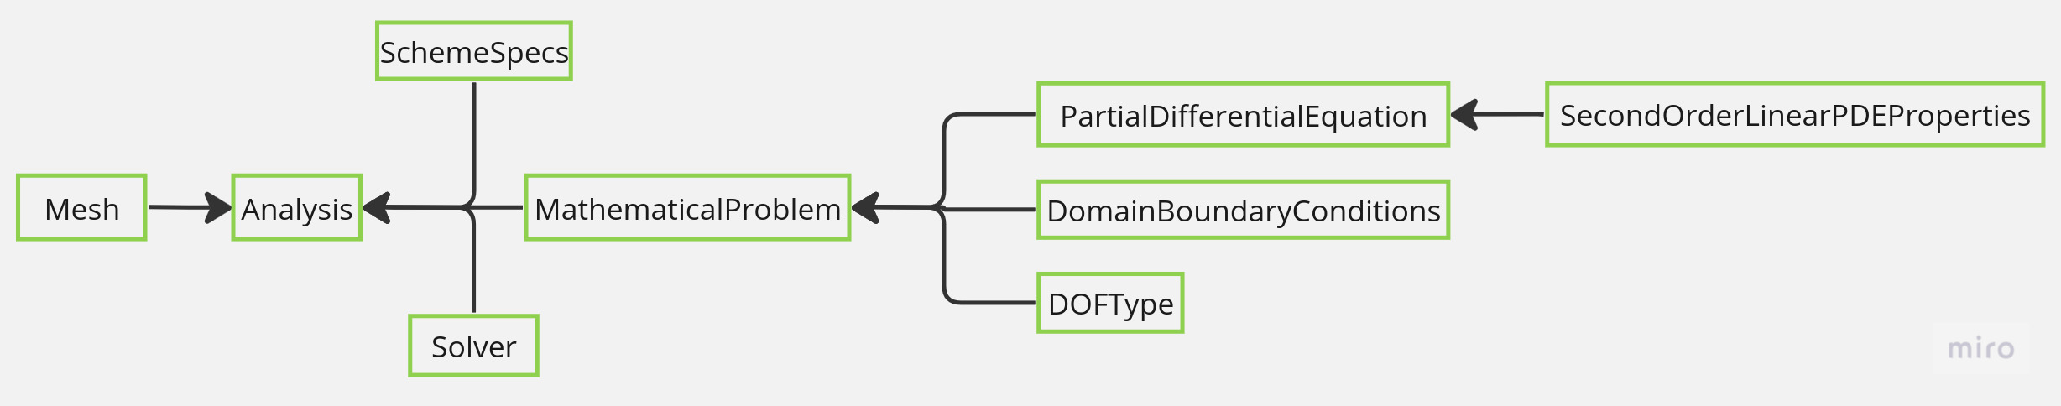
Software Design– Core Ideas
Avoidance of clustered “master classes”. Each class and function should perform only one task
Wide usage of enums to describe Directions, Positions, CoordinateTypes etc. Great and intuitive dictionary keys!
Consistent node identification combined with the iso-parametric curves of the mesh lead to a an intuitive and robust description of the nodal relations with O(1) complexity.

Slide 6
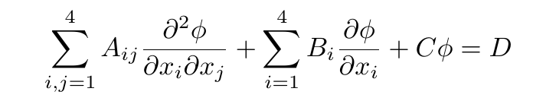
Software Design– Mathematical Application
Aim of the software is to solve the generalized second order PDE for a scalar or vector field.
It can can be applied to a domain with up to 4 dimensions (any combination of an orthonormal coordinate system (1-2-3) plus time.) Space and dimensions are used in an abstract way and can represent anything from physical space to frequencies (up to 3 +1)

Slide 7
Software Design– Mathematical Application
With some proper manipulation almost all other transport / conservation laws can be abstractly viewed as child classes of the generalized second order equation.
The main idea behind the design is to be as physics agnostic as possible. The main mathematical essence of the general equation is inherited to each child class that represents a transport equation and more specifications are added if needed.
Various DOF specifications for scalar and vector fields(Temperature, velocity, position, UnknownScalarVariable, UnknownVectorFieldVariableComponentI etc)

Slide 8
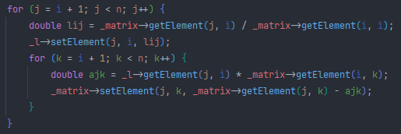
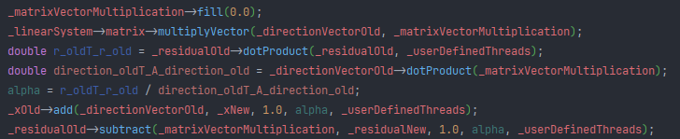
Software Design– Data access
MATLAB / Scipy (wannabe) user experience through carefully designed containers of std::vector.
Easily access and operate on matrices and vectors in element or in full data structure level.
Set the available threads for each operation.
Snippets from LUP and Conjugate Gradient Solvers

Slide 9
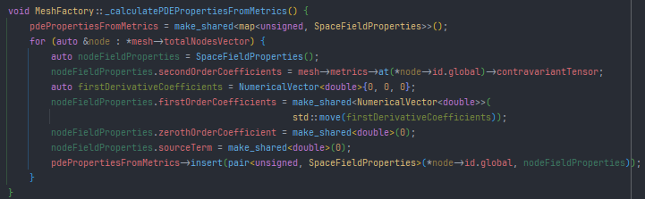
Software Design– Parametrization of Model Parameters
Properties can be uniform for all nodes or vary with each node
Constants ,where possible, are expressed in matrix/vector/scalar forms (isotropic-anisotropic, non-homogenous etc. host medium properties)
Snippet from non-symmetric and anisotropic properties assignement during mesh generation

Slide 10
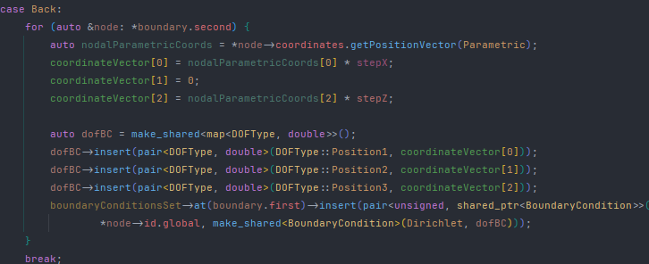
Software Design– Parametrization of Boundary Conditions
Dirichlet and Neumann
Boundary Conditions can be uniform for all nodes or vary with each node
Boundary values can be expressed as a scalar or a lambda of the nodal coordinates
Interpolation between two values of the same BC type at edge nodes
Snippet from the boundary conditions setting for the Back boundary of a parallelepiped

Slide 11
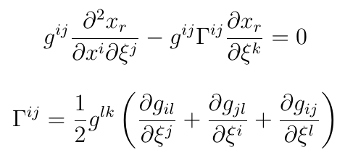

Curvilinear Mesh Generation
The equation solved for the generation of a curvilinear mesh is expressed as follows :
After some routine mathematical manipulations:
g_{ij} is the covariant tensor and g^{ij} is the contravariant tensor that quantify how the natural coordinate system changes over the parametric and vice versa.

Slide 12
Linear Algebra – Differentiation at arbitrarily spaced curvilinear grids
Numerical Differentiation with accuracy up to 6th order
Get number of points needed for input order accuracy (Hard-coded). For example:
Derivative Order 1, Error Order 2 :
points(+)->2
points(-)->2
points(+-)->1
For each node get the neighbor graph and check if it has sufficient number nodes .
Get the coordinates (in any coordinate system) of the qualified neighbours
Get the weights for arbitrarily space points

Slide 13
Linear Algebra – Numerical Vector
std::vector<T> template container class
Deference traits to operate between different types (ptr, smart ptr, stack objects)
Operates only on numerical data types (double, unsigned, short etc.)
Operators : =,==, !=, []
Norms : L1, L2, LInf, Lp
Iterators
Operations : add, subtract, dotProduct, crossProduct, deepCopy, scale, sum, magnitude, average, normalize, distance, angle, fillRandom, variance, covariance, correlation, standardDeviation

Slide 14
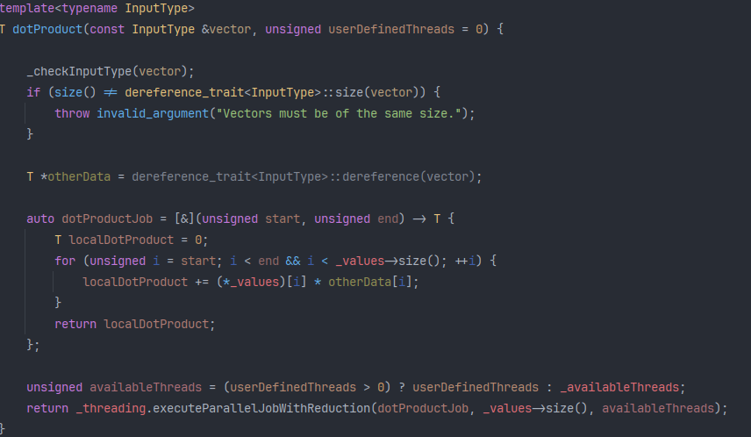
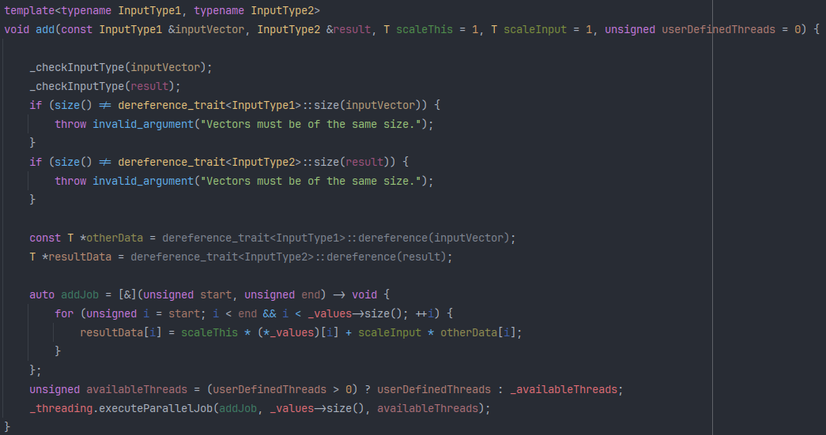
Linear Algebra – Numerical Vector

Slide 15
Linear Algebra – Numerical Matrix
NumericalVector<T> template container class
Deference traits to operate between different types (ptr, smart ptr, stack objects)
Operates only on numerical data types (double, unsigned, short etc.)
Operators : =,==, !=, []
Norms : L1, L2, LInf, Lp
Operations : add, subtract, matrixMultiply, vectorMultiply, vectorMultiplyPartial
Export to .m file

Slide 16
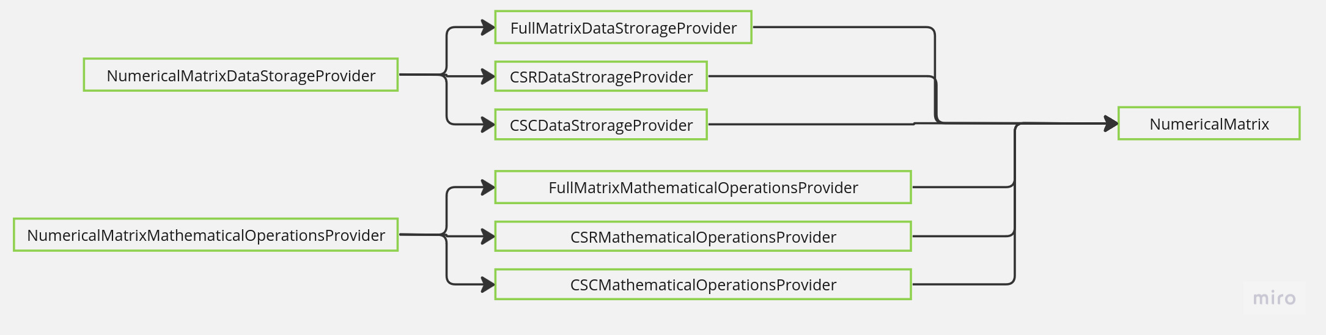
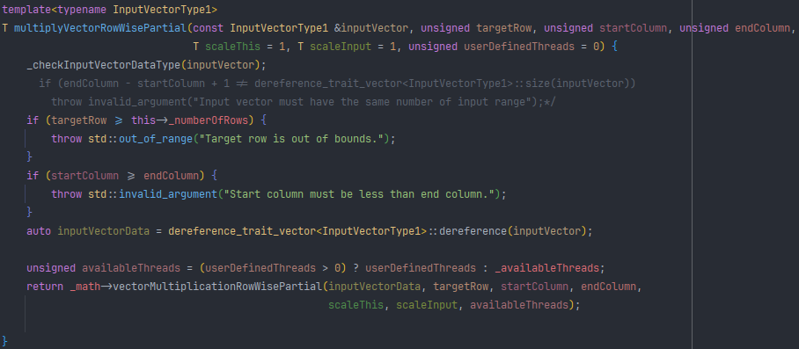
Linear Algebra – Numerical Matrix

Slide 17
Linear Algebra – Solvers
Stationary
LUP
Cholesky
Block Iterative with multi-thread vector operations
Conjugate Gradient
Point Iterative
Jacobi
Parallel Jacobi (Multithread & CUDA)
SOR
Gauss Seidel

Slide 18
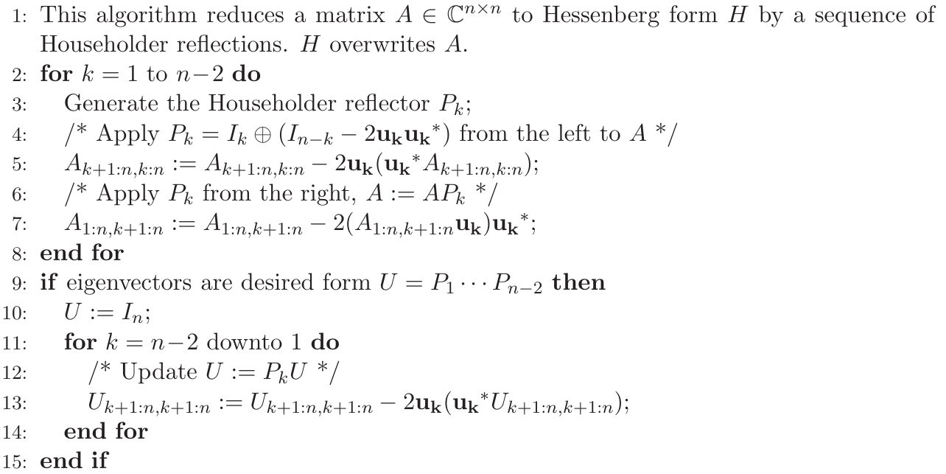
Linear Algebra – Eigendecomposition
QR Decomposition with Householder Transformation
Industry standard algorithm for every type of matrix (LAPACK, MATLAB, SciPy)
Expensive but very powerful method
Can be as used as a “precondtioner” for iterative eigendecompostion methods

Slide 19
Linear Algebra – Eigendecomposition
Lanczos Iteration
Fast Krylov-subspace method
Finds some eigenvalues of the matrix
Can be optimized by applying an approximate of an eigenvector as initial solution (from a QR iteration)
Power Method
Finds the most dominant eigenvalue of the matrix
Very fast

Slide 20
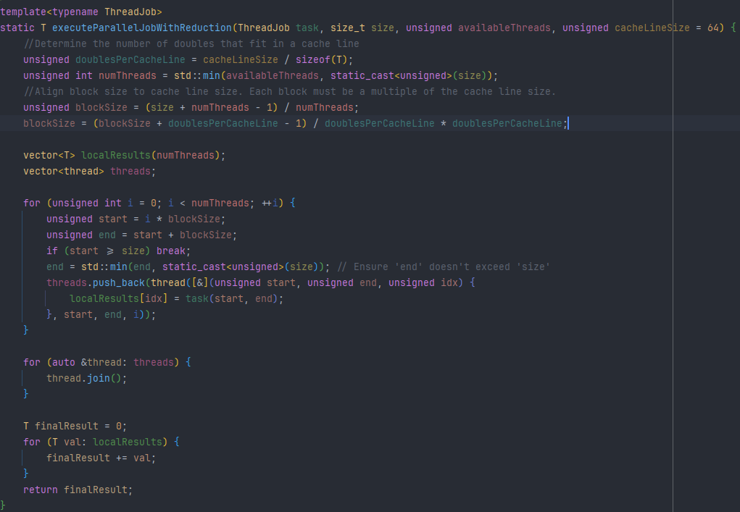
Linear Algebra – Threading

Slide 21
Linear Algebra – Threading
All CPU operations of vectorized data structures are performed by executeParallelJob and executeParallelJobWithReduction
Each thread executes the operations for a specific number of rows
Block size (rows operated by thread) tries to align with the cache line size, in order to be cache friendly

Slide 22
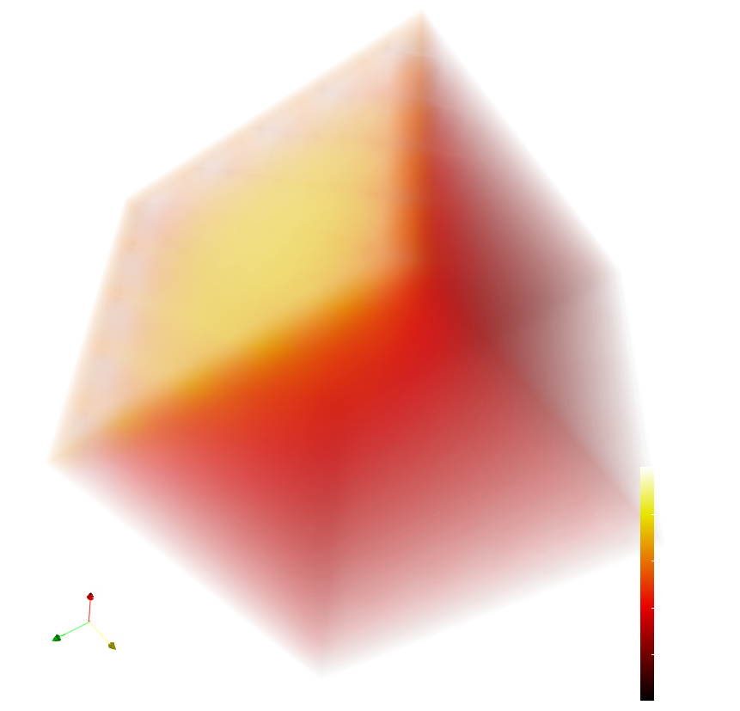
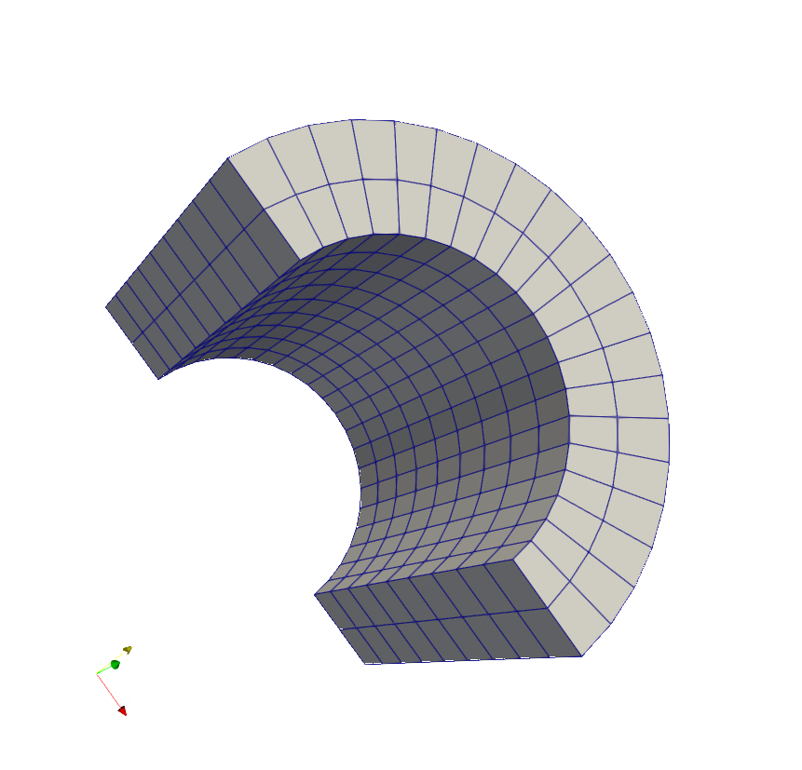
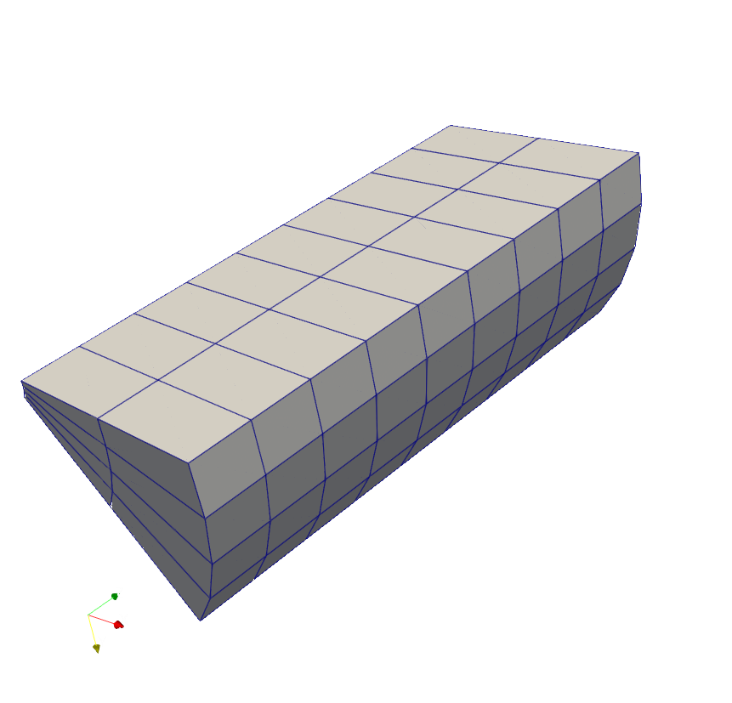
Results

Slide 23
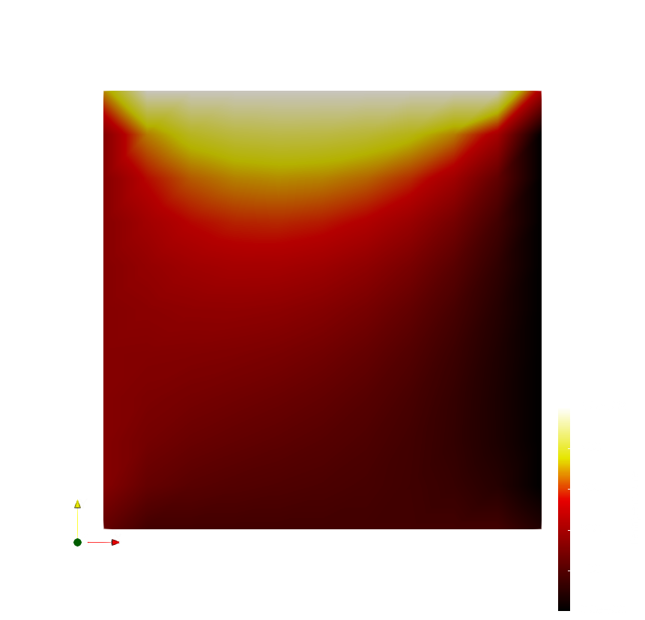
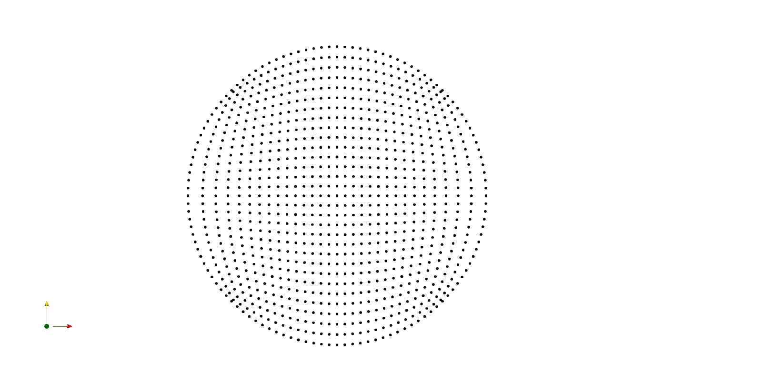
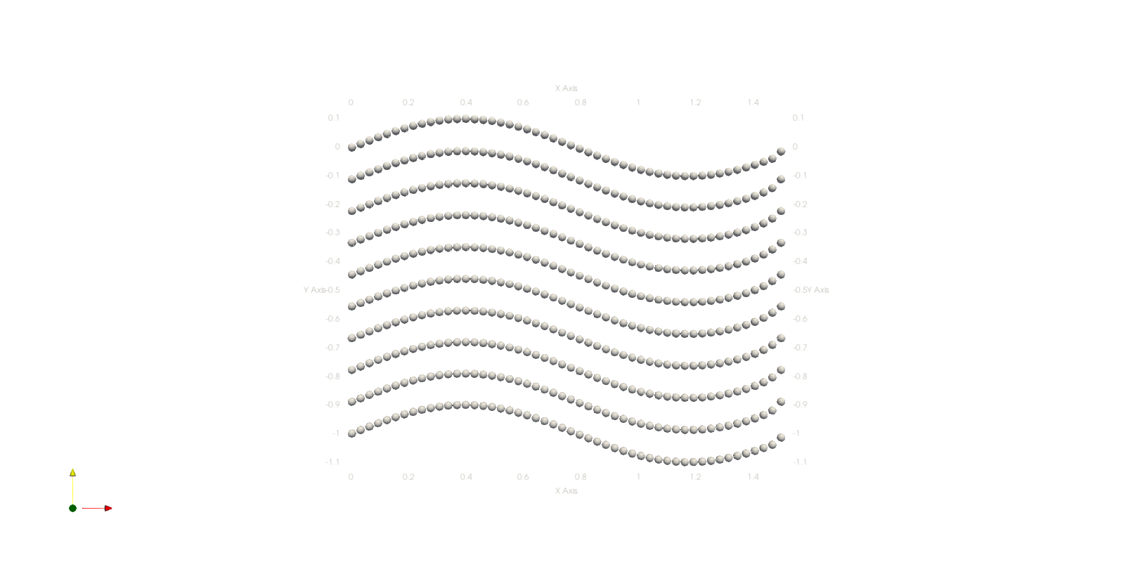
Results

