Slide 1
Detect generated text from ChatGPT
By Orestis Fryer-Petridis

Slide 2
Project Introduction
AI-generated content is becoming more commonly used in many areas. Many of these applications are beneficial, like medical chatbots that help speed up workflow; however, this is not true in all cases. Some bad actors take advantage of this technology to deceive others.
Applications for the detection of AI generated text:
AI plagiarism Detection
LLM Phishing Techniques Detection
Social Media Bot Detection

Slide 3
Objectives
This project aims to develop AI techniques to identify AI-generated text from large
language models
The established goals for the project are as follows:
1. Develop a method to identify AI-generated text using a similarity metric
2. Use Retrieval-Augmented Generation based responses
3. Implement these methods
4. Evaluate the success of the methods
5. Produce a report on the findings of the methods

Slide 4
Planning
Identifying current LLM detection methods
Identifying a LLM to implement
Investigating different libraries
Identifying different parameters that could lead to different results

Slide 5
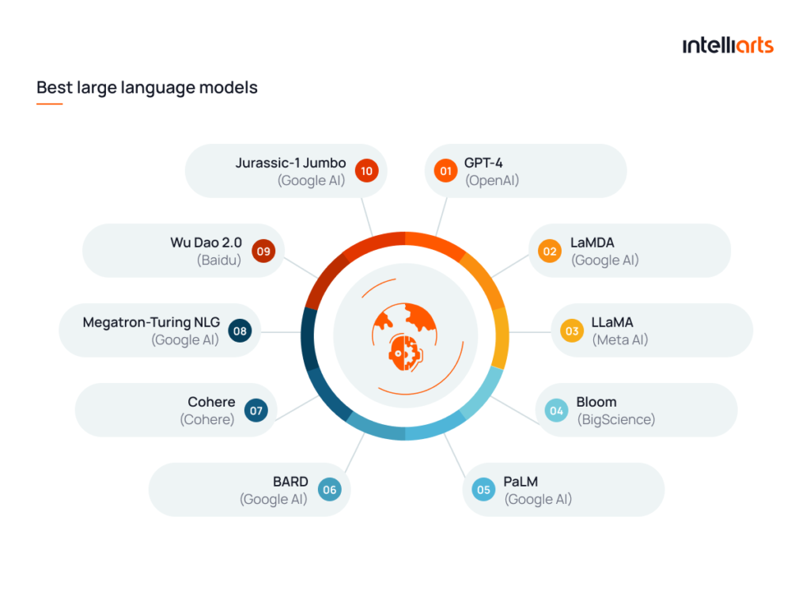
Large Language Models Landscape
Large Language Models of note in 2024:
OpenAI (GPT models)
Bard/Gemini (Google)
LLaMA (Meta AI)
Microsoft Copilot (Microsoft)
Popular Large Language Models in 2024 from Intelliarts Top 11 Large Language Models of 2024 (2024)

Slide 6
LLM Detection
Research into current detection methods for AI and plagiarism is essential to complete the project.
Some popular methods:
General Pattern Analysis
Web content comparison
Compares semantic consistency and structure
Natural Language Processing techniques are very popular in most of these.

Slide 7
OpenAI Classifier
There is a classifier created by Openai(2023) that can detect AI generated text.
Correctly Identifies 26% of AI-written text with a 9% of false positives for human text
Limitations:
Text under 1000 characters
Performs poorly outside of the training data
Openai(2023) detail how it should not be used as a primary decision-making tool

Slide 8
Data Gathering and Experiments
When gathering the data it is important to consider the effect of the prompt and how prompt complexity effects the responses generated.
Identified Experiments:
Different prompt generation
Different Comparison/Similarity Metrics

Slide 9

Jaccard Similarity
Common Comparison metric for plagiarism
Specialises in identifying patterns in sample sets
The equation is given as the size of the intersection over union

Slide 10
Cosine Similarity
This metric represents the data in a feature variable form
Uses these features to evaluate each against each other to get the distance between the human input and the derivative case
Can then use this to make an assumption about how similar the texts are

Slide 11
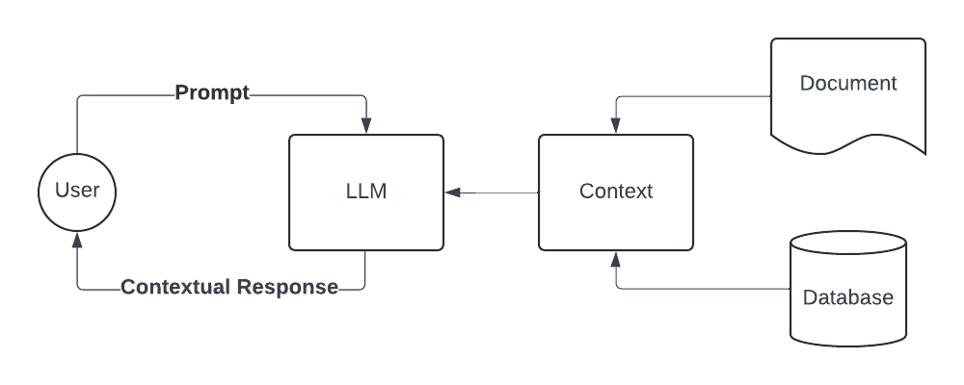
Retrieval-Augmented Generation (RAG)
A RAG based approach could lead to improvements in refining the test and sample data.
The process of RAG generates responses
based on context provided alongside the
prompt.

Slide 12
Design
This part details the design process and the decisions made during the creation of the system.
Topics:
The tools
Changes from the initial plan because of any challenges identified
Designed Frameworks

Slide 13
Design Tools Identified
The Natural Language Toolkit NTKL (2024) is used for the natural language process required for input handling.
The OpenAI python library, seen in The OpenAI GitHub repository (2024)
The LangChain Python Framework (2024) library is used for the RAG response generation

Slide 14
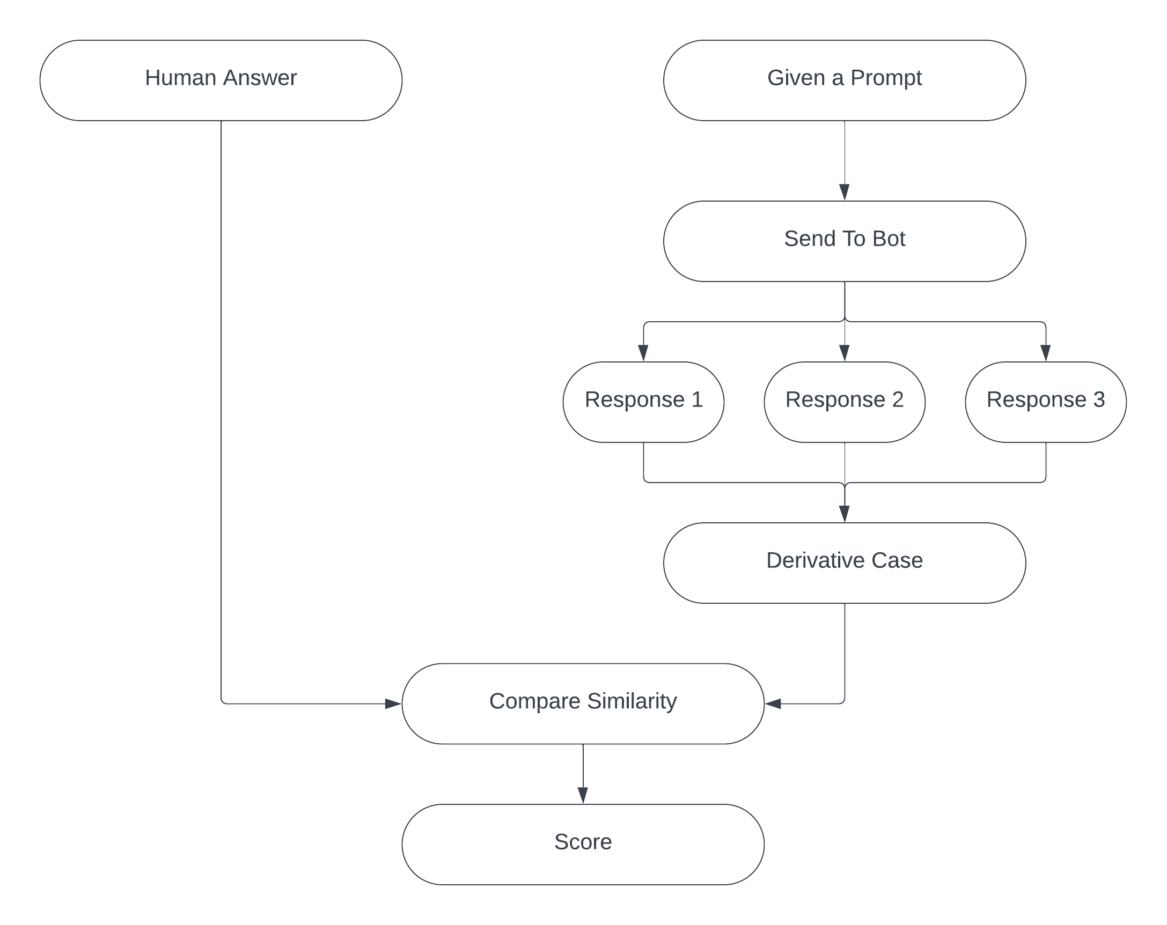
Design Framework

Slide 15
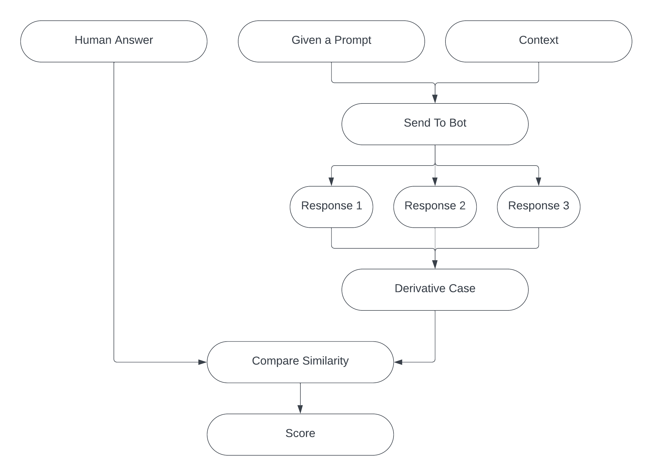
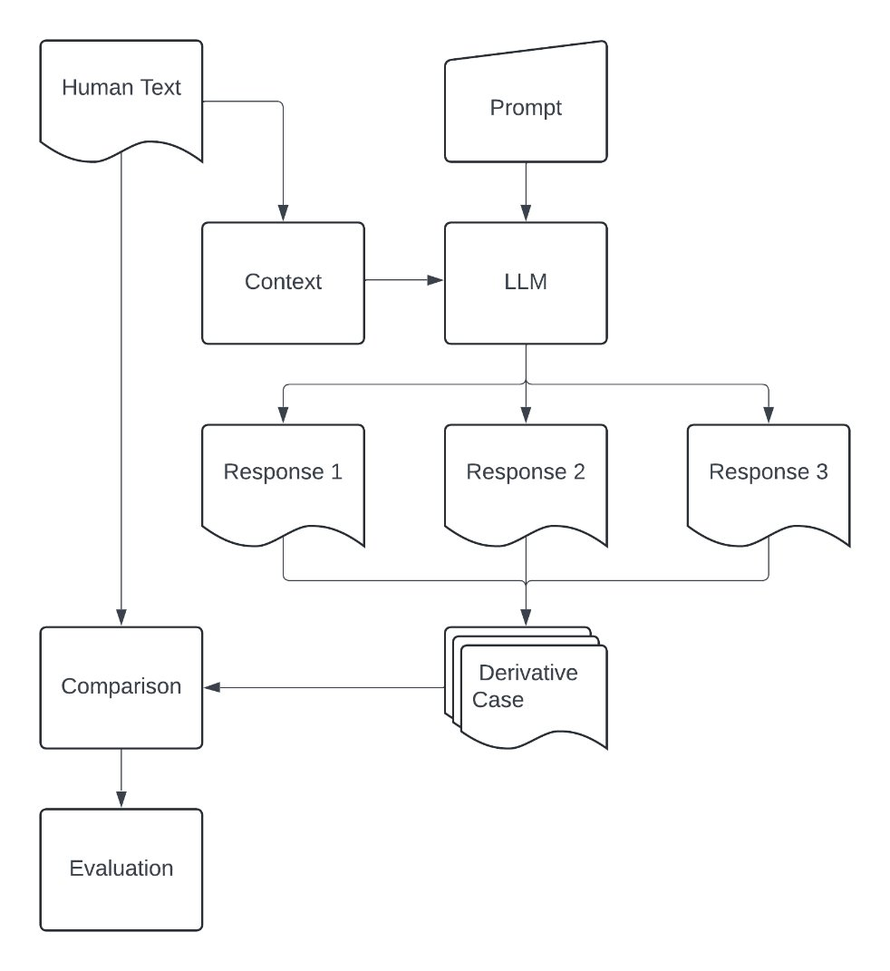
Design Framework RAG

Slide 16
Implementation
This section features the implementation of both methods and the different similarity metrics.
It shows how the systems have been applied.
There is also a demo to show how the system runs.

Slide 17
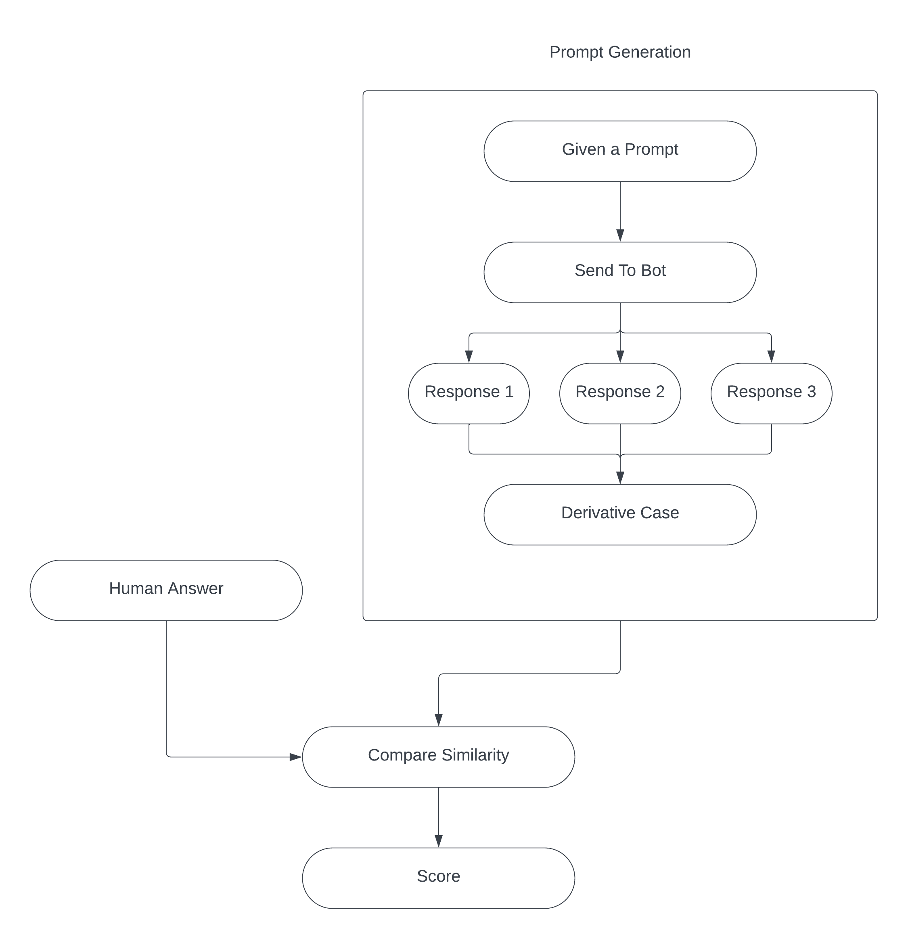
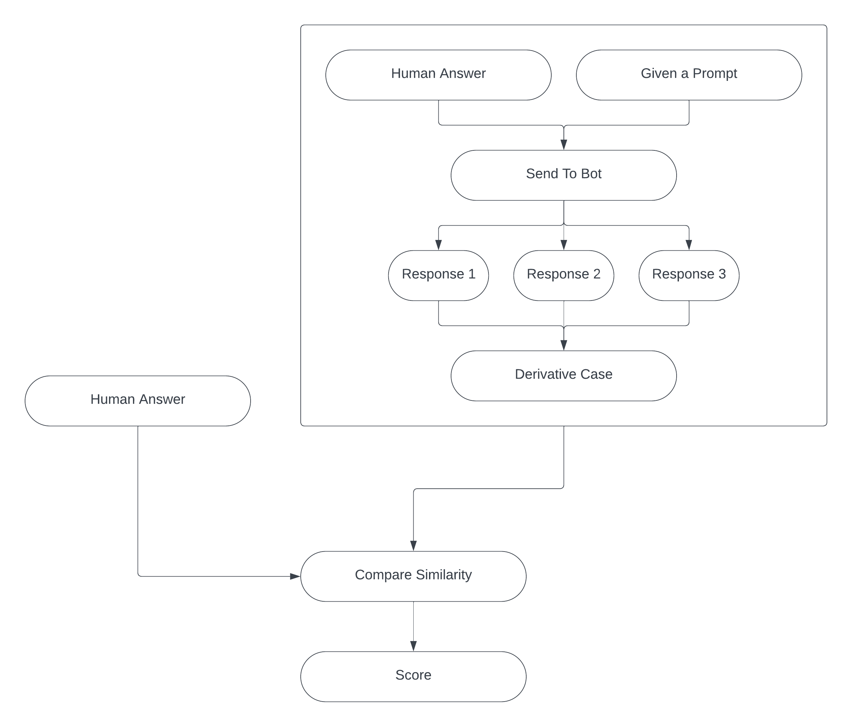
Implementation Frameworks
Non-RAG System
RAG System

Slide 18
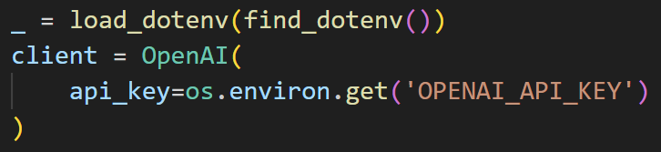
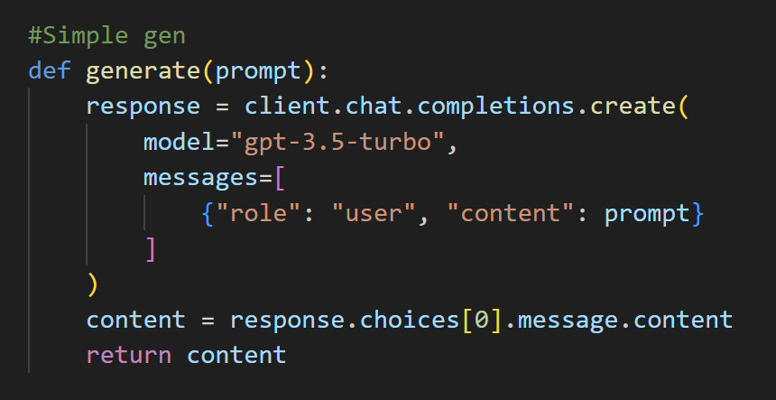
API Key to get a response
This is the code run to generate a query from a chatbot model.
The code requires an API key to get a response. This API key is stored in the .env environment variables.
In the generate function this simple function shows how the response can be generated using a prompt as an input and specifying "gpt-3.5-turbo" as the model.

Slide 19
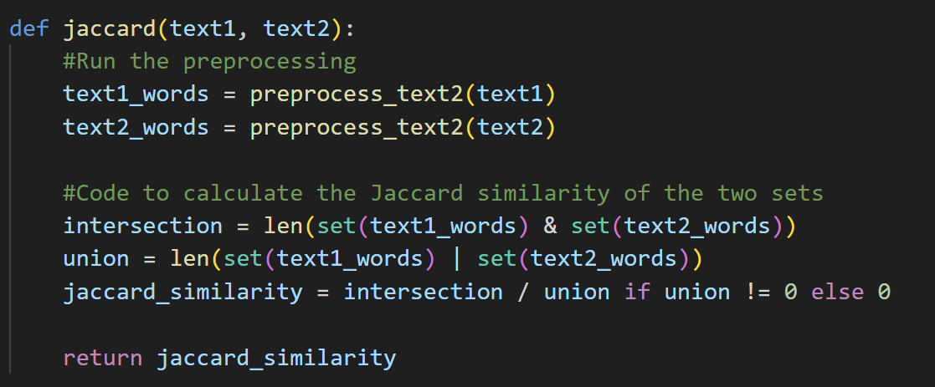
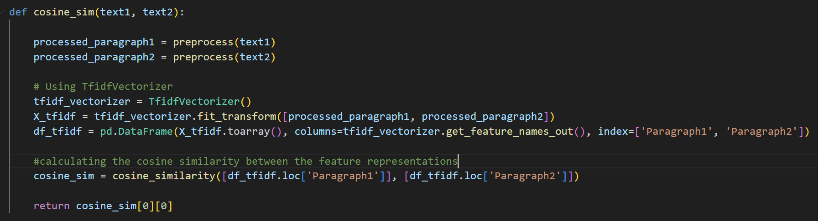
Jaccard and Cosine
The Jaccard function processes the text, then matches the text, and gets the amount of the same tokens divided by the total tokens.
The Cosine function processes the text and then obtains the feature data, a matrix of TF-IDF(term frequency-inverse document frequency) features.
Then convers these into sets that can be compared to find the cosine similarity.

Slide 20
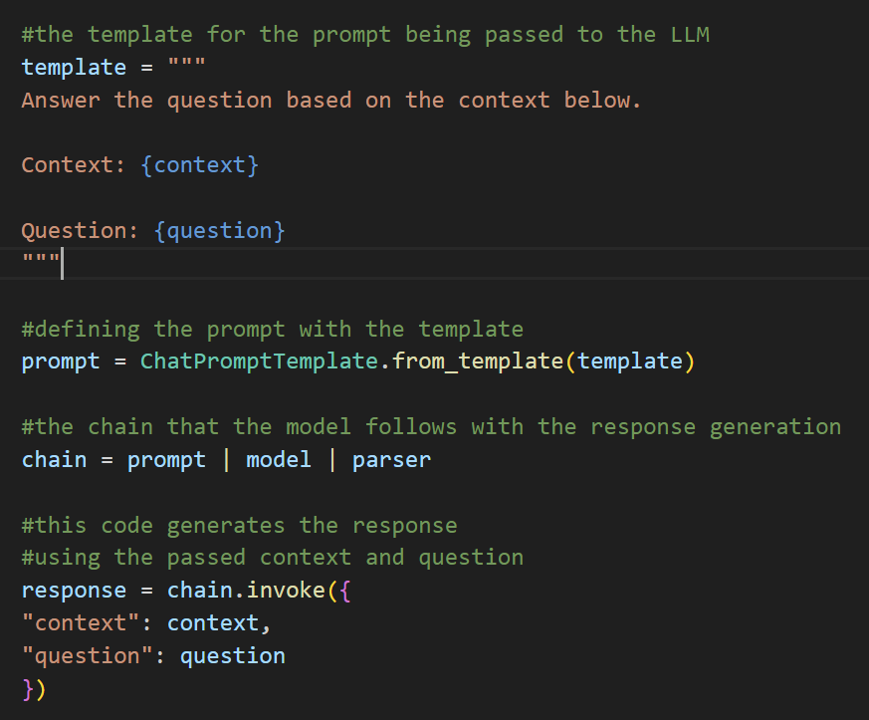
RAG-Implementation
When creating the response, the RAG-based system requires context as an argument.
It uses the template to infer the significance of the context when passed to the LLM and then the LLM answers the question based on the context to generate a similar response and ensure that the context is represented in the response.
Parser converts the output into a string.

Slide 21
Simple Demo

Slide 22
Results
This section details the different experiments conducted to test the system's effectiveness.
The prompts used for testing are:
Part 1: Vague Prompt: "Write a paragraph about dogs"
Part 2: Question(The generated code fits the question but is not obtained from using the question as the prompt): Write a paragraph about what discovery in the last 100 years has been most beneficial:
Actual Prompt: Write a paragraph about the beneficial discovery of computers:
The number of generated responses in the test case is also evaluated.

Slide 23
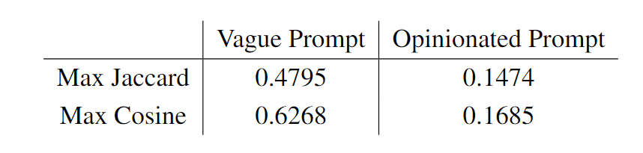
Results
The table below shows the effect of having an opinionated prompt while using the non-RAG system
Because the AI does not know what the user thinks is the most beneficial discovery, it writes a paragraph about penicillin, so the derivative case is filled with prompts on the wrong topic.

Slide 24
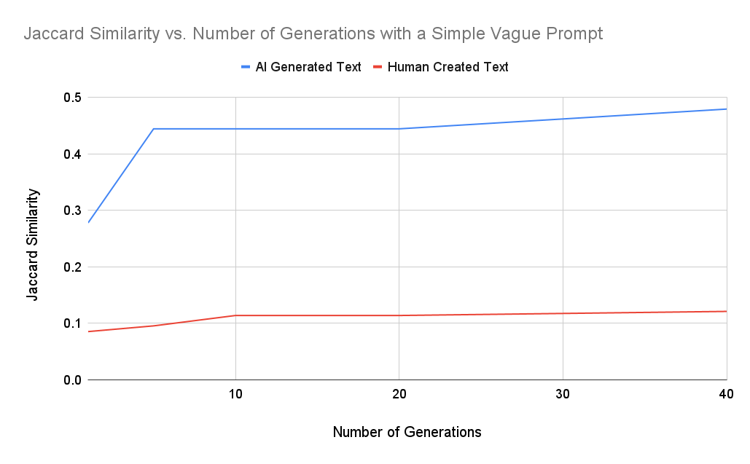
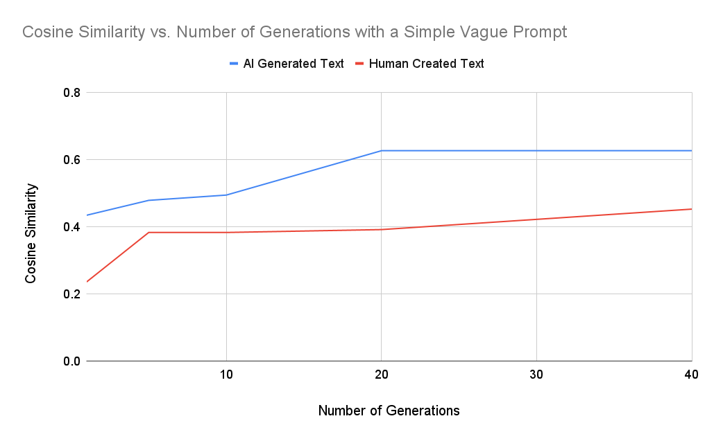
Experimental Results

Slide 25
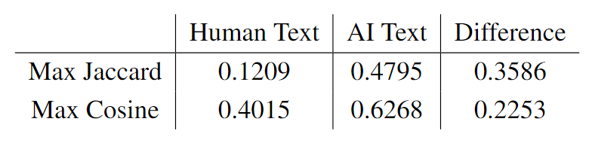
Results
This table highlights important data in the graphs, such as the maximum values for AI and human generation for the similarity metrics.
The table also has a third column detailing the difference between AI text and human text for similarity metrics. The difference between the human and AI text acts like a confidence metric.

Slide 26
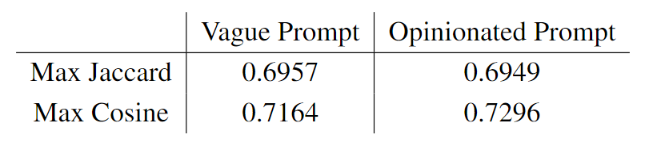
Results RAG
The table below shows the effect of having an opinionated prompt while using the RAG system
The table shows that this model does, as when it created the derivative case, the system knew and had the context available to work out what specific discovery was being written about.

Slide 27
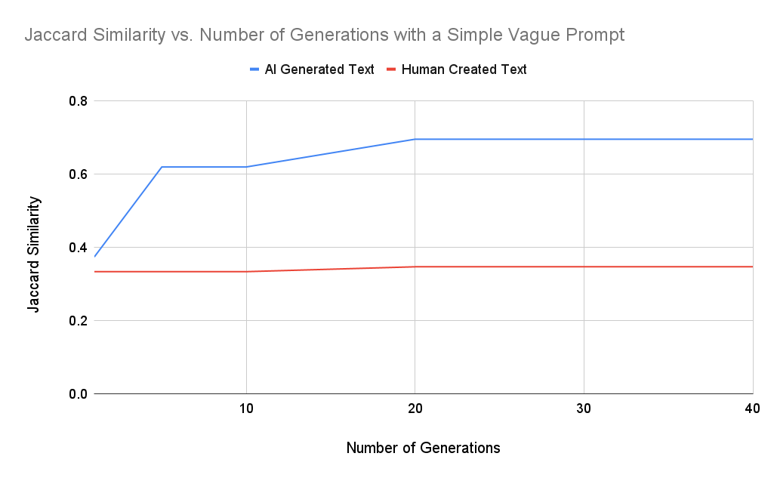
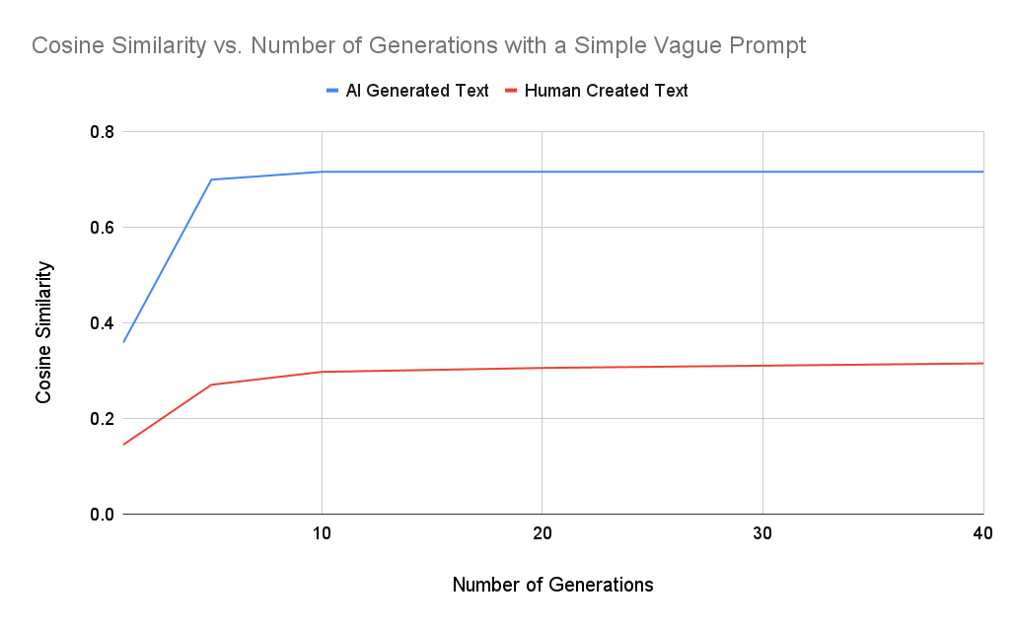
Experimental Results RAG

Slide 28
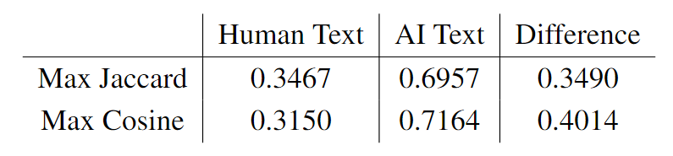
Results RAG
This table highlights important data in the graphs, such as the maximum values for AI and human generation for the similarity metrics.

Slide 29
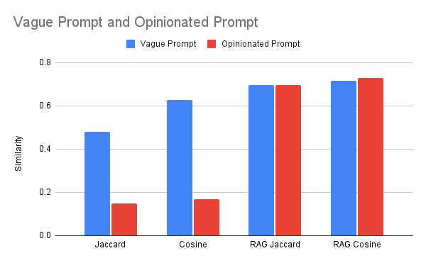
Model Comparison
This graph visualises the effect of changing the prompt and the text analysed.
NON - RAG
RAG​

Slide 30
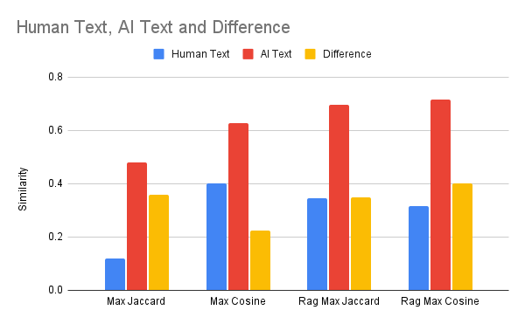
Model Comparison
This graph represents the data in a visual format to find the most effective method and parameters.
NON - RAG
RAG​

Slide 31
Evaluation
The non-RAG system’s framework effectively determines the difference between a human text and an AI text. Even when the prompt has an opinionated solution.
The framework effectively utilises both similarity metrics and has the largest confidence between human and AI input.
By setting a threshold at around 0.5, the system could be implemented to flag and detect AI content for review.

Slide 32
Conclusion
A RAG-based approach effectively determines the likelihood of a text being AI-generated. This system is effective over traditional methods especially in cases that have opinionated responses.
The systems implemented should not be the only system used to confirm whether a text is AI-generated, as there is a degree of randomness.
The Objectives:
1. Develop a method to identify AI-generated text using a similarity metric
2. Use Retrieval-Augmented Generation based responses
3. Implement these methods
4. Evaluate the success of the methods
5. Produce a report on the findings of the methods

Slide 33
Future Work
Testing with Other Models(LLaMA, Gemini).
A trigram-based system to look at the patterns and positions of words.
A database of common overused AI terms.
Fact and fake news detection.

Slide 34
Questions

Slide 35
References
Intelliarts Top 11 Large Language Models of 2024 (2024). Accessed: 2024-05-28.
Natural Language Toolkit NTKL (2024). test. Accessed: 2024-05-28.
LangChain Python Framework (2024). Accessed: 2024-05-28.
Openai(2023), AI classifier for detection, Accessed 04-06-2024, <https://openai.com/index/new-ai-classifier-for-indicating-ai-written-text/>
The OpenAI GitHub repository (2024, Accessed: 2024-05-28, <https://github.com/openai>

