Slide 1

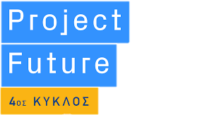

Project Future Data and Decision Sciences Team 8
Orestis Kaimas
Dorothea MparMPakou
Ioannis Savvides

Slide 2
98% prediction outcome for standard plan users
80% prediction outcome for paid plan users

Slide 3
Contents
Exploratory Data Analysis
Machine Learning
User Modelling
Unengaged and Churned Users

Slide 4
Exploratory Data Analysis Pre-processing
Only programmed in Python
From 6 csv files - - > 33mn data
To 3 csv files - - > 2mn data
handled missing values
dropped some columns
merged files on users id
outliers
local outlier factor
multivariate data
variable encoding
Defined new variables
min/ average/ max transaction value
number of transactions/ notifications
transactions frequency
Notes:
csv files: personal info for users, bank info, notifications, brand
Transactions: ~2,2mn

Slide 5
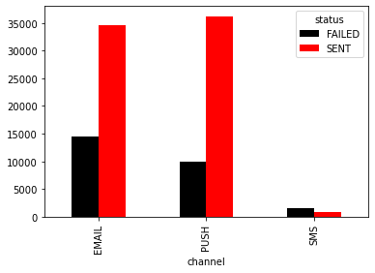
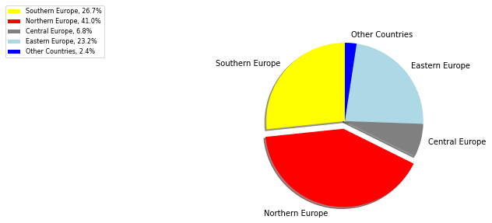
Exploratory Data Analysis Visualizations
34.656
36.268
or 4.143
or 6.373
or 1.054
or 3.601
or 373
14.493
9.976
1.542
769
Email
70% successfully sent
30% failed
Push
78% successfully sent
22% failed
SMS
33% successfully sent
66% failed
Greatest user concentration in the UK (5.018), Poland (1.834), and France (1.696)
Lowest user concentration in Australia (3), Liechtenstein (4), and Martinique (4)

Slide 6
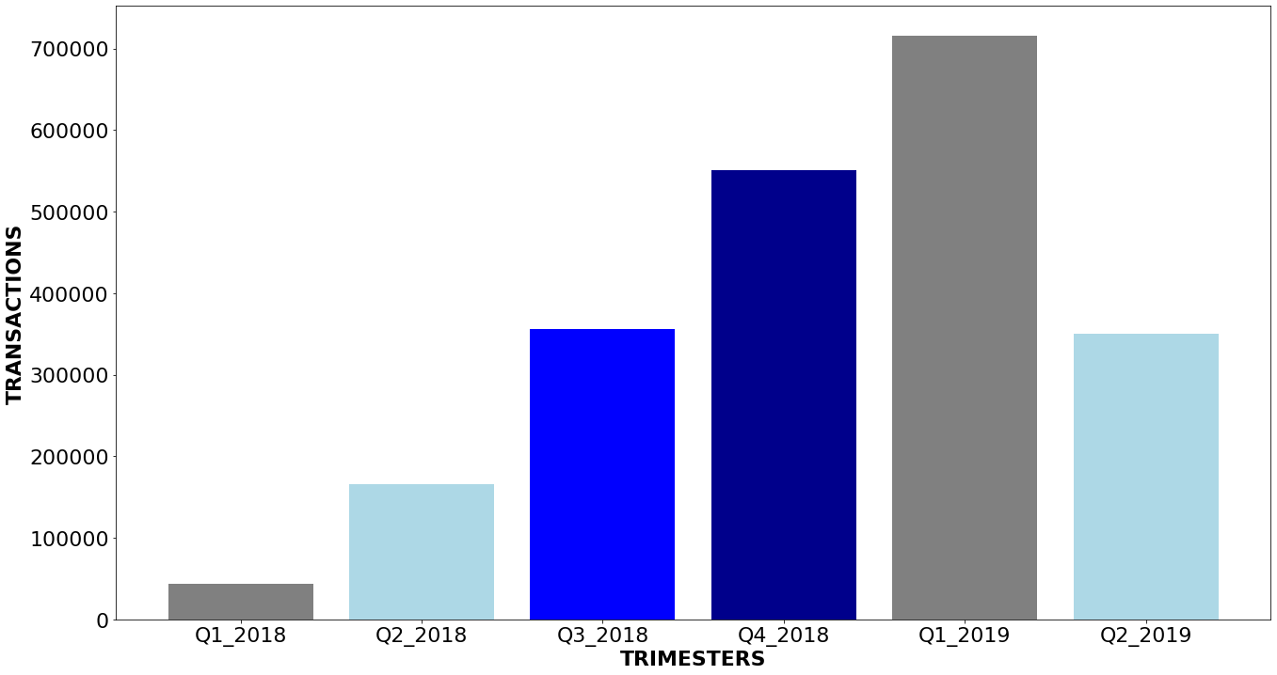
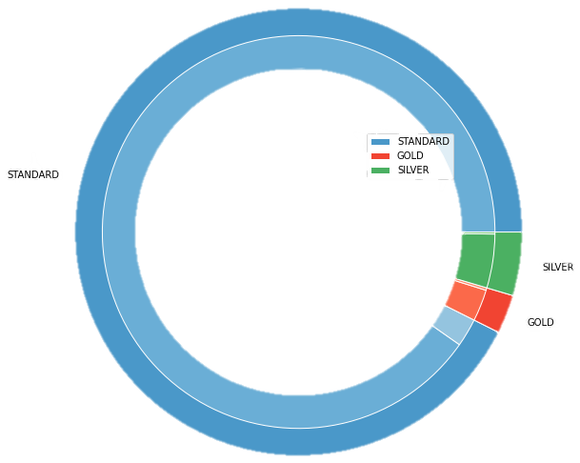
Exploratory Data Analysis Visualizations
716.145
550.445
355.452
349.790
165.526
43.668
2018 Compound Semester Growth Rate 88,4%
y-o-y change
Q1: 1.500%
Q2: 111%

Slide 7
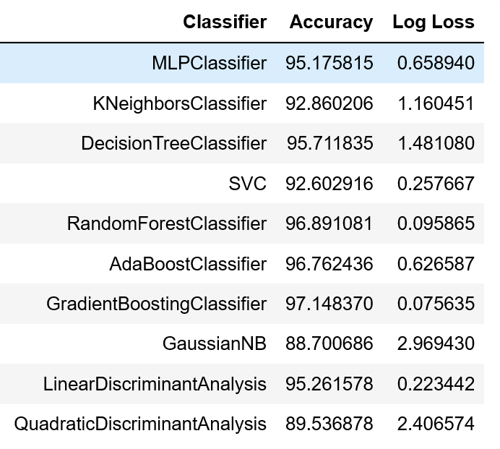
Machine Learning
f1_score
characteristics

Slide 8
























User Modelling Southern and Northern Europe
Southern Europe
NORTHERN Europe
1.696
5.018
93% Standard, 4% Silver and 3% Gold Plan
The average user prefers
Average number of transactions: 135
Average value of completed transactions: $1,6mn
92% Standard, 5% Silver and 3% Gold Plan
The average user prefers
Average number of transactions: 184
Average value of completed transactions: $107th
995
784
487
77
437
75
3.269
4.717
241
90% Standard, 6% Silver and 4% Gold Plan
The average user prefers
Average number of transactions: 98
Average value of completed transactions: $753
91% Standard, 6% Silver and 3% Gold Plan
The average user prefers
Average number of transactions: 124
Average value of completed transactions: $323
45
182
1.429
32
154
905
90% Standard, 10% Silver and 0% Gold Plan
The average user prefers
Average number of transactions: 40
Average value of completed transactions: $132
94% Standard, 5% Silver and 1% Gold Plan
The average user prefers
Average number of transactions: 82
Average value of completed transactions: $89
14
78
7
49
73
132
6
35
Young Middle Aged Old
Android photo by Unknown Author is licensed under CC BY
Apple photo by Unknown Author is licensed under CC BY-SA-NC

Slide 9













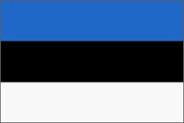

User Modelling Eastern and Central Europe
Eastern Europe
CENTRAL Europe
358
1.834
94% Standard, 3% Silver and 2% Gold Plan
The average user prefers
Average number of transactions: 153
Average value of completed transactions: $3,7th
93% Standard, 3% Silver and 3% Gold Plan
The average user prefers
Average number of transactions: 134
Average value of completed transactions: $77,5th
287
873
132
541
113
133
2.913
794
71
94% Standard, 6% Silver and 2% Gold Plan
The average user prefers
Average number of transactions: 107
Average value of completed transactions: $56
90% Standard, 8% Silver and 2% Gold Plan
The average user prefers
Average number of transactions: 97
Average value of completed transactions: $128
125
68
65
21
664
247
30
92% Standard, 4% Silver and 4% Gold Plan
The average user prefers
Average number of transactions: 50
Average value of completed transactions: $118
85% Standard, 8% Silver and 8% Gold Plan
The average user prefers
Average number of transactions: 66
Average value of completed transactions: $215
4
24
13
Young Middle Aged Old
Android photo by Unknown Author is licensed under CC BY

Slide 10





User Modelling Other Countries
Other Countries
350
89% Standard, 5% Silver and 6% Gold Plan
The average user prefers
Average number of transactions: 140
Average value of completed transactions: $3
9
7
258
81% Standard, 8% Silver and 11% Gold Plan
The average user prefers
Average number of transactions: 103
Average value of completed transactions: $308
4
3
110
80% Standard, 20% Silver and 0% Gold Plan
The average user prefers
Average number of transactions: 105
Average value of completed transactions: $77
5
Young Middle Aged Old
Android photo by Unknown Author is licensed under CC BY
Apple photo by Unknown Author is licensed under CC BY-SA-NC

Slide 11




Unengaged & Churned Users
CHURNED
One-size-fits all approach
Individualized approach
zero transactions
all transactions on user profile creation date
based on user’s activity frequency
Churned user: churn factor > 10,31
10,31 is 25% greater than the average delay
the average user makes a transaction 8,25 times later than the expected date
Example
user_1
Activity Frequency = 3,13 & Churn Factor = 4,47
performs a transaction every 3,13 days
its next activity takes 4,47 times longer than expected
Was not considered churned
$Churn Factor=\frac{Time Since Last Activity}{Activity Frequency}$
where $Activity Frequency :=\frac{Longevity −Recency}{Total Number of Transactions – 1}$
X photo by Unknown Author is licensed under CC BY-SA

