Slide 1
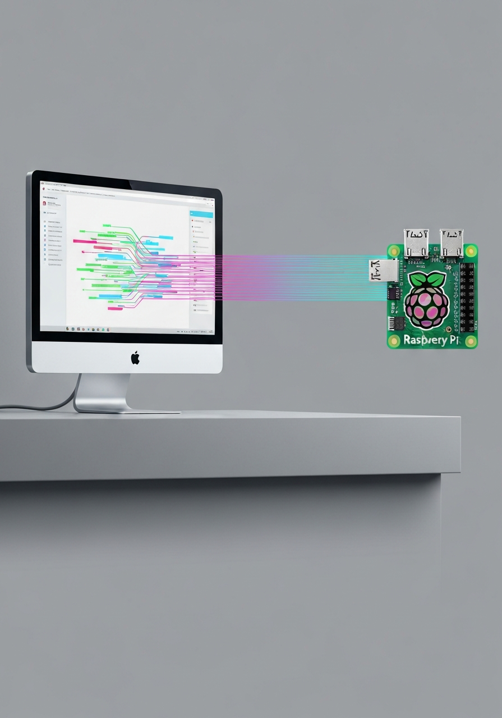
IoT Telemetry
Anomaly
Detection
End-to-End Streaming Anomaly Detection
with PC-to-Raspberry Pi Deployment
Orestis Kalogirou · Konstantinos Larkos
Github: https://github.com/orestisuchiha/telemetry-ad
Notes:
Welcome everyone. Today we present our end-to-end IoT telemetry anomaly detection system — from model training on a laptop all the way to real-time streaming inference on a Raspberry Pi. The project compares four detectors — a robust Z-score, Isolation Forest, an LSTM Autoencoder, and a CNN Autoencoder — evaluated across two benchmark datasets. We'll walk through the full pipeline, deployment architecture, and key results. Running time: approximately 20 minutes including Q&A.

Slide 2
Agenda
Problem & Datasets
System Architecture
01
02
Telemetry anomaly detection challenge, SKAB & NAB benchmarks
Two-stage offline/online pipeline and modular library design
Anomaly Detectors
PC-to-Pi Deployment
03
04
Z-score, Isolation Forest, LSTM-AE, CNN-AE
FastAPI stream server, Tailscale, streaming inference loop
Experimental Results
Discussion & Conclusion
05
06
Point F1, Event F1, PR-AUC across all dataset splits
Key findings, limitations, and future directions
Notes:
Here's the roadmap for today's talk. We'll start with the problem definition and our two benchmark datasets. Then walk through the system architecture — it's a clean two-stage design separating offline training from online inference. From there we cover the four anomaly detectors and the threshold calibration approach, before moving into the deployment section — which is really the distinguishing feature of this project. We'll close with results, discussion, and conclusions.

Slide 3
Problem Statement
Detecting anomalies under realistic operational constraints
Core Challenge
Telemetry streams are noisy, non-stationary, and sparsely labeled — detectors must cope with temporal structure, concept drift, and severe class imbalance while producing coherent operational alerts.
Multi-source
Support
Multi-metric
Evaluation
Alert
Coherence
Edge
Deployment
Common configurable pipeline across SKAB & NAB telemetry sources
Point F1 + Event F1 + PR-AUC — single metrics mislead
Event-level scoring penalises fragmented bursts of false alerts
Offline training on PC → lightweight streaming inference on Pi
Notes:
The core challenge is that real telemetry streams are messy. Unlike clean benchmark datasets, they're noisy, non-stationary — the statistical properties change over time — and labels for anomaly events are scarce or absent. The detector also can't just flag individual points. It needs to produce coherent alert sequences that an operations team can actually act on. A burst of 91 tiny alerts covering a single fault event is useless in practice — we need one clean alert. Our four design goals drive every architectural decision: support multiple data sources under a single configurable pipeline; evaluate with multiple complementary metrics; score at both point and event level; and make the system lightweight enough for edge deployment on a Raspberry Pi.

Slide 4
Benchmark Datasets
Two complementary benchmarks stress the system differently
SKAB — Skoltech Anomaly Benchmark
NAB — 3 AWS CloudWatch Series
Source:
Industrial sensor testbed (multivariate)
Series:
rds_cpu · ec2_cpu · ec2_network
Train:
Anomaly-free recording
Split:
70% train / 30% test (anomaly-aware)
Test:
valve1/1 — labeled fault scenario
Exclusion:
Labeled anomaly windows excluded from train
Anomaly:
Single collective fault event
Anomaly:
Cloud-style drifts & spikes (univariate)
Challenge:
Clean normal→fault; warmup calibration
Challenge:
Noise, non-stationarity, concept drift
Notes:
We use two very different benchmarks, deliberately chosen to stress the system in different ways. SKAB comes from a physical testbed at Skoltech — it gives us clean multivariate industrial sensor data with a well-defined normal period and a single valve fault scenario. The anomaly boundary is crisp, which makes it ideal for testing whether our warmup-based threshold calibration works. NAB is noisier and more realistic of cloud infrastructure monitoring — three AWS CloudWatch series covering CPU utilisation on RDS and EC2, and network traffic. These have slow trend components, daily periodicity, and cloud-style concept drift. We exclude labeled anomaly windows from training to prevent contamination, which is standard NAB protocol. Together they test the extremes: clean industrial vs messy cloud.

Slide 5
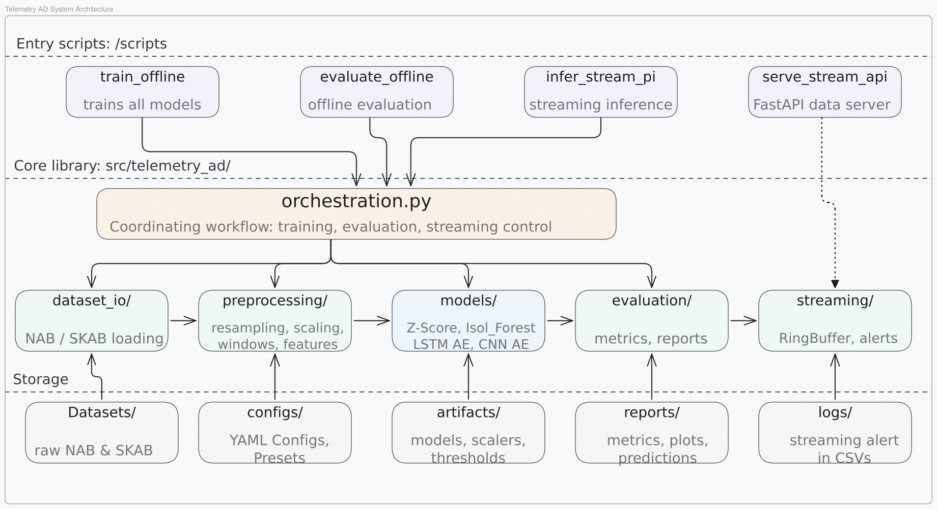
Software Architecture
Notes:
The architecture is strictly layered. There are five entry-point scripts — train_offline, evaluate_offline, infer_stream_pi, serve_stream_api, and pi_preflight — all of which delegate to a central orchestration module. Orchestration dispatches to five focused library packages: dataset_io for loading, preprocessing for resampling and feature engineering, models for the four detectors, evaluation for metrics and reporting, and streaming for the RingBuffer and alert logging. All state is stored as files — datasets, YAML configs, trained artifacts, reports, and alert logs. This means training and inference are completely decoupled: the Pi only needs the artifact files and never touches the training code. The dashed arrow from serve_stream_api to streaming illustrates that the FastAPI server feeds the Pi's streaming loop — we'll cover that in the deployment section.

Slide 6
Preprocessing Pipeline
All steps configurable via YAML.
①
②
③
④
⑤
Timestamp
Sort
Resample
& Fill
Rolling
Detrend
EWMA
Smooth
StandardScaler
Fit
›
›
›
›
Ensure chronological order
Linear interpolate + forward fill residual NaN
NAB: subtract rolling mean (window=144) to remove drift
Optional exponential smoothing (alpha configurable)
Fit on training windows, transform test consistently
SKAB uses no detrending (stable baseline). NAB applies rolling_detrend_window=144 to reduce slow cloud-metric drift before scoring.
Notes:
Preprocessing is crucial and dataset-specific. The pipeline runs five steps in order, each configurable via YAML. The key dataset difference: SKAB has a clean, stationary normal baseline, so we don't detrend — we want the detector to learn the true baseline directly. For NAB, we subtract a rolling mean with a 144-sample window (about 12 hours at 5-minute resolution) to remove slow trend components that would otherwise swamp the anomaly signal. StandardScaler is always fit on training windows only and applied to the test set consistently — this is critical for correctness on the Pi, where we use the same saved scaler. All five steps are on/off flags in the YAML, so experiments can be reproduced exactly or modified by changing a single config file.

Slide 7
Feature Engineering
Shared pipeline for all 4 models · window size = 60 · stride = 1
Rolling Statistics
Lag Embeddings
Mean · Std · Median · Min · Max over a sliding window — captures local distribution shape
Values at lags [1, 5, 10] — encode short-range temporal context and autocorrelation
Delta Features
FFT Window Energy
First-order differences — represent the instantaneous rate of change
Energy in the frequency domain per window — captures periodic and rhythmic patterns
Feature-column schema saved to metadata.json during training — the Pi reconstructs the identical representation at inference time.
Notes:
All four models share exactly the same feature engineering pipeline — the differences come purely from how they consume those features. We use a 60-sample sliding window with stride 1. For each window we compute rolling statistics (mean, std, median, min, max), lag embeddings at [1, 5, 10] steps, first-order deltas, and FFT energy. For SKAB's multivariate channels, these are computed per sensor. The critical engineering detail: the feature column schema is serialised into metadata.json at training time. The Raspberry Pi reads this schema and reconstructs the exact same feature vector using only NumPy. If any column is missing due to a version drift it's filled with zero and flagged. This schema lock is what guarantees correctness between the PC and Pi environments.

Slide 8
Anomaly Detectors
Four complementary approaches — statistical to deep learning
STATISTICAL
ENSEMBLE
Robust Z-score (MAD-based)
Isolation Forest (200 trees)
▸ Uses Median Absolute Deviation (MAD) for outlier resistance
▸ Anomaly score = negated average path length in the forest
▸ Score = max per-feature robust Z: 0.6745 × |x − median| / MAD
▸ Nonlinear — exploits the full engineered feature matrix
▸ Warmup-calibrated at 10th percentile of first 300 test windows
▸ No distribution assumption on normal data
▸ Best event-level alerting on SKAB → Event F1 = 1.000
▸ Prone to alert fragmentation on sustained anomalies
DEEP LEARNING
DEEP LEARNING
LSTM Autoencoder
CNN Autoencoder
▸ Encoder: LSTM(input → hidden=32) · Decoder: LSTM(32 → input)
▸ 4-layer 1-D Conv: ch→32→16 (encoder) · 16→32→ch (decoder)
▸ Trained on normal windows with MSE reconstruction loss
▸ Same-padding preserves time dimension; bottleneck in channels
▸ Score = mean squared reconstruction error over full window
▸ Captures local temporal shape patterns (short-range motifs)
▸ Best overall: PR-AUC 0.950, Event F1 1.000 on ec2_network
▸ Tracks LSTM-AE closely; weaker on sustained network spikes
Notes:
We compare four detectors across the complexity spectrum. The robust Z-score uses Median Absolute Deviation rather than standard deviation — this makes it resistant to outliers in the training data. The 0.6745 constant normalises MAD to be equivalent to std for Gaussian data. Crucially, it works on the full feature matrix and takes the maximum per-feature score — so a single anomalous feature will trigger it. Isolation Forest with 200 trees uses nonlinear path-length scoring and makes no assumptions about the data distribution. In theory this should make it robust, but we'll see it struggles operationally. The LSTM Autoencoder is our main deep learning model. It's an encoder-decoder: the encoder compresses the 60-step window, the decoder reconstructs it, and the MSE is the anomaly score. It captures long-range sequential dependencies — ideal when the anomaly manifests as a change in temporal pattern. The CNN Autoencoder focuses on local motifs using 1-D convolutions. Same architecture principle but better for short-range shape changes.

Slide 9
Threshold Calibration System
Artifact Mode
Warmup Percentile Mode
Used for NAB
Used for SKAB
● Fixed percentile of training reconstruction errors
● Score first 300 test windows (normal prefix only)
● NAB global: 99.9th percentile (IForest: 99.0th)
vs
● Alerts suppressed during warmup phase
● Stable — no online warmup needed
● Threshold set at per-model percentile of warmup scores:
● Threshold saved to thresholds.json
● Z-score 10th · IForest 50th · LSTM-AE 80th · CNN-AE 70th
● Best when train & test score distributions are similar
● Online adaptation — outperforms fixed artifact threshold
Notes:
Threshold calibration is arguably our biggest engineering contribution. The naive approach — set a fixed percentile at training time — works reasonably for NAB because the test stream's score distribution is similar to training. We use the 99.9th percentile of training scores, meaning only the top 0.1% of training scores would have been flagged. This is saved to an artifact file and loaded on the Pi. For SKAB, this fails. The valve fault produces scores that are orders of magnitude larger than anything in training — so even a generous training percentile will trigger on the normal warmup. Instead, we score the first 300 test windows (which correspond to the pre-fault normal period), suppress alerts during this time, then set the threshold at a per-model percentile of those warmup scores. Why different percentiles per model? Because the LSTM-AE reconstruction error is much noisier than the Z-score during normal operation, so a higher percentile is needed to avoid false positives. The threshold search module automates this: it tries a list of candidate percentiles, scores each against event F1 subject to a maximum alert rate, and picks the best one.

Slide 10
Evaluation Framework
Three complementary layers — single metrics mislead in operational settings
1
2
3
Point-Level Metrics
Event-Level F1
Operational Interpretation
▸ Precision · Recall · F1
▸ Predicted event = HIT if overlaps any true event
▸ Point · Contextual · Collective anomaly types
▸ ROC-AUC · PR-AUC (threshold-independent)
▸ Penalises alert fragmentation
▸ Labels: transient / fault / drift / setpoint shift
AUC metrics measure ranking quality independently of the chosen threshold. F1 at the calibrated threshold.
91 short bursts covering one fault → low event precision even with perfect point recall.
Bridges raw metric tables and actionable conclusions for operations teams.
+ STL Seasonality · Nonstationarity Analysis · Explanation Artifacts (per-feature/per-channel attribution)
Notes:
We deliberately avoid relying on a single metric, because each one tells a different story. Point-level F1 measures per-timestamp correctness. It's threshold-dependent. PR-AUC is threshold-independent and measures overall ranking quality — how well the model separates anomalous from normal windows regardless of where you draw the line. Event-level F1 is our operational metric. An event is a contiguous run of predicted anomalies. A predicted event is a "hit" if it overlaps with any true anomaly event — and vice versa. This penalises fragmentation: if Isolation Forest produces 91 short alert bursts covering one true fault, it has high point recall but near-zero event precision. That's what we mean by "operational failure." The interpretation layer goes further — it classifies events as point anomalies, contextual (2-sample), or collective (3+), and labels them with operational categories like "possible sustained fault" or "possible concept drift." This is what an on-call engineer would actually read. Beyond these three layers we also run STL seasonality decomposition and nonstationarity analysis to characterise the data, plus per-model explanation artifacts for interpretability.

Slide 11
PC-to-Pi Deployment Architecture
Training stays on PC · Raspberry Pi performs inference only
PC / Laptop
Raspberry Pi
Tailscale
Offline Training
Setup & Preflight
Private tailnet
train_offline.py
pi_setup.sh + pi_preflight.py
GET /health
Offline Evaluation
Receive Artifacts
API health check
evaluate_offline.py
thresholds.json · *.pkl · *.pt · metadata.json
FastAPI Stream Server
GET /stream/next
?cursor=N&batch_size=B
Streaming Inference
serve_stream_api.py :8000
infer_stream_pi.py --source api
Telemetry batches
Artifact Storage
Feature Rebuild
artifacts/<dataset>/<variant>/
Schema from metadata.json (offline-consistent)
Dataset Storage
Alert Logging
Datasets/NAB/ · Datasets/SKAB/
logs/*.csv (with --tui live dashboard)
▶
Artifact transfer (scp / rsync)
Notes:
The deployment architecture has three roles. The PC handles everything heavyweight: training, evaluation, and serving. The FastAPI server — serve_stream_api.py — loads the test dataset at startup and exposes it as a paginated stream via two endpoints: GET /health for schema validation, and GET /stream/next with cursor-based pagination. Tailscale creates a private encrypted mesh network between the PC and the Pi. No port forwarding, no VPN configuration — both devices just join the same tailnet and communicate securely by hostname. This is what makes the deployment practical on a home network. The Pi runs only inference. Before any inference begins, pi_preflight.py checks that all imports load correctly, all required artifact files are present, Tailscale is connected, and both API endpoints are reachable. If anything fails, it exits with a descriptive error before wasting time. Artifacts are transferred once via scp or rsync — shown by the orange arrow at the bottom. After that, the Pi is self-contained for feature rebuild and scoring; it only hits the API for telemetry data.

Slide 12
Streaming Inference Loop on the Pi
Per-row loop — O(1) RingBuffer push · NumPy feature vector · minimal Pi overhead
1
2
3
4
5
6
Fetch
Batch
Ring
Buffer
Build
Features
Score
Window
Threshold
Check
Log
Alert
GET /stream/next
from FastAPI on PC
Append row to deque
(O(1) push, maxlen=60)
NumPy feature vector
from buffer window
Apply saved model
& scaler locally
Compare score vs
effective threshold
Append CSV row
with timestamp
--tui flag: Live terminal dashboard via rich library — progress bar, anomaly score, effective threshold, alert count, calibration status and ETA.
Notes:
Here's the per-row inference loop that runs continuously on the Pi. Step 1: The Pi requests the next batch from the FastAPI server using cursor-based pagination — it sends its current cursor position and batch size (typically 32), and the server returns the next rows with a done flag. Step 2: Each row is pushed into a Python deque configured as a ring buffer of length 60. The deque has O(1) push — no copying. Once it's full, the oldest row drops off automatically. Step 3: We compute the feature vector directly from the buffer array using NumPy — the same rolling stats, lags, deltas, and FFT energy as training, but without pandas overhead. Step 4: The feature vector is passed through the saved scaler and model. For the autoencoders, this is a forward pass of a small PyTorch model on CPU — fast enough on a Pi 4. Step 5: The score is compared against the effective threshold. In warmup mode, the first 300 scores are accumulated silently to calibrate the threshold; alerts are suppressed during this period. Step 6: If the score exceeds the threshold, append_alert() writes a CSV row. The header is created automatically on first write. The --tui flag activates a live rich terminal panel showing all this in real time.

Slide 13
Results at a Glance
Key performance highlights across 4 datasets · 4 models · 3 metric layers
1.000
0.950
1.000
0.677
Event-Level F1
PR-AUC
Event-Level F1
Best Point-F1
Z-score on SKAB valve1/1
Perfect alert coherence
LSTM-AE on NAB ec2_network
Best ranking quality
LSTM-AE on NAB ec2_network
0 false positive events
Z-score leads SKAB
Best point precision
4 models · 4 datasets · Point F1 + Event F1 + PR-AUC + Event Classification + Operational Interpretation
Notes:
Before we go into the detailed charts, here are the four headline numbers from this study. First: calibrated Z-score achieves perfect event-level F1 of 1.000 on SKAB — one true fault event, one predicted alert, zero fragmentation. This is purely due to the warmup calibration giving a tight threshold. Second: LSTM-AE achieves a PR-AUC of 0.950 on the most complex NAB split, ec2_network. This is the ranking quality — it means the model almost perfectly separates normal from anomalous windows across all possible thresholds. Third: LSTM-AE also achieves event-level F1 of 1.000 on that same split with zero false positive events — its confusion matrix shows exactly one predicted collective event that perfectly overlaps the true one. Fourth: Z-score's best point-level F1 of 0.677 on SKAB, which is the best point score on that dataset — showing that the MAD-based formulation produces well-calibrated scores even at the point level. The next three slides break all of these down across all models and datasets.

Slide 14
Point-Level F1
LSTM-AE and CNN-AE lead on most NAB splits; Z-score leads SKAB
Notes:
Point-level F1 measures per-timestamp precision and recall at the calibrated threshold. On SKAB, Z-score leads at 0.677, with LSTM-AE close behind at 0.667. The models are relatively similar here because the fault is a large, sustained deviation that all models pick up. On NAB rds_cpu, LSTM-AE and CNN-AE both score 0.571 — significantly ahead of the baselines at 0.446 and 0.437. The autoencoders' temporal modelling helps localise the anomaly more precisely. NAB ec2_cpu is the hardest — all models score below 0.35. The daily CPU periodicity combined with a level shift makes this genuinely difficult. Even 0.302 for the autoencoders represents reasonable performance given the challenge. NAB ec2_network shows the widest divergence: LSTM-AE reaches 0.613 while CNN-AE collapses to 0.173. The anomaly here is a sustained network traffic spike spanning many timesteps — the LSTM captures the long-range pattern, while the CNN's local motif focus misses it. Important: these are point F1 scores. As we'll see next, point F1 alone can be deeply misleading for operational purposes.

Slide 15
Event-Level F1
Measures alert coherence — penalises fragmented bursts
Isolation Forest drops to 0.047 on ec2_network — 91 short alert bursts vs. 1 true collective event. Point F1 alone would have hidden this operational failure.
Notes:
This chart reveals the most important finding of the project — and why we need event-level evaluation. Look at ec2_network. Isolation Forest had a point-level F1 of 0.398 — not bad. But its event-level F1 collapses to 0.047. What happened? It generated 91 short alert bursts scattered across the test series, most not overlapping the true anomaly window. Event precision is essentially zero. From an operational standpoint, this model is useless — an on-call engineer would receive nearly 100 alerts and have to sift through them to find the one real event. Contrast this with LSTM-AE at 1.000: it produced exactly one predicted collective event, which perfectly overlapped the true event. Zero false positive events, zero alert fatigue. The ec2_cpu result is equally striking: Isolation Forest collapses to 0.237 while Z-score, LSTM-AE, and CNN-AE all hit 1.000. The model's score oscillates around the threshold throughout the anomaly period, fragmenting what should be one alert into dozens. On SKAB, LSTM-AE underperforms at 0.571 despite its high PR-AUC — it splits the fault into multiple segments. Z-score with warmup calibration produces exactly one tight alert.

Slide 16
PR-AUC
Precision–Recall AUC — threshold-independent ranking quality
LSTM-AE achieves PR-AUC 0.950 on ec2_network — 0 false positive events. The large residual spike is captured as a sequence-level reconstruction failure.
Notes:
PR-AUC measures ranking quality independently of the threshold — it integrates precision over all possible recall levels. A score of 0.950 means the model almost perfectly separates anomalous from normal windows regardless of where you draw the threshold line. The LSTM-AE's 0.950 on ec2_network is the strongest single result in the study. STL decomposition of that series confirms weak seasonality and a very large residual spike at the anomaly — precisely the signature an LSTM autoencoder is designed to detect as a sequence-level reconstruction failure. The Z-score's 0.762 on ec2_cpu is surprisingly strong — it suggests the MAD-based formulation produces well-calibrated scores even when the deployed threshold isn't optimal. The rolling detrend we apply for NAB appears to be doing significant work here by removing the slow level shift before scoring. Isolation Forest consistently underperforms on PR-AUC despite sometimes acceptable point F1 — this suggests its score distribution doesn't cleanly separate normal from anomalous windows, which is consistent with the fragmentation we observe at the event level.

Slide 17
Best Model by Dataset & Metric
No single model dominates every regime
Dataset | Best Point-F1 | Point F1 | Best PR-AUC | PR-AUC | Best Event-F1 | Event F1
SKAB valve1/1 | Z-score | 0.677 | LSTM-AE | 0.695 | Z-score | 1.000
NAB rds_cpu | LSTM-AE | 0.571 | LSTM-AE | 0.493 | All models | 1.000
NAB ec2_cpu | LSTM-AE | 0.302 | Z-score | 0.762 | Z/LSTM/CNN | 1.000
NAB ec2_network | LSTM-AE | 0.613 | LSTM-AE | 0.950 | LSTM-AE / CNN-AE | 1.000
LSTM-AE is strongest on NAB cloud series. Calibrated Z-score is most reliable on SKAB. Isolation Forest fragments alerts on complex NAB splits.
Notes:
This summary table makes the main conclusion clear: no single model wins across all regimes. Z-score wins SKAB on both point and event F1, and ties for the top event score on NAB ec2_cpu. Its strong PR-AUC on ec2_cpu (0.762) shows it ranks anomalies well even when its deployed threshold isn't perfectly calibrated. LSTM-AE wins the point F1 on three of four NAB splits and takes the PR-AUC on three. It ties for event F1 on three splits and is the sole winner on ec2_network. The event F1 column tells the key story: 1.000 across the board except for Isolation Forest on ec2_cpu (0.237) and ec2_network (0.047). All other models — even Z-score — achieve perfect operational alerting on NAB. The fragmentation issue is specific to Isolation Forest's scoring mechanism, not to the dataset or the threshold calibration approach. The practical recommendation from these results: use warmup-calibrated Z-score for clean industrial telemetry with stable baselines. Use LSTM-AE for noisy cloud telemetry with complex seasonal patterns. Avoid Isolation Forest for sustained anomaly detection without score smoothing.

Slide 18
Deep Dive: SKAB valve1/1
Clean normal→fault boundary — warmup calibration is highly effective
Z-score
Isol. Forest
Point F1
Event F1
PR-AUC
Point F1
Event F1
PR-AUC
0.677
1.000
0.383
0.628
0.681
0.516
10th percentile warmup → tight threshold → 1 coherent alert
91 predicted events — score oscillates around threshold
LSTM-AE
CNN-AE
Point F1
Event F1
PR-AUC
Point F1
Event F1
PR-AUC
0.667
0.571
0.695
0.642
0.667
0.491
Best ranker (PR-AUC 0.695) but splits fault into segments
Tracks LSTM-AE closely on this dataset
Key insight: The valve fault is one collective event. Warmup calibration at the 10th percentile produces a tight threshold, eliminating false positives in the normal prefix.
Notes:
SKAB is our clearest evaluation case because the fault boundary is well defined. The Pressure sensor (and others) has a stable baseline visible in the STL decomposition — trend and residual stay near zero, then sharply deviate at the valve fault. This stability makes warmup calibration work almost perfectly. Z-score at the 10th percentile warmup threshold produces exactly one predicted event that perfectly overlaps the true fault. Event F1 = 1.000. The threshold search module confirmed this as optimal: the Z-score's warmup distribution is tight, so even a 10th percentile threshold sits well below the fault-period scores. LSTM-AE is the better ranker (PR-AUC 0.695) but its deployed 80th percentile warmup threshold leads to a fragmented alert pattern during the fault — the reconstruction error oscillates rather than staying consistently above threshold. Event F1 drops to 0.571. Isolation Forest produces 91 predicted events across the test series — its score oscillates around the 50th percentile warmup threshold throughout the fault region. Event F1 = 0.681 despite 91 events, because all of them overlap the single true event window. The lesson: for clean industrial data with a stable pre-fault period, warmup calibration at a low percentile + robust Z-score is the most reliable operational choice.

Slide 19
Deep Dive: NAB Cloud Series
LSTM-AE dominates; Isolation Forest fails operationally
rds_cpu
ec2_cpu
ec2_network
Best model:
Best model:
Best model:
LSTM-AE / CNN-AE
Z-score (PR-AUC)
LSTM-AE
Best Point-F1:
0.571
Best Point-F1:
0.302 (LSTM)
Best Point-F1:
0.613
Event-Level F1:
1.000 (all)
Event-Level F1:
1.000 (Z/L/C)
Event-Level F1:
1.000 / 0.047
Best PR-AUC:
0.493
Best PR-AUC:
0.762 (Z)
Best PR-AUC:
0.950
All 4 models detect the event. Autoencoders localise it more precisely point-by-point.
Daily CPU periodicity + level shift. Rolling detrend (w=144) is critical. IForest collapses to 0.237.
LSTM-AE: 0 false positives, perfect precision. IForest: 91 short bursts → Event F1 = 0.047.
Notes:
Three NAB CloudWatch series, each progressively harder. rds_cpu is the most tractable — all four models detect the event at event level, and autoencoders localise it more precisely at the point level. This is a clear CPU spike on an RDS database; the temporal signature is clean enough for all methods. ec2_cpu has daily periodicity at 288 samples per cycle (5-minute resolution, 24 hours). This interacts badly with models that don't account for seasonality. Rolling detrend with window=144 removes approximately half a day of slow drift and materially improves point-level scores. Z-score achieves the best PR-AUC at 0.762 — surprisingly strong. LSTM-AE leads point F1 at 0.302. Isolation Forest collapses to event F1 = 0.237. ec2_network is LSTM-AE's showcase result. STL decomposition shows weak seasonality — most of the variance is in the residual — with one enormous spike at the anomaly. LSTM-AE captures this as a catastrophic reconstruction failure: it has never seen a spike this large during training, so the MSE score is off the charts. CNN-AE misses it (0.173 point F1) because the local motif focus misses the sustained nature of the spike. The ec2_network/Isolation Forest comparison is the clearest demonstration of why event-level evaluation matters: IForest point F1 = 0.398 (looks reasonable), event F1 = 0.047 (operationally useless).

Slide 20
Key Findings
What the numbers actually mean
1
No single model wins every regime
2
Event-level F1 is the operational metric
SKAB favours calibrated Z-score for tight alerting. NAB cloud series favour LSTM-AE for both ranking quality and alert coherence.
Isolation Forest looks plausible at point level on some splits but collapses operationally due to fragmented alerts. Point F1 alone hides this failure mode.
3
Warmup calibration is the key engineering win
4
The full pipeline IS the anomaly detector
Online threshold adaptation (SKAB 10th percentile warmup) dramatically outperforms fixed artifact thresholds when train/test score distributions differ.
Rolling detrend (NAB), anomaly-aware split, and schema-consistent feature rebuild are as impactful as model choice. The detector is not just the final model.
Notes:
Four lessons that generalise beyond this project. Finding 1 — context matters more than model family. A simple statistical method (Z-score with MAD) with good threshold calibration beats deep learning on industrial telemetry. Deep learning wins when the data is complex and the temporal structure is genuinely long-range. Finding 2 — report event-level metrics, not just point metrics. Any time you're deploying an anomaly detector to operations, event F1 is what tells you whether engineers can actually use the output. A model that halves your alert volume while keeping the same recall is twice as valuable operationally. Finding 3 — warmup calibration generalises. The approach — score a normal prefix in production, set the threshold from that distribution — can be applied to any scoring method. It adapts to covariate shift between training and deployment without requiring labeled data. Finding 4 — preprocessing is load-bearing. Removing the trend from NAB data before scoring, using an anomaly-aware train split, and locking the feature schema across environments are each necessary for the system to work correctly. This is often underappreciated.

Slide 21
Limitations & Future Work
Honest assessment and concrete next steps
Limitations
Future Work
✗ No formal Pi latency / memory benchmarking
✓ Pi latency & memory profiling across all 4 models
✗ Alerts in CSV only — no live monitoring dashboard
✓ Real-time dashboard (Grafana + Prometheus integration)
✗ Evaluation covers 4 splits only (limited generalization)
✓ Score smoothing to reduce Isolation Forest fragmentation
✗ CNN-AE uses same-padding only — no spatial downsampling
✓ Broader evaluation — more NAB & SKAB fault scenarios
✗ Docker path validated but not the primary deployment route
✓ Live sensor integration — replace replayed test stream
Notes:
We want to be honest about what this project doesn't do. The most significant missing piece is Pi performance benchmarking. We validated that inference runs correctly on the Pi, but we haven't measured per-window latency or peak memory usage for each model. The LSTM-AE on CPU is likely the bottleneck — this needs measurement before any real-time deployment. Alert delivery is currently CSV-only. For an actual operations team, you'd want webhook integration, a time-series database, and a visualization layer like Grafana. This is a significant engineering effort but not a research contribution. We evaluated four dataset splits. While SKAB and NAB are established benchmarks, broader evaluation across more fault scenarios and sensor types would strengthen the generalization claims. The CNN-AE uses same-padding throughout — no spatial downsampling — which means the bottleneck is only in the channel dimension. Adding strided or pooled encoding might improve the representation for long-duration anomalies. The most tractable future directions: score smoothing (a short median filter over the last K scores) would likely fix most of Isolation Forest's fragmentation without retraining. And connecting to a live sensor rather than replaying test data would be the final step toward a real edge deployment.

Slide 22
Conclusion
End-to-end pipeline validated
Offline PC training → Raspberry Pi streaming inference · FastAPI + Tailscale fully operational
Calibrated Z-score wins SKAB
Event-level F1 = 1.000 on SKAB with warmup-based threshold · one coherent alert on valve fault
Thank you for your attention.
LSTM-AE dominates NAB
PR-AUC 0.950 · Event F1 1.000 · 0 false positive events on ec2_network — best overall detector
Multi-metric eval is non-negotiable
Point F1 + Event F1 + PR-AUC together reveal what any single metric hides
Notes:
To summarise. We implemented and validated a complete end-to-end IoT telemetry anomaly detection system. Offline training on a PC, artifact transfer via scp, streaming inference on a Raspberry Pi over a Tailscale private network — the full path is validated and operational. Four key conclusions: One: the deployment works. FastAPI + Tailscale is a practical, zero-configuration private network solution for edge ML deployment. Two: for clean industrial telemetry with a stable pre-fault baseline, warmup-calibrated robust Z-score is the best operational choice. It produces a single coherent alert, is interpretable, and runs in microseconds on the Pi. Three: for noisy cloud telemetry, LSTM-AE is the strongest detector across all metrics. Its sequential reconstruction error naturally captures the sustained deviation signatures that characterise cloud infrastructure anomalies. Four: multi-metric evaluation is not optional. Point F1 and event F1 together reveal failure modes that neither metric alone would expose. In operational anomaly detection, coherent alerting is as important as statistical accuracy. We're happy to take questions. The codebase is available at github.com/orestisuchiha/telemetry-ad.

