Slide 1
SOIL
MONITORING
FOR SMART
AGRICULTURE
ESP32
Sensor-based soil monitoring with real-time measurements, local classification and an offline dashboard
MOISTURE
TEMP
pH
EEG 323 — Instrumentation and Measurement II | Group 2
Department of Electrical and Electronics Engineering · University of Lagos
Supervisor: Dr. Olumide Akintunde Alamu
SENSE → PROCESS → DISPLAY

Slide 2
THE PROBLEM
02
Soil decisions are only as good as the measurements behind them
The project turns three invisible soil conditions into numbers a farmer can act on.
1
Traditional judgment
Farmers may rely on soil appearance, touch and experience when measurement tools are unavailable.
THE DESIGN RESPONSE
Measure locally.
Process immediately.
Explain the result.
2
Laboratory testing
Accurate testing can require money, time and access to a laboratory — unsuitable for every immediate irrigation decision.
A compact ESP32 instrument combines sensing, calibration, classification and a local user interface in one build.
3
Instrument access
Imported or specialised equipment can be difficult to maintain when a component fails.
REAL-TIME
OFFLINE
SOIL MONITORING FOR SMART AGRICULTURE
EEG 323 • Group 2 • University of Lagos

Slide 3
AIM & OBJECTIVES
03
A small instrument with a clear job
Measure soil moisture, temperature and pH, then turn readings into usable information.
AIM
1
Portable
Stable enough to carry to and from the farm.
Design and implement a sensor-based system that measures soil moisture, temperature and pH, and processes and displays those readings in real time to support irrigation and crop management decisions.
2
Maintainable
Built from commonly available parts and simple interfaces.
The final build is intended to be portable, maintainable and usable without engineering know-how.
3
Operable
Useful without needing a laptop during normal operation.
SUCCESS LOOKS LIKE
LIVE VALUES
CALIBRATED
LOCAL UI
SOIL MONITORING FOR SMART AGRICULTURE
EEG 323 • Group 2 • University of Lagos

Slide 4
MEASUREMENTS
04
Why measure moisture, temperature and pH?
These three measurements describe different parts of the soil environment — water availability, thermal conditions and chemical availability.
1
MOISTURE
2
TEMPERATURE
3
pH
41 %
27.7 °C
9.29
Indicates how much water is available in the root zone and directly supports irrigation decisions.
Tracks the thermal condition of the soil environment, which affects germination, microbial activity and nutrient availability.
Shows the chemical condition of the soil and helps indicate whether nutrient uptake may be limited by acidity or alkalinity.
< 30% DRY · 30–70% GOOD · ≥ 70% WET
10-bit DS18B20 · 0.25 °C RESOLUTION
< 6.5 ACIDIC · 6.5–7.5 NEUTRAL · > 7.5 ALKALINE
In this project, the readings are not presented as raw numbers only — the firmware also translates them into plain-language categories.
SOIL MONITORING FOR SMART AGRICULTURE
EEG 323 • Group 2 • University of Lagos

Slide 5
SYSTEM ARCHITECTURE
05
One controller, three sensors, two user interfaces
The system is organised as a sensing layer, a processing layer and a display/network layer.
CAPACITIVE MOISTURE
SH1106 OLED
GPIO34 · analogue
ESP32
DEVKIT V1
1.3″ local display over shared I²C
DS18B20
GPIO4 · 1-Wire
Acquire • Calibrate • Classify • Buffer
WI-FI SOFT AP
PH4502C
Captive-portal dashboard · multi-device
GPIO35 · via divider
POWER STAGE
ASM1117 → dedicated 5 V rail for pH front-end
100 µF + 100 nF decoupling
ESP32 logic rail: 3.3 V
SOIL MONITORING FOR SMART AGRICULTURE
EEG 323 • Group 2 • University of Lagos

Slide 6
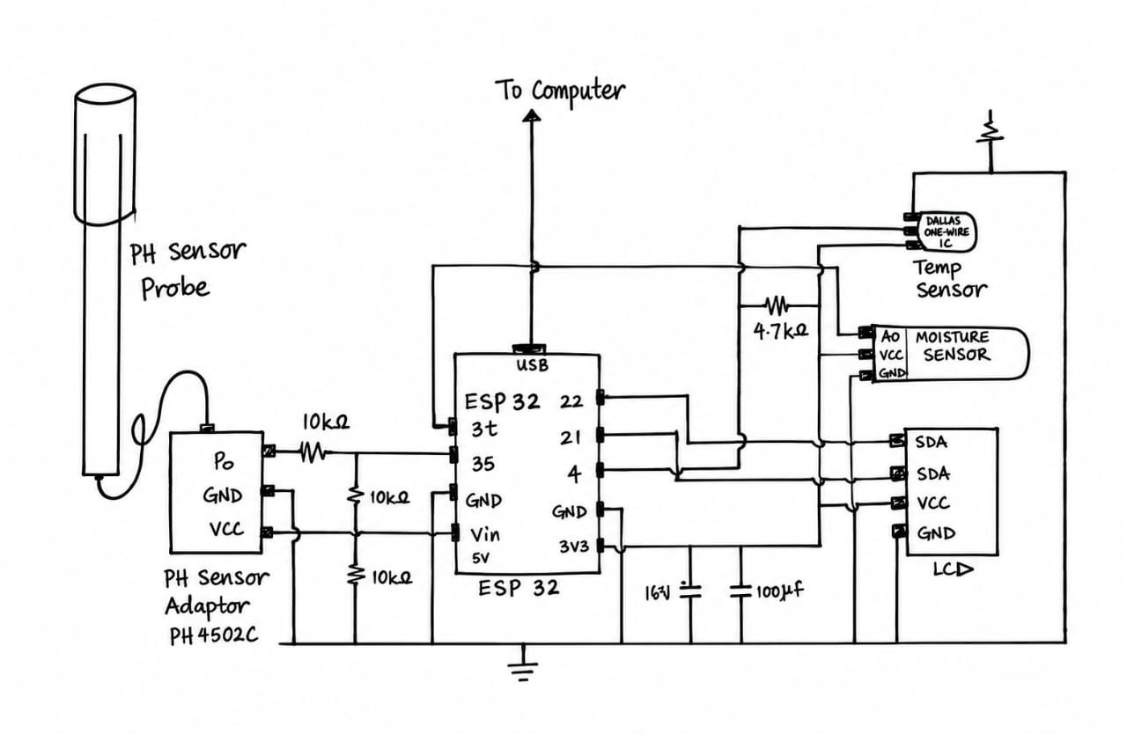
HARDWARE BUILD
06
The build is modular: each part has one job
Keeping sensing, conditioning and display roles separate makes the system easier to debug and maintain.
SENSE
Capacitive moisture v1.2
Analogue soil-water proxy · GPIO34
SENSE
DS18B20
Digital temperature · GPIO4 · 4.7 kΩ pull-up
CONDITION
PH4502C
Conditions the pH electrode signal · 0–5 V stage
PROTECT
10 kΩ / 20 kΩ divider
Scales pH output before GPIO35
DISPLAY
SH1106 1.3″ OLED
Reference circuit diagram from the original build
Shared I²C local display
POWER
LM2596 + capacitors
BUILD PRINCIPLE
Dedicated 5 V rail + transient buffering
Sensors produce signals; the controller never has to “guess” what a pin is supposed to mean.
SOIL MONITORING FOR SMART AGRICULTURE
EEG 323 • Group 2 • University of Lagos

Slide 7
SIGNAL & POWER INTEGRITY
07
The final build depends on clean signal paths
Most of the engineering detail sits between the sensor output and the ESP32 ADC.
pH SIGNAL PATH
FINAL WIRING CHECK
PH4502C
10 kΩ
20 kΩ
ESP32
GPIO35
Moisture → GPIO34 analogue
✓
✓
DS18B20 DATA → GPIO4
The divider scales the 0–5 V conditioned signal to an ESP32-safe range near 0–3.3 V while preserving the linear relationship used for calibration.
✓
pH → divider → GPIO35
✓
OLED uses shared I²C lines
✓
pH front-end gets dedicated 5 V
OTHER PROTECTION / STABILITY DETAILS
✓
ESP32 logic remains at 3.3 V
4.7 kΩ
100 µF
100 nF
DS18B20 1-Wire pull-up
Rail reservoir
High-frequency decoupling
This separation is what stopped Wi-Fi activity from disturbing the analogue pH measurement.
SOIL MONITORING FOR SMART AGRICULTURE
EEG 323 • Group 2 • University of Lagos

Slide 8
FIRMWARE
08
Firmware turns raw signals into readable soil status
The main loop runs once per second while calibration, averaging and history buffers make the output more useful than a raw ADC value.
1
ACQUIRE
2
CALIBRATE
3
CLASSIFY
4
BUFFER
5
DISPLAY
Sensors → raw values
Raw ADC → engineering
units
Moisture / pH → plain
language
5 seconds + 1 hour history
OLED + local dashboard
MAIN LOOP · ~1 SECOND
CALIBRATION FORMULAS
1
Read DS18B20 temperature
Moisture % = (ADCraw − ADCair) ÷ (ADCwater − ADCair) × 100
2
Read moisture ADC → percentage
3
Read pH from 20 averaged samples
pH = 7.0 − (ADCraw − ADCpH7) × 4.5 ÷ (ADCpH2.5 − ADCpH7)
4
Update OLED and dashboard variables
The calibration points are measured on the actual sensors used in the build.
5
Log to the 5-second and 1-hour buffers
SOIL MONITORING FOR SMART AGRICULTURE
EEG 323 • Group 2 • University of Lagos

Slide 9
USER INTERFACE
09
The system works without a PC or router
A local OLED gives immediate feedback; the ESP32 soft AP provides a browser dashboard to phones and laptops.
SH1106 OLED
BROWSER DASHBOARD
SMART_SOIL_MONITOR
SMART SOIL MONITOR
Join the ESP32 access point from Android, iOS or Windows and open the captive portal.
TEMP 27.7°C
MOIST 41%
pH 9.29
27.7 °C
41 %
9.29
TEMPERATURE
MOISTURE
PH
LOCAL DISPLAY · NO APP REQUIRED
24-HOUR HISTORY
5-SECOND BUFFER
NO INTERNET
SOIL MONITORING FOR SMART AGRICULTURE
EEG 323 • Group 2 • University of Lagos

Slide 10
DATA INTERPRETATION
10
The firmware explains the measurement
Calibration anchors raw ADC values to known conditions, then the classification layer makes the result understandable at a glance.
MOISTURE CALIBRATION
pH CALIBRATION
PLAIN-LANGUAGE CLASSIFICATION
AIR
WATER
pH 7.0 ADC
pH 2.5 ADC
MOISTURE
< 30%
DRY
2469
752
2975
3790
MOISTURE
30–70%
GOOD
MOISTURE
≥ 70%
WET
41 % → GOOD
9.29 → ALKALINE
pH
< 6.5
ACIDIC
The same mapping is applied continuously to the live ADC reading.
Twenty samples are averaged before the pH value is updated.
pH
6.5–7.5
NEUTRAL
pH
> 7.5
ALKALINE
ACTIONABLE STATUS
SOIL MONITORING FOR SMART AGRICULTURE
EEG 323 • Group 2 • University of Lagos

Slide 11
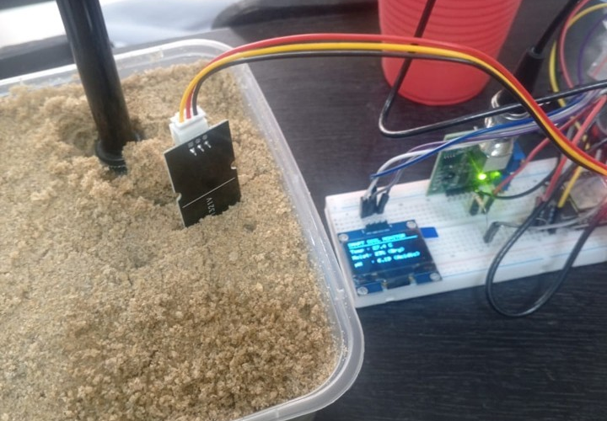
RESULTS
11
Bench testing shows the complete signal chain working
The final build produced stable live values, calibrated classifications and a much faster acquisition loop.
27.7 °C
41 %
9.29
187 ms
TEMPERATURE
MOISTURE
SOIL pH
CONVERSION TIME
Stable at 0.25 °C resolution
Classified “Good” from calibrated endpoints
Classified “Alkaline” from pH 7 and 2.5 points
Down from ~750 ms after using 10-bit DS18B20 resolution
TEST SETUP
WHAT THE RESULT MEANS
Bench testing used the completed sensor assembly and compared the live values produced by the firmware against the intended calibrated behaviour.
The important result is not a single “perfect” number. It is that the complete chain — sensor → conditioning → ESP32 → classification → interface — remains coherent and
usable in operation.
LIVE
CALIBRATED
OFFLINE
SOIL MONITORING FOR SMART AGRICULTURE
EEG 323 • Group 2 • University of Lagos

Slide 12
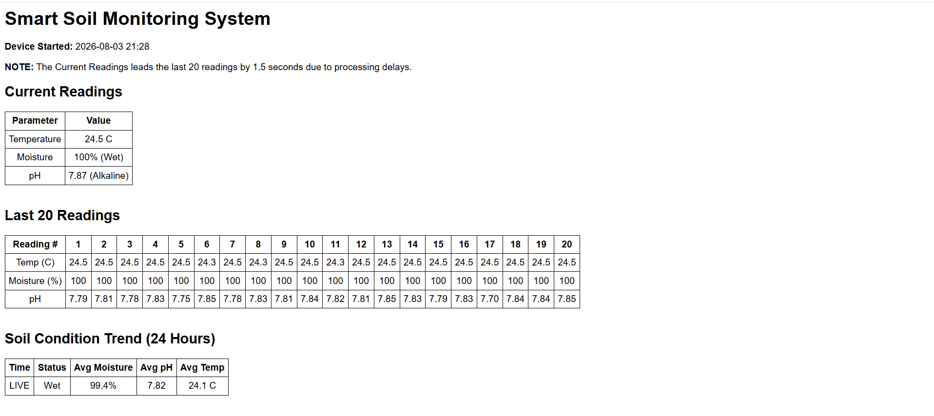
LIVE DASHBOARD
11
The finished system turns sensor readings into usable data
The ESP32 dashboard exposes the current state, recent samples and a longer-term trend view for practical decisions.
DATA APPLICATIONS
1
CURRENT STATE
24.5 °C · 100% moisture (Wet) · pH 7.87 (Alkaline)
SHORT-TERM HISTORY
2
The last 20 readings expose stability and variation before a decision is made.
TREND + DECISION
3
The 24-hour buffer can reveal drying, pH movement or temperature changes over time.
LIVE
OFFLINE
LOCAL
EXAMPLE CAPTURE • ESP32 LOCAL WEB DASHBOARD
SOIL MONITORING FOR SMART AGRICULTURE
EEG 323 • Group 2 • University of Lagos

Slide 13
APPLICATIONS
13
Where the finished system can be used
The current build is especially suited to situations where local measurements and immediate interpretation are more useful than a remote infrastructure stack.
1
Irrigation decisions
2
Crop management
Use live moisture status to support when-to-water decisions rather than relying only on visual judgement.
Track temperature and pH alongside moisture to build a more complete picture of the root-zone environment.
3
Offline field monitoring
4
Prototype platform
Operate from the ESP32’s local display and Wi-Fi soft AP without a router, internet connection or phone app.
Extend the same architecture with automatic irrigation, more sensor nodes, longer-term logging or additional soil measurements.
NEXT EXTENSIONS
AUTO IRRIGATION
SOLAR + BATTERY
ESP-NOW / LORA
SD / CLOUD LOGGING
NPK SENSING
MOBILE ALERTS
SOIL MONITORING FOR SMART AGRICULTURE
EEG 323 • Group 2 • University of Lagos

Slide 14
GITHUB COMPANION
14
A project page should show more than the firmware
The code explains how the controller behaves; this deck explains why the hardware, calibration and user interface were built that way.
HARDWARE
FIRMWARE
VALIDATION
APPLICATION
What each sensor does
Why the signal is compatible
Where protection is required
Acquisition order
Calibration equations
Classification + buffering
Measured values
Conversion-time improvement
Faults that were fixed
How a farmer would use it
What “offline” means
How the platform can grow
REPOSITORY CONTENTS:
Build overview, Wiring , Firmware, Calibration , Test Results , Applications.
SOIL MONITORING FOR SMART AGRICULTURE
EEG 323 • Group 2 • University of Lagos

Slide 15
CONCLUSION
15
The system met its core objectives
CORE BUILD
1
Real-time moisture, temperature and pH monitoring in a low-cost embedded build.
2
Calibrated conversion from raw sensor outputs into interpretable soil status.
ESP32
+
3 sensor inputs
+
local display
+
local dashboard
3
Safe pH voltage matching, dedicated 5 V power and decoupling for stable analogue behaviour.
4
Local OLED + Wi-Fi dashboard with 24-hour history and no router, internet connection or app.
A compact instrumentation project with a complete sensing → processing → interface pipeline.
From raw voltage to an actionable soil reading.

Slide 16
Thank you
Soil Monitoring for Smart Agriculture
A practical embedded instrumentation project built to make soil conditions measurable, visible and usable.
Group 2 · EEG 323 Instrumentation and Measurement II
Department of Electrical and Electronics Engineering · University of Lagos

