Slide 1

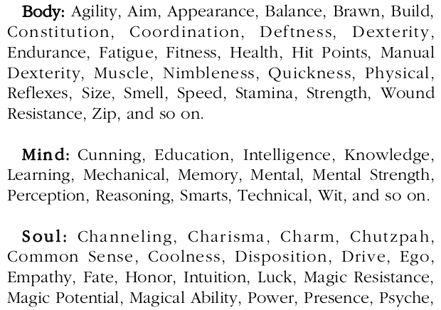

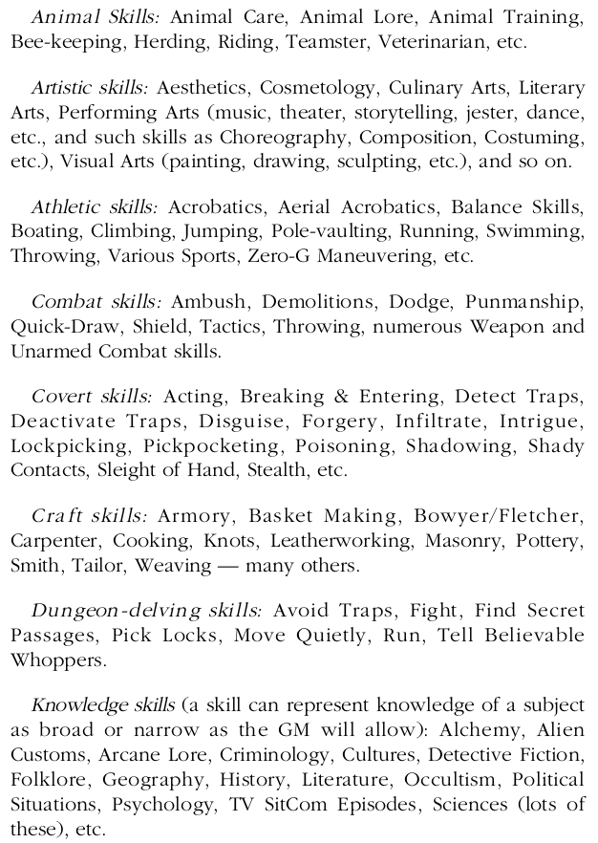
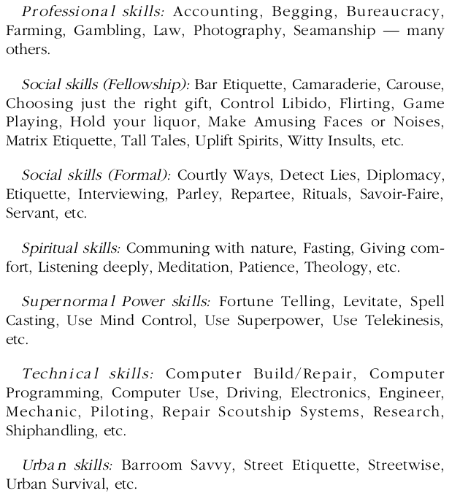
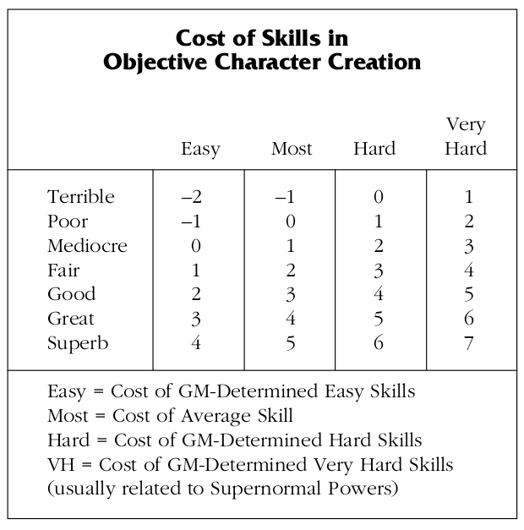
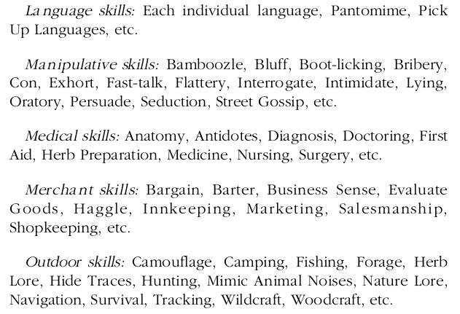
+3 | Superb | Fantastique
+2 | Great | Excellent
+1 | Good | Bon
0 | Fair | Correct
-1 | Mediocre | Médiocre
-2 | Poor | Mauvais
-3 | Terrible | Lamentable
For Supernormal Powers, 1 skill level is required to reach Terrible
and each level afterwards costs 2 skill levels

Slide 2
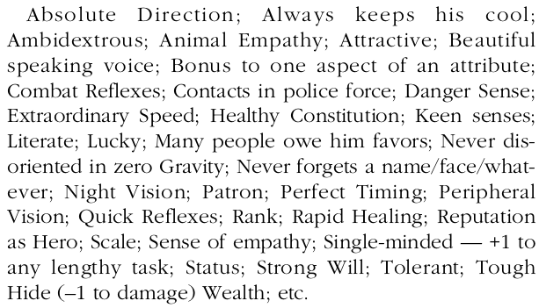
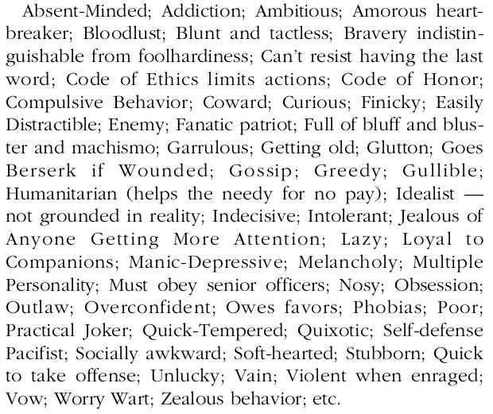
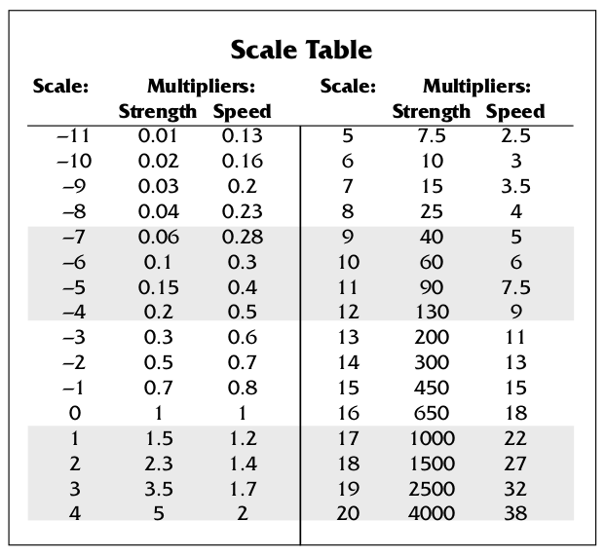
Gifts
Faults
Fudge Points
Fudge Points (FP) | 1 to 5 per session
 | 1 FP = 1-3 EP
Sample of use | Unopposed action successful with panache
 | Alter a result one level up and down
 | One wound is just a scratch
 | Automatic +4 in opposed actions
Default
Attributes | Fair
Skills | Poor (for most)
 | Terrible (for hard ones)
(See previous page) | Terrible -1 for magic or hardcore skills
PC Creation
Powers
Attribute levels | Nb of attributes/2 rounded up
Skill levels | For Extremely Broad Skill Groups: 15 levels max
 | For Moderately Broad Skill Groups: 30 levels max
 | For Specific Skills: 40 to 60 levels
1 Supernormal power | 2 gifts per level of power
Trade
1 fault | = | 1 gift
1 fault | = | 2 attribute levels
1 fault | = | 6 skills levels
1 attribute level | = | 3 skills levels
1 gift | = | 6 skill levels
1 gift | = | 2 attributes levels

