Slide 1
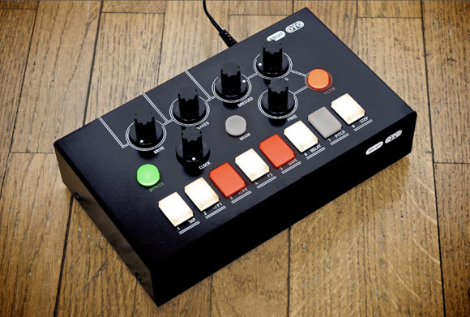
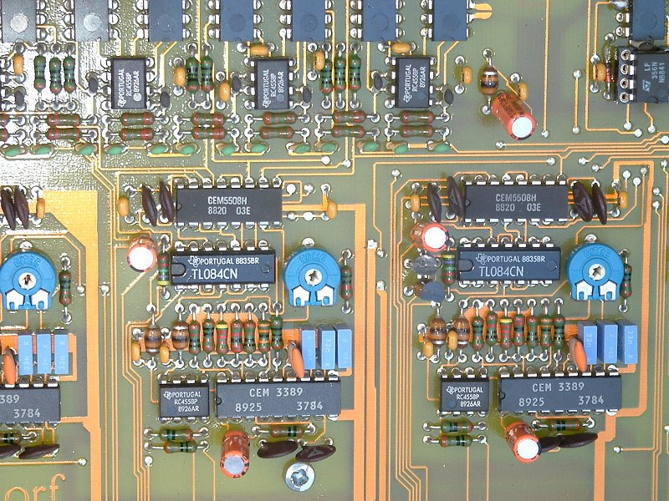
TOPIC
Realization Of Analog Lowpass Filters

Slide 2
Name Rahul Khanna Registration no. 13BEC0700 Subject Analog Circuit Design Slot A1
Submitted To Prof. Kumaravel S.

Slide 3
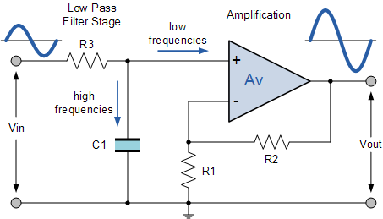

Analog Filters
Technically,c ircuits which perform signal processing functions
Main fuction to remove unwanted frequency components from the signal, to enhance wanted ones, or both
On the basis of implementation filters are of two types active filters or passive filters.

Slide 4
Passive Filters
Realized using only passive or lossless circuit elements , i.e. resistors, capacitors, transformers, gyrators and inductors
The number of elements determines the order of the filter
These elements cannot increase the signal energy, inductors and capacitors are the reactive elements of the filter

Slide 5
Active Filters
Realized using the passive and active components
Active components provide the amplifying action to the input signals
They were introduced to replace inductors due to their undesirable properties
non-linearity
losses
large physical size, weight
they are only possible to integrate for very high frequencies

Slide 6
Analog Filters Realization :Active Lowpass Filters
Ideal lowpass filters cannot be realized
approximation of ideal frequency response shoud be applied
filter specification contains all relevant performance requirements in terms of acceptable bounds within measurable quantities
Specifications contains bounds on acceptable passband ripple, stopband attenuation, cutoff frequency ,temperature range etc
frequency response (ratio of fourier transform of output and input signal) is such description
Description means specifyinf the system properties by using only input and output signals

Slide 7
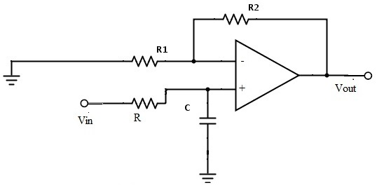
Butterworth Filters
Butterworth filter is a type of signal processing filter designed to have as flat a frequency response as possible in the passband.
Also referred to as a maximally flat magnitude filter. I
It gives the mathematically simplest and therefore most common approximation.

Slide 8
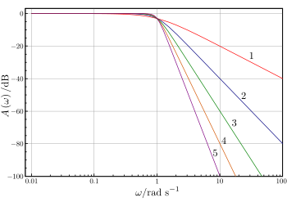
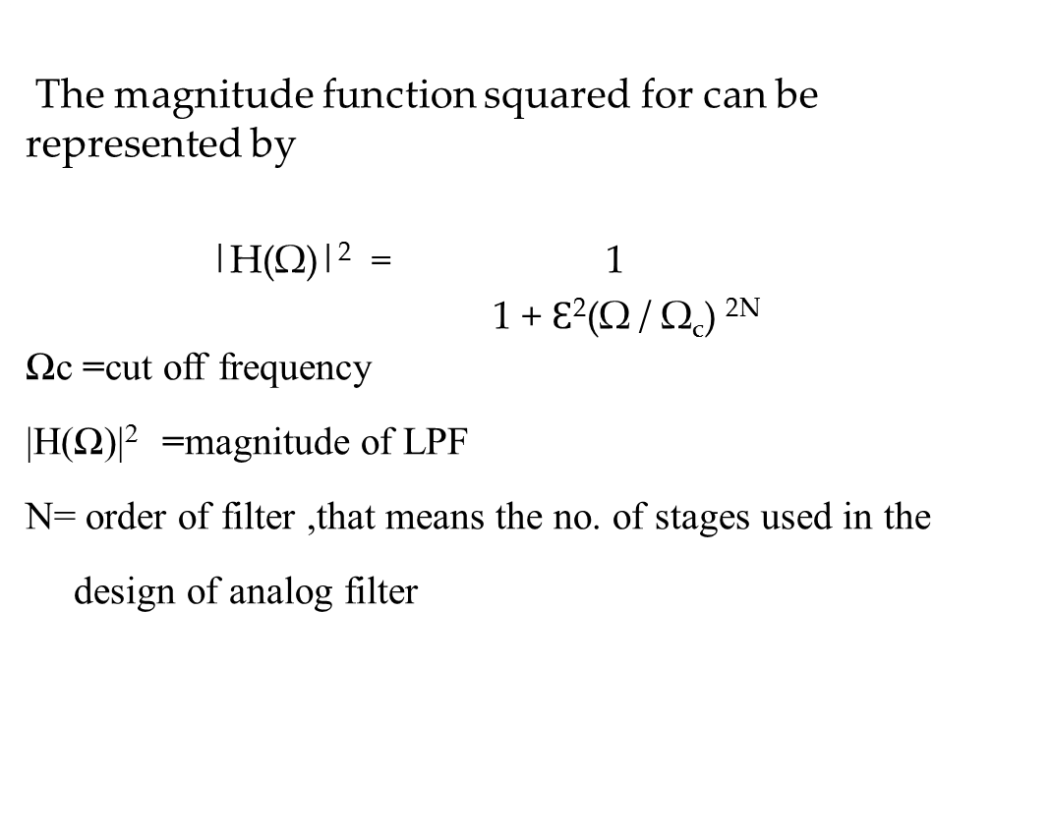
Butterworth Filters
The magnitude function squared for can be represented by
|H(Ω)|² = 1
1 + $Ɛ$²(Ω / Ω_{c}) ^{2N}
Ωc =cut off frequency
|H(Ω)|² =magnitude of LPF
N= order of filter ,that means the no. of stages used in the
design of analog filter

Slide 9
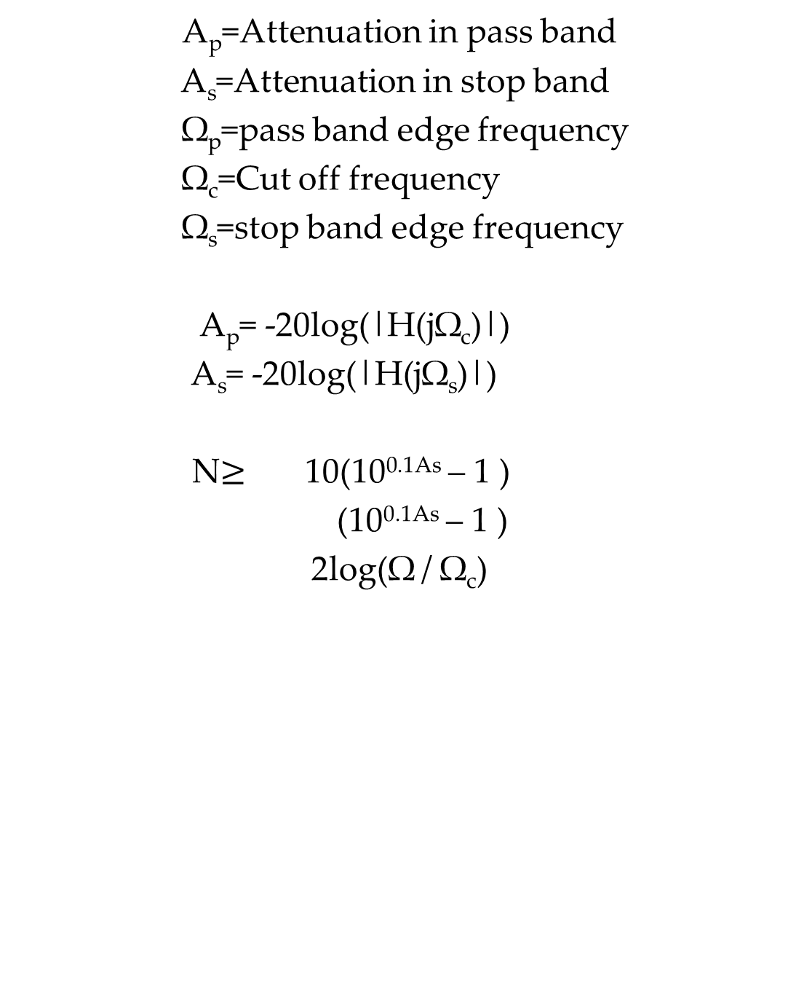
A_{p}=Attenuation in pass band
A_{s}=Attenuation in stop band
Ω_{p}=pass band edge frequency
Ω_{c}=Cut off frequency
Ω_{s}=stop band edge frequency
A_{p}= -20log(|H(jΩ_{c})|)
A_{s}= -20log(|H(jΩ_{s})|)
N$≥$ 10(10^{0.1As} – 1 )
(10^{0.1As} – 1 )
2log(Ω / Ω_{c})

Slide 10

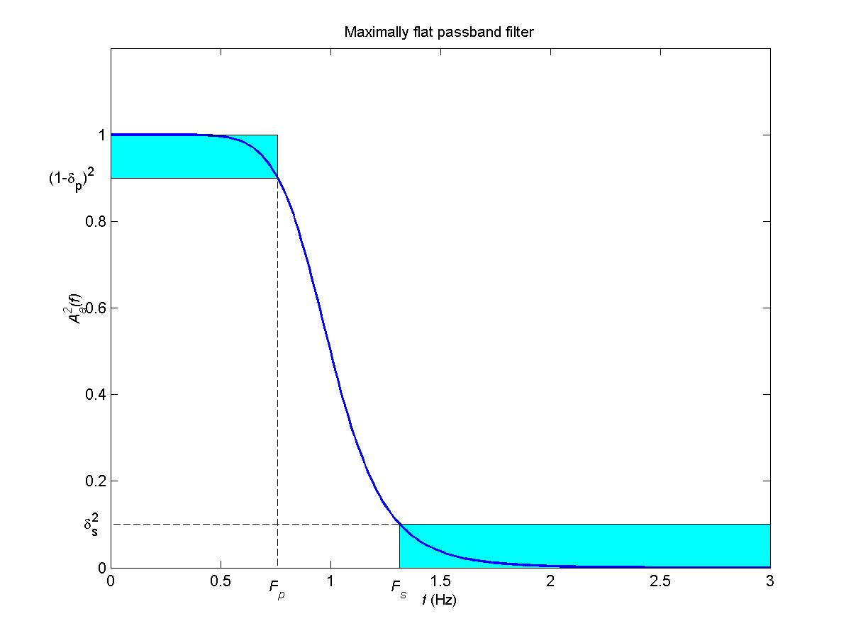
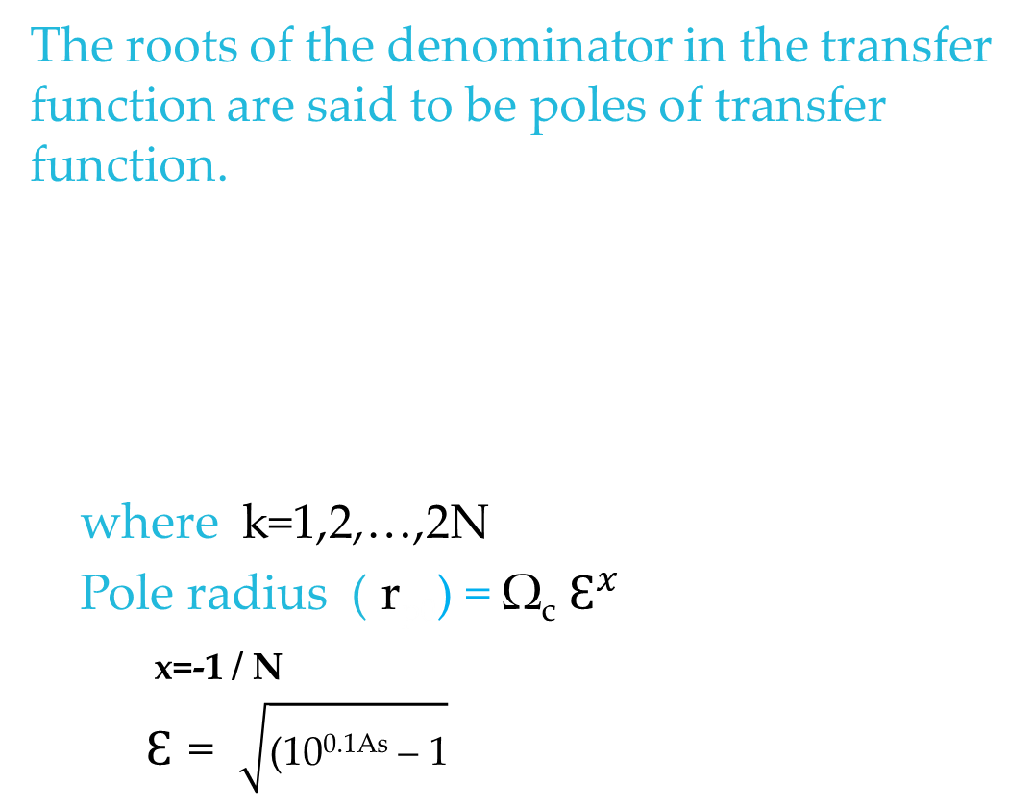
The roots of the denominator in the transfer function are said to be poles of transfer function.
where k=1,2,…,2N
Pole radius ( r_{p0}) = Ω_{c} $Ɛ^{x}$
_{x=-1 / N}
$Ɛ$ = $\sqrt{\text{(10}\text{0.1}\text{As}\text{ – 1}}$

Slide 11
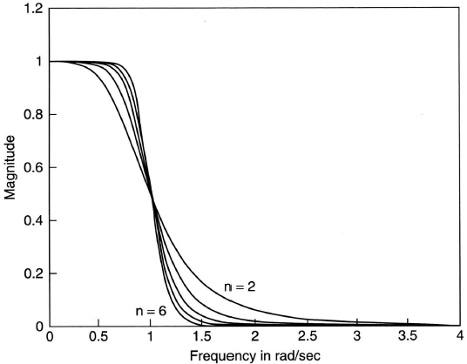
General response of butterworth filter

Slide 12
Chebyshev Type I Filter
Butterworth filter does not use the allowed passband tolerance efficiently
For a Chebyshev I filter, the magnitude function varies between the two tolerance bounds
Above means that filter has equiripple variation,i.e.,the error oscillates with equal peaks across the magnitude response in the passband
An equiripple error is optimal in the Chebyshev sense.
The magnitude function squared for chebyshev type I filter is represented by
|H(Ω)|² = 1
1 + Ɛ² (Ω / Ω_{c}) ^{2N} T²_{n}

Slide 13




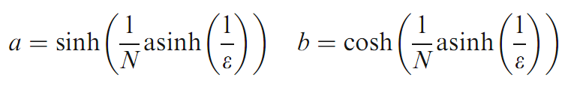
T_{n} is the Nth order chebyshev polynomial and is given by
With T₀(x)=1 , T₁(x)=x
The poles are given by
Where k=1,2,3….N
And

Slide 14
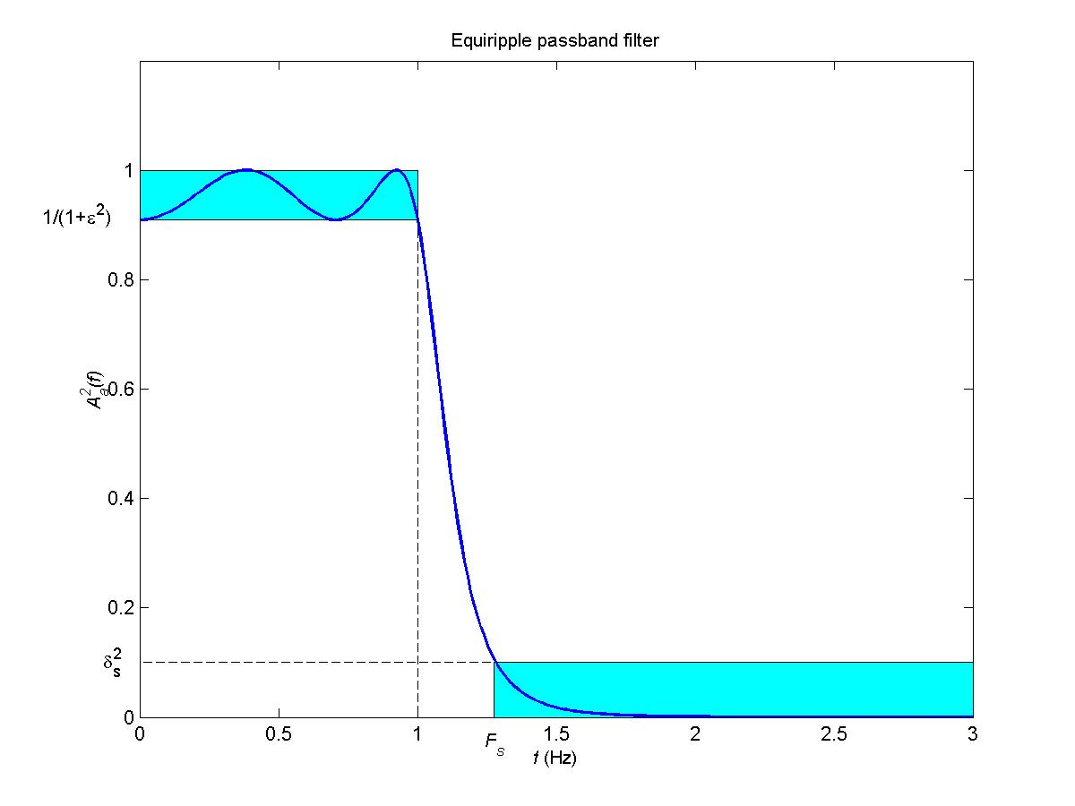
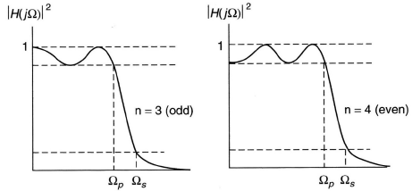
General response of chebychev type I filter

Slide 15
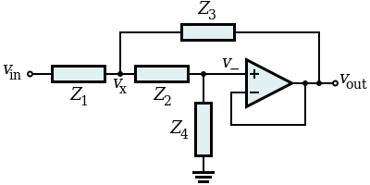
Circuit Diagrams(using Sallen Key Topology)
The Sallen–Key topology is an electronic filter topology used to implement second order active filters that is particularly valued for its simplicity.
It is a degenerate form of a voltage-controlled voltage-source (VCVS) filter topology.
A VCVS filter uses a super unity gain voltage amplifier with practically infinite input impedance and zero output impedance to implement a 2 pole (12 dB/octave) lowpass , highpass or bandpass response.

Slide 16
By choosing different passive components
(e.g., resistors and capacitors) for Z1,Z2
,Z3 and Z4 the filter can be made with
lowpass , highpass or bandpass
characteristics

Slide 17
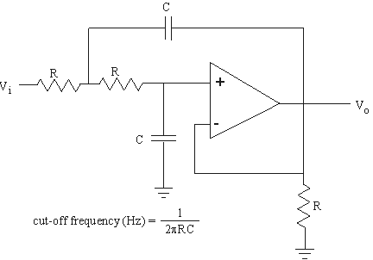
Butterworth filters
First order butterworth
filter
Second order butterworth
filter

Slide 18
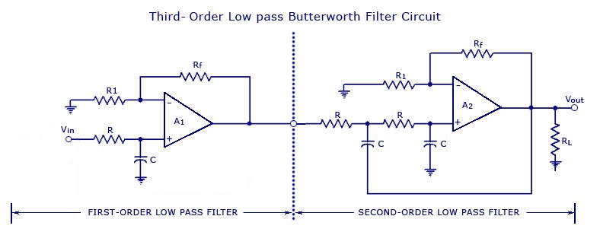
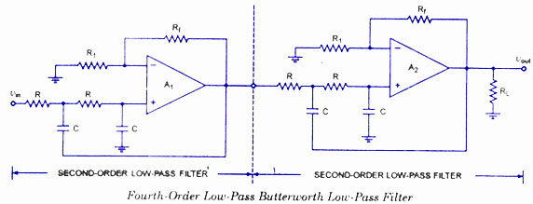
Other order butterworth filters can be realized from first and second order filters
3 order
filter
4 order
filter

Slide 19
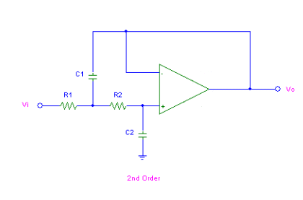
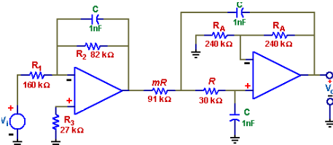
Chebyshev Type I Filters
Second order chebyshev
type I filter
Third order chebyshev
type I filter

Slide 20
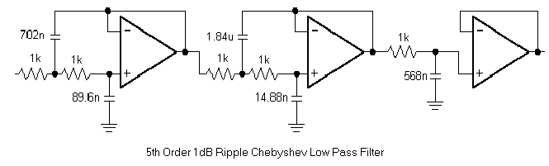
Fifth order chebyshev
type I filter

Slide 21


