Slide 1
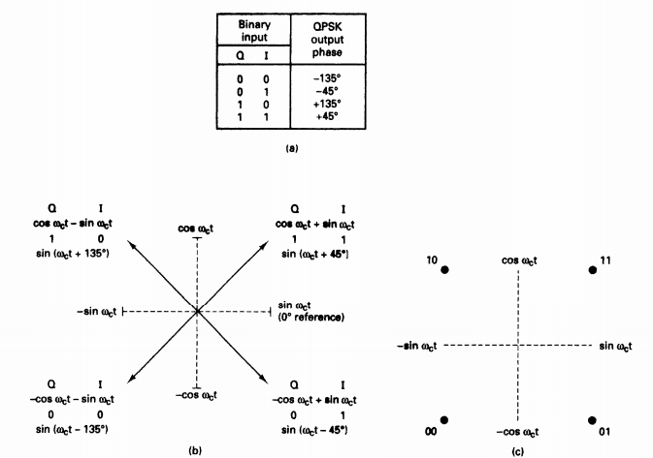
TOPIC
QPSK and OQPSK MODULATION TECHNIQUES

Slide 2
Name Rahul Khanna Registration no. 13BEC0700 Subject Digital Communication Slot B1
Submitted To Prof. Rajesh A.

Slide 3

Modulation Techniques
Employed in telecommunications transmission systems whereby an electromagnetic signal(the modulating signal) is encoded into one or more of the characteristics of another signal (the carrier signal) to produce a third signal (the modulated signal), whose properties are matched to the characteristics of the medium over which it is to be transmitted.
The encoding preserves the original modulating signal in that it can be recovered from the modulated signal at the receiver by the process of demodulation.

Slide 4
Purposes of Modulation
Efficient radiation of electromagnetic
the antenna from which the signal is being radiated should be of the order of one-tenth or more the wavelength of the wavelength of the signal radiated.
In case of multiple base-band signals, the wavelengths are too large for reasonable antenna dimensions
In order to transmit this signal a huge antenna of the order of at least 10km would be required which is impractical. Instead, we modulate a high frequency carrier, this translating the signal spectrum to the region of carrier frequencies that corresponds to a much smaller wavelength.

Slide 5
PSK
PSK uses a finite number of phases, each assigned a unique pattern of binary bits.
Each pattern of bits forms the symbol that is represented by the particular phase.
The demodulator, which is designed specifically for the symbol-set used by the modulator, determines the phase of the received signal and maps it back to the symbol it represents, thus recovering the original data.
This requires the receiver to be able to compare the phase of the received signal to a reference signal thus erecting a system which is termed coherent.
The demodulator then determines the changes in the phase of the received signal rather than the phase itself.

Slide 6
QPSK
QPSK is an M-ary encoding scheme where N = 2 and M= 4 (hence, the name "quaternary" meaning "4").
A QPSK modulator is a binary (base 2) signal, to produce four different input combinations,00, 01, 10, and 11.
Therefore, with QPSK, the binary input data are combined into groups of two bits, called dibits.
In the modulator, each dibit code generates one of the four possible output phases (+45°, +135°, -45°, and -135°).

Slide 7
QPSK Transmitter
Two bits (a dibit) are clocked into the bit splitter.
After both bits have been serially inputted, they are simultaneously parallel outputted.
The I bit modulates a carrier that is in phase with the reference oscillator
The Q bit modulates a carrier that is 90 deg out of phase with the reference oscillator
the outputs are
I balanced modulator =(-1)(sin ωct) = -1 sin ωct
Q balanced modulator =(-1)(cos ωct) = -1 cos ωct
The highest fundamental frequency at the input and fastest rate of change at the output of the balance modulators is equal to one-fourth of the binary input bit rate.
The output frequency spectrum extends from f' c + fb / 4 to f' c - fb / 4 and the minimum bandwidth (f N) is fb/2

Slide 8
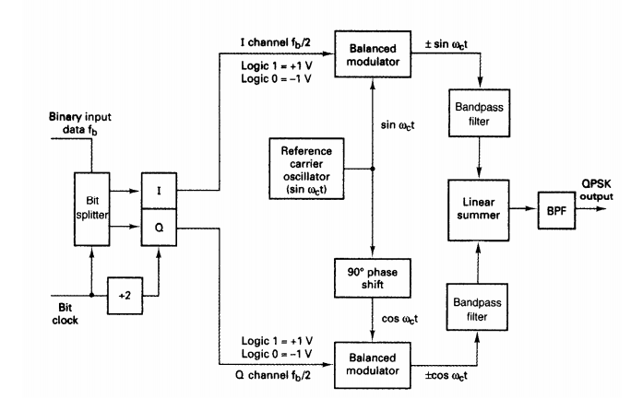
QPSK Transmitter

Slide 9
QPSK Receiver
The power splitter directs the input QPSK signal to the I and Q product detectors and the carrier recovery circuit.
The carrier recovery circuit reproduces the original transmit carrier oscillator signal. The recovered carrier must be frequency and phase coherent with the transmit reference carrier.
The QPSK signal is demodulated in the I and Q product detectors, which generate the original I and Q data bits.
The outputs of the product detectors are fed to the bit combining circuit, where they are converted from parallel I and Q data channels to a single binary output data stream.

Slide 10
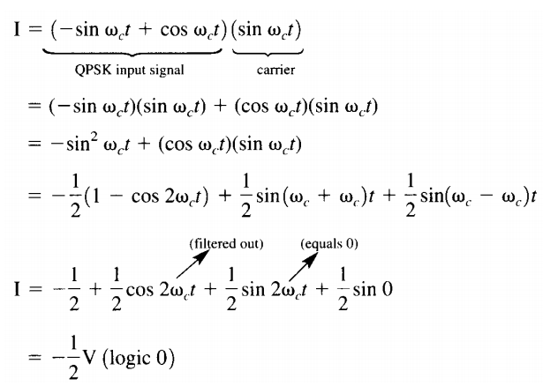
QPSK Receiver
The output of the I product detector is

Slide 11
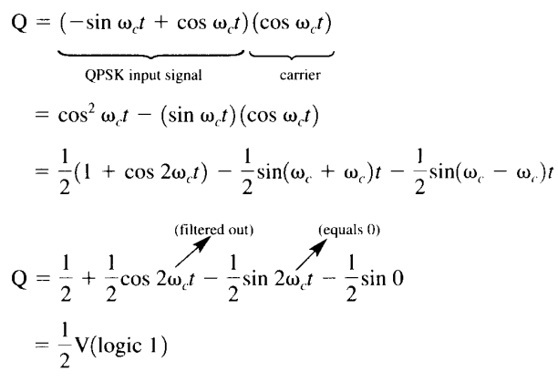
QPSK Receiver
The output of the Q product detector is

Slide 12
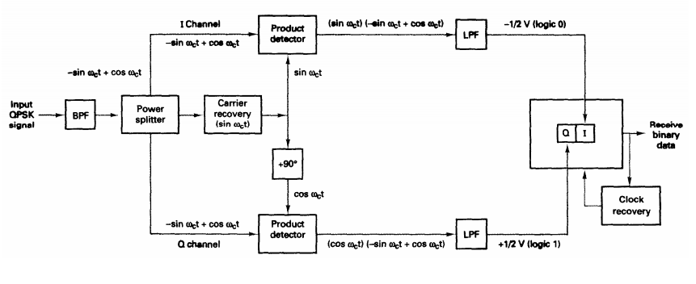
QPSK Receiver

Slide 13
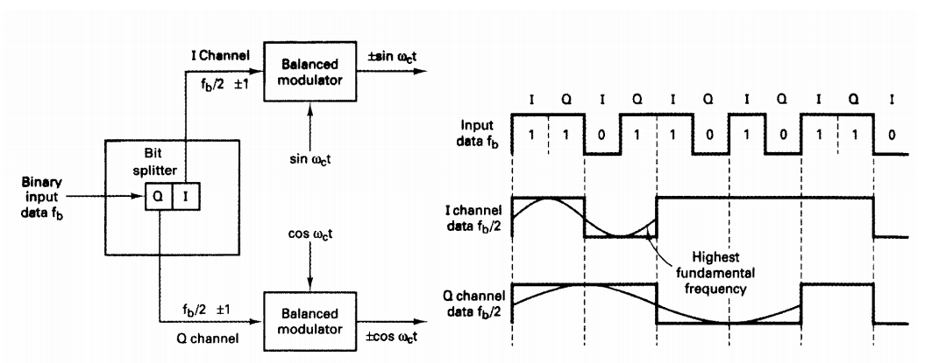
QPSK

Slide 14
QPSK
MATLAB CODE ALGORITHM
Input the sequence
Define the bit time and according to it sample the sequence
Now define the carrier signal
Change the phase of the carrier signal after 2 consecutive bits
The resultant signal is Qpsk signal
Now , compare the Qpsk signal with the carrier signal (at about 1.999 of the bit time ) .Comparison would give the difference in phase
From the knowledge of phase of each symbol the decision can be made
Arrange the symbols and the newly generated sequence is the recovered signal

Slide 15
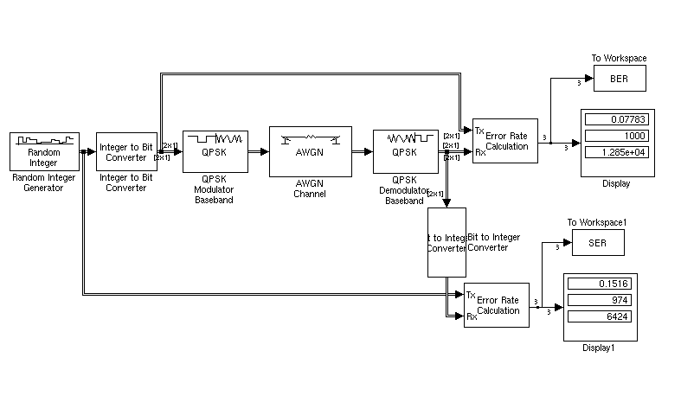
QPSK
MATLAB Simulink

Slide 16
OQPSK
Offset QPSK (OQPSK) is a modified form of QPSK where the bit waveforms on the I and Q channels are offset or shifted in phase from each other by one-half of a bit time.
Because changes in the I channel occur at the midpoints of the Q channel bits and vice versa, there is never more than a single bit change in the dibit code and, therefore, there is never more than a 90° shift in the output phase.
In conventional QPSK, a change in the input dibit from 00 to 11 or 01 to 10 causes a corresponding 180° shift in the output phase.
Therefore, an advantage of OQPSK is the limited phase shift that must be imparted during modulation.

Slide 17
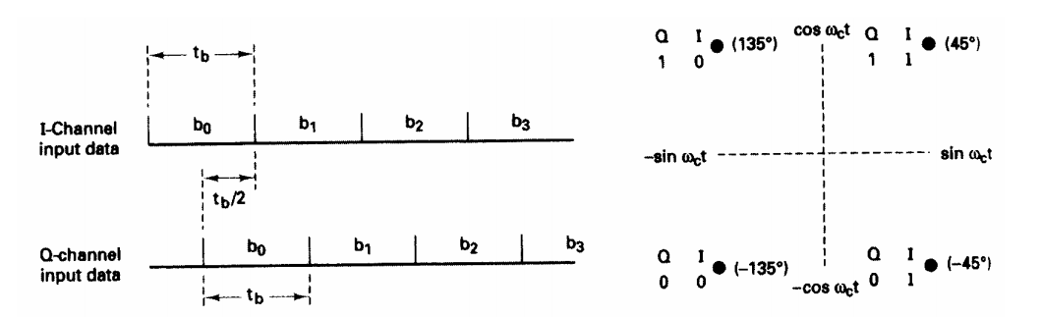
OQPSK
A disadvantage of OQPSK is that changes in the output phase occur at twice the data rate in either the I or Q channel".
Consequently, with OQPSK the baud and minimum bandwidth are twice that of conventional QPSK for a given transmission bit rate.
OQPSK is sometimes called OKQPSK (offset-keyed QPSK).

Slide 18
OQPSK
MATLAB CODE ALGORITHM
Input the sequence
Define the bit time and according to it sample the sequence
Now define the carrier signal
Delay the quadrature component by one bit time
The resultant signal is OQpsk signal
Now , find 1st bit by putting q(t)=0 at t=tb/2 and last bit putting i(t) =0 at t=tb*n+tb/2
Now use 1st bit to find the rest of the sequence
For i(t) at t=tb/2+tb and q(t) = tb –tb/0.99
Arrange the symbols and the newly generated sequence is the recovered signal

Slide 19
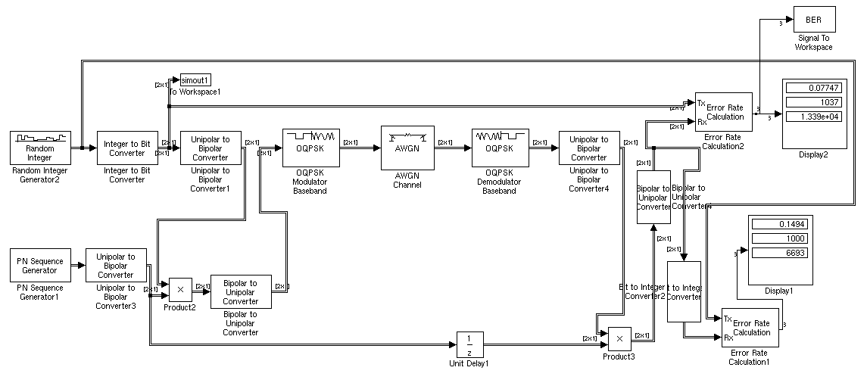
OQPSK

Slide 20
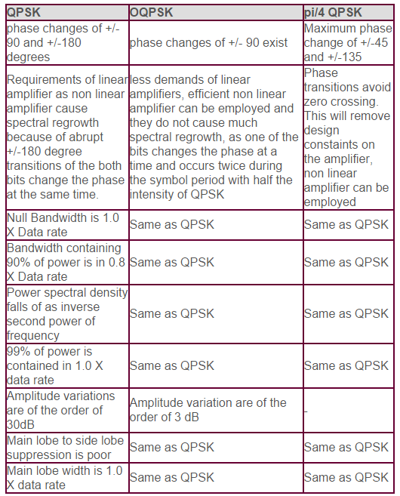
CONCLUSION

Slide 21
REFERENCES
Ender Bolat .―STUDY OF OFDM PERFORMANCE OVER AWGN CHANNELS .Electrical and Elctronic Engineering Department Eastern Mediterranean University
An Introduction to Orthogonal Frequency Division Multiplex
The various functions and examples available at www.mathtools.net
Glover Grant’s ,”digital commmuunication”,2nd edition
Jain, Raj, ”Channel Models A Tutorial1,” http://www.cse.wustl.edu/ jain/cse574- 08/ftp/channel˙model˙tutorial.pdf, 2007

Slide 22


