Slide 1

The ORFEO Toolbox Extreme Tutorial
  J. Inglada, CNES
  Adapted from L. Ibáñez's ITK Extreme Tutorial

Slide 2

Goals: make easier the
  development of new algorithms,
  their validation,
  their capitalisation
  development of tools for the users of the ORFEO system
CNES is responsible for specification and validation
Source code available for the labs, the users and the AVC

Slide 3
C++ library based on existing OS software
OTB
OTB Applications
External
User
libs
OTB Utilities
OTB library
Developer

Slide 4
External libs :
  ITK (segmentation and registratio)
  VTK (visualisation)
  FLTK (GUI)
  LibSVM (supervised lerning and classification)
  CAI and GDAL (image IO)
  MegaWave2

Slide 5
Library (v.1.0)
  IO
  Visualisation
  Image features and descriptors
  Change detection
  Supervised learning

Slide 6
Orfeo Toolbox
Utilities (v.1.0)
  QL generation
  ROI extraction
  Meta-data access
  Pseudo-ortho-rectification
Applications (v.1.0)
  Visualisation (interactive)
  Supervised change detection

Slide 7
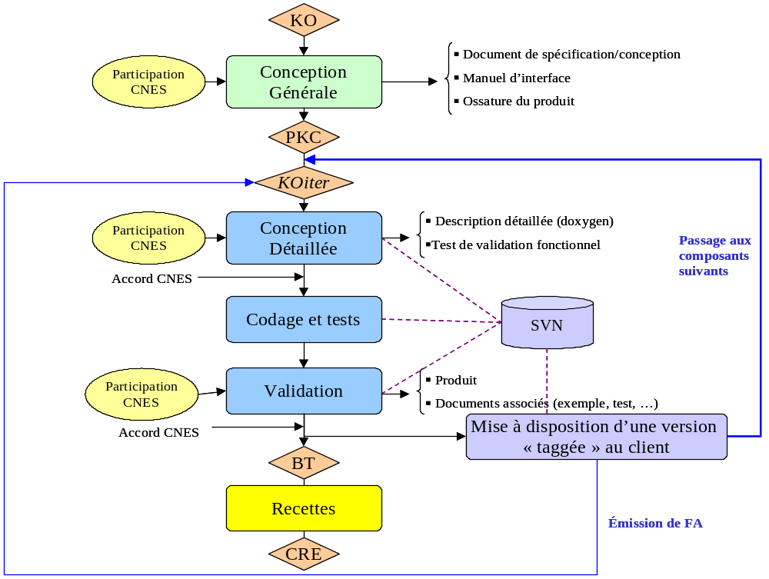
Extreme Programming

Slide 8
The Data Pipeline
Reader
Filter
Writer
File
File
Image
Image

Slide 9

Now, you know
OTB has a Data Pipeline architecture
Filters are connected together
The output image is own by each filter
Computation is performed on demand

Slide 10
OTB is
Not an Application
Not Graphical User Interface
Image Processing
Segmentation and Registration
Limited Visualization

Slide 11

OTB is
C++ Toolkit
Generic Programming
Templates

Slide 12
Generic Programming
Example: STL Standard Template Library
Abstraction of Types and Behaviors
std::vector< T >
std::vector< int >
std::vector< double >
std::vector< char * >
std::vector< Point >
std::vector< Image >

Slide 13
otb::Image
otb::Image< PixelType , Dimension >
otb::Image< char , 2 >
otb::Image< char , 3 >
otb::Image< char , 4 >
otb::Image< float , 2 >
otb::Image< RGB , 3 >
otb::Image< unsigned short , 2 >
otb::Image< itk::Vector<float,2> , 2 >

Slide 14
namespaces
Avoid naming collisions
otb::
itk::
itk::Statistics::
itk::fem::

Slide 15
The best way
to learn to play the drums is…
to play the drums
- Richard Feynman

Slide 16
Let's write some code
Hello World
Cmake
Hello World with image

Slide 17
Your favorite keyword
typedef
typedef otb::Image< char , 2 > ImageType;
typedef otb::ImageFilter< ImageType ,
ImageType > FilterType;
otherwise...
otb::ImageFilter< Image< char , 2 > ,
Image< char , 2 > > FilterType;

Slide 18
SmartPointers
Smart
Pointer
Smart
Pointer
Smart
Pointer
Object
counter=1
counter=2
counter=3

Slide 19
SmartPointers
typedef otb::Image< char , 2 > ImageType;
typedef otb::ImageFilter< ImageType ,
ImageType > FilterType;
FilterType::Pointer filter = FilterType::New();
ImageType::Pointer image = filter->GetOutput();
NO NEED FOR
filter->Delete();

Slide 20
Now, you know
OTB images are N-Dimensional
OTB has arbitrary pixel types
Dimension and pixel type must be defined at compile time

Slide 21
The simplest, yet useful program
#include “otbImage.h”
#include “otbImageFileReader.h”
#include “otbLeeImageFilter.h”
#include “otbImageFileWriter.h”
typedef otb::Image< unsigned char , 2 > ImageType;
typedef otb::ImageFileReader< ImageType > ReaderType;
typedef otb::LeeImageFilter<
ImageType, ImageType > FilterType;
typedef otb::ImageFileWriter< ImageType > WriterType;

Slide 22
The simplest, yet useful program
ReaderType::Pointer reader = ReaderType::New();
FilterType::Pointer filter = FilterType::New();
WriterType::Pointer writer = WriterType::New();
reader->SetFileName(“InputImage.png”);
filter->SetInput( reader->GetOutput() );
writer->SetInput( filter->GetOutput() );
writer->SetFileName(“OutputImage.png”);
writer->Update();

Slide 23
Exceptions
Error Management
Application Layer
Catch
ITK Layer
Throw

Slide 24
Exceptions
try
{
filter->Update();
}
catch( itk::ExceptionObject & exp )
{
std::cout << exp << std::endl;
}

Slide 25
OTB Goodies
Streaming / Threading
Transparent Image Format Handling
Iterators
Composite Filters
Frameworks
  Registration
  Change Detection
  Classification

Slide 26
Let’s Extract Features

Slide 27
Registration Framework
Registration Method
Fixed
Image
Metric
Optimizer
Interpolator
Moving
Image
Transform

Slide 28
Let’s Register
Run the demo application
ImageRegistration9
from the Bin directory of the ITK CD

Slide 29
Wrapping
Tcl
Python
Using CABLE

Slide 30
Wrapping Tcl Example
package require InsightToolkit
set reader [itk::create ImageFileReaderF2]
set laplacian [itk::create LaplacianImageFilterF2F2]
set rescaler [itk::create RescaleIntensityImageFilterF2US2]
set writer [itk::create ImageFileWriterUS2]
$laplacian SetInput [ $reader GetOutput ]
$rescaler SetInput [ $laplacian GetOutput ]
$writer SetInput [ $rescaler GetOutput ]

Slide 31
Wrapping Tcl Example
$rescaler SetOutputMinimum 0
$rescaler SetOutputMaximum 65535
$reader SetFileName “InputImage.png”
$writer SetFileName “OutputImage.png”
$writer Update

Slide 32
Enjoy OTB !

