Slide 1

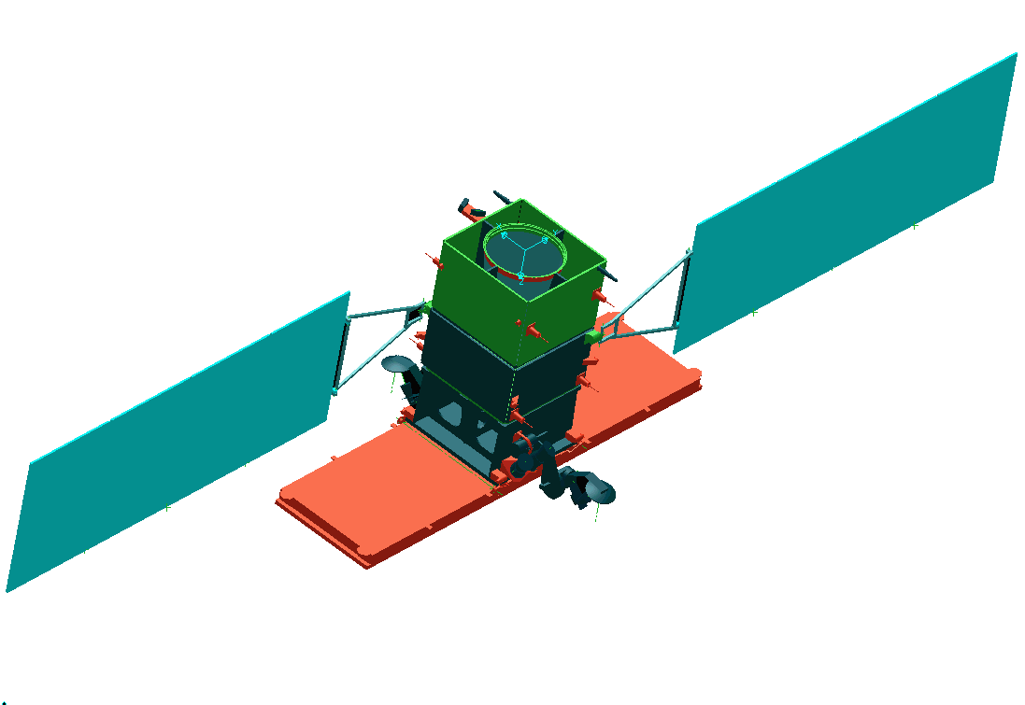
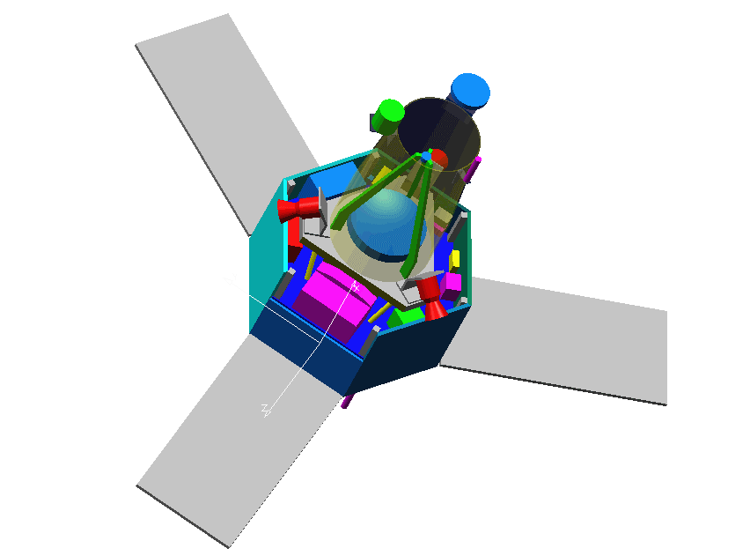
Title
  Author

Slide 2
What is ITK
Image Processing
Segmentation
Registration
No Graphical User Interface (GUI)
No Visualization

Slide 3
How to Integrate OTB in you application
C++ Glue Code
GUI
{MFC,Qt,
wxWin
FLTK}
OTB
Image
Processing
Visualization
{OpenGL, VTK}

Slide 4
What do I need ?
C++ Compiler
gcc 2.95 – 3.2
Visual C++ 6.0
Visual .NET
Intel 5.0
IRIX CC
Borland 5.0
Mac - gcc
CMake
www.cmake.org

Slide 5
Step 1. Download OTB
Stability
Release tar
files
Live on the
Edge
CVS
http://www.itk.org
Insight.tgz
CVS anonymous

Slide 6
Step 2. Download CMake
Latest
CMake
Release
OTB
Requires
http://www.cmake.org
Install
Binaries
Get the
Binaries
1.4.5

Slide 7


Step 3. Configure OTB
Source Tree
Binary Tree
Out
Source Build
OTB
OTBb
Recommended !
Common
Common
Algorithms
Algorithms
BasicFilter
BasicFilter
Numerics
In
Source
Build
Numerics
IO
IO

Slide 8
Step 3. Configure - Easy Start
Run CMake
Select the SOURCE directory
Select the BINARY directory

Slide 9
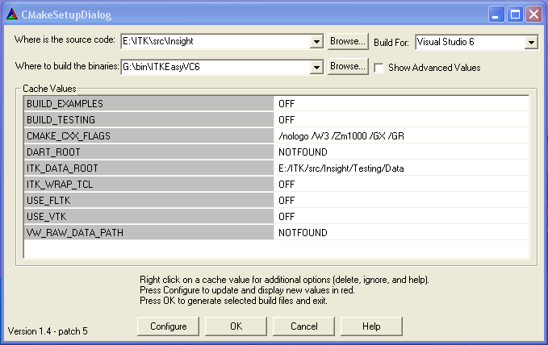
Step 3. Configure - Easy Start

Slide 10
Step 3. Configure - Easy Start
Disable BUILD_EXAMPLES
Disable BUILD_TESTING
Disable USE_FLTK
Disable USE_VTK
Disable ITK_WRAP_TCL

Slide 11
Step 3. Configure - Easy Start
Ignore CMAKE_CXX_FLAGS
Ignore DART_ROOT
Ignore OTB_DATA_ROOT
Ignore VW_RAW_DATA_PATH

Slide 12
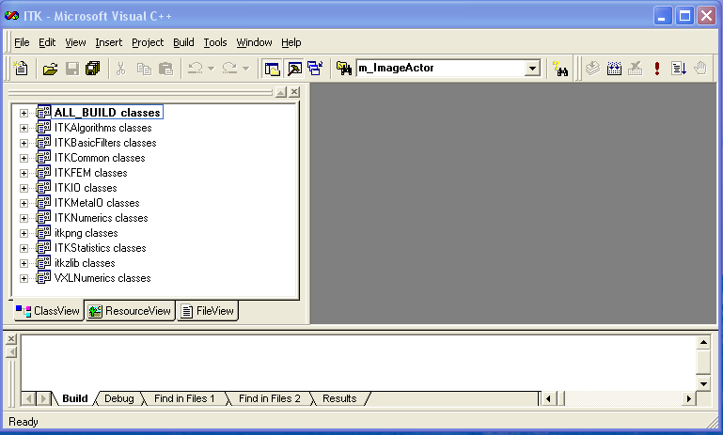
Step 4. Build OTB

Slide 13
Step 4. Build OTB
Open OTB.dsw in the Binary Directory
Select ALL_BUILD project
Build it
…It will take about 15 minutes …

Slide 14
Step 4. Build Project
Most of OTB classes are C++ Templates
Basic libraries are small
they only contain non-templated classes
Basic libraries are built in about 15 min

Slide 15
Step 5. Verify the Build
Libraries will be found in
OTB_BINARY / bin / { Debug, Release }

Slide 16
Step 5. Verify the Built
The following libraries should be there
ITKCommon
ITKBasicFilters
ITKAlgorithms
ITKNumerics
ITKFEM
ITKIO
ITKStatistics
VXLNumerics
itkpng
itkzlib
ITKMetaIO
OTBCommon
OTBBasicFilters
OTBFeatureExtraction
OTBLearning
OTBChangeDetection
OTBIO

Slide 17
Step 6. Use OTB from an external Project
Copy
“SampleProject”
from the Examples
Directory
into another
directory
Run
CMake
Select Source Dir
Select Binary Dir

Slide 18
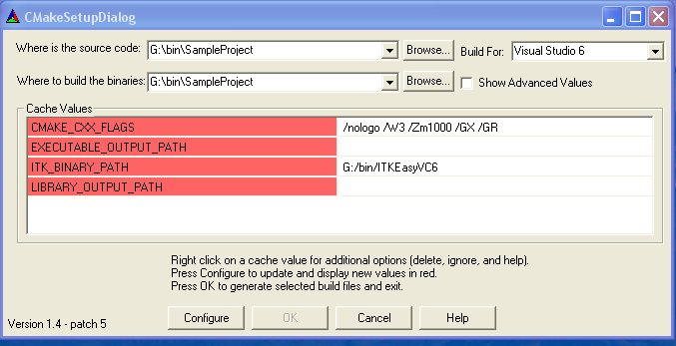
Step 6. Use OTB from an external Project

Slide 19
Step 6. Use ITK from an external Project
Ignore CMAKE_CXX_FLAGS
Ignore EXECUTABLE_OUTPUT_PATH
Ignore LIBRARY_OUTPUT_PATH
Point OTB_BINARY_PATH to the
binary directory where OTB was built

Slide 20
Step 7. Build Sample Project
Open SampleProject.dsw
generated by CMake
Select ALL_BUILD project
Build it
…It will take about 10 seconds …

Slide 21
Step 8. Run the example
Locate the file otbSampleProject.exe
Run it…
It should produce the message:
Test Passed !

Slide 22
Starting your own project
Create a clean new directory
Write a CMakeLists.txt file
Write a simple .cxx file
Configure with CMake
Build
Run

Slide 23
Step 9. Writing CMakeLists.txt
PROJECT( myProject )
INCLUDE (${CMAKE_ROOT}/Modules/FindOTB.cmake)
IF ( USE_OTB_FILE )
INCLUDE(${USE_OTB_FILE})
ENDIF( USE_OTB_FILE )
ADD_EXECUTABLE( myProject myProject.cxx )
TARGET_LINK_LIBRARIES ( myProject
OTBCommon OTBIO VXLNumerics ITKCommon ITKIO ITKMetaIO itkpng itkzlib )

Slide 24
Step 10. Writing myProject.cxx
#include "itkImage.h"
#include "itkImageFileReader.h"
#include "itkGradientMagnitudeImageFilter.h"
int main( int argc, char **argv ) {
typedef itk::Image<unsigned short,2> ImageType;
typedef itk::ImageFileReader<ImageType> ReaderType;
typedef itk::GradientMagnitudeImageFilter<
ImageType,ImageType> FilterType;
ReaderType::Pointer reader = ReaderType::New();
FilterType::Pointer filter = FilterType::New();
reader->SetFileName( argv[1] );
filter->SetInput( reader->GetOutput() );
filter->Update();
return 0;
}

Slide 25
Step 11. How to find what you need
http://www.itk.org/Doxygen/html/index.html
Follow the link Alphabetical List
Follow the link Groups
Post to the insight-users mailing list

Slide 26
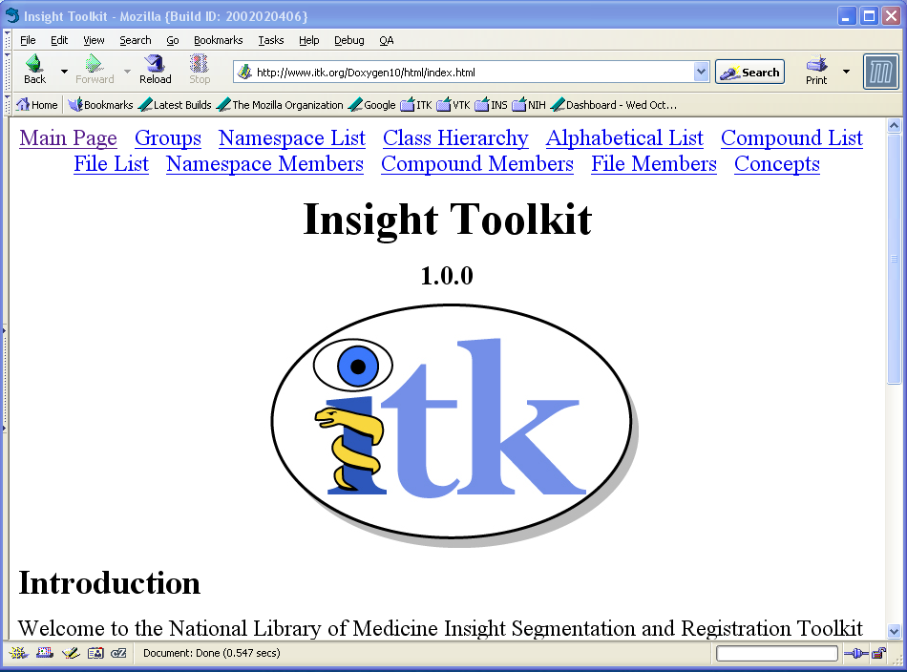

Slide 27
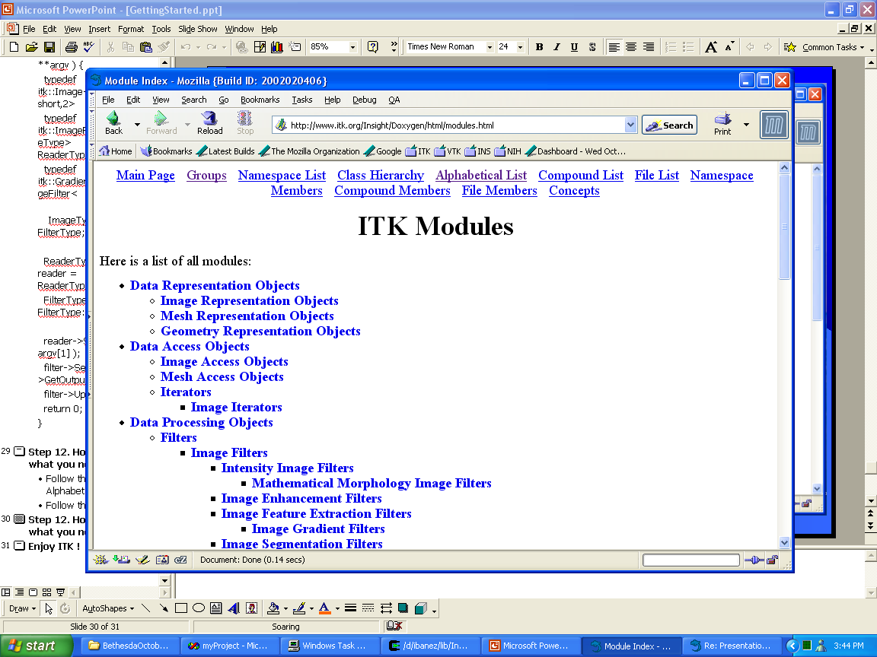

Slide 28
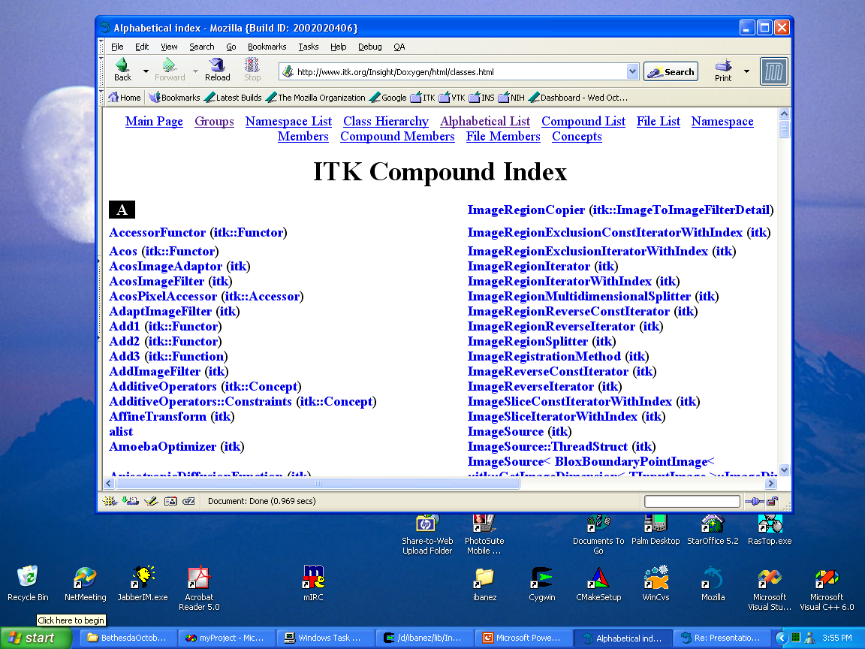

Slide 29
Enjoy ITK !

