Slide 1
Gesture Recognition for Immersive Gaming
Divyam Singh (17204007)
Prathamesh Khandare(17204005)
Shahbaz Shaikh(17204018)
Under the guidance of: Ganesh Gourshete
Ap.Shah Institute of Technology
Department of Information Technology

Slide 2
Content
Introduction
Problem definition & Proposed solution
Scope of project
Review of literature
System description
Architecture or block diagram (broader topic/algorithm)
Explanation of individual blocks (if exists) or algorithm
Hardware & software requirements
User Interface Design (GUI snapshots)
Test cases
Results and Discussions
Conclusions
Future Scope
Literature Cited (book, web & paper References)
Publications by your group (if any)
Acknowledgements
Demo to be given

Slide 3
Introduction
Games are primarily played on computer system using various input devices of which keyboard and mouse are the most often used. While using these devices, it is just tapping the keys which make changes in the game accordingly.
There also exist other input devices which actually translate a user’s body movement in to actions in the game (Example Kinect). This makes the playing experience better and makes the user connected to the game. But these devices are expensive and not every gamer can afford it.

Slide 4
An alternative to playing games through traditional input devices is using gestures that system can understand. Hence this topic, “Gesture Recognition for Immersive Gaming” comprises of using Gestures for playing games.
The Aim of this project is to make a low-cost alternative to the existing systems that users can use on their computers without any hassle. The project will cover games that can be played by mouse or keyboard on any computer system

Slide 5
Problem definition
Presently, majority of games are played using mouse and keyboard controls which don’t provide much depth.
Gesture recognition hardware presently available in the market are very costly and hence can’t be experienced by everyone. Also, these controllers comes with special set of drivers and software which require regular updating and failing to do so will make things complicated for users as they could no longer support latest games.

Slide 6
These controllers also require games specially made for them and can’t be used to play all the games. For Example Xbox-Kinect can only be played on Xbox device with specific games like tennis, cricket, boxing etc.
Games with genre racing requires joystick for its efficient controlling and playing racing games with Kinect or Wii Motion sensor is kind of a task itself.

Slide 7
Proposed Solution
The aim of this project is to enhance the level of immersion in computer games by creating an application that will allow users to interact with the game only using their hands.
The proposed application will enable the user to play computer games with their fingers without the need of either a keyboard or a mouse. The application will have an option to tune various background parameters and morphological operations to subtract the environment from the Region of Interest (ROI).

Slide 8
After Extracting the ROI, the contours will be detected and the inputs will be generated from the gesture and mapped to computer games.
Thus, the user can use the applications in different environments because of the presence of various parameters that can eliminate the noise.
Basically, Gesture Recognition for immersive gaming provides gamers an inexpensive platform to control high-end games with gestures.

Slide 9
Scope of project
The scope of this project is to develop interface for human-computer-interaction based on visual input captured by computer vision systems, and to integrate such interfaces to produce actions that replace traditional interfaces based on keyboards, mouse, remote controls, data gloves or speech.
Since the computer technology continuous to grow up, the importance of human computer interaction is enormously increasing.

Slide 10
Nowadays most of the mobile devices are using a touch screen technology. However, this technology is still not cheap enough to be used in desktop system.
Creating a virtual human computer interaction device such as mouse or keyboard using a webcam and computer vision techniques can be an alternative way for the touch screen.
In this study, gesture recognition is implemented in gaming using a regular webcam.
In this system, the inputs are the gesture movement of one person that is captured by a webcam and the output is the appropriate mapping of gestures with games.

Slide 11
Review of literature
The Review of Literature focuses on techniques used for hand gesture recognition and the color spaces used while detecting different colors against the backgrounds.
The survey done by Ibraheem, Noor A., et al in [1] provides a good knowledge about various color models used for color detection. It is a review paper for different color models used as well as the mathematical representation of each with their corresponding advantages and disadvantages along with their comparison and their suitable application area.

Slide 12
An approach in [2] narrates skin detection in HSV color space. In order to detect skin from an RGB image it is first converted to HSV as it can be perceived closely as human colors. RGB to HSV conversion is done by using values ranging from 6 to 38 for H and mixtures of different filters to detect skin color.
Image filtering algorithms are needed to filter out the noise which is the main focus of [3]. Filtering is required to reduce the noise and improve the visual quality of the image.

Slide 13
The Adaptive boosting [4] for hand detection and haar classifier algorithm to train the classifier was implemented in a system. It used HSV color model for background subtraction & noise removal, convex hull algorithm for drawing contour around palm and fingertip detection.
Boundary detection algorithm of an object was proposed by S.Satoshi, K.Abe in [5]. The algorithm finds a detailed boundary that includes object’s outer border also known as 1-component. It also consists of hole-border between the hole and the 1 –component surrounding it directly. This can be modified for detecting convex and concave parts (hulls) of the hand to detect the contours.

Slide 14
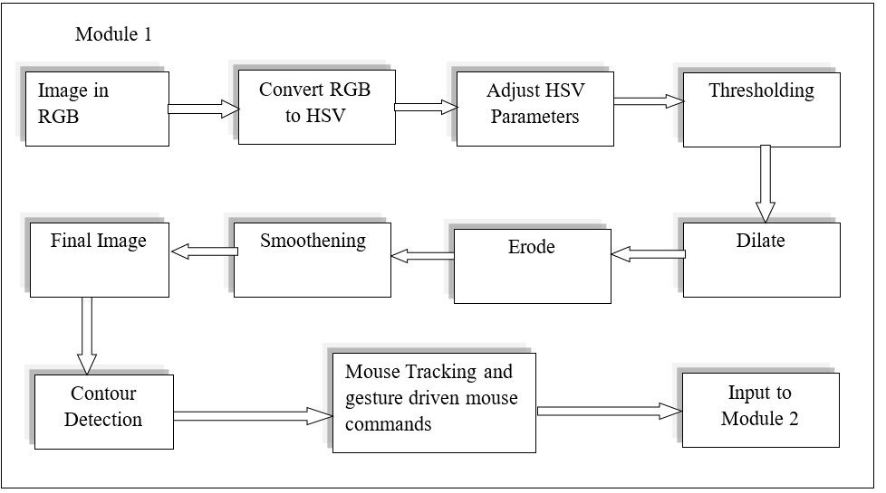
System description

Slide 15
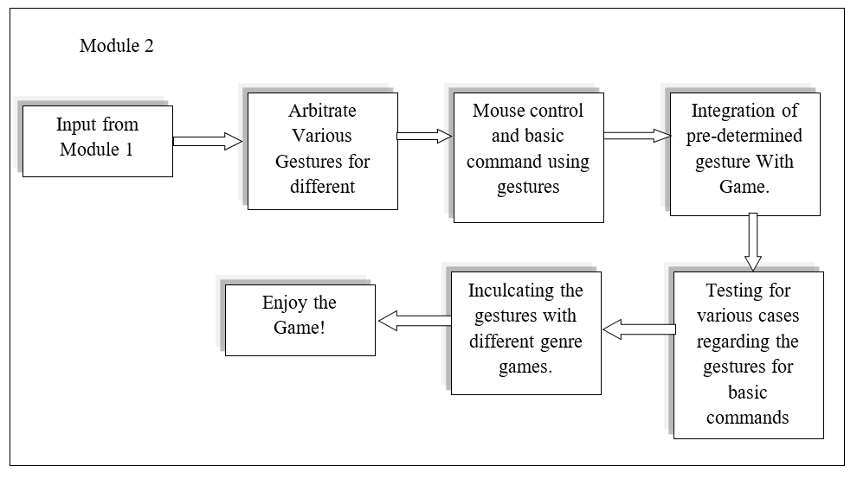

Slide 16
Detailed study of each Module-1
Image in RGB: Image will be accepted as input from the web cam in RGB format.

Slide 17
Conversion of RGB image to HSV
HSV color space is the most suitable color space for color based image segmentation. So, in the proposed application, it is necessary to convert the color space of original image of the video from RGB to HSV image.
HSV color space is consists of 3 matrices, 'hue', 'saturation' and 'value'. In OpenCV, value range for 'hue', 'saturation' and 'value' are respectively 0-255, 0-255 and 0-255. 'Hue' represents the color, 'saturation' represents the amount to which that respective color is mixed with white and 'value' represents the amount to which that respective color is mixed with black.

Slide 18
Thresholding, Dilate and Erode:
Thresholding is the simplest method of image segmentation. From a grayscale image, thresholding can be used to create binary images.
Dilation is one of the basic operations in mathematical morphology. Originally developed for binary images, it has been expanded first to grayscale images, and then to complete lattices. The dilation operation usually uses a structuring element for probing and expanding the shapes contained in the input image
Erosion is one of two fundamental operations (the other being dilation) in image processing from which all other morphological operations are based. It was originally defined for binary images, later being extended to grayscale images, and subsequently to complete lattices.
The basic idea in binary erosion is to probe an HSV image with a simple, pre-defined shape, drawing conclusions on how this shape fits or misses the required significant part in the image.

Slide 19
Smoothening and Final image:
Image free of all the noise, unwanted pixels or one can call them redundant pixels is referred as smoothen image or final image in this case.
The smoothened image contains only the required part that is highlighted by the program and rest even if present is neglected. This thereby only focuses on the area required whose gesture will be captured for further actions like gesture recognition for mouse controlling or any basic commands using gestures.

Slide 20
Mouse Tracking and Gesture driven Mouse commands:
Contour once detected are then used in multiple ways for tracking the mouse cursor using the hand with glove of any RGB color.
The cursor on the screen moves as and when the hand in front of the laptop cam or web camera moves or changes its position.
For example, if the index and middle finger are aligned in proper angle and the one of the finger is tilted slightly, depending on which finger was tilted, left or right mouse click can be performed.

Slide 21
Detailed study of Module-2
Module-2 being the most complicated and connected module, its detailed study is mentioned in a form of algorithm.
It is better understood visually.
void showimgcontours (Mat & threshedimg, Mat &original)
Step 1: Find Contours using findContours function
Step 2: Find the convex hull, contours and defects for each contour
Step 3: Iterate through each contour
Step 4: Find the area of contour
Step 5: Store the index of largest contour
Step 6: Draw Contours using drawContours function

Slide 22
Software requirements and Cost
Coding: C++, OpenCV
Operating System: Windows 7/8/8.1/10
Requirements | Details | Cost
OpenCV Framework | 2.4.10 or lower | Open Source
C++ Environment | Microsoft Studio | Free Student Version

Slide 23
Hardware Requirements
Processor : 1 gigahertz (GHz) or faster 32-bit or 64-bit processor
RAM : 1GB RAM (32-bit) or 2GB RAM (64bit)
Hard Disk : 16 GB available hard disk space (32-bit) or 20 GB (64-bit)
Display Driver : DirectX 9 graphics device with WDDM 1.0 or higher driver.
Web Camera : Capable of capturing true colors.
Glove : Colored Glove

Slide 24
Hardware Cost
Requirements | Details | Cost
Processor | Core 2 Duo E8400 | 799/-
RAM | 2GB | 999/-
Hard Disk | 80GB | 950/-
Display Driver | DirectX 9 | Free
Web Camera | Intex IT-305WC | 1240/-
Glove | Any colored glove | 60/-

Slide 25
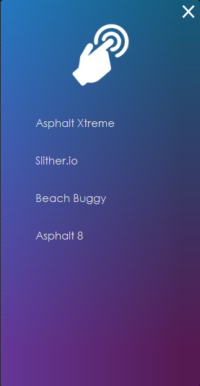
User Interface Design
After adjusting the parameters, the contour of the ROI will get detected in this case the glove. This interface will convert the gesture inputs from the web camera into the game inputs using Windows Virtual codes.
This interface will be coupled with Track-bar shown in next slide and Camera feed which will recognize the gestures and the contours.

Slide 26
The track-bar interface will be used in adjusting the parameters to convert the webcam video from RGB to HSV color plane and applying morphological operations if needed.
This interface provides ranges so that the user can adjust the parameters depending on the background that he/she currently has behind themselves.
Thus, it provides more robustness to the application. This interface will also provide the ability to choose the games that the user wants to play with hands.

Slide 27
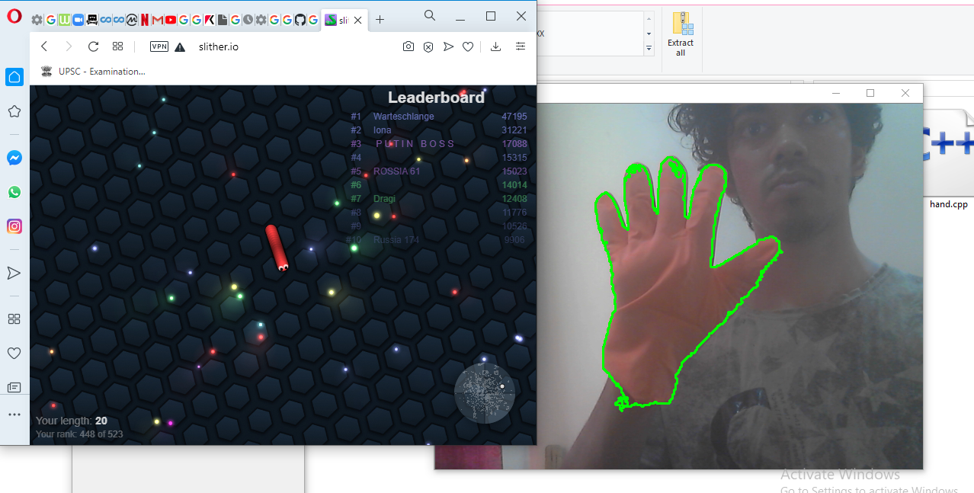
Test cases
Purpose | Test-Case regarding working of project on Online Games
Result | Positive Test-Case

Slide 28
Conclusions
Hand tracking is the main idea behind the implementation of gesture recognition using webcam. The report throws light on all the major aspects of gesture recognition including the concept of morphological operations like erode and dilate, background conversion and filtering.
In this project, we have proposed a vision based hand gesture recognition using a simple system connected with a web camera. Minimum hardware is required to detect hand and counting number of fingers and translate the gestures into commands.

Slide 29
People have been trying to use hands as an interface to computers. This application gives user an easy way to interact with computer games with only their hands.
With more robust hand detection, this application can replace the mouse.

Slide 30
Future Scope
The current system deals with games that have minimal controls so that the system can recognize gestures accurately. The future versions of the system can be designed such that it can be used to control more complex controls while also maintaining the accuracy e.g. – controls in multiple axis, single gestures such that it can mimic multiple controls accurately.
Accuracy and speed of the system is utmost important and hence improving those two areas will always be a considered in any future version.
A more efficient way to add and play games that are compatible will be made so that the user is not limited to the presently listed games.

Slide 31
Future work is required to improve the tracking speed. Future work not only includes improvement of designed strategy but also considering more challenges such as dynamic gestures involving both hands and multiple cameras.
Final objective involves gestures with a high degree of freedom; which may require detection of articulated fingers.

Slide 32
Literature Cited
[1] Ibraheem, Noor A., et al. "Understanding color models: a review" ARPN Journal of Science and Technology 2.3 (2012): 265-275.
[2] Oliveira, V. A., and A. Conci. "Skin Detection using HSV color space" H. Pedrini, & J. Marques de Carvalho, Workshops of Sibgrapi. 2009.
[3] R.Chandel, G. Gupta. "Image Filtering Algorithms and Techniques: A Review." International Journal of Advanced Research in Computer Science and Software Engineering 3.10 (2013): 198-202.
[4] G.R Manish, and P.K Kadbe. "Real time finger tracking and contour detection for gesture recognition using OpenCV" Industrial Instrumentation and Control (ICIC), 2015 International Conference on. IEEE, 2015.
[5] S.Satoshi, K.Abe "Topological structural analysis of digitized binary images by border following." Computer Vision, Graphics, and Image Processing 30.1 (1985): 32-46.

Slide 33
Acknowledgements
We hereby take the privilege to present our project “Gesture Recognition for Immersive Gaming”. We are very grateful to all those individuals for their kind support and constant motivation that helped making our endeavor success.
Firstly, we are highly indebted to our institute, St. Francis Institute of Technology for providing us the platform to showcase our talent.
We would extend our gratitude to our Principal Dr. Sincy George and H.O.D. Dr. Joanne Gomes.

Slide 34
We would like to sincerely thank our Project Guide Ms. Mrinmoyee Mukherjee for her support, motivation and constant supervision as well as for providing information and showing constant concern for betterment of our project.

Slide 35
Questions??
Thank You!

