Slide 1



Crowdsourcing Metadata
Reliably Augmenting Documents By Collecting and Interpreting Amateur Contributions
Peter Organisciak
September 22, 2015
1

Slide 2
Notes:
Placeholder:
thank committee, collaborators, and support

Slide 3
Maximizing data quality
in using paid crowds for objective and
subjective encoding tasks

Slide 4
INTRODUCTION
Crowdsourcing



Commons-Based Peer Production

Human Computation
Free/Open Source
Human work organized in the manner and tropes of computation
Creation from the commons, stemming from increased agency in networked information economy.
Crowdsourcing
Lemon drops oat cake oat cake sugar plum
Broadly describes the use of distributed crowds to complete a task that would otherwise be done by one or a few people.
Captures the ability of the Internet toefficiently connect people

Lemon drops oat cake oat cake sugar plum sweet
Chocolate cake sweet pastry candy canes chocolate cake
Cake lollipop sweet

User Innovation
Wisdom of the Crowds
Lemon drops oat cake oat cake sugar plum sweet gingerbread cake.
observes the collected effectiveness of crowds when properly aggregated
2008
2011
von Ahn 2004
Surowiecki 2004
Benkler 2006
Howe 2006
4
Notes:
If the wisdom of the crowds refers to the unique abilities of human intelligence in aggregate, human computation focuses on human abilities as distinct from computational methods -- for so long as they are distinct -- and aims to formalize methods to organize humans in manners akin to automation.

Slide 5
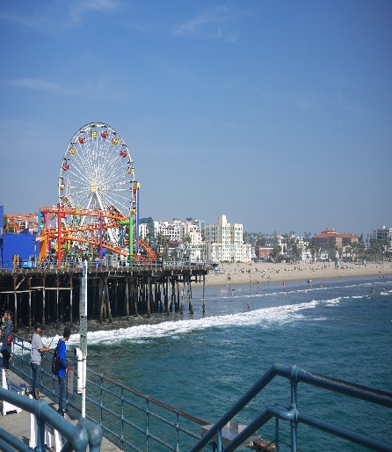
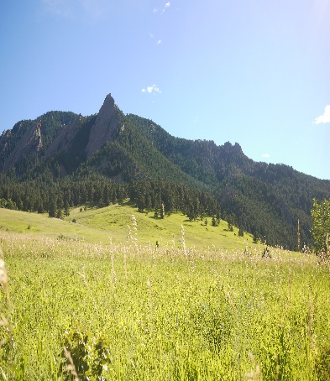
INTRODUCTION
Information Science
Image Tagging
Content Recommendation
Lemon drops oat cake oat cake sugar plum sweet cake oreo
Lemon drops oat cake oat cake sugar plum sweet cake oreo


Relevance Judgments (IR Evaluation)

Lemon drops oat cake oat cake sugar plum sweet cake oreo



Transcription
Lemon drops oat cake oat cake sugar plum sweet cake oreo
Research
Other Encoding
Lemon drops oat cake oat cake sugar plum sweet cake oreo
Lemon drops oat cake oat cake sugar plum sweet cake oreo
5

Slide 12
INTRODUCTION
Typical Task



12

Slide 13
INTRODUCTION
Typical Task









13

Slide 15
SECTION ONE
Creative Visual Design
Basic
Business
Professional
Expert




Liquorice chupa chups applicake apple pie cupcake brownie bear claw gingerbread cotton candy. Bear claw croissant apple pie. Croissant cake tart liquorice tart pastry cake
Liquorice chupa chups applicake apple pie cupcake brownie bear claw gingerbread cotton candy. Bear claw croissant apple pie. Croissant cake tart liquorice tart pastry cake
Liquorice chupa chups applicake apple pie cupcake brownie bear claw gingerbread cotton candy. Bear claw croissant apple pie. Croissant cake tart liquorice tart pastry cake
Liquorice chupa chups applicake apple pie cupcake brownie bear claw gingerbread cotton candy. Bear claw croissant apple pie. Croissant cake tart liquorice tart pastry cake
VIEW DETAILS
VIEW DETAILS
VIEW DETAILS
VIEW DETAILS
15

