Slide 1
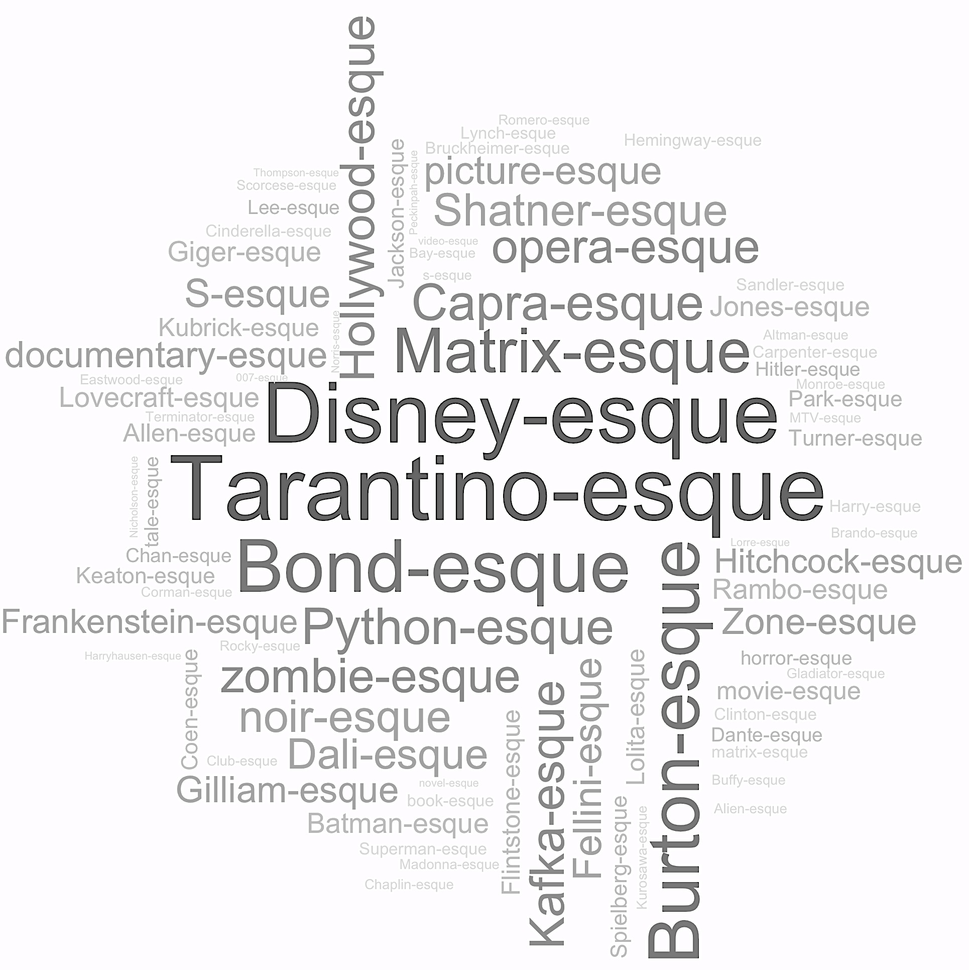
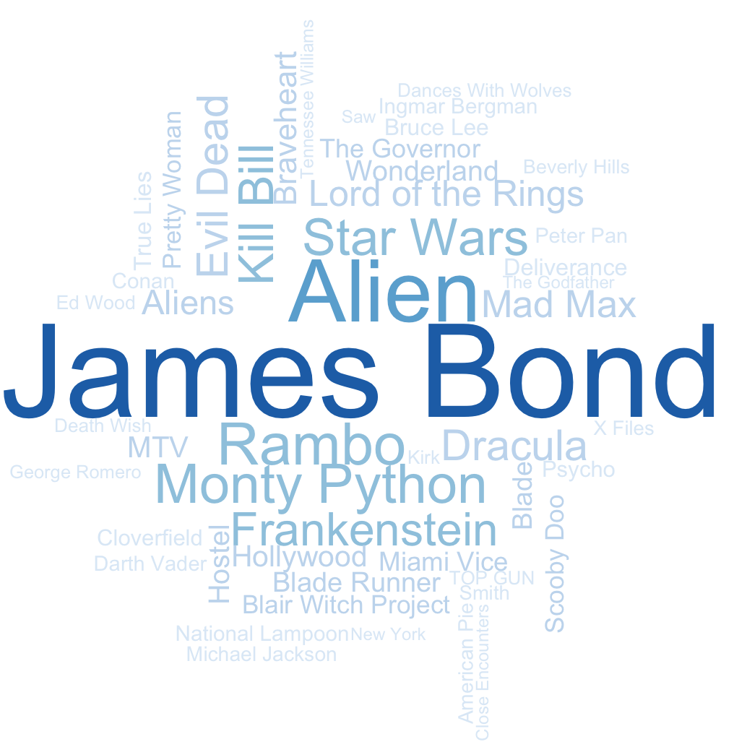
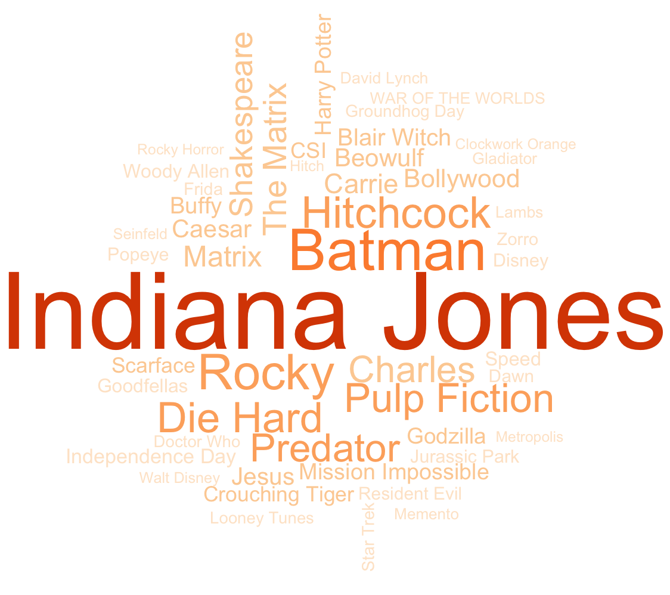
Case Study: Super 8
Super 8 is 2011 Science-Fiction Adventure film, directed by J.J. Abrams. The film is an homage to 70s and 80s Spielberg films in script and in style, causing many reviewers recall films from that period and genre. Some of the descriptions overlap with the director’s stated influences, others are inferred similarities.
Structure - Properties of A Film Mixture
descriptions
twists
great
Tarantino
French
Tim Burton
Kubrick
Lynchy
British
Star Trek
Japanese
James Bond
Huge
Scorsese
Christmas
Muppet
A strong Transformers meets Monty Python in Space!
X meets Y
X / Y / Z
mix of X and Y
mashup of X and Y
combination of X and Y
Offspring of X and Y
Recurring Films
Qualification
Description
Twist
With a
twist
Complexity
The most lucid descriptions mix films across different attributes, such as
Genre Character Themes
Visual Style Narrative Themes
In a single description, films can represent one or more of attributes, but not necessarily all of them.
Goonies
Relative popularity of two types of twists
Character Themes
The Sandlot
Stand By Me
Common Patterns of Description through Mixture
Jurassic Park
Super
8
Aliens
Archetypes
Many films recur often as archetypes: a Rosetta Stone for a shared language of film. While occasionally the reason for the similarity is noted, generally the purpose of a citation is unspoken, assumed to be apparent. When mixed, the contexts of what the cited films represent also mixes, alternating between facets such as genre, themes, and atmosphere.
Jaws
Genre / Stylistic Themes
Narrative Themes
Cloverfield
Close Encounters of the Third Kind
Sherlock Holmes meets Godzilla
Examples
E.T.
 | Qualified | Unqualified
Single-Film | ET revisited, modern style The Goonies for the new millenium! Had potential for 5 stars, but faded into an ET clone at end | I realized it's Goonies revisited a similar feel to the classic 1977 Spielberg film Close Encounters of the Third Kind I usually don't like movies about kids, but this one had the same kind of appeal that Goonies had
Multi-Film | a pretty good mix of "Cloverfield" and "Stand By Me" with a steadier camera and more tense Alien meets Close Encounters, and definitely disappoints ...some sort of mutant offspring of ET, Close Encounters, Cloverfield, and the Goonies? Except in the Goonies we actually had a group of kids that were likeable. the plot is a badly disjointed patchwork of ideas stolen from "Close Encounters of the Third Kind" "E. T." , "Jaws" and Stephen King's "Tommyknockers." had the charm of the Goonies/the Sandlot, but it was more grown up than that | Sort of a mixture of Gremlins, ET, Jurassic Park (lots of Spielberg-style in this movie), the Goonies, Predator, with a little zombie stuff and Dazed and Confused thrown in. E.T. with Jaws Mixing equal parts of The Goonies, Cloverfield, ET and Red Dawn in the same blender It reminded me of movies like close encounters of the third kind, stand by me, and the goonies. I loved that the movie felt like a mashup of the goonies/sandlot vs. whatever monster movie Wow. ET/Close Encounters of the 3rd Kind/Cloverfield/The Goonies all rolled into one with some Stand by Me thrown in as well It's like an odd mashup of Jurassic Park, Stand By Me, District 9... And many other movies I've seen before Stand By Me/It/Dreamcatcher/ET/Goonies E.T., Goonies etc., plus movies like Cocoon and Explorers. many parents will doubtless think of films such as E.T., the Explorers, Flight of the Navigator, et al. If you liked "The Sandlot", "Stand By Me" & "Goonies" - this is the movie for you cuz this one rolls all 3 of those movies into one
Film Description through Comparison
meets
PETER ORGANISCIAK meets MICHAEL TWIDALE
Occurrences of Common Films in {X} Meets {Y} pattern
Introduction
Describing things briefly, clearly and well is hard work. We know that – we study it and try to do it in many parts of LIS. Describing a movie is quite a challenge – especially if you are trying to do a good job in just a few words. Using a set of nearly 8 million Amazon user reviews of films we find that some people are able to use a very terse and yet surprisingly effective way of describing some aspects of what makes the movie stand out - a qualified mixture of other films.
These descriptions seem to get to the heart of the movie, in a way that many people who have seen the movie can agree with. They are clearly inspired by the popular culture view of the movie pitch – where an idea for a movie has to be described to busy executives as clearly and quickly as possible.
We explore examples of this activity through 7,911,684 Amazon user reviews of films (McAuley and Leskovic 2013*) to understand how, why and when they are effective and speculate on the potential of this approach to inform novel information organization and access.
*J. McAuley and J. Leskovec. From amateurs to connoisseurs: modeling the evolution of user expertise through online reviews. WWW, 2013.
Questions
How do people describe films by the “pitch”: eliciting other films for helping a listener understand a film?
How efficient is it to create these descriptions? What would be lost if we tried to generate them?
How effective is this form of description for the receiver? When do these descriptions fail? How does it apply to our ability to communicate information objects in any medium in a clear, understandable way?
Examples
Film | Formal Film Description (via IMDB) | Mixture Description
Daddy Day Care | Two men get laid off and have to become stay-at-home dads when they can't find jobs. This inspires them to open their own day-care center. | “a cross between Mr. Mom and Kindergarten Cop“
Looper | In 2074, when the mob wants to get rid of someone, the target is sent into the past, where a hired gun awaits - someone like Joe - who one day learns the mob wants to 'close the loop' by sending back Joe's future self for assassination. | “12 Monkeys meets The Terminator”
The Incredibles | A family of undercover superheroes, while trying to live the quiet suburban life, are forced into action to save the world. | “a cross between Toy Story, Superman, and Office Space.”
Spacehunter | Three women makes an emergency landing on a planet plagued with a fatal disease, but are captured by dictator Overdog. Adventurer Wolff goes there to rescue them and meets Niki, the only Earthling left from a medical expedition. Combining their talents, they try to rescue the women. | “Mad Max Meets Star Wars” “Mad Max in space”
Last of the Mohicans | Three trappers protect a British Colonel's daughters in the midst of the French and Indian War. | “Dances With Wolves meets Miami Vice”
In Their Own Words
Reviewers explain the reasons because their citations
Take Goonies (kids experimenting), Close Encounters (the grand evacuation), ET (in the end, the alien was a misunderstood cutie), Transformers (the self assembling cubes), Cloverfield (the monster is a reduced copy)
Coming of age characters reminiscent of The Sandlot, Stand by Me, and The Wonder Years - I grew up with kids just like these…. A story about the military and an alien that is every bit as enjoyable as Close Encounters and ET.
This film also reminds me of Stand By Me because it truly captures the mind of a 13 year old perfectly
“
”
Future Directions
Satisfaction survey: do recipients feel that they understand a film that has been described through a mixture?
Generation: can we adopt the findings of this study to describe new films or other information objects?
Can this approach be useful for things other than movies? Books? Research papers? datasets?
“
”
“
”

