Slide 1
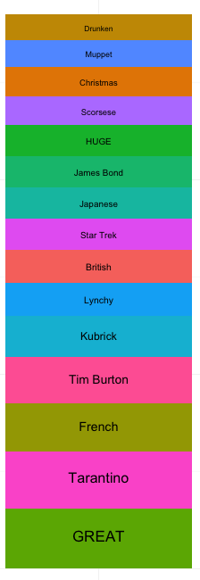
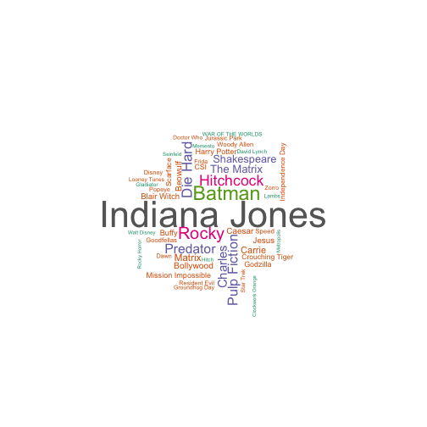
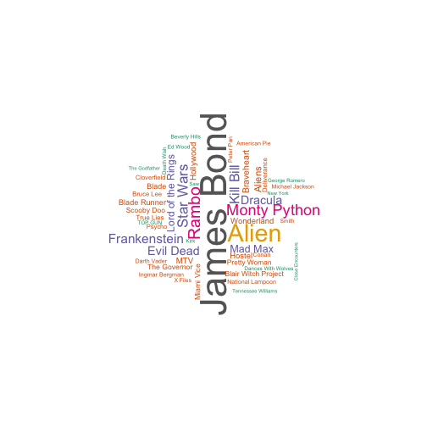
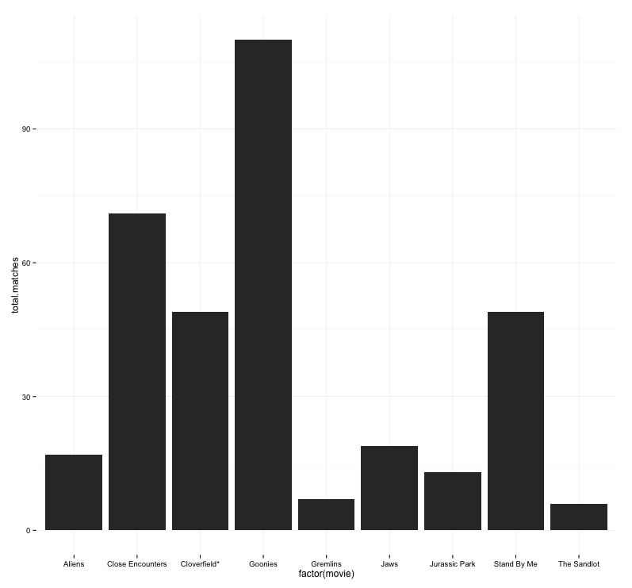
Character Themes
A strong
Transformers meets Monty Python
In space!
Goonies
Qualification
Film Mixture
Twist
The Sandlot
Stand By Me
Jaws
Super
8
Aliens
Jurassic Park
E.T.
Stylistic Themes
Cloverfield
Close Encounters of the Third Kind
Narrative Themes
a
twist
meets

