Slide 1
Compressed Compute-and-Forward with correlated audio signals
Faculty of Electrical and Computer Engineering , Communications Laboratory, Deutsche Telekom Chair of Communication Networks
Dresden, 14.07.2016
Raphael Hildebrand, Orell Garten, Florian Roth, Lucas Weber

Slide 2
Table of Content
Introductiom
  Task
  Motivation
Underlying Theroy
  Crosscorrelation
  Contrived parameters
Basics of the Octave-Tool
Signals
  Recorded Signals
  Examples
Conclusion

Slide 3
Task
develop software to correlate stereo audio streams
develop models for characteristic values to describe correlation
record audio signals

Slide 4
Motivation
500 billion devices in 2022
huge amount of data
using correlation between data streams to reduce amount
massive sensor networks (e.q earthquake detection)

Slide 5
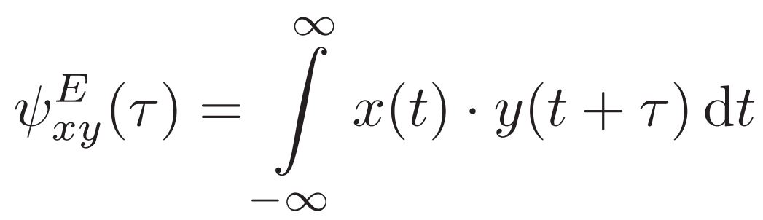
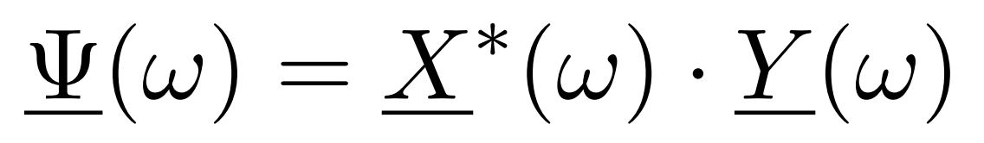
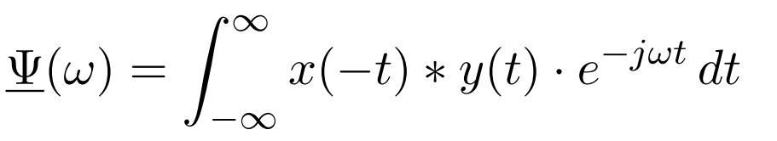
Underlying theory (crosscorrelation)
time domain
frequency domain
[ISV, S. 48 f]
[ISV, S. 180]
[ISV, S. 180]
convolution theorem
[ISV] Rüdiger Hoﬀmann, Matthias Wolﬀ: Intelligente Signalverarbeitung 1. Springer Verlag Berlin Heidelberg 2014

Slide 6
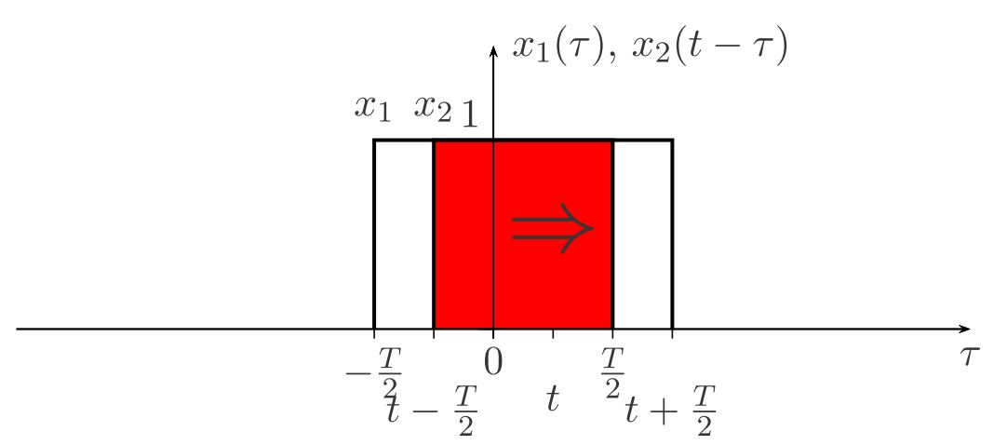
Underlying theory
[NT, S. 28]
[NT]Prof. Dr.-Ing. Dr. h.c. Gerhard P. Fettweis: Einführung in die Nachrichtentechnik. Technische
Universität Dresden, Fakultät Elektrotechnik, Vodafone Stiftungslehrstuhl Mobile Nachrichtensys-
teme, D-01062 Dresden Sommersemester 2015

Slide 7
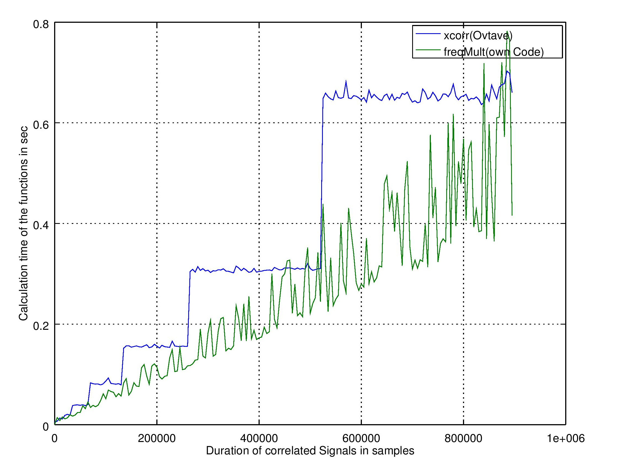
Underlying theory

Slide 8
Designed Parameters
Aim: check what kinds of signals are suitable for compressed-sensing
→ classify signals
Categories: physical information and shape of cross-correlation
express characteristics in numbers
-simplify characteristics
-developed parameters have to stay valid

Slide 9

Designed Parameters – ripple
Scale for energy distribution of the signal
0 ≤ ripple ≤ 1

Slide 10
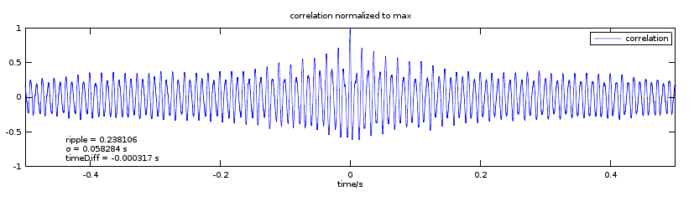
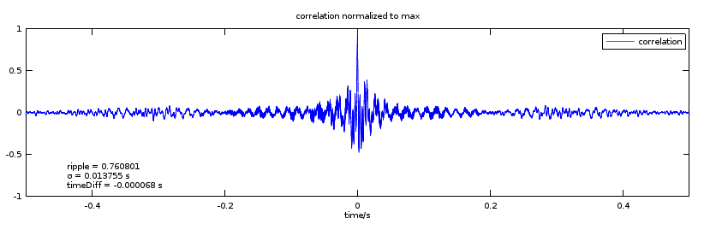
Designed Parameters – ripple

Slide 11
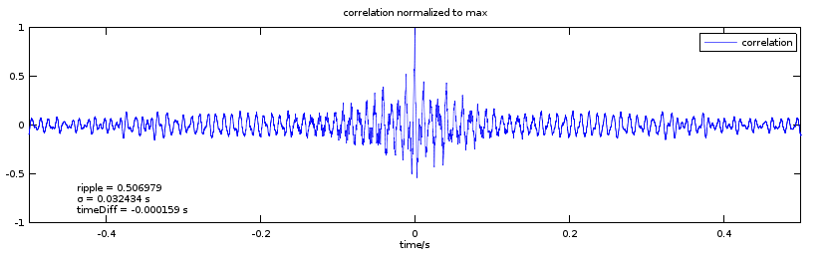
Designed Parameters – sigma
Typical shape of a cross-correlation:
Find a scale for width of the peak

Slide 12
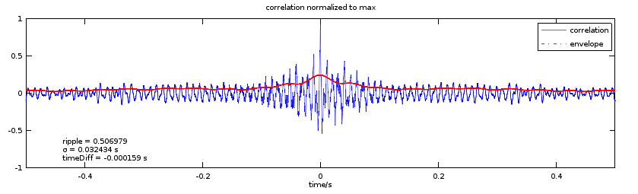
Designed Parameters – sigma
Amplitude-demodulation to receive an envelope:

Slide 13

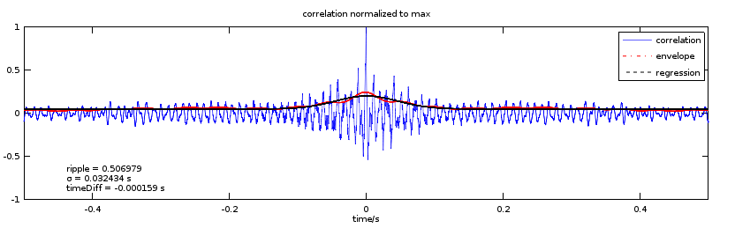
Designed Parameters – sigma
Fit a bell-shaped curve to envelope:
Take sigma as parameter

Slide 14
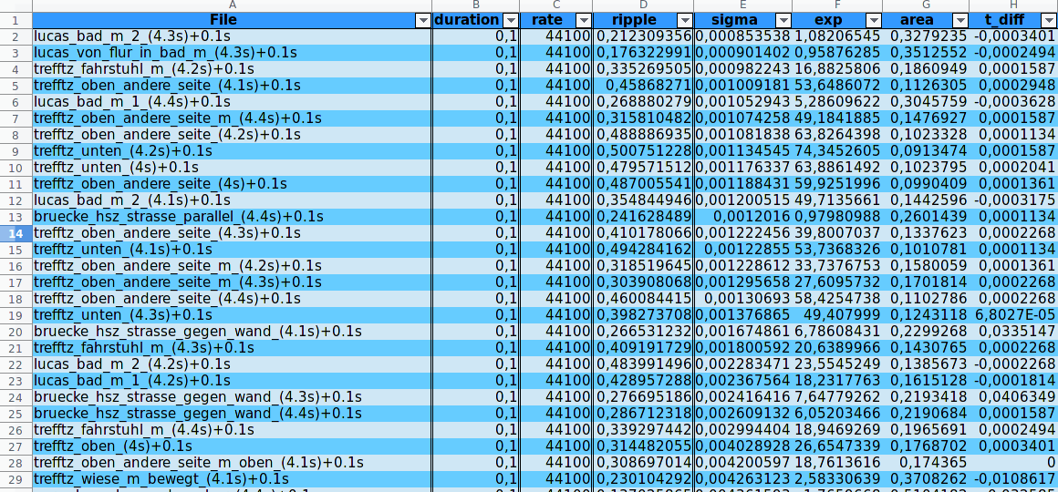
Octave script
modular and easily extendable
processing lots of files
concise output format

Slide 15
Table of Content
Punkt XYZ
Überschrift 1
Text

Slide 16
Conclusion
Octave tool for automated correlation of lots of data
fairly simple models to classify correlation
software can easily be extended with own models and analysis functions
compact excel spreadsheet for easy selection of test signals

Slide 17


