Slide 1
Beyond the Dashboard:
The Association as an Intelligence Platform
ARDA’s connected data and application platform
BRIAN KALTENBAUGH
JOHN STOVER
Vice President, Technology and Innovation, ARDA
Founder and Principal, Org Data Solutions
Notes:
Welcome and introduce Brian Kaltenbaugh (Vice President, Technology and Innovation, ARDA) and John Stover (Founder and Principal, Org Data Solutions).
Protech is the foundation, Microsoft is the ecosystem, and ARDA's platform connects that foundation to industry knowledge, specialized operations, external intelligence, analytics, and governed AI.
The case study inside the session is "ARDA's connected data and application platform".

Slide 2



What should your association be able to answer?
Who do we represent?
What is changing across our field?
What information will help our community, members, or mission?
ASSOCIATION
SOCIETY
Which corporate families own or operate resorts in each state, and which of them are part of our membership?
Which credentials, employers, and participation patterns are changing across our membership?
Keep at least one recurring question from your own association in mind for the rest of the session.
PART 1 · ARDA’S VISION AND FOUNDATION
Notes:
Three questions every association should be able to answer: who do we represent, what is changing across our field, and what information would help our community take the next step?
Trade-association example: corporate families and resort geography. Professional-society example: credentials, employers, and participation.

Slide 3

ARDA knows an industry, as well as its members
Member organizations
Foundation activity
People and roles
ARDA
Resort Owners’ Coalition
Resorts
Industry partners
Developers and operators
Being in the industry’s information model is different from holding a membership. ARDA maintains the industry picture; membership is one relationship within it.
PART 1 · ARDA’S VISION AND FOUNDATION
Notes:
Lead: Brian (about 1 minute).
Introduce the information model: member organizations and people, resorts, developers and operators, industry partners, the Resort Owners' Coalition, and Foundation activity.
Key distinction: being in the industry's information model is different from holding a membership. ARDA maintains the industry picture; membership is one relationship within it.
Production: replace the photograph placeholder with approved resort or association imagery.

Slide 4






Protech provided the foundation. Microsoft is the ecosystem.
Association records
Automation
Data and analytics
FOUNDATION
Dynamics 365
Power Automate
Azure SQL
Protech
Dataverse
Supported APIs
SQL views
The trusted transactional system of record. Members, organizations, dues, events, and finance stay in Protech.
Protech AMS
Dataverse events
Power BI
Identity and security
Delivery
Protech stays the system of record. The platform reads analytically and writes back only through supported paths.
Protech on Dynamics 365 and Dataverse, provides supported APIs, automation, identity, and the wider Microsoft ecosystem.
Microsoft Entra ID
Power Apps and portals
Roles and groups
Teams
Audit
Copilot and MCP
PART 1 · ARDA’S VISION AND FOUNDATION
Notes:
Dynamics 365 and Dataverse, supported APIs, automation, identity and security integration, and access to Microsoft's wider ecosystem.
Protech remains the trusted transactional system of record. The platform reads analytically and writes back only through supported paths.

Slide 5

Four business needs shaped our Association platform
1
2
3
4
Preserve and expand analytical expertise
Support specialized workflows
Connect Resort Tracker with association relationships
Analyze outside intelligence beside trusted records
Staff enhance their existing technical skills, reports, and views on a governed analytical layer.
Renewal statements, badges, event check-in, and staff worklists that the improve staff efficiency.
Proprietary resort information linked to companies, people, and membership.
Public filings, economic indicators, legislative information, and social network discussions, in context, and aligned with our managed data sources.
Example: the by-state property view
Example: badge preview and printing from registration data and onsite registrations
Example: resort → operator → parent company, linked to membership
Example: EDGAR trends with membership status
“We worked to turn these opportunities into a connected data and application architecture.”
PART 1 · ARDA’S VISION AND FOUNDATION
Notes:
1. Preserve and expand SQL-based analytical expertise.
2. Support specialized workflows such as statements and badges.
3. Connect proprietary Resort Tracker information with association relationships.
4. Analyze outside intelligence alongside trusted internal records.

Slide 6








How ARDA’s platform connects the pieces
SOURCES
SHARED GOVERNANCE LAYER
EXPERIENCES
Protech AMS
Analytical layer
Staff applications and worklists
Dynamics 365 · Dataverse
System of record
Azure
Shared relationships
Power BI reporting
Resort Tracker
Agreed definitions and measures
Public data products
Proprietary resort and company knowledge
Scheduled refresh
APIs
External sources
SEC EDGAR filings · economic indicators · legislative information · engagement data
Permissions and audit
Governed AI (MCP services)
Analytical reads through SQL views
Approved operational updates through supported APIs
Designed and built with ARDA by Org Data Solutions
PART 2 · CONNECTED DATA AND USEFUL APPLICATIONS
Notes:
Walk left to right: Protech on Dynamics 365 and Dataverse, Resort Tracker, and external sources feed the analytical SQL layer, which holds shared relationships, agreed definitions, scheduled refresh, and permissions. From there: staff applications and worklists, Power BI, public data products, APIs, and governed AI through MCP services.
Distinguish analytical reads (solid arrows) from the supported path for approved operational updates back into Protech (dashed arrow).
Production: confirm exact deployment labels (Azure SQL and related services) against Brian's description before finalizing this graphic.
Credit: platform designed and built with ARDA by Org Data Solutions.

Slide 7
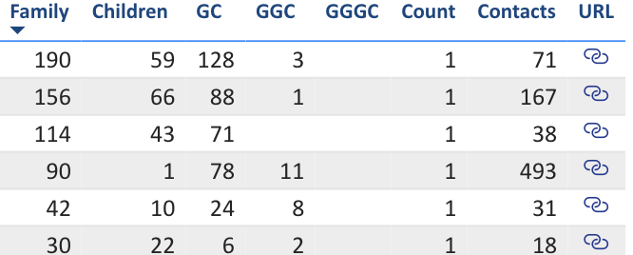
Relationships make the information useful
Corporate family view
Parent company
owns
Member A
Member B
Member C
Subsidiary
Person and role
role at
develops
Resort
Operator
operates
Visualize ownership across generations—from parent companies to subsidiaries, grandchildren, and great-grandchildren… with Links to Protech.
DISTINCT RULES FOR EACH RELATIONSHIP
Ownership
Operation
Membership
Benefits
Who pays
Each one has its own rule: who owns is not who operates, and who belongs is not always who pays.
Translation to other types of Orgs: employers, chapters, committees, groups, and credentials follow the same pattern.
PART 2 · CONNECTED DATA AND USEFUL APPLICATIONS
Notes:
Explain parent company, subsidiary, resort, operator, person, and role. Ownership, operation, membership, benefits, and financial responsibility each need distinct rules: who owns a property is not who operates it, who belongs is not who pays, and who receives benefits may be a different entity again.
For professional societies the same pattern covers employers, chapters, committees, and credentials.
Production: use an approved or anonymized relationship/hierarchy screen on the left.

Slide 8
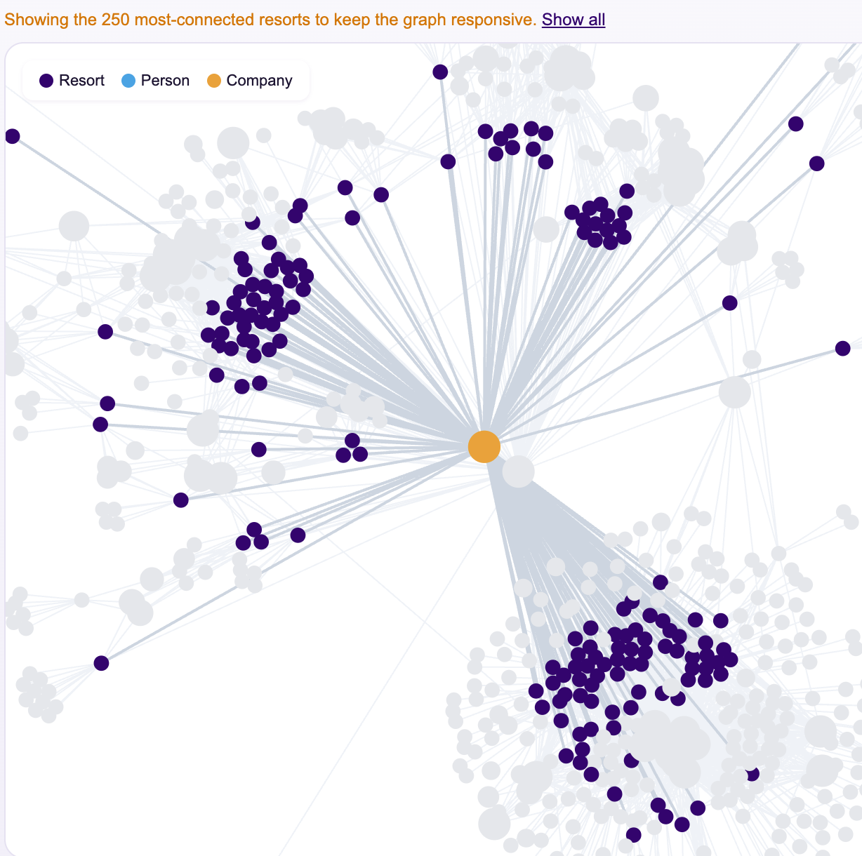
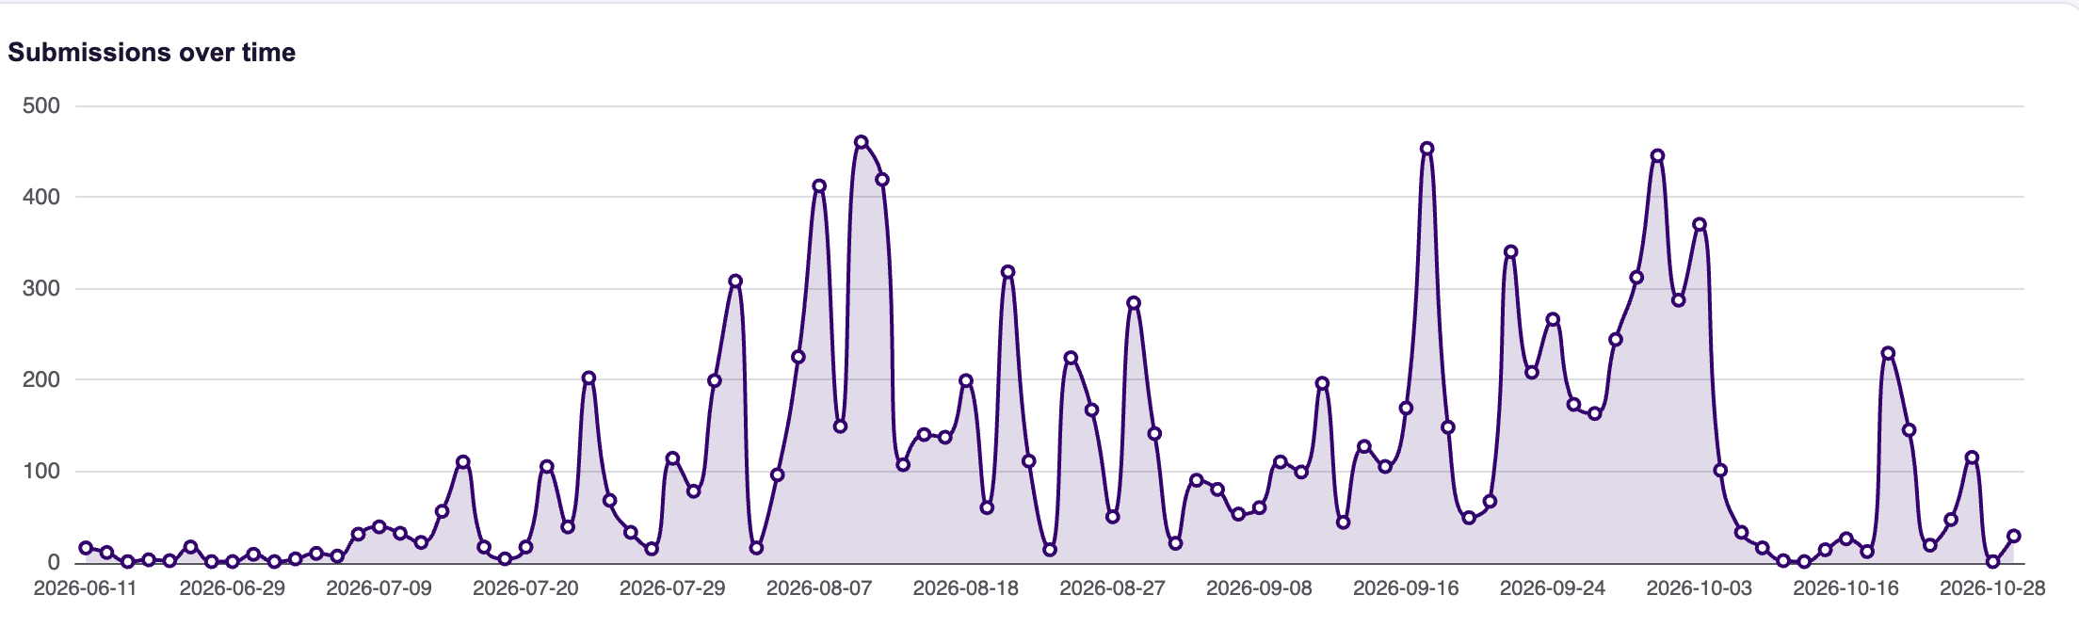
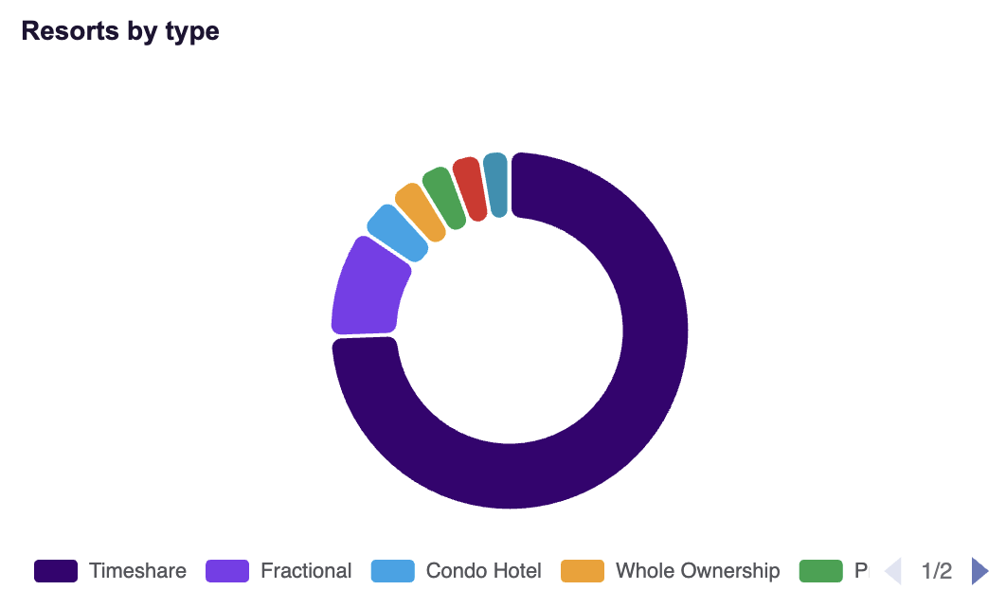
Resort Tracker brings up to date industry relationships
PART 2 · CONNECTED DATA AND USEFUL APPLICATIONS
Notes:
Show how a resort relates to companies and contacts, how authorized participants review the information assigned to them, and what they can propose to improve it. Focus on one task: reviewing an assigned record and proposing a correction.
Production: insert the Resort Tracker overview screenshot; the record card on the right uses synthetic values and can be replaced with an enlarged real record.

Slide 9
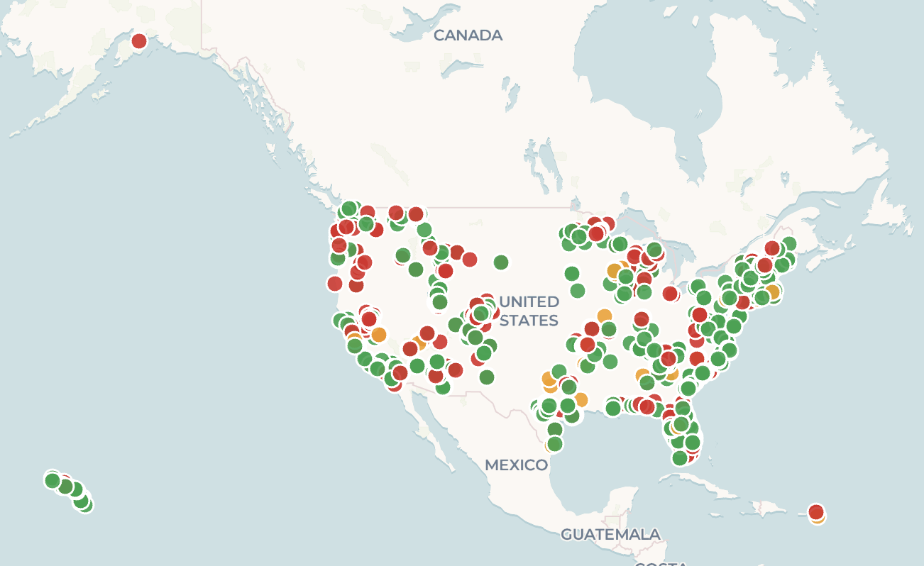
Resort Tracker adds industry knowledge into the platform
Resort Tracker overview
Resort record
EXAMPLE
Resort
Sunrise Bay Villas
Developer
Harbor Point Development
Operator
Acme Hospitality Group
Parent company
Acme Resorts Holdings
Primary contact
J. Rivera, General Manager
Assigned reviewer
Operator staff (authorized)
Review assigned information
Propose a correction
Participants see only the records assigned to them and can propose, not publish, changes.
PART 2 · CONNECTED DATA AND USEFUL APPLICATIONS
Notes:
Show how a resort relates to companies and contacts, how authorized participants review the information assigned to them, and what they can propose to improve it. Focus on one task: reviewing an assigned record and proposing a correction.
Production: insert the Resort Tracker overview screenshot; the record card on the right uses synthetic values and can be replaced with an enlarged real record.

Slide 10



Contributors improve the data through a reviewed process
1 Correction submitted
2 Staff review
3 Amend or approve
4 Supported update
5 Views refreshed
REVIEW QUEUE
EXAMPLE
Record | Field | Current value | Proposed value | Evidence | Status
Sunrise Bay Villas | Operator | Acme Resorts | Acme Hospitality Group | Management agreement | In review
Harbor Point Resort | Parent company | (missing) | Harbor Point Development | Public filing (10-K) | Approved
Lakeside Club | Address | 12 Main St, Austin TX | 1200 Main St, Austin TX | Contributor photo | Needs evidence
Submission
Review
Update and refresh
Authorized contributors propose changes to records assigned to them and receive an acknowledgment.
Staff review and may amend the proposal. The approval policy is configured per field, with staff-specific handling for sensitive fields.
An approved change is written through the supported API path to Dataverse; analytical views refresh on schedule.
PART 2 · CONNECTED DATA AND USEFUL APPLICATIONS
Notes:
Follow one proposed correction: it enters the queue, staff review and may amend it, approval triggers a supported update to Dataverse, and the analytical views refresh on schedule.
Explain the configured approval policy, including any staff-specific handling for sensitive fields.
The queue shown is a synthetic example; replace with a prepared real queue if an approved screenshot is available.

Slide 11
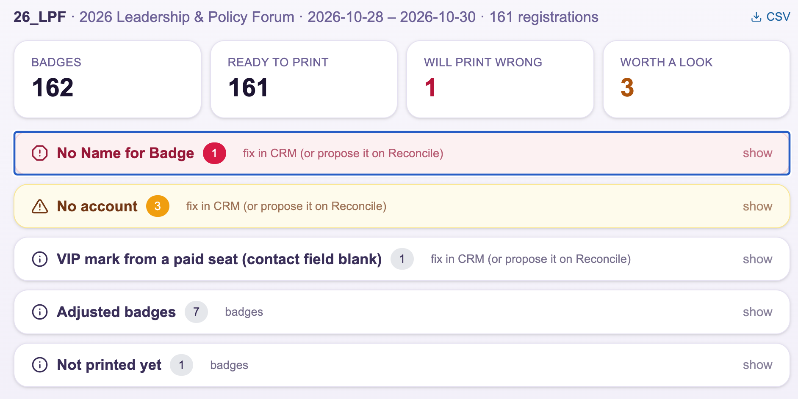

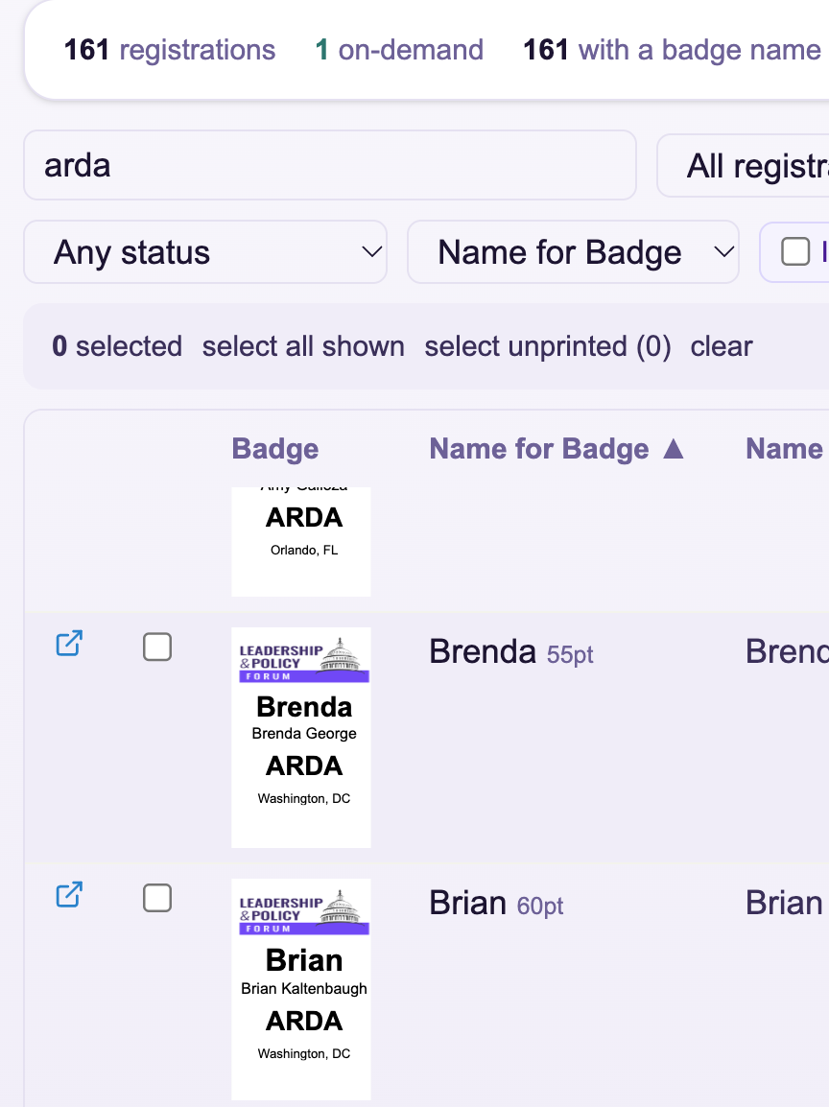
The foundation also supports Badge preview, printing, and check-in
Makes it easier to preview and print event badges straight from registration data, without manual layout.
PART 2 · CONNECTED DATA AND USEFUL APPLICATIONS

Slide 12
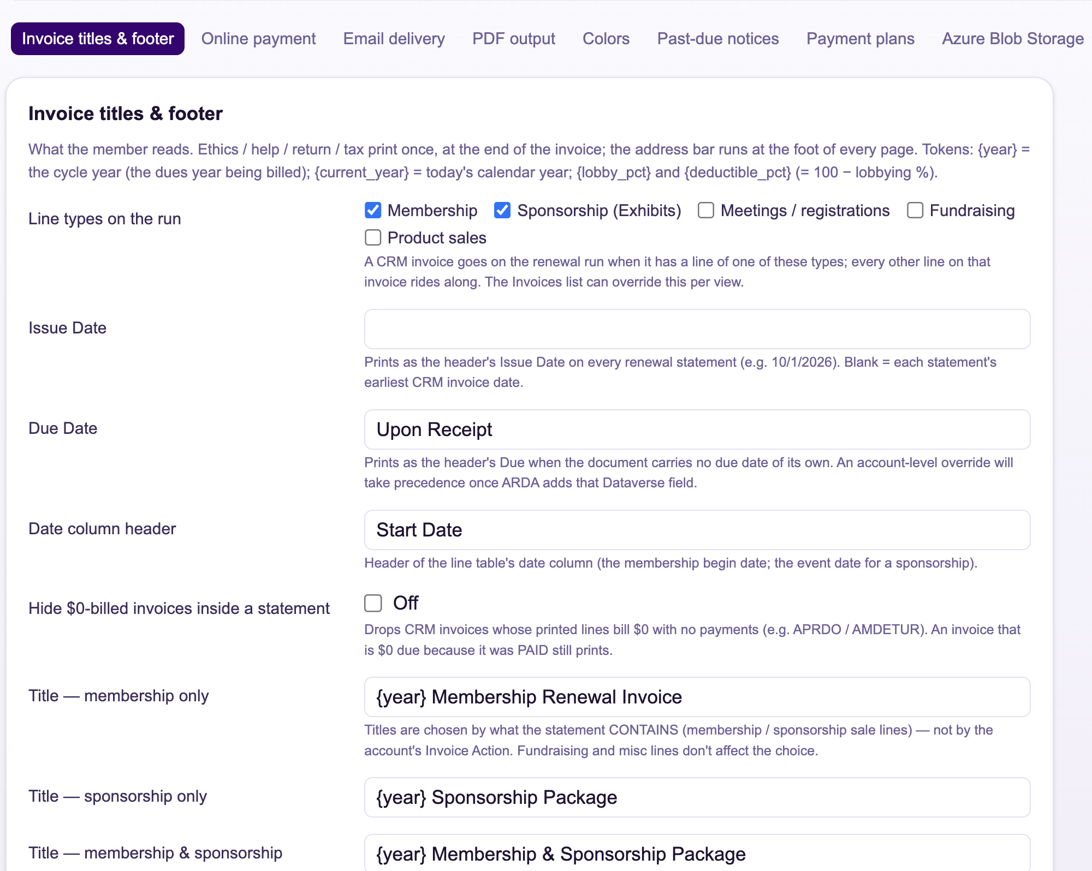

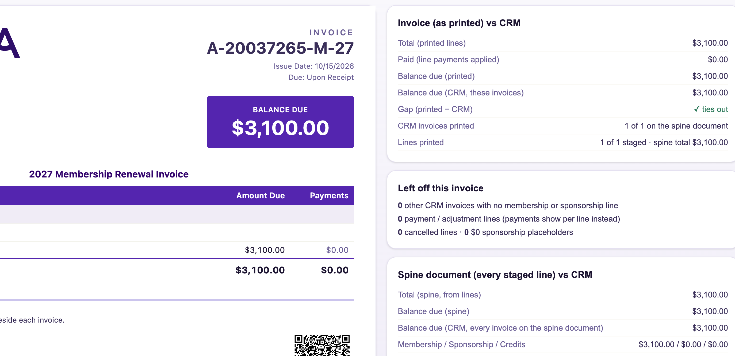
The foundation also supports customizable renewal statements
Makes it easier to send each organization a renewal statement it can review and pay without back-and-forth.
PART 2 · CONNECTED DATA AND USEFUL APPLICATIONS

Slide 13
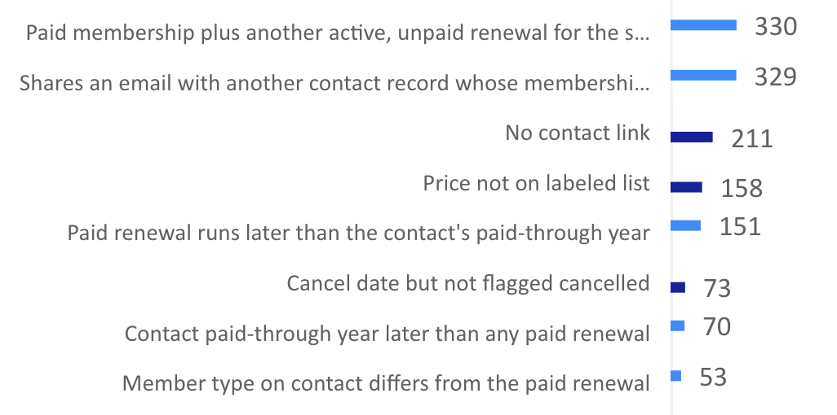

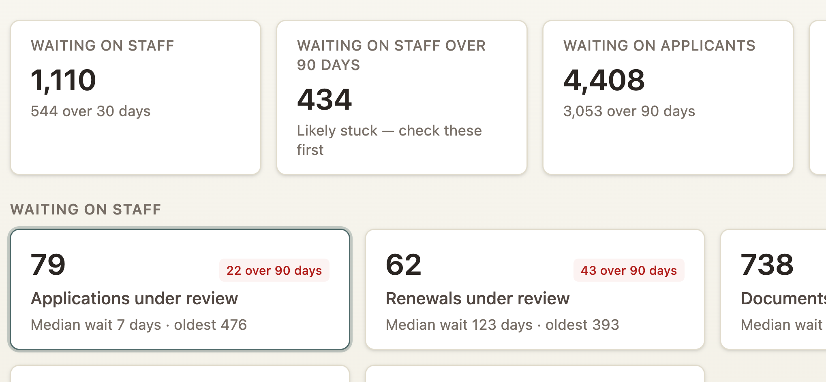
The foundation also supports reports that serve as Staff work lists
Makes it easier for staff to work a queue of exceptions and jump straight to the record that needs attention.
PART 2 · CONNECTED DATA AND USEFUL APPLICATIONS

Slide 14



Outside information gains context beside the AMS
Public-company reporting
CURRENT
SEC EDGAR filings (10-K, 10-Q, 8-K) for covered public companies
Economic indicators
CURRENT
Employment, travel and tourism, and consumer spending series
Legislative and congressional information
PILOT
Bills, hearings, and regulatory actions that affect the industry
Engagement and industry conversations
PILOT
Web and email engagement, events, industry news, and surveys
PART 3 · EXTERNAL EVIDENCE AND TRUSTED DEFINITIONS
Notes:
Group sources by the question they answer: public-company reporting, economic indicators, legislative and congressional information, and engagement and industry conversations.
The status labels (current, pilot, planned) are placeholders for the actual integration plan. Confirm each label before presenting.
Avoid a wall of provider logos; the catalog screenshot should show selected sources with their reporting period, refresh schedule, and limitations.

Slide 15

Shared definitions support different experiences
Shared definition: Resort property
SQL transformations and views
Staff analysis and extracts
Entity
Resort property
Unit
One record per physical property
Power BI semantic model
Applied once
Staff and member reporting
Relationships
Property → operator → parent company
Date rule
As of the end of the reporting period
Portal and public page logic
Public data products
Calculation
Count of active properties
Cohort
By state; public view suppresses small groups
Approved AI tools (MCP)
Governed natural-language answers
A catalog describes the information. Implemented measures and views apply the definitions, so every experience gives the same answer.
PART 3 · EXTERNAL EVIDENCE AND TRUSTED DEFINITIONS
Notes:
Lead: John (about 1 minute).
Common entities, units, relationships, date rules, calculations, and cohorts are agreed once and reused through SQL transformations and views, Power BI semantic models, portal logic, and approved AI tools.
A catalog describes the information; implemented measures and views apply the definitions, so every experience gives the same answer.

Slide 16
The measure behind “resort properties by state”
Measure card: Resort properties by state
ILLUSTRATIVE
What counts?
An active resort property with a physical street address
Included records
Resort Tracker records with status Active on the as-of date
Duplicates
One record per physical property; aliases merged by address and parcel
Geography
The property’s physical address, not the operator’s mailing address
Reporting date
As of the last successful refresh; the period is shown with the answer
Owner
ARDA research and analytics (definition v1.3)
Coverage gaps
Properties without a verified address are counted separately
Sample values for layout only. Replace with the approved measure, or keep as a labeled concept.
PART 3 · EXTERNAL EVIDENCE AND TRUSTED DEFINITIONS
Notes:
Walk the measure card: what counts as a property, which records are included, how duplicates are handled, which address supplies geography, what reporting date applies, who owns the definition, and what coverage is missing.
The rules and chart values are illustrative. Do not present them as an approved ARDA measure or total; replace with the approved definition or keep as a labeled concept.

Slide 17
Another Example: Professional Association “Members by program year”
Measure card: Members by program year
ILLUSTRATIVE
What counts?
A person with an active BPS Membership, paid through the program year or later
Included records
BPS Membership renewal records in Protech; subgroups follow the membership on the same invoice
Duplicates
One count per person per year; with several records, the member type comes from that year’s rate
Program year
The year the membership was purchased for, not the year it was bought; “Next Year” rates sold after July 1 count toward the following year
Reporting date
As of the last successful refresh; “same point last year” compares to today minus 12 months
Owner
BPS Membership with Finance (definition v1.0)
Exclusions
Staff and vendor test accounts; renewals billed but never paid
Sample values for layout only. Replace with the approved measure, or keep as a labeled concept.
PART 3 · EXTERNAL EVIDENCE AND TRUSTED DEFINITIONS
Notes:
Walk the measure card: what counts as a property, which records are included, how duplicates are handled, which address supplies geography, what reporting date applies, who owns the definition, and what coverage is missing.
The rules and chart values are illustrative. Do not present them as an approved ARDA measure or total; replace with the approved definition or keep as a labeled concept.

Slide 18


The answer carries its source and freshness
SOURCE REGISTER
CONCEPT
About this answer
CONCEPT
Source | Reporting period | Last refresh | Owner | Status
SEC EDGAR filings | FY2025 | 24 Oct 2026 | Research | Current
Resort Tracker | As of refresh | 24 Oct 2026 | Industry data | Current
Employment series | Sep 2026 | 20 Oct 2026 | Research | Pilot
Source
SEC EDGAR; Resort Tracker
Reporting period
FY2025 (company fiscal years vary)
Last successful refresh
24 Oct 2026, 06:00 ET
Definition
Resort property v1.3
Reporting period
≠
Refresh time
Methodology
Method note (link)
What the data describes: the company’s fiscal year, the survey month, or the as-of date of a record.
When the platform last loaded the source successfully. A failed refresh needs to keep the previous data.
Limitations
Private companies not covered; 3 states suppressed (small groups)
The same “about this answer” detail travels with the answer in screens, exports, and AI responses.
PART 3 · EXTERNAL EVIDENCE AND TRUSTED DEFINITIONS
Notes:
Every answer shows its source, reporting period, last successful refresh, definition and version, methodology, and limitations.
Distinguish the source's reporting period (what the data describes) from the platform's refresh time (when it was last loaded successfully).
The popover and register are labeled concepts; replace with the real interface when it is available.

Slide 19
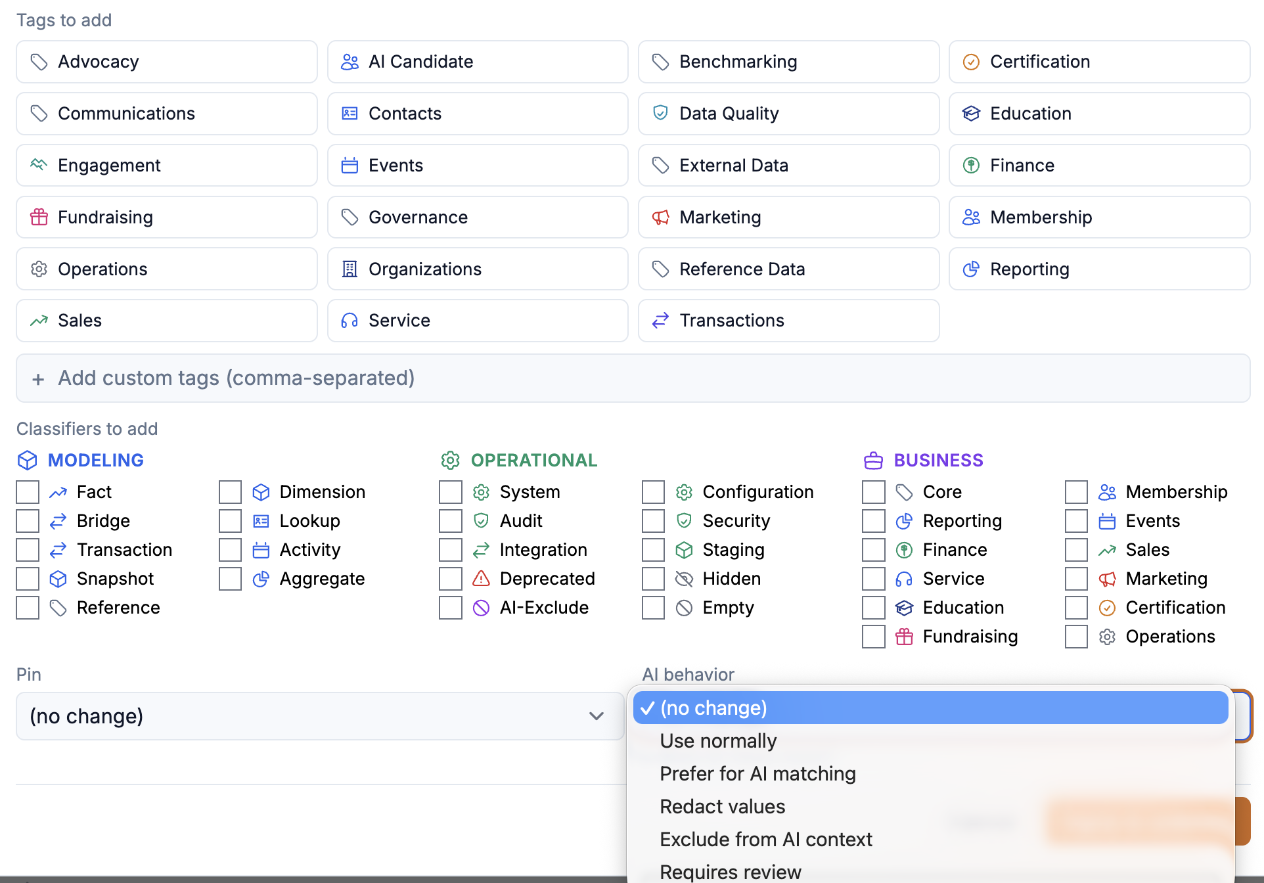




Security and ownership guide every experience
Information | Staff | Member | Contributor | Public | Staff AI | External AI
Member and dues records | Role-based | Own org | — | — | Role-based | —
Sensitive fields (balances, notes) | Restricted | — | — | — | — | —
Resort Tracker records | Full | Related | Assigned | Published | Full | Published
Public-company data | Full | Full | — | Published | Full | Published
Published measures | Full | Full | Full | Published | Full | Published
Governance screen
Identity: Microsoft Entra ID
The same boundaries apply to screens, exports, and AI answers. A service never sees more than the person using it is allowed to see.
Role, record, and field boundaries
Controlled update paths
ACCOUNTABLE OWNERS
Audit and access review
Membership and dues records
Resort Tracker
Published measures
Membership team
Industry data team
Research and analytics
Accountable owners per dataset
PART 4 · GOVERNANCE AND AUDIENCE-SPECIFIC PRODUCTS
Notes:
Identity and appropriate access; role, record, and field boundaries; protection across screens, exports, and AI; controlled update paths; audit and access review; accountable owners.
The matrix shows the pattern, not a final policy: confirm each cell against the configured roles. Mention deployment choices only with accurate labels.
Production: insert a small real governance-screen crop (role or security-group assignment).

Slide 20

One foundation serves different audiences
Staff
Members
Public
Contributors
Same topic: resort properties by state (illustrative)
Same topic: resort properties by state (illustrative)
Same topic: resort properties by state (illustrative)
Same topic: resort properties by state (illustrative)
By-state counts with record-level drill-down
Exceptions: missing addresses, duplicates
Worklist linked to the records
Approved comparisons against a cohort
Their own organization’s properties and status
Eligible benchmarks only
Curated counts by state, with explanation
Definition, source, and date shown
Small groups suppressed
Assigned records to review
Reviewed correction path with acknowledgment
Nothing beyond the assignment
e.g., 12 Florida properties missing addresses
e.g., your 18 properties vs. cohort median 24
e.g., Florida leads with 180 properties
e.g., 3 assigned records to confirm
AI is another interface to the same permitted information: each audience’s assistant answers only within that audience’s boundary.
PART 4 · GOVERNANCE AND AUDIENCE-SPECIFIC PRODUCTS
Notes:
Staff get operational detail, exceptions, and worklists. Members get approved comparisons and eligible organization-specific information. The public gets curated industry facts with explanation. Contributors get their assigned records and reviewed correction paths.
AI is another interface to the information permitted for each audience, never a way around the boundary.

Slide 21

Benchmarking starts with a meaningful comparison
Member benchmark
SYNTHETIC VALUES
COHORT
PERIOD
GEOGRAPHY
MEASURE
Developers, 10–50 properties ▾
FY2025 ▾
Southeast ▾
Properties per organization ▾
Public-record benchmarks
Built from public filings and published measures. Shareable with members under the publication rules.
Confidential member benchmarks
Member-contributed data needs its own collection rules, consent, suppression, and publication policy before any comparison is shown.
Cohort: 23 organizations · groups below the policy threshold are suppressed · source: published measures and public filings
PART 4 · GOVERNANCE AND AUDIENCE-SPECIFIC PRODUCTS
Notes:
A benchmark needs comparable entities, time periods, geography, measures, and cohort rules before it means anything.
Distinguish benchmarks built from public-company filings and published measures from confidential member-contributed benchmarks, which need their own collection, consent, suppression, and publication rules.
The screen is a labeled concept with synthetic values; replace with an approved benchmark screen if available.

Slide 22
A public data product answers, explains, and invites action
CONCEPT
Resort properties by state
State: All ▾
Year: 2025 ▾
Type: All ▾
1
Finding
1
Florida, California, and Nevada hold the largest share of resort properties (illustrative finding)
One clear statement in plain language
3
Why it matters
2
Accessible visualization
2
Where properties cluster shapes staffing, regulation, and demand for industry services. The count is a starting point for comparing markets.
Chart or map with a text alternative
3
Editorial explanation
Why it matters and how to read it
4
Example
A developer evaluating a new market compares a state’s property count with its visitor volume before deciding where to build.
4
Concrete example
An industry or practitioner scenario
5
Trust information
5
About this data: Resort Tracker · definition Resort property v1.3 · as of 24 Oct 2026 · 3 states suppressed (small groups) · method note
Definition, source, date, limitations
6
Explore related
Suggest a correction
Contribute
Explore membership
Contact staff
6
Next action
Explore, correct, contribute, join, or contact
PART 4 · GOVERNANCE AND AUDIENCE-SPECIFIC PRODUCTS
Notes:
Continue the resort-properties-by-state example: one finding, an accessible visualization, an editorial explanation, a concrete industry or practitioner example, trust information, and a meaningful next action.
Possible actions: explore related information, suggest a correction, contribute through a reviewed form, explore membership, or contact staff.
Production: replace the annotated concept with the approved public page if one exists. Photography can add context but never stands in for evidence.

Slide 23


Participation strengthens the next release
CONTRIBUTION QUEUE
EXAMPLE
Item | Submitted by | Evidence | Stage
Missing resort: Pelican Cove | Public visitor | Website, photo | Steward review
Wrong operator: Lakeside Club | Member contact | Management agreement | Approved
Duplicate: Harbor Point (2 records) | Staff | Address match | Refresh pending
Visitor flags an issue
Product refreshes
Submits evidence
Disclosure review: small groups can expose contributors even when individual records are absent. Suppression thresholds are set per product and reviewed, never promised as one universal minimum.
Participation loop
Approved data reaches Resort Tracker
Steward reviews
Every contributor receives an acknowledgment. Approved information reaches the right system, and the product refreshes on the next cycle, so the next release is better than the last.
PART 4 · GOVERNANCE AND AUDIENCE-SPECIFIC PRODUCTS
Notes:
A visitor identifies a missing resort or an incorrect relationship, submits evidence, and receives an acknowledgment. A steward reviews it; approved information reaches the right system (Resort Tracker); the product refreshes.
Disclosure and suppression review: small groups can expose contributors even when individual records are absent. Do not present a single minimum group size as a universal guarantee.

Slide 24
Two AI services with different permissions
Staff MCP service
DEMONSTRATED
External MCP service
IN PROGRESS
INFORMATION PERMISSIONS
TOOL PERMISSIONS
INFORMATION PERMISSIONS
TOOL PERMISSIONS
✓ Authorized internal information, within the requester’s role
✓ Approved external context: filings, indicators
✓ Read, group, and summarize
✓ Prepare draft text in chat
✕ Update, approve, invoice, or send
✓ Approved published measures
✓ Methodology and source notes
✓ Public-company financials
✕ Private dues, balances, contacts, notes
✓ Read and summarize
✓ Link to correction and contact paths
✕ Any update or message
Identity: the staff member signs in; the service inherits that person’s permissions
Identity: anonymous, public, or member account; only the published scope is reachable
Governed foundation · shared definitions · permissions · audit · refresh
A connector is a defined way for an approved AI application to request information and tools. Access permissions decide what can be retrieved; tool permissions decide what can be done.
PART 5 · TWO REAL-WORLD MCP SCENARIOS
Notes:
A connector is a defined way for an approved AI application to request information and tools. The staff service exposes authorized internal information and approved external context. The external service exposes approved published information and methodology.
Access permissions determine what may be retrieved. Tool permissions determine what may be done.
The status labels (demonstrated, proposed) are placeholders: identify which services are demonstrated and which are configured or proposed before presenting. A small custom-connector setup crop can be added if helpful.

Slide 25

Staff MCP: a read-only renewal briefing
Staff assistant · connector: staff MCP service
SYNTHETIC CONVERSATION
WHAT IT CAN DO
Which organization memberships expire in the next 60 days and remain unrenewed? Group them by corporate family, flag exceptions, and link to the records staff should review.
✓ Read within the requester’s role
✓ Group, flag, and link records
✓ Draft text in chat
Renewal briefing · as of 24 Oct 2026 · scope: Membership team role
Corporate family | Organizations | Expires | Flag
Acme Resorts Holdings | 3 | 15 Nov 2026 | Parent renewed; 2 subsidiaries open
Harbor Point Development | 1 | 30 Nov 2026 | Invoice disputed
Lakeside Club | 1 | 12 Dec 2026 | New primary contact
WHAT IT CANNOT DO
✕ Update memberships or invoices
✕ Approve changes
✕ Send messages
Source: Protech membership records through analytical views · 12 organizations in scope · Open record →
Mark those renewed and send confirmation emails.
Brian’s example: Jason’s company analysis (Marriott, Hilton, Travel + Leisure) using approved output.
I can’t do that. This service is read-only: it cannot update memberships, change invoices, approve changes, or send messages. I can draft the confirmation text for you to send from Protech.
PART 5 · TWO REAL-WORLD MCP SCENARIOS
Notes:
Prompt: "Which organization memberships expire in the next 60 days and remain unrenewed? Group them by corporate family, flag exceptions, and link to the records staff should review."
The answer is a dated worklist within the requester's authorized scope. The assistant can explain information and prepare text in chat. It cannot update memberships, change invoices, approve changes, or send messages.
Boundary test: "Mark those renewed and send confirmation emails."
Alternate staff example: Jason's Marriott, Hilton, and Travel + Leisure analysis, using original approved output when available.

Slide 26
External MCP: a sourced industry briefing
Public assistant · connector: external MCP service
Chat CONVERSATION
IN SCOPE
Using ARDA’s published information, summarize resort locations by state and recent trends among the covered public companies. Include sources, reporting periods, coverage, and limitations.
✓ Published measures and methodology
✓ Public-company financials
✓ Correction and contact paths
Industry briefing · published information only · as of 24 Oct 2026
Resort properties by state: Florida, California, and Nevada lead (illustrative); definition Resort property v1.3
Covered public companies (6): revenue index rose for 4 of 6 in FY2025 (illustrative); fiscal years vary
Sources: SEC EDGAR filings; ARDA published measures and method notes
Coverage and limitations: public companies and published measures only; 3 states suppressed; private companies excluded
Suggest a correction → · Contact ARDA staff →
OUT OF SCOPE
✕ Dues and balances
✕ Contact details
✕ Internal notes and member records
Which companies owe ARDA dues?
Professional-society analogue: approved credential verification, public requirements, and workforce statistics; applications and exam records can stay restricted.
That isn’t available here. Dues, balances, contact details, and internal notes are outside this service’s scope. For published measures and public filings, I can continue.
PART 5 · TWO REAL-WORLD MCP SCENARIOS
Notes:
Prompt: "Using ARDA's published information, summarize resort locations by state and recent trends among the covered public companies. Include sources, reporting periods, coverage, and limitations."
The answer uses approved published measures and public records, with methodology and correction/contact links. Public-company financials may be included. Private dues, balances, contact details, and internal notes stay outside scope.
Boundary test: "Which companies owe ARDA dues?"
Keep the demonstration read-only; link to the separate reviewed contribution process.
Professional-society analogue: approved credential verification, public requirements, and workforce statistics, with applications and exam records restricted.

Slide 27










The Public Data Product Kit
Public Data Product Kit.xlsx
1
2
3
Decision
Entry
Owner
Purpose and audience
Governed measures
Sources and methodology
1 Purpose and audience
Public visitors
Research
Who it is for and what it answers
Definitions, versions, owners
Where it comes from and how
2 Governed measures
Resort property v1.3
Research
3 Sources and methodology
Resort Tracker, EDGAR
Industry data
4
5
6
4 Cohorts and suppression
By state; small groups hidden
Research
Cohorts, comparisons, suppression
Privacy and access
Public experience and next action
5 Privacy and access
Public counts only
Membership
What is comparable and what stays hidden
Who may see what
The page and what to do next
Start Here
Example
Decisions
Sources
Tables-Views
Relationships
Operations
7
8
9
Inventory sheets (Sources, Tables/Views, Relationships, Operations) record what exists. The nine decisions record what the product promises. A worksheet records decisions; the services enforce them.
Narrative and examples
Contributor workflow
Governed AI
Explanation people can use
How corrections come in and get reviewed
What assistants may retrieve and do
PART 6 · THE KIT AND THE CLOSE
Notes:
Nine decisions: purpose and audience; governed measures; sources and methodology; cohorts, comparisons, and suppression; privacy and access; public experience and next action; narrative and examples; contributor workflow; governed AI.
The inventory sheets (Sources, Tables/Views, Relationships, Operations) support the product decisions. A worksheet records decisions; the services must enforce them.
Production: replace the workbook mock with a preview of the finished Excel toolkit.

Slide 28
One completed example makes the Kit usable
COMPLETED WORKSHEET
EXAMPLE
Field | Entry
Audience | Public visitors and prospective members
Question | How many resort properties are in each state?
Measure | Resort properties by state (definition v1.3)
Sources | Resort Tracker; SEC EDGAR for public-company context
Access and release rules | Public counts by state; small groups suppressed; no record-level detail
Public page | Finding, chart, explanation, about-this-data, next actions
Correction process | Suggest-a-correction form → steward review → refresh
Owner | Research and analytics
Refresh responsibility | Data team, monthly; failed refreshes alert the owner
Resort properties by state
CONCEPT
Florida, California, and Nevada lead (illustrative)
About this data: Resort Tracker · v1.3 · as of 24 Oct 2026 · small groups suppressed
Explore
Correct
Contribute
Contact
Your turn
Write down:
One question
One audience
One owner
That is your first release.
PART 6 · THE KIT AND THE CLOSE
Notes:
Lead: John (about 1.5 minutes).
Walk the linked resort-properties-by-state example: audience, question, measure, sources, access and release rules, public page, correction process, owner, and refresh responsibility.
Invite attendees to name one question, one audience, and an owner for their own first release.
The worksheet uses synthetic entries; label them as such.

Slide 29
ARDA’s next chapter
1
Analytical expertise
2
Specialized workflows
NOW
SQL views on a governed analytical layer
NOW
Statements, badges, and staff worklists
NEXT
Extend analytics and industry products
NEXT
Evolve the website and application strategy
3
Resort Tracker connected
4
Outside intelligence
NOW
Linked records and reviewed corrections
NOW
Public-company reporting in context
NEXT
Invite better contributions from more participants
NEXT
Refine and audit sources; expand governed natural-language access
“Protech provided the foundation. Microsoft gave us room to build. Thoughtful connections and governance let us turn that investment into information and services our community can use.”
PART 6 · THE KIT AND THE CLOSE
Notes:
Priorities: refine and audit sources, extend useful analytics and industry products, invite better contributions, expand governed natural-language access, and evolve the website and application strategy.
Return to the four business needs from slide 5: show how current work addresses them and where the roadmap continues.
Closing thought: "Protech provided the foundation. Microsoft gave us room to build. Thoughtful connections and governance let us turn that investment into information and services our community can use."
Production: replace the photograph placeholder with approved ARDA or industry photography.

Slide 30


What could your association make easier to understand or do?
Free Tools
Public Data Product Kit + more tools to use with Protech
Scan to explore ↓
Kit.xlsx
Questions and discussion
BRIAN KALTENBAUGH
JOHN STOVER
ARDA
[verified email]
Org Data Solutions
john@orgdatasolutions.com
OrgDataSolutions.com/appcon26
Notes:
Open the floor. Keep this slide visible during discussion.
Production: add the verified presenter contacts, the working Kit download URL, and a QR code. Deliver the promised resource; identify any optional signup clearly.

