Slide 1

>>> print ’’’ The first INSEAD Python Bootcamp ’’’
Put together by Julien Clement, Helge Klapper and Maciej Workiewicz

Slide 2
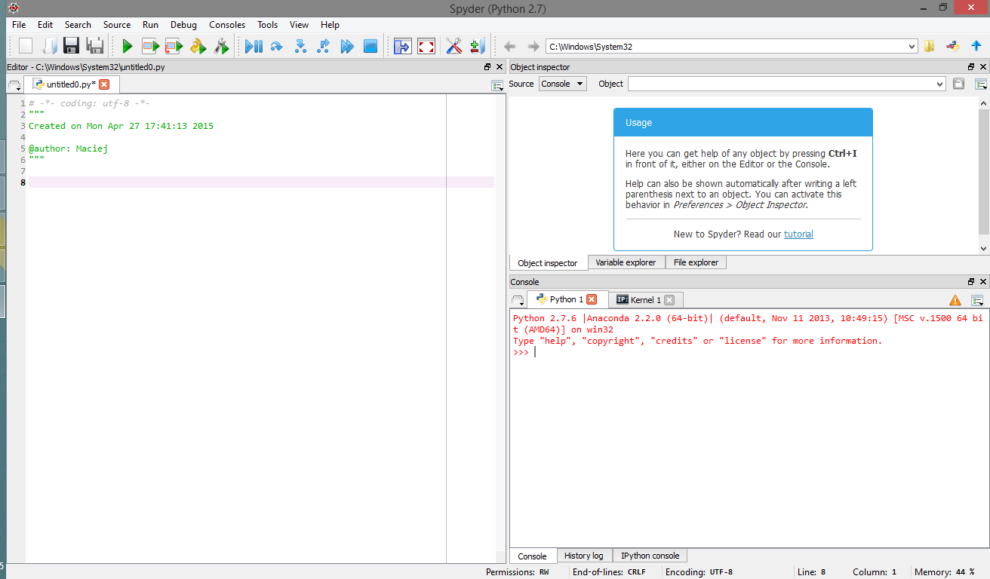
Spyder
Start a new project
Save current project
information on objects
Run the entire code
Run the selected code
This is where you write your code
Here you see your
code executed

Slide 3
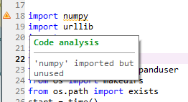
Spyder and programming
linting (error analysis)
A few coding tips
Comment your code as if you were sharing it with someone else
Keep a journal of changes you make to your code (either within the file itself or in a separate file). You can also use git, but that is for more advanced projects.
Do not write lines longer than 80 characters (74 is the most common).

Slide 4
What you need to know (that’s it!)
1 | Importing modules
2 | Random numbers (and conditions)
3 | Loops
4 | Functions
5 | Storage
6 | Graphs

Slide 5
1 | Importing modules
Which modules do we need for simulations?
random: random number generator and choice functions
numpy: calculations, especially matrix operations
matplotlib: graphs
csv: export results to a csv file (if necessary)
We can import entire modules, or parts of them
# import entire module
import datetime
# import entire module with an alias
import numpy as np
# import only one part of a module
from random import choice

Slide 6
2 | Random numbers (and conditions)
Create random numbers…
# Generate a random number between 0 and 1 (uniform distribution)
number = random.random()
# … between -0.5 and 0.5
number = random.random() – 0.5
# … integer between 1 and 100
number = random.randint(1,100)
… and use them to make probabilistic models
number = random.random()
# Do action 1 with 60% probability…
if number < 0.6:
action = 1
# Or action 2 with 30% probability…
elif number < 0.9 :
action = 2
# Or action 3 with 10% probability…
else:
action = 3

Slide 7
3 | Loops
Loops enable you to run the model for different parameters, different agents, different runs… in different ways
# Print numbers from 0 to 9
for i in range(10):
print(i)
# Add 1 to each element of a list
my_list = [0, 1, 2, 3, 4, 5]
for element in my_list:
element += 1
# Draw from a list of numbers until you get the number 5
my_list = [0, 1, 2, 3, 4, 5]
while random.choice(my_list) != 5:
print("Trying again…")
print("Found my number!")

Slide 8
4 | Functions
Any element that you use several times can be stored as a function
This will make your code clearer!
# Define a function that gives the inverse of a number
def inverse(number):
new_number = 1/number
return new_number
inverse(5)
>>> 0.2

Slide 9
5 | Storage
Numpy matrices provide flexible storage
import numpy as np
# Create a 5x7 matrix filled with zeros
row_nb = 5
col_nb = 7
storage = np.zeros((row_nb , col_nb))
# Over the course of the simulation, store random numbers in it
for i in range(row_nb):
for j in range(col_nb):
storage[i,j] = random.random()
… and we can run a bunch of operations on them
# get the averages of each column
col_averages = np.mean(storage, axis=0)
# get the averages of each row
row_averages = np.mean(storage, axis=1)

Slide 10
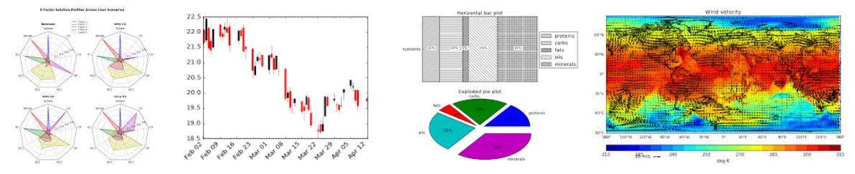
6 | Graphs
Matplotlib is super flexible… ask Google for the graph you want!
One simple example: bar plot
# import matplotlib’s plotting library
import matplotlib.pyplot as plt
# Plot the averages of each column (continued from last page)
x_pos = np.arange(col_nb)
plt.xlabel('Column number')
plt.ylabel('Average score')
plt.bar(x_pos, col_averages)
plt.show()

