Slide 1
DOCKER, kubernetes & Ibm cloud private

Slide 2
Agenda:
Brief introduction
Docker
Virtualization v/s Containerization
Build and run a docker image
Build and push docker image into IBM Cloud
Need for Kubernetes
Configure kubectl command
Deploy docker image on kubernetes cluster
Overview of IBM Cloud Private

Slide 3
Basic Definitions
Images and Containers
An image is an executable package that contains all the required libraries and environment to run an application.
A container is a runtime instance of the image.
Containers and Virtual Machines
A container runs natively on linux and shares the kernel of host machine.
A virtual machine runs on a full-blown guest operating system, with virtual access to hist resources through hypervisors.

Slide 4
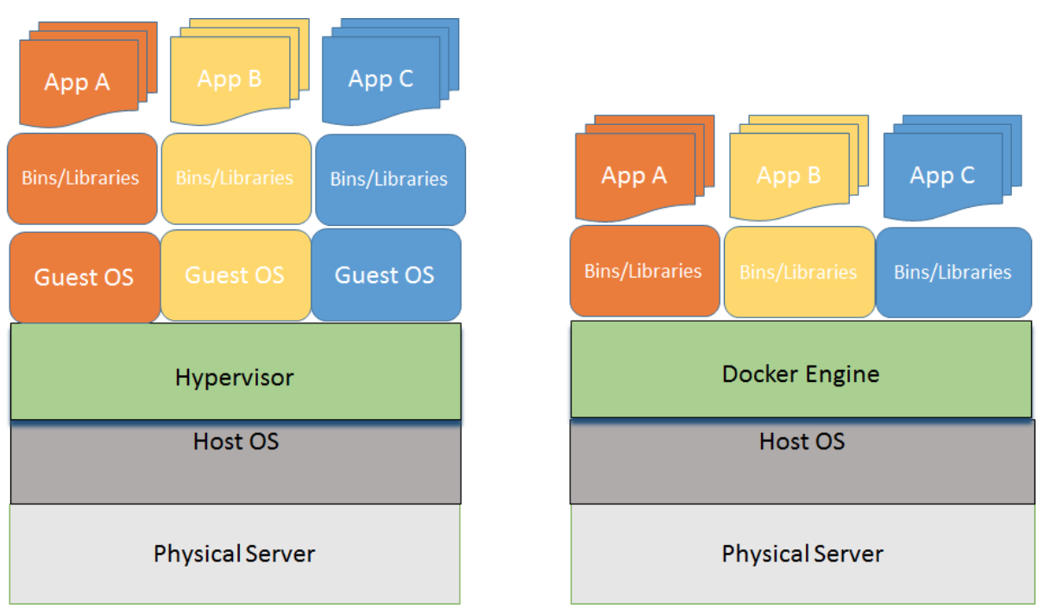
Virtualization v/s containerization
Notes:
A hypervisor or virtual machine monitor is computer software, firmware or hardware that creates and runs virtual machines. A computer on which a hypervisor runs one or more virtual machines is called a host machine, and each virtual machine is called a guest machine.
Docker is a set of platform-as-a-service products that use operating-system-level virtualization to deliver software in packages called containers.

Slide 5
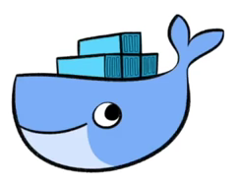
Where does docker operate?
Design
Development
Deployment
Testing
Release

Slide 6
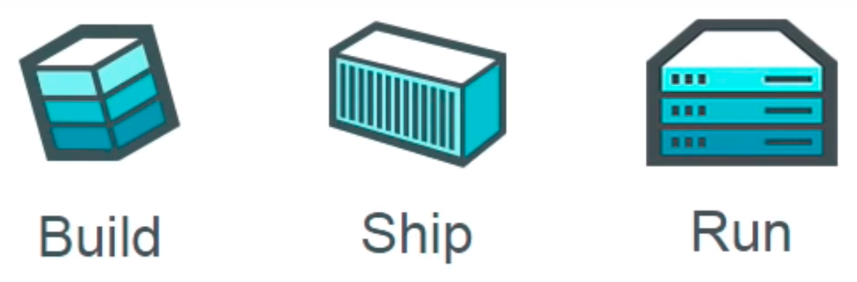
docker
A Docker is an open source platform for containers that provides a lightweight application isolated virtualization that reduces system overhead. It also enables to create, run, and deploy applications as a single package to any kind of environment, without the consideration of differences between build and production environments.

Slide 7
Why docker ?
Build any application in any language using any stack.
Dockered application can run anywhere on anything.
Reduce dependency clashes between developers and sysadmins.

Slide 8
Docker COmponents
Core Components
Docker Daemon: This runs on the host machine and can spin up containers inside the daemon.
Docker Client: The command line to interact with the daemon.
Workflow Components
Docker Image: Holds the environment required and application related binaries/libraries.
Docker Containers: Allows the images to turn on in the form on container, through which we can manage to start, stop, delete and move.
Docker Registry: To store docker images into public or private repositories.
Docker File: Automate the process of building a docker image.
Notes:
If you are on a windows machine, then we might need a extra layer called virtual box and install boot2docker, which will spin up a virtual linux box

Slide 9
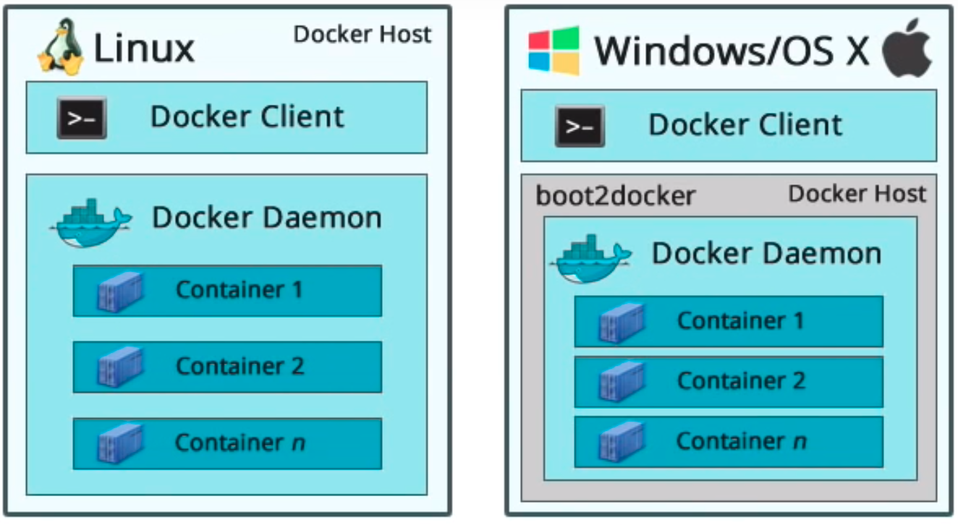
Docker install scenario
Notes:
OCI: Open Container Initiative
Containerd: An industry-standard container runtime with an emphasis on simplicity, robustness and portability. containerd is the core container runtime of the Docker Engine.
CNCF: Cloud Native Computing Foundation

Slide 10
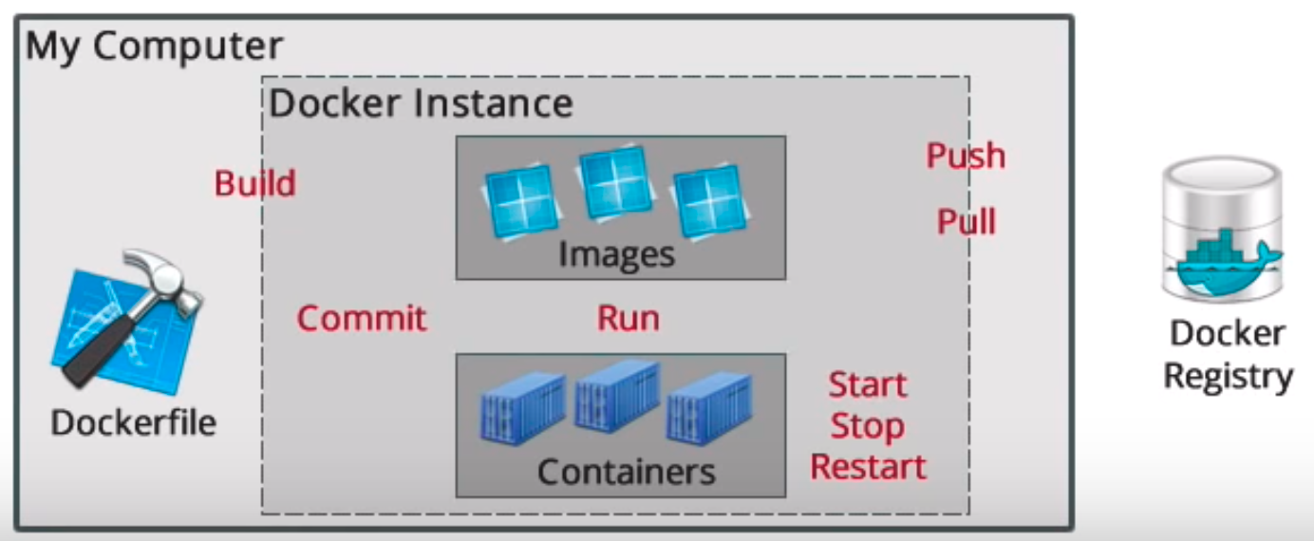
Docker devops
Notes:
OCI: Open Container Initiative
Containerd: An industry-standard container runtime with an emphasis on simplicity, robustness and portability. containerd is the core container runtime of the Docker Engine.
CNCF: Cloud Native Computing Foundation

Slide 11
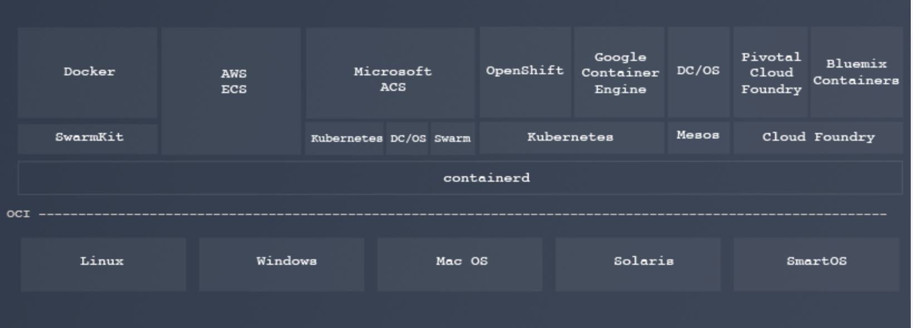
Core container runtime
Notes:
OCI: Open Container Initiative
Containerd: An industry-standard container runtime with an emphasis on simplicity, robustness and portability. containerd is the core container runtime of the Docker Engine.
CNCF: Cloud Native Computing Foundation

Slide 12
Docker relevance on dev-ops
Developers: The developers need not worry about setting up the specific development environment every time. Instead, they need to focus on building good quality code. This obviously leads to acceleration in the development efforts.
Operations: For IT operations team/Sysadmins, Docker makes it possible to set up environments that are exactly like a production server, and allow anyone to work on the same project with the exact same settings, regardless of the local host environment.

Slide 13
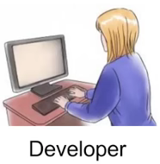

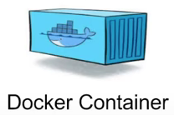
Docker workflow
Docker
Hub
Docker Image
Notes:
A developer defines all the application and dependencies into a Docker file.
This docker file is used to create a docker image.
When we run this docker image, we get a docker container.
Docker containers are runtime instances of a docker image.
This docker images can also be stored in an online repository at Docker hub

Slide 14
Install required tools
Install IBM Cloud tools
console.bluemix.net/docs/cli/index.html#downloads
Install Docker
docker.com (Download and install Docker community edition)
Install Kubernetes tools
kubernetes.io/docs/tasks/tools/install-kubectl/
Download the sample python web application
git clone https://github.com/orgveer/24august.git
Notes:
Typically for linux variants we can run any of the below command to start docker:
- sudo systemctl start docker
- sudo service docker start

Slide 15
Logging into IBM cloud
Type “bx login” from command line
Install IBM Container Service ” bx plugin install container-service -r Bluemix”
Install IBM Registry Service “bx plugin install container-registry -r Bluemix”
To access docker images in the public registry of IBM Cloud, log into the container registry service “bx cr login”
Dockerid: vchitral

Slide 16
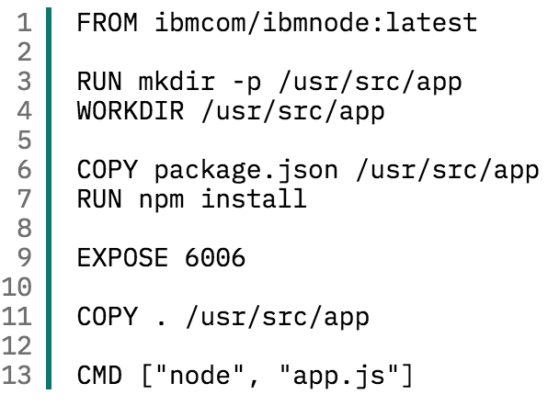
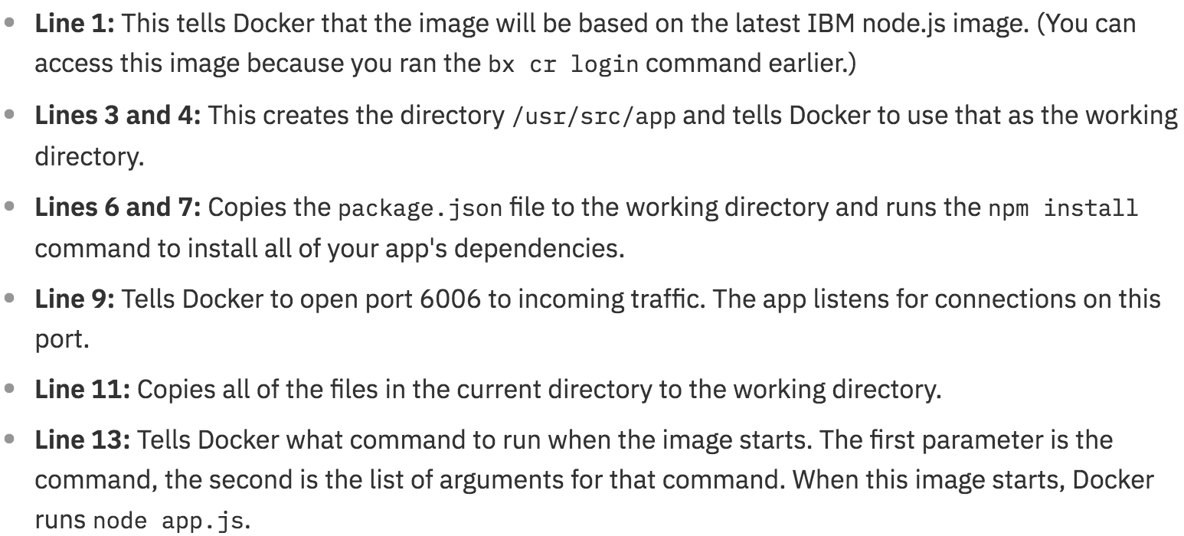
Building a docker image

Slide 17
Running docker image
Step -1: Build the docker image. (docker build -t <appname>:<versiontag> .)
Step -2: Create container from the docker image. (docker create <appname>:<versiontag>)
Step -3: Use Kitematic tool for working with containers.

Slide 18
Push docker image into ibm cloud
Step -1: Create a namespace. (bx cr namespace-add <namespace>)
There are two ways of pushing the existing docker image into IBM Cloud
a: Execute this commands:
docker tag basicapp:v1 registry.ng.bluemix.net/mailbag/basicapp:v2
docker push registry.ng.bluemix.net/mailbag/basicapp:v2
b: ibmcloud cr build -t registry.ng.bluemix.net/<namespace>/<appname>:<versiontag> .

Slide 19
At this point we have an image on IBM Cloud.. But this is not yet running and the runtime for running an docker image is container. So we will use the Kubectl and ibmcloud command line tools to deploy the image as container, running in the cluster and expose the container to the world.

Slide 20
Kubernetes – platform to work with containers
Open Source - Container Orchestrator
Help to automate DevOps – Deployment, scaling and management of containerized apps
Helps organize container in logical units( pods, nodes)
Will relaunch apps that have failed – (self healing )
Expose apps as service – load balance request between multiple apps
Usually installed on Cloud Infra (public) as well on private, hybrid
Also a application platform that makes app deployment easier and automate (declarative)

Slide 21
Need for kubernetes
Application grows-multiple, independent microservice
Experience higher load
Applications running with a huge number of components, can be tricky
Way to take those docker containers and make them into distributed systems.
Run large scale production based containers on small and large systems, cloud provider.

Slide 22
Kubernetes client
CLI tool to interact with Kubernetes cluster
Platform specific binary available to download https://kubernetes.io/docs/tasks/tools/install-kubectl
The user directly manipulates resources via json/yaml $ kubectl (create|get|apply|delete) -f myResource.yaml

Slide 23
Create kubernetes cluster on ibm cloud
Create a cluster
Get the configuration details for the cluster we created. (ibmcloud cs cluster-config <clustername>
The above command will output the value for environment variable KUBECONFIG
Set the environment variable as-is, this allows to map the commands we run using the kubectl, and will affect the cluster running on IBM Cloud.

Slide 24
At this point, the Docker image you want to deploy is in the IBM Cloud, your Kubernetes cluster is up and running, and the kubectl command is configured to work with your cluster.

Slide 25
Deploy docker image on kubernetes cluster
Start docker image from your IBM Cloud container repository in the cluster.
kubectl run <kubernetes deployment name> --image=registry.ng.bluemix.net/<namespace>/<appname>:<versiontag>
At this point the deployment is been created, lets expose the deployment on a port
kubectl expose deployment/<deploymentname> --type=NodePort --name=<servicename> --port=6006
At this point our service is exposed
To view more details for the service created
kubectl describe service <servicename> .. See the a nodeport has been assigned
Now to find the kubernetes cluster Ip and details
ibmcloud cs workers <clustername>
Launch the web application which is now running on cluster
Notes:
Delete a service
kubectl delete svc vthinkclusterdeploy2-service

Slide 26
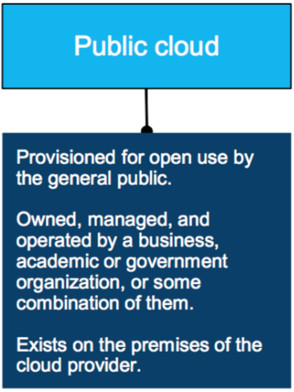
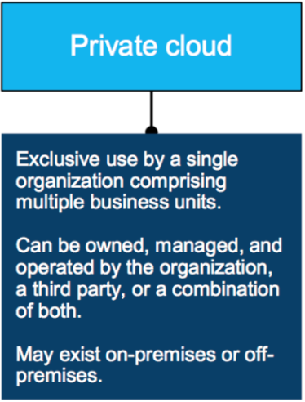
Overview of IBM Cloud private

Slide 27
Why interest in private cloud?
Many organizations are grappling with the need to work faster, deliver sooner, and scale infinitely but, in many cases, cannot run their applications on the public cloud. Most of the time they are held back by regulatory and legal requirements. Others do not want their strategic assets to leave their organization.
Does this mean that organizations with sensitive or strategic applications will lose out on the benefits of a cloud architecture?
No. A Private cloud can bring the benefits of a public cloud behind your firewall.
A private cloud allows companies to customize their environments according to their own unique needs and based on their own security requirements. Private cloud leverages the benefits of public cloud, including rapid deployment, scalability, ease of use and elasticity. But it can also offer additional capabilities such as greater control, increased performance, predictable cost, tighter security and flexible management options.

Slide 28
THANK YOU!!!

