Slide 1
Kubernetes
Deploy, scale and manage containerized applications

Slide 2
Agenda
Need for container orchestration
What is Kubernetes?
Architecture
Key Objects
Application deployment workflow
Demo: Deploy a node Js web application and Redis database onto IBM Cloud Kubernetes Cluster

Slide 3
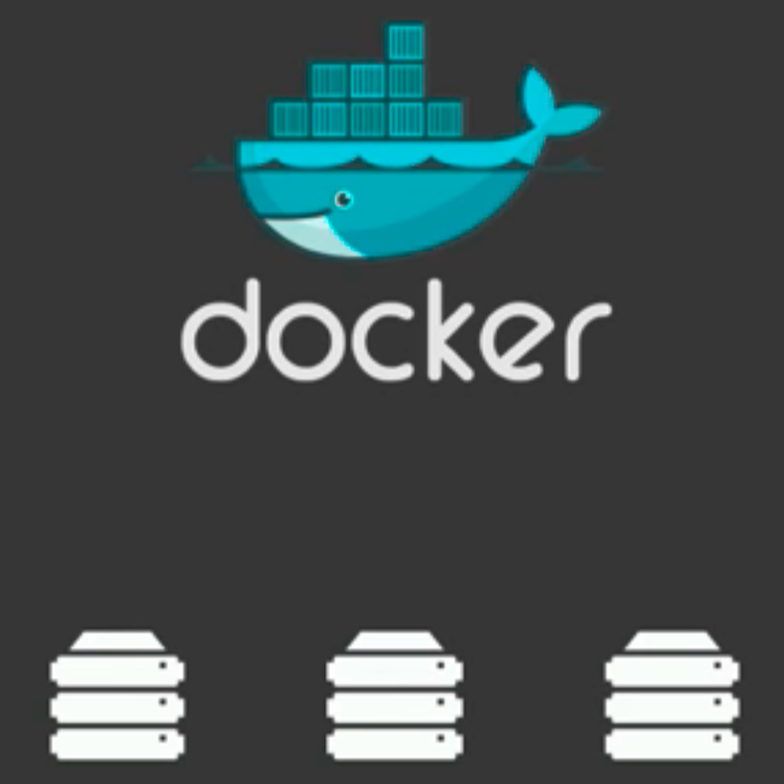
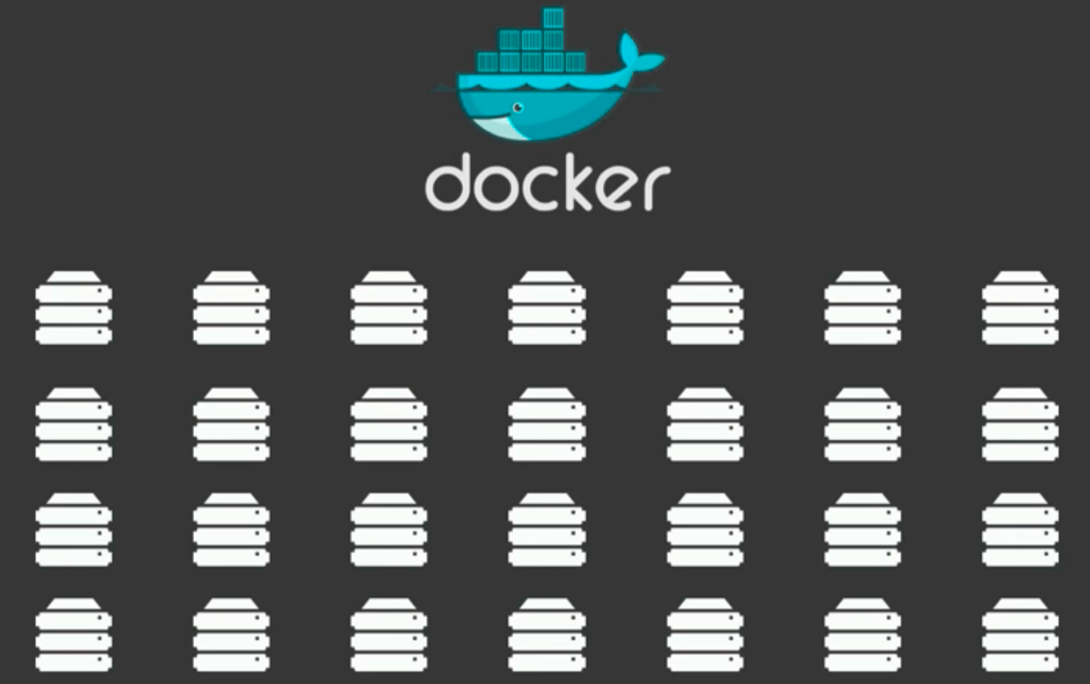
Need for Container Orchestration
Deployed on 3 servers - SIMPLE
Jump to 40 - 50 servers – DIFFICULT
Keep track
Scale out
What container and Where?

Slide 4
What is Kubernetes?
Kubernetes is a container orchestrator to provision, manage, and scale applications. In other words, Kubernetes allows you to manage the lifecycle of containerized applications within a cluster of nodes (which are a collection of worker machines, for example, VMs, physical machines etc.).
Notes:
The key paradigm of kubernetes is it’s Declarative model. The user provides the "desired state" and Kubernetes will do it's best make it happen. If you need 5 instances, you do not start 5 separate instances on your own but rather tell Kubernetes that you need 5 instances and Kubernetes will reconcile the state automatically. Simply at this point you need to know that you declare the state you want and Kubernetes makes that happen. If something goes wrong with one of your instances and it crashes, Kubernetes still knows the desired state and creates a new instances on an available node.

Slide 5
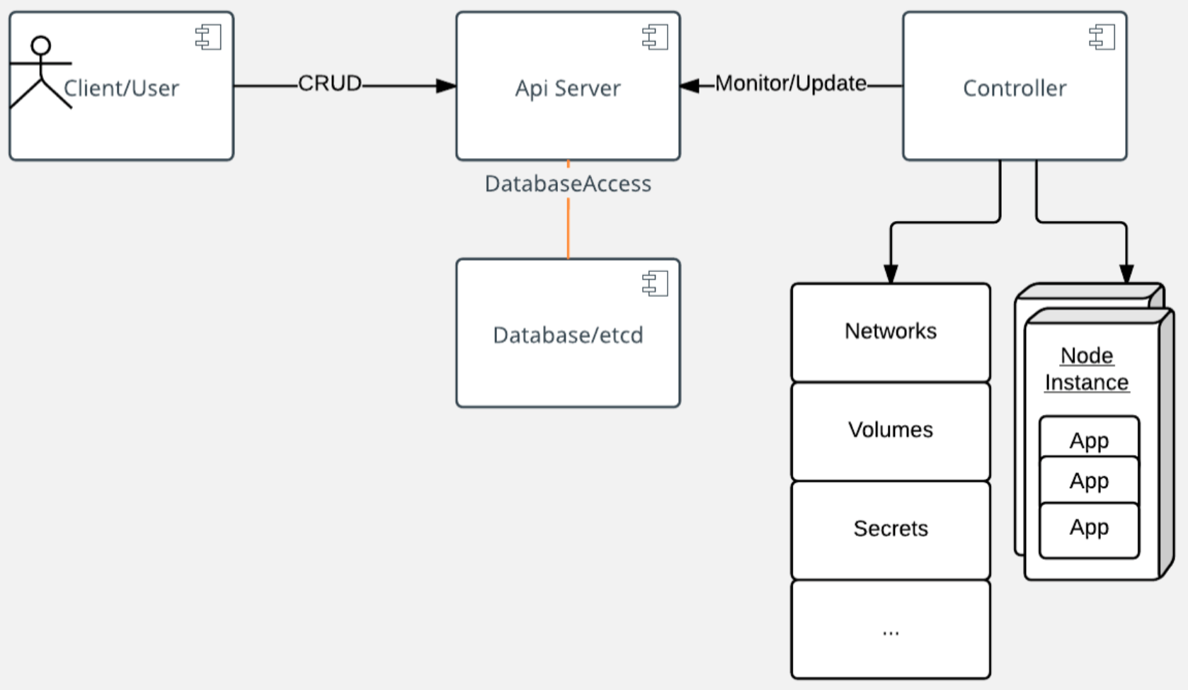
Architecture
At its core, Kubernetes is a data store (etcd). The declarative model is stored in the data store as objects, that means when you say I want 5 instances of a container then that request is stored into the data store. This information change is watched and delegated to Controllers to take action. Controllers then react to the model and attempt to take action to achieve the desired state.
Notes:
As shown, API server is a simple HTTP server handling create/read/update/delete(CRUD) operations on the data store. Then the controller picks up the change you wanted and makes that happen. Controllers are responsible for instantiating the actual resource represented by any Kubernetes resource. These actual resources are what your application needs to allow it to run successfully.

Slide 6
Key Objects
Pod
Pod/s are smallest and simplest object
Pod represents a set of running containers on cluster
Pod typically setup to run a single primary container.
Pods are commonly managed by a deployment definition object
Deployment
This object describe desire state
Deployment controller changes the actual state to desired state at controlled rate
Define deployments to create new ReplicaSets or remove existing deployments and adopt all their resources with new deployments
Service
Is an API object that describes how to access applications such as a set of Pods
Is an abstraction which defined a logical set of Pods and a policy by which to access them, sometimes called a micro service
Kube-Proxy in each worker node is responsible for managing virtual IPs for the service

Slide 7
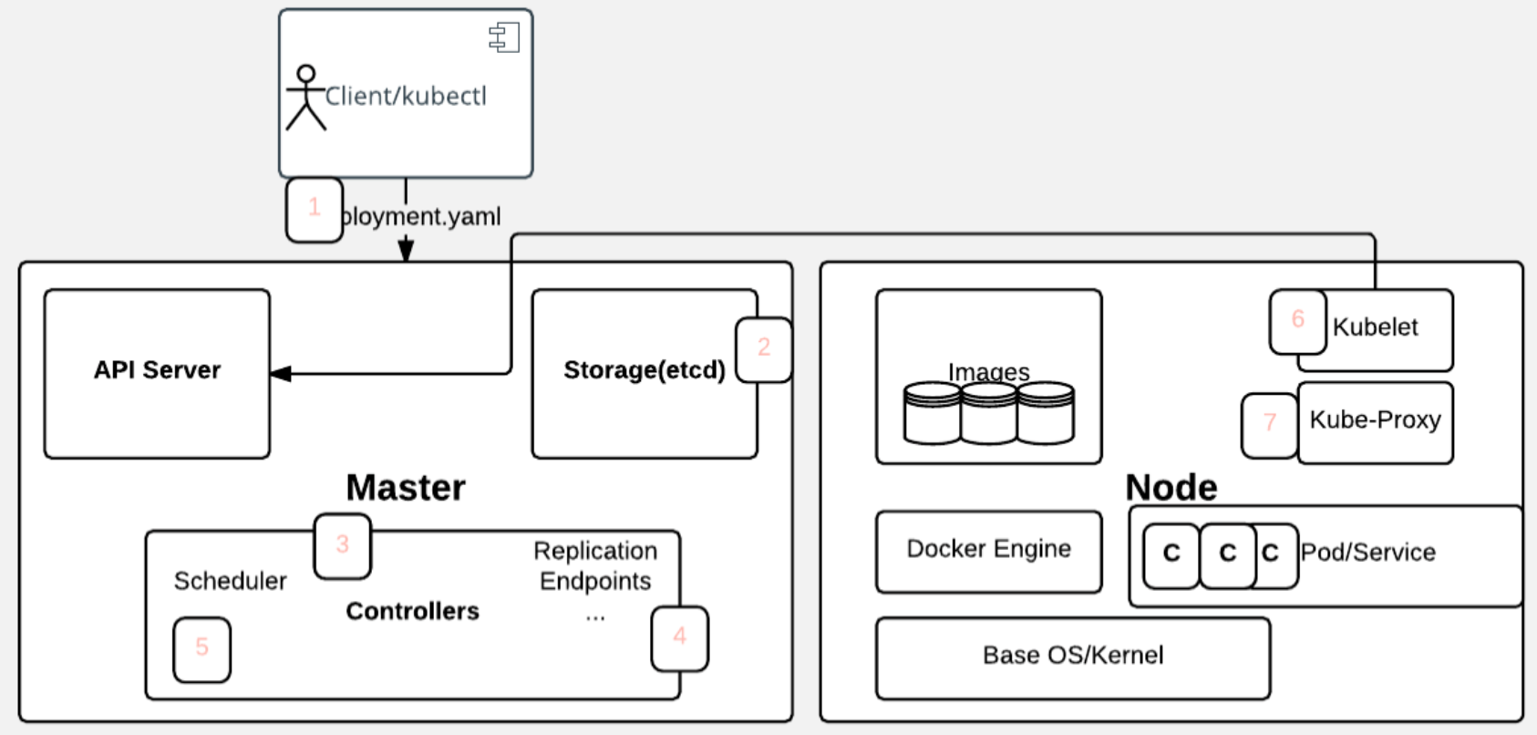
Application Deployment Flow
Notes:
User via "kubectl" deploys a new application. Kubectl sends the request to the API Server.
2. API server receives the request and stores it in the data store (etcd). Once the request is written to data store, the API server is done with the request.
3. Watchers detects the resource changes and send a notification to controller to act upon it
4. Controller detects the new app and creates new pods to match the desired number# of instances. Any changes to the stored model will be picked up to create or delete Pods.
5. Scheduler assigns new pods to a Node based on a criteria. Scheduler makes decisions to run Pods on specific Nodes in the cluster. Scheduler modifies the model with the node information.
6. Kubelet on a node detects a pod with an assignment to itself, and deploys the requested containers via the container runtime (e.g. Docker). Each Node watches the storage to see what pods it is assigned to run. It takes necessary actions on resource assigned to it like create/delete Pods.
7. Kubeproxy manages network traffic for the pods – including service discovery and load-balancing. Kubeproxy is responsible for communication between Pods that want to interact.

Slide 8
Demo
Deploy NodeJs application and Redis as backend database, onto IBM Cloud Kubernetes cluster.
Repo: https://github.com/orgveer/31August.git

Slide 9
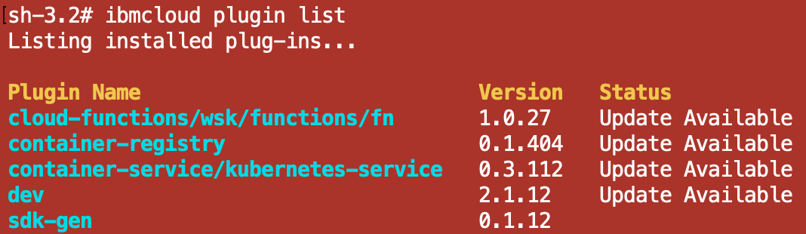
Pre-requisites
Step-1: Install IBM Cloud Cli (https://cloud.ibm.com/docs/cli?topic=cloud-cli-getting-started)
Step-2: Install IBM cloud Kubernetes Service plugin
> ibmcloud plugin install container-service -r Bluemix
Step-3: Install IBM cloud Container registry plugin
> ibmcloud plugin install container-registry -r Bluemix

Slide 10
Pre-requisites
Step-4: Install Kubectl (https://kubernetes.io/docs/tasks/tools/install-kubectl/)
Step-5: Provision a kubernetes cluster on IBM Cloud

Slide 11
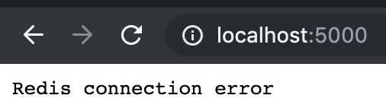
Build Application as Docker Image and Run
Step-6: Build docker image
> docker build -t <namespace>/webapp .
Step-7: Run the container for the image created
> docker run -d -p 5000:5000 veer/nodewebapp
Step-8: Launch the node web application from browser
http://localhost:5000

Slide 12
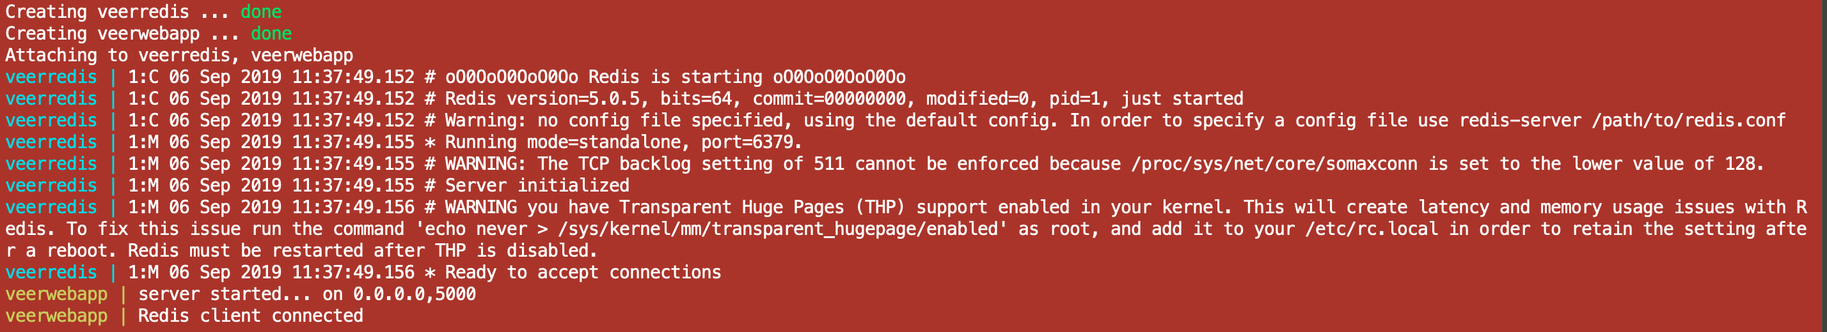
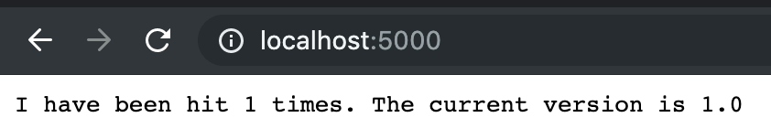
Use docker compose to use the database service with web
Step-9: Use docker-compose to run web and redis server
> docker-compose up

Slide 13
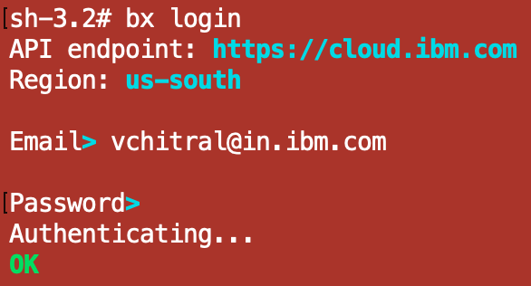
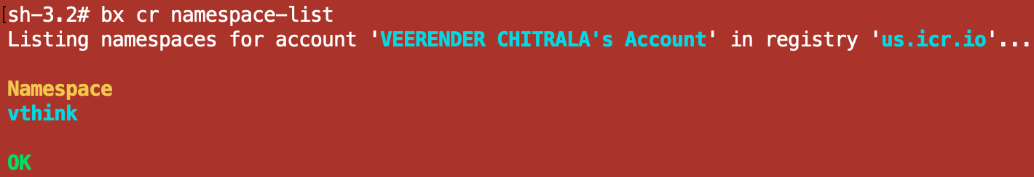
Push docker image to IBM Cloud
Step-10: Login into IBM Cloud
> bx login
Step-10: Login into container registry of IBM Cloud
> bx cr login
Step-11: In order to upload images to the IBM Cloud Container Registry, you first need to create a namespace.
> bx cr namespace-add <my_namespace>

Slide 14
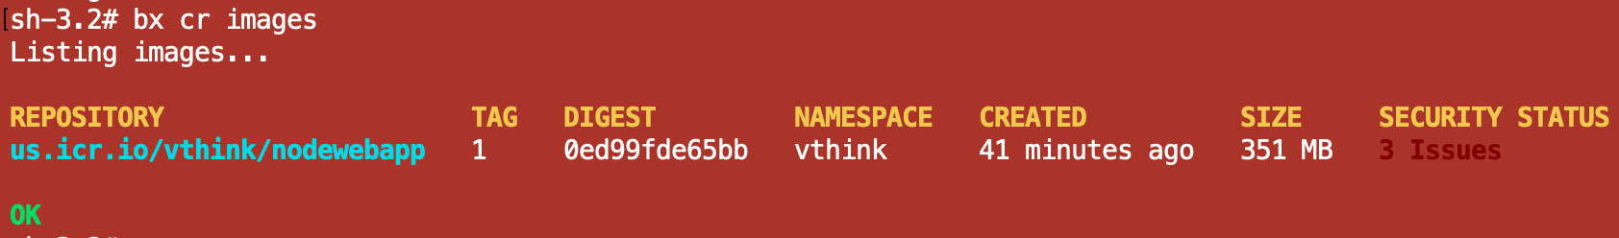
Push docker image to IBM Cloud
Step-12: Tag the docker image to the IBM Cloud container registry
> docker tag veer/nodewebapp registry.ng.bluemix.net/vthink/nodewebapp:1
Step-13: Push this image to the IBM Cloud container registry
> docker push registry.ng.bluemix.net/vthink/nodewebapp:1

Slide 15
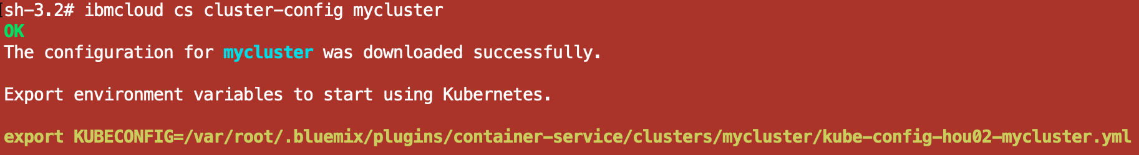

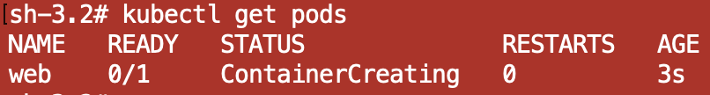
Deploy the application onto IBM Cloud Kubernetes Cluster
Step-14: Map kubectl command to manage the IBM Cloud Kubernetes cluster from command line
> Ibmcloud cs cluster-config mycluster
Step-15: Create the web pod object in Kubernetes
> kubectl create –f webpod.yaml

Slide 16
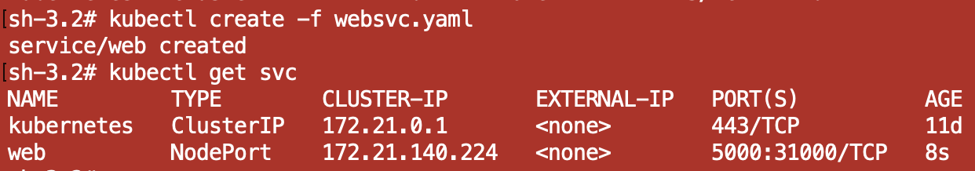
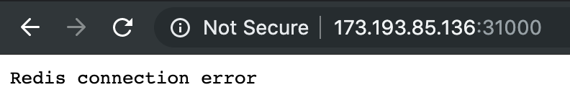
Deploy the application onto IBM Cloud Kubernetes Cluster
Step-16: To get into the container/pod
> kubectl exec –it web /bin/bash
Step-17: Expose the application, by creating a service
> kubectl create -f websvc.yaml
Step-18: Fetch the public IP of the Kubernetes cluster
> bx cs workers mycluster

Slide 17
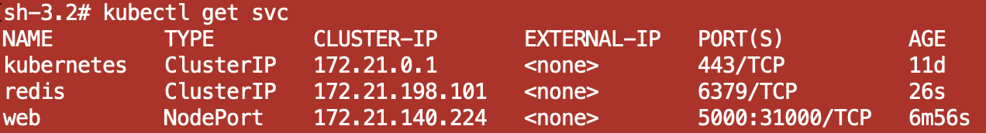
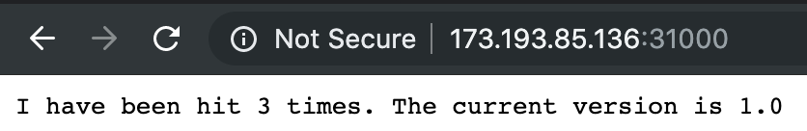
Deploy the application onto IBM Cloud Kubernetes Cluster
Step-19: Create the database pod
> kubectl create –f dbpod.yaml
Step-20: Expose the database, by creating a service
> kubectl create –f dbsvc.yaml
Step-21: Now try hitting the web application

