Slide 1
EE540 Advanced Digital Design
Central Processing Unit (CPU)
Faik Başkaya, Boğaziçi University

Slide 2
Central Processing Unit (CPU)
Central Processing Unit (CPU) is a hardware unit that performs arithmetic/shift, logic and input/output (I/O) operations to execute the instructions in a computer program.
The main components of a CPU are:
a datapath unit called Arithmetic Logic Unit (ALU) that performs arithmetic and logic operations.
a finite state machine called control unit that generates the necessary control signals required for I/O access and ALU operation.

Slide 3
A Simple Processor
Data and instruction storage area can be read-only, read-write, sequential or
random access. Dynamic memory needs refresh, static memory keeps data
until power is off, nonvolatile memory (flash drive) keeps data even after
power is off.
Memory
A finite state machine consisting
of registers and logic (thus it is a
sequential circuit). For simple
architectures it can also be
combinational.
Control
Unit
I/O
Datapath
The core of the μP where all computation is done.
It includes basic logic functions such as AND, OR,
arithmetic operators (ALU, shift, multiply), and registers
to store intermediate results.

Slide 4
Major Components of CPU
ALU: Performs calculations and comparisons (changes/processes data)
CU (control unit): performs fetch/execute cycle
Functions:
Moves data to and from CPU registers and other hardware components (no change in data)
Accesses program instructions and issues commands to the ALU
Subparts:
Memory management unit: supervises fetching instructions and data
I/O Interface: sometimes combined with memory management unit as Bust Interface Unit
Registers
Example: Program counter (PC) or instruction pointer determines next instruction for execution

Slide 5
Registers
Small storage locations within the CPU used for a particular purpose.
Manipulated directly by the Control Unit.
Wired for specific function.
Size in bits or bytes (not MB like memory).
Can hold data, an address or an instruction.

Slide 6
General purpose registers
Holds frequently and quickly needed data.
Scratchpad for currently executing program.
Holds intermediate results or data values, e.g., loop counters.
Can be accessed and modified by users.
A typical CPU contains several dozen of them.

Slide 7
Special purpose registers
Program Count Register (PC)
Address of next program instruction. Also called instruction pointer.
Instruction Register (IR)
Stores instruction fetched from memory.
Status/Flag Register
Stores information about CPU status during program execution.
Flags (one bit Boolean variable) to track conditions like arithmetic carry and overflow, power failure, internal computer error, etc.

Slide 8
Memory-related registers
Memory Address Register (MAR)
Memory address of data to be accessed.
Memory Data Register (MDR)
Stores data to be written to/read from memory.
Stack Register
Stores pointer to a call stack (LIFO memory).

Slide 9
Register Operations
Stores values from other locations (registers and memory).
Addition and subtraction.
Shift or rotate data.
Test contents for conditions such as zero or positive.

Slide 10
Register Files
Used when multiple registers are attached to single bus.
May be multi-ported and/or concurrent read/write.

Slide 11
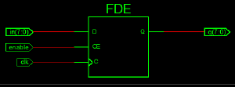
How to implement register files?
Single write-port : load-enable edge-triggered register.

Slide 12
How to implement register files?
Dual write-port : load-enable edge-triggered register, mux and priority.

Slide 13
How to implement register files?
Increased critical path delay.
Multi-port registers are slower then single-port registers.

Slide 14
Operation of Memory
Each memory location has a unique address
Address from an instruction is copied to the MAR which finds the location in memory
CPU determines if it is a store or retrieval
Transfer takes place between the MDR and memory
MDR is a two way register

Slide 15
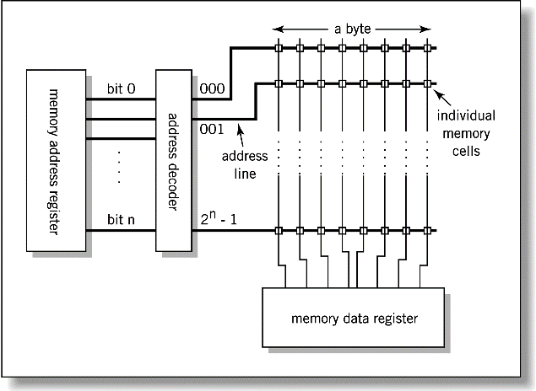
Relationship between MAR, MDR and Memory
Address
Data

Slide 16
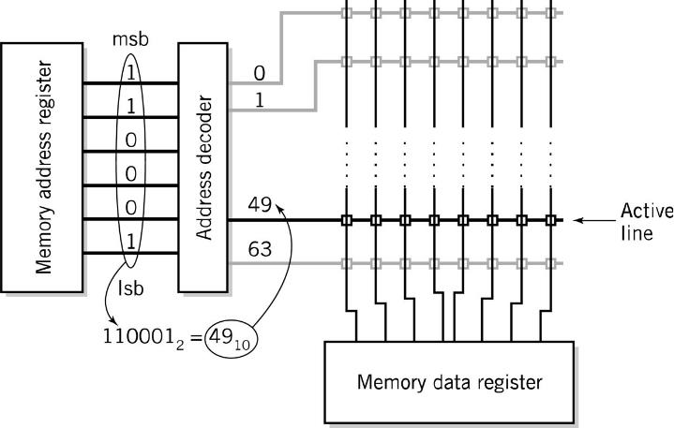
MAR-MDR Example

Slide 17
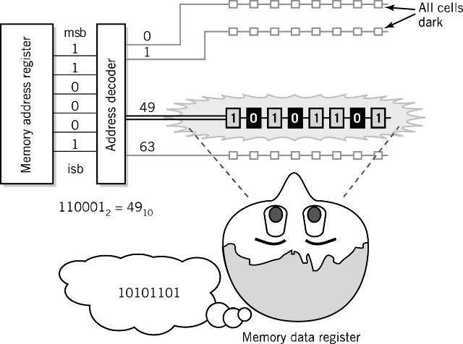
Visual Analogy of Memory

Slide 18
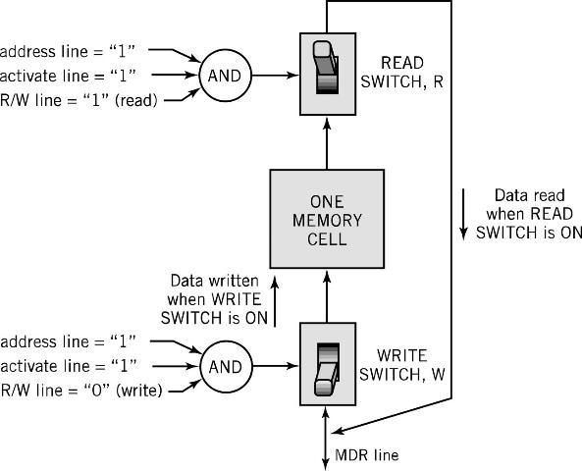
Individual Memory Cell

Slide 19
Memory Capacity
Determined by two factors
1. Number of bits in the MAR
2^{K} where K = width of the register in bits
2. Size of the address portion of the instruction
4 bits allows 16 locations
8 bits allows 256 locations
32 bits allows 4,294,967,296 or 4 GB
Important for performance
Insufficient memory can cause a processor to work much slower!

Slide 20
RAM: Random Access Memory
DRAM (Dynamic RAM)
Volatile.
Most common, cheap, large size.
Must be refreshed (recharged with power if holding logic 1) every few milliseconds.
SRAM (static RAM)
Volatile.
Faster but more expensive than DRAM.
No refresh necessary.
Frequently small amount used in cache memory for high-speed access used.

Slide 21
ROM - Read Only Memory
Non-volatile memory to hold software that is not expected to change over the life of the system
Magnetic core memory
EEPROM
Electrically Erasable Programmable ROM
Slower and less flexible than Flash ROM
Flash ROM
Faster than disks but more expensive
Uses
BIOS: initial boot instructions and diagnostics
Digital cameras

Slide 22
Instructions
Instruction
Direction given to a computer
Causes electrical signals to be sent through specific circuits for processing
Instruction set
Design defines functions performed by the processor
Differentiates computer architecture by the
Number of instructions
Complexity of operations performed by individual instructions
Data types supported
Format (layout, fixed vs. variable length)
Use of registers
Addressing (size, modes)

Slide 23
Instruction Elements
OPCODE: task
Source OPERAND(s)
Result OPERAND
Location of data (register, memory)
Explicit: included in instruction
Implicit: default assumed
Addresses
Source
OPERAND
Result
OPERAND
OPCODE

Slide 24
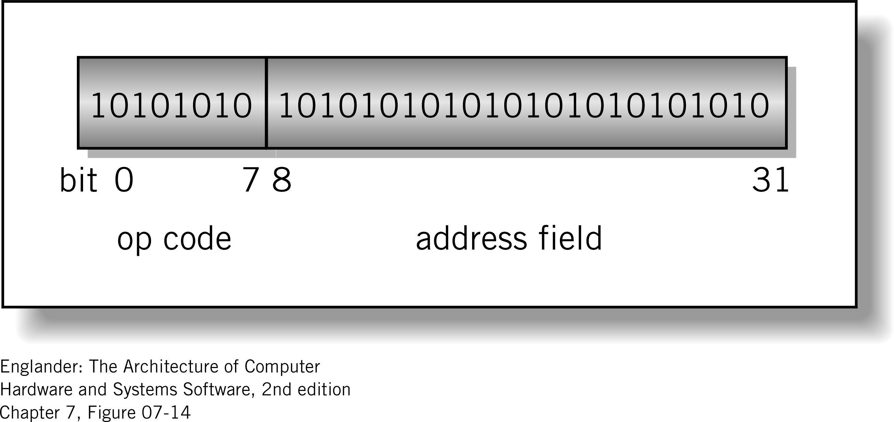
Instruction Format
Machine-specific template that specifies
Length of the op code
Number of operands
Length of operands
Simple 32-bit Instruction Format: 8 bits for opcode allows 256 different opcodes.

Slide 25
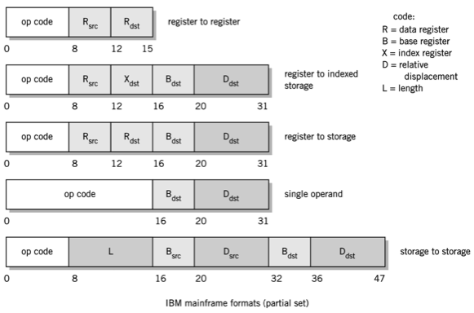
Instruction Formats: CISC

Slide 26
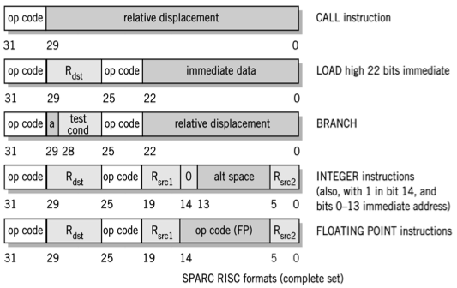
Instruction Formats: RISC

Slide 27
Instruction Types
Data Transfer (load, store)
Most common, greatest flexibility
Involve memory and registers
What’s a word ? 16? 32? 64 bits?
Arithmetic
Operators + - / * ^
Integers and floating point
Logical or Boolean
Relational operators: > < =
Boolean operators AND, OR, XOR, NOR, and NOT
Single operand manipulation instructions
Negating, decrementing, incrementing

Slide 28
More Instruction Types
Bit manipulation instructions
Flags to test for conditions
Shift and rotate
Program control
Stack instructions
Multiple data instructions
I/O and machine control

Slide 29
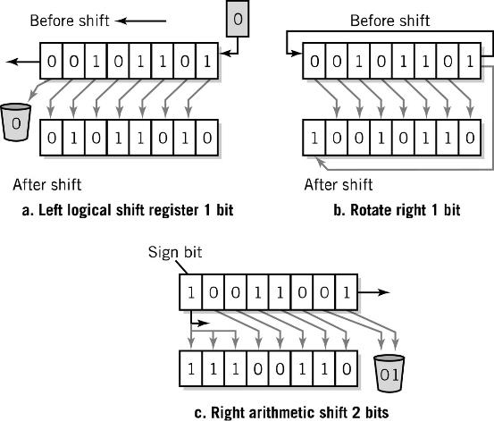
Register Shifts and Rotates

Slide 30
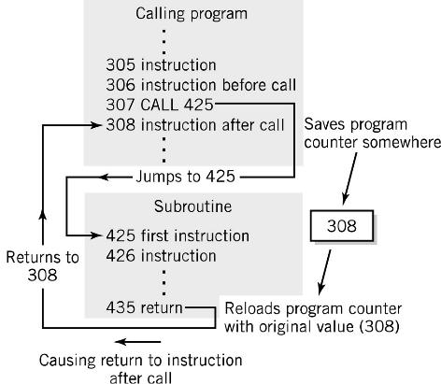
Program Control Instructions
Program control
Jump and branch
Subroutine call and return (Jump and Link)

Slide 31
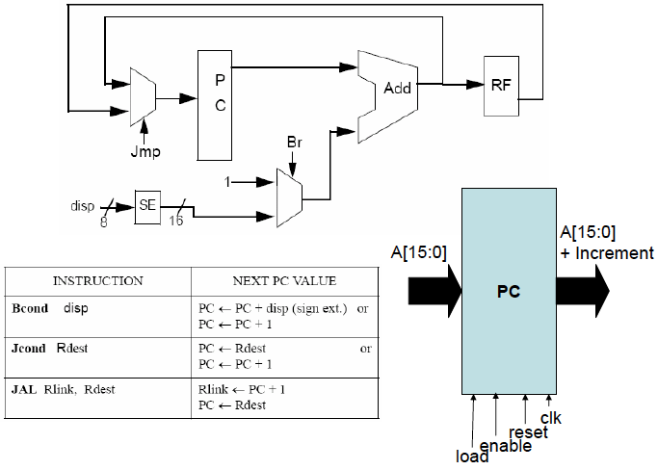
Program Control Instructions

Slide 32
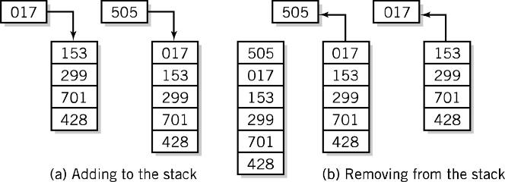
Stack Instructions
Stack instructions
LIFO method for organizing information
Items removed in the reverse order from that in which they are added
Push
Pop

Slide 33
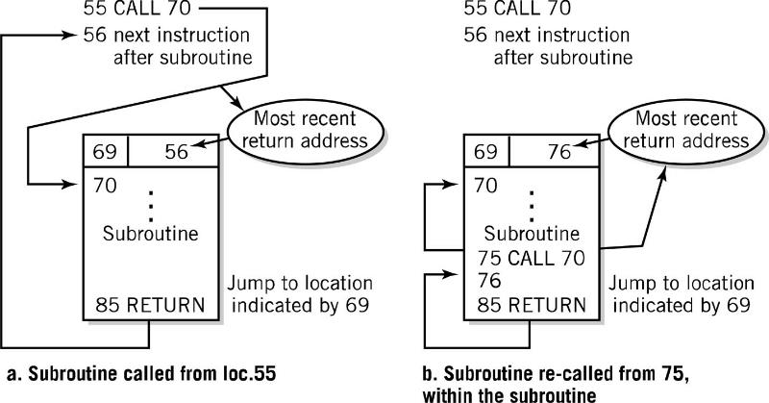
Fixed Location Subroutine Return Address Storage: Oops!

Slide 34
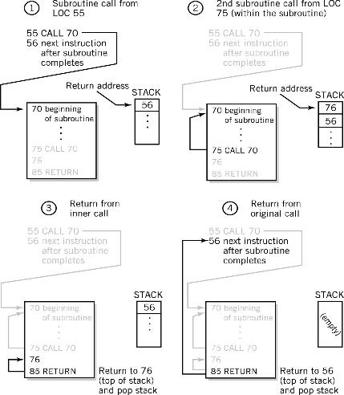
Stack Subroutine Return Address Storage

Slide 35
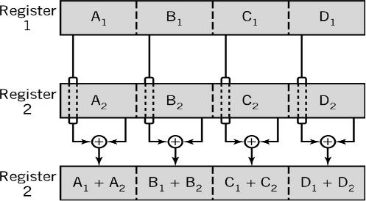
Multiple Data Instructions
Perform a single operation on multiple pieces of data simultaneously
SIMD: Single Instruction, Multiple Data
Intel MMX™: 57 multimedia instruction
Commonly used in vector and array processing applications

Slide 36
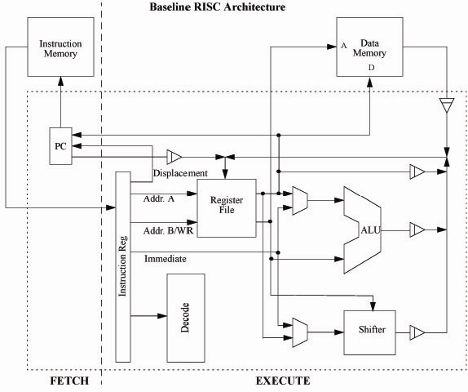
Baseline RISC Architecture

Slide 37
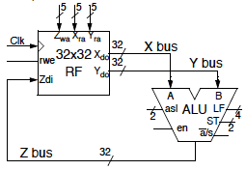
Microcode
Microcodes are all the control signals required to execute an operation for a clock cycle.
For example: R3 = R1 + R2
1. Choose R1 and R2 as X and Y outputs of Register File (RF)
via X_{ra} and Y_{ra}
2. enable ALU for ADD operation
3. Choose R3 as the Z input of RF
via Z_{wa}

Slide 38
Translating Code
As a programmer, we don’t want to interface with the microprocessor and manually send each and every control signal as is done with microcode.
We would prefer to abstract the instruction sent to the microprocessor.
Let the microprocessor designer handle the decoding of the abstracted instruction into the microcode control operations.

Slide 39
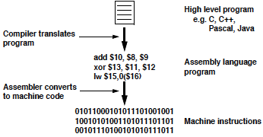
Translating Program in a High Level Language to Machine Opcodes

Slide 40
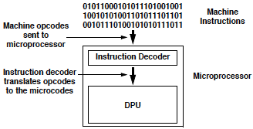
Translating Opcode Instructions to Microcodes

Slide 41
Fetch-Execute Cycle
Two-cycle process because execution can begin only after instruction is fetched and decoded.
Fetch
Load instruction pointed by PC from memory into IR.
Decode instruction.
Execute
Perform operation required by instruction by generating control signals for registers and ALU.
Move/transform memory and/or register data.

Slide 42
Fetch-Execute Cycle for Load
PC(address) -> IR
Transfer the instruction to the IR.
IR(address) -> MAR
Address portion of the instruction loaded in MAR.
MDR -> A
Actual data copied into the accumulator.
PC + 1 -> PC
Program Counter incremented.

Slide 43
Fetch-Execute Cycle for Store
PC(address) -> IR
Transfer the instruction to the IR.
A -> MDR
Accumulator copies data into MDR.
IR(address) -> MAR
Address portion of the instruction loaded in MAR.
PC + 1 -> PC
Program Counter incremented.

Slide 44
Fetch-Execute Cycle for Add (Accumulate)
PC(address) -> IR
Transfer the instruction to the IR.
IR(address) -> MAR
Address portion of the instruction loaded in MAR.
A + MDR -> A
Contents of MDR added to contents of accumulator.
PC + 1 -> PC
Program Counter incremented.

Slide 45
Other Fetch/Execute
SUBTRACT
PC[addr] → IR
IR[addr] → MAR
A – MDR → A
PC + 1 → PC
IN
PC[addr] → IR
IOR → A
PC + 1 → PC
OUT
PC[addr] → IR
A → IOR
PC + 1 → PC
HALT
PC[addr] → IR
BRANCH
PC[addr] → IR
IR[addr] → PC
BRANCH on Condition
PC[addr] → IR
If condition false: PC + 1 → PC
If condition true: IR[addr] → PC

Slide 46
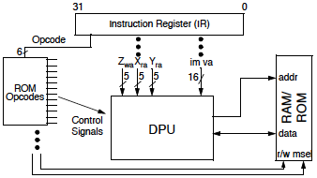
Control Signals
Each opcode has its own set of general control signals for the DPU.
These signals can be generated by a FSM or read from a ROM.

Slide 47
Connecting Blocks: Bus
The physical connection that makes it possible to transfer data from one location in the computer system to another
Group of electrical conductors for carrying signals from one location to another
Line: each conductor in the bus
4 kinds of signals
Data (alphanumeric, numerical, instructions)
Addresses
Control signals
Power (sometimes)

Slide 48
Connecting Blocks: Bus
Connect CPU and Memory
I/O peripherals: on same bus as CPU/memory or separate bus
Physical packaging commonly called backplane
Also called system bus or external bus
Example of broadcast bus
Part of printed circuit board called motherboard that holds CPU and related components

Slide 49
Bus Characteristics
Protocol
Documented agreement for communication
Specification that spells out the meaning of each line and each signal on each line
Throughput, i.e., data transfer rate in bits per second
Data width in bits carried simultaneously

Slide 50
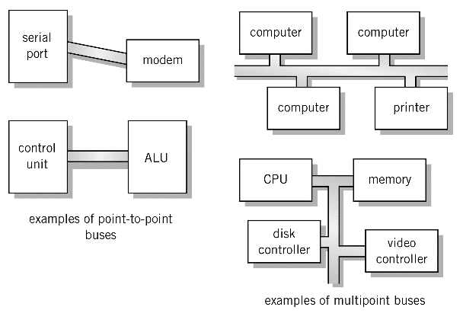
Point-to-point vs. Multipoint
Plug-in device
Broadcast bus Example: Ethernet
Shared among multiple devices

Slide 51
Point-to-point vs. Multipoint
A fully wired motherboard with n units needs [(n − 1)*n]/2 interconnections:
Unmanageable!
Example: p2p interconnections for n = 2 . . . 6 units (and bus with 6 units):

Slide 52
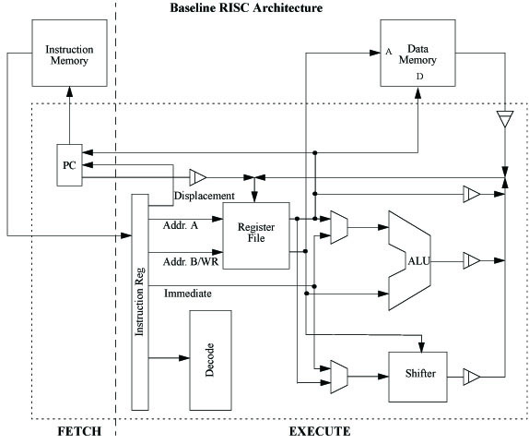
Sample CPU and Instruction Set Architecture (ISA)

Slide 53
Rdest <-- Rdest op Imm (sign extended)
Rdest <-- Rdest op Rsrc
 |  |  |  | ImmHi/ OP Code Ext | ImmLo/ Rsrc
 |  | OP CODE | Rdest
Mnemonic | Operands | 15-12 | 11-8 | 7-4 | 3-0 | Notes (only baseline)
ADD | Rsrc, Rdest | 0000 | Rdest | 0101 | Rsrc
ADDI | Imm, Rdest | 0101 | Rdest | ImmHi | ImmLo | Sign Extended Imm
SUB | Rsrc, Rdest | 0000 | Rdest | 1001 | Rsrc
SUBI | Imm, Rdest | 1001 | Rdest | ImmHi | ImmLo | Sign Extended Imm
CMP | Rsrc, Rdest | 0000 | Rdest | 1011 | Rsrc
CMPI | Imm, Rdest | 1011 | Rdest | ImmHi | ImmLo | Sign extended Imm
AND | Rsrc, Rdest | 0000 | Rdest | 0001 | Rsrc
ANDI | Imm, Rdest | 0001 | Rdest | ImmHi | ImmLo | Zero Extended Imm
OR | Rsrc, Rdest | 0000 | Rdest | 0010 | Rsrc | NOP= OR R0, R0
ORI | Imm, Rdest | 0010 | Rdest | ImmHi | ImmLo | Zero extended Imm
XOR | Rsrc, Rdest | 0000 | Rdest | 0011 | Rsrc
XORI | Imm, Rdest | 0011 | Rdest | ImmHi | ImmLo | Zero extended Imm
MOV | Rsrc, Rdest | 0000 | Rdest | 1101 | Rsrc
MOVI | Imm, Rdest | 1101 | Rdest | ImmHi | ImmLo | Zero extended Imm
LSH | Ramount, Rdest | 1000 | Rdest | 0100 | Ramount | -15 to 15 (2s compl)
LSHI | Imm, Rdest | 1000 | Rdest | 000s | ImmLo | S=sign (0=left, 2s comp)
LUI | Imm, Rdest | 1111 | Rdest | ImmHi | ImmLo | Load & 8 bit left shift
LOAD | Rdest, Raddr | 0100 | Rdest | 0000 | Raddr
STOR | Rsrc, Raddr | 0100 | Rsrc | 0100 | Raddr
Bcond | disp | 1100 | cond | DispHI | DispLo | 2s comp displacement
Jcond | Rtarget | 0100 | cond | 1100 | Rtarget
JAL | Rlink, Rtarget | 0100 | Rlink | 1000 | Rtarget

Slide 54
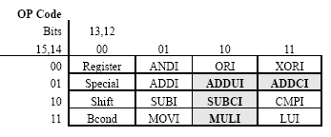
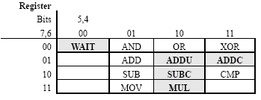
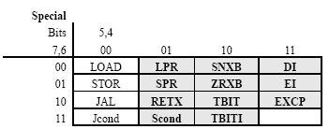
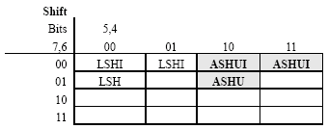
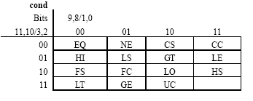
Bold ones are not baseline instructions.
Empty ones are not used.

Slide 55
Of the baseline subset of instructions, the only ones which can change the program status register (PSR) are the arithmetic instructions ADD, ADDI, SUB,SUBI, CMP, CMPI.
CMP and CMPI perform the same operations as SUB, SUBI but affect different PSR flags and do not write back the result. Only flags FLCNZ are needed for the baseline implementation.
ADD, ADDI, SUB,SUBI set the C flag if a carry/borrow from the most significant bit position occurs when the operands are treated as unsigned numbers, and set the F flag if an overflow occurs when the operands are treated as two’s complement numbers. (Note: the processor does not know which interpretation you are using, so must set both flags appropriately for each operation.)
CMP, CMPI perform a subtraction without write back to Rdest and set the Z flag if the result is zero, set the L flag if Rsrc/Imm > Rdest when the operands are treated as unsigned numbers (i.e. when a carry/borrow occurs), and set the N flag if Rsrc/Imm > Rdest when the operands are treated as two’s complement numbers (N can be computed as the exclusive-or of L and the sign bits of Rsrc/Imm and Rdest). All other baseline instructions leave the flags unchanged.

Slide 56
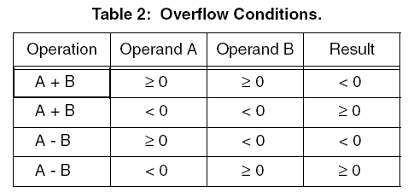
Program status register (PSR)
In a full implementation, PSR (program status register) is a dedicated 16 bit register with flag entries (in the following order, MSB at the left) rrrrIPE0NZF00LTC, where the “r” entries are reserved, the “0” entries are zeros, I, E are used for interrupt processing, T, P are for program tracing (debugging), and the rest are flags have been defined elsewhere. For this processor, you only implement the flags FLCNZ.

Slide 57
Jcond, Bcond are absolute and relative jumps respectively based on the condition codes specified in the condition code (cond) table. (See Table 1.)
JAL (jump and link) stores the address of the next instruction in Rlink, and jumps to Rtarget. Its main use is for subroutine calls. Return with a JUC Rlink (where Rlink is the same register used to store the link).
LSH is a logical left shift by the number of bits specified in Rsrc/Imm treated as a signed twos complement number (which must be in the range -15 to +15). A negative left shift is effectively a right shift.
LOAD loads data from memory address Raddr to register location Rdest and STOR stores data located in register Rsrc to data memory address Raddr. The NOP instruction is really OR r0, r0 and does not need to be implemented separately. Unconditional jumps (JUMP) and branches (BR) are equivalent to JUC and BUC respectively, so do not need separate implementation either. Compilers may have these alternative instruction ops for convenience, however.
LUI (load upper immediate) loads the 8 bit immediate data into the upper (most significant) bits of the destination register.
MOV copies the source register or immediate into the destination register.
NOP (No operation) is simply OR R0 R0. You do not need to implement it separately.

Slide 58
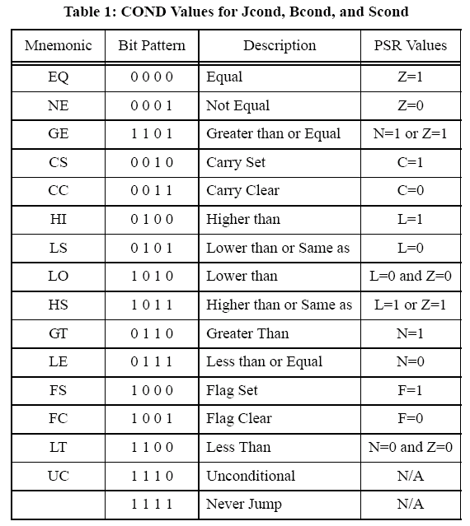

Slide 59
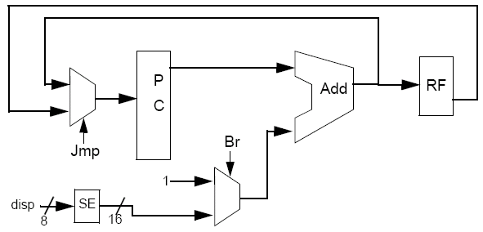
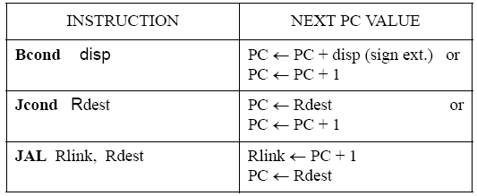
PC
A[15:0]
+ Increment
A[15:0]
clk
reset
enable
load

Slide 60
0140 / 0020; #0000000000100000 ( 99) test5 or r0 r0
0141 / C70F; #1100011100001111 (100) ble j1
0142 / 0434; #0000010000110100 (101) xor r4 r4
#0000000101010001 (103) .orig 0x0151
0151 / 0020; #0000000000100000 (104) j1 or r0 r0
0152 / CC0F; #1100110000001111 (105) blt j2
0153 / 0434; #0000010000110100 (106) xor r4 r4
Note that the displacement for the ble at 0x141 is 0x0F (e.g. 0x142 + 0xF = 0x151), not 0x10! Defining the displacement in this manner makes the design of your program counter simpler since the pc has been incremented to 0x142 by the time you are ready to calculate the new branch address.
A complication is presented by the fact that the processor is pipelined. One must decide how to handle changes in program flow in general, as the change in program flow happens, in our case, in the second stage. Meanwhile, unless we design the control to do differently, the processor would continue to fetch and decode subsequent instructions that follow the branch or jump. Several possible solutions are:
1. Always follow a branch or jump instruction with a NOP, or with other instructions that should be executed anyway. This is done by the compiler in many RISC processors. This is the simplest solution from a hardware point of view. Often the branch delay slots can be filled with useful instructions.
2. Lock the first stages of the pipeline so that they do not continue to fetch and decode instructions following a jump or branch. This is equivalent to forcing NOPs in the hardware. This approach adds some complexity, while reducing code size somewhat, and reducing throughput somewhat.
3. For conditional branches, guess whether program flow will be changed or not, and continue fetching and decoding instructions. This requires a fast decode (to know whether the instruction is a conditional branch or jump), a separate arithmetic unit to calculate PC values, and the ability to squash instructions in the pipe if the guess was wrong (this is found out when the instruction gets to the second stage).
Option 1 is acceptable for the baseline machine.

Slide 61
References
Irv Englander, “The Architecture of Computer Hardware and Systems Software: An Information Technology Approach”, John Wiley & Sons, 3rd Edition.
Lecture notes of Sung Kyu Lim from CS8803: Advanced Digital Design for Embedded Hardware.

