Slide 1

Why you need to know the internals of list and tuple?
Ravi Chityala, Ph.D.,
@chityala
http://essentialeducation.co

Slide 2
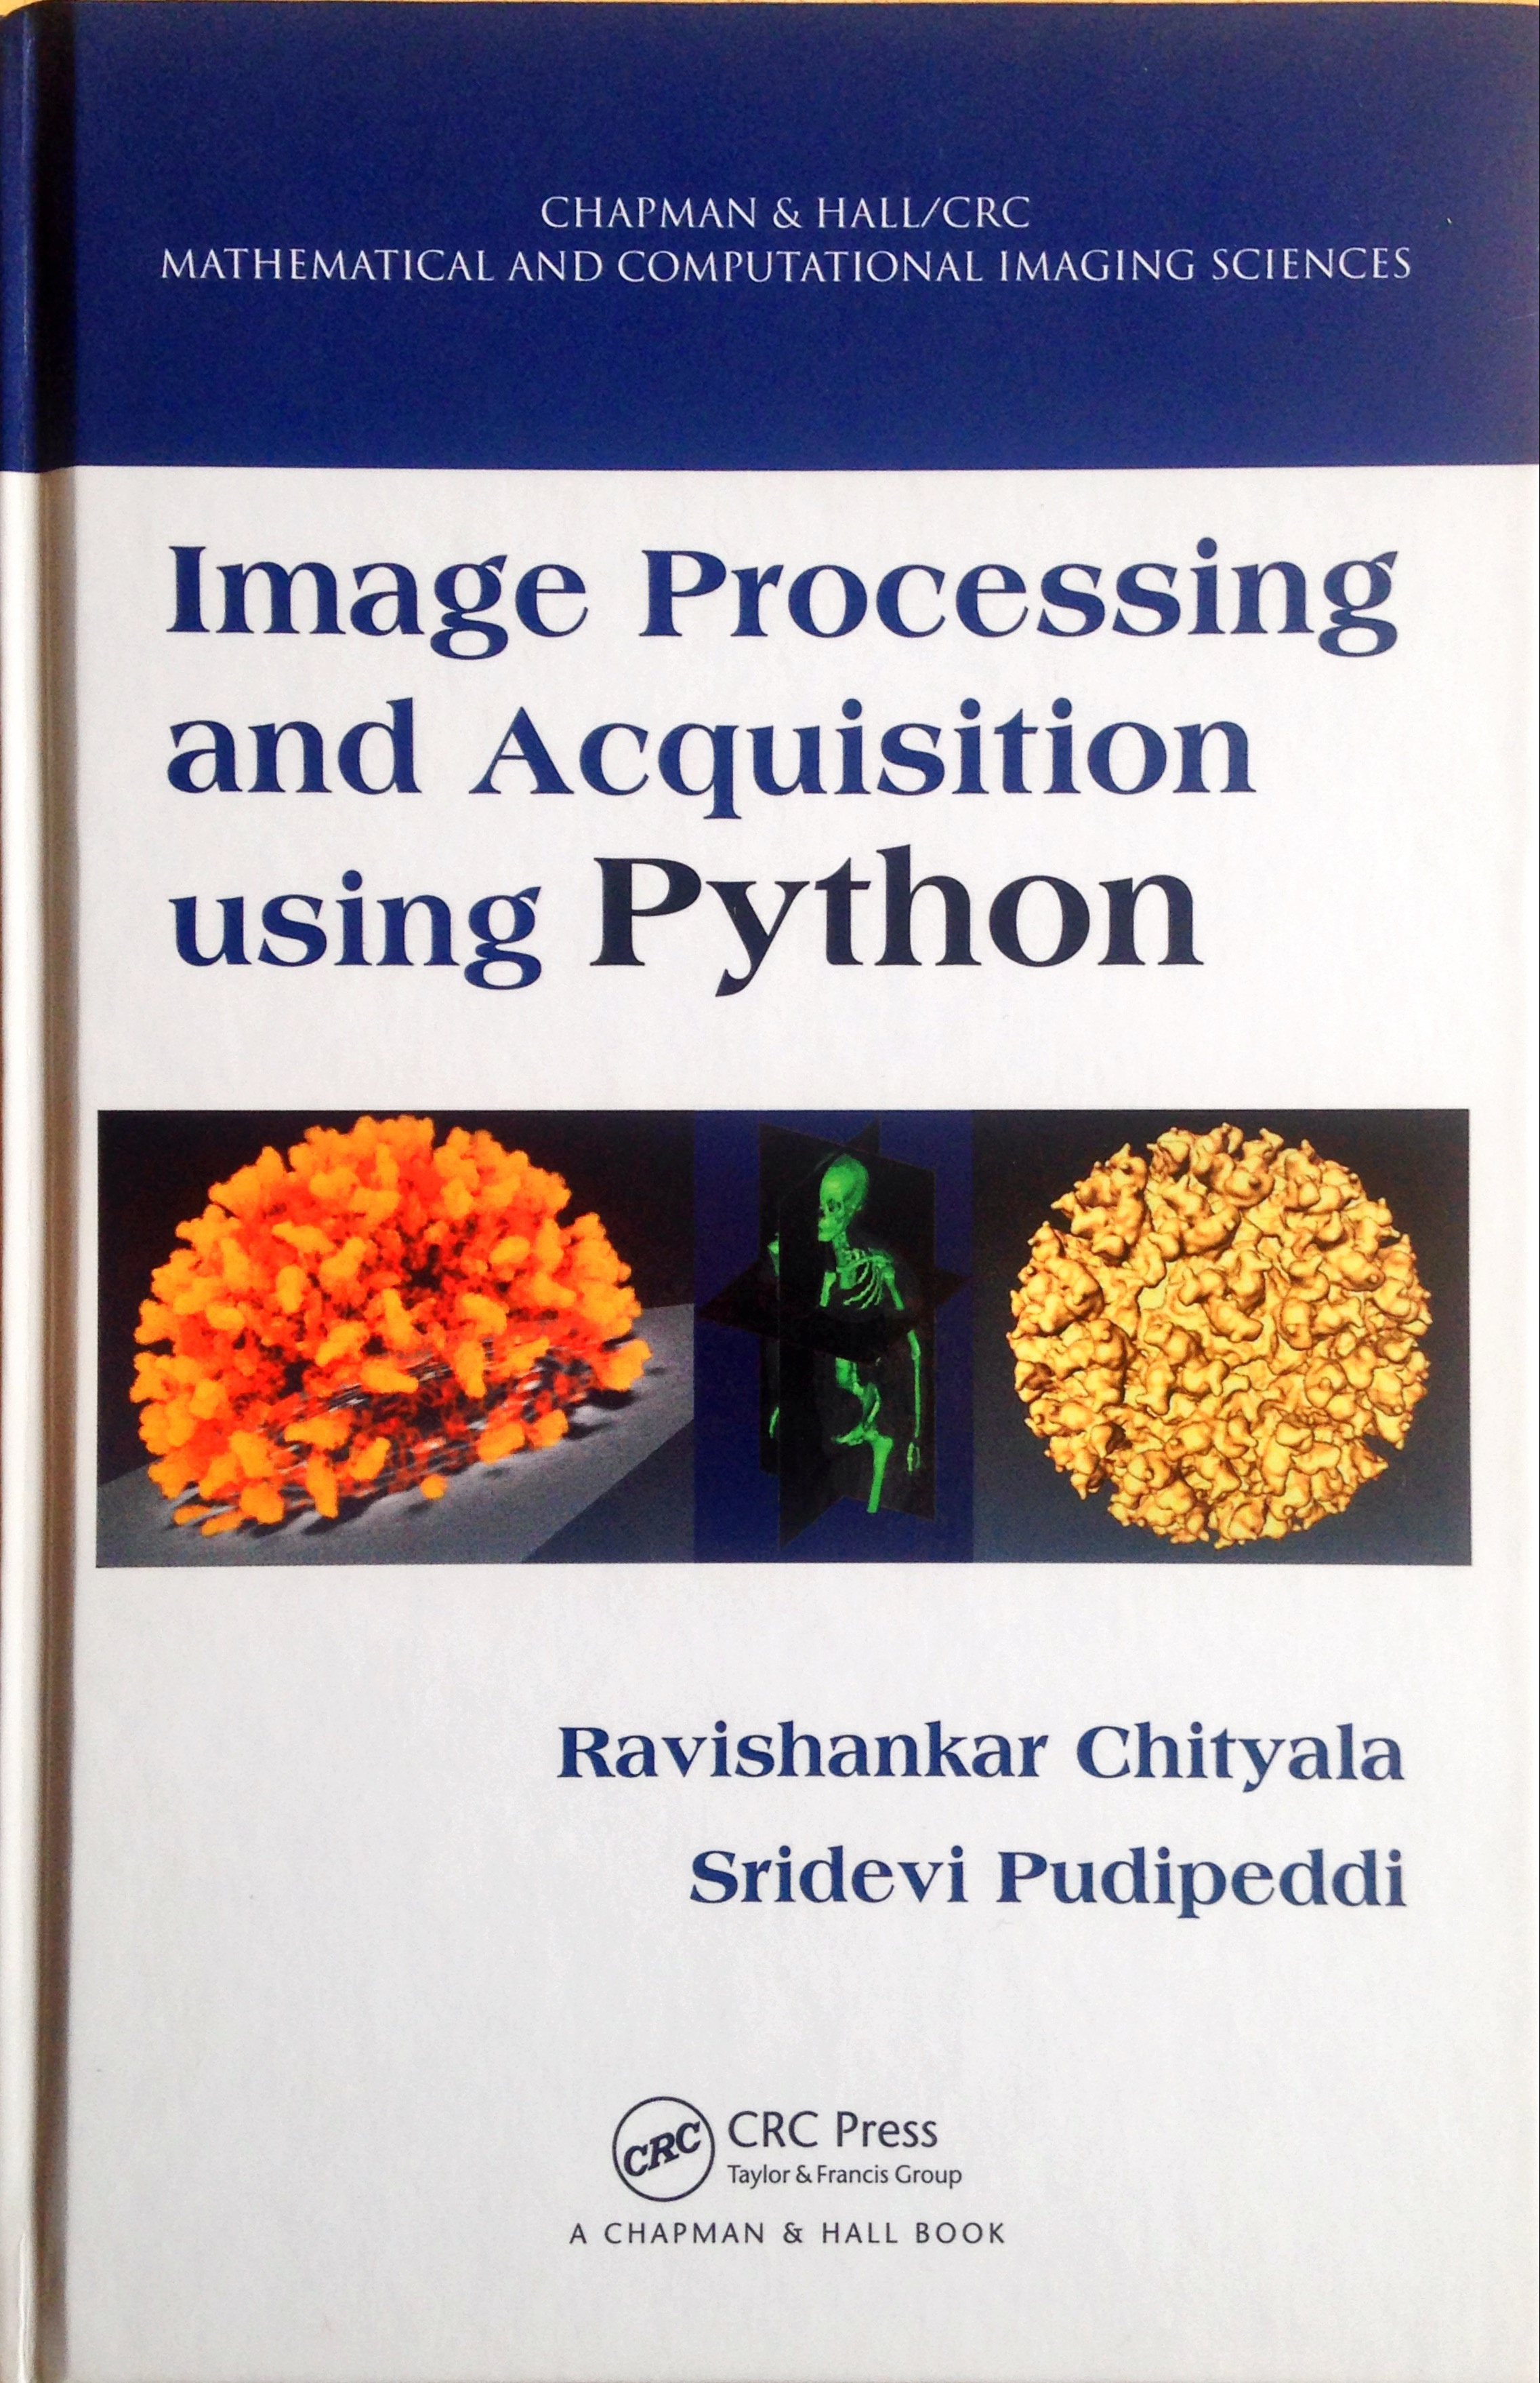
Book
Image Processing and Acquisition using Python by Ravi Chityala and Sridevi Pudipeddi
Published by CRC Press

Slide 3

Python for programmers
Deep Learning and Artificial Intelligence with TensorFlow
Notes:
beginning Jan 22 2018

Slide 4
Content
List
Examples
Construction
Performance
Tuple
Examples
Construction
Performance

Slide 5
list

Slide 6
List characteristics
Mutable
Expandable
Sortable

Slide 7
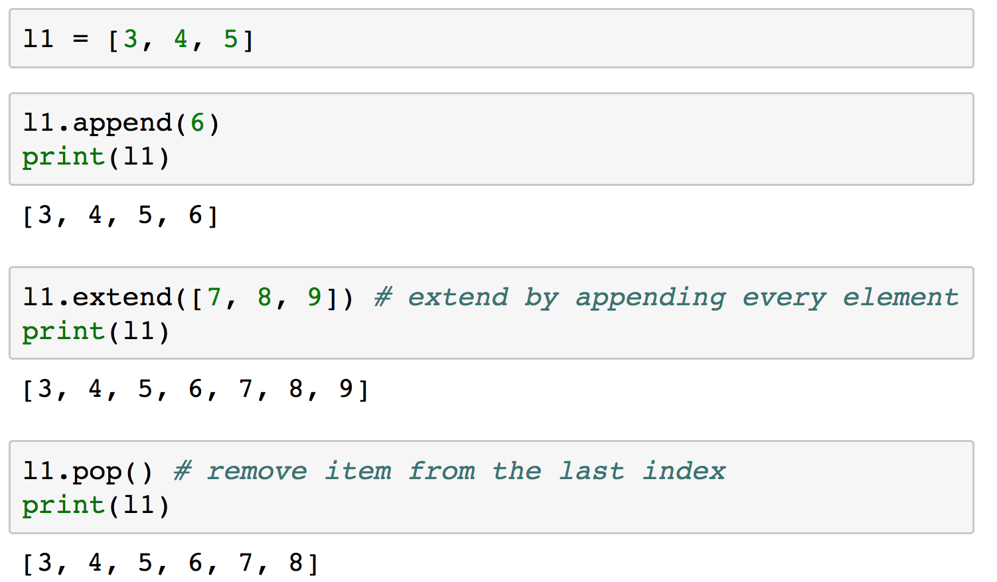
examples

Slide 8
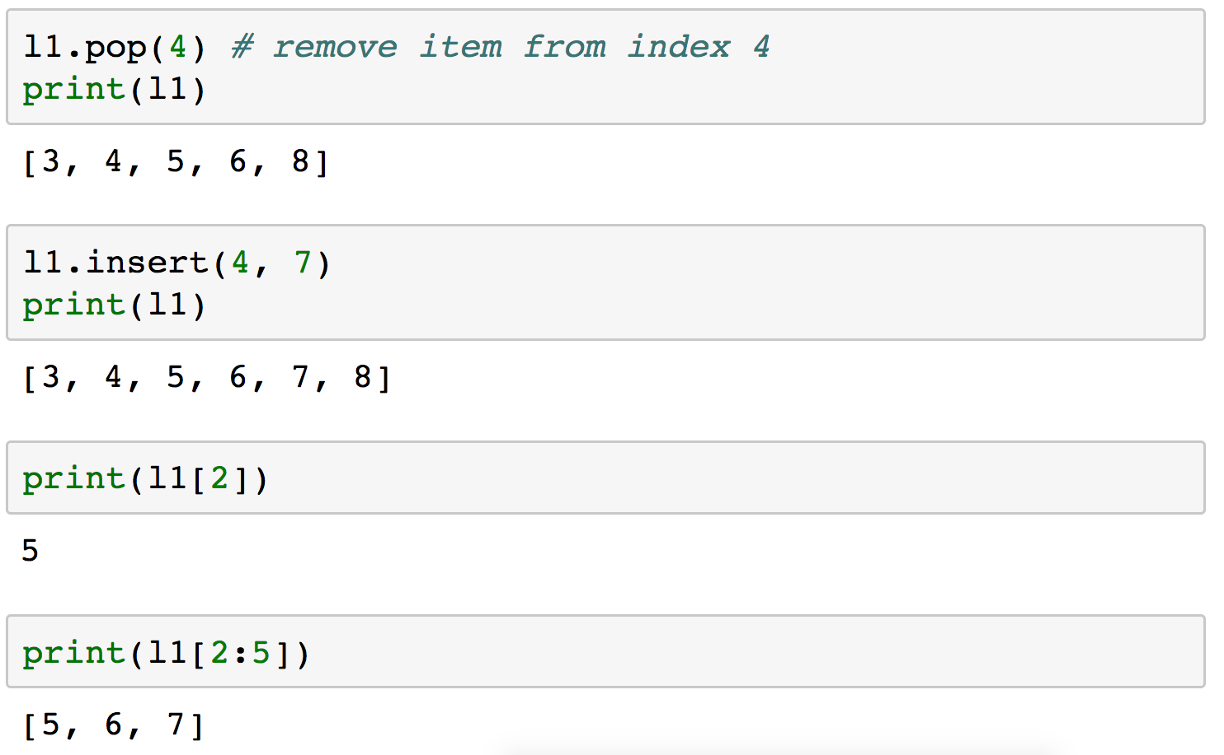
examples

Slide 9
mylist = [”a”, “b”, “c”, “d”]
”d”
”c”
”b”
3
”a”
2
1
0

Slide 10
mylist.append(“e”)
”d”
”e”
”c”
7
6
5
”b”
4
3
”a”
2
1
0

Slide 11
List details
new_allocated = (size_t)newsize +
(newsize >> 3) +
(newsize < 9 ? 3 : 6);
Growth pattern: 0, 4, 8, 16, 25, 35, 46, 58, 72, 88, ...
Linear-time amortized over multiple appends
https://github.com/python/cpython/blob/master/Objects/listobject.c line 59.

Slide 12
mylist.pop(2)
”d”
”e”
”c”
7
6
5
”b”
4
3
”a”
2
1
0

Slide 13
mylist.pop(2)
”d”
”e”
7
6
5
”b”
4
3
”a”
2
1
0

Slide 14
mylist.insert(2, “f”)
”d”
”e”
”f”
7
6
5
”b”
4
3
”a”
2
1
0

Slide 15
Big-o for a list
Operation | Time
Append | O(1)
Extend | O(k)
Pop last element | O(1)
Pop anywhere else | O(n) worst case
Insert | O(n) worst case
Index | O(1)
Slice | O(k)
in operator | O(n)
Sort | O(nlogn)

Slide 16
Tuple

Slide 17
tuple characteristics
Immutable

Slide 18
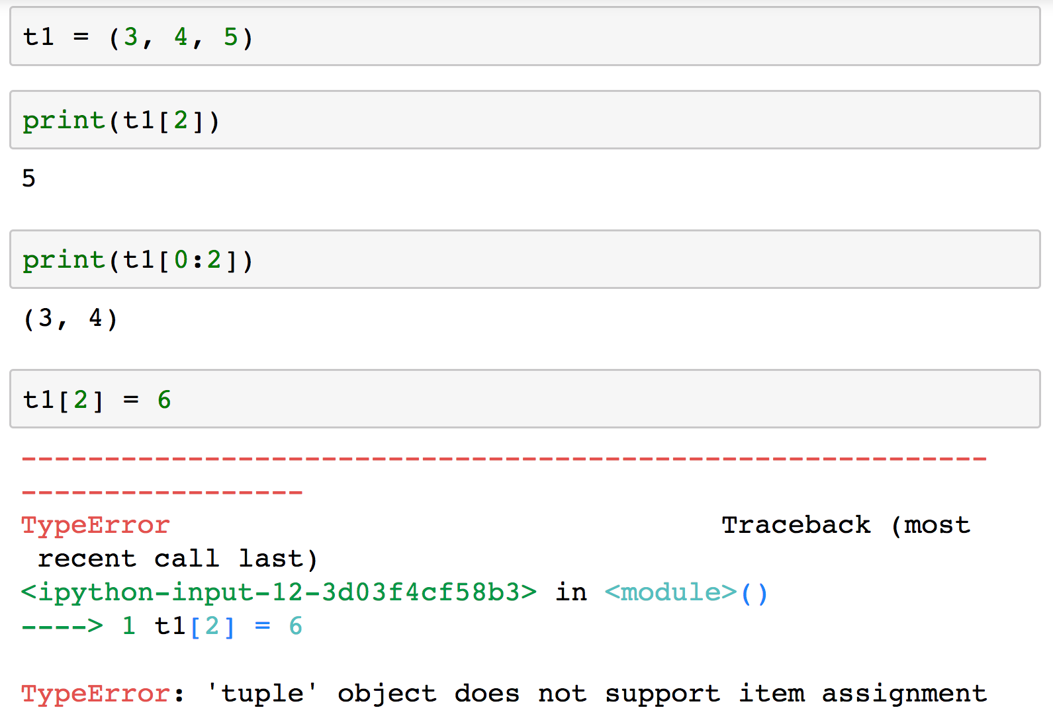
Examples

Slide 19
t1 = (”a”, “b”, “c”, “d”)
”d”
”c”
”b”
3
”a”
2
1
0

Slide 20
Tuple characteristics
To reduce memory fragmentation and for performance, Python tuples are reused (i.e.,) the memory id of the previously cleared tuples of the same size is used for a new tuple
t1 = (3, 4, 67)
print(id(t1))
t1 = 6
t2 = (1, 2, 423)
print(id(t2))
4590801976 4590801976

Slide 21
Tuple characteristics
They are not over-allocated as they are not resizable

Slide 22
conclusion
Use the appropriate data structure for the appropriate purpose.
Returning collection from function, use a tuple.
Lists are more complex to implement and hence need 3000+ lines of code while tuple needs only 1000 lines of code.

Slide 23
Thank you
/in/chityala
@chityala

Slide 24
References
https://github.com/python/cpython/blob/master/Objects/listobject.c
https://github.com/python/cpython/blob/master/Objects/tupleobject.c
https://wiki.python.org/moin/TimeComplexity
https://stackoverflow.com/questions/68630/are-tuples-more-efficient-than-lists-in-python/22140115#22140115

