Slide 1
Motion Planning for Mobile Robot Navigation Using a Toyota Human Support Robot
4YP Presentation
Robert Shi

Slide 2
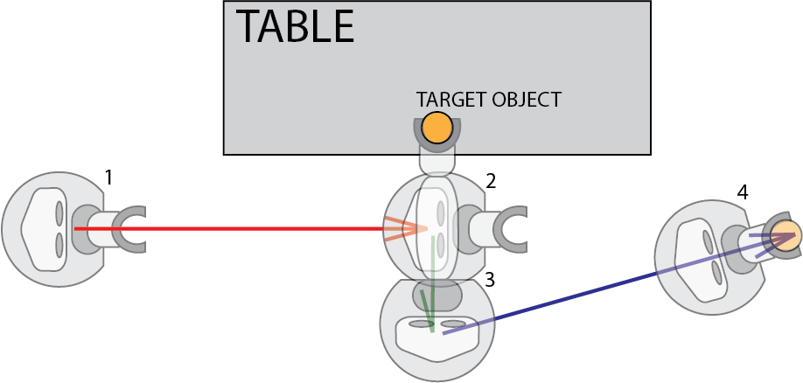
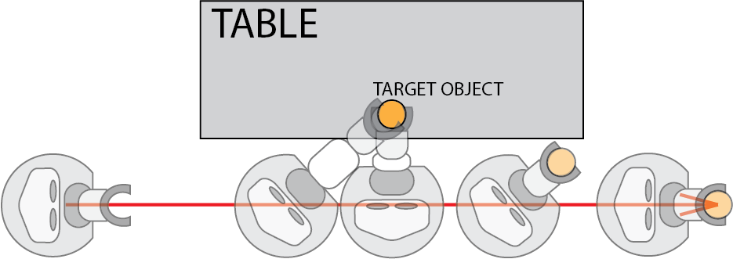
Introduction
Pick-and-Place action given in the HSR documentation using built-in functions
Drive-by Pick-and-Place approach

Slide 3
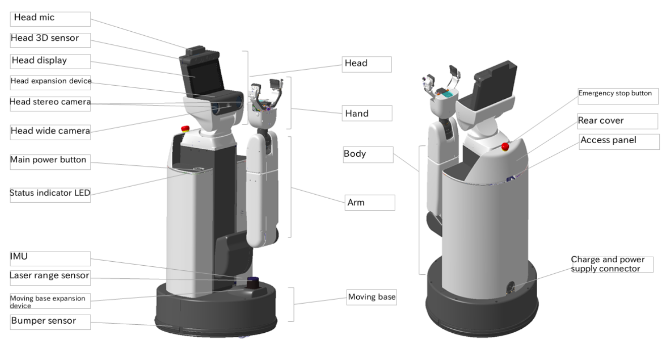
HSR Overview

Slide 4
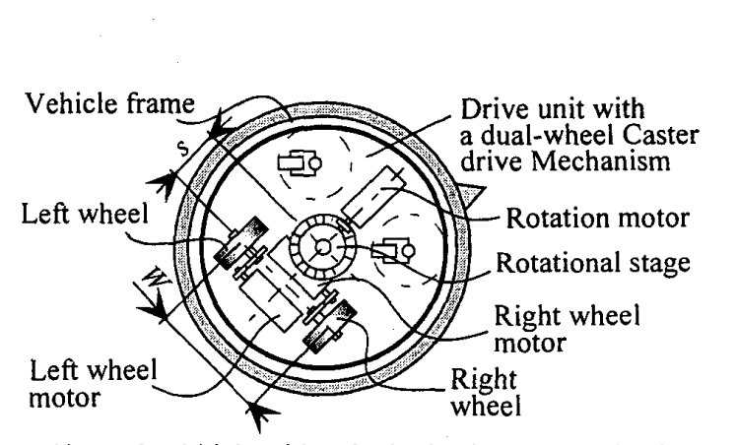
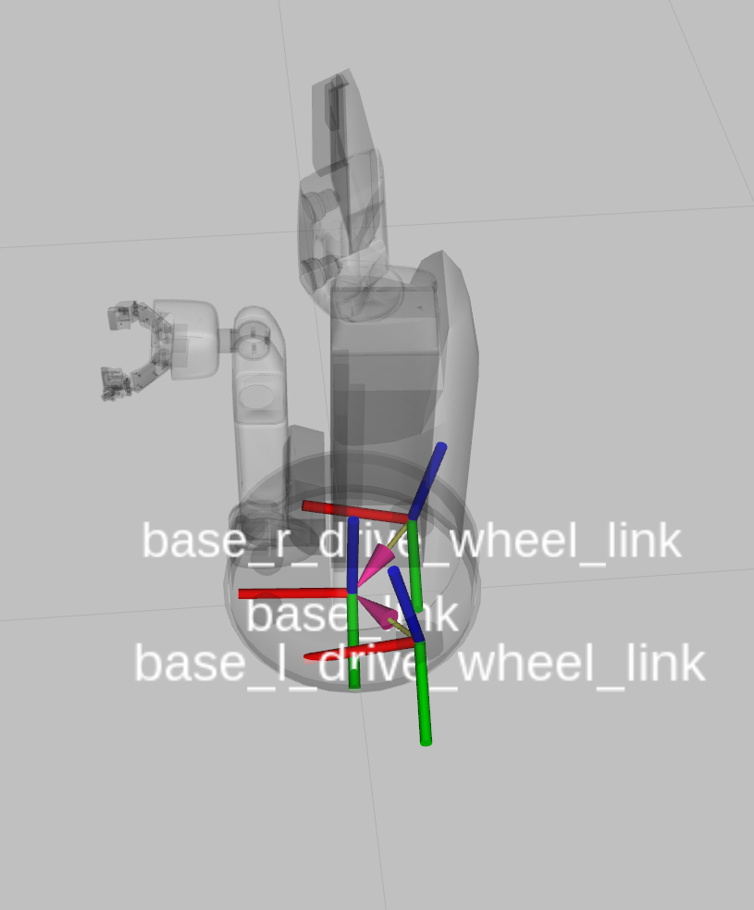
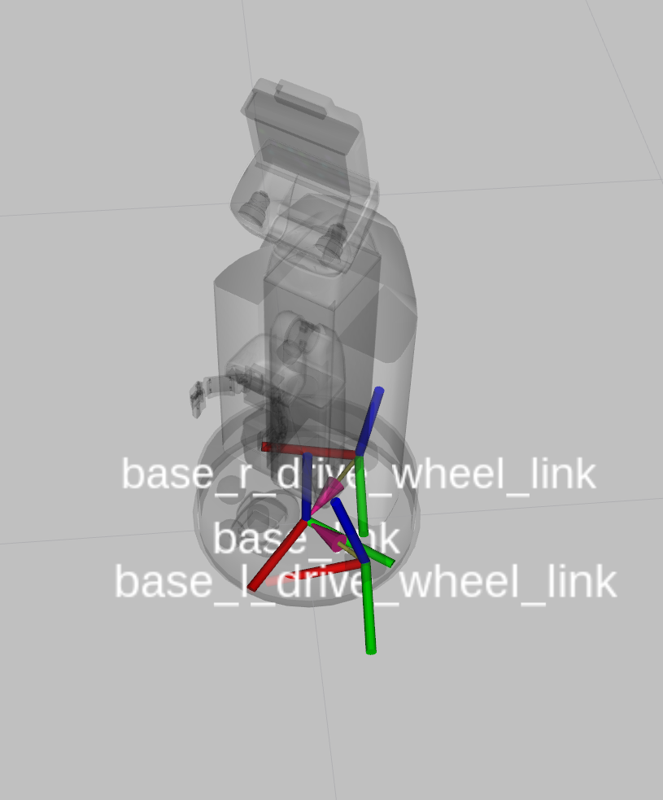
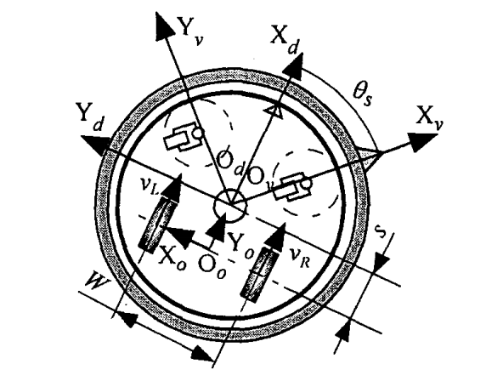
HSR Omnibase
Uses a dual-wheel caster drive mechanism. Similar to differential-drive, but with driving wheels offset from central axis.
A base_roll_link allows the torso to rotate independently from the base

Slide 5
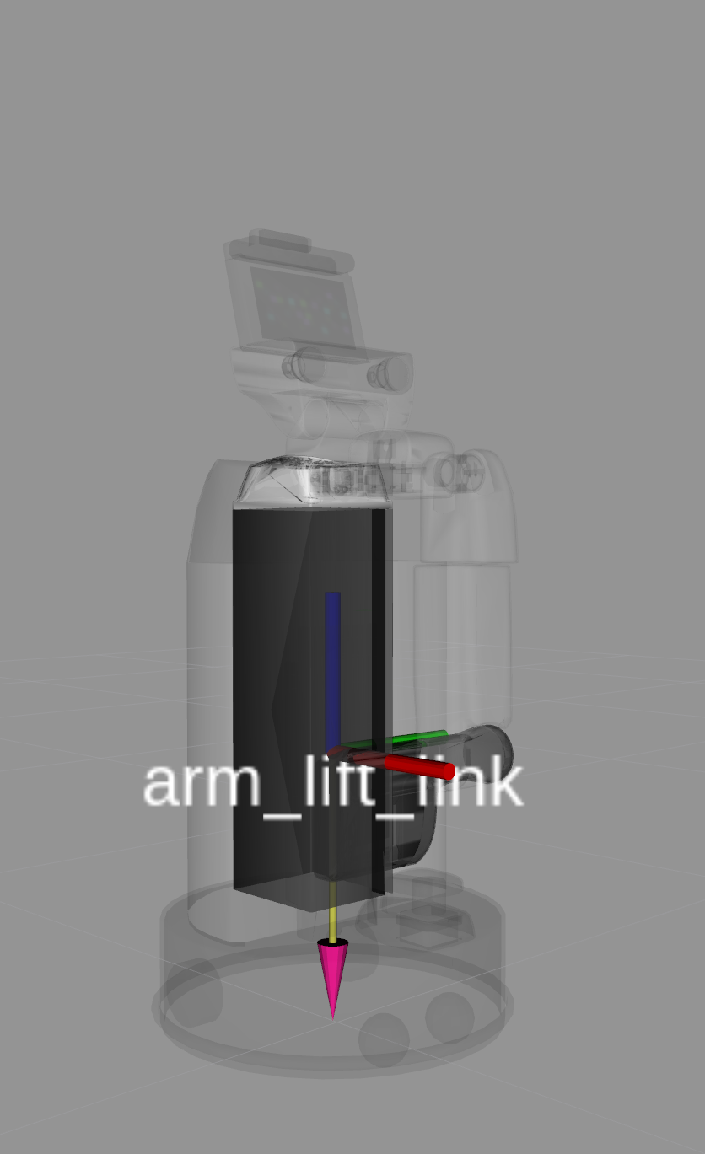
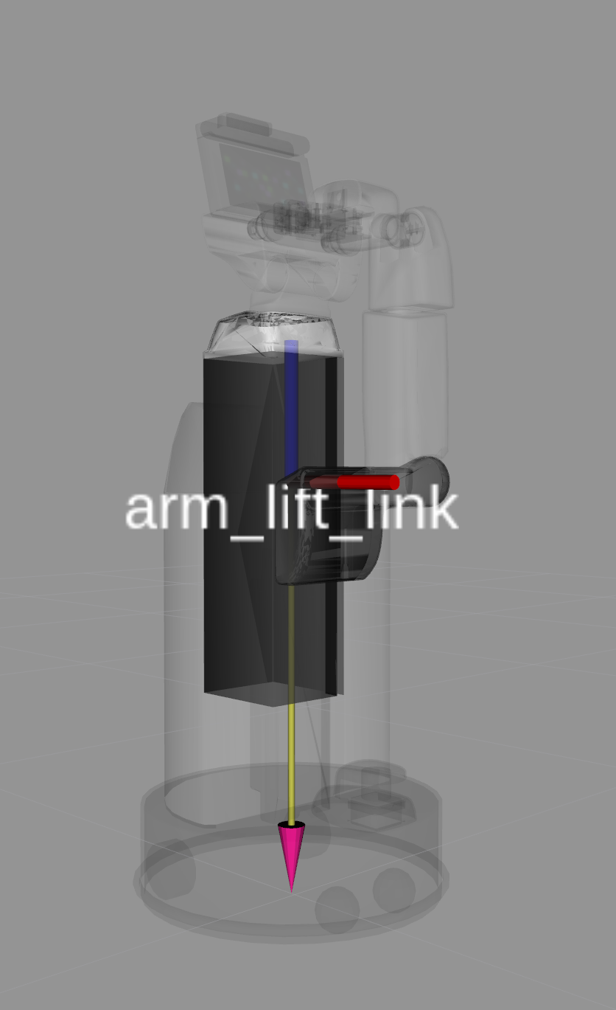
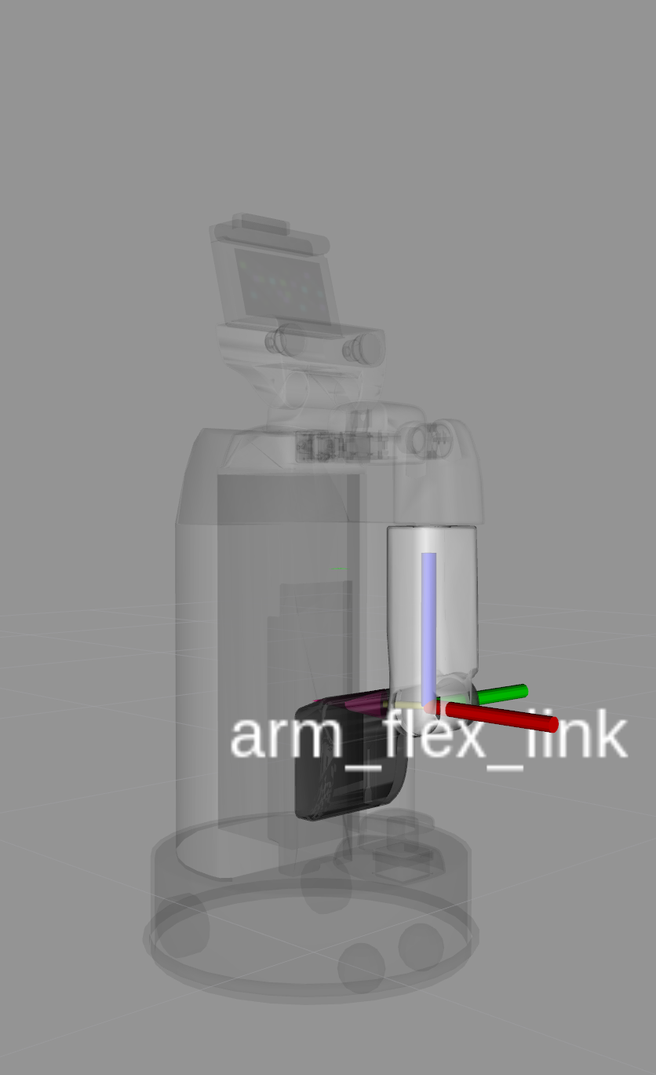
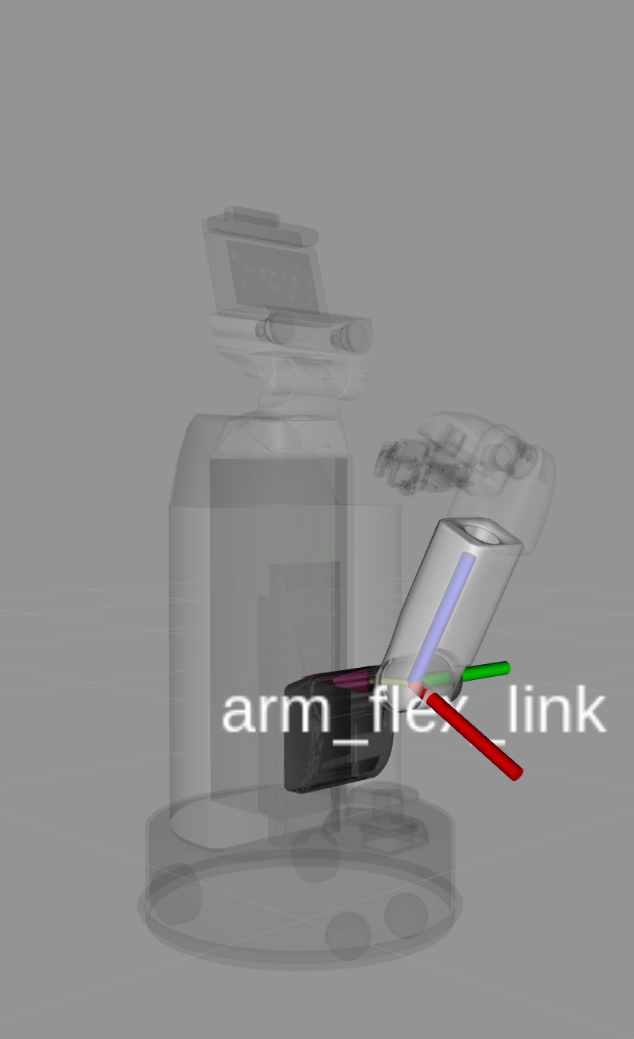
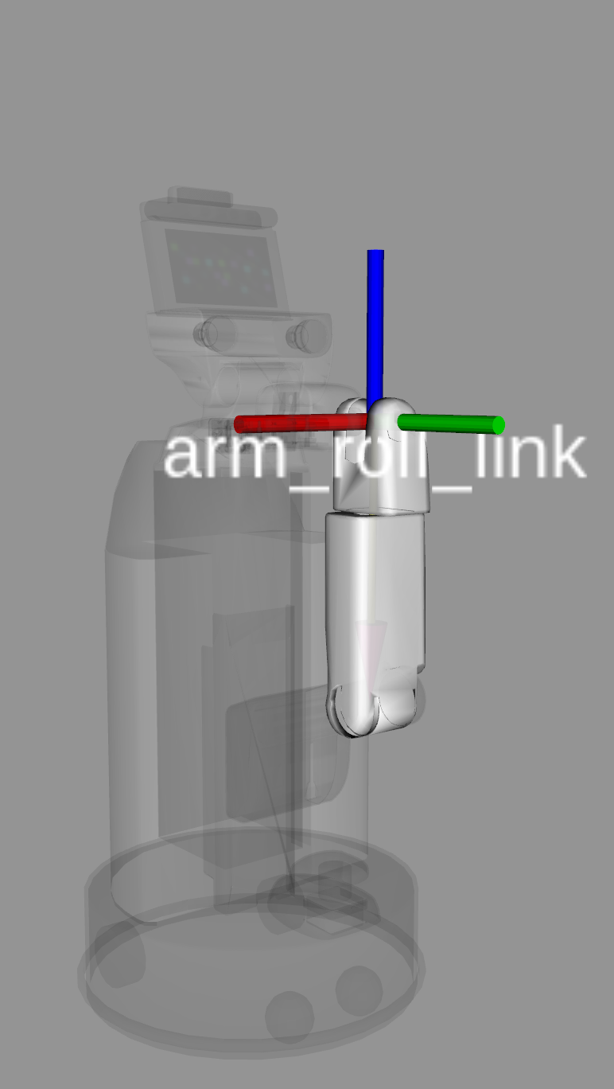
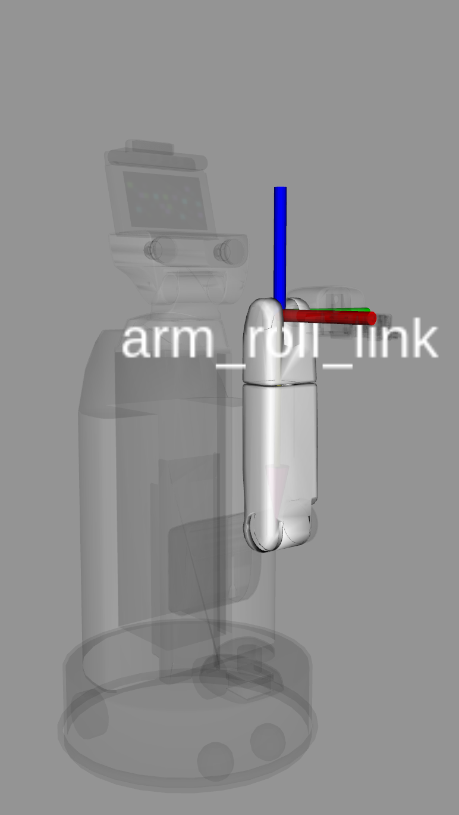
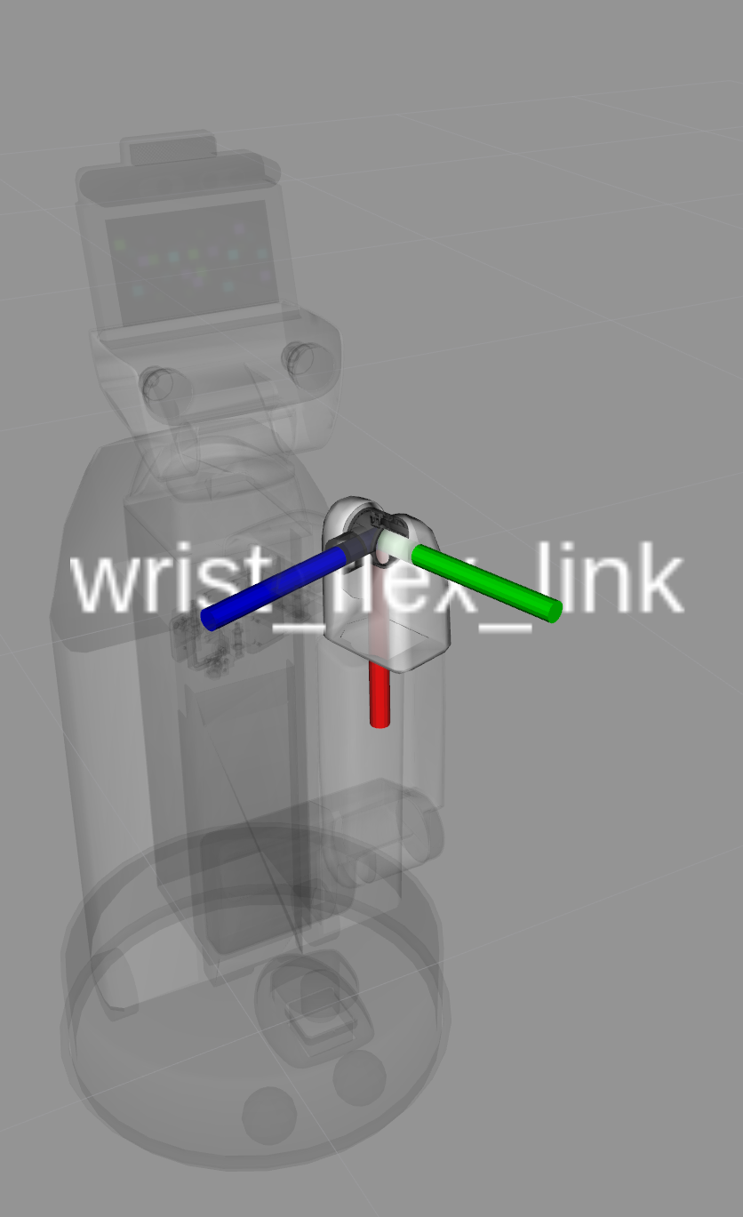
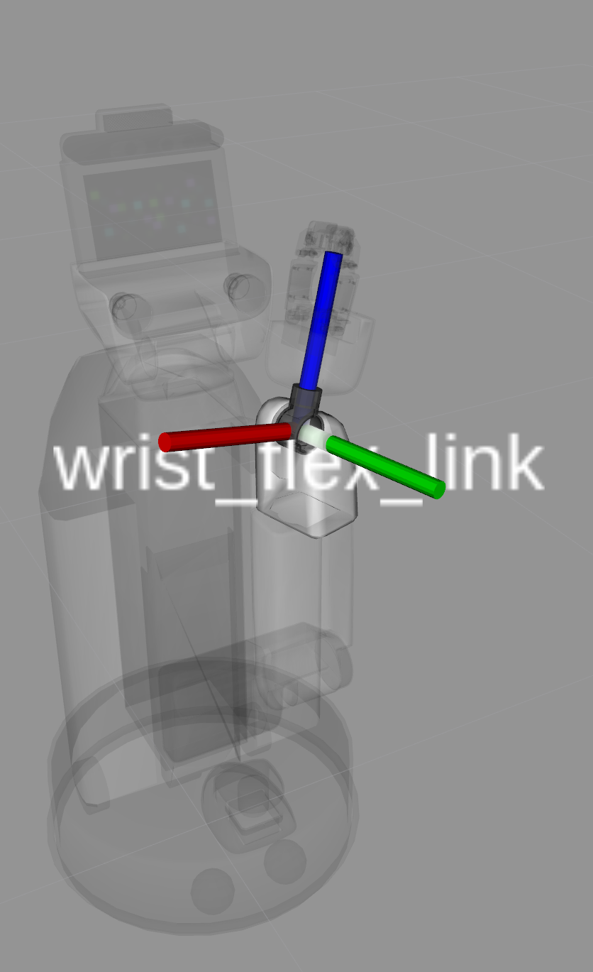
Arm Joints

Slide 6
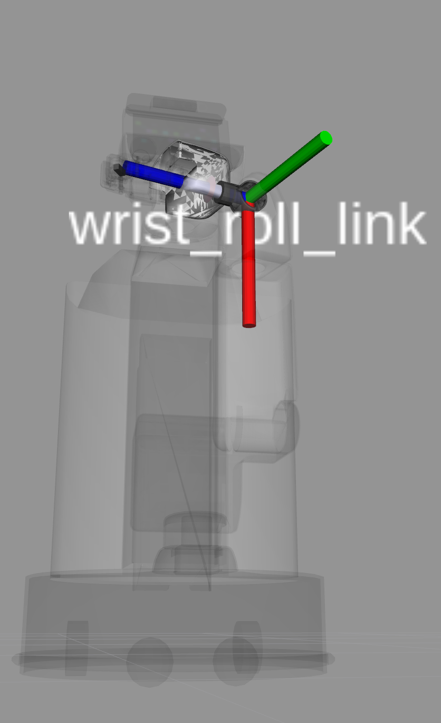
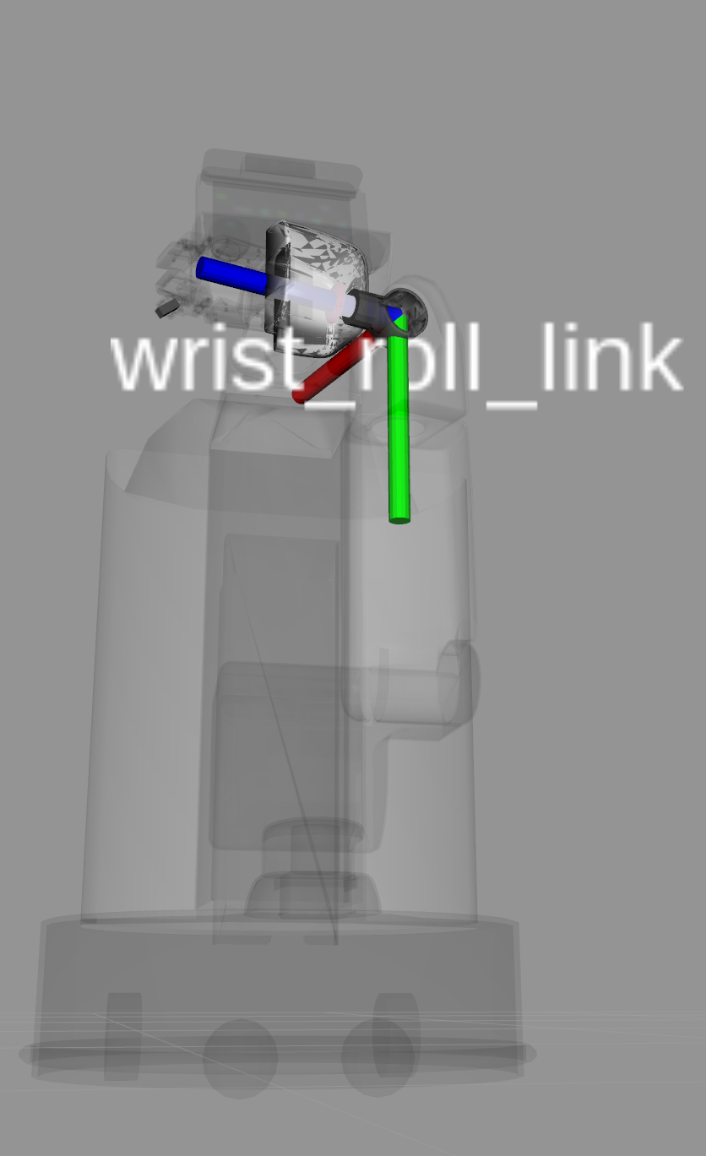
Arm Joints

Slide 7
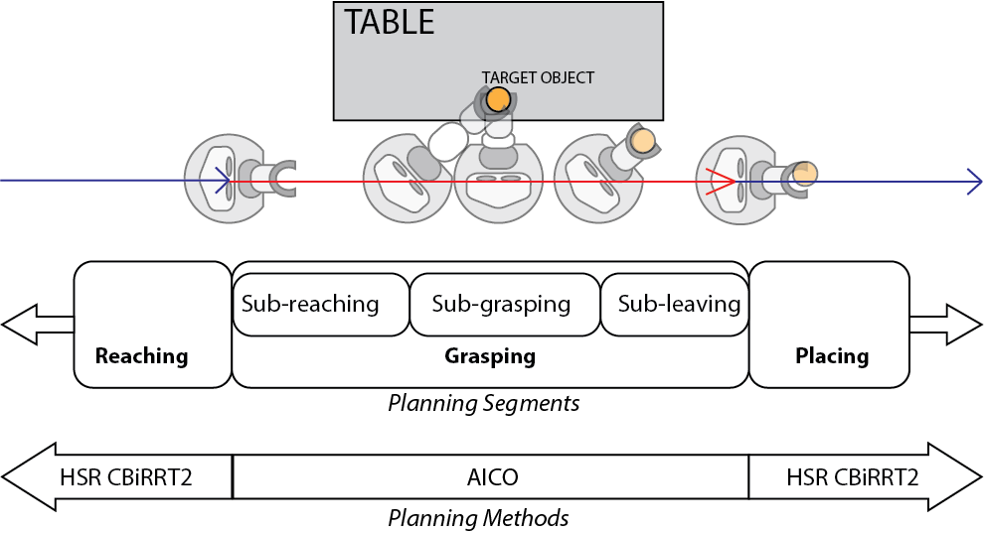
Approach
Split Problem into 3 segments: Reaching, Grasping, and Placing.
Focus of project is on the Grasping Segment, where the drive-by pick-up action occurs.
Reaching step brings HSR to the starting pose of the grasping segment.
Placing step starts at end pose of grasping and places the target object at the desired location.

Slide 8
Approximate Inference Control
Non-linear trajectory optimization
Cost function from taskmaps
Uses message-passing to propagate beliefs.
Allows for local configuration updates instead of updating to the entire trajectory.
Implemented in the Extensible Optimization Toolkit (EXOTica)

Slide 9
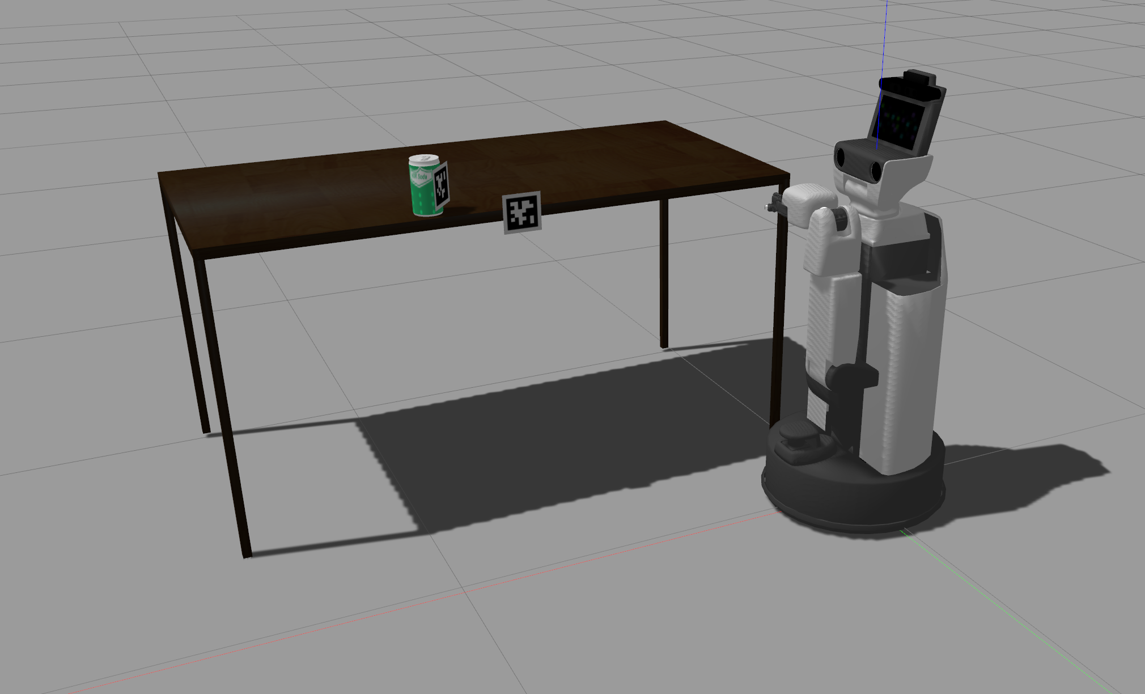
Scenario

Slide 10
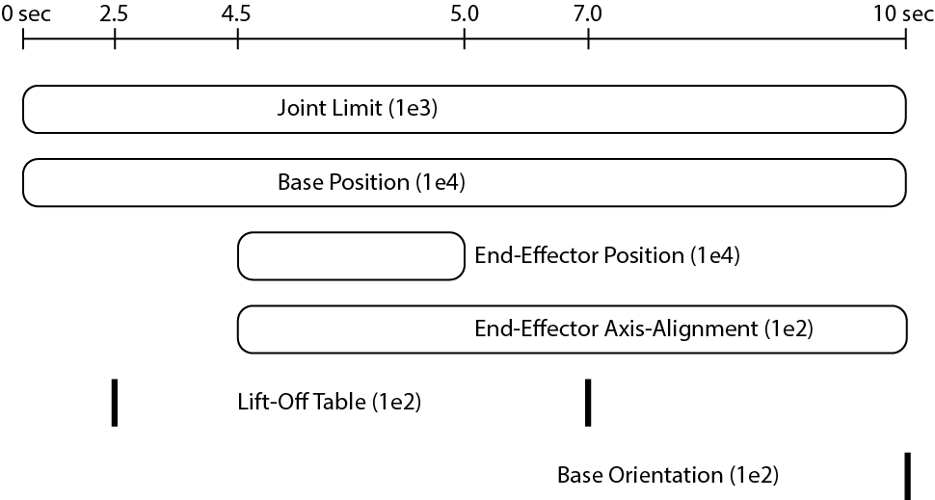
The Grasping Segment
Timing of when taskmaps are active and what the weights are for the AICO solver within the EXOTica framework.
Sub-reaching: 0 to 4.5 sec
Sub-grasping: 4.5 to 5.0 sec
Sub-leaving: 5.0 to 10.0 sec

Slide 11
Explanation of Tasks
Joint position limits
Approximately follow a given base trajectory
Keep gripper centered on the soda can while gripper closes
Optimization planning method bad at encoding collision. Avoid collision by keeping gripper above tabletop.
Achieve a certain final base orientation.

Slide 13
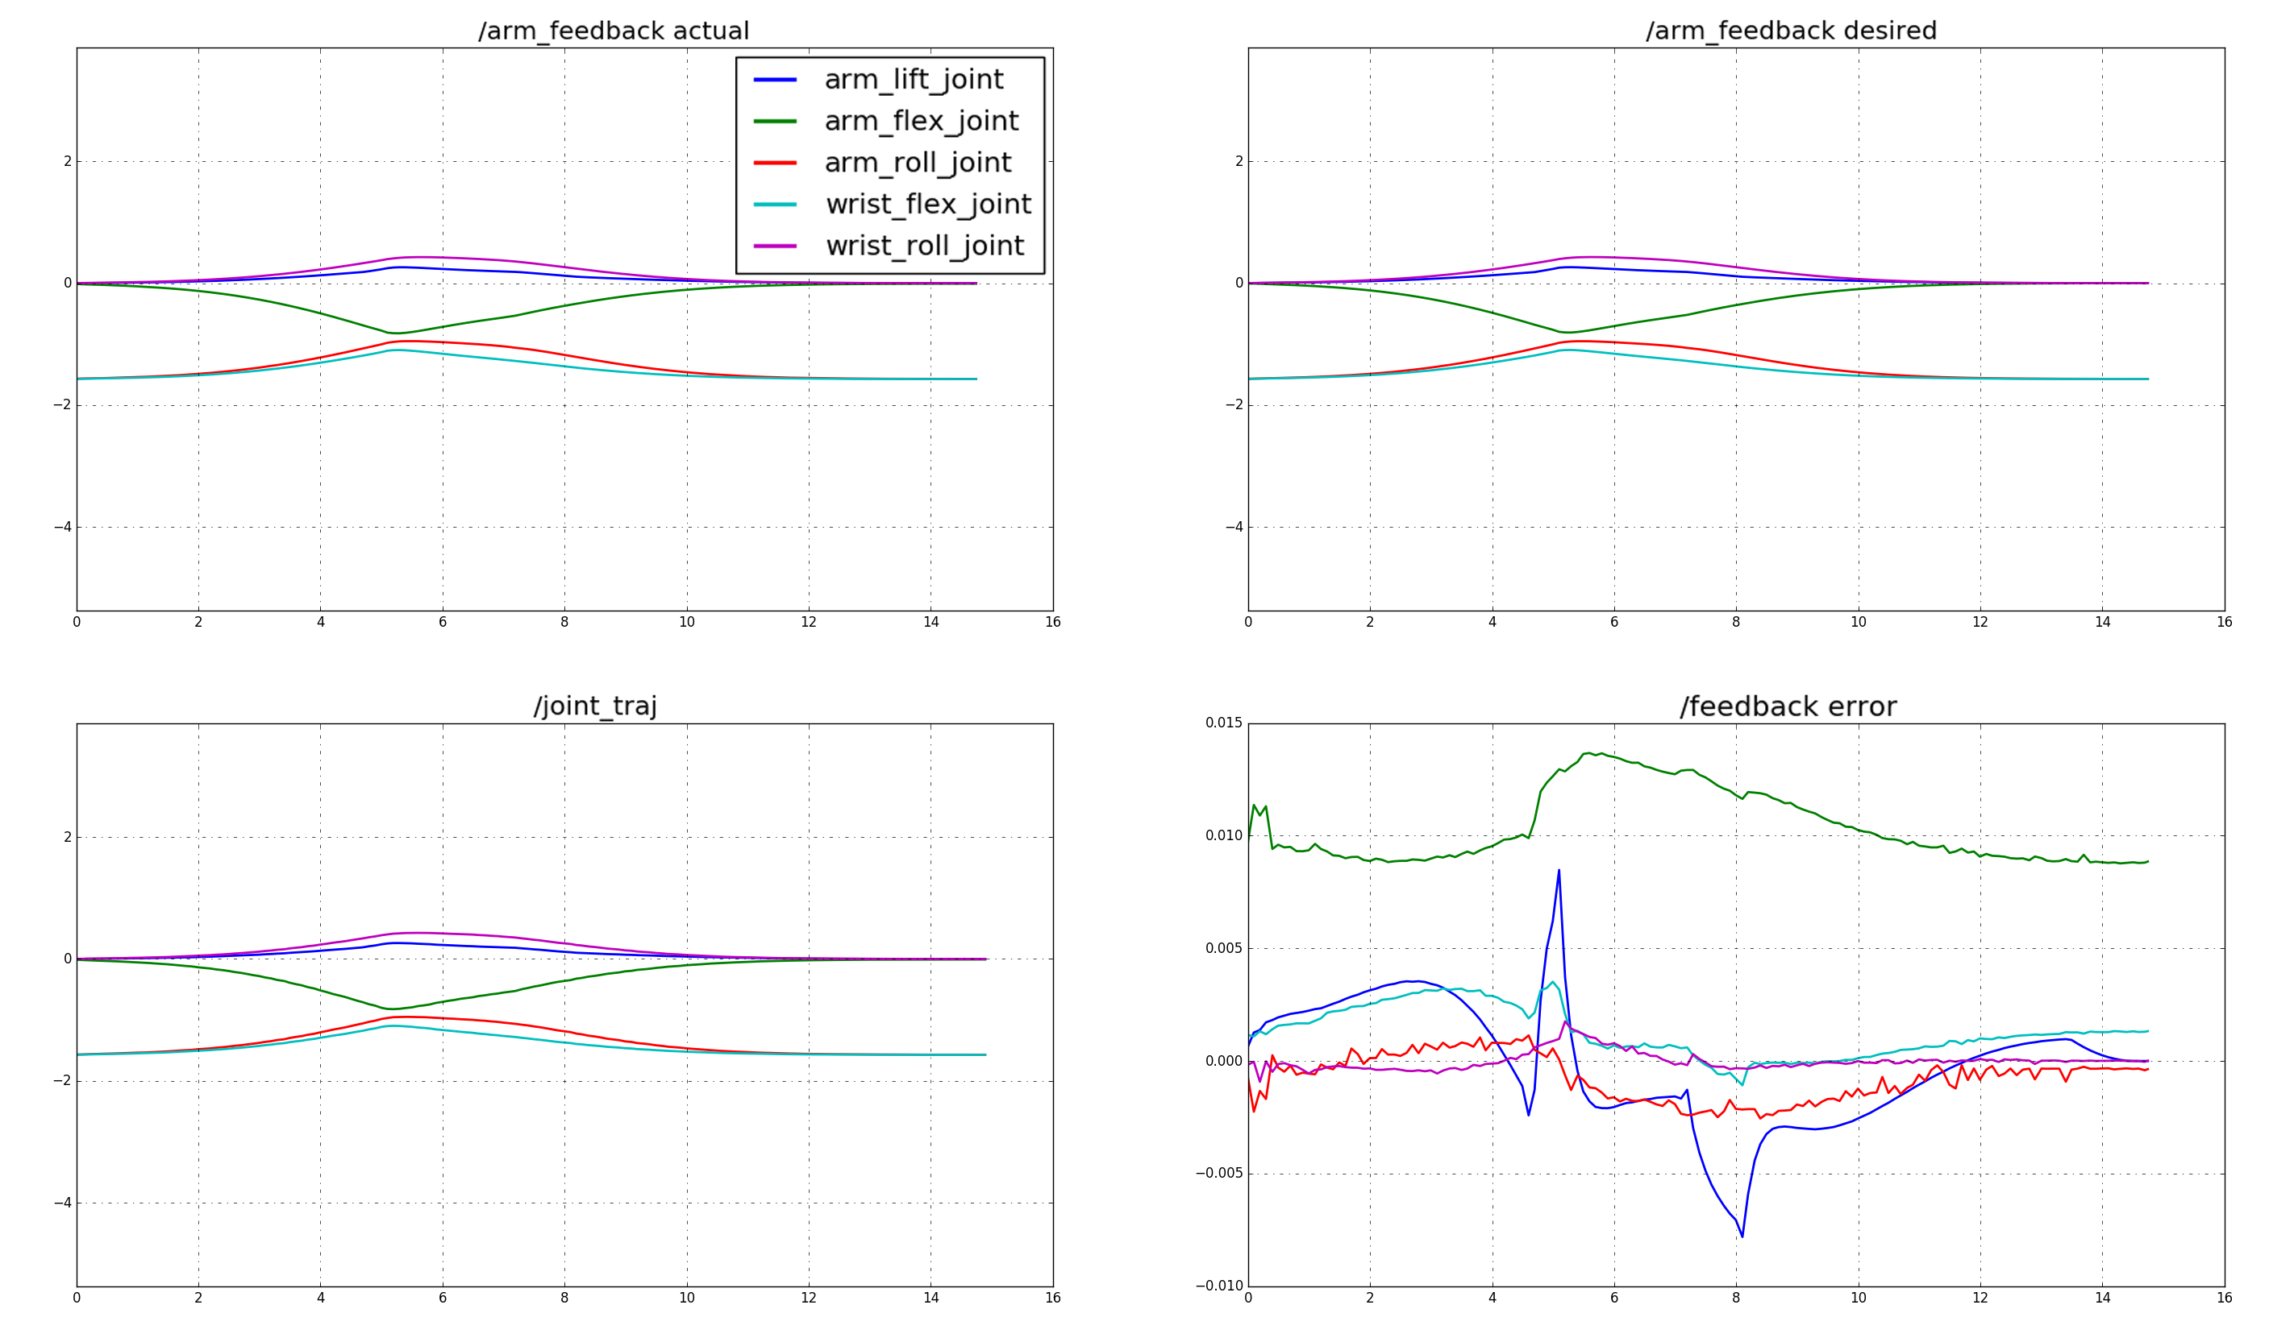
Position Plots

Slide 14
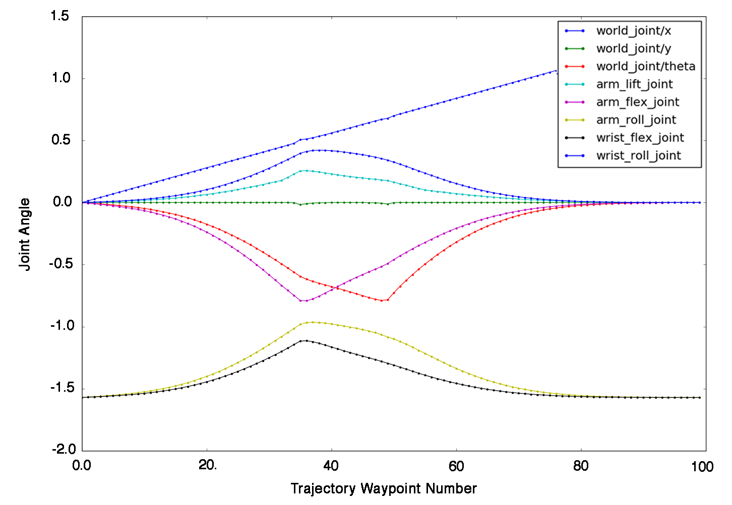
Position Plots
The HSR follows position waypoints pretty closely in simulation.
Trajectory output from AICO solver

Slide 15
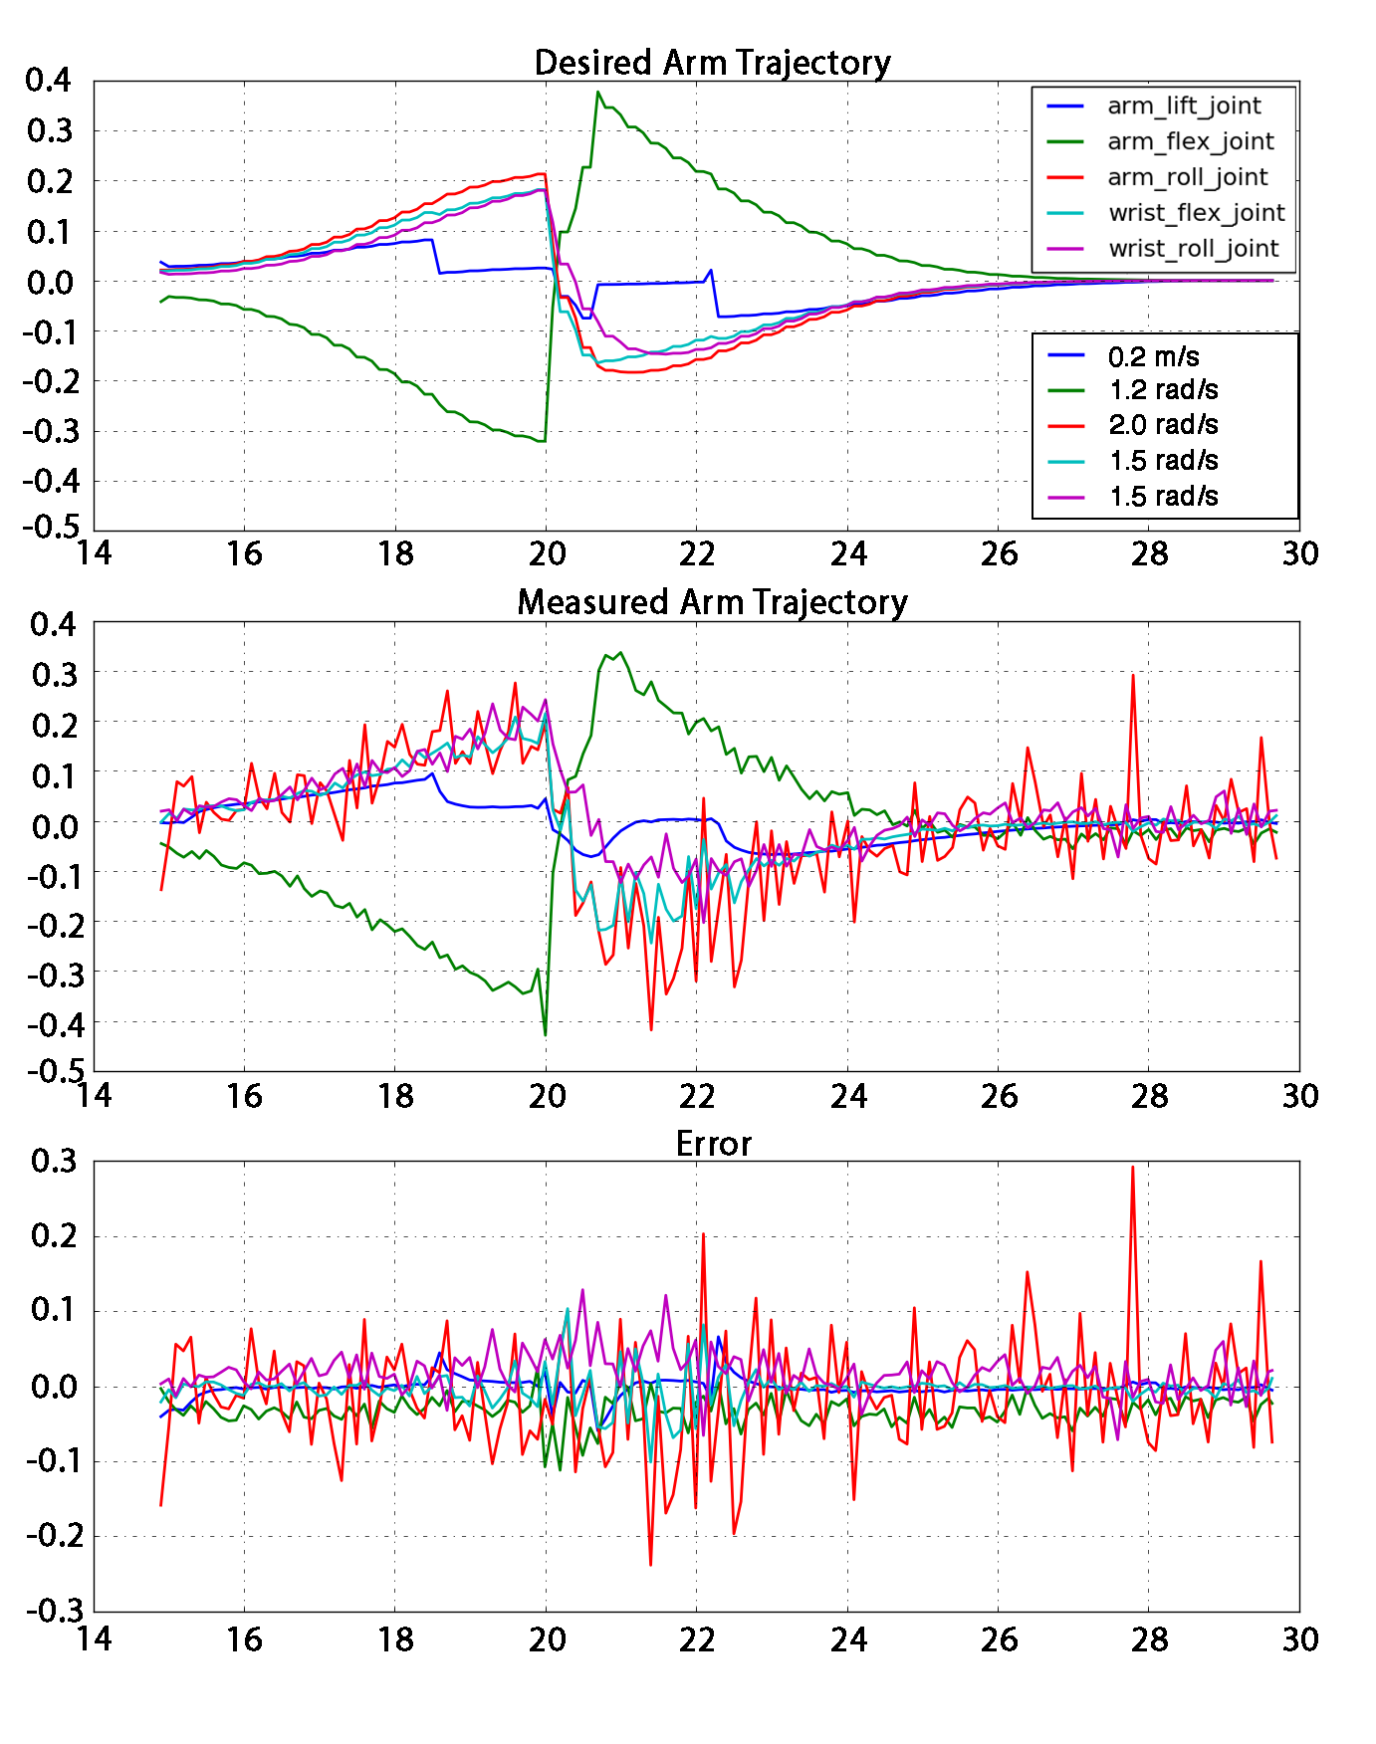
Velocity
There is significant noise in measurements for the arm_roll_joint in Gazebo.
Possibly due to a low damping parameter value in urdf (0.1 instead of 1.0 for other arm joints).
Although velocity limits are not explicitly included in the taskmaps, the values fall within the HSR’s limits.

Slide 16
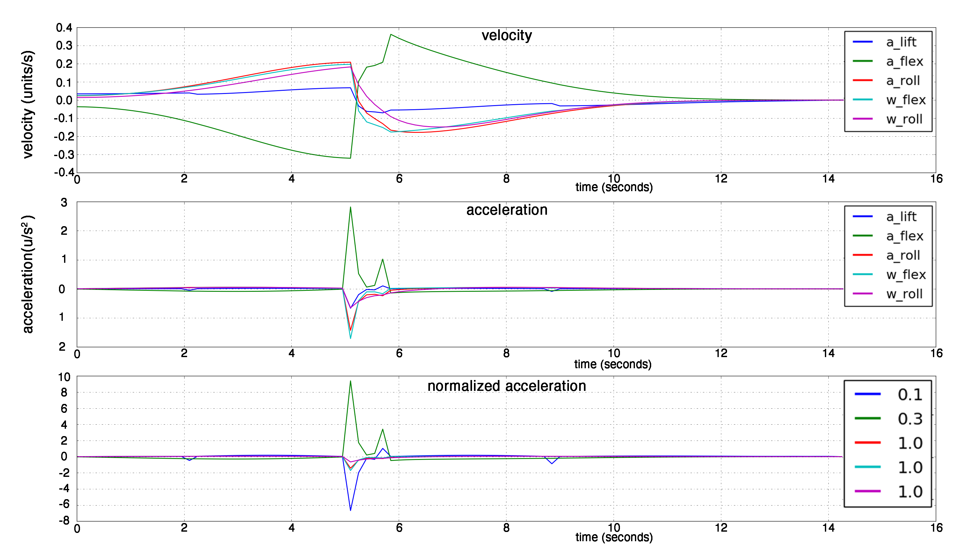
Acceleration
The acceleration limits are exceeded at transitions between taskmaps.
Possible adjustments include:
increasing the timestep
Adjusting joint weights
Changing timing of sub-grasping phase

