Slide 1
Towards Objective Measures of Algorithm Performance Across Instance Space
Kate Smith-Miles, Davaatseren Baatar, Brendan Wreford, Rhyd Lewis

Slide 2
Question
How to find the strengths and weaknesses of different optimization algorithms in order to be compared across a broader instance space?

Slide 3
Contents
Introduction
Framework: The Algorithm Selection Problem
Methodology
Generating the instance space
Algorithm performance prediction
Analysis of algorithmic power
Graph Coloring Case Study
Conclusions

Slide 4
Introduction
This paper tackles the dificult but important task of objective algorithm performance assessment for optimization. It demonstrates the use of the methodology proposed by applying it to some computational results reported recently for an extensive comparison of graph coloring heuristics.

Slide 5
Framework: The Algorithm Selection Problem
There are four essential components of the model proposed by Rice in 1976:
the problem space P represents a possibly infinitely-sized set of instances of a problem;
the feature space F contains measurable characteristics of the instances generated by a computational feature extraction process applied to P;
the algorithm space A is a set (portfolio) of algorithms available to solve the problem;
the performance space Y represents the mapping of each algorithm to a set of performance metrics.
For a given problem instance x ∈ P, with feature vector f(x) ∈ F, and the selection mapping S(f(x)) into algorithm space A, such that the selected algorithm α ∈ A maximizes the performance mapping y(α, x) ∈ Y.
The collection of data describing {P, F, A, Y} is known as the meta-data.

Slide 6
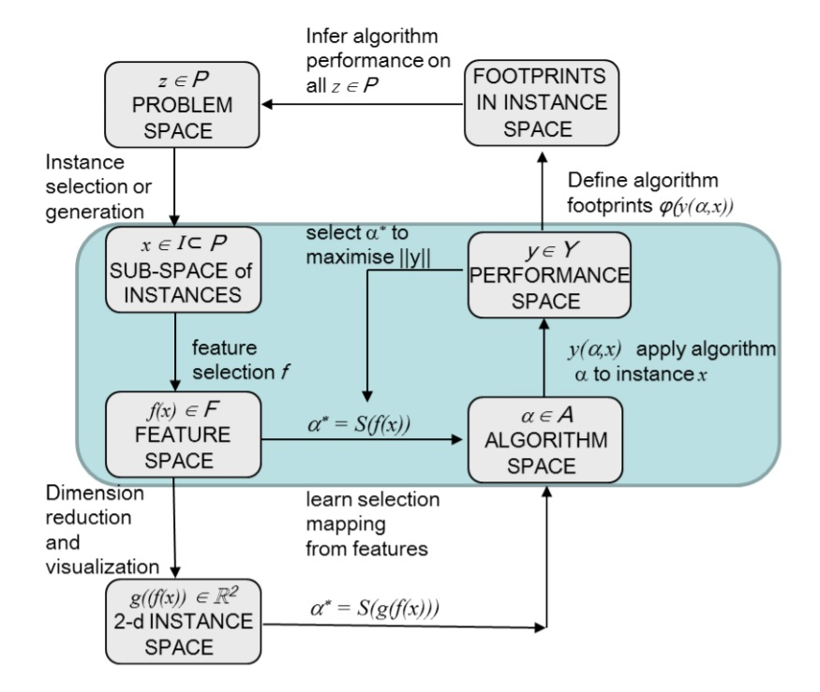

Slide 7
Generating the instance space
A process whereby instances are selected, their features calculated, and an optimal subset of features is generated to create a high-dimensional summary of the instances in feature space that, when projected to the two-dimensional instance space, achieves good separation of the easy and hard instances. Using dimensional reduction techniques such as principal component analysis (PCA), we have previously proposed projecting all instances to a two-dimensional instance space where we can visualize the region where an algorithm can be expected to perform well based on generalization of its observable performance on the test instances. We call this region the algorithm footprint in instance space, and the relative size and uniqueness of an algorithm's footprint can be used as an objective measure of algorithm power.

Slide 8
1. Instance selection or generation
For many optimization problems, large collections of well-studied instances exist. If they are suficiently diverse based on measurable features that correlate with dificulty, then that is probably suficient for generating a useful instance space. If diversity is not achieved, then we must take steps to generate additional instances that extend the boundaries of the instance space.
Measuring the diversity of the instances as they appear in the resulting instance space requires two considerations:
Instance dissimilarity
Algorithmic discrimination
The diversity of the instances will not be apparent until the instance space has been created, which requires the features to be selected and instances to be projected to R².

Slide 9
2. Feature selection
Generally, feature selection is a two-step process: firstly we need to define how we will measure the goodness of a particular subset of features, and after we can use an optimization search strategy to find the subset F ∗ that maximizes the goodness metric.
In this methodology, we define the goodness of a subset of features based on the extent to which instances that elicit similar performance of algorithms are close together in the instance space defined by the two-dimensional projection of the subset of features.
We use Principal Component Analysis to create the two-dimensional projection based on the candidate subset of features, and use a Naive Bayes classiffier as the machine learning technique. A genetic algorithm is then used to search the large space of possible subsets of m features, with this goodness measure (the classification accuracy on an out-of-sample test set) used as the fitness function to drive the search for the optimal subset of features F ∗ ⊆ F. Among the best subsets for each value of m, we select the optimal subset as the one with the smallest test set classier error.

Slide 10
3. Visualization via dimension reduction
We use Principal Component Analysis (PCA), which essentially rotates the data to a new coordinate system in R ^{m}, with axes defined by m new features which are linear combinations of the m selected features in F ∗ . We will consider that the new two-dimensional instance space is an adequate representation of the original feature space if most of the variation in the data is explained by these two principal axes.

Slide 11
Algorithm performance prediction
For the task of performance prediction, we utilize standard machine learning methodologies that use a subset of the instances (the training set) to learn the relationship between the instance features (in either R ^{m} or R ² ) and the label we assign each algorithm for each instance to indicate how well the algorithm performed. Our choice of performance metric Y is user-defined, and machine learning methods are used to build a model to predict that performance metric, evaluated on unseen test set instances that have been randomly extracted from the available data I ⊂ P.

Slide 12
Analysis of algorithmic power
In this paper we use a binary label of easy or hard for each algorithm in our portfolio, and then visualize the boundary in instance space between good and bad performance for each algorithm. The region in instance space where an algorithm is expected to perform well is called the footprint.
The relative size of each algorithm's footprint provides some objective measure of algorithm strength across the instance space, but it is also important to understand where in the instance space an algorithm is strong.
The final analysis that should be done to complete the methodology is to explore the instance space to gain insights into how the features affect the algorithm footprints.

Slide 13
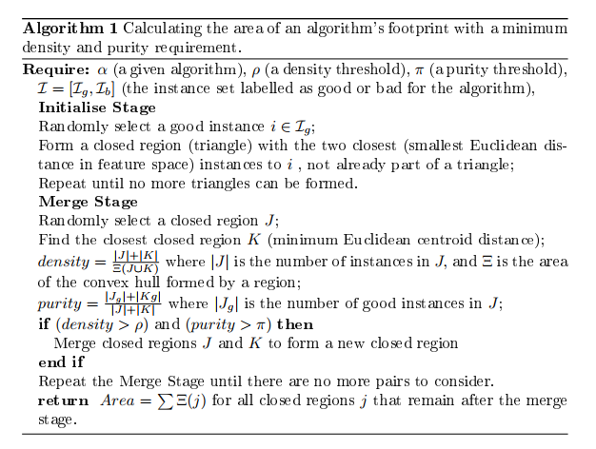
Analysis of algorithmic power

Slide 14
Graph Coloring Case Study
The graph coloring problem (GCP) is to assign colors to the vertices, minimizing the number of colors used, subject to the constraint that two vertices connected by an edge (called adjacent vertices) do not share the same color. The optimal (minimal) number of colors needed to solve this NP-complete problem is called the chromatic number of the graph.

Slide 15
Graph Coloring Problem Instances (P)
B (Bipartivity-controlled): bipartite graphs, with the number of nodes |V| randomly generated in the range [100, 1000]
C1 (Culberson - cycle driven graphs): This generator creates graphs with cycles of a specified length
C2 (Culberson - geometric graphs): Vertices in the graph correspond to the points (x, y) in the plane, with edges included if the distance between a pair of vertices is less than the radius r
C3 (Culberson - girth and degree inhibited graphs): The girth limit indicates that no cycle will be created with girth less than g. Hence if an edge (v, w) is being considered as a new edge, every pair of vertices (x, y) will have a distance of less than g after the addition is blocked, and will never be selected as a possible new edge. p is the probability that a possible edge will be used
C4 (Culberson - uniform or IID graphs): edges are assigned to vertex pairs with a fixed probability p
C5 (Culberson - weight-biased graphs): These graphs contain cliques limited to a given size

Slide 16
Graph Coloring Problem Instances (P)
D (DIMACS and Networkx): DIMACS instances are 125 benchmark instances consisting of different type of graphs such as Leighton, at, Mycielski, queen, miles, game, register, insertions etc.
E (Social Network graphs): These graphs are based on the social networks of school friends
F (Sports Scheduling graphs): These graphs represent roundrobin tournaments used in sports leagues with n teams, and each team is required to participate in a match against all other teams m times in m(n − 1) rounds
G (Exam Timetabling graphs): These graphs represent the conflicts in real-world exam timetabling problems
H (Flat graphs): Graphs constructed by partitioning the vertices into K almost equisized sets. Edges are then added between pairs of vertices in different sets with probability p in such a way that the variance in vertex degrees is kept to a minimum
I (Random graphs): These are the random graphs. Each pair of vertices are made adjacent with probability p ranging from 0.05 (sparse) to 0.95 (dense)

Slide 17
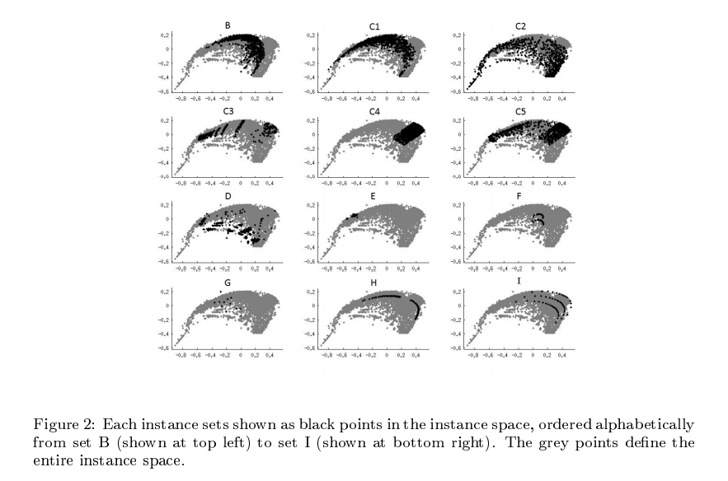

Slide 18
Graph properties or features (F)
For the graph G = (V, E), we consider 18 features relating to
the nodes and edges
the cycles and paths on the graph
the spectral properties of the graph

Slide 19
Algorithms (A)
DSATUR: Brelaz's greedy algorithm based on saturation degree of the vertices , which has been shown to be exact for bipartite graphs.
Bktr: a backtracking version of the DSATUR heuristic which also includes an operator for dynamically reordering the vertices when a node in the search tree is revisited. This algorithm was implemented by Culberson and is available for download.
HillClimb: A hill-climbing method that operates in the space of feasible solutions with the initial solution being formed using the DSATUR heuristic.
HEA: A hybrid evolutionary algorithm of Galinier and Hao that operates by maintaining a (typically small) steadystate population of candidate solutions which are evolved via a problemspecic recombination operator and a local search method.
TabuCol: Galinier and Hao's variant of the Tabu search algorithm for graph colouring.
PartialCol: The algorithm of Blochliger and Zuerey that operates in a similar fashion to TABUCOL but with a dierent neighborhood operator that does not allow improper solutions to be considered.
AntCol: Ant Colony meta heuristic-based method of Dowsland and Thompson combining global and local search operators.
RandGr: This is a simple greedy algorithm that takes a random permutation of the vertices and then colours them using a rst-t greedy algorithm. This is the heuristic used to provide the initial number of colours for both the PartCol and TabuCol algorithms

Slide 20
Performance metric (Y)
In this paper we measure algorithm performance as either easy or hard, based on the gap between the best solution (number of colors) produced by the portfolio and the number of colors needed by an algorithm to properly color the graph within the stated computation limit of 5 × 1010 constraint checks. We say that an algorithm is good if the number of colors needed by the algorithm is no more than % greater than the best algorithm in the portfolio on that instance. We will consider both = 0% and = 5%.

Slide 21
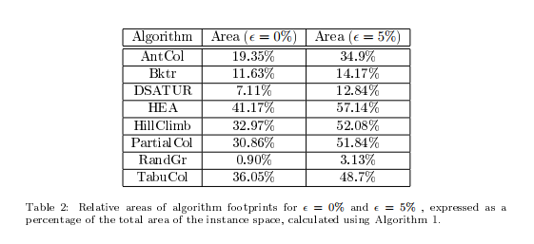

Slide 22
Predicting algorithm performance for automated algorithm selection
Our first attempt to use a Naive Bayes classier resulted in a model that predicted that HEA would be best across the whole instance space, and failed to detect the small regions where other algorithms are best. We then employed a more powerful machine learning method: support vector machines (SVMs), trained in MATLAB. Using a random extaction of 50% of the instances, with the remaining 50% reserved for out-of-sample testing, we built eight SVMs to predict the boundaries of each algorithm's footprint, achieving better results, although still not perfect due to the many contradictory instances within a region.

Slide 23
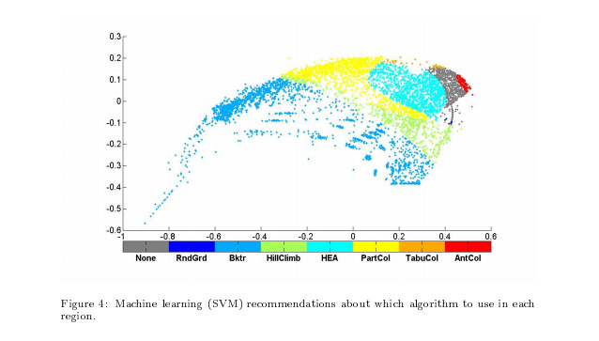

Slide 24
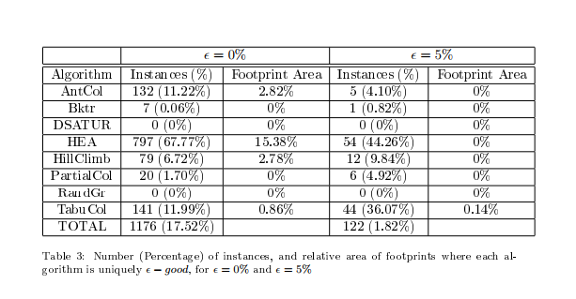

Slide 25
Conclusions
We have been able to identify the regions in instance space where HEA is not the best algorithm, and to dene classes of instances where other algorithms, such as AntCol and HillClimb, consistently outperform HEA. Most signicantly, we are able to relate the instance features to these classes, and show that HEA (or at least the implementation of HEA that we used) has a relative weakness on instances with extreme values of the instance features. Of course, an algorithm is really just a particular implementation of an algorithmic strategy, with parameter values that are tunable and can aect the performance of the algorithm. We are not attempting to draw any conclusions about any particular algorithm's potential with this analysis. Indeed, the same algorithm with a dierent parameter combination can be considered as a new algorithm, with its own footprint, within this methodology. We are simply demonstrating that, using exactly the same algorithmic implementations as used in the study of Lewis et al. [19] we can obtain additional insights that were not otherwise apparent using a standard analysis of computational results.

