Slide 1

Alexandru Ioan Cuza University of Iaşi
Faculty of Computer Science
DISSERTATION
A Model for Heart Sounds
Segmentation and Classification
using Neural Networks
A Model for Heart Sounds Segmentation and Classification using Neural Networks
Student: Oriana-Maria Oniciuc
Scientific Coordinator: Conf. Dr. Liviu Ciortuz
July 2018

Slide 2
Contents
I. Introduction
II. Methodology and research methods
II.1. Data processing
II.2. Classification models
III. Results and comparisons
III.1. Multi-Class CNN
III.2. Multi-Task Learning
IV. Conclusion
<number>
A Model for Heart Sounds Segmentation and Classification using Neural Networks

Slide 3
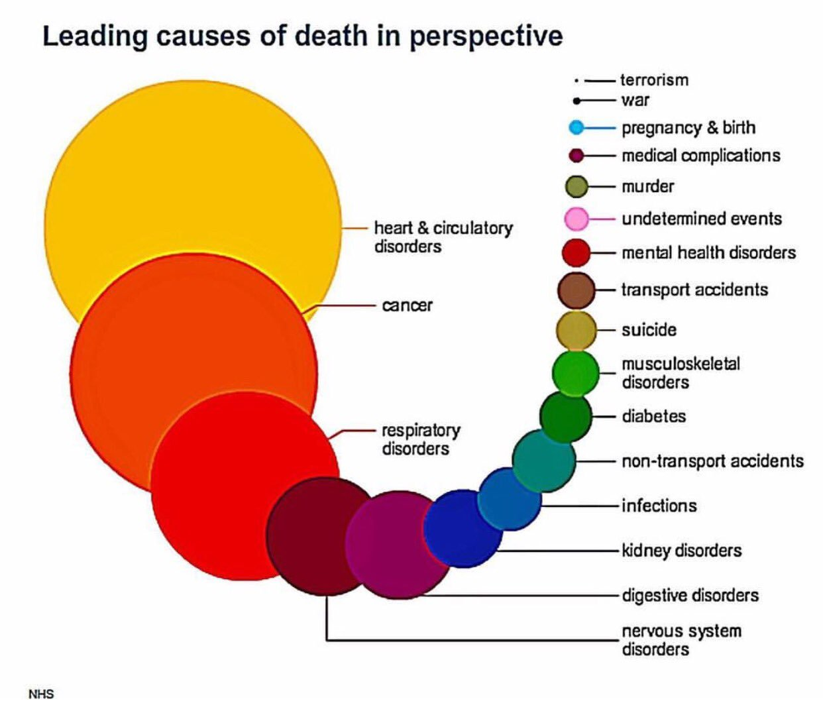
<number>
A Model for Heart Sounds Segmentation and Classification using Neural Networks

Slide 4
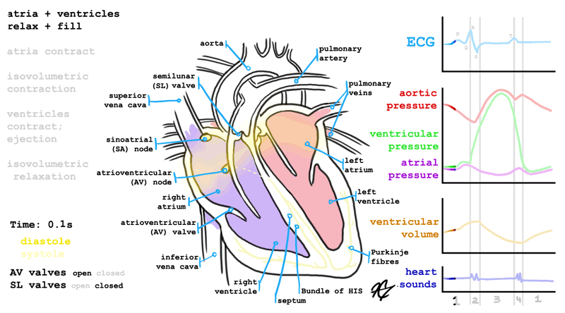
<number>
A Model for Heart Sounds Segmentation and Classification using Neural Networks - Introduction
Notes:
ECG != PCG
Boli detectabiile prin PCG -> murmur si extrasistole
<number>

Slide 5
Problem description
Predict with a high rate of trust if a person has arrhythmia or murmurs through a phonocardiogram.
Data specifications
The .wav recordings have the following properties:
varying lengths, between 1 second and 30 seconds
44100 Hz and 4000 Hz samplerate
3 classes
<number>
A Model for Heart Sounds Segmentation and Classification using Neural Networks

Slide 6
Data processing
Normalization
Peak analysis
Sliding window for data selection
Feature extraction
<number>
A Model for Heart Sounds Segmentation and Classification using
Neural Networks - Methodology and research methods - Data processing

Slide 7
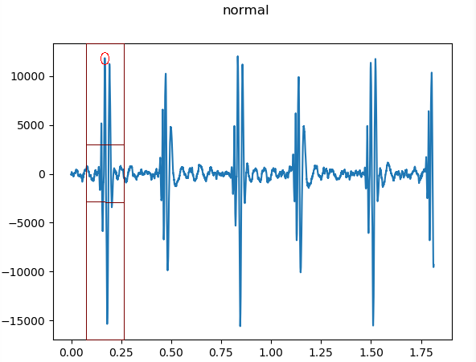
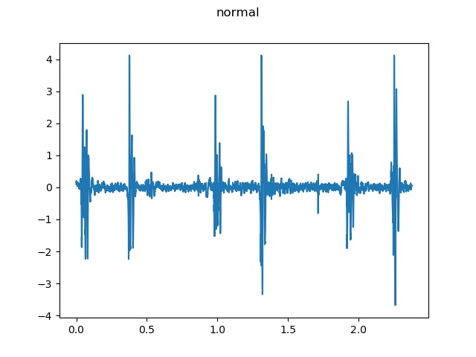
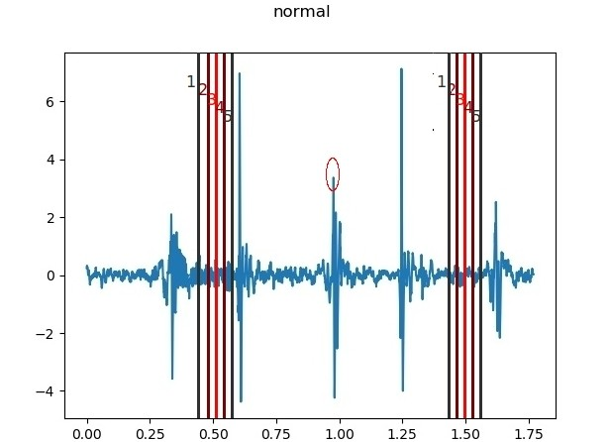
<number>
A Model for Heart Sounds Segmentation and Classification using
Neural Networks - Methodology and research methods - Data processing

Slide 8
Feature extraction
Mean Peak Frequency and Amplitude
Peak Frequency and Amplitude Standard Deviation
Minimum and Maximum Peak Distance
Minimum and Maximum Peak Amplitude
Mean Amplitude
Standard Deviation Amplitude
Number of Peaks
A Model for Heart Sounds Segmentation and Classification using
Neural Networks - Methodology and research methods - Data processing
<number>

Slide 9
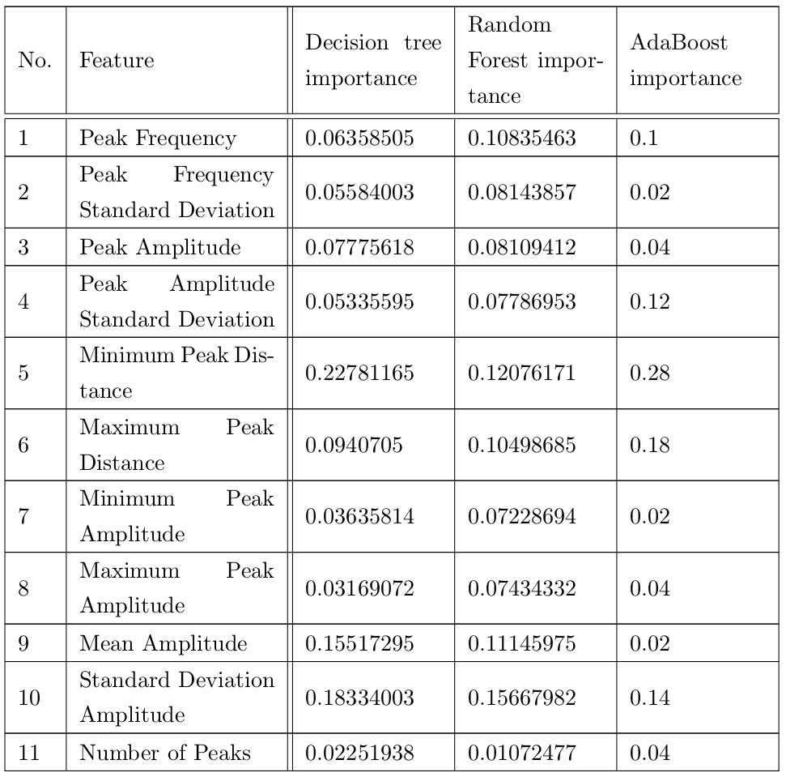
Feature extraction
<number>
A Model for Heart Sounds Segmentation and Classification using
Neural Networks - Methodology and research methods - Data processing

Slide 10
Classification Models
Multi-Class Convolutional Neural Network
Multi-Task Learning
<number>
A Model for Heart Sounds Segmentation and Classification using
Neural Networks - Methodology and research methods - Classification models

Slide 11
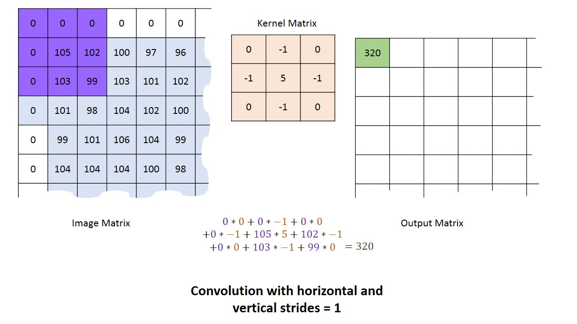
Convolutional Neural Network
<number>
A Model for Heart Sounds Segmentation and Classification using
Neural Networks - Methodology and research methods - Classification models

Slide 12
Multi-Class CNN
Input layer: 16000
Hidden layer 1: 15991, 12
Hidden layer 2: 3198, 12 => 38376
Hidden layer 3: 500
Hidden layer 4: 100
Hidden layer 5: 20
Output layer: 3
Activation function: ReLU and Softmax
Loss function: Categorical crossentropy
<number>
A Model for Heart Sounds Segmentation and Classification using
Neural Networks - Methodology and research methods - Classification models

Slide 13
CNN Murmur heartbeat
Input layer: 16000
Hidden layer 1: 15991, 4
Hidden layer 2: 3198, 4 => 12792
Hidden layer 3: 500
Hidden layer 4: 100
Hidden layer 5: 20
Output layer: 2
Activation function: ReLU and Softmax
Loss function: Kullback Leibler divergence
<number>
A Model for Heart Sounds Segmentation and Classification using
Neural Networks - Methodology and research methods - Classification models

Slide 14
CNN Normal heartbeat
Input layer: 16000
Hidden layer 1: 15991, 4
Hidden layer 2: 3198, 4 => 12792
Hidden layer 3: 500
Hidden layer 4: 100
Hidden layer 5: 20
Output layer: 2
Activation function: ReLU and Softmax
Loss function: Kullback Leibler divergence
<number>
A Model for Heart Sounds Segmentation and Classification using
Neural Networks - Methodology and research methods - Classification models

Slide 15
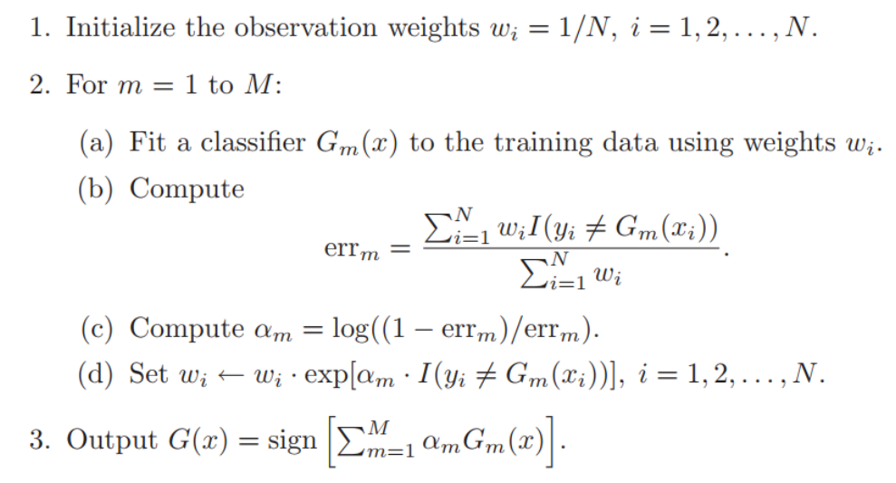
AdaBoost Extrastole heartbeat
<number>
A Model for Heart Sounds Segmentation and Classification using
Neural Networks - Methodology and research methods - Classification models

Slide 16
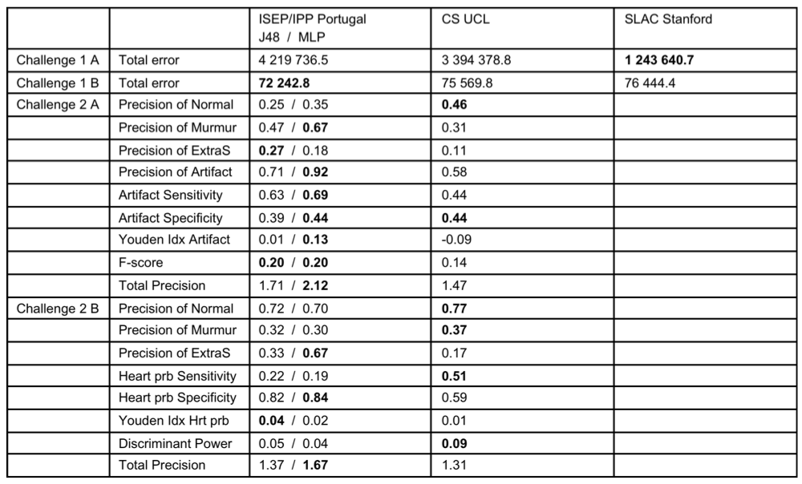
State of the art
<number>
A Model for Heart Sounds Segmentation and Classification using Neural Networks – Results

Slide 17
Results
Multi-class CNN
Test accuracy: 65.74%
CNN Normal heartbeat
Test accuracy: 55.65%
CNN Murmur heartbeat
Test accuracy: 79.81%
AdaBoost Extrastole heartbeat
Test accuracy: 70.03%
<number>
A Model for Heart Sounds Segmentation and Classification using Neural Networks - Results

Slide 18




Technologies
<number>
A Model for Heart Sounds Segmentation and Classification using Neural Networks - Technologies

Slide 19

Thank you for your attention!
<number>
A Model for Heart Sounds Segmentation and Classification using Neural Networks

