Slide 1
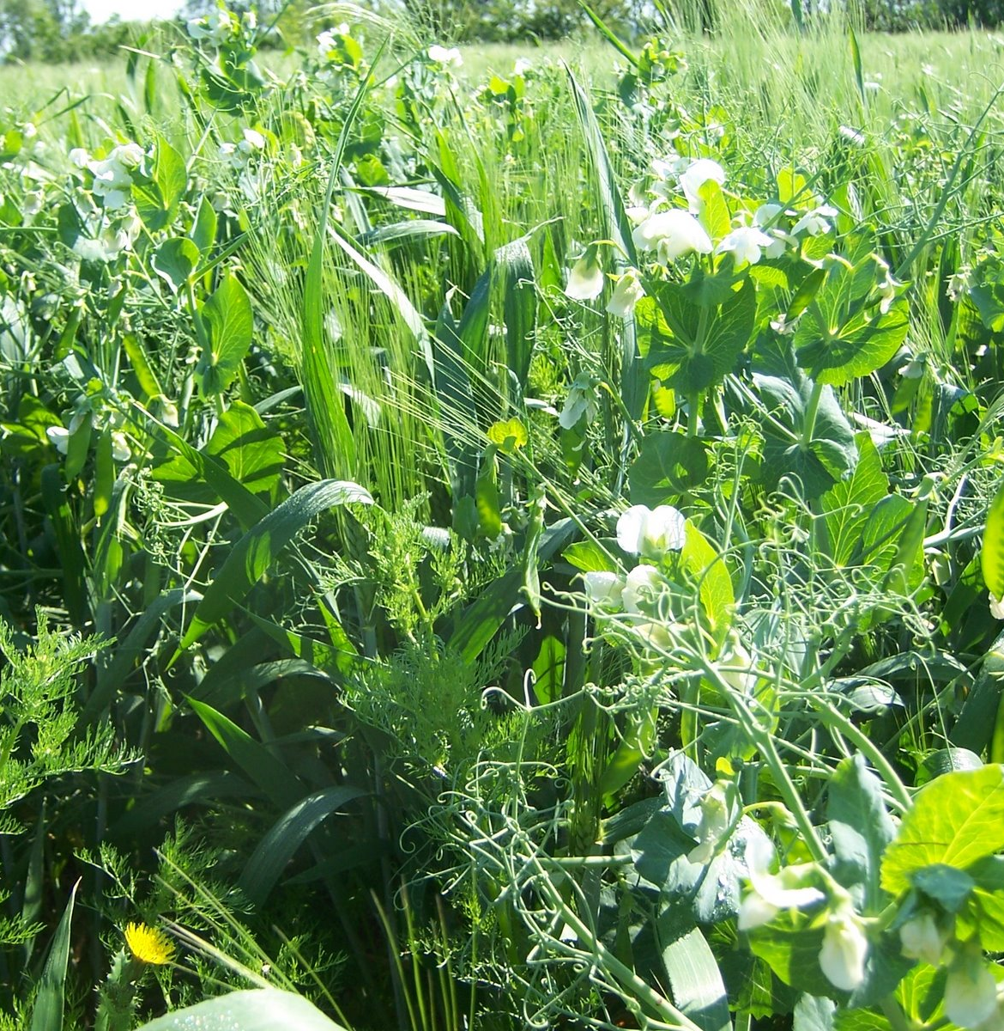




Modelling intercrops: which hypothesis for which model ?
Oriane BRAUD, 1st year PhD Student
Supervision: Marc Jaeger (HDR), Myriam Adam (HDR), Christophe Pradal, Rémi Vezy, Thomas Arsouze
Notes:
Name, PhD co supervised, names, project, modelling intercrops, and we’re gonna see that the choice of an adapted model can be limited by its hypotheses

Slide 2
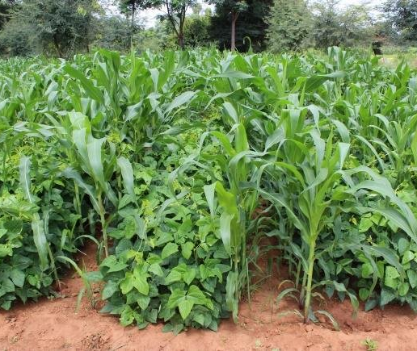
Intercropping
=
Agroecological practice which involves mixtures of arable crop species
(Vandermeer, 1989)
Many benefits… ​
+ yield
- fertilizer and water use
+ sustainable land use
- biotic stresses
etc.
(Bedoussac et al., 2015; Yin et al., 2020, Stomph et al., 2020; Jensen et al., 2020; Li et al., 2021; Chadfield et al., 2022)
…iff it is well managed !
LEGUME
ex: cowpea
CEREAL
ex: sorghum
Sannagoudar et al., 2020​
Notes:
In order to find the best combinations of plants (genotypes), environment and management, models can be an interesting tool, before implementing field experiments

Slide 3
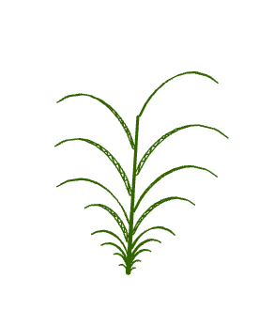
Models as pre-screening tools to optimize GxGxExM
Crop models
ex: STICS (Vezy et al., 2023), APSIM (Chimonyo et al., 2016)
Spatially explicit (3D)
Organ scale
Heterogeneity of resource partitioning
Functional-Structural Plant Models (FSPM)
ex: Virtual GrassLand (Louarn et al., 2020), SIMBAL (Perthame et al., 2023)
1D homogeneous plot
Calibrated parameters
Calibrated parameters
Hardly a whole plant cycle
Months to years
→ High computing cost
Daily time scale
Hourly or less
Notes:
Crop models consider a 1D homogeneous plot, so the only heterogeneity is vertical, and it considers an average plant for the whole crop. So you calibrate your parameters with field data, and then you can run your model for months to years of simulation on a daily time scale.
FSPM are spatially explicit, which means that they consider the 3D architecture of the plant and operate at organ scale and at a finer time scale, hourly or even less. At that scale it is possible to consider so many details the heterogeneity of resource partitioning, etc, but it has a cost, a high computing cost, and also it is hard to model all processes on a whole plant cycle.
Different assumptions, which imply different formalisms for plant processes → ex

Slide 4
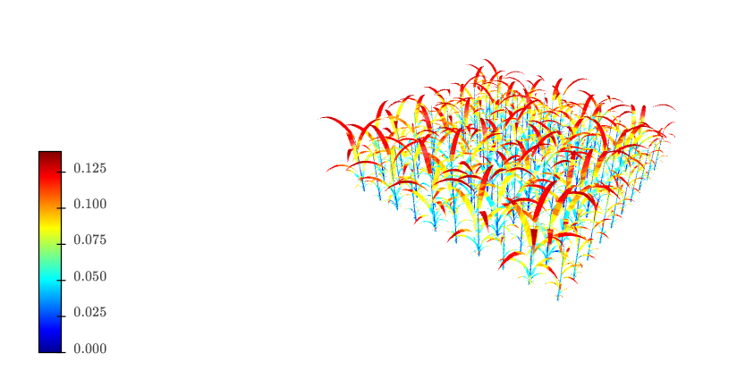

Ex: light interception
Crop models
FSPM
Beer-Lambert law:
$$exp⁡(−k∗LAI)$$
homogeneous canopy
Radiative transfer
(Barillot et al., 2011; Ponce de León and Bailey, 2019)
(Barillot et al., 2014)
Notes:
Crop model: Beer Lambert law of light extinction in homogeneous canopy, that depends on leaf area index
FSPM: we can use radiative transfer in light interception models
There have been some improvements in formalisms in crop models, more adapted for heterogeneous canopies

Slide 5

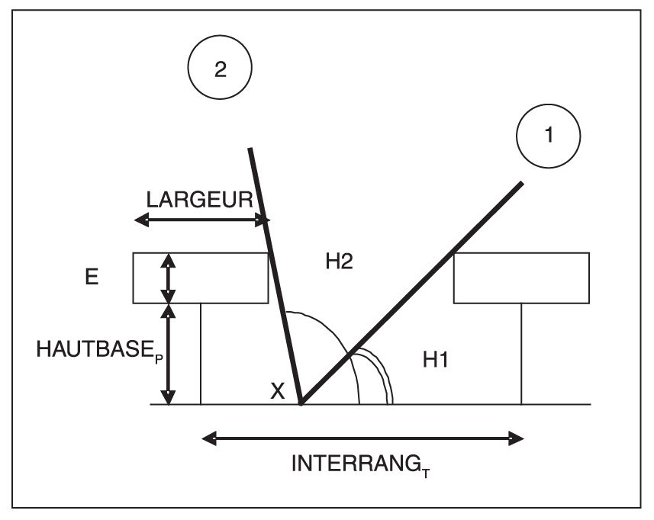
Ex: light interception
Crop models
FSPM
Radiative transfer (2.5D)
(Vezy et al., 2023)
(Vezy et al., 2023)
Notes:
Recent formalism implemented in STICS crop model, using radiative transfer in 2.5D, which enables to roughly account for plants architectures

Slide 6
Which type of model for intercrops ?
Crop models
FSPM
→ Hybrid approach to exploit the best of each
how ?
improve crop model with FSPM
→ + heterogeneity needed ?
(Evers et al., 2019; Gaudio et al., 2019, 2022)
Notes:
We have seen that both types of models had their benefits and drawbacks when it comes to modeling intercrops
So why not adopting a hybrid approach to exploit the best of each
How in practice ?
Well by improving a crop model with an FSPM, and thus adding heterogeneity to crop model when needed

Slide 7
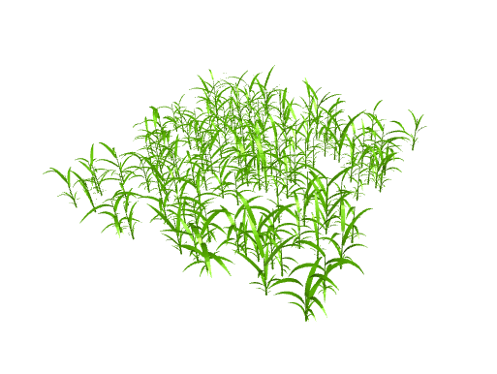
Hypothesis: The error in crop models when modeling intercrops lies in the non-consideration of plant structure (G), plant-plant interactions (GxG) and explicit spatial arrangement (M)
Shoot & root dynamic parametric 3D model (ArchiCrop)
Constrained by crop model
But consideration of structural and spatial aspects adds degrees of freedom and enables to create variability
➔ Explore possible morphospace for a given crop model simulation
Notes:
It’s like having a picture of what a crop model would look like in 3D

Slide 8
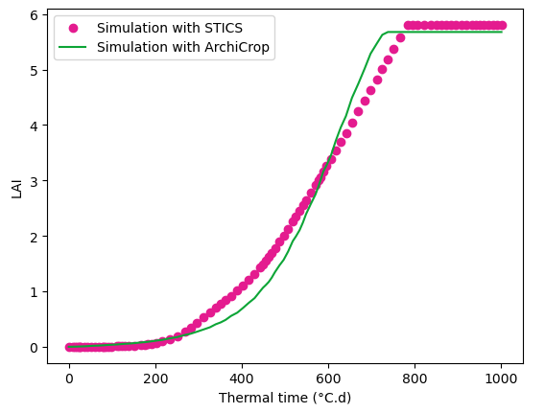
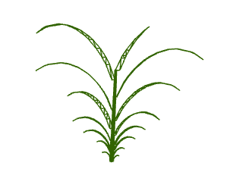
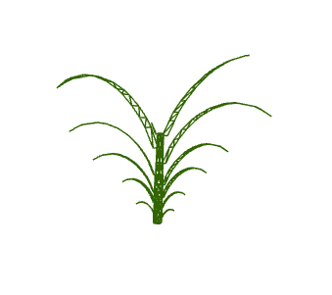
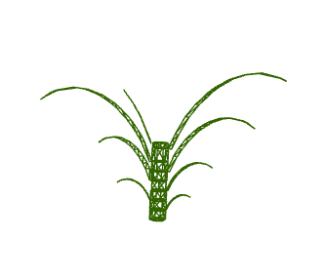
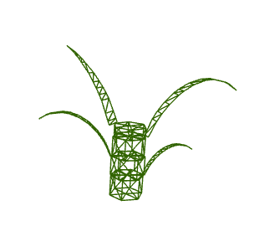
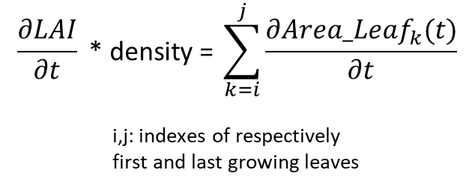
Ex: constrain leaf growth with Leaf Area Index (LAI) from crop model for maize crop
$$\frac{∂LAI}{∂t} \text{∗ }\text{density} \text{= }\sum_{k=i}^{j}{\frac{∂Area_{Leaf}_{k}(t)}{∂t}}$$
i,j: indexes of respectively
first and last growing leaves
dLAI
dt

Slide 9
Workflow for the assessment of hypotheses in crop models
For various GxGxExM:
1 crop model simulation
→
many morphotypes
Analyses:
to verify or not our hypothesis
If so, to spot architectural and/or spatial parameters of interest
If needed, find new formalisms for a given plant process
For identified plant processes:
1 process
→
1 formalism / model

Slide 10
Conclusion
First results: shoot parametric model can reproduce crop model dynamics while considering architecture
Intercrop sorghum/cowpea, but aim to be generic
Next steps:
Assessment of formalisms in STICS
→ Further improve STICS

Slide 11
Thank you for your attention

