Slide 1








Multiscale hybrid modeling framework for intercrops : the best of crop and plant models
PhD in computer science, 2nd year
Christophe Pradal
Remi Vezy
Thomas Arsouze
Marc Jaeger
Myriam Adam
PhD Student
Oriane Braud
Supervision

Slide 2
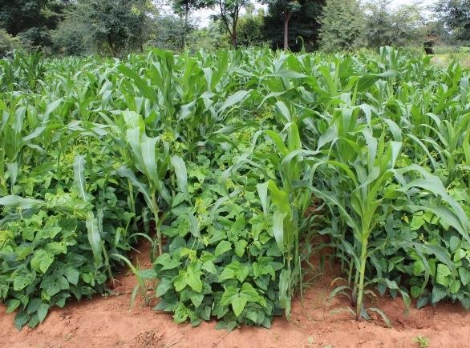
Intercropping
= agroecological pratice where at least two crop species are grown together
(Vandermeer, 1989)
Potential benefits :
more resilience to stresses
reduction of use of fertilizers and pesticides
increased yield
(Jensen et al., 2020, Stomph et al., 2020, Gaudio et al., 2021)
LEGUMES
e.g.: cowpea
CEREALS
e.g.: sorghum
… only if intercropping systems are optimized
Notes:
Plantes annuelles parmi les légumineuses et les graminées
Climate change imply an increase of biotic and abiotic stresses.
Agroecology and introducing heterogeneity in crop systems is one lever to create more resilient agronomic systems, while reducing their environmental impacts (less inputs) …

Slide 3
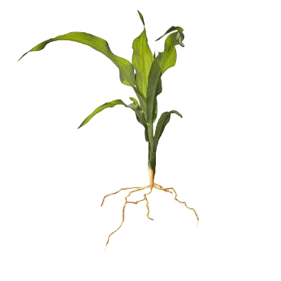
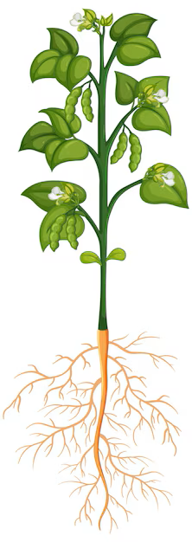
Intercropping systems
G x G x E x M
Genotype of a legume
Genotype of a cereal
Environnement
Soil & atmosphere
Management
Sowing pattern
Inputs
Notes:
Ensembles (pluriels)
Beaucoup d’expe

Slide 4
Intercropping systems
G x G x E x M
Genotype of a legume
Genotype of a cereal
Environnement
Soil & atmosphere
Management
Sowing pattern
Inputs
Interspecific interactions
Heterogeneous spatial and temporal distribution of resources

Slide 5
Intercropping systems
G x G x E x M
Genotype of a legume
Genotype of a cereal
Environnement
Soil & atmosphere
Management
Sowing pattern
Inputs
➔ Crop and FSP models are needed to explore the complexity of these systems at different scales.
Notes:
Combinaison of several factors
Transition : optimise these combinaisons using models, before field experiments (explore more possibilities)

Slide 6
Crop models
(Boote et al., 2013, Jones et al., 2017)
e.g.: STICS (Vezy et al., 2023), APSIM (Githui et al., 2023)
Objective: prediction, decision-support tool
Characteristics:
crop scale (unit = hectare)
homogeneous hypotheses
simulate multiple processes through the whole development cycle
already calibrated for intercrops
Limits:
no heterogeneity
no explicit plant-plant interactions
Notes:
Limits due to scale
integrate environmental stresses, as factors of reduction for processes of a potential averaged plant

Slide 7
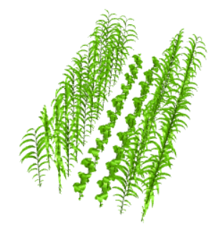
FSPM (Functional-Structural Plant Models)
(Evers et al., 2019 , Louarn and Song, 2020)
e.g.: Virtual GrassLand (Louarn et al., 2020),
SIMBAL (Perthame et al., 2023)
Objective: integration of knowledge at organ scale, plasticity studies
Characteristics:
organ scale (unit = organ)
3D plant structure influence and emerges from plant processes
enable to represent heterogeneous crops
Limits:
complexity
cannot always simulate whole development cycle
need lots of 3D measures
Notes:
Limits due to scale

Slide 8
How to benefit from the best of both approaches?
Possible way: by adapting crop models for considering more architectural and spatial heterogeneity of intercrops
(Gaudio et al., 2019; Laurans et al., 2024)
1. Evaluate performance of existing crop model formalisms for heterogeneous canopies
2. Identify architectural traits of interest for a given process
3. Find new formalisms for crop models
Turbid medium approach for simulating light interception
(Barillot et al., 2011; Feng et al., 2014; Ponce de Leon and Bailey, 2019; Li et al., 2024)
Impact of plant architectural variations on light interception
(Barillot et al., 2014; Truong et al, 2015; Barillot et al., 2019)
Hybrid 2.5D formalism in STICS
(Vezy et al., 2023)
Incorporate effect of clumping
(Bailey et al., 2020)
Notes:
Complémentarité des modèles, trade-off robustesse et précision
Top-down approach
For modeling heterogeneous cropping systems, considering 3D explicit plant architecture is interesting. Measurements of 3D plants are hard to get. We know some allometric relationships between plant architectural parameters, as well as development patterns. Crop models, which operate at canopy scale thanks to homogeneous hypotheses, are easily calibrated and integrate environmental stresses.
State of the art:
Vezy 2023: hybrid 2.5D formalism for light interception in STICS crop model
Feng et al., 2014:
GreenLab
Ecomeristem
Li et al., 2024:
Barillot et al., 2011: assessment of turbid medium approach for simulating light interception of intercrops
Ponce de Leon and Bailey, 2019: assessment of turbid medium approach for simulating light interception of heterogeneous and anisotropous canopies
Bailey et al., 2020: incorporate the effects of vegetation heterogeneity or “clumping” within crop models; the models were evaluated by comparing against simulated data generated by a three-dimensional leaf-resolving model in which the exact inputs are known
Incorporate effect of vegetation heterogeneity within crop models + in silico model evaluation
Barillot et al., 2014 (wheat/pea intercrop): impact of archi variations on light interception
Truong et al, 2015 (sorghum); Barillot et al., 2019 (wheat/pea intercrop) : impact of leaf angle on light interception
Ponce de Leon and Bailey, 2024 : impact of leaf angle and density distribution on WUE
How to conceive a 3D cereal model with few architectural and developmental parameters and with a canopy-scale constrain on growth ?
We conceive a well-constrained parametric 3D cereal model, with known allometric relationships between parameters, and using a top-down approach to simulate the differential growth of cereal plants through time from canopy-scale dynamic constraints on growth (e.g. crop model simulation outputs).

Slide 9
How to benefit from the best of both approaches for intercrops?
by adapting crop models for considering more architectural and spatial heterogeneity of intercrops
1. Evaluate performance of existing crop model formalisms for heterogeneous canopies
2. Identify architectural traits of interest for a given process
3. Find new formalisms for crop models
Evaluate turbid medium approach for simulating light interception
(Barillot et al., 2011; Feng et al., 2014; Ponce de Leon and Bailey, 2019; Li et al., 2024)
Impact of plant architectural variations on light interception
(Barillot et al., 2014; Truong et al, 2015; Barillot et al., 2019, Perez et al., 2019)
Hybrid 2.5D formalism in STICS
(Vezy et al., 2023)
Incorporate effect of clumping
(Bailey et al., 2020)
(Gaudio et al., 2019)
Notes:
Maintenant on peut se demander comment on pourrait s’y prendre pour tirer le meilleur de chaque approche pour modéliser les cultures en mélange ?
Certains travaux se sont déjà attachés, processus par processus, à

Slide 10
My PhD : Multiscale hybrid modelling for intercrops
For given processes, what in plant architecture should we consider in intercrop models?
Chapter I
ArchiCrop, a 3D dynamic parametric model
How to conceive a 3D plant model with few architectural and developmental parameters and with a canopy-scale constraint on growth ?
Notes:
For a given process, for intercrops, what scale is the most relevant ?
C1: how to create an equivalent of a crop model simulation, but architectured ?
Peng 2020
Mix with previous slide

Slide 11
My PhD : Multiscale hybrid modelling for intercrops
For given processes, what in plant architecture should we consider in intercrop models?
Chapter I
ArchiCrop, a 3D dynamic parametric model
How to conceive a 3D plant model with few architectural and developmental parameters and with a canopy-scale constraint on growth ?
Chapter II
Uncertainty analysis of intercrop models considering architectural parameters
Which plant architectural traits and sowing pattern bring most of the uncertainty and should be considered explicitly in crop models?
Notes:
For a given process, for intercrops, what scale is the most relevant ?
C1: how to create an equivalent of a crop model simulation, but architectured ?
Peng 2020
Mix with previous slide

Slide 12
My PhD : Multiscale hybrid modelling for intercrops
For given processes, what in plant architecture should we consider in intercrop models?
Chapter I
ArchiCrop, a 3D dynamic parametric model
How to conceive a 3D plant model with few architectural and developmental parameters and with a canopy-scale constraint on growth ?
Chapter II
Uncertainty analysis of intercrop models considering architectural parameters
Which plant architectural traits and sowing pattern bring most of the uncertainty and should be considered explicitly in crop models?
Chapter III
Proposition of multi-scale modelling approaches
How to consider explicitly identified parameters in crop models in order to improve their accuracy?
Notes:
For a given process, for intercrops, what scale is the most relevant ?
C1: how to create an equivalent of a crop model simulation, but architectured ?
Peng 2020
Mix with previous slide

Slide 13
SPPM: Structural Parametric Plant Model
Plant 3D architecture and development are defined by parameters.
Few parameters → known allometric laws for potential plant
Explore morphological space
≠ FSPM: 3D plant architecture emerges from plant processes
Notes:
The growth of architectured plant organs does not emerge from local laws, nor is directly conditioned by environmental resources. Indeed, it is calculated using an integro-differential approach from a global constraint.
ArchiCrop, a 3D dynamic parametric model for cereals
using a top-down approach to simulate the differential growth of cereal plants through time from canopy-scale dynamic constraints on growth (e.g. crop model simulation outputs).

Slide 14
SPPM: Structural Parametric Plant Model
Plant 3D architecture and development are defined by parameters.
Few parameters → known allometric laws for potential plant
Explore morphological space
≠ FSPM: 3D plant architecture emerges from plant processes
Constraint-driven model
Global growth constraint from crop model dynamics → emergence of growth patterns for each organ
ArchiCrop: a SPPM for cereals
➔ where growth is constrained from crop model dynamics
Notes:
The growth of architectured plant organs does not emerge from local laws, nor is directly conditioned by environmental resources. Indeed, it is calculated using an integro-differential approach from a global constraint.
ArchiCrop, a 3D dynamic parametric model for cereals
using a top-down approach to simulate the differential growth of cereal plants through time from canopy-scale dynamic constraints on growth (e.g. crop model simulation outputs).

Slide 15
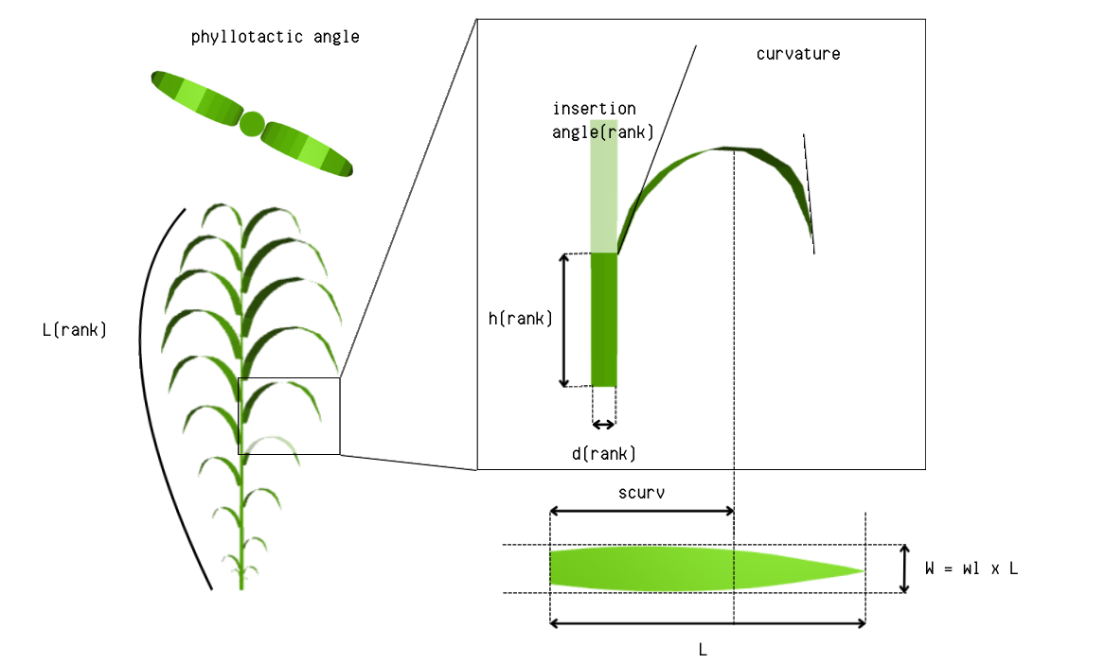






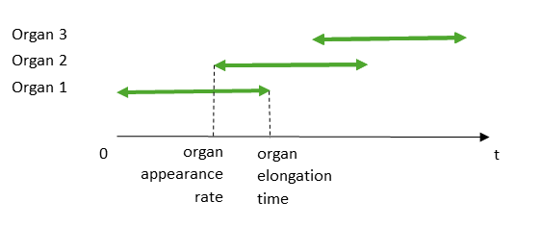
Potential plant architecture and development are defined by parameters.
Phytomer
Growing leaf
Plant
architecture
Leaf
Internode
Geometrical parameters
Developmental parameters
Notes:
Cereal architecture is defined by parametric laws
Known from literature

Slide 16
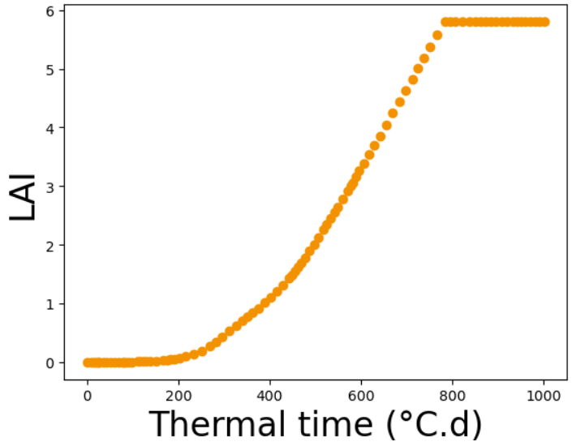
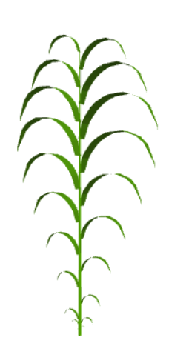

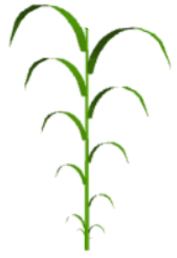
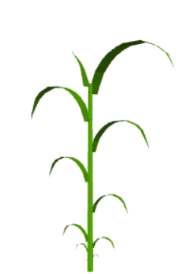

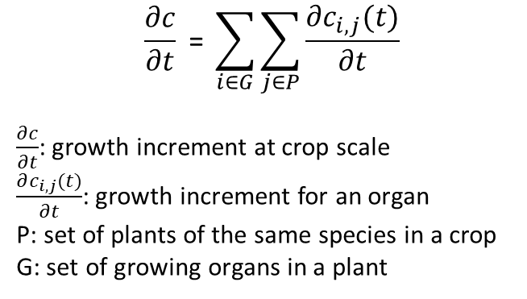
Organ growth is constrained by canopy-scale dynamics generated by crop model.
How to distribute a constraint c (LA and height) among n growing elements ?
→ among plants in a canopy and among organs within a plant
dt
*
dLA
LAI
$$\frac{∂c}{∂t} \text{= }\sum_{i∈G}{\sum_{j∈P}{\frac{∂c_{i,j}(t)}{∂t}}}$$
$\frac{∂c}{∂t}$: growth increment at crop scale
$\frac{∂c_{i,j}(t)}{∂t}$: growth increment for an organ
P: set of plants of the same species in a crop
G: set of growing organs in a plant
Thermal time (°C.d)
*LAI = Leaf Area Index
Notes:
Stresses integrated in growth dynamics can impede the growth of potential plant

Slide 17
Different scales of heterogeneity for an intercrop
Interspecific heterogeneity
→ Intercropping sowing pattern
Intraspecific heterogeneity
→ Varietal variability
Inter-organs heterogeneity
→ Plant architecture
➔ degrees of freedom compared to crop model
Notes:
Individual variability : parametrized and emergent !
For instance, for a given simulation with a crop model, it is possible to obtain a large number of corresponding simulations on a finer scale, by varying these degrees of freedom within a given range of values for a given species. In other words, we can explore the architectural variability of a species by generating a set of morphotypes.

Slide 18

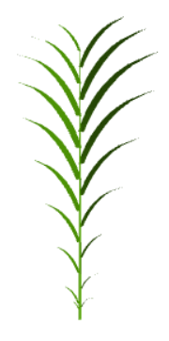
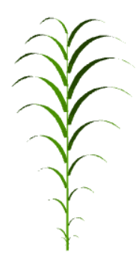
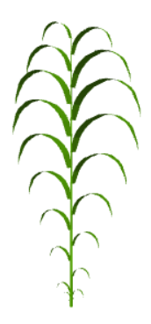
Create morphospace of potential plants
Architectural degrees of freedom:
number of phytomers
longest leaf length
leaf width-to-length ratio
internode lengths
insertion angle
leaf curvature
leaf curvature
Notes:
varying within species-specific range

Slide 19

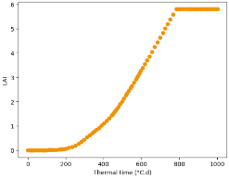
Workflow of simulations of intercrops through time
GxG experimental design :
Morphospace species 1
x
Morphospace species 2
x
Spatial configurations
1 simulation
with crop model
Growth dynamics
LAI(t), height(t)
ExM experimental design
x
ArchiCrop
Generation of 3D scenes of intercrops through time
Notes:
Comparison with crop model outputs and analysis of the uncertainty associated to architecture parameters and spatial configuration
Allometries to restrain morphological space (to what extent)
Test crop model hypotheses
Which parameters (+1 slide)

Slide 20
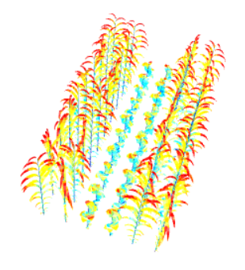
Workflow of simulations of intercrops through time
GxG experimental design :
Morphospace species 1
x
Morphospace species 2
x
Spatial configurations
1 simulation
with crop model
Growth dynamics
LAI(t), height(t)
ExM experimental design
x
ArchiCrop
Computation of light interception at organ scale
Notes:
Comparison with crop model outputs and analysis of the uncertainty associated to architecture parameters and spatial configuration
Allometries to restrain morphological space (to what extent)
Test crop model hypotheses
Which parameters (+1 slide)

Slide 21
Workflow of simulations of intercrops through time
GxG experimental design :
Morphospace species 1
x
Morphospace species 2
x
Spatial configurations
1 simulation
with crop model
Growth dynamics
LAI(t), height(t)
ExM experimental design
x
ArchiCrop
Analysis of the uncertainty of the crop model associated to architecture parameters and spatial configuration
Notes:
Comparison with crop model outputs and analysis of the uncertainty associated to architecture parameters and spatial configuration
Allometries to restrain morphological space (to what extent)
Test crop model hypotheses
Which parameters (+1 slide)

Slide 22
Perspectives
Extension of the cereal model to legumes (chapter 1)
Simulations and uncertainty analyses for light interception (chapter 2)
Similar approach for roots, looking at processes like water and nitrogen uptake (chapter 1&2)
Propositions of new formalisms for STICS crop model (chapter 3)
2024
2025
2026
First article on chapter 1 submitted
Second article on chapter 2 submitted
Thesis manuscript ready

