Slide 1
ArchiCrop, a 3D dynamic parametric model for cereals
Oriane Braud, Thomas Arsouze, Rémi Vezy , Marc Jaeger, Myriam Adam, Christophe Pradal

Slide 2
Message
We want to be able to generate 3D realistic cereal plants, knowing:
plant architectural parameter relationships,
and canopy-scale data through time, which integrate environmental effects.
So we conceive a parametric model of 3D cereal plant shoot, where:
potential plant architecture is defined by parametric laws
differential growth of the organs is constrained by canopy-scale time series (LAI, height)
Notes:
For modeling heterogeneous cropping systems, considering 3D explicit plant architecture is interesting. Measurements of 3D plants are hard to get. We know some allometric relationships between plant architectural parameters, as well as development patterns. Crop models, which operate at canopy scale thanks to homogeneous hypotheses, are easily calibrated and integrate environmental stresses.
How to conceive a 3D cereal model with few architectural and developmental parameters and with a canopy-scale constrain on growth ?
We conceive a well-constrained parametric 3D cereal model, with known allometric relationships between parameters, and using a top-down approach to simulate the differential growth of cereal plants through time from canopy-scale dynamic constraints on growth (e.g. crop model simulation outputs).

Slide 3
1.Introduction
1.1. General introduction of the topic:
Climate change imply an increase of biotic and abiotic stresses. Agroecology and introducing heterogeneity in cropping systems is one lever to create more resilient agronomic systems, while reducing their environmental impacts (fewer inputs; Jensen et al., 2020; Stomph et al., 2020).
Process-based crop models as a common tool for decision support, for exploring more possibilities than field experiments, for predicting.

Slide 4
1.2.State of the art:
1.Introduction
Crop models
Objective: prediction, decision-support tool
Characteristics:
crop scale (unit = m² or ha)
homogeneous hypotheses
consider GxGxExM and simulate multiple processes through the whole development cycle
already calibrated for intercrops
Limits due to scale:
no heterogeneity
no explicit plant-plant interactions
hard to know where the uncertainty comes from (formalisms, calibration, inputs; Chapagain et al., 2022)
(Boote et al., 2013, Jones et al., 2017)
e.g.: STICS (Vezy et al., 2023), APSIM (Githui et al., 2023)
Notes:
Limits due to scale
integrate environmental stresses, as factors of reduction for processes of a potential averaged plant

Slide 5
1.Introduction
1.2. State of the art
Considering plant architecture enables the study of spatio-temporal plant-plant interactions in heterogeneous cropping systems, by showing how structural traits shape resource access, competitive dynamics, and niche complementarity over time (Justes et al., 2021; Laurans et al., 2024).

Slide 6
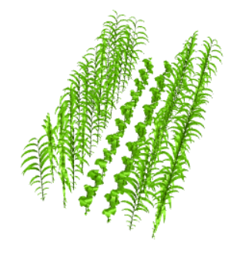
FSPMs
1.Introduction
1.2.State of the art:
3D plant models (process-based)
Objective: integration of knowledge at organ scale, plasticity studies
Characteristics:
organ scale (unit = organ)
3D plant structure influence and emerges from plant processes
enable to represent heterogeneous crops
Limits due to scale:
complexity:
cannot always simulate whole development cycle
hard to simulate many processes at the same time
plant → population is heavy
need lots of 3D measures (hard to get)
(Evers et al., 2019 , Louarn and Song, 2020)
e.g.: Virtual GrassLand (Louarn et al., 2020),
SIMBAL (Perthame et al., 2023)
Notes:
Data-driven
Limits due to scale
Ex: Evers et al., 2005; Zhu et al., 2015; Evers et al., 2019; Louarn and Song, 2020; Courturier et al., 2022; Hammer et al., 2023; etc

Slide 7
1.Introduction
1.2.State of the art:
3D plant models
In the continuum of FSPMs: grammars, bottom-up (= system emerges from local laws, through simulation)
ex: recursive and hierarchical algorithms: L-systems (Lindenmayer, Prusinkiewicz, Boudon), fractals (Oppenheimer, 1986)
In computer graphics: user-defined models, easy to use for non-specialists, but
ex: parametric trees (Weber and Penn, 1995, Guo et al., 2018); Xfrog (Deussen and Lintermann, 2006); TreeSketch (Longay et al., 2012)

Slide 8
1.Introduction
1.3. Hybrid approaches
How to take the best of both scales ?
Hybrid models
GreenLab
Ecomeristem
Downscale crop models or upscale 3D plant models
table with characteristics of each and highlight what I take from both
→ how do I link everything ? ArchiCrop

Slide 9
2.Model
2.1. My hybrid multiscale approach:
Constraint-driven Plant Model for cereals
Individual-based approach (inherits from FSPMs) → build stands as replications of individuals
Plant 3D architecture and development are defined by parameters.
Known allometric laws for potential plant → Few parameters
Global growth is constrained from crop model dynamics
➔ Explore morphological space of degrees of freedom
Differential growth for each organ
Reaction to stresses
Notes:
Abichou et al., 2018; Fournier
The growth of architectured plant organs does not emerge from local laws, nor is directly conditioned by environmental resources. Indeed, it is calculated using an integro-differential approach from a global constraint.
ArchiCrop, a 3D dynamic parametric model for cereals
using a top-down approach to simulate the differential growth of cereal plants through time from canopy-scale dynamic constraints on growth (e.g. crop model simulation outputs).

Slide 10
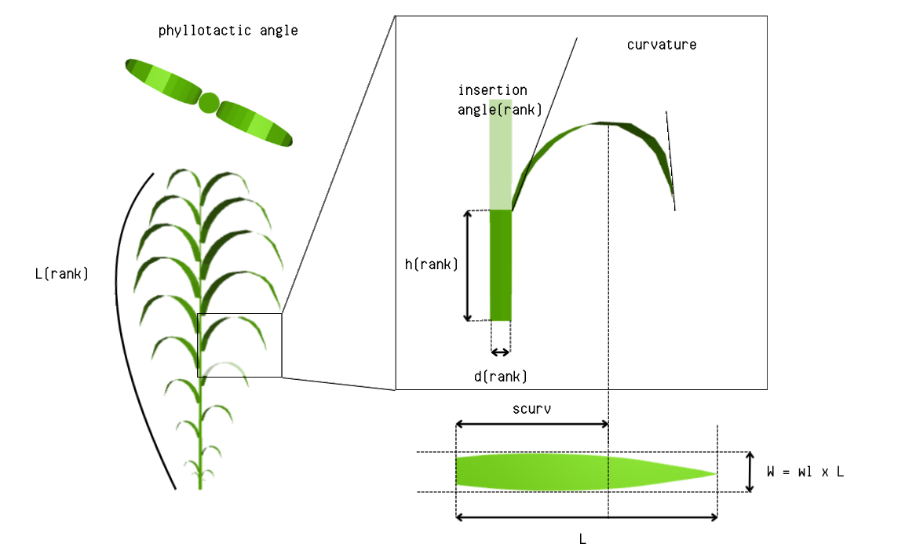






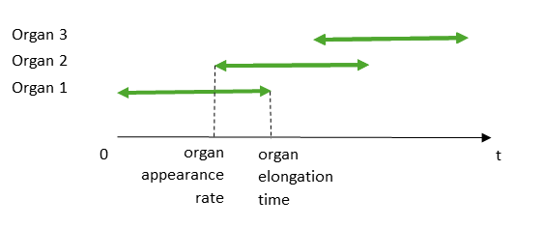
2.Model
Phytomer
Plant
architecture
Leaf
2.2.Formalism of ArchiCrop model
Topology
A crop is a set of plants. A plant is a set of axis connected to each other as a tree structure. An axis is a sequence of phytomers. A phytomer is the sequence of two organs: an internode and a leaf.
Geometry
Internodes are represented as cylinders. Leaves are represented as curved surfaces.
Development
The development of each axis and each organ is defined in time.
Internode
Figure: Geometric parameters at different scales
Growing leaf
Figure: Organ development parameters

Slide 11
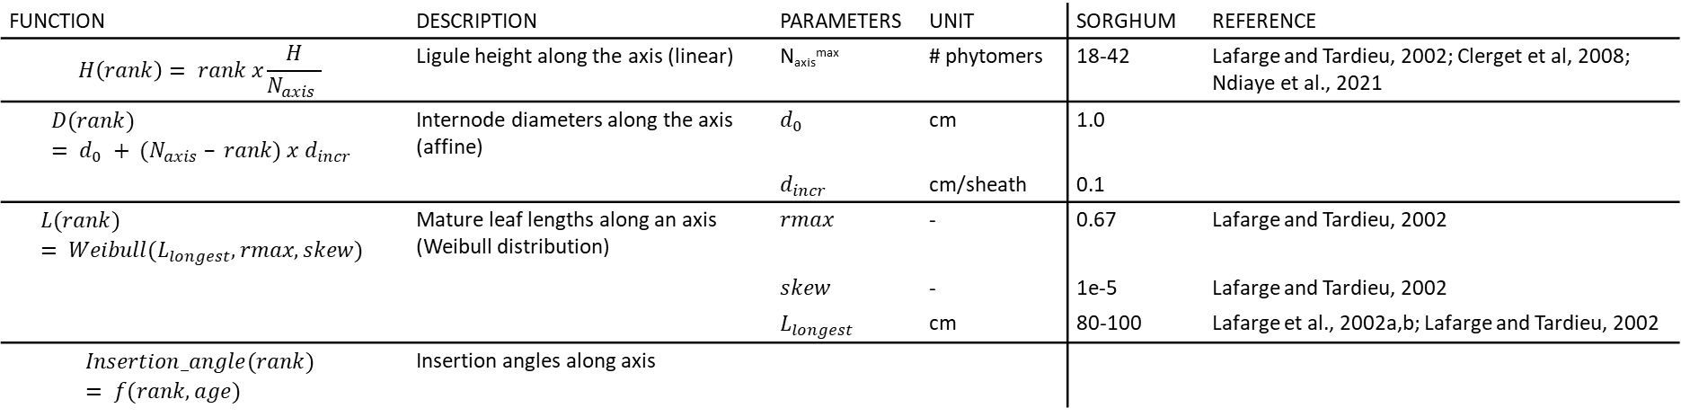
2.Model
2.3.Parameters of the model
All parameters (= degrees of freedom), classified by scale:
crop (sowing pattern),
plant (nb of axes mostly)
axis (axis geometry and developpement, nb of phytomers, related to allometric laws)
internode/leaf (geometry and development)
Parameter relationships on one axis → reduce parameter space (help shaping organ geometry)
Table: Allometric laws describing organ geometry in ArchiCrop.
Function | Description | Parameters | Unit | Sorghum | Reference
$$H\left(rank\right)= rank x\frac{H}{N_{axis} }$$ | Ligule height along the axis (linear) | N_{axis}^{max} | # phytomers | 18-42 | Lafarge and Tardieu, 2002; Clerget et al, 2008; Ndiaye et al., 2021
$$D(rank) = d_{0} + (N_{axis} – rank) x d_{incr}$$ | Internode diameters along the axis (affine) | $d_{0}$ | cm | 1.0
 |  | $d_{incr}$ | cm/sheath | 0.1
$$L(rank) = Weibull(L_{longest}, rmax, skew)$$ | Mature leaf lengths along an axis (Weibull distribution) | $rmax$ | - | 0.67 | Lafarge and Tardieu, 2002
 |  | $skew$ | - | 1e-5 | Lafarge and Tardieu, 2002
 |  | $L_{longest}$ | cm | 80-100 | Lafarge et al., 2002a,b; Lafarge and Tardieu, 2002
$$Insertion_angle(rank) = f(rank, age)$$ | Insertion angles along axis

Slide 12
2.Model
2.4.Constrain plant growth with leaf area and height
Distribution of leaf area and height variations among plants and growing organs
Organ growth (in particular for leaves that grow from tip to base, conversion area to length)
Senescence
Table 2: Time series as inputs for ArchiCrop.
Table 3: Variables to compute for each appeared phytomer in ArchiCrop.
Symbol | Description | Unit
T in [0, Tveg] | Thermal time series to the end of the vegetative phase Tveg | °C.day
H(t) | Plant height dynamics | cm
S(t) | Plant leaf area dynamics | cm²
Symbol | Description | Unit
Naxis(t) in [0, N_{axis}^{max}] | Number of appeared phytomers per axis | # phytomers
hi(t) in [0,Hi] | Height of an internode I_i | cm
di(t) in [0,Di] | Diameter of an internode I_i | cm
li(t) in [0,Li] | Length of a leaf L_i | cm
si(t) in [0,Si] | Surface of a leaf L_i | cm²

Slide 13
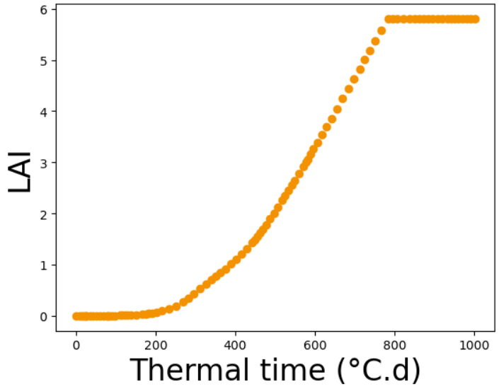
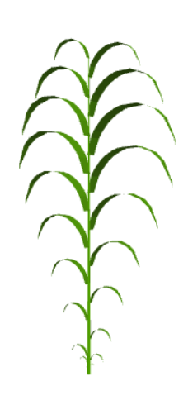

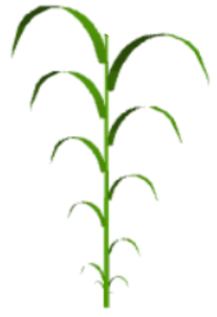
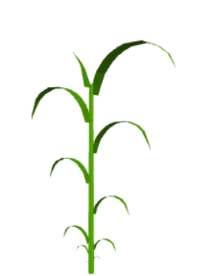

dt
Vector field or local interpolation to have a continuous variation dLA/dt
LAI
dLA
Thermal time (°C.d)
Figure: Distribution of growth within a plant from crop model growth dynamics (+ add senescence)

Slide 14
2.Model
2.5.Implementation
Python
OpenAlea
GitHub repo

Slide 15
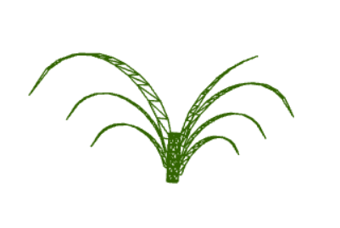
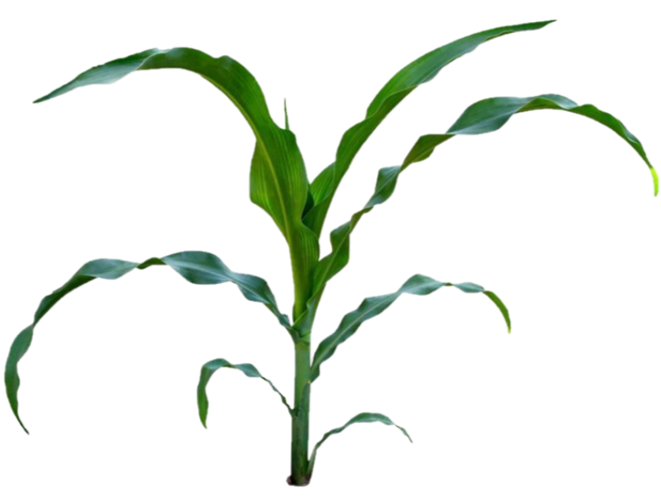
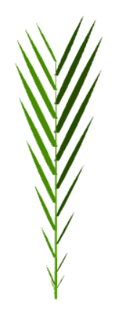
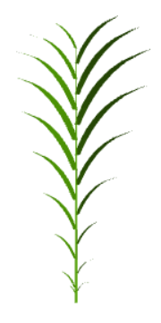
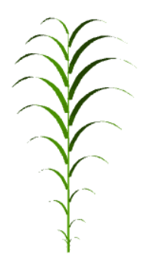
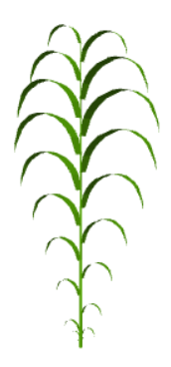
3.Results
3.1.Generate various species and varieties
Reproduce pictures with model for different species (sorghum, maize, wheat and rice ?)
Morphospaces (2D) according to degrees of freedom within species-specific ranges:
number of phytomers
longest leaf length
leaf width-to-length ratio
phyllotaxy
insertion angle
leaf curvature
Picture of plant in field
Compare organ growth dynamics with Kaitaniemi 1999; Lafarge ?
Generate all combinations and see what we keep
leaf curvature

Slide 16
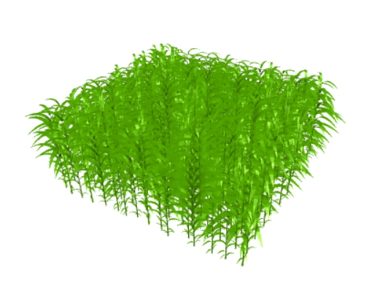
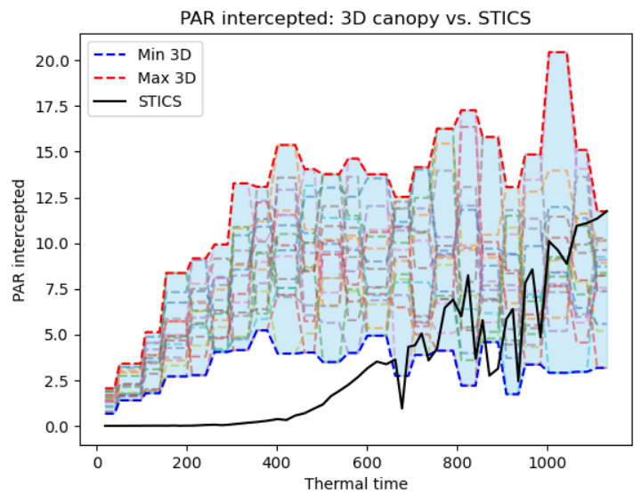
3.Results
3.2.A monocrop through time
Growth constrained with STICS simulation outputs
See differences in light interception through time given different architectural parameters (1 LAI → many morphotypes)
See differences in organ growth dynamics in case of stresses (compare with and without stress)
Be careful, some stresses may lead to plant mortality, so some plant might have to die to stick to STICS density
leaf or internode length = f (t)
with and without stress
Whole crop through time, for both visualizing light interception and effects of stresses on canopy

Slide 17
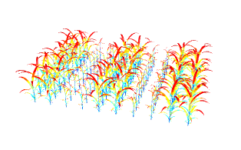
3.Results
3.3.An intercrop through time
Growth constrained with STICS simulation outputs
Show the differences in light interception through time given different architectural parameters for both crops and sowing patterns (comment on border effect, etc)
Analysis of influential archi traits
Visualization of light interception for different architectural parameters for both crops and sowing patterns
17

Slide 18
Preliminary results: PAR intercepted in sorghum monocrop
*Pbs:
I might refine the implementation of the beginning of growth
I must consider Eabs and not Ei
Plot LAI to better understand
Plot individual curves for each set of parameters
Plot incoming PAR and PAR intercepted as % of incoming PAR
?*
~ 15 MJ/m² at the largest
Density = 10
Notes:
My plants grow too fast ?
Canopy closure early ?

Slide 19
4.Discussion
4.1. Positioning of my hybrid multiscale approach:
Constraint-driven Plant Model for cereals
Plant 3D architecture and development are defined by parameters.
Known allometric laws for potential plant → Few parameters
Global growth is constrained from crop model dynamics
➔ Explore morphological space of degrees of freedom
Differential growth for each organ
Reaction to stresses
≠ FSPM: 3D plant architecture emerges from plant processes
No need for lots of measures
≠ Parametric model: do not react to environment
Notes:
Abichou et al., 2018; Fournier
The growth of architectured plant organs does not emerge from local laws, nor is directly conditioned by environmental resources. Indeed, it is calculated using an integro-differential approach from a global constraint.
ArchiCrop, a 3D dynamic parametric model for cereals
using a top-down approach to simulate the differential growth of cereal plants through time from canopy-scale dynamic constraints on growth (e.g. crop model simulation outputs).

Slide 20
4.Discussion
4.2.Strengths of model
4.3.Weaknesses of model
4.4.Perspectives
Possible improvements of the model
Possible uses
5.Conclusion

