Slide 1
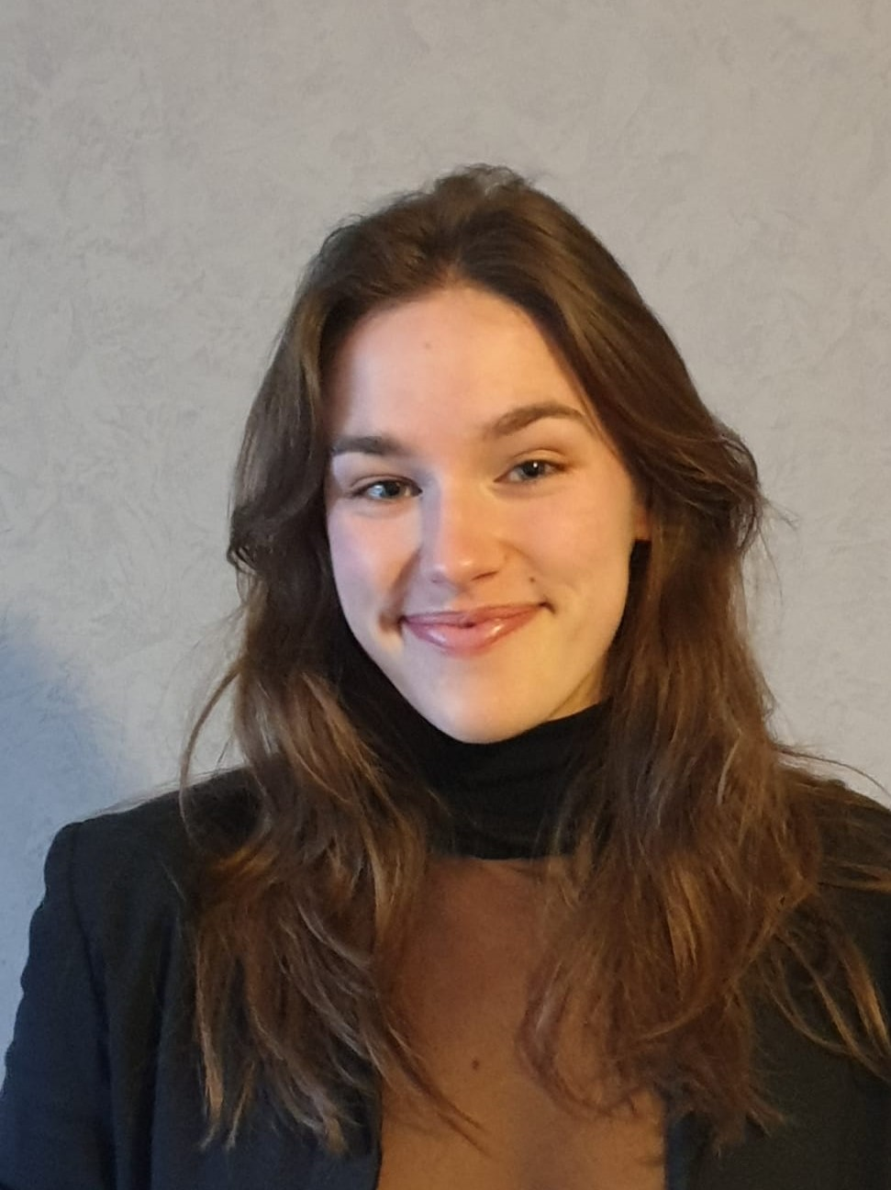
PhD Multiscale hybrid modeling approach for intercrops : the best of plant and crop models
Oriane Braud
Hypothesis : important to consider 3D plant architecture for modeling heterogeneous cropping systems (Laurans et al., 2024)
But : measurements of 3D plants are hard to get
Known (for cereals and legumes, cf Abichou et al., 2018; ) :
allometric relationships between plant architectural parameters
development patterns
Crop models :
are easily calibrated
integrate environmental stresses
→ How to conceive a 3D plant model with few architectural and developmental parameters and with a canopy-scale constrain on growth ?

Slide 2
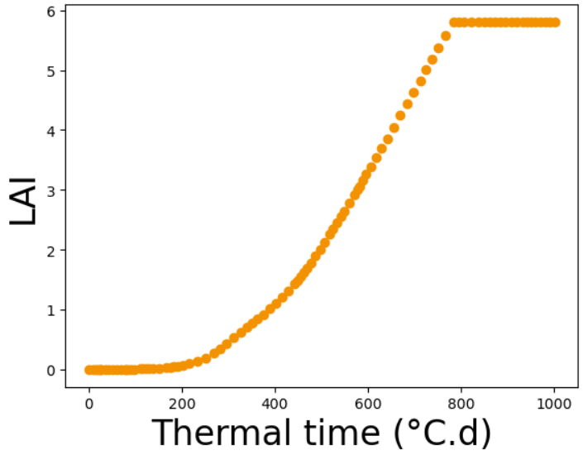
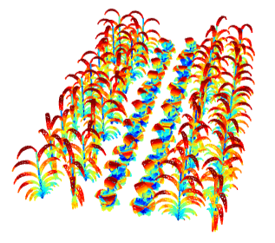
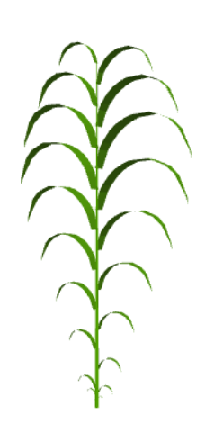

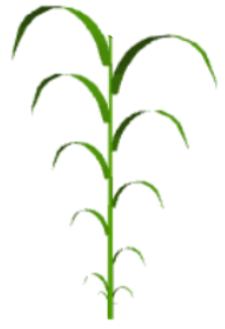
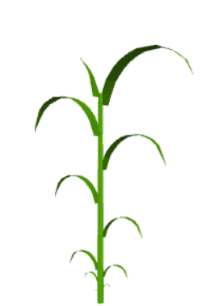
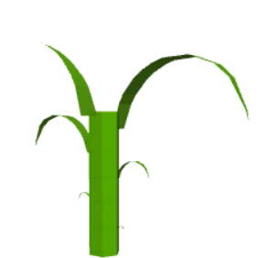
Organ growth constrained by canopy-scale dynamics generated by crop model
Simulation of heterogeneous crop through time
Computation of processes at organ scale
Ex: light
dt
LAI
dLA
Comparison with crop model outputs and analysis of the uncertainty associated to architecture parameters and spatial configuration
Thermal time (°C.d)

Slide 3
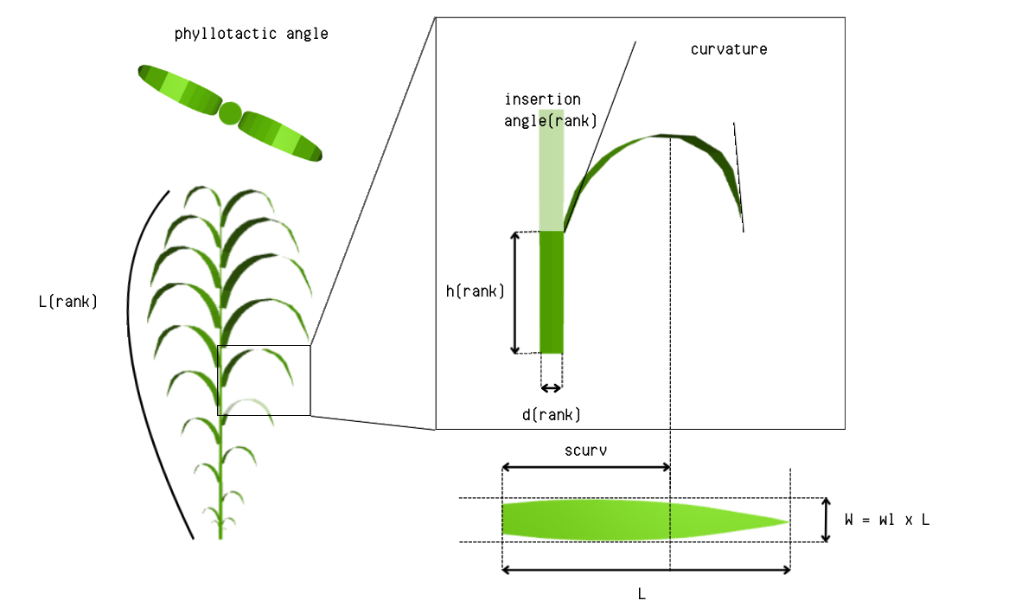






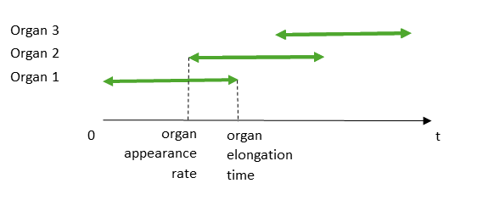
Geometrical parameters of potential plant
Developmental parameters
Phytomer
Growing leaf
Internode
Leaf

