Slide 1




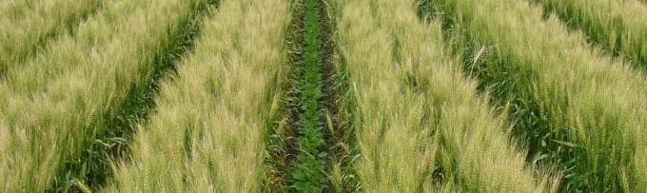
Multiscale Hybrid Modelling Framework for Intercropping: the best of Plant and Crop Models
Christophe Pradal
Remi Vezy
Thomas Arsouze
Marc Jaeger
Myriam Adam
PhD Student
Oriane Braud
Direction
Supervision

Slide 2
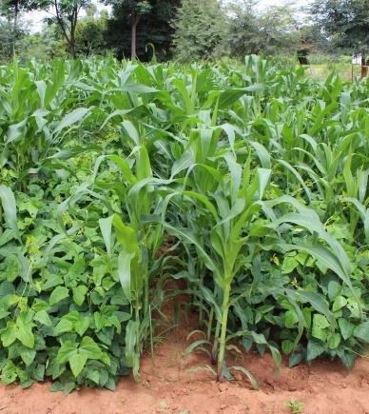
Context
Goal of sustainable food production ​
Among potential solutions: crop diversification ​
Intercropping = agroecological practice which involves mixtures of arable crop species
+ yield (Stomph et al., 2020; Yang et al., 2021)​
- fertilizers
→ less pollution risks and GHG emissions (Jensen et al., 2020) ​
- area required and + ecosystem services
→ + sustainable land use (Della Rossa et al., 2022)​
- water used (Yin et al., 2020)​
- pests and diseases (Chadfield et al., 2022; He et al., 2019)​
→ when it is well managed !
LEGUME
CEREAL
Sannagoudar et al., 2020​

Slide 3
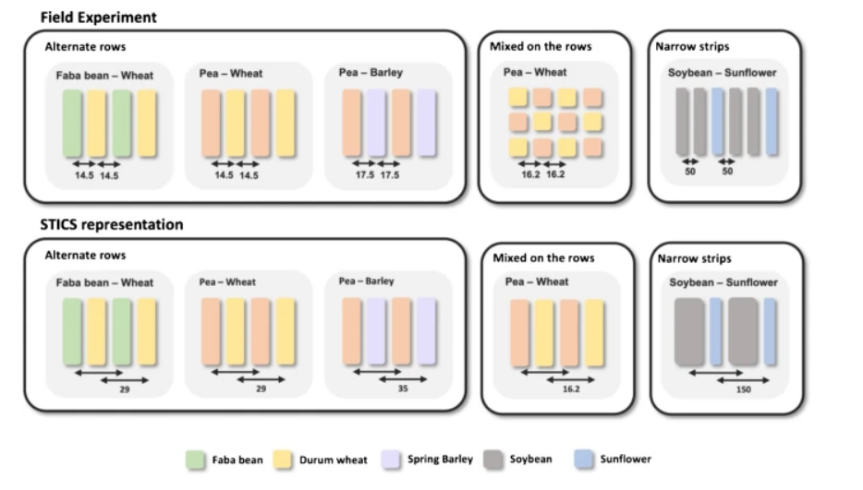
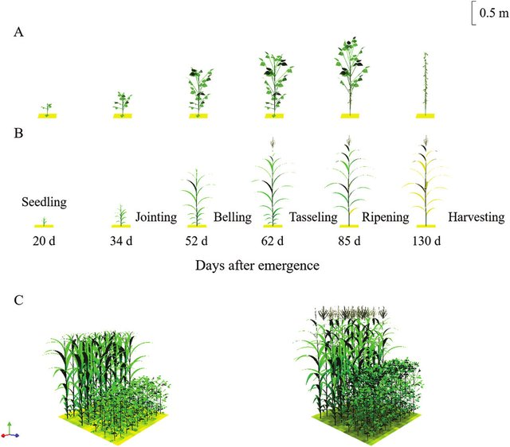
Context
Useful pre-screening tools: models
Some models already adapted to intercrops, but:
Crop models → homogeneous hypotheses
(Gaudio et al., 2019)
FSPM → high computational time,
hard to model whole years
(Evers et al., 2019)
➔ Hybrid multiscale approach
Vezy et al., 2023​
Li et al., 2021​

Slide 4
To what extent are crop model hypotheses valid for intercropping systems ? And how to improve the crop models accordingly ?
Methodology & application with STICS crop model (Vezy et al., 2023)
Goal of 1 article / year

Slide 5
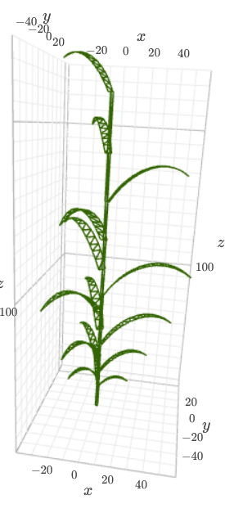

1st year. Analyzing accuracy of formalisms of crop models when adding shoot structural variability
Hypothesis : The error of crop models, when it comes to modeling intercrops, are mainly due to the non-consideration of the plant architecture.
Developing a dynamic shoot parametric FSPM for each type of plant (to adapt for intercrops for which we have data):
→ growth constrained by LAI(t) and height(t) from a crop model
→ leaving degrees of freedom (for plant architecture and spatial arrangement)
➔ explore phenotypic space (i.e. create many morphotypes)​
A cereal with ArchiCrop, developed with OpenAlea

Slide 6

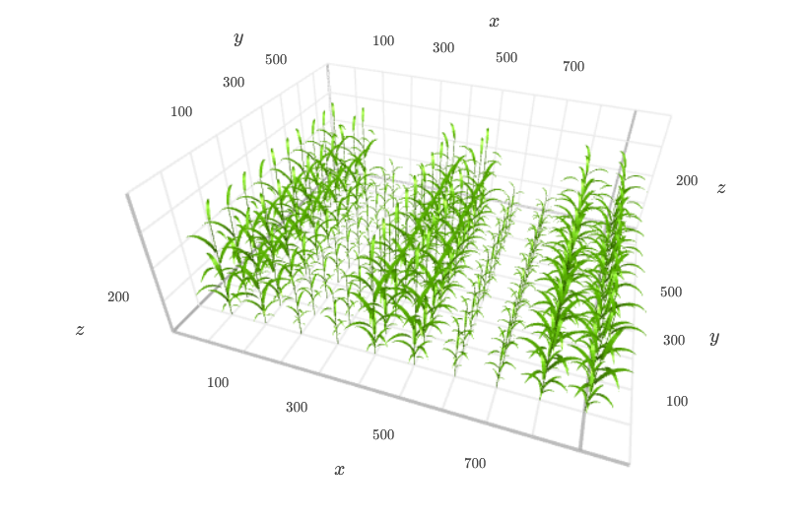
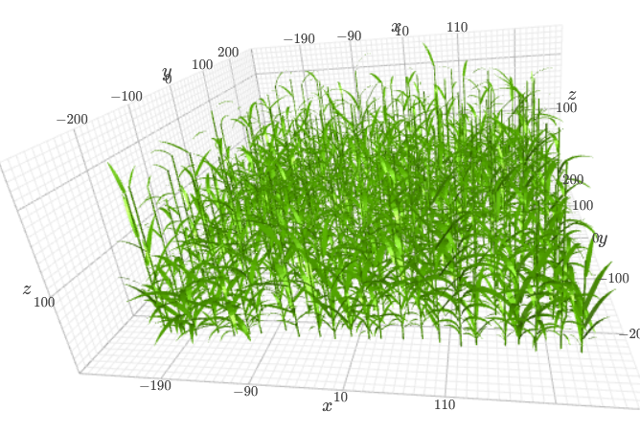
From
Big leaf hypothesis
To
Architectural variability
Spatial heterogeneity

Slide 7
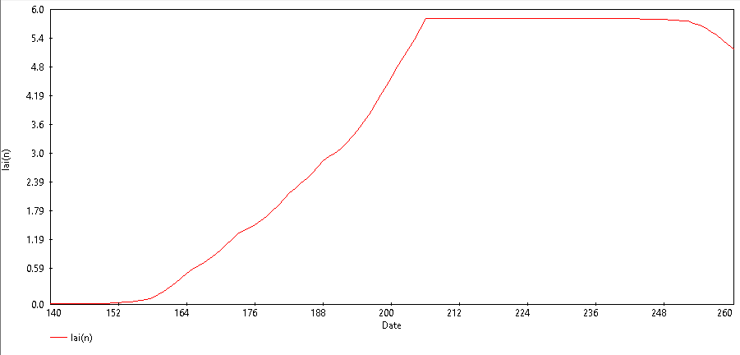
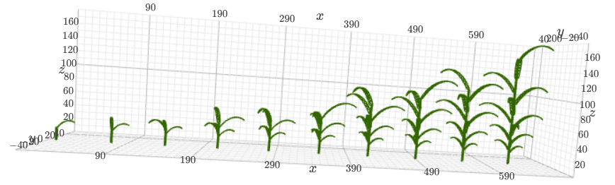
LAImax
dLAI
dt

Slide 8
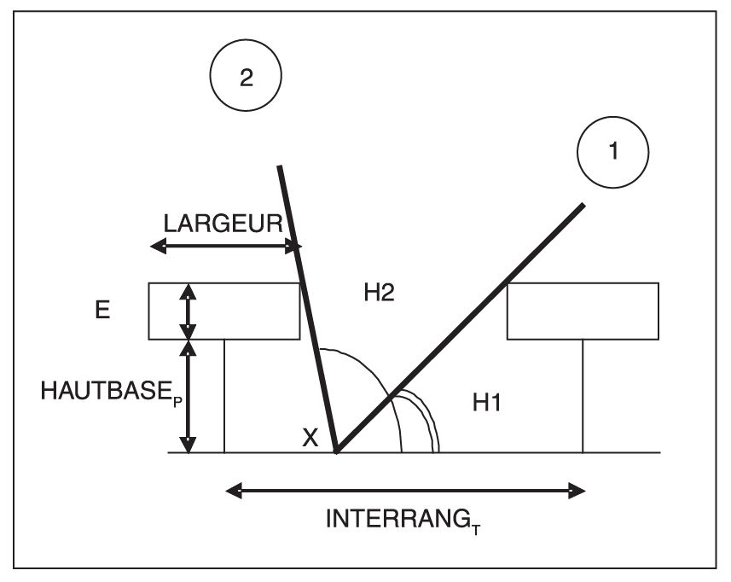
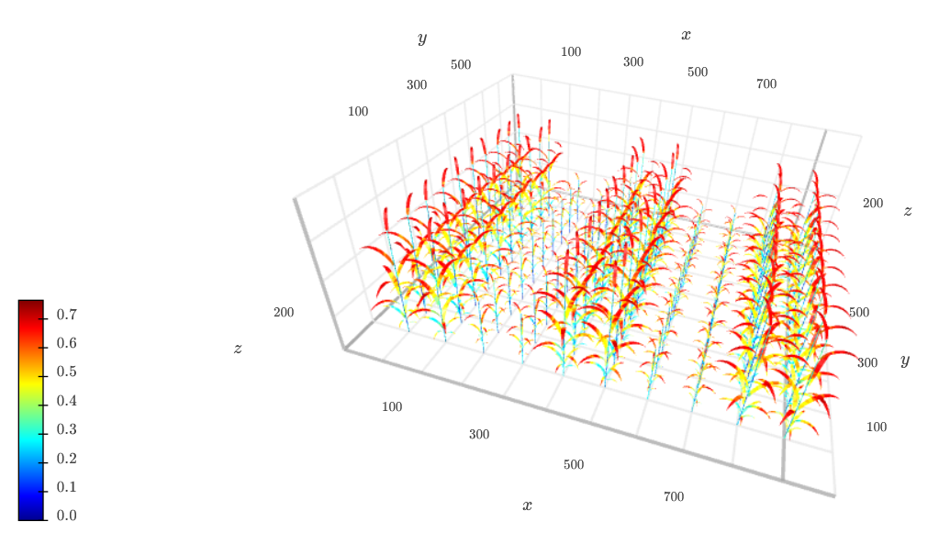
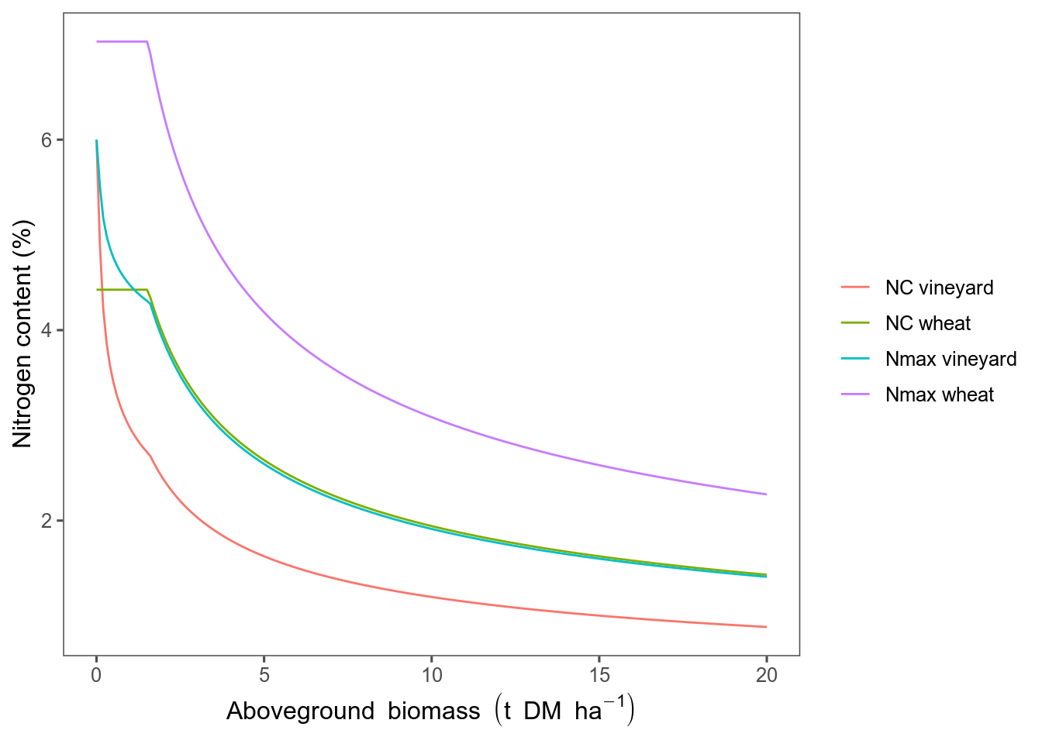
1st year. Analyzing accuracy of formalisms of crop models when adding shoot structural variability
Simulate various GxGxExM and compare outputs between FSPM and STICS of some processes (light inter, RUE, aerial biomass, N demand, etc.)
→ uncertainty analysis
→ sensitivity analysis
Unvalidate some formalisms in STICS
Light interception in STICS IC vs. with FSPM (Caribu)
N dilution curves in STICS

Slide 9
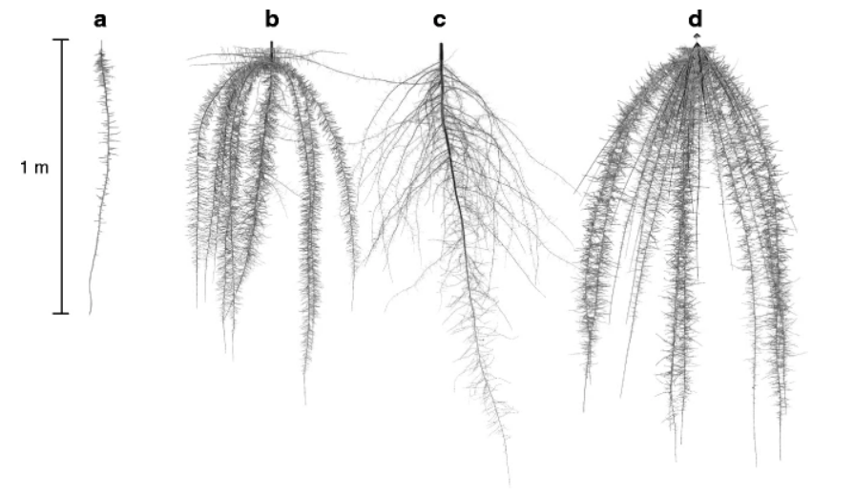
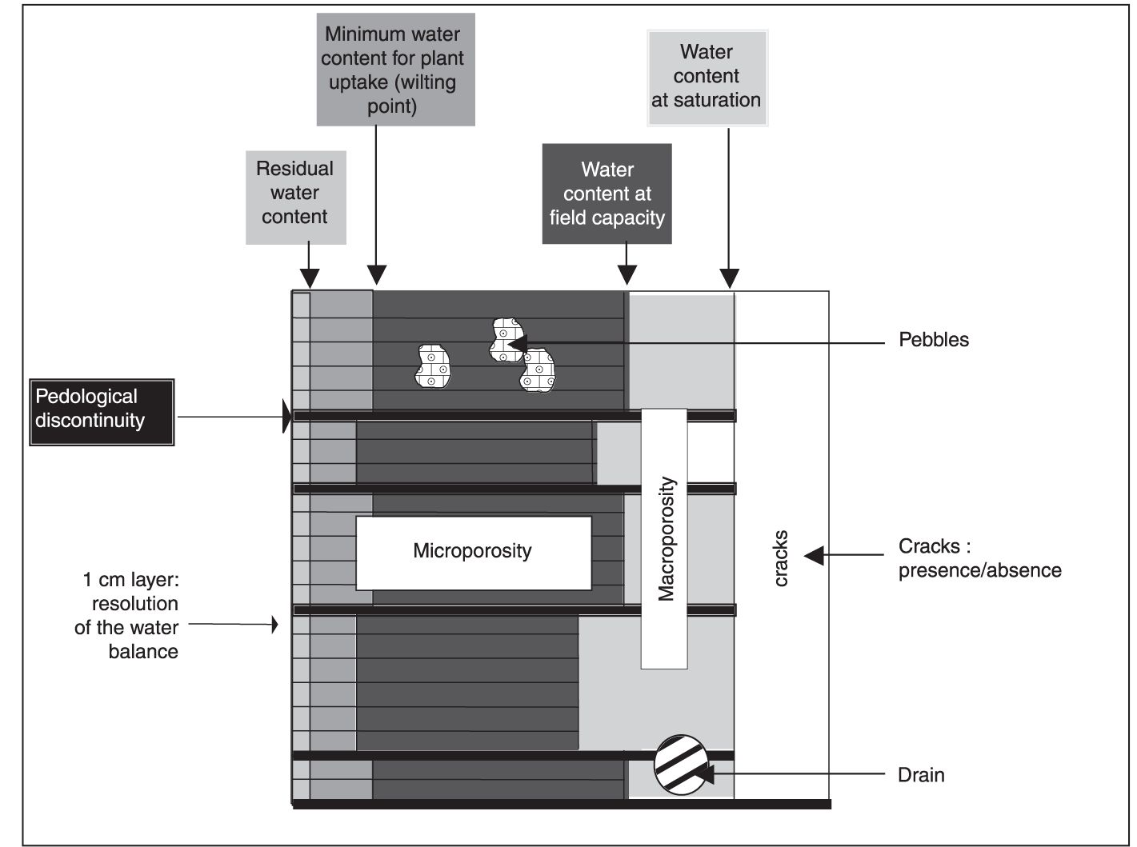
2nd year. +/- same for roots
Collaboration with post-doc from WUR, Jie Lu
Using STICS soil model (already not bad)
Processes analyzed: water and N uptake,
N fixing, etc.
Then couple shoot and root models
Dunbabin et al., 2013
Schema of soil representation in STICS

Slide 10

3rd year. Improving STICS
Change in STICS the formalisms of the processes targeted previously, by:
adding parameters
changing equations
metamodeling
or any other method​
Make sure new STICS fits data even better
v. 12 (?)

Slide 11
Comments on my thesis
There is much work.
I'm a diesel engine, a bit slow to start up, but once I am up and running I can be super efficient.
I started constructing my 3D model from bits of code I found in OpenAlea, and Frankenstein-ing may lead to inconveniencies, so I have to solicitate mainly Christophe who is already overwhelmed, so sometimes I can be a little stuck, but not for long and I manage to find other activities where I can be autonomous.

