Slide 1








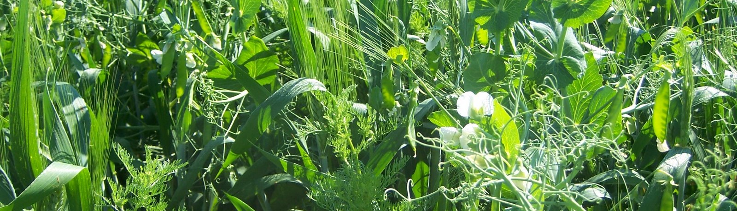
Architecturing crop models for intercrops using a multiscale modelling approach
Christophe Pradal
Remi Vezy
Thomas Arsouze
Marc Jaeger
Myriam Adam
PhD Student
Oriane Braud
Supervision

Slide 2
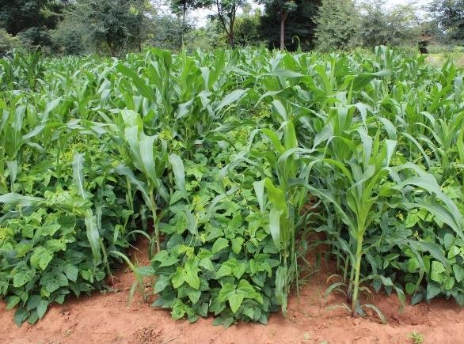
Context
Intercropping = cropping system where at least two crop species grow together for a significant portion of their growth cycle (Vandermeer, 1989)
Potential benefits :
improved resource sharing and soil quality
reduction of diseases and pests
→ reduction of inputs
increased yield
(Jensen et al., 2020, Stomph et al., 2020, Gaudio et al., 2021)
LEGUMES
e.g.: cowpea
GRASSES
e.g.: sorghum
… only if intercropping systems are optimized
Notes:
Plantes annuelles parmi les légumineuses et les graminées

Slide 3
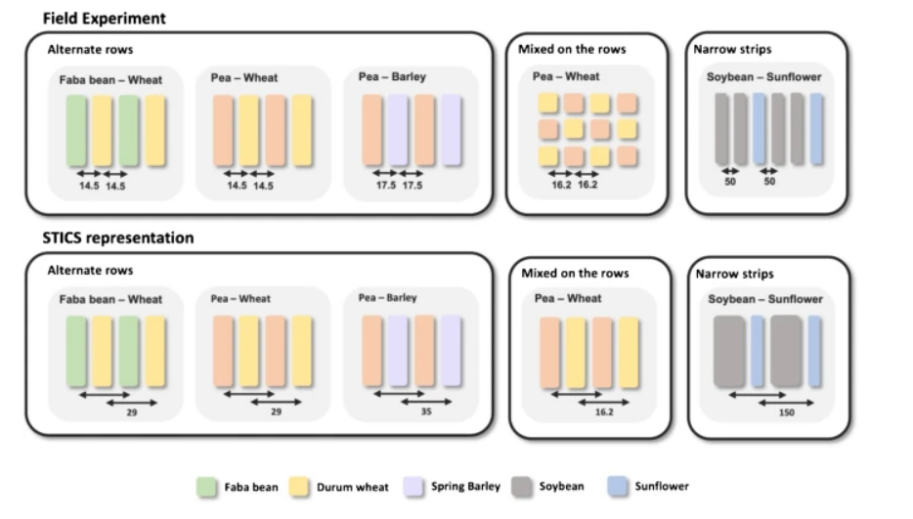
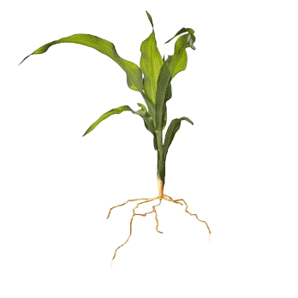
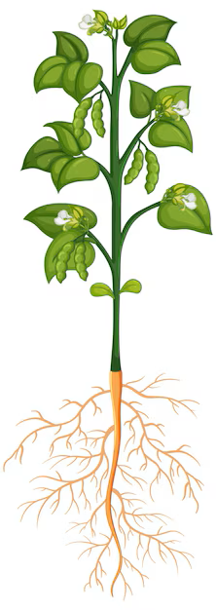
Intercropping systems
Adapted from Vezy et al., 2023
G x G x E x M
Genotype of a legume
Genotype of a grass
Environnement
Soil & atmosphere
Management
Sowing pattern
Inputs
Architecture
Ecophysiological processes
Plant-plant interactions for resources acquisitions
(Justes et al., 2021)
Heterogeneous spatial and temporal distribution of resources and plants
Notes:
Combinaison de plusieurs facteurs
Transition : optimiser ces combinaisons à l’aide de modèles, première étape avant l’expé en champs

Slide 4
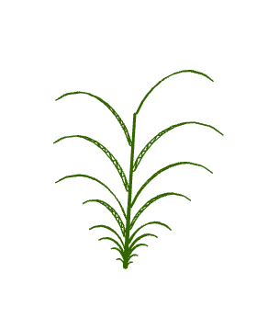
State of the art of plant and crop models
Crop models
(Boote et al., 2013)
e.g.: STICS (Vezy et al., 2023), APSIM (Chimonyo et al., 2016)
Functional-Structural Plant Models (FSPM)
(Louarn and Song, 2020)
e.g.: Virtual GrassLand (Louarn et al., 2020),
SIMBAL (Perthame et al., 2023)
Spatial scale plot (N = 1 volume or some layers)
Time step daily
Temporal scale (multi-)year
decision-support tool,
Objectives prediction,
ideotyping
organ (N = nb of organs)
(infra-)hour
≤ development cycle
ecophysiology and interactions,
ideotyping

Slide 5
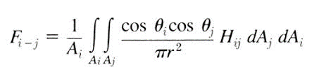
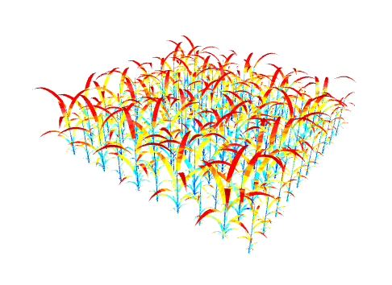

Exemple of process : light interception
Crop models
FSPM
Beer-Lambert law :
Radiative transfer
$$exp⁡(−k∗LAI)$$
Homogeneous volume
Heterogeneous distribution
Calibration
Emergence
(Sinoquet et al., 1991)
(Chelle et al., 1998)

Slide 6
Limits of existing models for modelling intercrops
Crop models
FSPM
Difficulties to take spatial and temporal heterogeneity into account
Difficulties to simulate plant-plant interactions as emerging phenomena
Need data
Complexity
Few processes at a time
Do not always simulate whole development cycle
Need data
→ Complementarity
(Gaudio et al., 2019)
Notes:
Complémentarité des modèles, trade-off robustesse et précision
Outro : besoin d’approches intermédiaires

Slide 7
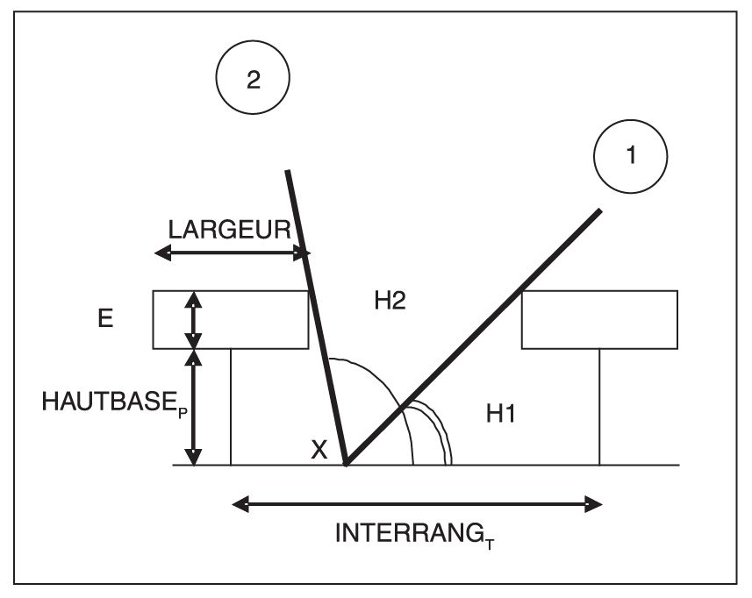

Hybrid formalism
Crop models
FSPM
Radiative transfer (2.5D)
Beer-Lambert law :
Radiative transfer
$$exp⁡(−k∗LAI)$$
Homogeneous volume
Heterogeneous distribution
Calibration
(Vezy et al., 2023)
Emergence
(Sinoquet et al., 1991)
(Chelle et al., 1998)

Slide 8
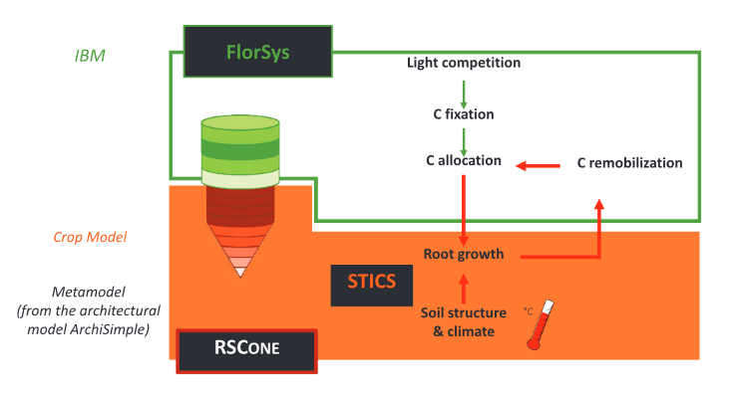
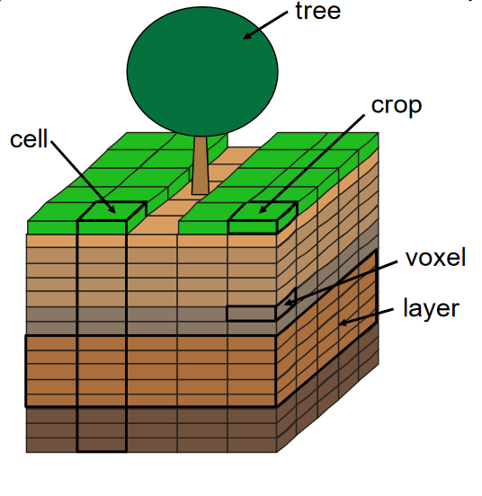
Hybrid approaches for intercrops
Crop models
FlorSys
(Pagès et al., 2020 ; Colbach et al., 2021)
FSPM
Gaudio et al. (2022)
Hi-sAFe
(Dupraz et al., 2019)
No heterogeneity within the plot
Heterogeneity among plants
Heterogeneity among organs

Slide 9
My PhD : Multiscale hybrid modelling for intercrops
At what spatial and temporal scales should we model ecophysiological processes for intercrops?
Chapter I
Conception of a Structural Parametric Plant Model (SPPM)
How to conceive a model that reproduces the growth of a crop model while considering plant architecture?
Chapter II
Method for comparing ecophysiological processes at different scales
Which plant architectural traits and sowing factors bring most of the uncertainty and should be considered explicitly in crop models?
Chapter III
Proposition of multi-scale modelling approaches
How to consider explicitly identified parameters in crop models in order to improve their accuracy?
Notes:
For a given process, for intercrops, what scale is the most relevant ?
C1: how to create an equivalent of a crop model simulation, but architectured ?
Peng 2020

Slide 10
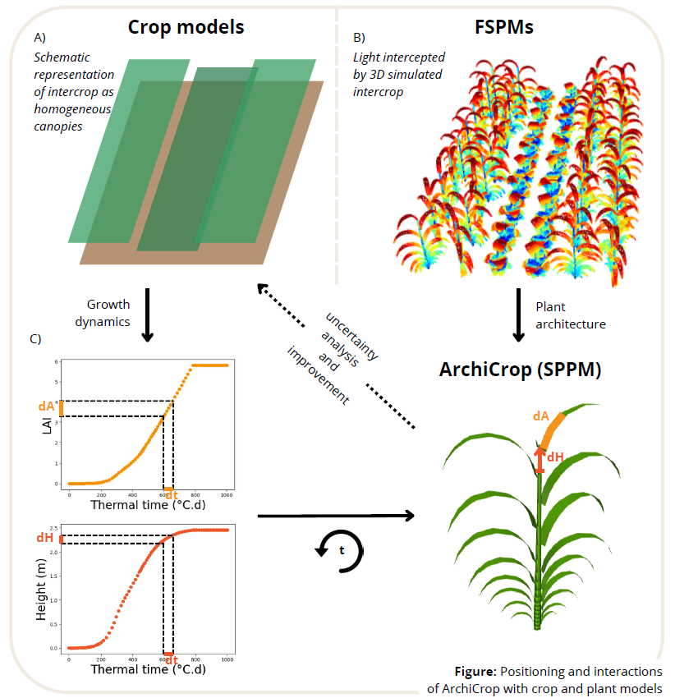
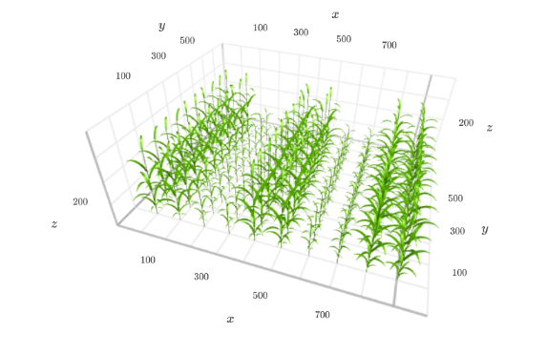
Conception of a Structural Parametric Plant Model (SPPM)
3D+t architectured parametric model
(topology, geometry, development)
Crop models
FSPM
(ADEL, Fournier et al., 2003)
constrained by growth dynamics
degrees of freedom linked to plant architecture & spatial configuration
heterogeneity among plants and organs
Notes:
TOP-DOWN APPROACH, from global to local
Few parameters → easily parametrible, generic model for Gramineae and Fabaceae if possible

Slide 11
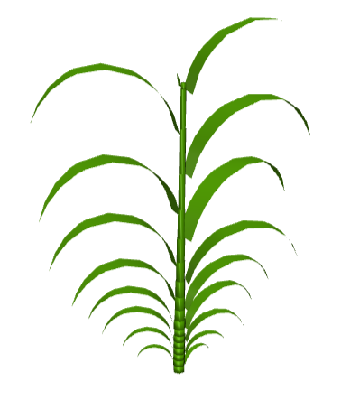
Different scales of heterogeneity for a simulated intercrop
constraints
Interspecific heterogeneity
→ Intercropping sowing pattern
Intraspecific heterogeneity
→ Individual variability
Inter-organs heterogeneity
→ Plant architecture
Notes:
Individual variability : parametrized and emergent !

Slide 12
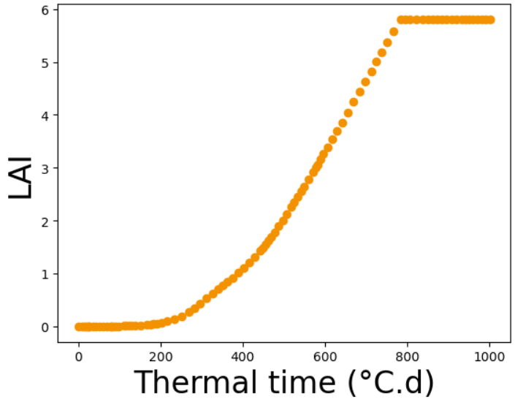
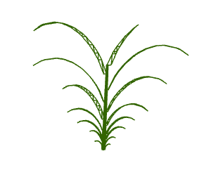
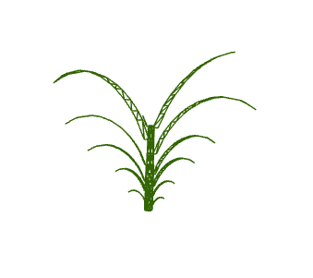
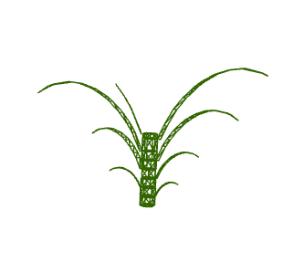
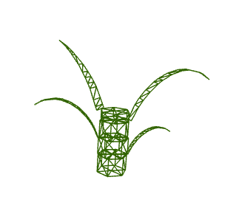
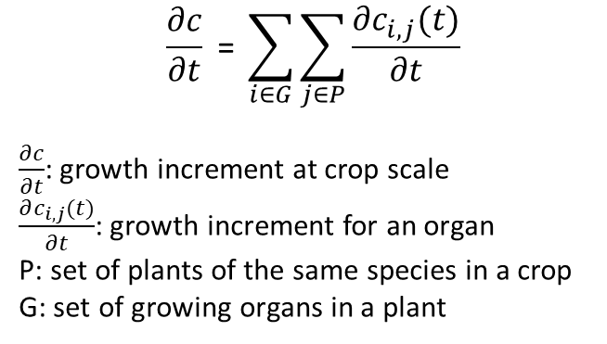
Constrain the growth of plant organs with crop model outputs
How to distribute a constrain c (e.g. leaf area, height) among n growing elements ?
→ among plants in a canopy and among organs within a plant
dLA
dt
*
$$\frac{∂c}{∂t} \text{= }\sum_{i∈G}{\sum_{j∈P}{\frac{∂c_{i,j}(t)}{∂t}}}$$
$\frac{∂c}{∂t}$: growth increment at crop scale
$\frac{∂c_{i,j}(t)}{∂t}$: growth increment for an organ
P: set of plants of the same species in a crop
G: set of growing organs in a plant
*LAI = Leaf Area Index
Notes:
Or input from phenotyping
And known plasticity behaviours

Slide 13

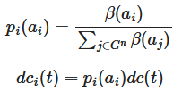
Distribution of the constraints (growth)
…among plants :
…among growing organs :
Height of canopy :
H0: Same height gain for all plants
H1: Or more stochastic
LAI of canopy :
H0: LA gain distributed equally among all plants
H1: Random distribution among plants
H2: Proportional to light intercepted at t-1
H0: All organs of a given type get the same gain.
H1: Organs receive a gain proportional to their sink strength, related to their age a until end of growth.
Notes:
H0: Development is fixed, no defined final structure.
H1: Final structure is fixed, development adapts to reach it.

Slide 14

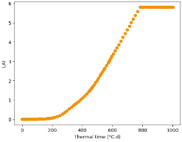
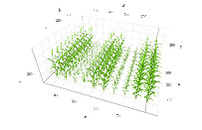
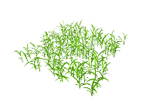
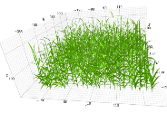
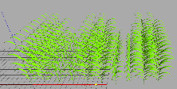
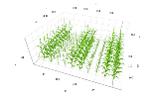
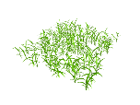
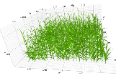
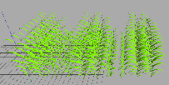




Workflow of simulations
1 simulation
with crop model
Dynamic outputs
E.g. : PAR intercepted (t)
Growth dynamics
E.g. : LAI(t), height(t)
Experimental design :
Species 1 morphological space
x
Species 2 morphological space
x
Explicit spatial configurations
Comparison and uncertainty analysis
ArchiCrop
Process computation
(e.g.: light interception)
…
…
…
t
t
t
t
Notes:
Allometries to restrain morphological space (to what extent)
Test crop model hypotheses
Which parameters (+1 slide)

Slide 15
Perspectives
Similar approach for roots
Plasticity analyses
restrain morphospace a posteriori or implement rules during growth (allometries, compute neighbourhood, etc)
Bottom-up
Questions for the community:
Any advice for conceiving a generic parametric architectured model for both grasses and legumes ?
What are your insights regarding the archi traits and spatial aspects relevant to consider in crop models ?
Archi traits or spatial aspects of interest ?
Top-down
Notes:
Parsimony
Equifinality
Reductionist approach

