Slide 1
Re-Bootstrapping the Free World
Mark Jenkins
BCSc (honours)
mark@markjenkins.ca
1DEE 93CC DA25 F8A3 F9E3 57A9 A8F8 6493 AA4D B1FB

Slide 2





About me: Affiliations
(All opinions mine)

Slide 3
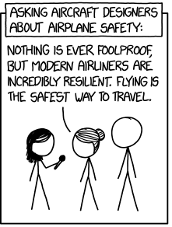
https://xkcd.com/2030/

Slide 4
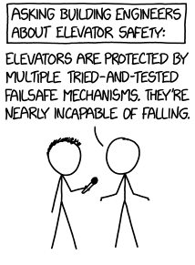

Slide 5
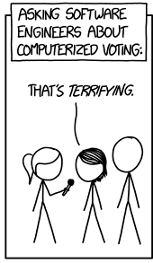

Slide 6
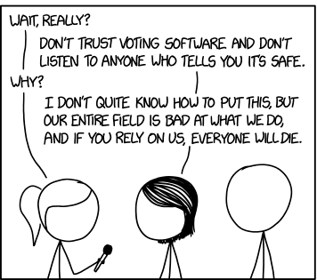

Slide 7
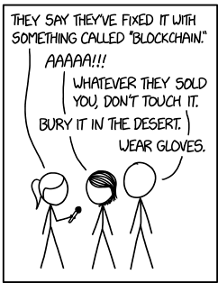

Slide 8
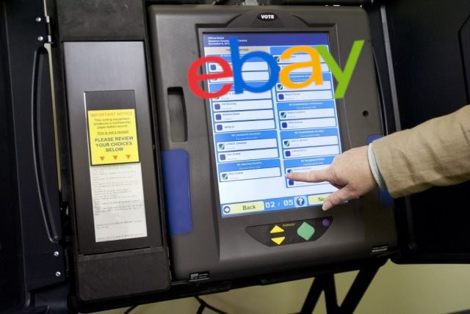
Wired 2018-10-25
I BOUGHT USED VOTING MACHINES ON EBAY FOR $100 APIECE.
WHAT I FOUND WAS ALARMING -- Brian Varner
Image source Boing Boing

Slide 9

N>=2 users, 1 computer

Slide 10
Raising the bar: some voting machine criteria
Published FLOSS
Scrutineer witnessed software load
Supervised after load
(Trusted Platform Module [TPM] attestation during operation and as part of final output may be too late)

Slide 11
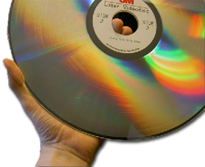
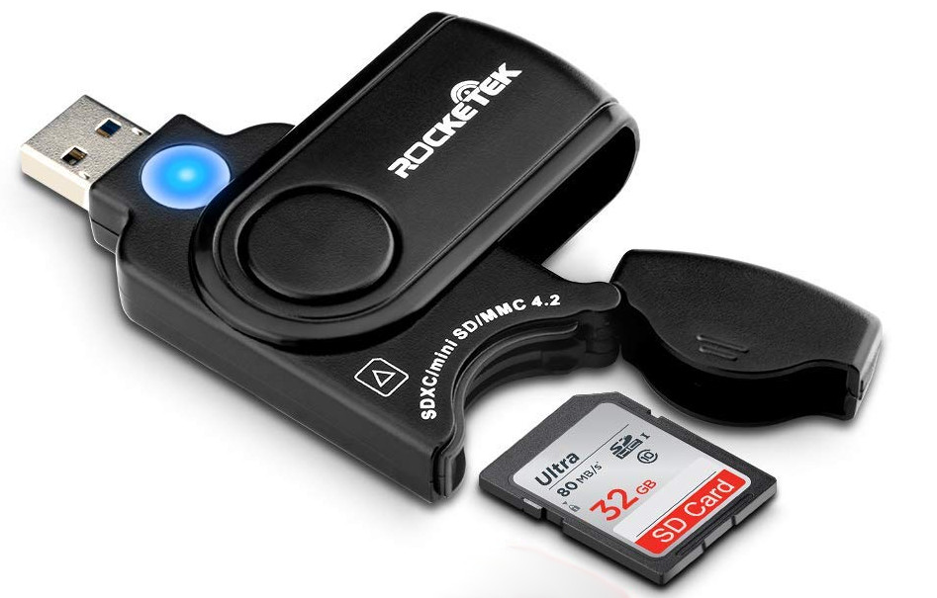
Software load option #1
Reproducible build
Read-only install media passed around for read-back by scrutineer

Slide 12
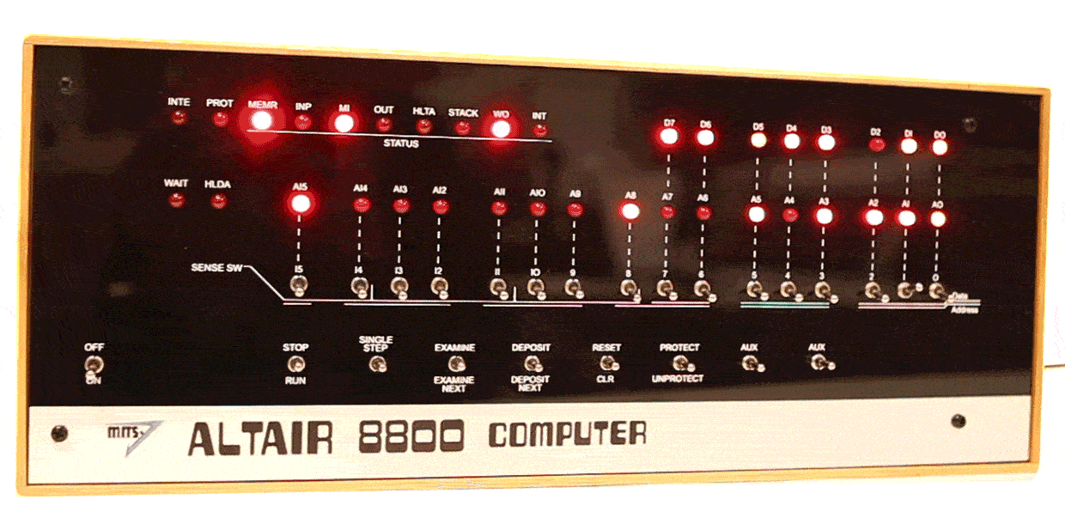
Software load option #2
Firmware is a short bootstrap ROM
Bootstrap ROM verified by some external means

Slide 13

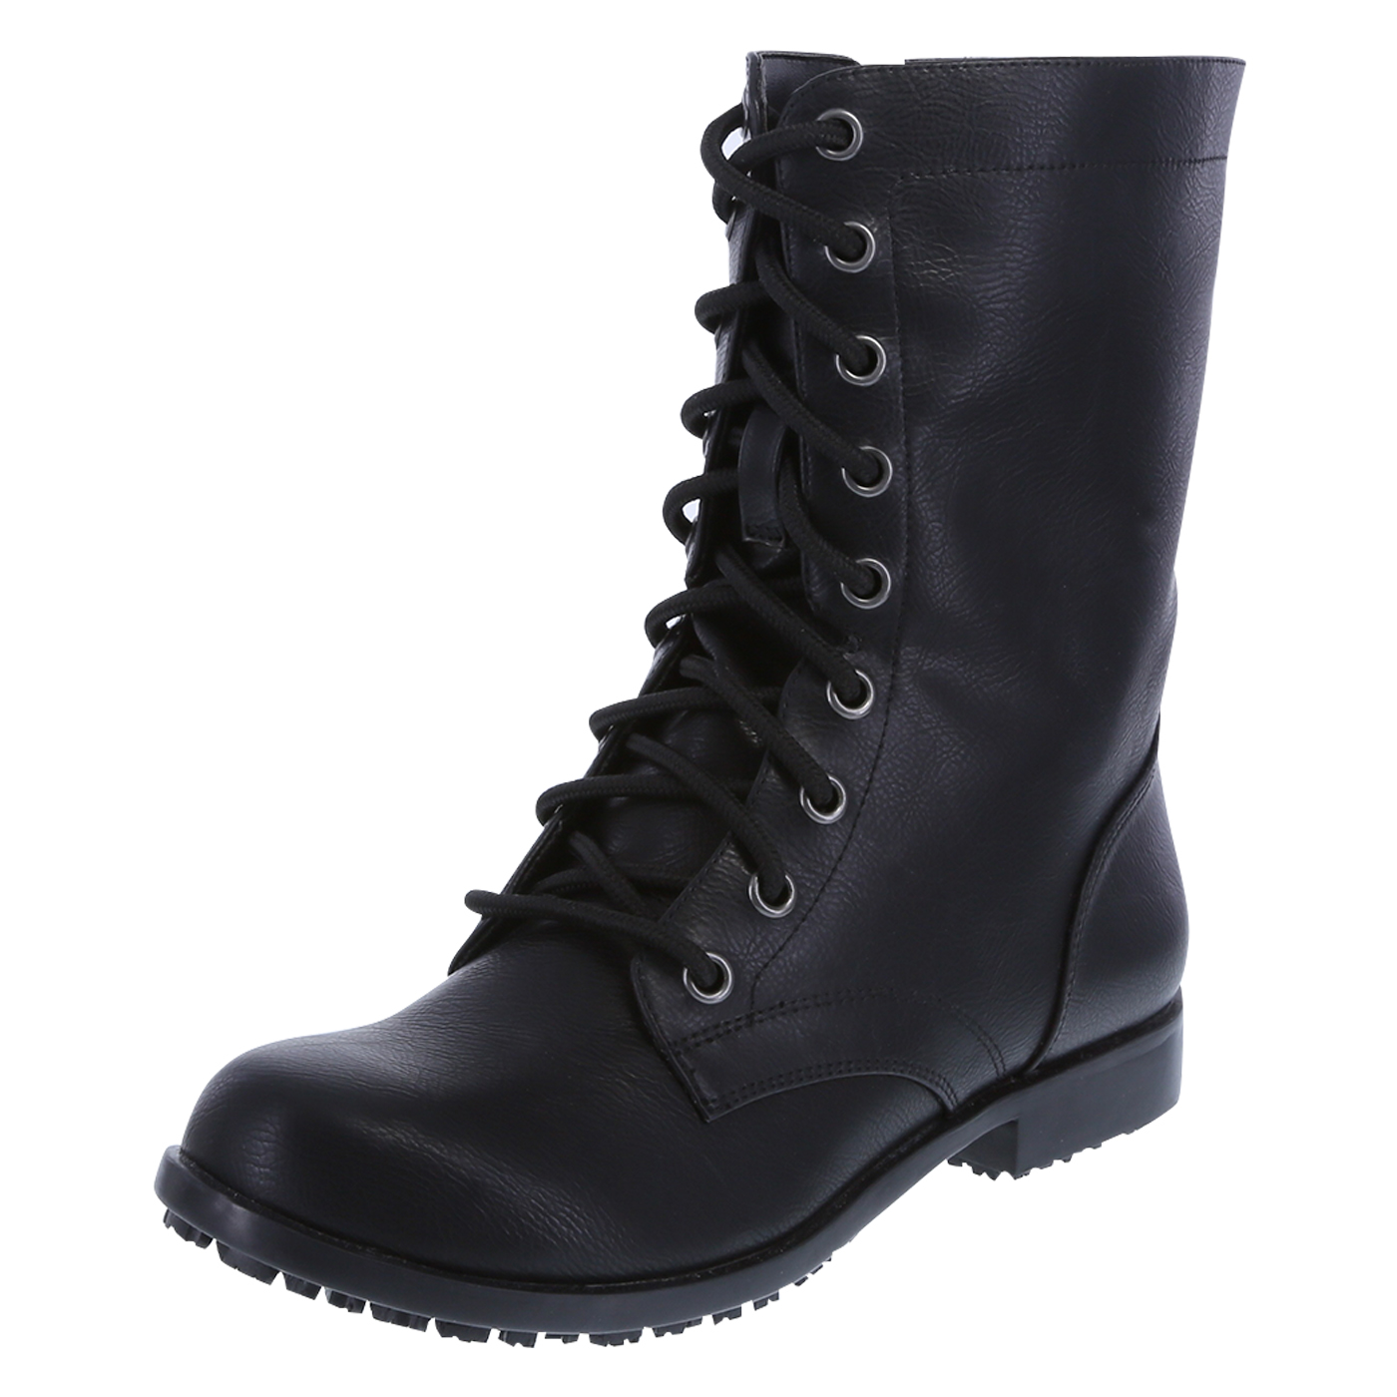
Software load option #2 -- continued
Software loaded by bootstrap process
Each bootstrap phase can report cryptographic hash of next stage source before compiling/interpreting it
linux-4.14.78.tar.xz
SHA256:
f4da4dc0f079e420e1c1b8c713
12eaa5415b08be847aa224a61
d8af6a6e74c6c

Slide 14
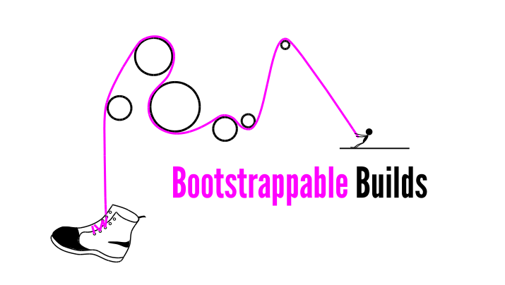
https://bootstrappable.org

Slide 15
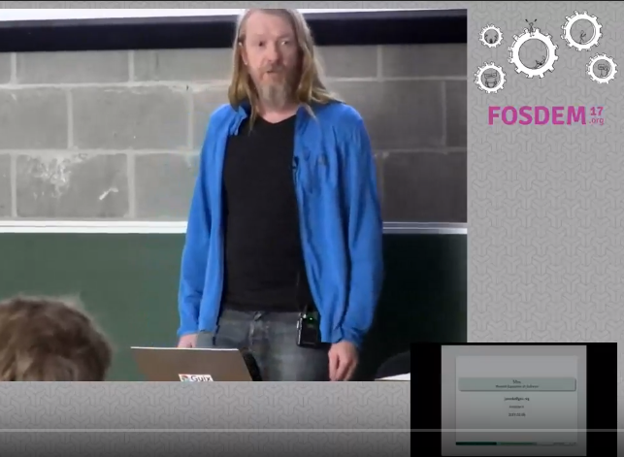
Jan Nieuwenhuizen https://gitlab.com/janneke/
https://archive.fosdem.org/2017/schedule/event/guixsdbootstrap/
https://www.youtube.com/watch?v=7NFD_9d7J3Q

Slide 16
GNU Mes https://www.gnu.org/software/mes/
Mutual self-hosting
mes.c
Scheme interpreter written in simple C
(a good language for writing a portable interpreter that you want to bootstrap)
MesCC
C compiler written in scheme
(a good language for writing a language compiler)

Slide 17
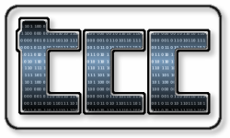

Slide 18

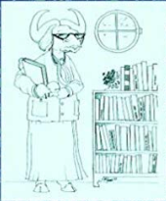

The GNU tripplet
glibc
GNU binutils

Slide 19
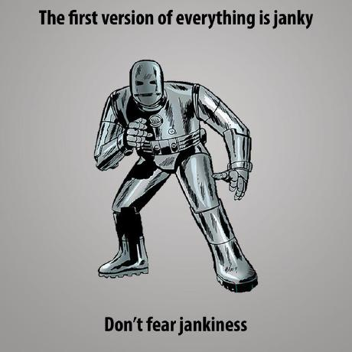
Jeremiah Orians https://github.com/oriansj

Slide 20
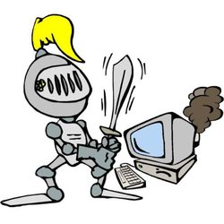
https://github.com/oriansj/stage0

Slide 21
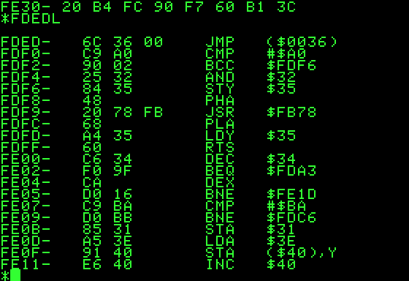
Stage0 -- Machine code monitor

Slide 22
Stage1
Hex assemblers of increasing complexity (labels, absolute/relative addressing) (Hex0-Hex2)
Macro assemblers of increasing complexity (M0, M1, M2)

Slide 23
Stage0 + Mes combined progress
Mes.c (scheme interpreter) output to M1 macro assembler language, free world now bootstrapable with 1M “readable” blob of that M1 code. Much smaller than previous blob of GNU triplet (gcc, glibc, binutils) binary build.
Subset of C compiler written in macro assembler (M2Planet, Orians), rewrites of Mes.c into simplified C variant in progress (mes-m2)

Slide 24
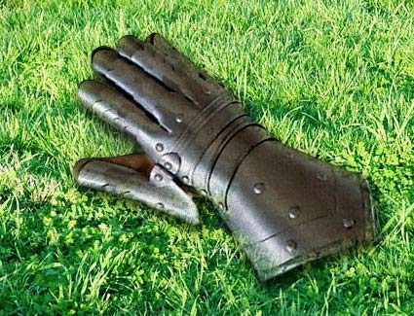
FORTH
“Because a great many people stated FORTH would be an ideal bootstrapping language the time and effort was put forth....ultimately it was determined, Assembly was preferable as the underlaying architecture wasn’t total garbage.
It now sits waiting for any FORTH programmer who wishes to prove FORTH is a real bootstrapping language.”

Slide 25
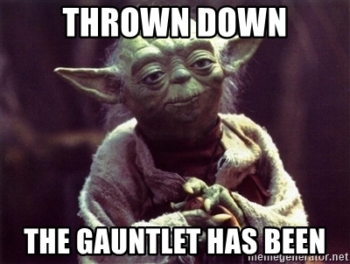

Slide 26
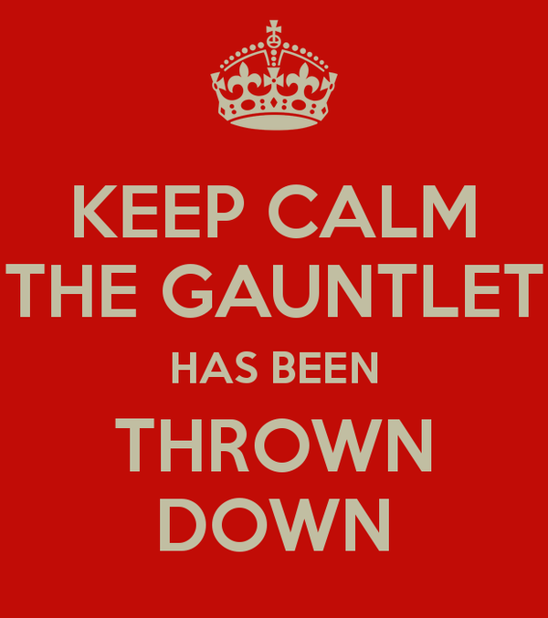

Slide 27
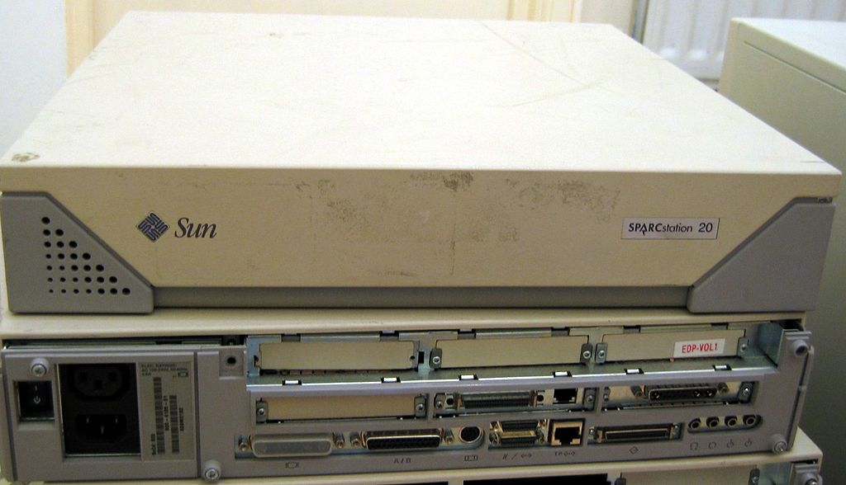
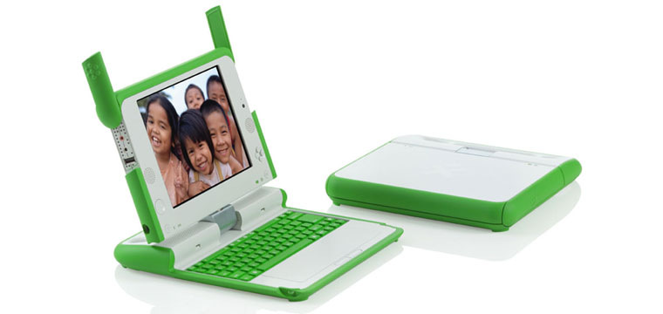
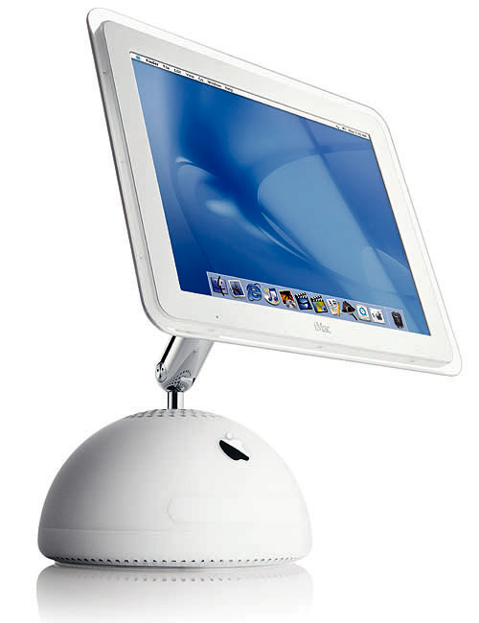
Self programable with FORTH

Slide 28
Other in-person cases for bootstraping a software load for problems of
N>=2 users, 1 computer
Wright-Andresen (N=2) Problem
Authenticated data feed for smart contracts (“oracle”), but without relying on Intel secure enclaves (SGX) as town-crier.org does.
(to avoid depletion, requires a periodic meetup and re-bootstraping of a fleet of additional battery backed oracle nodes)

Slide 29
Other cases page 2
Privacy sensitive shared tenancy hosting co-op where hosting customers are secured against co-location host. Requires one-time meetup for each new piece of hosting gear group bootstrap/load and new TPM keys. Combine with a fleet of battery backed, periodically refreshed bootstraped oracles that validate TPM attestation before unlocking rest of boot process
(alternative to Golem cryptocurrency’s future reliance on Intel secure enclaves [SGX])

Slide 30
?

Slide 31
Happy Hacking

