Slide 1
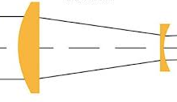
Beam expander
mask
HeNe laser
camera
0.5 cm
d
rail
3m

