Slide 1
CSS

Slide 2
Objectives
Understand major CSS concepts
See real life CSS samples
Present common issues and fix them

Slide 3
The Big Three
The three major aspects of every web application
Content
Logic
Styling
Each aspect should be defined separately and independently to allow ease of maintenance
HTML
Java Script
CSS

Slide 4
CSS
Allow for separation of content from styling
Markup page content
Then apply style to it
<html xmlns="http://www.w3.org/1999/xhtml">
<head>
<title></title>
</head>
<body>
<div id="header"></div>
<div id="body"></div>
<div id="footer"></div>
</body>
</html>
#header {
font-size: 2em;
}
#footer {
border-top: 1px solid black;
font-size: 0.85em;
}

Slide 5
CSS Versions
CSS 1.0
Visual styles
Layout
CSS 2.1
Positioning
CSS 3.0
Transform
Animation
Media Query (View Port)
Much more …

Slide 6
Applying Stylesheet
Styles can be applied to a page in different ways
Link
Import
Embedded
In line
Link is the preferred way
Separation of concerns
Caching

Slide 7
Linking a Style sheet
Use link element
Browser must download the CSS file before continue rendering the page
Therefore, CSS links are usually located inside the HEAD element
The HTML automatically being rendered with the correct styling
HTML5 allows you to drop the type attribute
<link rel="stylesheet" href="Site.css" type="text/css" />
<link rel="stylesheet" href="Site.css" />

Slide 8
Embedding
Styling instructions are embedded directly inside the HTML
Faster HTML rendering since browser does not send another HTTP request
Can remove the type attribute when running under HTML5 compatible browser
<head>
<title></title>
<style type="text/css">
#header {
font-size: 2em;
}
#footer {
border-top: 1px solid black;
font-size: 0.85em;
}
</style>
</head>

Slide 9
In line Styling
Styling instructions that are located inside an HTML element using the style attribute
Should be used rarely
Cannot be overwritten by external styling
<body>
<div id="header" style="font-size: 2em;">Header</div>
<div id="body"></div>
<div id="footer" style="border-top: 1px solid black; font-size: 0.85em;"></div>
</body>

Slide 10
Importing
One stylesheet file may import other stylesheet
Nice from maintenance aspect
Bad for performance
Browser need to issue another HTTP request
@import url("Second.css");
#header {
font-size: 2em;
}
#footer {
border-top: 1px solid black;
font-size: 0.85em;
}

Slide 11
Cascading
Style declarations cascade down to elements from many origins
The cascade combines
Importance
Origin
Specificity
Order
Decides which declaration should be applied to any given element

Slide 12
Style Rules
A rule consist of two parts
Selector
List of styles in the form of property: value;
Writing high quality CSS files is all about building the right selector with the right styling
#footer
{
border-top: 1px solid black;
font-size: 0.85em;
}

Slide 13
CSS Selector
Can be seen as a specification on its own
An expression based language which allows the developer to select one or more elements
Can be applied to any XML based document
Don’t we have XPath ?
CSS usually performs better
CSS is less powerful
CSS was born before XPath

Slide 14
Basic Selectors
All tags of particular type
The universal selector
button {
border: none;
padding: 1em;
}
* {
font-family: Tahoma;
}

Slide 15
ID Selector
From HTML perspective id attribute must be unique cross all elements
From CSS perspective this is not a limitation
ID selector may return more than one element
Still, it is not common to set the same ID to different elements
Thus, we need a different way to treat multiple element in the same way … See next slide
#header {
font-size: 2em;
}

Slide 16
Class Selector
HTML element can be associated with zero or more CSS classes
All elements with a specified class can be selected using the dot syntax
Can select elements with multiple classes
<button id="button1" class="btn btn-large">Button 1</button>
.btn-large {
font-size: 2em;
}
.btn.btn-large {
font-size: 2em;
}

Slide 17
Relationship Selectors
Select all links that are descendants of a div
Select all links that are direct children of a div
Following sibling (not previous)
div a {
color: blue;
}
div > a {
color: blue;
}
button + button {
color: red;
}

Slide 18
Sibling Selector
+ selects only immediate element that is following the left side of the operand
Below selector does not match the second button
~ does the magic
There is no “previous sibling” selector in CSS
button + button {
color: red;
}
<button>Button 1</button>
<span></span>
<button>Button 2</button>
button ~ button {
color: red;
}

Slide 19
Attribute selectors
Select element if a certain attribute is present
Regardless of whether the attribute has a value
Check for an attribute's value
Check for an attribute's partial value
use ~= for space separated, use |= for hyphen-separated
<style type="text/css">
a[href] {color: blue;}
</style>
<style type="text/css">
img[src="spacer.gif"] {width: 5px;}
</style>
<style type="text/css">
table[title~="important"] {width: 100%;}
</style>
Notes:
The hyphen-separated attribute value selector
element[attribute|="value"]
strictly only matches when the value is on the left-hand side of the hyphen. This selector was added to the specification for use with the language attribute
lang="country-code"
so the selector
*[lang|="en"]
would match all elements with a language attribute of en, en-GB, en-US, etc.

Slide 20
More attribute selectors
Check for an attribute beginning with a value
Check for an attribute ending with a value
Check for an attribute's partial value
<style type="text/css">
table[title^="important"] {width: 100%;}
</style>
<style type="text/css">
table[title$="important"] {width: 100%;}
</style>
<style type="text/css">
table[title*="important"] {width: 100%;}
</style>

Slide 21
Pseudo Class Selectors
Selectors with a colon preceding them
The most known sample is the A pseudo classes
Order is important
All pseudo classes are of the same specificity level
Therefore, last wins
a:visited {
color: blue;
}
a:active {
color: green;
}

Slide 22
More Pseudo Class Selectors
first-child: The first element within a parent
first-of-type: The first element of a specific type
Allows you to select the first IMG inside a DIV even when the IMG is not the first child
<div>
<p></p>
<button>Button</button>
</div>
div button:first-child {
background-color: blue;
}
div button:first-of-type {
background-color: blue;
}

Slide 23
Pseudo Element Selectors
Select “unreal” element that does not exist on the page
Are used to inject content without modifying the HTML … Didn’t we say separation of concerns?
::before – Creates a pseudo-element that is the first child of the element matched
::after
::first-letter
::first-line

Slide 24
CSS 2 vs. CSS 3
CSS 2
Both pseudo class and pseudo element use colon “:”
CSS 3
Pseudo class uses colon “:”
Pseudo element uses double colon “::”
Motivation is to distinguish the twos
Most browser support both

Slide 25
Injecting Icons using CSS
Is an icon content or styling ?
Using pseudo-element we can add an icon without modifying the HTML
<ul>
<li class="css">
<span>Ori</span>
</li>
<li class="html">
<span>Roni</span>
</li>
</ul>
li:before {
position: relative;
top: 5px;
}
li.css:before {
content: url(CSS3.ico);
}
li.html:before {
content: url(HTML.ico);
}

Slide 26
Specificity
Assuming the following markup
And the following selectors
Who wins ?
<div>
<button class="btn">Button</button>
</div>
div button {
color: red;
}
.btn {
color: green;
}

Slide 27
Specificity – Formal Definition
Count the number of ID selectors (=a)
Count the number of class selectors, attribute selectors, pseudo-class (=b)
Count the number of type selectors and pseudo-element (=c)
Ignore the universal selector
Selectors inside negation are counted as usual. The negation itself does not count
Concatenate the three number a-b-c
Assuming a number system with a large base

Slide 28
Specificity - Samples
➔ 2
➔ 10
➔ 111
Inline style is always stronger
In case of two selectors with same specificity the later wins
div button {
color: red;
}
.btn {
color: green;
}
#header .progressbar a {
text-decoration: none;
}

Slide 29
!important
Style rule annotated with !important is more specific than any other selectors
Even inline rule ☺
Is considered bad practice
Hard to maintain
In case of multiple !important styles → Later wins
button {
color: blue !important;
}
button {
color: green !important;
}
<button style="color: red;">Button 1</button>

Slide 30
Why a selector is ignored ?
Consider following Markup
And the following rules
What is wrong ?
<body>
<p>
<div>Hello</div>
</p>
</body>
p div {
font-size: 2em;
}

Slide 31
Invalid HTML
According to the HTML specification P tag can only contain inline elements
When browser encounters DIV inside P it assumes that the DIV element is a sibling and therefore “closes” the P tag
The following rule DOES match
<body>
<p></p>
<div>Hello</div>
<p></p>
</body>
p + div {
font-size: 2em;
}

Slide 32
Inheritance
Some styles are inherited from parent element
font-size, color, background-color
Other styles can be set by the designer to be inherited
The inheritance rule is weak
Every new definition overrides it
.child {
background-color: blue;
padding: inherit;
}

Slide 33
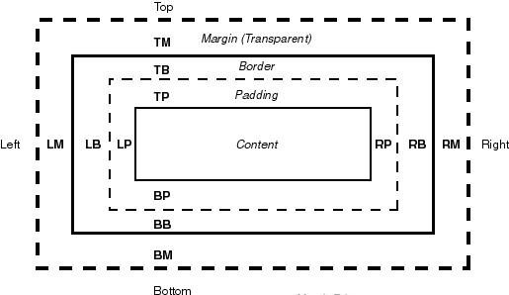
The CSS box model
Every element is treated as a box
A box consists of
Content
Padding
Border
Margin
Margin vs. padding
The margin takes the colour of the container's background
The padding takes the colour of the content's background
Notes:
To enable the dynamic positioning of CSS layers with script it is necessary to explicitly set the CSS position declaration to relative, absolute or fixed.
What is it that we are setting the position of? When a browser displays a Web document, it displays the content in invisible boxes, using the CSS 2 Box Model. If we don't specify the position of marked up content then the browsers lays out the information according to its in-built default style sheet . If CSS styles have been specified then it is these styles are used instead of the default style.
When dealing with Web documents, HTML tags generally fall into one of two categories. They are either inline elements or block elements.
Block elements can contain other block elements and inline elements.
Inline elements can contain other inline elements but are not allowed to contain block elements.
Although a browser may display your page if these rules are not followed, problems may arise when dynamically altering the properties of CSS layers. To avoid this, make use of the W3C HTML and CSS validation services.
HTML http://validator.w3.org/
CSS http://jigsaw.w3.org/css-validator/
Use these services often when you first start to use CSS because a small error in your CSS or HTML can give problems that are hard to track down otherwise.
Netscape 4 uses a different model for positioning. Its layers are window objects.

Slide 34
CSS Box model
The total width that an element occupies is the addition of content, padding and border
Setting element’s width using CSS only effect the content width, not the total width
Usually, this behavior breaks our design
See next slide

Slide 35

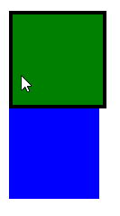
Was IE right ?
Suppose we have two child elements that are exactly filling their parent element
We want to add border when mouse is hovering
The extra border pushes the second element to the next line
<div class="parent">
<div class="child child1"></div>
<div class="child child2"></div>
</div>
.child1 {
background-color: green;
}
.child2 {
background-color: blue;
}
.child:hover {
border: 2px solid black;
}

Slide 36
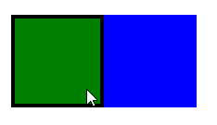
box-sizing
By default CSS width means content width
box-sizing changes the box model
When box-sizing is border-box the CSS width means content+padding+border
Other supported values: content-box, padding-box
.child {
width: 100px;
height: 100px;
float: left;
box-sizing: border-box;
}

Slide 37
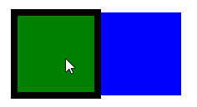
Outline
Continuing our previous example
It would be nicer if the border appears around the element and not inside it
Thus element remains the same size
Sibling elements should not be effected
Why position relative ?
.child:hover {
outline: 4px solid black;
position: relative;
}

Slide 38
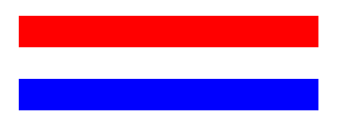
Colliding Margin
Two plus two doesn’t always equal four
When bottom margin of one element touches the top margin of another
The browser applies the larger of the two
<div class="block1"></div>
<div class="block2"></div>
.block1 {
height: 1em;
background-color:red;
margin-bottom: 1em;
}
.block2 {
height: 1em;
background-color:blue;
margin-top: 1em;
}

Slide 39
Go with the flow
HTML tags act much like text in a word-processing program
Tags are filling the entire width of a page and flowing from top to bottom
Each box flows one after the other
Except special boxes
Many problems can be solved by flowing with the flow …

Slide 40
Inline vs. Block element
Not all boxes are alike
Two different types
Block
Inline
Block element creates a break before and after it
For example, P tag
Inline element appears on the same line as the content and tags beside them

Slide 41
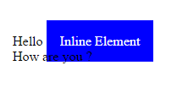
Inline Element’s Padding & Margin
Assuming following markup & CSS
The result is surprising
<body>
Hello <span class="labe1">Inline Element</span>
<br /> How are you ?
</body>
.label {
color: white;
background-color: blue;
padding: 1em;
}

Slide 42
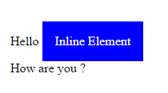
Inline Element’s Padding & Margin
Vertical padding and margin have no effect on sibling elements
Horizontal padding and margin are honored
You can change the element display style to inline-block
.label {
color: white;
background-color: blue;
padding: 1em;
display: inline-block;
}

Slide 43

Inline Element’s Height & Width
Height and width are completely ignored !!!
Width and height are determined according to the element’s content
Solution: Again, move to inline-block
<body>
Hello <span class="label">Inline Element</span><br />
How are you ?
</body>
.label {
color: white;
background-color: blue;
width: 200px;
height: 200px;
}

Slide 44
inline-block Element
From parent perspective inline-block element is just like a plain inline element
Flows from left to right
The margin & padding are taken into account
However, the element itself feels like a block
By default width and height are set according to content
Or you can change them to other values

Slide 45
Line Box
Inline elements are arranged inside a virtual line space
CSS defines a set of rules to determine the position of an element inside the line
Horizontal positioning is straightforward
Vertical positioning is tricky

Slide 46
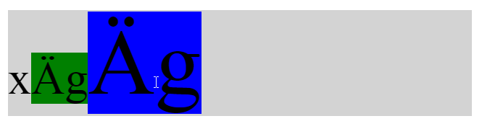
Line’s Baseline
By default all inline element are positioned according to the line’s baseline
.line {
background-color: green;
width: 4em;
}
.label1 {
background-color: red;
font-size: 0.5em;
}
<div class="line">
<span class="label1">&#xC4g</span>
</div>

Slide 47
Where is the baseline ?
This is the tricky part
Officially, the line’s baseline is the position where a non styled “x” (lowercase) is located
However, there are many factors that effect the position of the baseline
Font
Minimization of the line height
Elements inside the line ☹

Slide 48
vertical_align
Effects only inline elements
Determines the vertical position of an element relative to the line
Supports
baseline (default)
bottom/top
middle
sub/super
text-top/text-bottom

Slide 49


Centering an Icon
You want to attach a small icon with a line of text
The icon is not vertically centered
Let’s use vertical_align
Ooops … worse
<div class="line">
<span class="icon"></span>
<span class="label1">Very very long text ...</span>
</div>
.icon {
...
vertical-align: middle;
}

Slide 50
vertical_align middle
middle is relative to the line’s baseline ☹
Not to the line vertical center point
How can we change the location of the baseline ?
The trick is to define an element that its height equals to the line’s height
Then set its vertical align property to middle
Since the element cannot be moved inside the line (too tall) the browser moves the baseline (Wow …)

Slide 51

vertical_align middle
Most designers are surprised that changing .label1 vertical_align property actually effects the .icon position
.icon {
display: inline-block;
height: 16px;
width: 16px;
background-color: red;
vertical-align: middle;
}
.label1 {
font-size: 1em;
vertical-align: middle;
}

Slide 52
Vertical Centering
Can the vertical_align be used to implement a general vertical centering of an element ?
Only if
Parent consists of one line
Child is inline element
The line’s baseline is located at the center point
The last requirement is difficult
However, we can inject a pseudo element with 100% and vertical_align middle

Slide 53
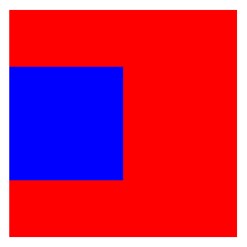
Vertical Centering
Works even if parent and child heights are of unknown value
<div class="parent">
<div class="child"></div>
</div>
.parent {
display: inline-block;
background-color: red;
}
.parent:after {
content: "";
height: 100%;
display: inline-block;
vertical-align: middle;
}
.child {
display: inline-block;
background-color: blue;
vertical-align: middle;
}

Slide 54
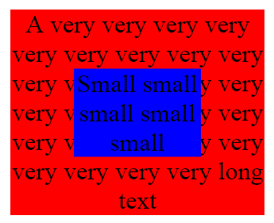
Vertical Centering
What if parent consists of two or more lines ?
Use transform (CSS3)
.parent {
width: 10em;
display: inline-block;
background-color: red;
position: relative;
text-align: center;
}
.child {
position: absolute;
top:50%;
left: 50%;
transform: translate(-50%, -50%);
width: 5em;
display: inline-block;
background-color: blue;
}

Slide 55
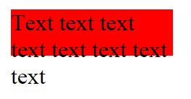
Wrap
Inline element is treated as a single word
When a line has no more space, the next element is pushed to a new line
New line might overflows its container (vertically)
<div class="parent">
Text text text text text text text text
</div>
.parent {
display: inline-block;
width: 7em;
height: 2em;
background-color: red;
}

Slide 56
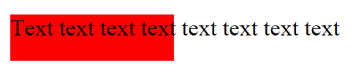
white-space: nowrap
You can prevent element wrapping by setting white-space to nowrap
<div class="parent">
Text text text text text text text text
</div>
.parent {
display: inline-block;
width: 7em;
height: 2em;
background-color: red;
white-space: nowrap;
}

Slide 57

Controlling the overflow
By default the overflow content is visible
Can configure parent’s overflow style to
hidden - Hide the overflow content
scroll – Always display a scrollbar
auto – Display a scrollbar only if overflow exists
.parent {
display: inline-block;
width: 7em;
height: 2em;
background-color: red;
white-space: nowrap;
overflow-x: auto;
}

Slide 58

Exact filling
Suppose we have two child elements that need to exactly fill their parent
The result is surprising
<div class="parent">
<div class="child1"></div>
<div class="child2"></div>
</div>
.parent {
background-color: red;
width: 200px;
height: 200px;
}
.child1 {
background-color: green;
width: 100px;
height: 200px;
}
.child2 {
background-color: blue;
width: 100px;
height: 200px;
}

Slide 59
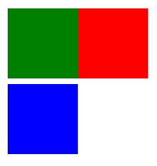
Block means block
A block element breaks the line
Following element are moved to next line
Setting a width for the block element has no effect on the line breaking
Change child DIVs to inline-block
Ooops … why is that ?
div div {
display: inline-block;
}

Slide 60

White Space
There is no difference between one white space and multiple white space characters
However, one white space character does occupy some space (0.25em)
<div class="parent">
<div class="child1"></div><!—
--><div class="child2">
</div>
</div>
<div class="parent">
<div class="child1"></div><div class="child2"></div>
</div>

Slide 61
Zero font-size
Previous problem can be solved by zeroing the font-size
However, remember that font-size is inherited to child elements
Therefore, you may need to “restore” the font-size for child elements
.parent {
background-color: red;
width: 200px;
height: 100px;
font-size: 0;
}

Slide 62
Floating
Floating can solve our problem too
However, float has side effects that must be considered
See next slides for more details
.child {
width: 100px;
height: 100px;
float: left;
}

Slide 63
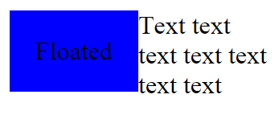
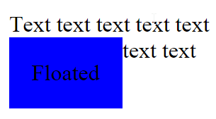
Floating – Float First
Floated element must come before the content itself
Not following the rule creates strange layout
<div class="parent">
<span class="floated">Floated</span>
Text text text text text text text
</div>
<div class="parent">
Text text text text text text text
<span class="floated">Floated</span>
</div>

Slide 64


Floating – Collapsing Height
A block parent with only floated children has no height
Can fix that with overflow: hidden
<div class="parent">
<span class="floated">floated</span>
<span class="floated">floated</span>
</div>
.floated
{
float: left;
}
.parent
{
background-color: red;
}
.parent
{
background-color: red;
overflow: hidden;
}

Slide 65
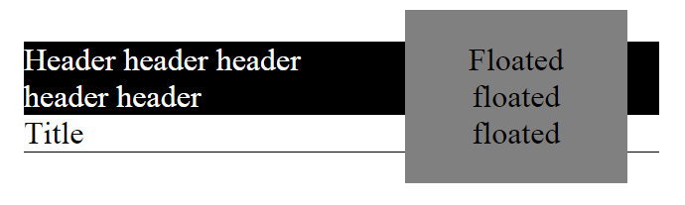
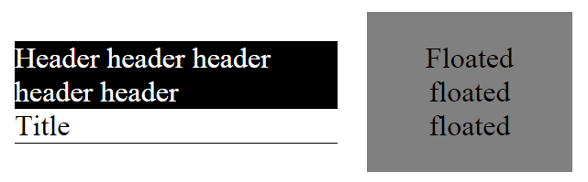
Floating – Border and Background
Text wraps around floating elements
Border and background do not
Can fix that with overflow: hidden (again …)
<div class="view">
<div class="floated">
Floated floated floated
</div>
<div class="header">
Header header header header header
</div>
<div class="title">
Title
</div>
</div>
.header {
overflow: hidden;
}
.title {
overflow: hidden;
}

Slide 66
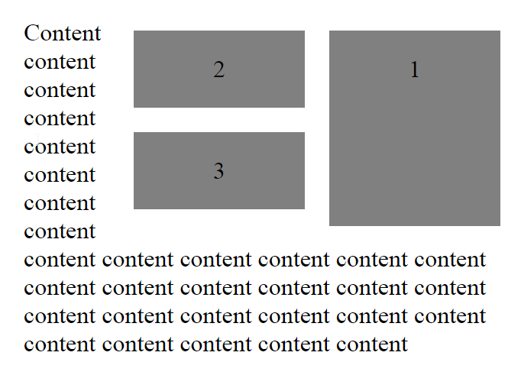
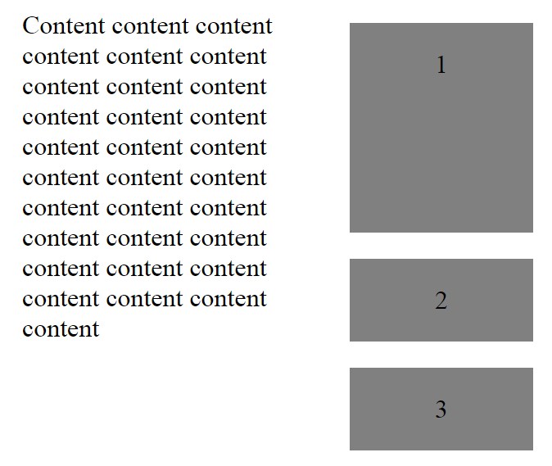
Stopping the Float
Floating elements sit one after the other (horizontal ordering)
What if we want the floating elements to sit one below the other
.floated
{
clear: both;
}

Slide 67
CSS Positioning
CSS offers four types of positioning
Static – The default behavior
Absolute
Relative
Fixed
Remember our moto: “Go with the flow”

Slide 68
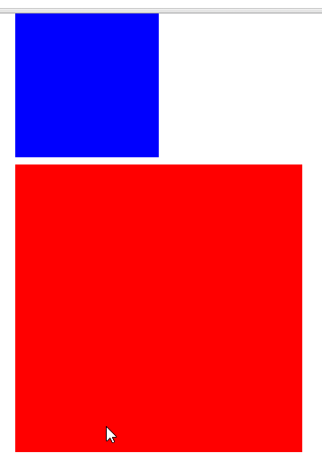
Absolute Positioning
Position an element relative to the boundaries of its closest positioned ancestor
Positioned ancestor = parent element with non default position style
The .child element has no positioned ancestor and therefore is positioned relative to the window
.child {
height: 5em;
width:5em;
background-color:blue;
position: absolute;
top: 0;
}
<div class="parent">
<div class="child">
</div>
</div>

Slide 69

Absolute Positioning
Common scenario is to position an element relatively to its parent while keeping the parent in the exact location
Solution: Use relative positioning
.parent {
height: 10em;
width: 10em;
background-color: red;
position: relative;
}

Slide 70
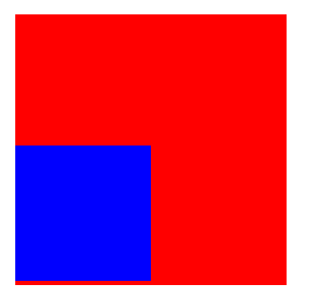
Absolute Position: bottom & right
Absolute positioning using top and left is straightforward
However, what does it mean absolute position with bottom equal 5px ?
Answer: The bottom edge of the child element should be located 5px above the bottom edge of the parent

Slide 71

Absolute Position: Docking
Absolute positioning can be used to dock an element
For example, bottom docking
.parent {
width: 10em;
height: 10em;
background-color: blue;
position: relative;
}
.child {
height: 2em;
background-color: red;
}
.dock-bottom {
position: absolute;
left:0;
right:0;
bottom:0;
}
<div class="parent">
<div class="child dock-bottom">
</div>
</div>

Slide 72
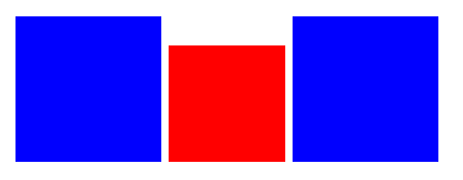
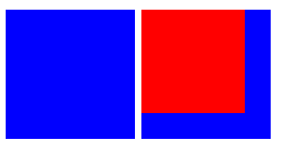
Absolution Position: Out of flow
Absolute positioned element is out of the normal document flow
As if all other elements don’t know that the element exist
Now, lets add position: absolute
<div class="child1 child"></div>
<div class="child2 child"></div>
<div class="child3 child"> </div>
.child2 {
background-color: red;
position: absolute;
}

Slide 73
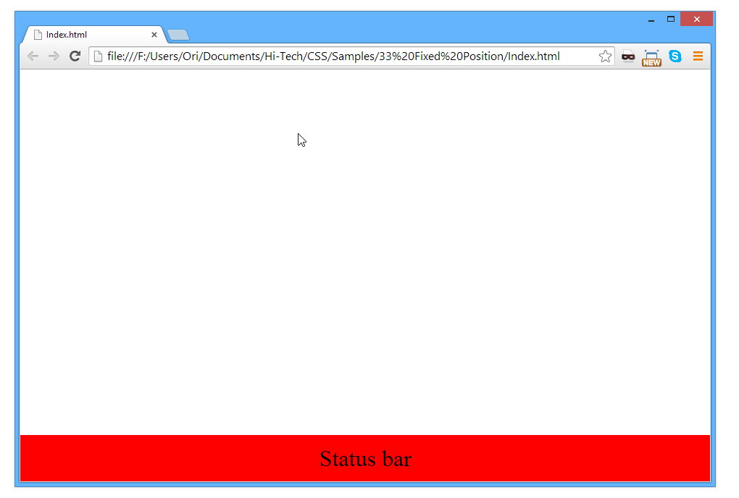
Fixed Position
Position an element relative to the boundaries of the window
Beside the different parent it behaves the same as absolute positioning
Out of flow
.status-bar {
position:fixed;
height: 2em;
line-height: 2em;
background-color: red;
left:0;
right:0;
bottom:0;
text-align: center;
}

Slide 74
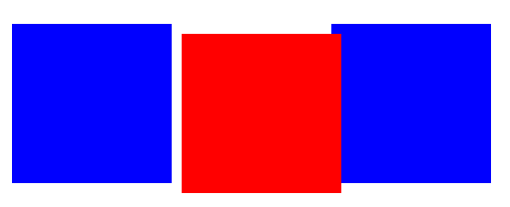
Relative Position
Position an element relative to itself
Are you serious ?
Actually, very useful
Relative positioned element + left: 5px → move 5px to the right while keeping all other elements untouched
.child {
width: 5em;
height: 5em;
background-color: blue;
display: inline-block;
float: left;
}
.child2 {
background-color: red;
position: relative;
left: 10px;
top: 10px;
}
<div class="child1 child"></div>
<div class="child2 child"></div>
<div class="child3 child"></div>

Slide 75

z-index
Absolute positioned elements might overflow each other
By default, the later absolute positioned element has higher z-index priority
.child {
position: absolute;
width: 5em;
height: 5em;
}
.child1 {
top: 1em;
left: 1em;
background-color: red;
}
.child2 {
top: 2em;
left: 2em;
background-color: green;
}
<div class="child child1"></div>
<div class="child child2"></div>

Slide 76
Size Units
So many options
You probably need only three: em, rem, px
Type |  | Type
px | Pixel | pc | 12pt
in | Inch | ex | Relative to “x”
cm | Centimeter | ch | Relative to “0”
mm | Millimeter | vw/vh/vmin/vmax | Relative to view port
em | Relative to font-size | % | Like em
rem | Root em
pt | 1/72 inch

Slide 77
The Pixel unit - px
px is easily understood
Parent size has no effect
Browser zoom may effect
Be aware, that 1 CSS pixel does not necessary means 1 hardware pixel
Apple Retina and other modern monitors
Most of the time using px is not convenient
You probably want to change parent size and accept all children to adjust accordingly

Slide 78
The M unit - EM
EM means the size of the M letter (printing world)
Inside the CSS world 1em means the size of the base font
By default is 16px (most browsers)
Changing font family has no effect
em is a relative unit
Changing parent’s font-size effects children

Slide 79

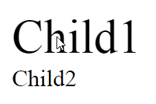
em vs. px
1em = 16px
When changing parent font-size
<div class="child child1">Child1</div>
<div class="child child2">Child2</div>
.child1 {
font-size: 2em;
}
.child2 {
font-size: 32px;
}
html
{
font-size: 32px;
}

Slide 80
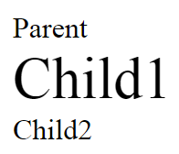
The Root EM - rem
Size is relative to the HTML tag’s font-size and not to the parent
<div class="parent">
Parent
<div class="child1">
Child1
</div>
<div class="child2">
Child2
</div>
</div>
.parent {
font-size: 2em;
}
.child1 {
font-size: 2em;
}
.child2 {
font-size: 2rem;
}

Slide 81
Which unit is the best ?
Depends (like always …)
Most of the time you should use em
Use rem for padding & margin
Use px for border

Slide 82
Summary
Mastering CSS is not easy
Web Designer is a profession
Can greatly improve your skills by understading some major CSS concepts
Box model
Inline vs. block element
Line box
Floating
Unit size

