Slide 1
Node.js -Getting started
Ori Calvo, 2017 oric@trainologic.com http://trainologic.com

Slide 2
Objectives
© 2017 Ori Calvo
2
Overview
Node performance comparisons
Installation
Hello World
REPL
NVM
IDE support

Slide 3
Overview
© 2017 Ori Calvo
3
Node.js® is a server-side JavaScript platform
Built on Chrome’s V8 JS engine
Open source
Single threaded
Uses an event-driven, non-blocking I/O model
Developed by Ryan Dahl in 2009
Supported by Joyent
Governed by The Node.js Foundation Technical Steering Committee (TSC)

Slide 4
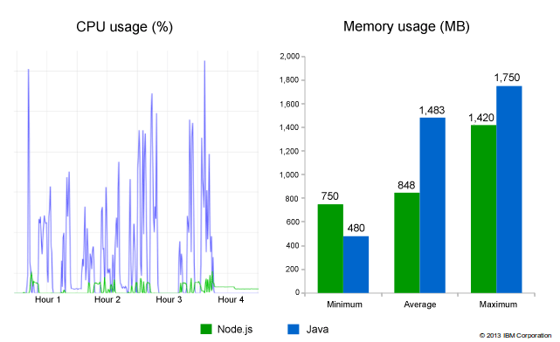
Performance
© 2017 Ori Calvo
4

Slide 5
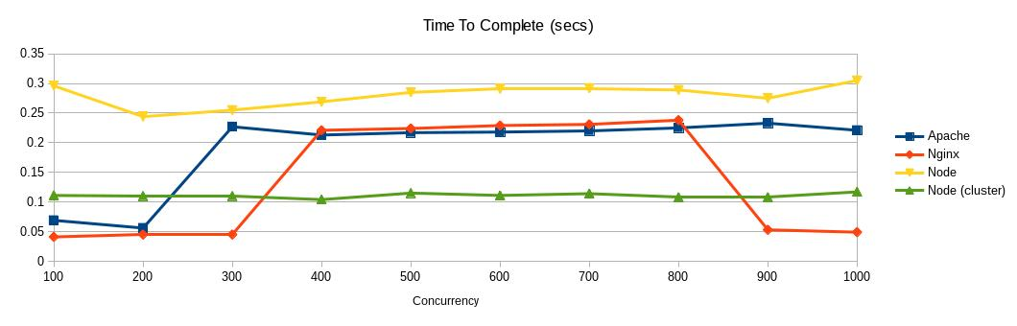
Performance
© 2017 Ori Calvo
5

Slide 6
Installation
© 2017 Ori Calvo
6
Found on https://nodejs.org
Latest versions come in 2 flavors
Both are stable
Current
Is the latest
May change rapidly
Inconvenient for consistent developing environment
LTS (Long Term Support)
updated and maintained for longer and predefined schedules
Is recommended

Slide 7
Installation
© 2017 Ori Calvo
7
Download and install
Default installation folders:
Windows: C:Program Files\nodejs
Mac: /usr/local/
Verify installation
Installed version: node -v
Multiple versions may be installed and run
Using NVM

Slide 8
Hello World
© 2017 Ori Calvo
8
Create helloworld.js
Windows: NUL > helloworld.js
Mac: touch helloworld.js
In the file:
Console.log(‘Hello world!’)
In the console:
Node helloworld.js
Output : Hello world!

Slide 9
REPL
© 2017 Ori Calvo
9
A console-like interactive environment
Experiment with Node commands
Debug JS code
Run node
> function add(a, b){
... return a+b;
... }
undefined
> const c=add(3,5);
undefined
> console.log(c)
8
undefined
>
Exit: ^c ^c

Slide 10
NVM
© 2017 Ori Calvo
10
Node Version Manager
Webstorm
No need to manually install/uninstall versions
Install and switch between Node versions
Windows NVM is a totally different app

Slide 11
Debugging
© 2017 Ori Calvo
10
Node Version Manager
Webstorm
No need to manually install/uninstall versions
Install and switch between Node versions
Windows NVM is a totally different app

Slide 12
IDEs
© 2017 Ori Calvo
10
Node is supported by many IDEs
Webstorm
Visual Studio Code
Atom
Sublime text
IntelliJ IDEA
…

