Slide 1

The TA Reporting System
Oli

Slide 2
TA Pool
TA Assignments!
???
Cornell CS Graduate TA Handbook for MS & PhD Students (cs.cornell.edu/sites/default/files/shared/graduate_ta_handbook.pdf)
Survey Data
Available TAships

Slide 3
Why Have a TA Reporting System?
Individual
2
1
Aggregate
4
Benefits
dept can identify problematic instructors/courses, to intervene;
easy way to ask CSGO for help
dept gets overall statistics
might be useful to guide policy
CSGO does too
TAs can get a sense of the time that other TA’s are putting in.
3
CSGO
dept
Drawbacks
requires:
time to fill form regularly;
some trust
minor maintenance

Slide 4
The TA Reporting System
site @ research.cs.cornell.edu/csgo/ta/
code @ github.com/Cornell-CSGO/website

Slide 5
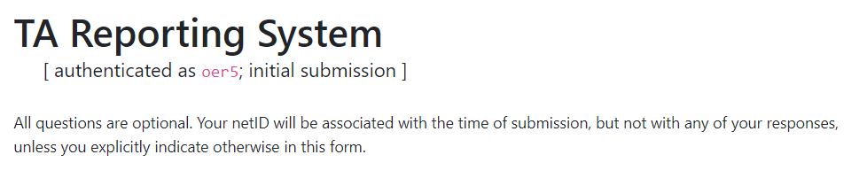

Slide 6
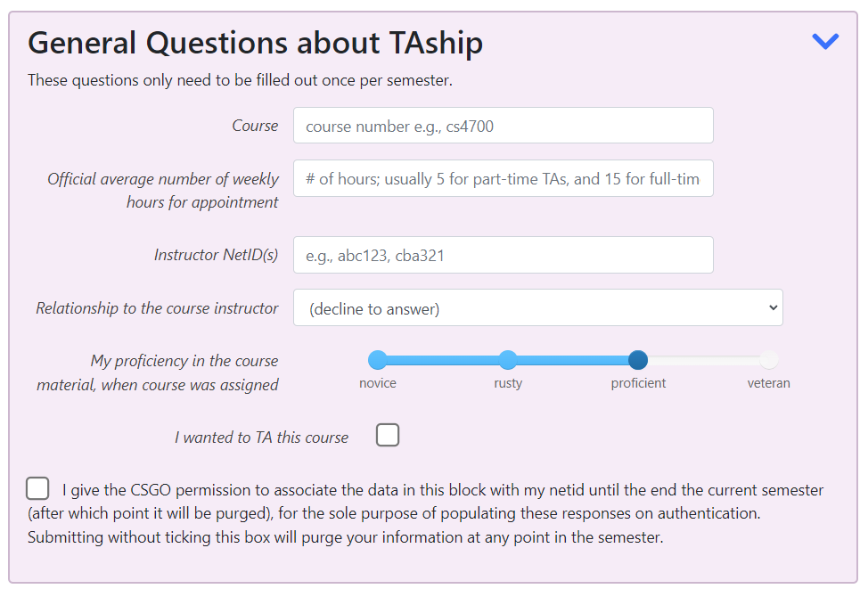
Drawbacks
time to fill form every week;
some trust
(some) maintenance

Slide 7

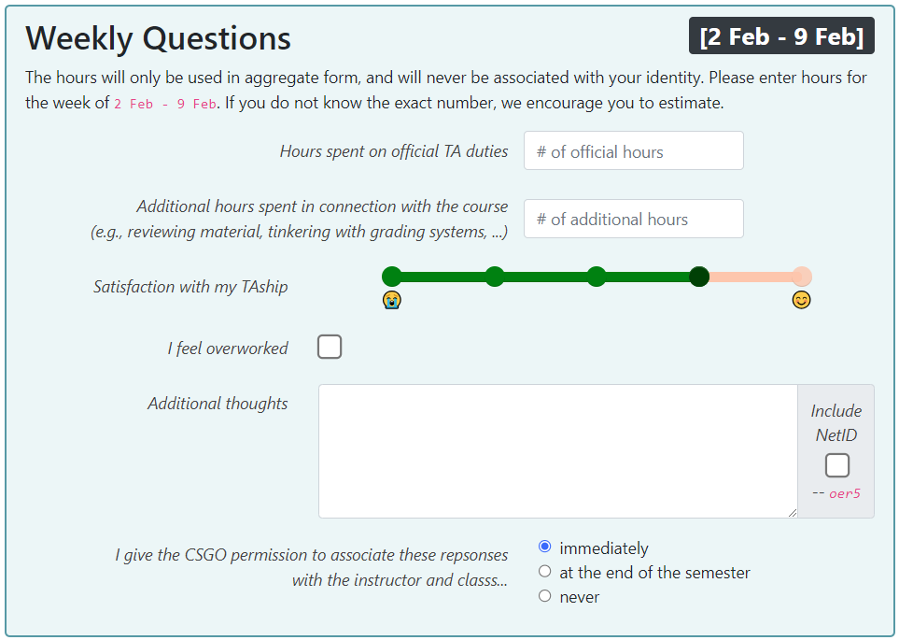

Slide 8

netid
Log
netid
Autofill Information
TA Form Data
Text Feedback

Slide 9
Internal State: Tables
Autofill-Information
Drawbacks
time to fill form regularly;
some trust
minor maintenance
Text Feedback
keep
discard @ semester end
TA Form Data
Log
Autofill Information

Slide 10
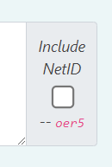

TA Text Feedback
feedback | netid | course | instructor | timestamp
 |  | CS2770 | kqw4
Lots of grading this week, but usually there’s none | oer5 | CS4820 | ec583
I’m very sad; pls help ☹

Slide 11
TA Form Data
course | instructor | appthours | irelation | proficiency | wantedta | ohours | ahours | happiness | overworked
cs4780 | kqw4 | 15 | collaborator | 0 | 0 | 10 | 3 | 4 | 0
 |  | 15 | maybe-advisor | 1 | 1 | 8 | 1 | 2 | 0
cs4820 | ec583 | 15 | advisor | 1 | 1 | 10 | 5 | 3 | 0
… | … | 15 | none | 2 | 0 | 20 | 15 | 1 | 1
… | … | 15 | maybe-advisor | 2 | 1 | 15 | 0 | 4 | 0
… | ... | 5 | none | 1 | 0 | 15 | 5 | 2 | 0
ts

Slide 12
Discarded Tables
Autofill Information
Populate first half of response
Log
Prevent duplicate submission
worst-case debugging
netid | course | instructor | appthours | irelation | proficiency | wantedta
 | cs4780 | kqw4 | 15 | colaborator | 0 | 0
 |  |  | 15 | maybe-advisor | 1 | 1
 | cs4820 | ec583 | 15 | advisor | 1 | 1
 | … | … | 15 | none | 2 | 0
 | … | … | 15 | maybe-advisor | 2 | 1
 | … | ... | 5 | none | 1 | 0
netid | timestamp
oer5 | 5:15am Jan 31st
… | …

Slide 13




Reflecting on
Purported Benefits
dept can identify problematic instructors/courses, to intervene;
easy way to ask CSGO for help
dept gets overall statistics
might be useful to guide policy
CSGO does too
TAs can get a sense of the time that other TA’s are putting in.
apparently has been helpful after the semester to help department identify & resolve issues with problematic courses
requires the CSGO to monitor the form; how to help?
noisy, not fully adopted, few datapoints, many confounders
what to do with this? How to publish?

Slide 14
How to publish the data?
What questions do we have about it?
Any changes to what we collect?

Slide 15
Some of the Data

Slide 16
Fall 2021
86 entries
Column1 | proficiency | wanted to TA this course? | official hours | additional hours | happiness (0-4) | overworked
[OVERALL] | 1.22 | 0.86 | 10.21 | 1.97 | 2.78 | 0.039
full-time | 1.26 | 0.87 | 10.68 | 2.00 | 2.72 | 0.043
part-time | 0.75 | 0.75 | 4.63 | 1.63 | 3.50 | 0.000
olumn1 | proficiency | wanted to TA this course? | official hours | additional hours | happiness (0-4) | overworked
advisor | 0.90 | 0.90 | 13.55 | 2.50 | 2.80 | 0.10
maybe-advisor? | 2.00 | 1.00 | 10.00 | 0.69 | 2.54 | 0.00
none | 1.00 | 0.75 | 8.75 | 1.59 | 3.25 | 0.00
{0,1,2,3,4}
{-1,0,1,2}

Slide 17
Spring 2022
104 entries
data lost because of a bug :(

Slide 18
Spring 2023
68 entries
{0,1,2,3,4}
{-1,0,1,2}
 | happiness | defer | proficiency | wanted? | ahours | ohours
advisor | 3.33 | 0.00 | 2.00 | 1.00 | 7.67 | 1.00
collaborator | 3.00 | 0.60 | 0.00 | 1.00 | 8.20 | 1.80
maybe-advisor | 3.00 | 0.91 | 1.00 | 1.00 | 8.68 | 1.94
none | 2.96 | 0.04 | 1.43 | 0.96 | 8.10 | 1.83
(blank) | 3.04 | 0.04 | 0.96 | 0.12 | 4.84 | 2.66

Slide 19
Fall 2023
186 entries
{0,1,2,3,4}
{-1,0,1,2}
 | happiness | overworked | proficiency | wanted? | ahours | ohours
advisor | 3.08 | 0.00 | 1.00 | 0.97 | 7.97 | 3.91
collaborator | 2.91 | 0.00 | 1.00 | 0.09 | 8.18 | 2.14
maybe-advisor | 3.00 | 0.00 | 1.00 | 1.00 | 7.33 | 3.50
none | 3.27 | 0.01 | 1.08 | 0.95 | 7.99 | 2.60
(blank) | 3.20 | 0.00 | 1.00 | 0.06 | 10.90 | 2.64

Slide 20

at a very high level
Happiness is slowly increasing after pandemic, reliably here
Try not to TA for your advisor.
On average, TAs (claim to) work 8 + 2.5 hours / week
… so no reason for you to work past the department limits! (20 hours in any one week; 15 on avg)
(default)

Slide 21
I am looking for a successor!
Drawbacks
time to fill form regularly;
some trust
minor maintenance
Primary responsibility: Give data to CSGO & CS Dept, then press button to reset database (1x per semester)
Optional responsibilities:
analyze data
publish or present data / analysis
make improvements to system

