Slide 1


Cat Thoughts
An introduction to applied category theory
Oliver Richardson

Slide 2
Category Theory is:
A theory of weak equivalence: what makes two things structurally (but not literally) equal?
A generalized theory of composition: what do all things that can be composed and thought of a single unit have in common?
An alternate foundation of mathematics

Slide 3


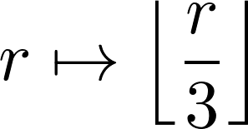



Set Theory has Two Levels
Types capturing the abstraction we want to deal with
Types with complete information

Slide 4




Set Theory has Two Levels
Objects contain elements
Functions contain fibers

Slide 5








… but there are lots of composable things!
Partial Functions
Continuous Maps
Ring Homomorphisms
Group Homomorphisms
-----------------------
Database Queries
Program Traces
Automaton Transitions
Neural Network Layers
Package Forwards
Grammars
Circuits
---------------------
Valid moves in Chess
Quantum Measurements
Facebook Shares
Relations
Paths in Graphs
Bijections
Monotone Functions

Slide 6
Potential Concerns
Why not just use graph theory?
Graph theory is a particular case in which all of the structure has been flattened, there are no equations, and nothing is infinite
This isn’t even all that general. What about hyper-graphs?
This definition can be used to build hyper-graphs

Slide 7
A Primordial Ooze
Everything could be defined in terms of anything else.

Slide 8





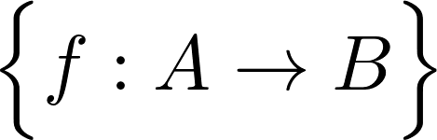



Formal Definition: a category consists of
a collection of objects
a collection of arrows from A to B, for each pair of objects A and B
A way of composing arrows (associative)
An identity arrow, for every object A

Slide 9
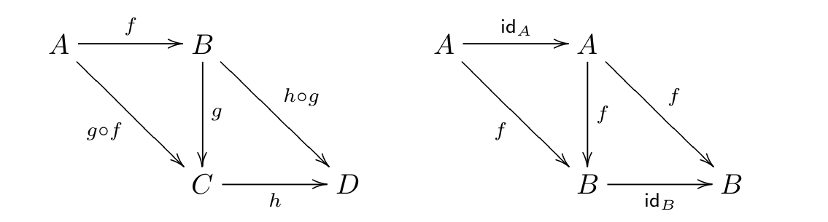
Formal Definition: a category
Associativity
id_{A} is a right and left identity

Slide 10
Examples of categories
Generated by graphs
Groups
Orders
Sets

Slide 11
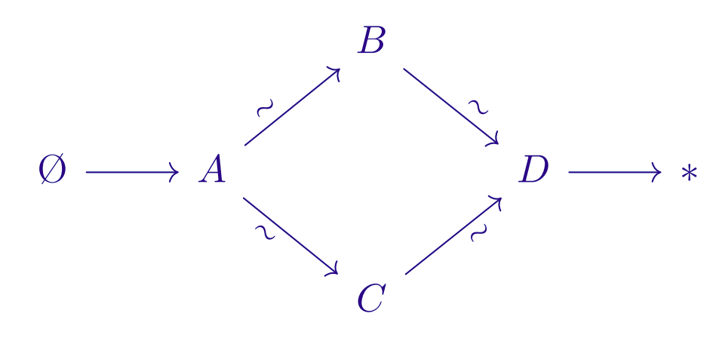

Orders are purely horizontal categories.

Slide 12

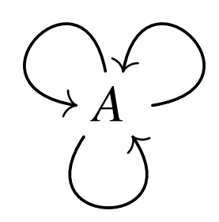



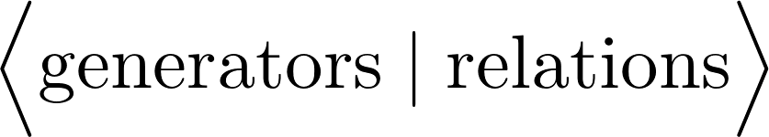
Groups are Vertical Categories
A group regarded as a category
(composition given by G)

Slide 13



Functors
Assigns an object of B to each object of A
And a morphism of B to each morphism of A

Slide 14




Examples
Set functions are functors between discrete categories
Monotone functions are functors between orders
Group homomorphisms are functors between groups
List functor
String
List[String]
f
map(f, -)
Int
List[Int]

Slide 15


Making Categories out of categories
We can get an opposite category
Objects: same as the objects of C
Arrows (A,B): the arrows (B, A) of C
The category of categories, Cat, is a category
Objects: categories
Arrows: functors between them
If A, B are categories, we can form the functor category
Objects: functors from A to B
Arrows: natural transformations between them

Slide 16


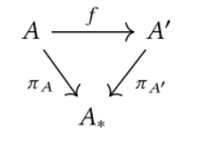
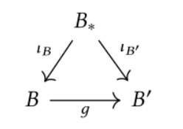
Making Categories out of categories
Slice Categories
Coslice Categories

Slide 17
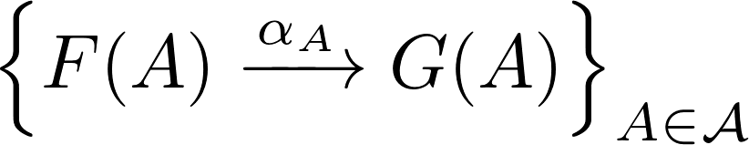

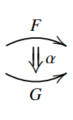


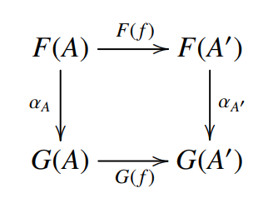
Natural Transformations

Slide 18
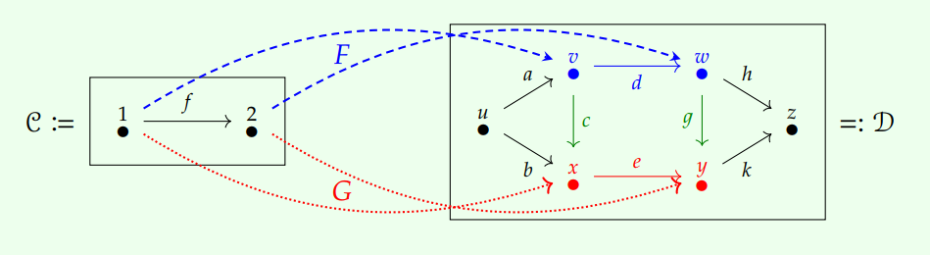
Natural Transformations

Slide 19
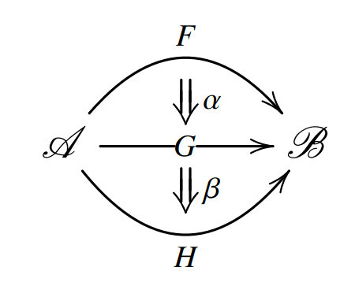
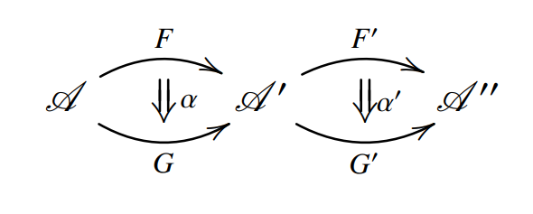
Natural Transformations: composition
Vertical
Horizontal

Slide 20
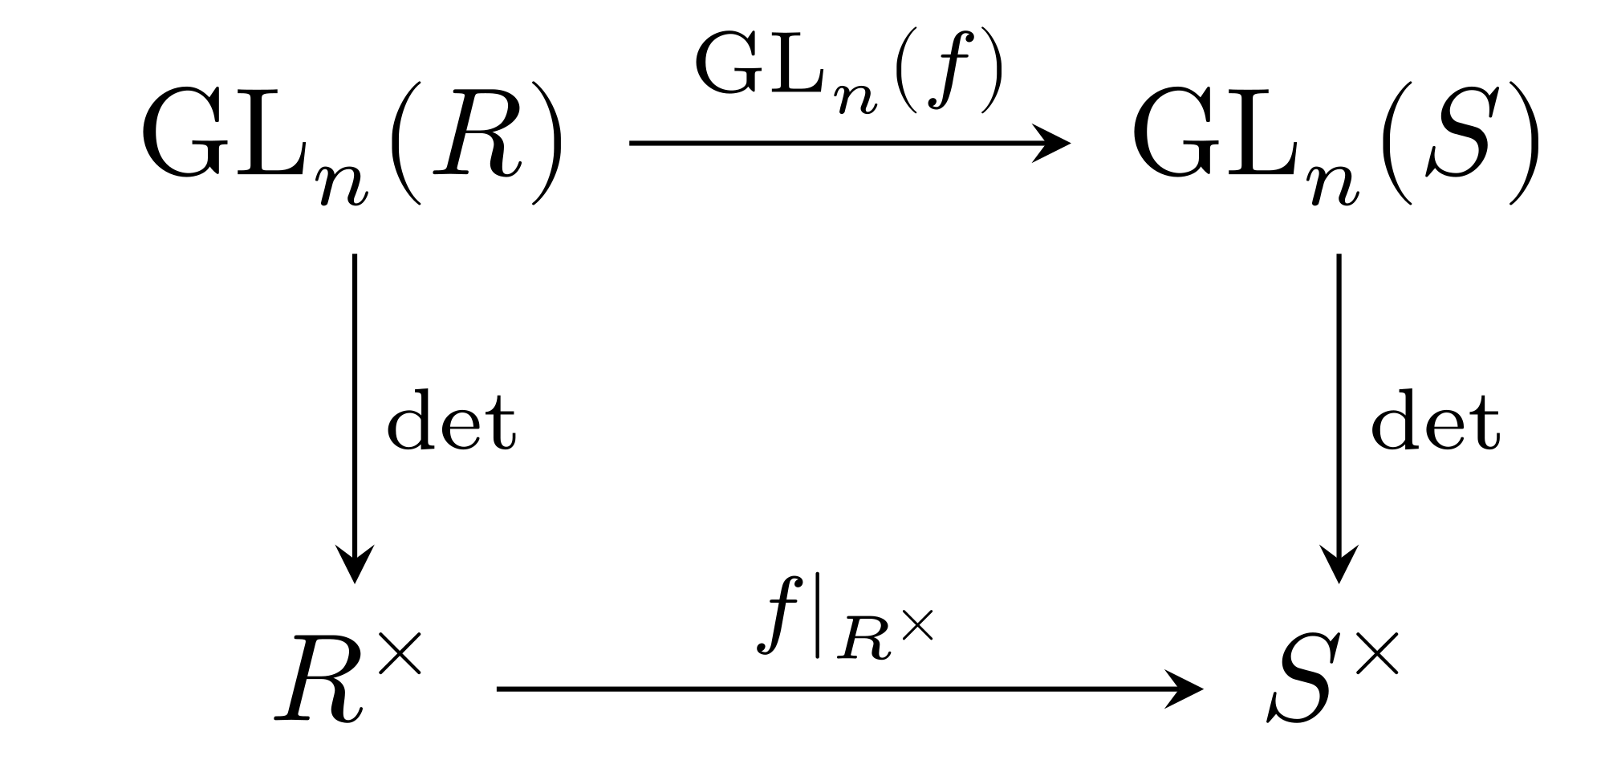
Examples
List => Set
Double Dual <=> Identity
Determinant

Slide 21

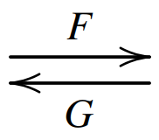


Equivalences of Categories
Inside a set, the right notion of element sameness is equality
It’s not important that two objects are literally the same, if they’re isomorphic --- we say “THE set with five elements”, and “THE complete graph on 3 vertices”
^ for objects of functor categories (functors), this means the right notion of sameness is natural isomorphism
But for categories, even isomorphism is too strict:
Should be

Slide 22


Membership

Slide 23


Vectors
2.114
e
3.45
3.5
7
…

Slide 24


Tensors

Slide 25


Subsets
…

Slide 26
Moral: Even objects, especially infinite ones, can be sometimes better described as maps. These come in two flavors: left (maps into), and right (maps out of).

Slide 27
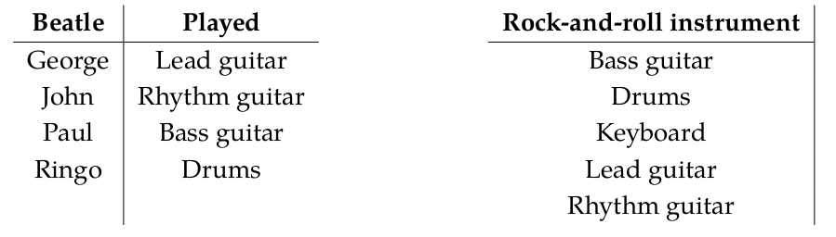
Databases

Slide 28
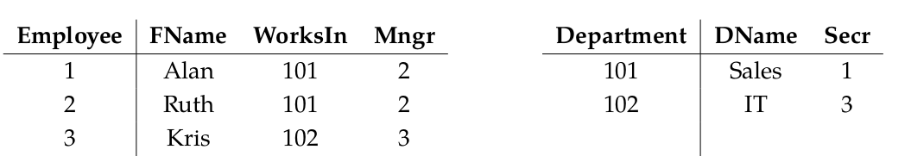

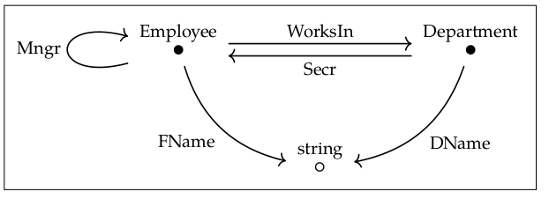

Databases

Slide 29
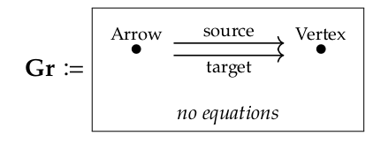
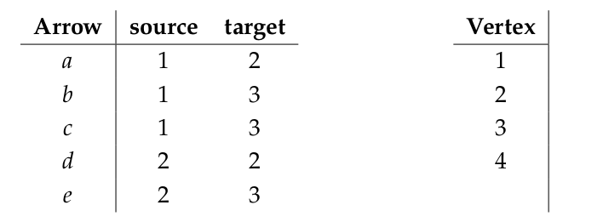
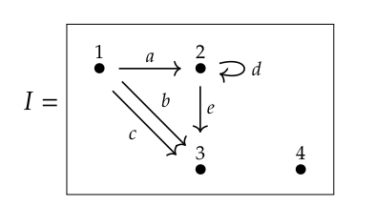
Graphs

Slide 30
Representability, Adjunctions, Limits

Slide 31

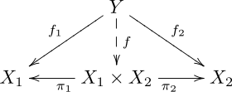
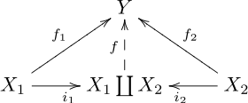
Limit
Colimit

Slide 32

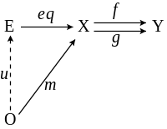
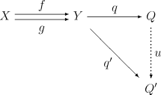
Limit
Colimit

Slide 33
String Diagrams (dual in the plane)

Slide 34
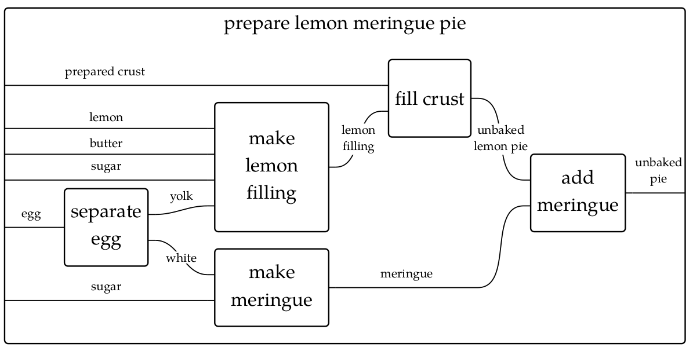

Slide 35
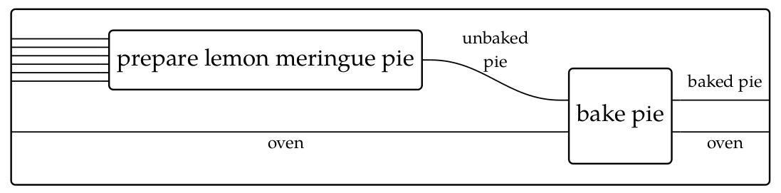

Slide 36
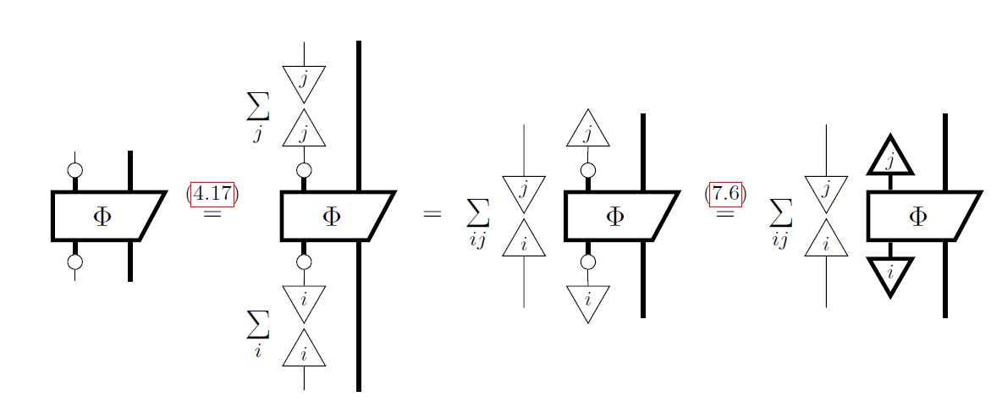

Slide 37
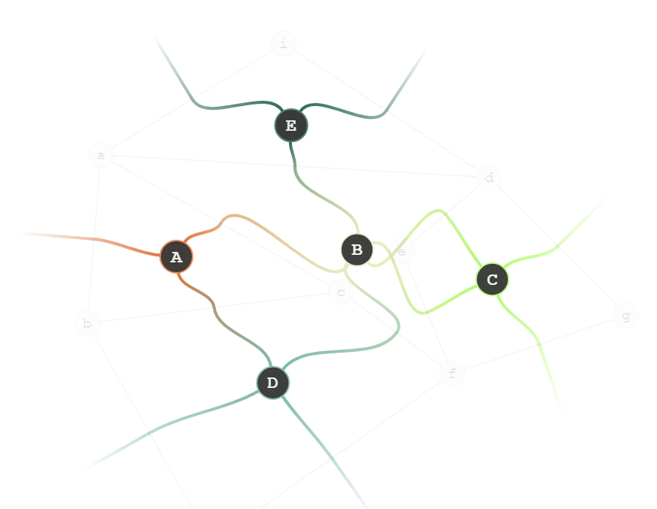
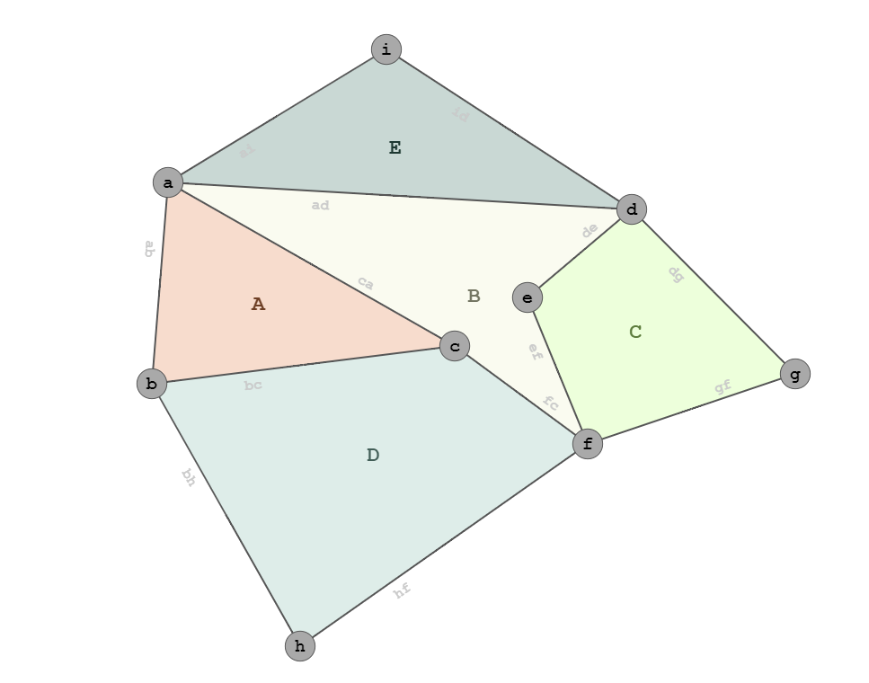
The (Poincare) Dual Diagram

Slide 38
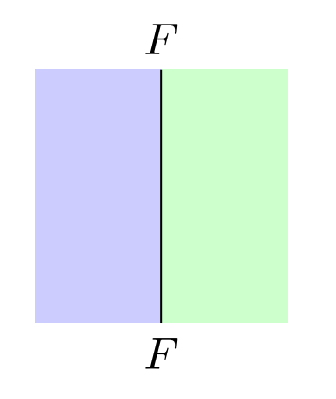


Slide 39
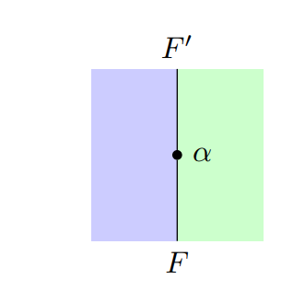


Slide 40
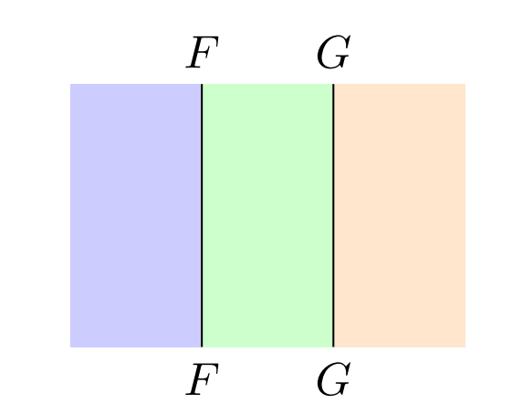


Slide 41
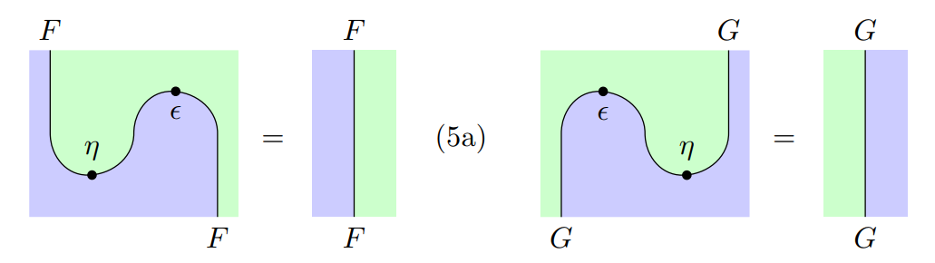
Adjunctions via Snake Equations

Slide 42
Bibliography
Fong, B., & Spivak, D. I. (2018). Seven Sketches in Compositionality: An Invitation to Applied Category Theory. arXiv preprint arXiv:1803.05316.​
Leinster, Tom. Basic category theory. Vol. 143. Cambridge University Press, 2014.​
Coecke, Bob, and Aleks Kissinger. Picturing quantum processes. Cambridge University Press, 2017.​
David I. Spivak. “Database queries and constraints via lifting problems”. In: Mathematical Structures in Computer Science 24.6 (2014), e240602, 55. url: http://dx.doi.org/10.1017/S0960129513000479 (cit. on p. 94).​
David I Spivak. Category theory for the sciences. MIT Press, 2014​
Contributors To nLab. Symmetric monoidal category. 2018. url: https://ncatlab.org/nlab/revision/symmetric+monoidal+category/30​
Selinger, Peter. "A survey of graphical languages for monoidal categories." New structures for physics. Springer, Berlin, Heidelberg, 2010. 289-355.
Fong, B., Spivak, D. I., & Tuyéras, R. (2017). Backprop as Functor: A compositional perspective on supervised learning. arXiv preprint arXiv:1711.10455.

Slide 43
Takeaways
Mathematics has left and right handed versions of stuff. The right-handed things play well together, as do the left-handed things
Every property and theorem (in a 2-category) comes with a dual result, by reversing the arrows.
Diagrams communicate more at once than equations, with equal precision
Many seemingly unrelated things can be phrased in terms of morphisms
Internal structure can be captured by maps into and out of objects
“Level Shifting” abstractions allows

Slide 44
