Slide 1
Mixture Languages
Oliver Richardson and Jialu Bao

Slide 2



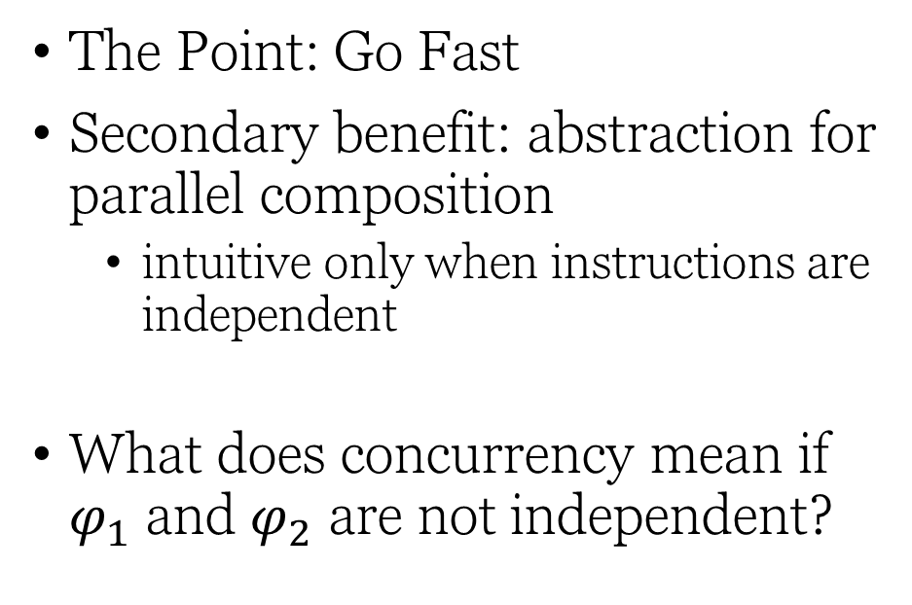






The standard model of concurrency
$$φ_{1};φ_{2}$$
$$φ_{2};φ_{1}$$
$$φ_{1}⊕φ_{2}$$
$$φ_{1}$$
$$φ_{2}$$
$$φ_{2}$$
$$φ_{1}$$
The Point: Go Fast
Secondary benefit: abstraction for parallel composition
intuitive only when instructions are independent
What does concurrency mean if $φ_{1}$ and $φ_{2}$ are not independent?
=
$$φ_{2}$$
$$φ_{1}$$
???
time

Slide 3
A Different, Intuitive Notion of Parallel Composition
Multiple forces in a physics simulation
Multiple players in a game
Multiple data points to learn from
Continuous processes all compose in the same (surprisingly unfamiliar) way…

Slide 4






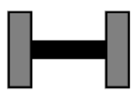




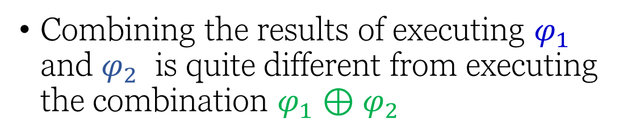


$$φ_{1};φ_{2}$$
$$φ_{1}$$
$$φ_{1}⊕φ_{2}$$
Combining the results of executing $φ_{1}$ and $φ_{2}$ is quite different from executing the combination $φ_{1}⊕φ_{2}$
$$φ_{2}$$
$$φ_{2};φ_{1}$$

Slide 5
A Generic Formal Model
(i.e., a language + operational semantics)
for parallel composition (“mixture”) of continuous processes

Slide 6






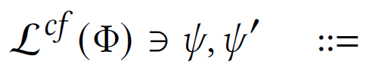
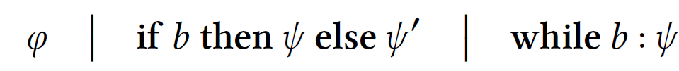

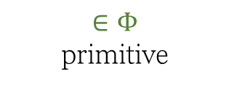
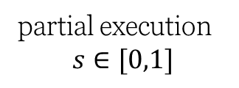

Syntax
set of primitive commands
$$Φ$$
$$Φ$$
$∈Φ$ primitive
partial execution $$s∈[0,1]$$
sequencing
mixture
(extension with control flow)

Slide 7
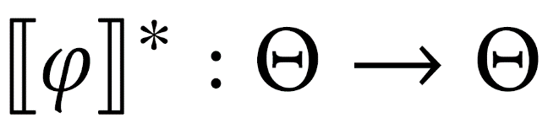
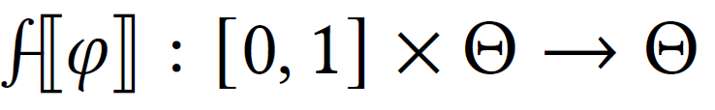


Operational Semantics
$$Θ$$
: set of program states
+ topology
initial
final
State Transformer
Path
initial
Trajectory
$$∞$$
final

Slide 8
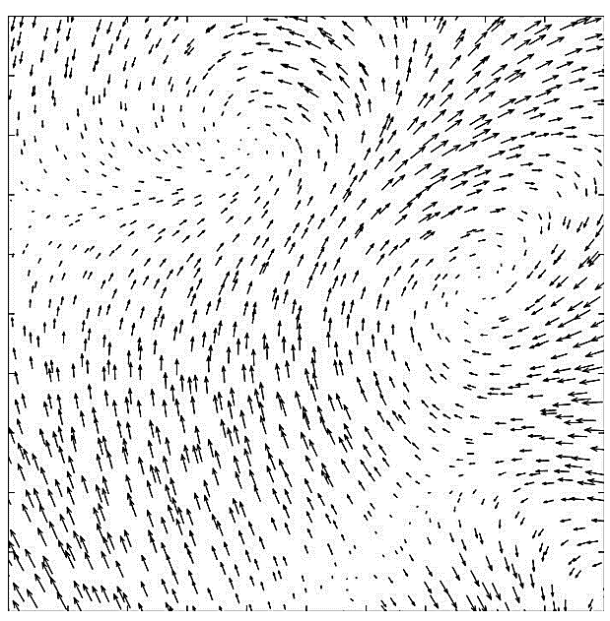

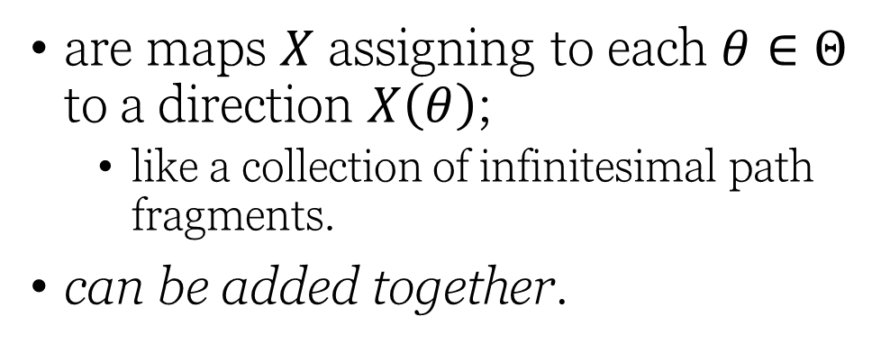
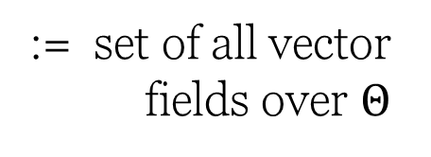
Vector Fields
are maps $X$ assigning to each $θ∈Θ$ to a direction $X\left(θ\right)$;
like a collection of infinitesimal path fragments.
can be added together.
:= set of all vector fields over $Θ$

Slide 9



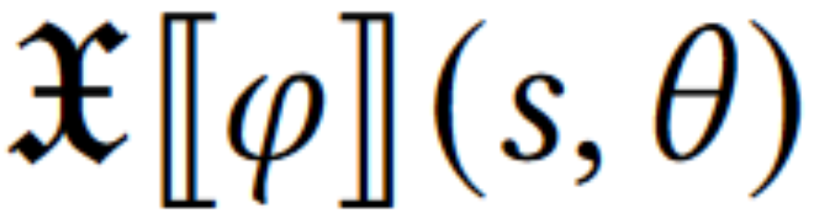




time-dependent
vector field semantics for $φ$
$$∞$$
$$t$$
$$t=0$$
$$t=∞$$

Slide 10
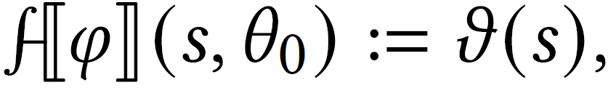
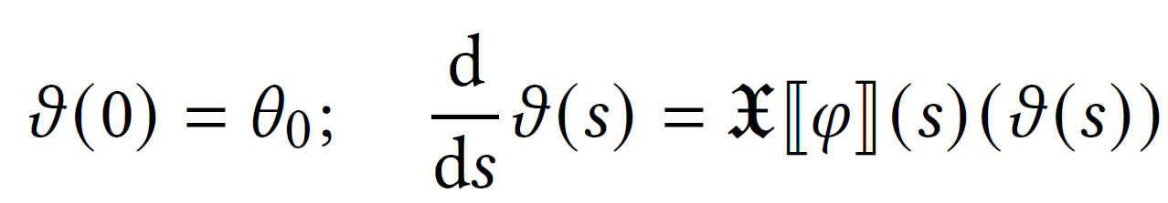
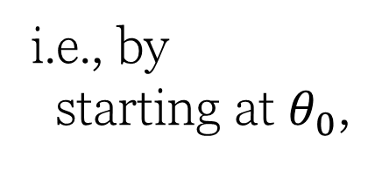
From Vector Fields to Paths
Given vector field, there is a natural path
i.e., by starting at $θ_{0}$,
and following the vector field {when/where}ever you are.

Slide 11
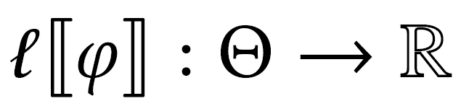

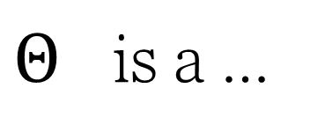
Review: Operational Semantics
$Θ$ is a …
State Transformer
set
+ topology
Path
(time-dependent) Vector Field
+ manifold structure
$$∞$$
Loss Function
+ Riemannian metric

Slide 12









State Transformer
$s←1$ (endpoint)
Trajectory
$$s=1−e^{−t}$$
Path
$$t=− log\left(1−s\right)$$
$∫$ (solve ODE)
$$∫$$
Vector Field
$∇$ (gradient)
Loss Function

Slide 13



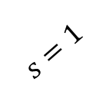


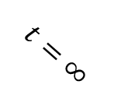
State Transformer
initial
final
$$s=1$$
( select endpoint )
$$t=∞$$
fraction $s$
initial
final
$$s=1−e^{−t}$$
time $t∈[0,∞]$
Path
Trajectory
$$t=− log\left(1−s\right)$$
(s-dependent) Vector Field
(time-dependent) Vector Field
( take gradient )
$$∇$$
Loss Function

Slide 14
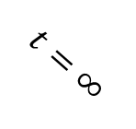
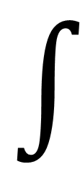

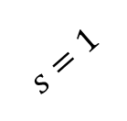




State Transformer
initial
final
$$s=1$$
$$t=∞$$
( select endpoint )
fraction $s$
initial
final
time $t∈[0,∞]$
Trajectory
Path
Given vector field, there is a natural path
$$∫$$
$$∫$$
starting at $θ_{0}$,
following the vector field {when/where}ever you are.
(s-dependent) Vector Field
(time-dependent) Vector Field
( take gradient )
$$∇$$
Loss Function

Slide 15


State Transformer
initial
final
$$s=1$$
( select endpoint )
$$t=∞$$
fraction $s$
initial
final
$$s=1−e^{−t}$$
time $t∈[0,∞]$
Path
Trajectory
$$t=− log\left(1−s\right)$$
( solve ODE )
$$∫$$
$$∫$$
(s-dependent) Vector Field
(time-dependent) Vector Field
( take gradient )
$$∇$$
Loss Function

Slide 16


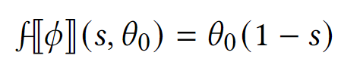

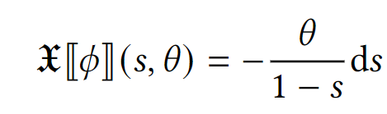

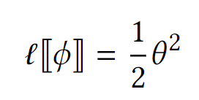




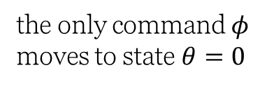

Simple Example:
Path
$$s=1−e^{−t}$$
the only command $φ$ moves to state $θ=0$
$$t=− log\left(1−s\right)$$
Vector Field
$$∫$$
$$∫$$
Loss
$∇$ (gradient)

Slide 17


Inductive Construction over vector fields
State Transformer
initial
final
$$s=1$$
$$t=∞$$
fraction $s$
initial
final
$$s=1−e^{−t}$$
time $t∈[0,∞]$
Path
Trajectory
$$t=− log\left(1−s\right)$$
$$∫$$
$$∫$$
(s-dependent) Vector Field
(time-dependent) Vector Field
$$∇$$
Loss Function

Slide 18
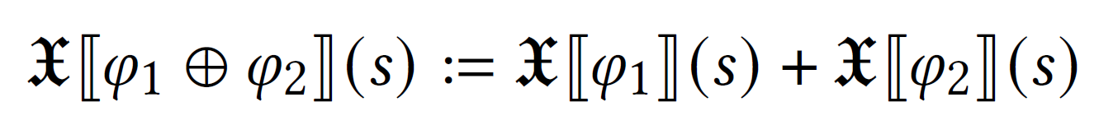
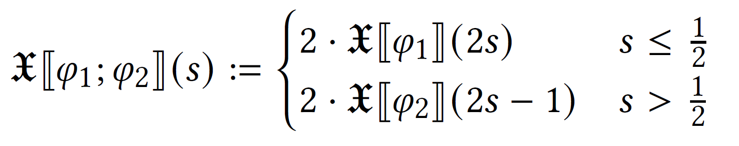








Inductive Construction over vector fields
Parallel composition: add fields
Sequential composition: “twice as fast for half as long”
($φ_{1};φ_{2});φ_{3}$
$$φ_{1}$$
$$φ_{2}$$
$$φ_{3}$$
not associative, but resulting paths are equivalent up to reparameterization (and have identical endpoints):
$$φ_{1}$$
$$φ_{2}$$
$$φ_{3}$$
$φ_{1};(φ_{2};φ_{3})$

Slide 19
Case Study: The Probabilistic Setting

Slide 20




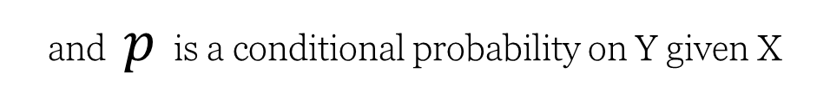

Case Study: Probabilistic Setting
Let be a set of variables.
Primitive Commands:
where
are variables,
and $p$ is a conditional probability on Y given X
State Space
$Θ ≔$ $\{$Joint distributions over $\}$
(with Fisher metric)

Slide 21
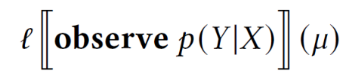
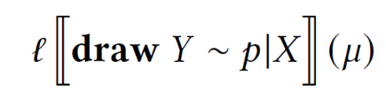
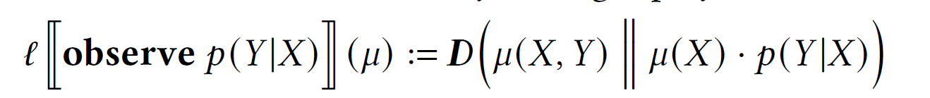
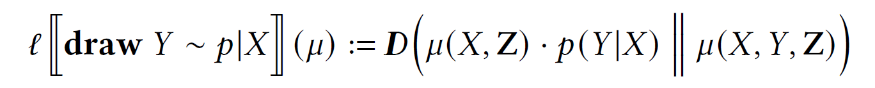
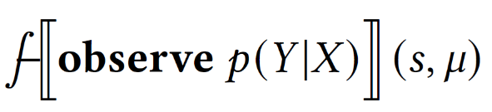
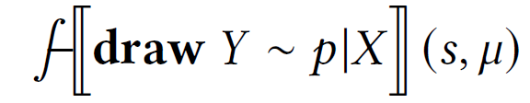
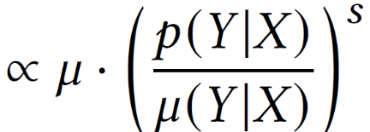
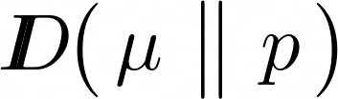
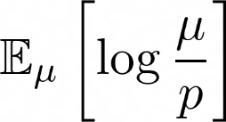

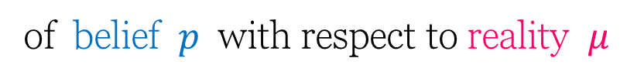
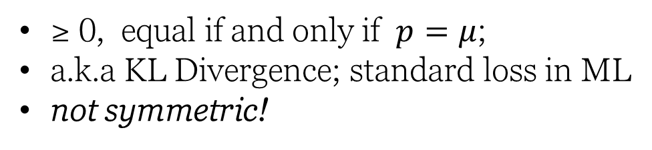
Observe
Draw
p acts as reality
p acts as belief
Loss Semantics
…
…
Relative Entropy
Path Semantics
of belief $p$ with respect to reality $μ$
=
≥ 0, equal if and only if $p=μ$;
a.k.a KL Divergence; standard loss in ML
not symmetric!
additive interpolation
multiplicative interpolation

Slide 22
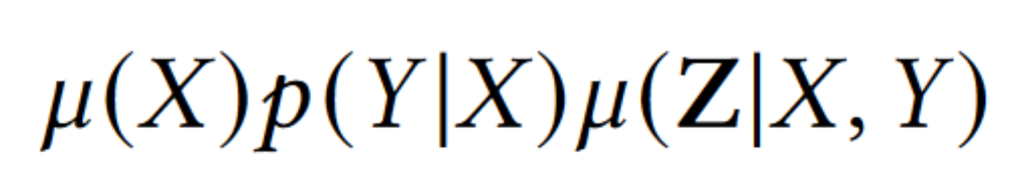
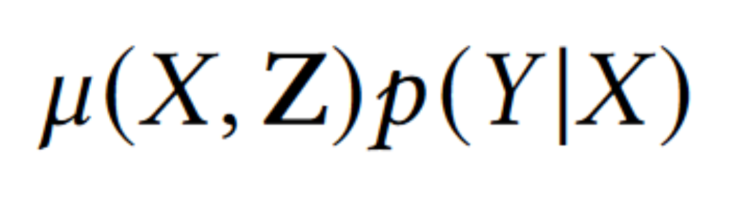
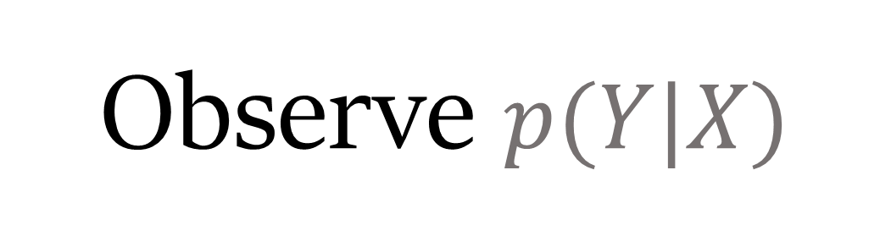

Observe $p(Y|X)$
Draw $y∼p | X$
Loss
p acts as reality
p acts as belief
…
…
Path
additive interpolation
multiplicative interpolation
Endpoint
replace conditional distribution $μ\left(Y | X\right)$ with $p(Y|X)$
re-sample Y given X, leaving Z alone

Slide 23
Observe
Draw
p acts as reality
p acts as belief
Probabilistic Dependency Graphs ^{[1]}
(and hence Bayesian Networks and Factor Graphs) are mixtures of observe commands!
Probabilistic programs are sequences of draw commands (and deterministic observe commands).

Slide 24
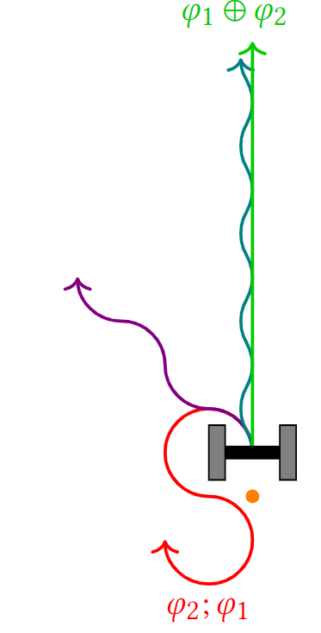
Summary
By giving programs continuous-time semantics, gain two closely related abilities: mixture and partial execution
(and so even discrete programs can benefit from such a continuous semantics)
Open questions
denotational semantics? (+distributive law?)
how deep is observe/draw duality?

