Slide 1




Learning with Confidence
$$χ$$
$$φ$$
Oliver Richardson Uncertainty in Artificial Intelligence (UAI) 2025

Slide 2
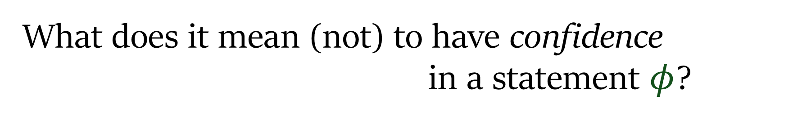
What does it mean (not) to have confidence in a statement $φ$?
Two interpretations:
How likely do I find it?
DEGREE OF BELIEF
How much should it influence my beliefs?
DEGREE OF TRUST

Slide 3



DEGREE OF TRUST
low
high
low
Irrelevant Garbage
The Credible Challenge
DEGREE OF BELIEF
Even a Broken Clock…
Authoritative Corroboration
high

Slide 4



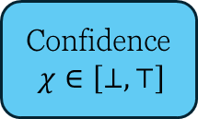



DEGREE OF TRUST
Confidence $χ∈\left[⊥, ⊤\right]$
Observation
$$φ$$
DEGREE OF BELIEF
Prior
Belief
$$Θ$$
Lrn
Posterior
Belief
$$Θ$$
Proposition
$$φ$$
Bel
Confidence $χ∈\left[⊥, ⊤\right]$
Belief State
$$θ$$

Slide 5





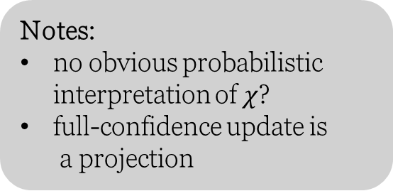
A Simple Example
: Linear Interpolation
belief states
are probability measures;
Notes:
no obvious probabilistic interpretation of $χ$?
full-confidence update is a projection
statements
are events;
confidence
in the unit interval;
ignore @ no confidence
fully incorporate @ full confidence

Slide 6
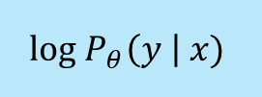

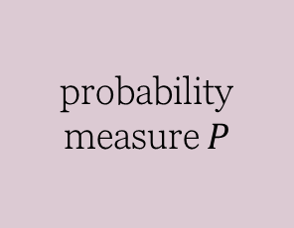
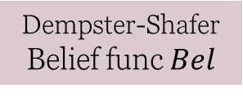

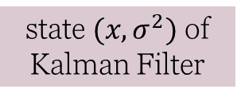

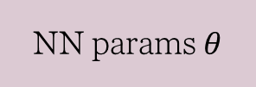

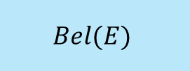

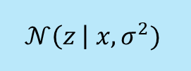

Unifying Existing Concepts
Learner’s Confidence (trust)
degree of belief in the statement
Prior Belief State
$$θ$$
Statement
$$φ$$
Posterior Belief State
$$Lrn(φ,χ,θ)$$
prior belief state
statement
belief state (posterior)
$χ∈\left[⊥, ⊤\right]$
$$χ∈\left[⊥, ⊤\right]$$
P(E)
probability measure $P$
event $E$
(full confidence)
conditioned measure
P(E)
interpolation
partially conditioned measure
$$log P_{θ}\left(y \right| x)$$
NN params$θ$
example (x,y)
learning rate; number of epochs
trained model
$$𝒩\left(z \right| x, σ^{2})$$
state $(x,σ^{2})$ of Kalman Filter
sensor reading z
Kalman Gain
tracked position
$$Bel(E)$$
Dempster-Shafer Belief func $Bel$
event E
weight of evidence
combined evidence
…
…
…
…
…

Slide 7












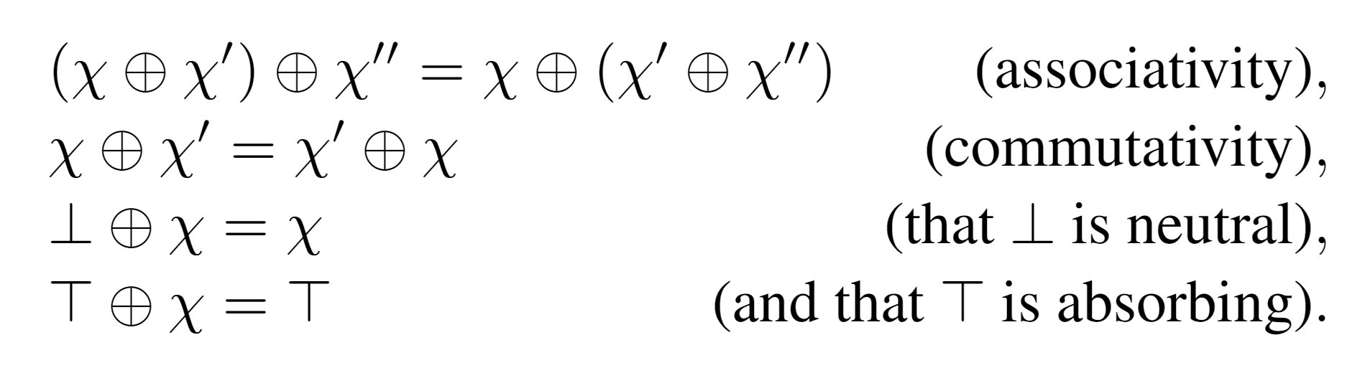
Confidence Domain
preorder
no confidence
geometry (topology, diffble structure on D)
full confidence
independent combination

Slide 8

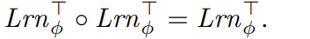

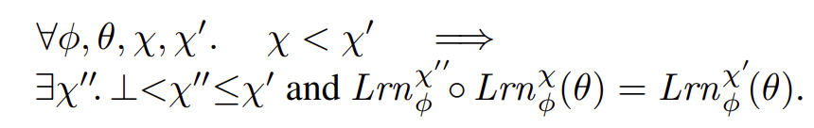
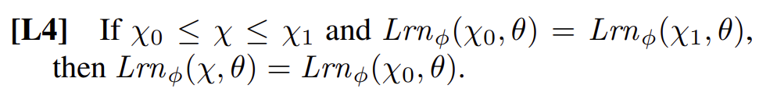











Axioms for Confidence
[L1]
no confidence
[FC]
full confidence
Confidence $χ∈\left[⊥, ⊤\right]$
[L2]
continuity
is continuous, twice diffble
[L3]
$$φ$$
$$Lrn_{φ}$$
Prior
Belief
$$Θ$$
Posterior
Belief
$$Θ$$
residuals
[L4]
acyclic
$$θ_{0}$$
$$θ_{f}$$
$$Lrn_{φ}(θ_{0},χ)$$
[L5]
combinative
$$χ= ⊥$$
$$χ=⊤$$

Slide 9




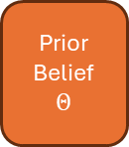


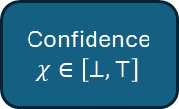


no confidence
geometry (topology, diffble structure on D)
full confidence
An action of the confidence domain
[L1]
no confidence
[FC]
full confidence
[L2]
continuity
is continuous, twice diffble
Confidence $χ∈\left[⊥, ⊤\right]$
[L3]
residuals
$$φ$$
$$Lrn_{φ}$$
Prior
Belief
$$Θ$$
Posterior
Belief
$$Θ$$
[L4]
acyclic
[L5]
$$θ_{0}$$
$$θ_{f}$$
combinative
$$Lrn_{φ}(θ_{0},χ)$$
$$χ= ⊥$$
$$χ=⊤$$

Slide 10
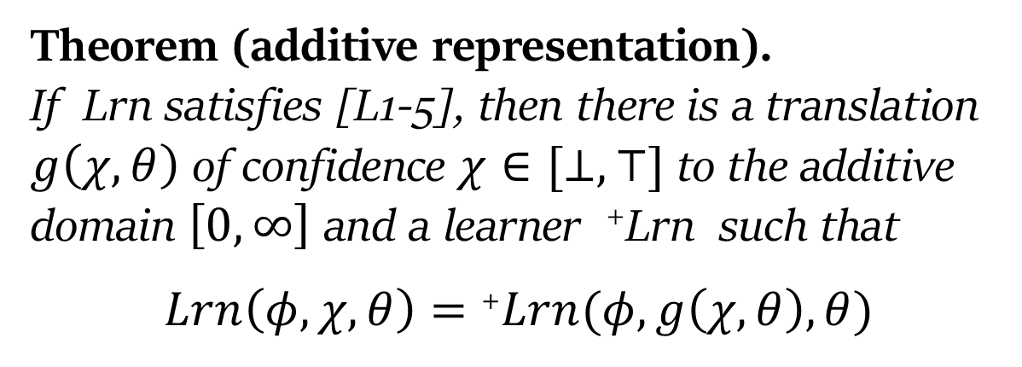
Canonical Representations of Confidence
Theorem (additive representation). If Lrn satisfies [L1-5], then there is a translation $g\left(χ,θ\right)$ of confidence $χ∈[⊥,⊤]$ to the additive domain $\left[0,∞\right]$ and a learner ⁺Lrn such that
$$Lrn\left(φ, χ,θ\right)=\text{+}Lrn(φ, g\left(χ,θ\right), θ)$$
This “flow form” implies a vector field representations of learners which can be very useful;

Slide 11
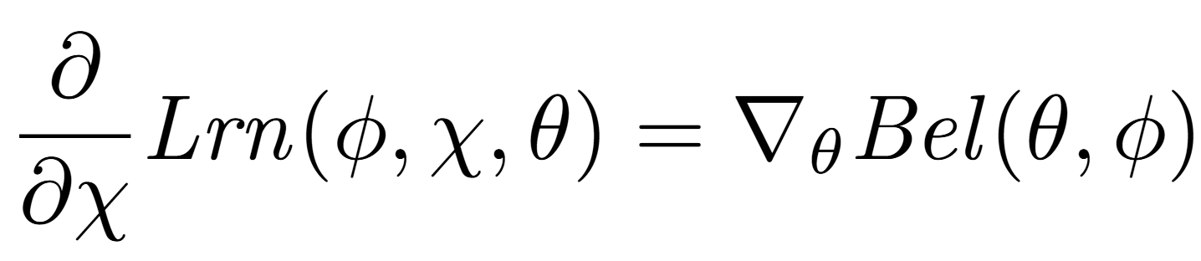
Optimizing Learners
[LB4]
Gradient flow (idealized training)
learning is about locally increasing belief, i.e., gradient descent to minimize loss.
linear interpolation
Probabilistic Dependency Graphs (PDGs)
Some examples using relative entropy and log probability:
Jeffrey’s Rule (full-confidence)

Slide 12
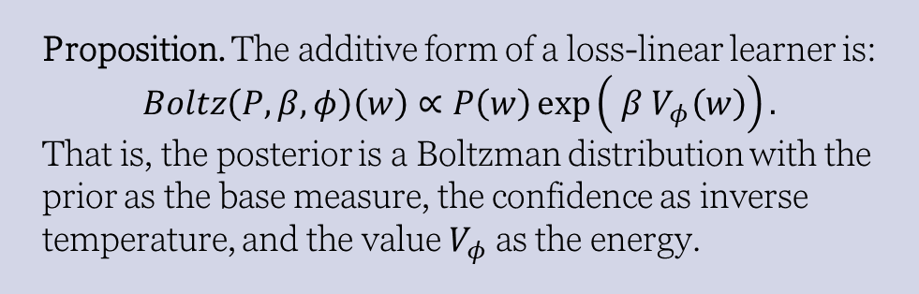
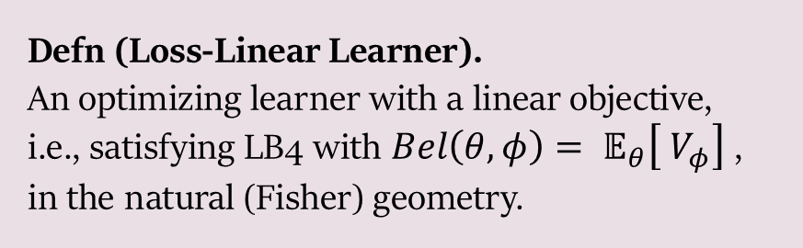
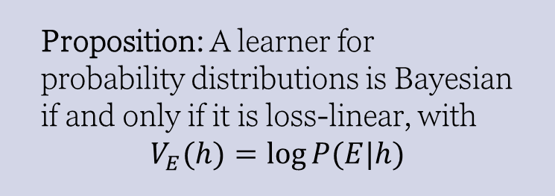
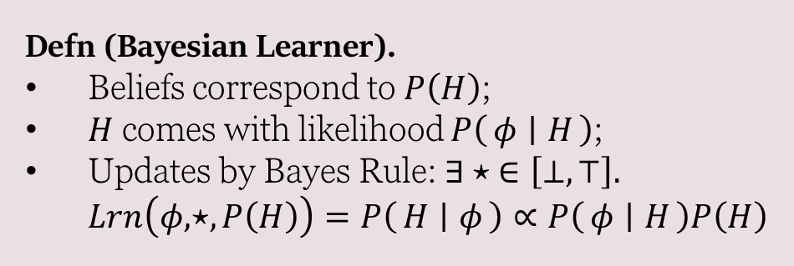
What about when learning objective is linear?
Defn (Bayesian Learner).
Beliefs correspond to $P\left(H\right)$;
$H$ comes with likelihood $P\left(φ ∣ H\right)$;
Updates by Bayes Rule: $∃⋆ ∈\left[⊥,⊤\right].$ $Lrn\left(φ, ⋆,P\left(H\right)\right)=P\left(H ∣ φ\right)∝P\left(φ ∣ H\right)P\left(H\right)$
Defn (Loss-Linear Learner). An optimizing learner with a linear objective, i.e., satisfying LB4 with $Bel\left(θ,φ\right)= 𝔼_{θ}\left[ V_{φ}\right]$, in the natural (Fisher) geometry.
Proposition: A learner for probability distributions is Bayesian if and only if it is loss-linear, with $$V_{E}(h)=\log{P(E|h)}$$
Proposition. The additive form of a loss-linear learner is: $$Boltz\left(P, β, φ\right)\left(w\right)∝P\left(w\right)\exp\left( β V_{φ}\left(w\right)\right).$$
That is, the posterior is a Boltzman distribution with the prior as the base measure, the confidence as inverse temperature, and the value $V_{φ}$ as the energy.

Slide 13
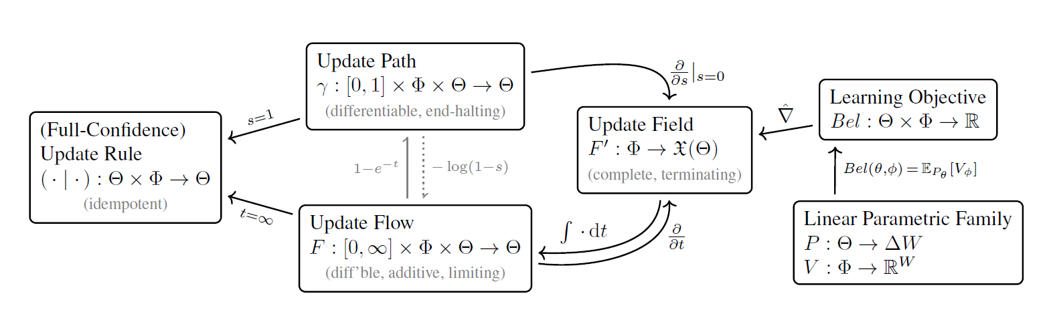

Representations of Confidence-based Learners
Update Rules
Learners on a confidence continuum
Optimizing Learners
“Bayesian” Learners

Slide 14

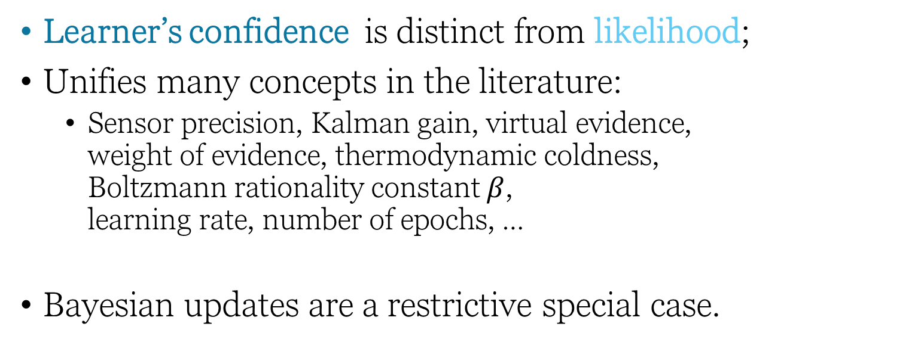
Conclusion
If certainty is about black and white, then probability is about shades of gray, learner’s confidence is about transparency.
Learner’s confidence is distinct from likelihood;
Unifies many concepts in the literature:
Sensor precision, Kalman gain, virtual evidence, weight of evidence, thermodynamic coldness, Boltzmann rationality constant $β$, learning rate, number of epochs, …
Bayesian updates are a restrictive special case.

Slide 16








Axioms for Confidence
no confidence $⇒$ no update
[L1]
[FC]
full confidence $⇒$ projection
continuous & differentiable
[L2]
differentiable wherever continuous
smoothness
[L3]
order and residuals
[L4]
learning is acyclic
$$θ_{0}$$
$$θ_{1}$$
$$Lrn_{φ}(θ_{0},χ)$$
Independent combination
[L5]
$$χ= ⊥$$
$$χ=⊤$$

Slide 17




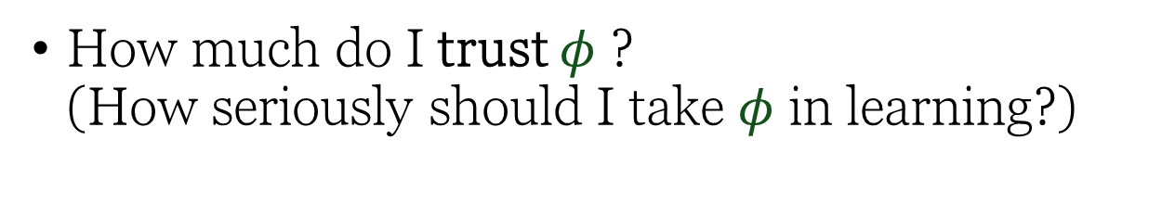
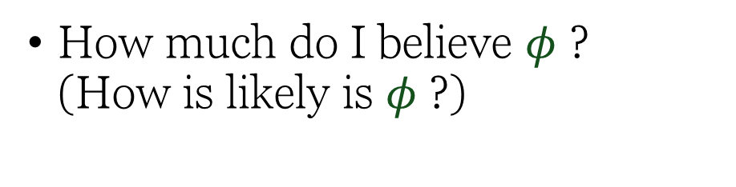
What does it mean to have confidence in $φ$?
$φ$ : sentence about the world
Observation $$φ$$
How much do I believe $φ$ ? (How is likely is $φ$ ?)
Observation
$$φ$$
How much do I trust $φ$ ? (How seriously should I take $φ$ in learning?)

Slide 18
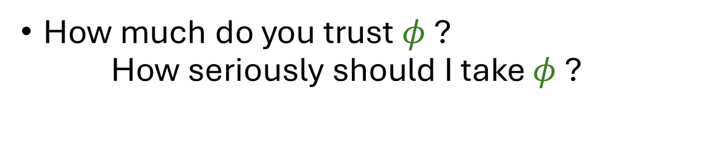



I happen to believe this but I don’t trust you
I told you so
How much do you believe $φ$ ? How is likely is $φ$ ?
$$φ$$
False
Time to Learn …
How much do you trust $φ$ ? How seriously should I take $φ$ ?
$$φ$$

Slide 19


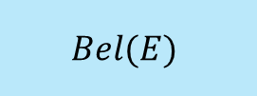
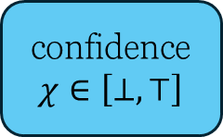
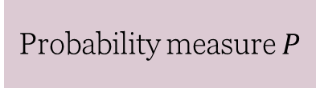
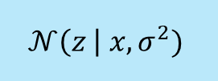
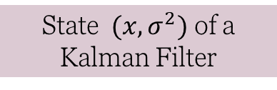
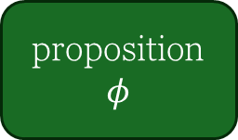
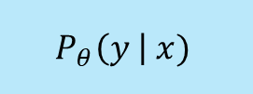

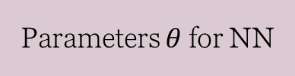
Confidence as degree of belief
proposition
$$φ$$
Bel
Belief State
$$Θ$$
confidence $χ∈\left[⊥, ⊤\right]$
1.
Probability measure $P$
Event $E$
P(E)
Examples:
2.
Parameters $θ$for NN
training example (x,y)
$$P_{θ}\left(y \right| x)$$
3.
State $(x,σ^{2})$ of a Kalman Filter
measurement z
$$𝒩\left(z \right| x, σ^{2})$$
4.
Dempster-Shafer Belief fn
Event E
$$Bel(E)$$
…
…
…

Slide 20

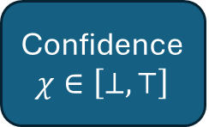
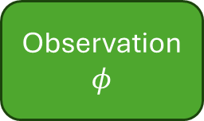

Confidence as trust (an input)
Confidence $χ∈\left[⊥, ⊤\right]$
Observation
$$φ$$
Lrn
Posterior
Belief
$$Θ$$
Prior
Belief
$$Θ$$

Slide 21
Confidence $χ∈\left[⊥, ⊤\right]$
Observation
$$φ$$
Lrn
Prior
Belief
$$Θ$$
Posterior
Belief
$$Θ$$

Slide 22




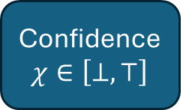





[L1]
Confidence $χ∈\left[⊥, ⊤\right]$
no confidence
[FC]
full confidence
$$φ$$
$$Lrn_{φ}$$
Prior
Belief
$$Θ$$
Posterior
Belief
$$Θ$$
$$θ_{0}$$
$$θ_{1}$$
$$Lrn_{φ}(θ_{0},χ)$$
$$χ= ⊥$$
$$χ=⊤$$

Slide 23

Confidence Domain
Confidence $χ∈\left[⊥, ⊤\right]$
preorder
no confidence
geometry (topology, diffble structure on D)
full confidence
independent combination

Slide 24
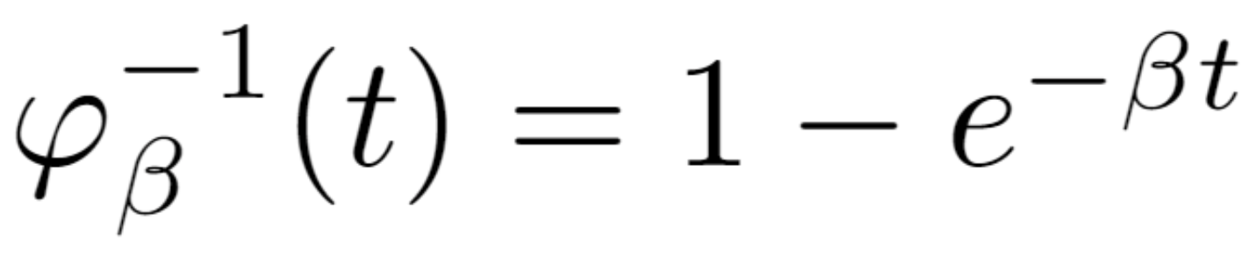
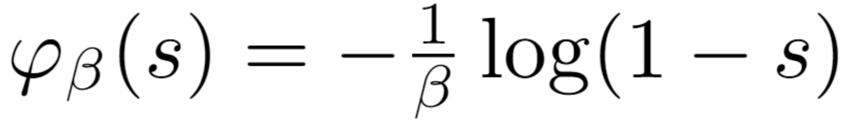




Standard Confidence Domains
$$[0,1]$$
Proposition (Tempering). These domains are isomorphic, and with isomorphisms naturally in correspondence with $β∈(0,∞)$
$$[0,∞]$$

Slide 25

[L1]
Confidence $χ∈\left[⊥, ⊤\right]$
no confidence
[FC]
full confidence
[L2]
continuity
is continuous, twice diffble
$$φ$$
$$Lrn_{φ}$$
Prior
Belief
$$Θ$$
Posterior
Belief
$$Θ$$
[L3]
residuals
[L4]
acyclic
$$θ_{0}$$
$$θ_{f}$$
$$Lrn_{φ}(θ_{0},χ)$$
[L5]
combinative
$$χ= ⊥$$
$$χ=⊤$$

Slide 26

no confidence
geometry (topology, diffble structure on D)
full confidence
An action of the confidence domain
[L1]
no confidence
[FC]
full confidence
[L2]
continuity
is continuous, twice diffble
Confidence $χ∈\left[⊥, ⊤\right]$
[L3]
residuals
$$φ$$
$$Lrn_{φ}$$
Prior
Belief
$$Θ$$
Posterior
Belief
$$Θ$$
[L4]
acyclic
[L5]
$$θ_{0}$$
$$θ_{f}$$
combinative
$$Lrn_{φ}(θ_{0},χ)$$
$$χ= ⊥$$
$$χ=⊤$$
on belief state $θ$

Slide 27
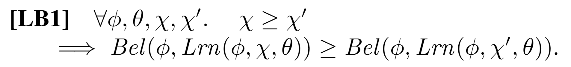

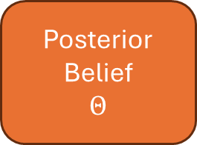
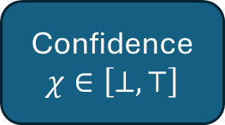



Confidence $χ∈\left[⊥, ⊤\right]$
Observation
$$φ$$
Bel
Prior
Belief
$$Θ$$
Lrn
Posterior
Belief
$$Θ$$
Belief State
$$Θ$$

Slide 28


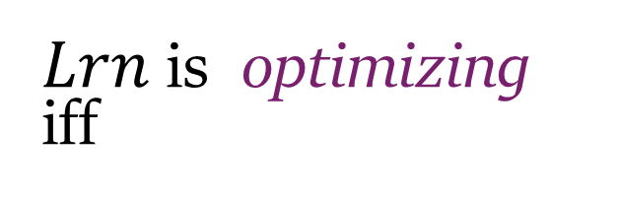
Theorem (Additive Representation). If $\left[⊥,⊤\right]$ is a continuum and Lrn satisfies [L1-5], then Lrn can be translated to use the additive domain $\left[0,∞\right].$
can view $Lrn_{φ}$ as a vector field.
many vector fields of interest come from taking the gradient of a potential…
$Lrn$ is optimizing iff
[LB4]

Slide 29
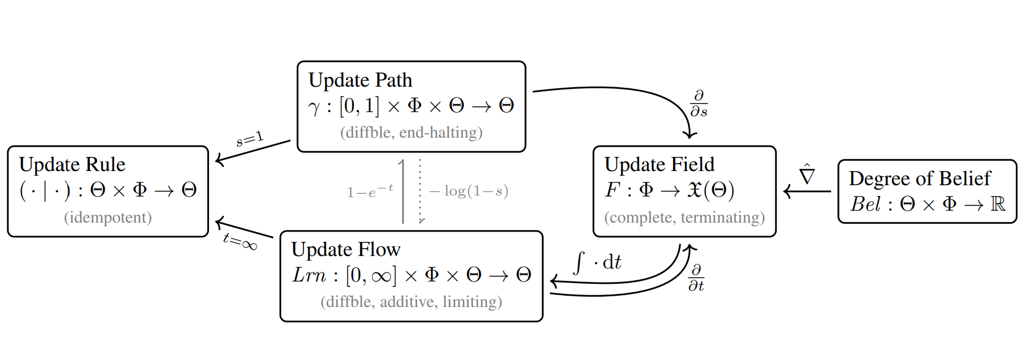
Representations of Optimizing Learners

Slide 30
Concave (“splitters”)
Convex (“lumpers”)
Linear Bayesian updates = Boltzman updates
KL Divergence (Relative Entropy)?

Slide 31
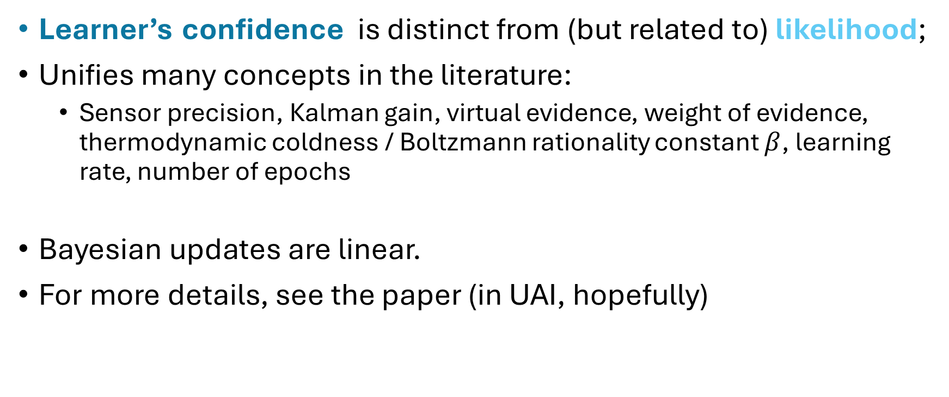
Summary
Learner’s confidence is distinct from (but related to) likelihood;
Unifies many concepts in the literature:
Sensor precision, Kalman gain, virtual evidence, weight of evidence, thermodynamic coldness / Boltzmann rationality constant $β$, learning rate, number of epochs
Bayesian updates are linear.
For more details, see the paper (in UAI, hopefully)

