Slide 1


Qualitative Mechanism Independence
Oliver Richardson, Spencer Peters, and Joseph Halpern
describe qualitative aspects of probability such as (conditional) (in)dependence
with (directed) hypergraphs whose arcs represent independent mechanisms.
U
X
V
Y
Z
W

Slide 2


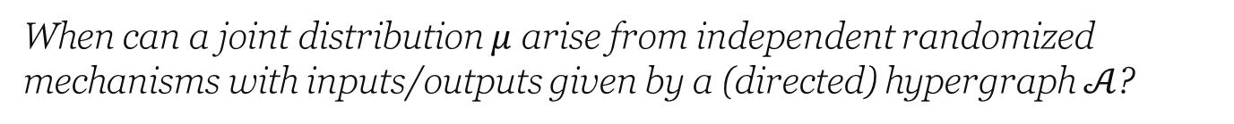

Examples:
X
Z
X and Y are independent
Y
X
Y
What does this mean:
?
X and Y are conditionally independent given Z
X
Z
Y
Z
and Z is a function of X
X is constant (i.e., X and X are independent)
X
When can a joint distribution $μ$ arise from independent randomized mechanisms with inputs/outputs given by a (directed) hypergraph $𝒜$?

Slide 3
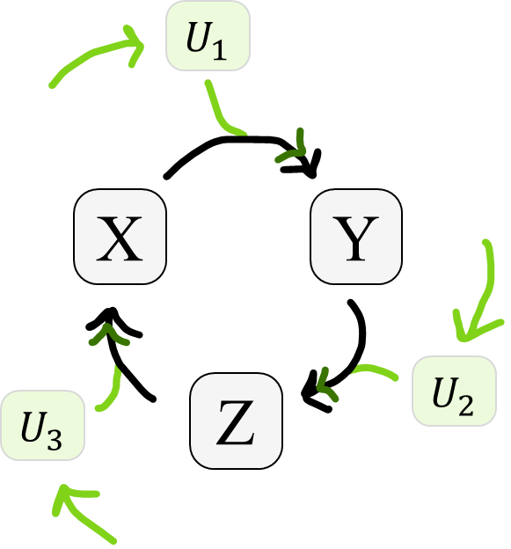




















Defn. Joint distribution (QIM-)compatible with hypergraph
$$U_{1}$$
X
Y
means
extension (“witness”)
to mutually independent variables
such that, arcs ,
determine targets
.
Z
$$U_{2}$$
and sources
$$U_{3}$$
Generalizes independencies of Bayesian Networks
Captures arbitrary functional dependencies
Gives meaning to cyclic and over-constrained models
Causality
Information Theory
QIM

Slide 4

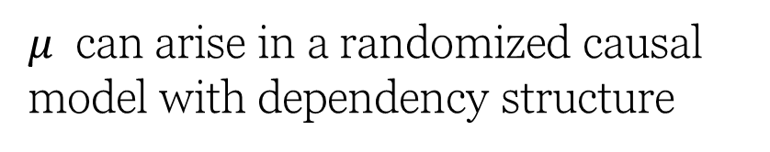
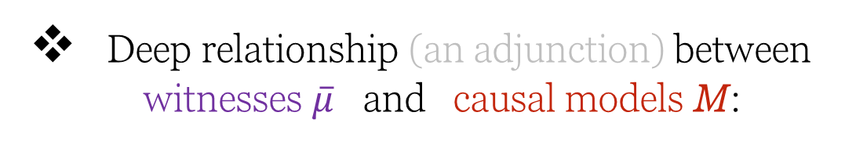
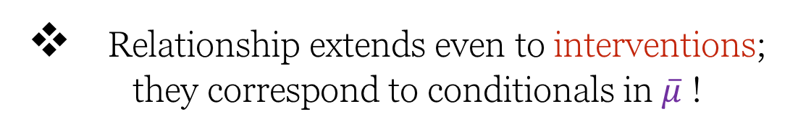
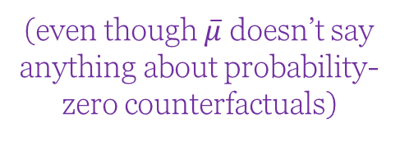
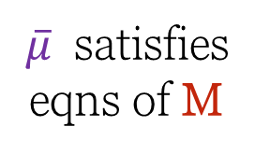
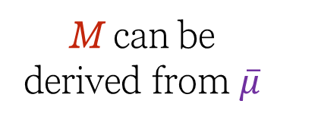
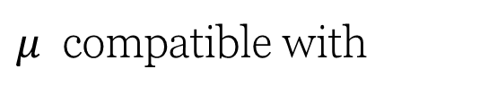
Causality
$μ$ can arise in a randomized causal model with dependency structure
$μ$ compatible with
Deep relationship (an adjunction) between witnesses $\overline{μ}$ and causal models M:
(even though $\overline{μ}$ doesn’t say anything about probability-zero counterfactuals)
(even though M doesn’t specify choice between fixed points)
M can be derived from $\overline{μ}$
$\overline{μ}$ satisfies eqns of M
Relationship extends even to interventions; they correspond to conditionals in $\overline{μ}$ !

Slide 5
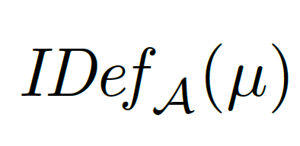
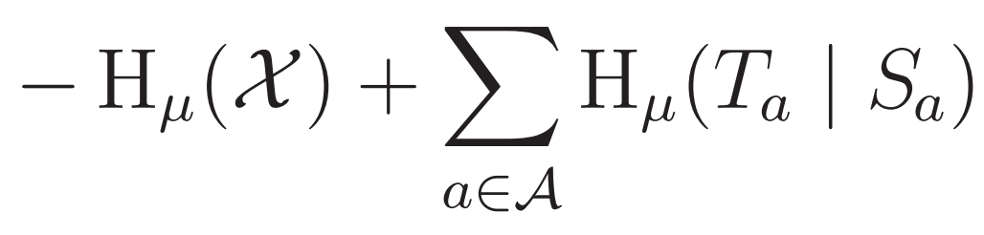

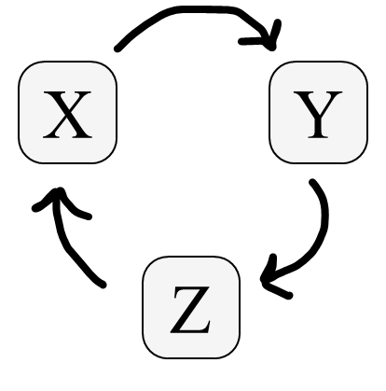

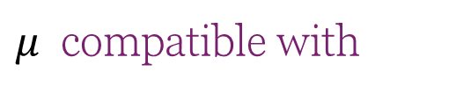








Information Theory
$μ$ compatible with
$$≤0$$
A deep information-theoretic consequence of arbitrary structures;
Generalizes independence property of BNs
Y
X
Captures functional dependence properties
$$H\left(X\right|Y,Z)$$
$$I(X;Y|Z)$$
$$H\left(Y\right|X,Z)$$
Application to the 3-cycle
resolves longstanding confusion about interaction information
$$I(X;Y;Z)$$
$$I(X;Z|Y)$$
$$I(Z;Y|X)$$
$$H\left(Z\right|X,Y)$$
Z
more in the paper!

Slide 6
Causality
Information Theory
QIM

