Slide 1

Learning, Inference, and the Pursuit of Consistency
Oliver Richardson,
Joe Halpern

Slide 2

Equally important, but vaguer
A critical part of machine learning; involves selecting task and training data.
Related to alignment
What does it mean to choose a “good” objective?
Define objective
Optimize objective
The focus of most learning and optimization algorithms
Consistency is a natural objective in every situation. ... but it only makes sense in contexts where we can model inconsistency….

Slide 3
Probabilistic Dependency Graphs
(PDGs)

Slide 4
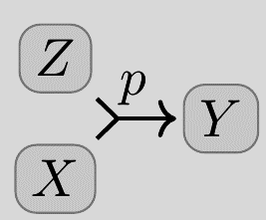
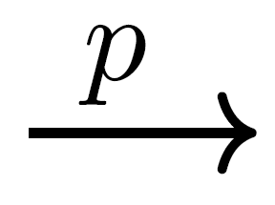
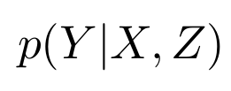

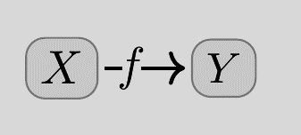
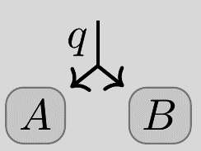
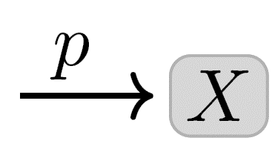


conditional probability distributions (cpds)
attach to arcs, not to variables!

Slide 5
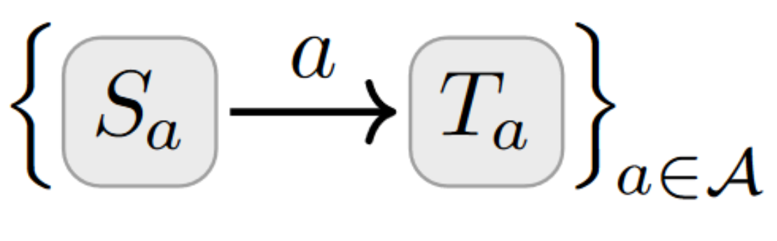

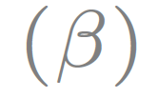
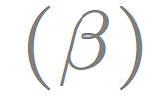
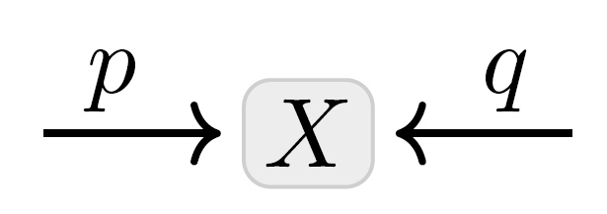
Probabilistic Dependency Graphs (PDGs)
weighted by confidence
weighted by confidence
In brief: a collection of cpds
β = 0 “no confidence”
β = ∞ “absolute confidence”
β = 1 default
can model multiple beliefs about the same variable

Slide 6
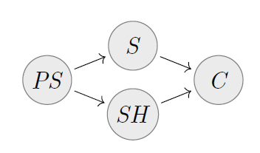
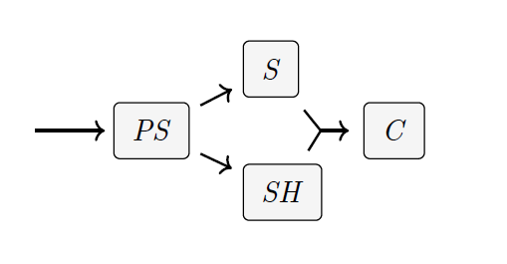
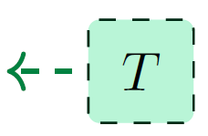
PDGs as Bayesian Networks (BNs)
BN
PDG
can model multiple beliefs about the same variable

Slide 7
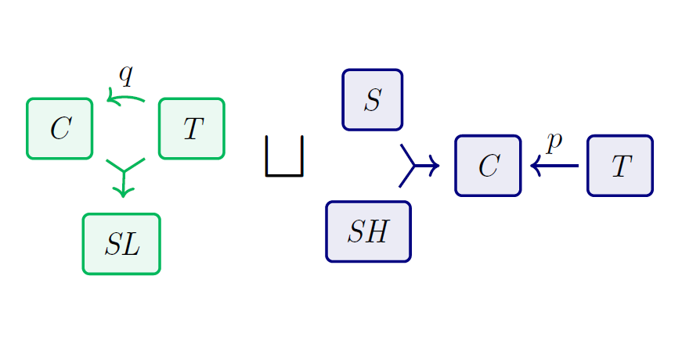
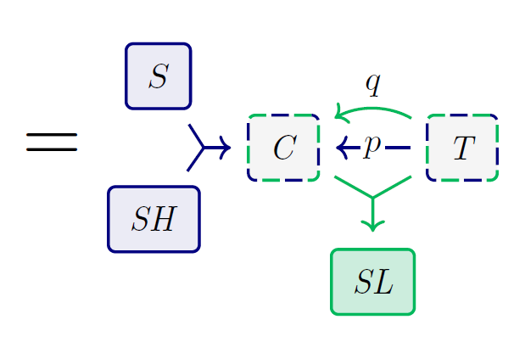
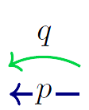
PDGs are particularly modular.
+
Combine independent PDGs by taking disjoint union of arcs, union of variables

Slide 8
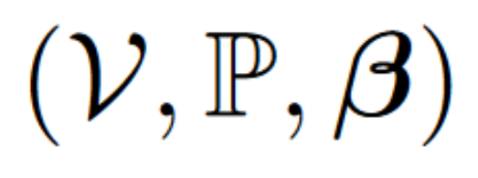

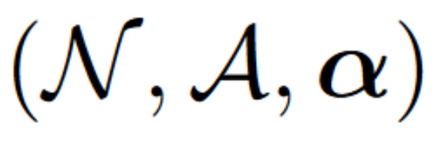
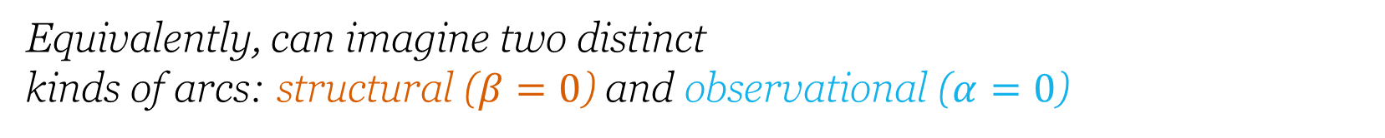
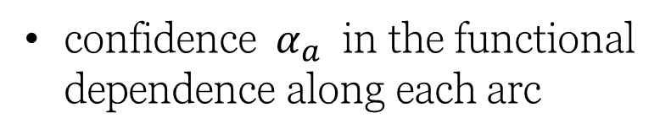
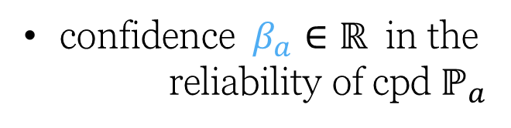
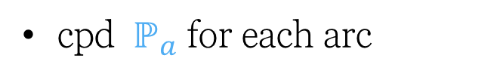
Probabilistic Dependency Graph: Definition
Probabilistic Dependency Graph: Definition
Probabilistic Dependency Graph: Definition
Structural Info
Observational Info
set of values for each node
set of nodes
set of directed (hyper)arcs
cpd $ℙ_{a}$ for each arc
confidence $α_{a}$ in the functional dependence along each arc
confidence $β_{a}∈ℝ$ in the reliability of cpd $ℙ_{a}$
Equivalently, can imagine two distinct kinds of arcs: structural ($β=0$) and observational ($α=0$)

Slide 9





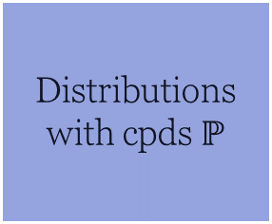
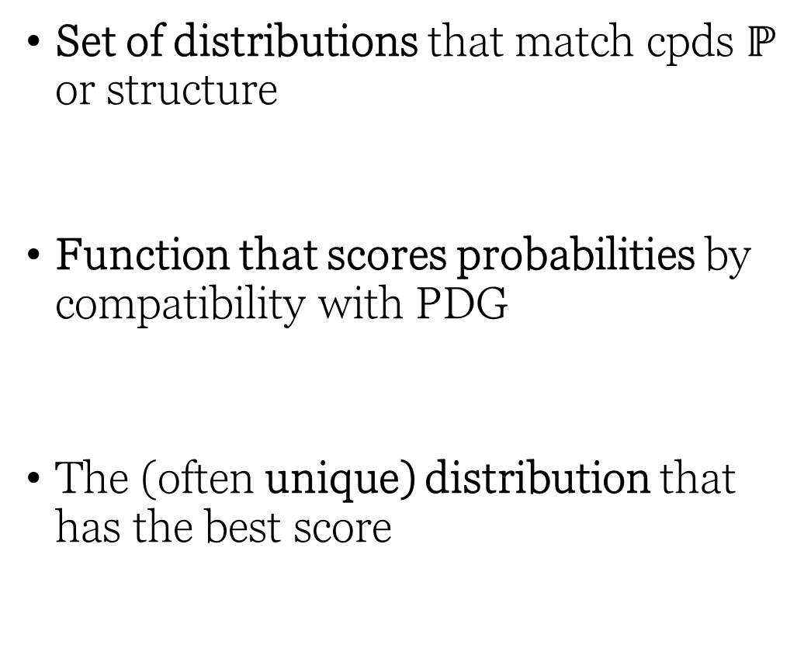

PDG Semantics
Joint probability Δistribution
over all 𝒱ariables
Set of distributions that match cpds $ℙ$ or structure
Function that scores probabilities by compatibility with PDG
The (often unique) distribution that has the best score
Distributions with cpds $ℙ$
Matches $A$

Slide 10
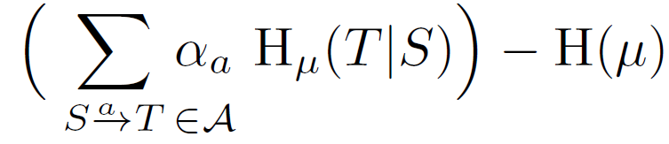
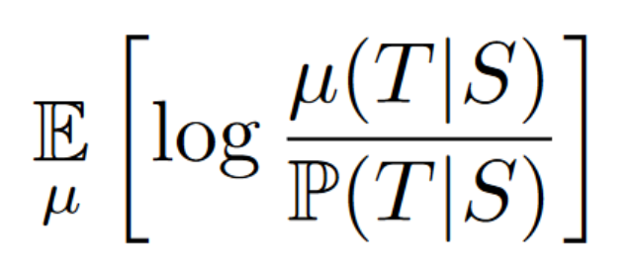
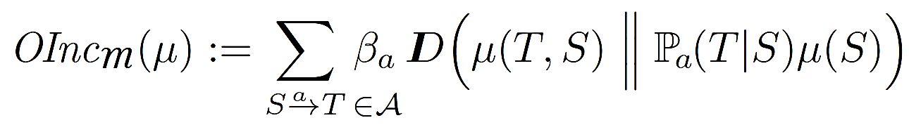
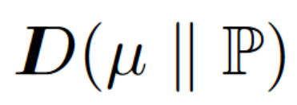
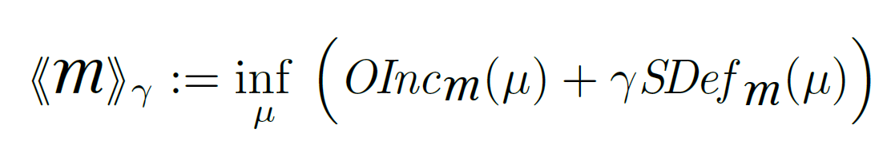
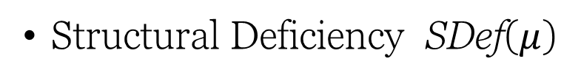
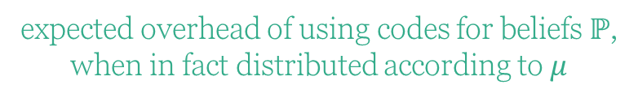

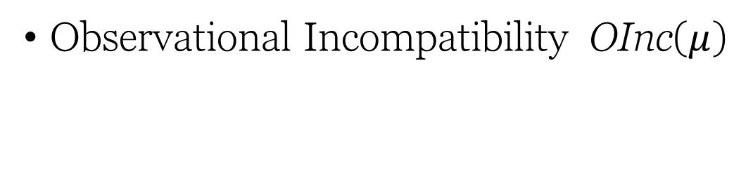
Scoring Function Semantics
Score joint Δistribution
over all 𝒱ariables
Observational Incompatibility OInc($μ$)
Structural Deficiency SDef($μ$)
expected overhead of using codes for beliefs $ℙ$,
when in fact distributed according to $μ$
# bits needed to determine all vars together
# bits needed to separately determine each T from S
(scaled by confidence)
(not the focus of this talk)
(Observational)
Inconsistency of a PDG := the smallest possible incompatibility with any $μ$
Importance of structure ($≥0$)

Slide 11
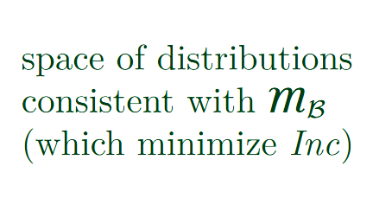
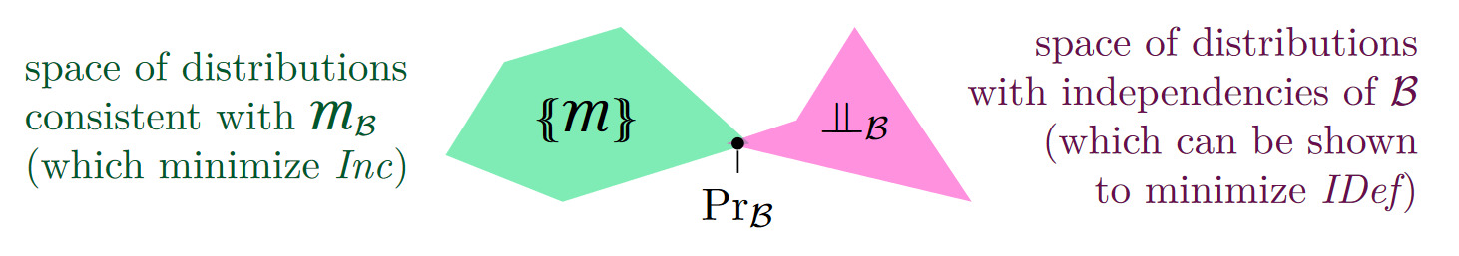
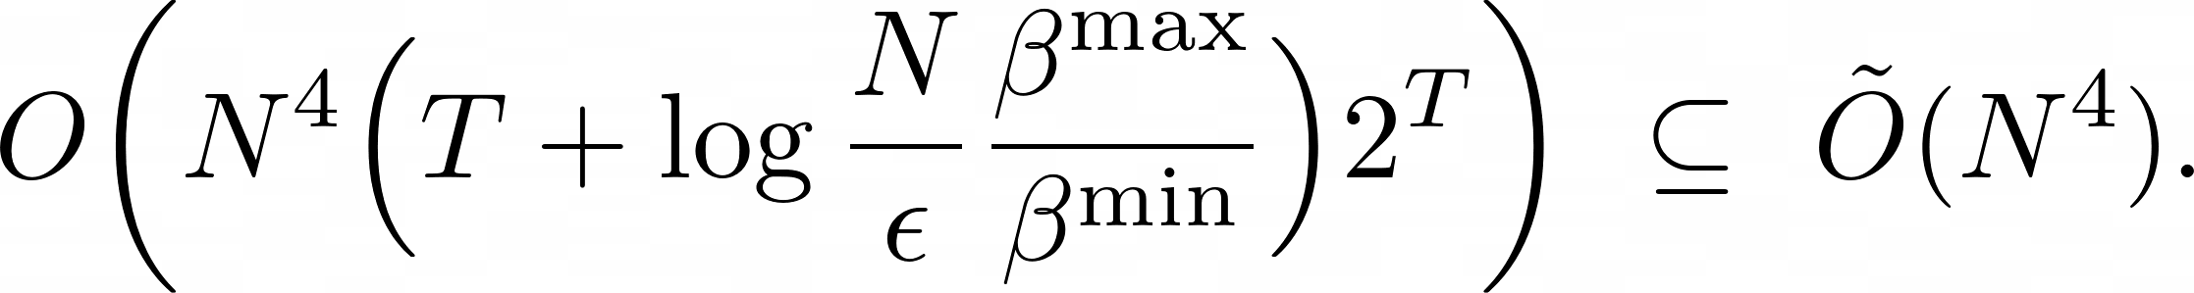
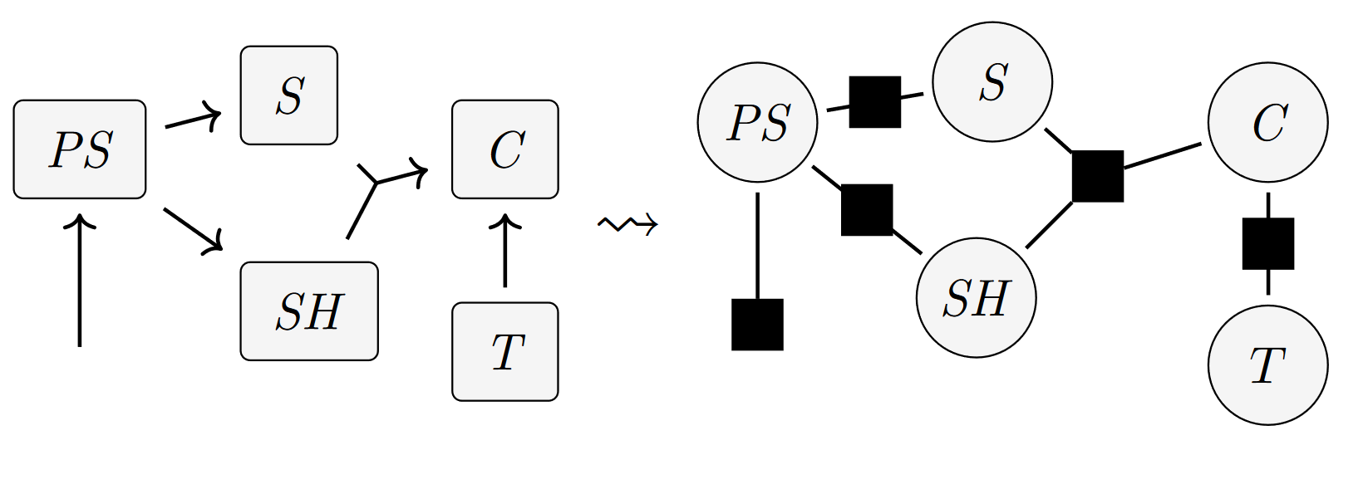


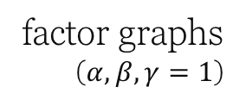




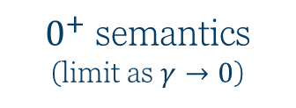



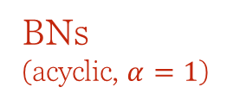
A Few Theorems
For a PDG corresponding to a BN $B$, $μ_{B}$ is the unique optimal distribution, independent of $β, γ$ (so long as $α=1$).
For PDGs with $β>0$, there is a unique optimal distribution in the observational limit ($γ→0$).
When structure and observation are balanced ($γ=1, α=β$), PDGs becomes factor graphs (i.e., optimal dist $∝$ product of cpds).
$$B$$
$0^{+}$ semantics
(limit as $γ→0$)
cpds of $B$
(which can be shown to minimize SDef )
(which minimize OInc)
$μ_{B}$
$$β$$
factor graphs
($α,β,γ=1$)
confidence in observation
BNs (acyclic, $α=1$)
factored exponential families ($γα=β$)
$$±γ$$
$$\text{confidence} \text{in} \text{structure}$$
$$γα$$

Slide 12


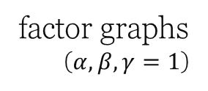







PDG Inference
[UAI 23]
Theorem: Polynomial Inference
$0^{+}$ semantics
(limit as $γ→0$)
?
under bounded treewidth
$$β$$
When $β≥γα$,
factor graphs
($α,β,γ=1$)
can do inference and
calculate inconsistency
N arcs and vars and treewidth T,
confidence in observation
BNs (acyclic, $α=1$)
for a PDG that has
factored exponential families ($γα=β$)
in
time.
$$±γ$$
$$\text{confidence} \text{in} \text{structure}$$
$$γα$$

Slide 13
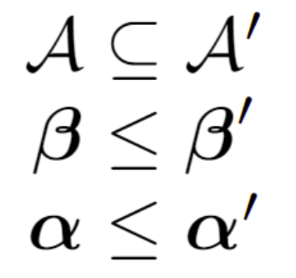
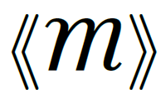

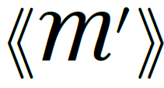

Key Fact:
Believing more things cannot make you any less inconsistent.
more arcs,
larger
confidences
only increase inconsistency

Slide 14
Minimizing (PDG) Inconsistency is a universal objective.

Slide 15
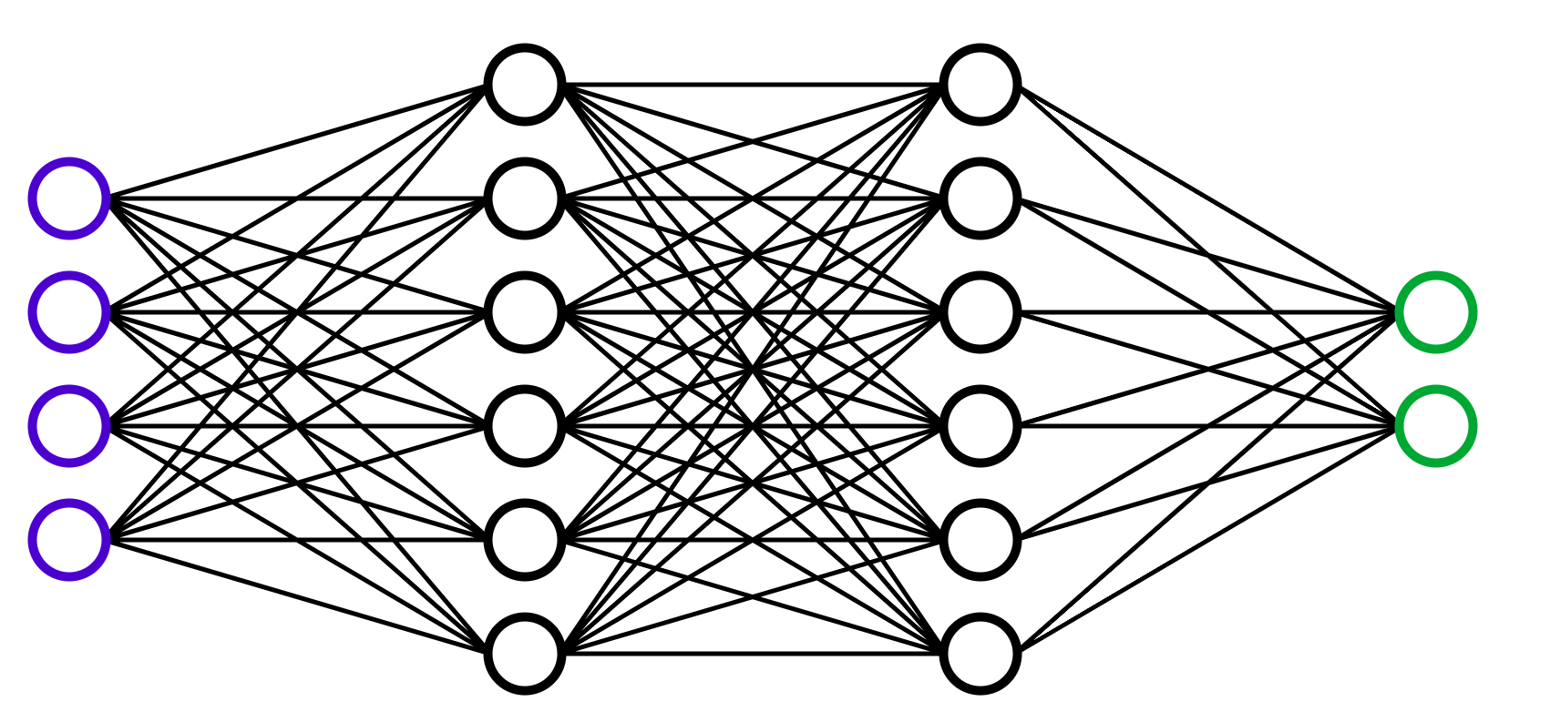
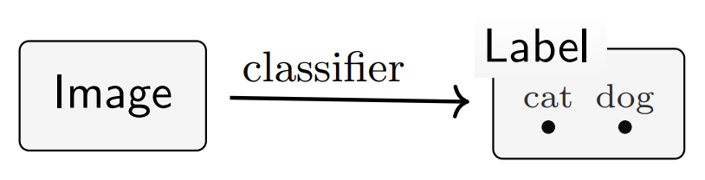
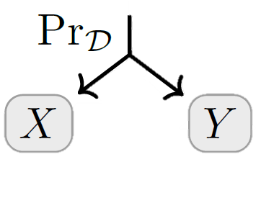

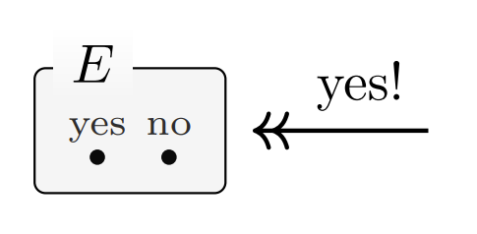
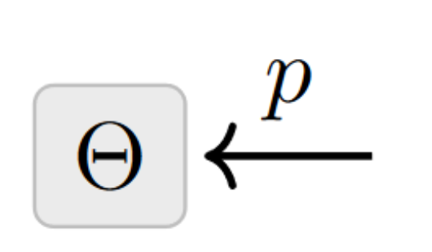

The important building blocks of ML systems are conditional probabilities.
statistical models
(e.g., neural networks)
datasets
constraints
priors

Slide 16


How To Choose A Loss Function?
data
priors
predictor
Surprising Fact: Standard loss functions can be viewed as measuring the degree of inconsistency of the PDG describing the situation.
Log Likelihood, Cross Entropy, variants
Log Accuracy
Mean-Squared Error
Statistical Divergences
Variational Objectives (ELBO ++)

Slide 17
1. STATISTICAL DIVERGENCES as Inconsistencies

Slide 18





Statistical Divergence as Inconsistencies
You believe both $p(X)$ and $q(X)$.
Your inconsistency: a divergence between $p$ and $q$?

Slide 19



Map of
as $(r,s)$ vary

Slide 20
By Monotonicity ,
twice Bhattacharya Distance is no larger than forward or reverse KL.
( many other properties … )

Slide 21
2. VARIATIONAL OBJECTIVES as Inconsistencies

Slide 22







Variational Auto Encoders (VAEs), Take 1.
Loss Function: Negative ELBO(x)
= reconstruction error + encoding’s divergence from prior $p(Z)$
Variational Justification:
might suffice to maximize this?
want to maximize
“evidence” of x

Slide 23




VAEs, Take 2
Structure:
encoder $e(Z|X)$
decoder $d(X|Z)$
prior $p\left(Z\right)$
observe a sample $x$
loss function is free:

Slide 24

Visual Proof: The ELBO
More beliefs can only increase inconsistency

Slide 25
Inconsistency Resolution: A Generic AI Problem

Slide 26






Inconsistency Resolution: A Generic AI Problem
An algorithm that resolves inconsistency by…
… adjusting parameters $θ$
= training the model
adjusting $y$
= inference
… adjusting input $x′$
= constructing an “adversarial example”

Slide 27

Summary
can model inconsistency, including conflicting information
cleanly separate quantitative from qualitative information, and can express variable confidence in each ($β$ and $α$)
capture standard graphical models (BNs & FGs)
capture standard loss functions, and are a visual language for reasoning about them
paint a unifying picture of many ML algorithms in terms of inconsistency resolution
provide a foundation for a different kind of agent: one driven by pursuit of coherence, not (necessarily) maximization

Slide 28
EXTRA

Slide 29
A NON-STANDARD SETTING “Do PDGs ever prescribe a loss that’s not what you’d first think of?”

Slide 30





Want to predict Y from X,
and have access to both simulated and real data.
What loss to use?
Simulator & data don’t interact!
Uncalibrated!
Geometric mean of
s and d

Slide 31



Hypergraphs vs Graphs

Slide 32




Training Generative Adversarial Networks (GANs). Typically trained with minimax game: $\min_{G}{\max_{D}{ℒ^{GAN}}}$
Generator’s focus
Discriminator’s focus
inconsistency = JSD$( G, p_{data})$
or +$ℒ^{GAN}$ if disbelieves D
inconsistency = KL($D, D^{opt})$
or - $ℒ^{GAN}$ if disbelieves e

Slide 33





From Factor Graphs to PDGs

Slide 34
Learning
Inference
Model
Query
Data
Model
Model
Response
(update model to make it more consistent with data)
(update query to make it more consistent with model)

